Slide 1
MIT 3.022 Microstructural Evolution in Materials 1: Introduction
Juejun (JJ) Hu
hujuejun@mit.edu

Slide 2

Contact Information
Juejun (JJ) Hu
Office: 13-4054
hujuejun@mit.edu
Office hour: Mon 1-3 pm
Research interests
We work with light
Optics & photonics
Spectroscopy, imaging, sensing, photovoltaics, communications, …

Slide 3
Class organization
Lectures: MWF 10-11 (4-231)
Lab sessions: 02/25-03/04, 04/01-04/08, 04/29-05/06
Recitations: TR11 or TR12 (13-3101)
TAs: Qian Song, qiansong@mit.edu; Cindy Shi, cindyshi@mit.edu
Office hours: Tue 4-5 (13-4101), Th 4:30-5:30 (13-4106)
Learning Modules site
Syllabus, class schedule, announcements, lecture slides, assignments, exam solutions will be posted on the website
No required textbook

Slide 4
Grading policy
Mid-term 1 (Mar. 20): 15%
Mid-term 2 (Apr. 24): 15%
Final (TBD): 25%
Homework assignments: 15%
Discussions are allowed and encouraged; but you are supposed to complete the assignments independently
We do NOT accept late submissions
Lab: 30%

Slide 5
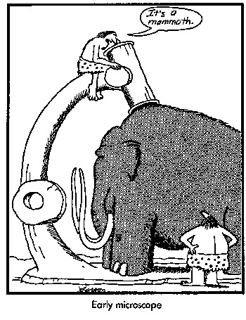

Exams
Exams will be closed book (no laptop, cell phones, etc.): no phone calls, texting, or collaboration is allowed. However, you will be allowed to bring one (mid-terms) or three (final) A4- or letter-sized sheets to the exam.
You may print/write whatever you want on the sheets (equations, formulae, definitions, drawings, etc.)
No font/margin requirement
Magnifying lenses or microscope (!!!) prohibited in exams
Calculators are allowed

Slide 6
Course schedule
Posted online
No late submissions will be accepted (see below)
If you need to reschedule an exam or have to postpone a submission
E-mail TA and instructor at least 24 hours in advance
A valid reason
A statement from S^3
Make-up exams are scheduled before or on the same day as the exams

Slide 7


Slide 8
Some tips
Review 3.012
Focus on the lectures in class
Lectures and slides cover all the information you need to know
Slides will be posted online prior to classes: preview slides before class and print them out
If there is a question, ask
Review lecture content after every lecture
Make use of office hours
Complete PSets early

Slide 9
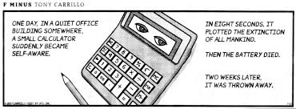
More about the homework & exams
Homework assignments are divided into two parts
Calculations
Concepts & real-world applications
Exams focus on conceptual questions

Slide 10

What will you learn from this course?
Thermodynamics
There WILL be another surge of the stock market.
What will happen?
Statistical Mechanics
Why would it happen?
Kinetics
Credit: KDS4444, CC BY-SA 4.0
When will it happen?
But WHEN???

Slide 11
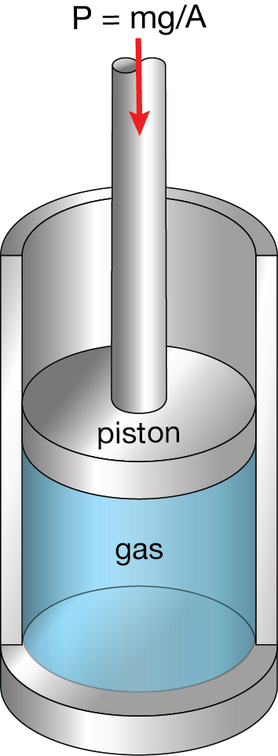
Consider one mole of Ar gas in a container
A thermodynamic description:
The gas is fully characterized by a set of macroscopic parameters in equilibrium:
Pressure P, temperature T, volume V
These parameters are called state functions
Microscopically, these parameters have specified very little information about the system (gas)!
Notes:
Non-equilibrium: resistive heating of gas

Slide 12
Consider one mole of Ar gas in a container
The classical deterministic approach:
6 × 10²³ atoms: 3 × 6 × 10²³ degrees of freedom (DOF)
Two parameters (coordinate q and momentum p) associated with each DOF at any instant of time
If we know all these 2 × 3 × 6 × 10²³ parameters at a given time, in principle we can use classical mechanics to predict the evolution
Need to know the initial conditions exactly!
Each macroscopic equilibrium state corresponds to many microscopic states

Slide 13
Three-body problem and the butterfly effect
Three-body gravitational interaction
https://evgenii.com/blog/three-body-problem-simulator/
Extreme sensitivity to initial values
Chaos theory
“One flap of a seagull's wings could change the course of weather forever…”
Rapidly amplifies any measurement or computation error

Slide 14
Consider one mole of Ar gas in a container
The statistical mechanics approach:
Derive the statistical (“average”) behavior of gas molecules based on the law of mechanics
Ensemble: a large number of virtual copies of a system, each of which represents a possible microscopic state that the real system might be in subjecting to certain constraints
Time average of mechanical variables equals ensemble average

Slide 15
Microcanonical ensemble
Boundary condition: system energy and volume are kept constant
The fundamental postulate: given an isolated system in equilibrium, it is found with equal probability in each of its accessible microstates
Gas molecule
Elastic process
Rigid, thermally insulating walls

Slide 16
Microcanonical ensemble
Example: if no external force acts on the molecule, it has equal probability to be found in any location inside the container
Probability of finding the molecule in either side
50%
50%
Gas molecule
Rigid, thermally insulating walls

Slide 17
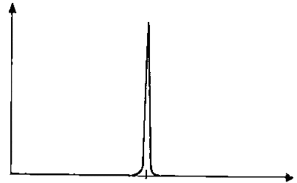
Microcanonical ensemble
Assume that all the N molecules do not interact with each other
The probability of having N₁ molecules on the left side and N₂ molecules on the right side (N = N₁ + N₂) is:
N → ∞
width 2δ/N → 0
Rigid, thermally insulating walls
Notes:
Binomial distribution

Slide 18
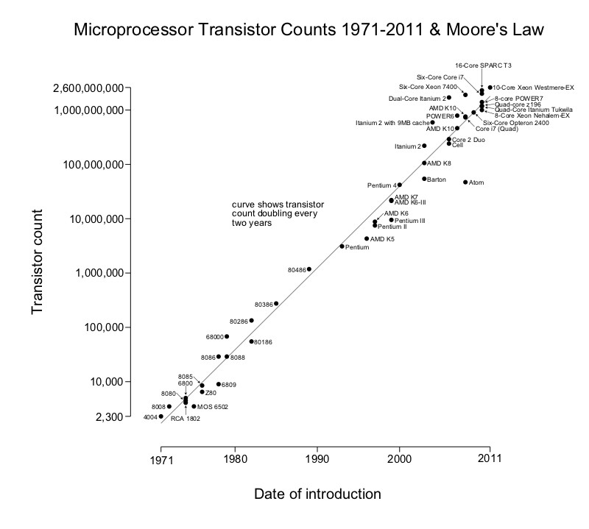
Fluctuations
Random deviations from statistical mean values
Exceedingly small in macroscopic systems
Fluctuations can be significant in nanoscale systems
A transistor (MOSFET) with a gate length of 50 nm contains only ~ 100 electrons on average in the channel. Fluctuation of one single electron can lead to 40% change of channel conductance!
Credit: Wgsimon, CC BY-SA 3.0

Slide 19
Statistical interpretation of entropy
The function S has the following property: in equilibrium, S maximizes in an isolated system
Entropy:
Ω : number of accessible microscopic states (degeneracy of macrostate)
An isolated system tends to evolve towards a macroscopic state which is statistically most probable (i.e. a macroscopic state corresponding to the maximum number of microscopic accessible states)
in an isolated system

Slide 20
Entropy is an extensive variable
Two systems with no mutual interactions
Gas molecule
One molecule
N independent classical molecules

Slide 21
Entropy maximization in isolated systems
Remove constraint
N, V_{i}
N, V_{f} > V_{i}
Classical thermodynamics:
Removal of constraint leads to increased entropy
Statistical mechanics:
Removal of constraint leads to increased number of accessible microstates
Probability of the system remaining in the initial state:
Irreversible process

Slide 22
Summary
What is the thermal equilibrium condition?
Each macroscopic equilibrium state corresponds to many microscopic states
Statistical interpretation of the 2nd law: thermal equilibrium in an isolated system corresponds to the statistically most likely state
Equilibrium state of macroscopic systems can be identified by finding the maximum of the probability distribution function
What defines the thermodynamic parameters of a macroscopic system?
Statistical ensemble
Time average of mechanical variables equals their ensemble average
The fundamental postulate
Fluctuation

Slide 23
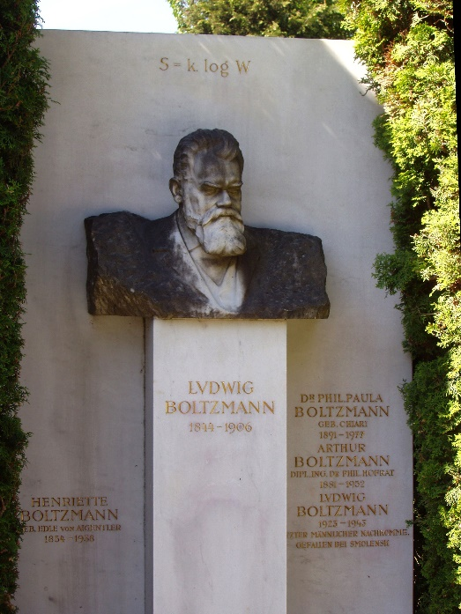
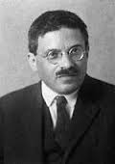
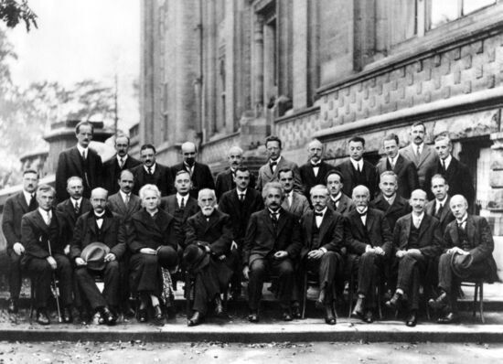
Entropy
Entropy is a measure of the accessible microscopic states in a system
Ludwig Boltzmann (1844-1906)
Credit: Daderot, CC BY-SA 3.0
Now it is our turn to study statistical mechanics !
Paul Ehrenfest (1880-1933)

Slide 24
List of symbols
P – probability
N – number of molecules/particles
S – entropy
k – Boltzmann constant (1.38 × 10⁻²³ m² kg s⁻² K⁻¹)
Ω – Number of microscopic states
V – Volume
Subscript i represents initial state and f denotes final state

