Slide 1
MIT 3.022
Microstructural Evolution in Materials
12: Nucleation
Juejun (JJ) Hu
hujuejun@mit.edu

Slide 2
Thermodynamics of phase transition
G
H
Liquid
Supercooled liquid
Liquid
Crystal
Crystal
T_{m}
T
T_{m}
T
Notes:
Crystal melting usually does not require superheating due to surface nucleation. For example, the surface energies of ice/water follows the Antonov’s rule, and therefore there is no surface energy barrier for liquid water formation on solid ice surface.

Slide 3
Homogeneous nucleation from a fluid phase
Liquid
Crystal nucleus
r
Volumetric
Surface

Slide 4
Thermodynamics of homogeneous nucleation
G
Liquid
Volumetric Gibbs free energy change
Surface energy change
Crystal
T
T_{m}

Slide 5
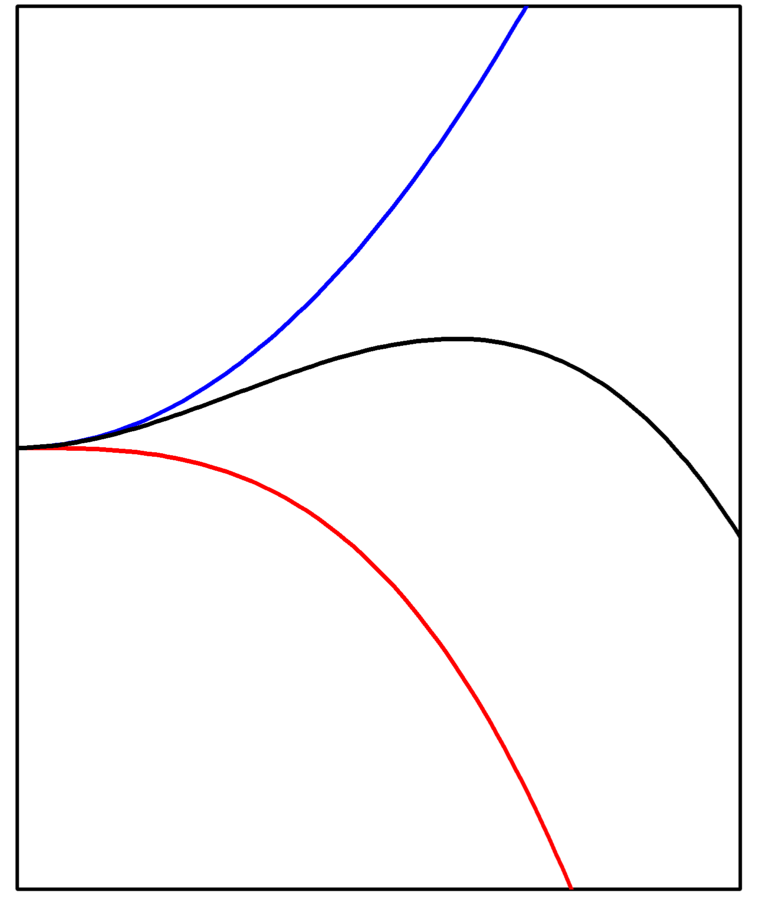
Gibbs free energy change in solidification
Gibbs free energy change of nucleation
Critical nucleus size
Energy barrier towards nucleation
Gibbs free energy change
Nucleus size r

Slide 6
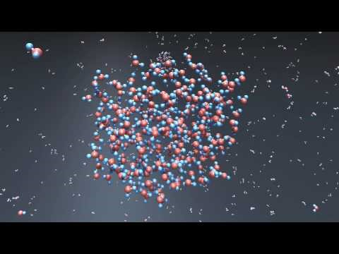
Vapor-liquid nucleation of water

Slide 7
“Seeing” nucleation using atomic tomography
https://www.nature.com/articles/s41586-019-1317-x

Slide 8
Density of critical nuclei
Number of clusters with size greater than r
Example: number of ice clusters in 1 g of water at 0 °C
  r > 0.4 nm (~ 9 molecules): 1.3 × 10¹⁵
  r > 0.7 nm (~ 48 molecules): 0.7
where
γ = 0.033 J/m², ΔH_{m} = 333.6 J/g, T_{m} = 273.15 K
A supercooling threshold exists for onset of nucleation events
Notes:
The pre-exponential factor n0 is usually linked to atomic numbers in the classical nucleation theory. This is, however, heuristic. See for example, Ford, I. J. "Statistical mechanics of nucleation: a review“ for more detailed discussions.

Slide 9
Homogeneous nucleation rate
Nucleation rate I
  Number of nuclei with size just under r* × Rate of atoms hopping to the nuclei
I
Nucleation onset
ΔT
0
Driving force limited
Diffusion limited

Slide 10
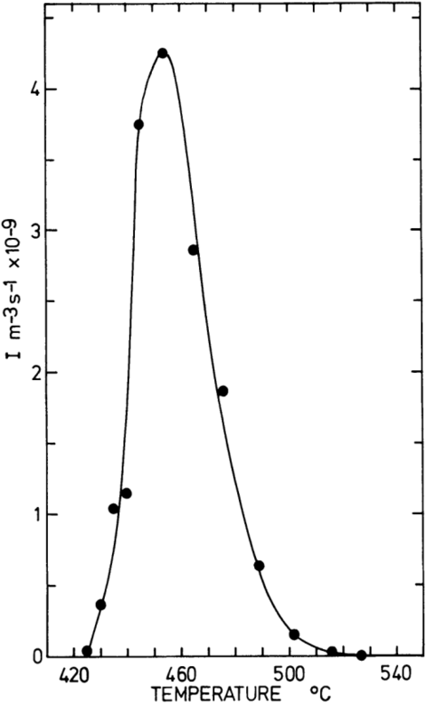
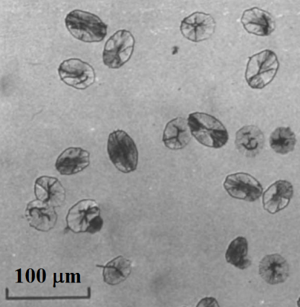
Experimental measurement of nucleation rate
Liquid
Nucleation
Growth
Nucleation rate in lithium silicate glass
T
Nucleation zone
T_{m}
Nucleation zone
t
Adapted from Phys. Chem. Glasses 15, 95 (1974)
Notes:
For vapor-liquid transition latest technology leverages Mie scattering measurement to quantify nucleation rate

Slide 11
Heterogeneous nucleation
Gibbs free energy change of cluster formation
  Volumetric term
  Surface term
Liquid
Cluster
Substrate
Y-L equation:

Slide 12
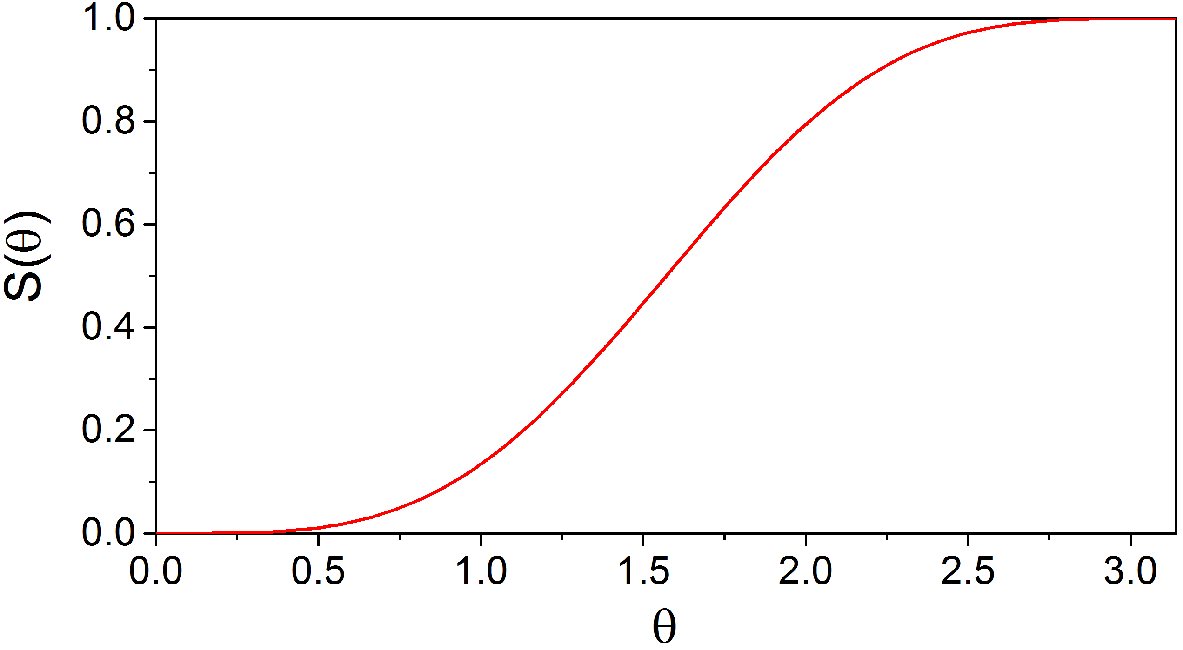
Heterogeneous nucleation
Gibbs free energy change of cluster formation
  Volumetric term
  Surface term

Slide 13
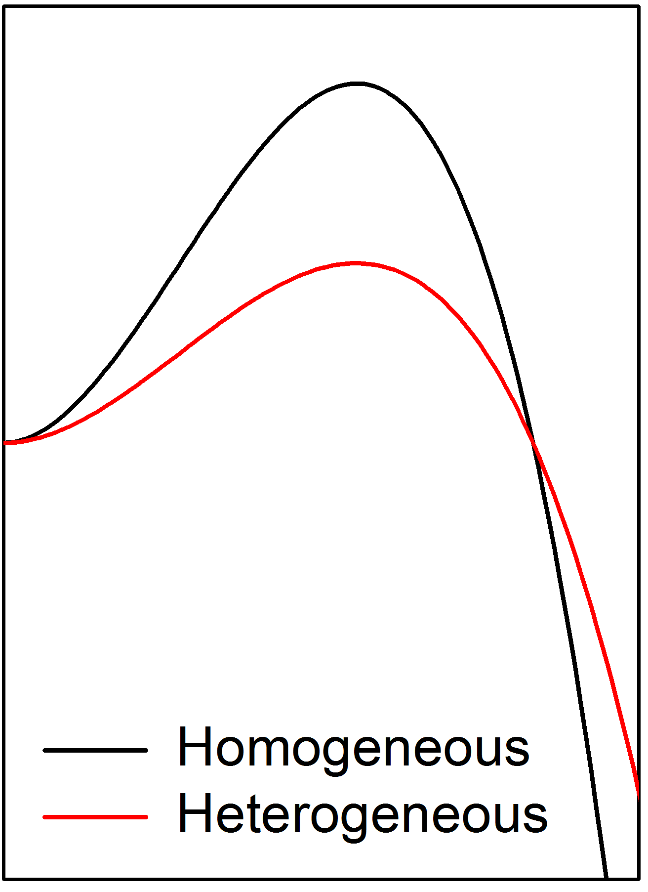
Heterogeneous nucleation
Critical nucleus size
Energy barrier towards nucleation
Gibbs free energy change
Wetting on a substrate reduces energy barrier towards nucleation
Nucleus size r

Slide 14
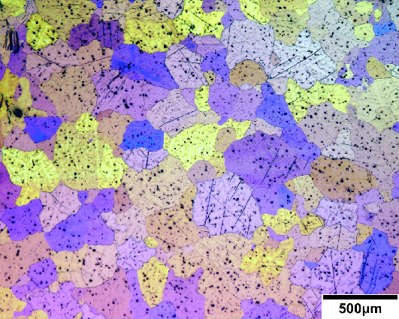
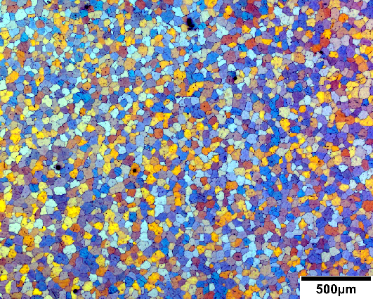
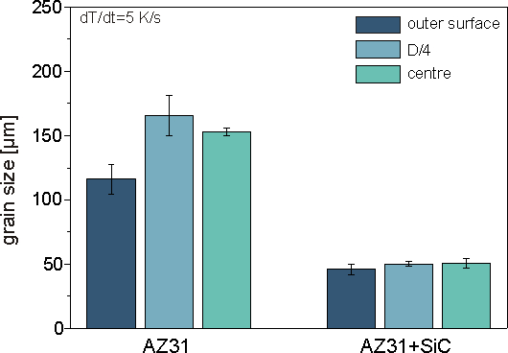
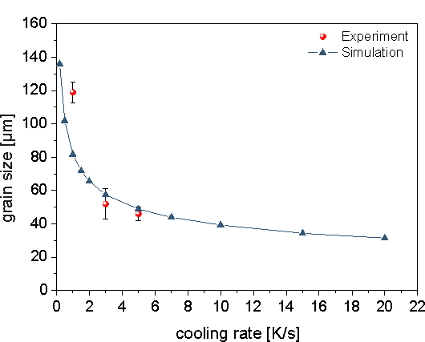
Nucleation kinetics and grain size
Magnesium alloy w/o SiC particles
Magnesium alloy with SiC particles
Fast cooling and addition of secondary phase contribute to grain refinement
Acta Mater. 54, 5591 (2006)
Notes:
http://innomag.gkss.de/english/projekte/15/index.html

Slide 15

Vapor-Liquid-Solid (VLS) nanowire growth
SiCl₄ vapor + H₂
Interface where growth continues
Growth direction
Melted gold nanoparticles saturated with SiH₄
Substrate
Substrate
Heterogeneous nucleation of Si at the interface
Diameter of nanowire is determined by the gold droplet size
Temperature for Si deposition on a planar substrate (homogeneous nucleation): ~ 800 ˚C

Slide 16
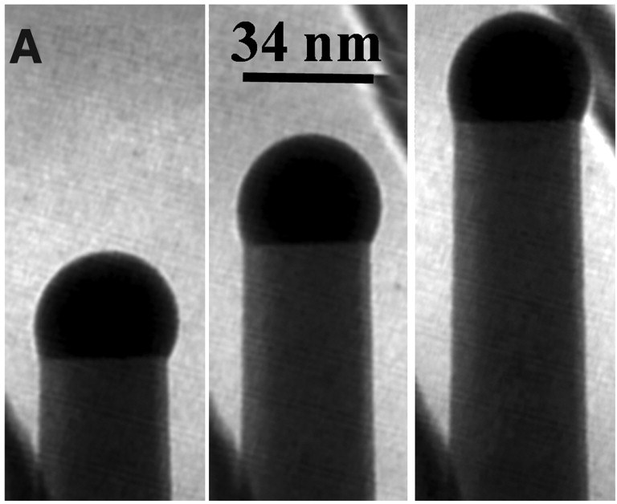
Nanowires formed by VLS growth
Gold nano-particle
Growth direction
S. Kodambaka, J. Tersoff, M. C. Reuter, and F. M. Ross, Science 316, 729 (2007).

Slide 17
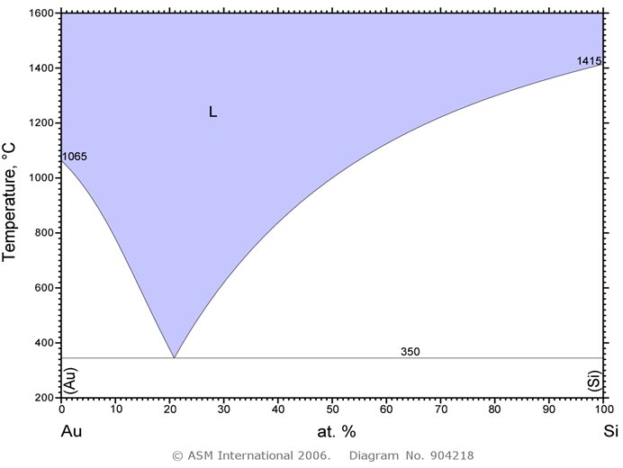
Why gold?
Reason #1:
Low eutectic temperature
Question: what would happen if we were to grow nanowires at high temperature?
“The influence of the surface migration of gold on the growth of silicon nanowires,” Nature 440, 69-71 (2006).

Slide 18
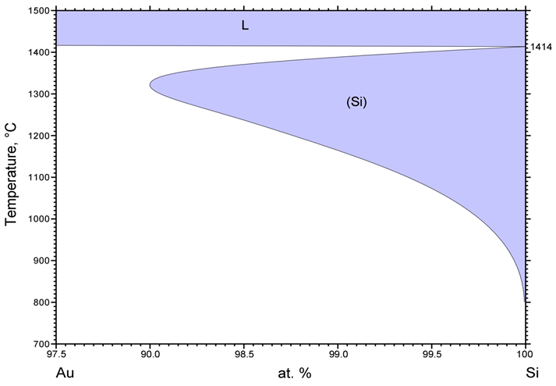
Why gold?
Reason #2:
Small gold solubility in Si (Eutectoid transformation)
Question: why is such small solubility important?
99.8%
Solubility: 0.2%
Albert P. Levitt, Whisker Technology (1975)

Slide 19
Summary
Driving force for nucleation
  Supercooling (undercooling)
  Volumetric Gibbs free energy reduction
Energy barrier against nucleation
  Surface energy
Kinetics of nucleation
  Number of sub-critical nuclei
  Diffusion
Heterogeneous nucleation
  Lowering the surface energy barrier of nucleation

Slide 20
List of symbols
T – temperature
k – Boltzmann constant (1.38 × 10⁻²³ m² kg s⁻² K⁻¹)
G^{L} / H^{L} / S^{L} – Gibbs free energy / enthalpy / entropy of liquid
G^{C} / H^{C} / S^{C} – Gibbs free energy / enthalpy / entropy of crystalline solid
T_{m} – melting point
ΔG – Gibbs free energy change associated with phase transition
ΔG_{V} / ΔG_{S} – volumetric / surface contributions to Gibbs free energy change of phase transition
r – radius of nucleus

Slide 21
List of symbols
ΔH_{m} – enthalpy of fusion per unit volume
V – volume of nucleus
ΔT – supercooling, defined as:
γ – surface/interface energy
S – surface area of nucleus
r* – critical nucleus size
ΔG* – energy barrier towards nucleation
n_{r} – number of clusters with size greater than r
n₀ – number of atoms/molecules in the system (see discussions at the notes section of slide 7)
I – nucleation rate

Slide 22
List of symbols
ν_{h} – frequency of successful atomic hops from liquid phase to the nucleus
ν – vibrational frequency of atoms in the liquid phase
D – diffusion coefficient (from liquid phase to the nucleus)
α – atomic hopping distance
V_{C} – volume of cluster (which serves as a nucleus in heterogenous nucleation process)
γ_{SL} / γ_{SC} / γ_{LC} – interface energy between S: substrate, C: cluster, and L: liquid phase
θ – contact angle
– defined as:

Slide 23
List of symbols
ΔG_{het} / ΔG_{homo} – Gibbs free energy change associated with heterogeneous / homogeneous nucleation
– critical nucleus size in heterogeneous / homogeneous nucleation
– energy barrier towards heterogeneous nucleation

