Slide 1
MIT 3.022
Microstructural Evolution in Materials
14: Interface Stability
Juejun (JJ) Hu
hujuejun@mit.edu

Slide 2
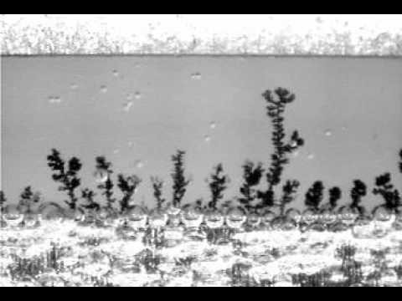
Dendritic growth
© Aqueous Technologies

Slide 3
Condition for dendritic growth: interface instability
Solid
Liquid
A
B
x
Stable interface: planar growth
Solid
Liquid
A
B
x
Unstable interface: dendritic growth
Notes:
Interface stability deals with macroscopic interface morphology, whereas the Jackson model evaluates atomic scale interface roughness

Slide 4
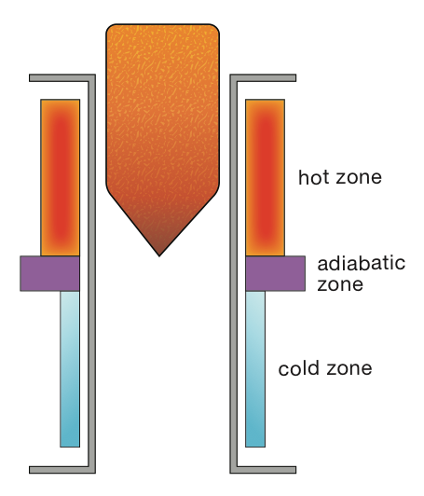
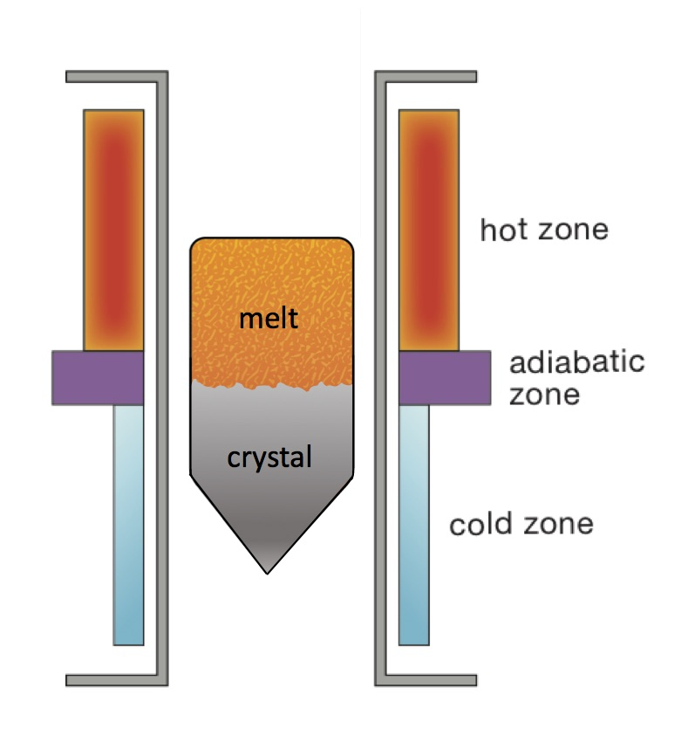
Example 1: Bridgman-Stockbarger crystal growth
melt

Slide 5
Example 1: Bridgman-Stockbarger crystal growth
Solid
Liquid
T
Heat flux
T_{m}
Single-component system
x

Slide 6
Example 1: Bridgman-Stockbarger crystal growth
Heat flux continuity at solid-liquid interface
Supercooling in liquid
Solid
Liquid
T
Heat flux
T_{m}
Single-component system
Planar interface: heat removal via the solid side
x

Slide 7
Example 2: Solidification in a supercooled liquid
Heat flux continuity at solid-liquid interface
Supercooling in liquid
Solid
Supercooled liquid
T
Heat flux
T_{m}
Heat extraction is more efficient at dendrites
Single-component system
x

Slide 8
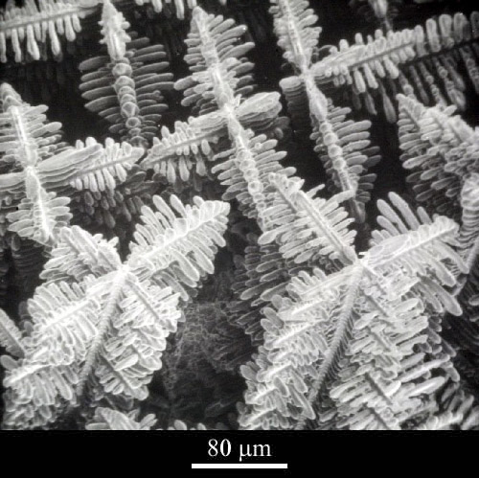
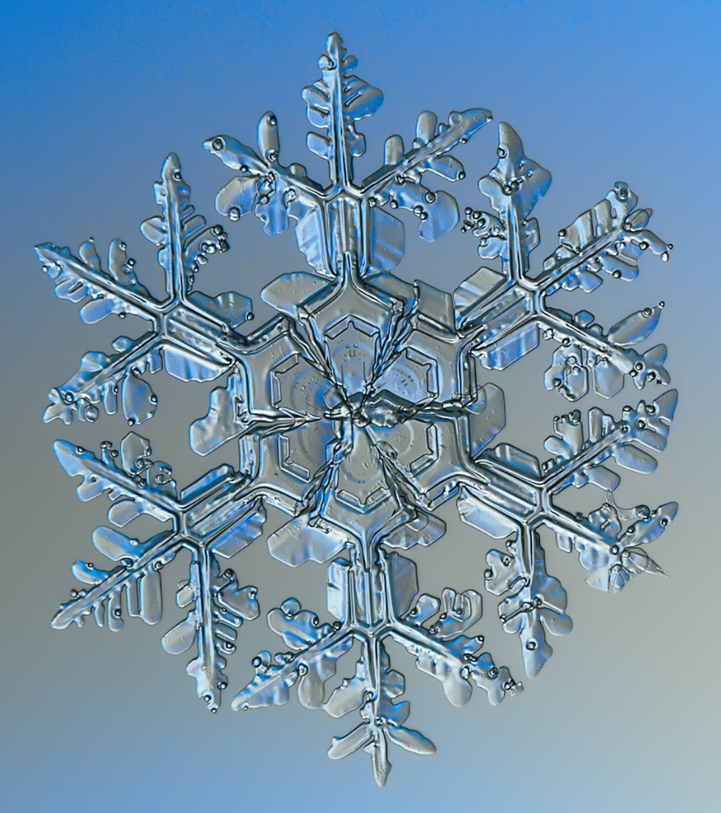
Dendrite branching and crystallography
<100>
Directionally solidified Co-Sm-Cu alloy
Image credit: University of Cambridge CC BY-NC-SA 2.0 UK
Image credit: Alexey Kljatov CC BY-SA 4.0

Slide 9
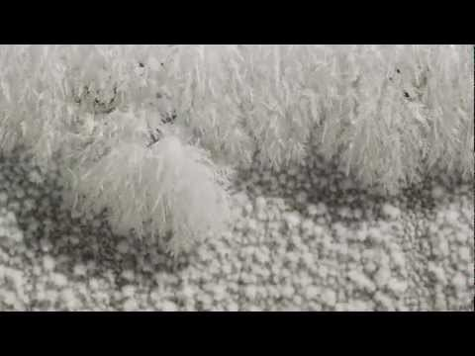
“At sub-zero temperature, moisture from the surrounding atmosphere condenses almost immediately. The dendritic form of the crystallization is a natural fractal pattern.”
– Francis Chee / Science Photo Library

Slide 10
Example 3: constitutional supercooling
Solid α
Liquid L
C_{α}
C_{L}
L
C_{B}
T₀
C_{L}
α
β
C₀
C_{α}
x
A
B
C₀
x = 0

Slide 11
Example 3: constitutional supercooling
Steady state solution
Solid α
Liquid L
C_{B}
RΔt
C_{L}
C₀
Growth rate is determined by diffusion of solute away from the interface
C_{α}
x
x = 0

Slide 12
Example 3: constitutional supercooling
Liquidus temperature
Supercooling in liquid
C_{α}
C_{L}
L
T₀
α
β
A
C₀
B
Interface stability condition

Slide 13
Example 3: constitutional supercooling
Solid α
Liquid L
Solid α
Liquid L
C_{B}
T_{L}
Critical T (x)
C_{L}
T_{L} (C₀)
C₀
Supercooling zone ΔT (x) > 0
C_{α}
T_{L} (C_{L})
x
x
x = 0
x = 0

Slide 14
Summary
Interface stability criterion: supercooling decreases away from the solid-liquid interface
  Single-component system:
  Binary or multi-component system:
In single component systems, latent heat removal from the solid phase side usually indicates stable interface
Phase transition occurring at condition far away from equilibrium (large supercooling) is often accompanied by dendritic growth
Impurities can lead to constitutional supercooling and dendrite growth (even in nominally ‘single-component’ alloys)

Slide 15
List of symbols
ΔT – supercooling, defined as the difference between the liquidus temperature and the phase transition temperature
T_{m} – melting point or liquidus temperature
T – temperature
x – coordinate along the x-axis
k_{S} / k_{L} – thermal conductivity of solid / liquid phase
R – precipitate growth rate measured by the velocity of the solid-liquid interface
ΔH_{m} – enthalpy of fusion per unit volume
C_{B} – concentration of component B
C₀ – concentration of B in the starting liquid phase

Slide 16
List of symbols
T₀ – temperature at which the solidification takes place
C_{α} / C_{L} – equilibrium concentration of component B in the α / liquid phase at T₀
D – diffusion coefficient of B in the liquid phase
T_{L} – liquidus temperature of the A-B binary alloy, which is a function of the alloy composition C_{B}

