Slide 1
MIT 3.022 Microstructural Evolution in Materials 6: Substitutional Diffusion
Juejun (JJ) Hu
hujuejun@mit.edu

Slide 2
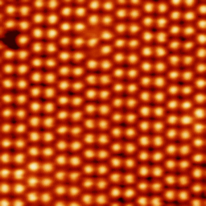
Vacancy mechanism (substitutional diffusion)
Ultra High Vacuum Scanning Tunneling Microscopy movie showing the thermal migration of a single vacancy on a Ge(111)-c(2×8) surface. The vacancy was deliberately created with the STM tip by a slight tip-sample contact.
Used with permission from the American Physical Society
Brihuega et al., Phys. Rev. B 70, 165410 (2004)

Slide 3
Frequency of successful hops in substitutional diffusion
Frequency of successful hops
Frequency of atomic vibration
Probability of having sufficient energy
Probability of finding an adjacent vacancy
= vacancy concentration x_{v} × coordination number Z

Slide 4
Equilibrium vacancy concentration
Entropy contribution
Enthalpy contribution
Gibbs free energy
Equilibrium vacancy concentration
Notes:
ΔSv is due to vibrational entropy change

Slide 5

Entropy is the cause of imperfection
ΔG
Equilibrium concentration
Vacancy fraction x_{v}

Slide 6
Substitutional self-diffusion
Atom vibration frequency:
Successful hop frequency:
Self diffusion coefficient:
Energy
harmonic potential

Slide 7
Data for substitutional self-diffusion
Class | Material | T_{m} (K) | D₀ (mm²/s) | E_{SD} (kJ/mol)
BCC alkali metals | Rb | 312 | 23 | 39.4
 | K | 337 | 31 | 40.8
 | Na | 371 | 24.2 | 43.8
 | Li | 454 | 23 | 55.3
FCC | Pb | 601 | 137 | 109.1
 | Al | 933 | 170 | 142.0
 | Ag | 1234 | 40 | 184.6
 | Au | 1336 | 10.7 | 176.9
 | Cu | 1356 | 31 | 200.3
 | Ni | 1726 | 190 | 279.7
Data from Acta. Metall. Mater. 28, 1085 (1980)

Slide 8
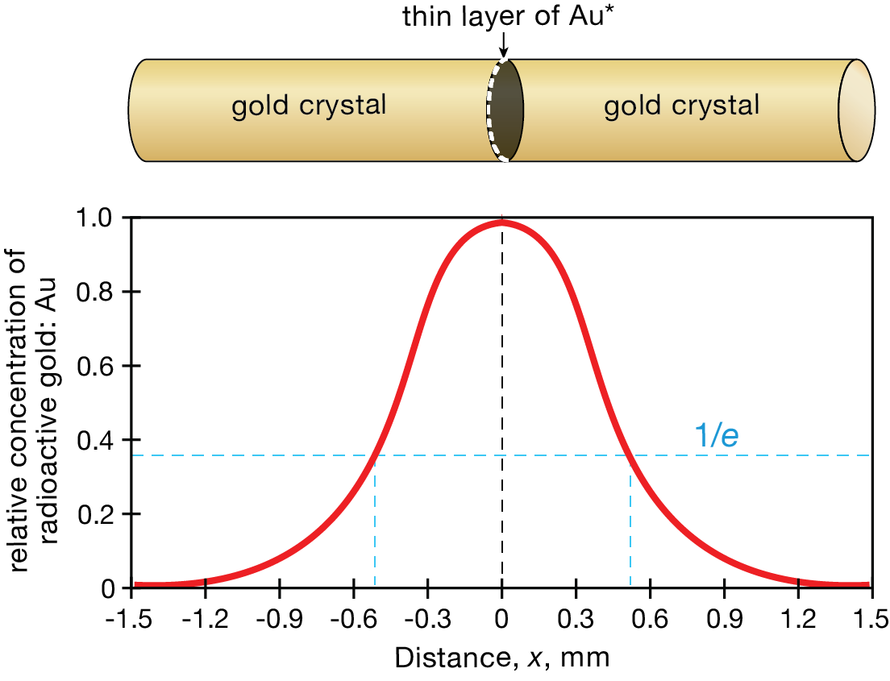
Example: substitutional self-diffusion in gold
A thin layer of radioactive gold is placed on the end of a gold rod. This surface is bonded to another gold crystal and the two are heat treated for 100 h at 920 °C. Estimate the diffusivity of gold.
Point source diffusion:
Diffusion length:
Using data from last slide:

Slide 9
Vacancy diffusion
An atom hopping into a vacancy is equivalent to the vacancy hopping into that atom’s initial position
Frequency of successful vacancy hops
Frequency of atomic vibration
Coordination number
Probability of having sufficient energy
Diffusion of atoms is always accompanied by an opposing vacancy flux (in the lattice reference frame)

Slide 10
Interdiffusion in binary alloys
A
B
B atom
A atom
Vacancy
x
What happens when ?

Slide 11
Re-examine the Fick’s 1st law
Number of atoms hopped from plane 1 to 2 per unit time and per unit area:
Similarly, the flux from 2 to 1 is:
The net diffusion flux is:
Fick’s 1st law
The flux is defined with respect to lattice planes
1
2

Slide 12
Vacancy diffusion in a binary system
Diffusion flux of atoms with respect to the lattice
Concentration of lattice sites
Net vacancy diffusion flux (with respect to the lattice)

Slide 13
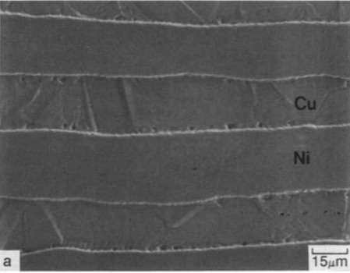
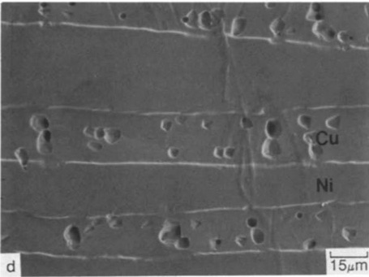
Sources and sinks of vacancy
Surfaces, voids, grain boundaries, dislocations
Heat treated at 1000 °C in Argon for 1 min
Heat treated at 1000 °C in Argon for 15 min
Vacancy
“An analysis of diffusion-induced porosity in Cu-Ni laminate composites,” A124, I. Choi, D. Matlock, L15-L18, Copyright 1990, with permission from Elsevier.

Slide 14
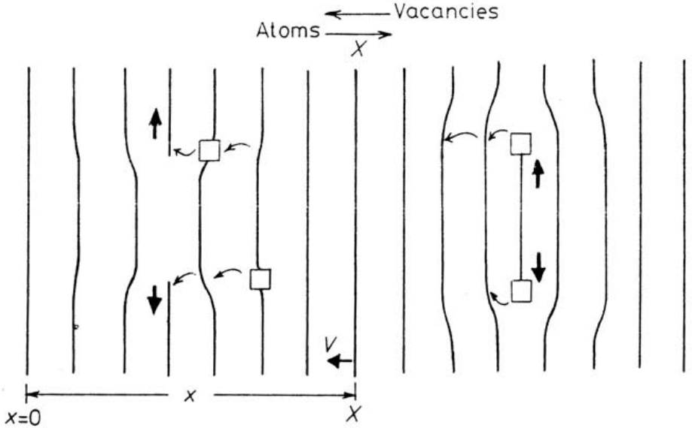

Dislocation motion and crystal plane growth/removal
Image Credit: Nick Bagnall; CC0 1.0 Universal License
Climb of edge dislocations leads to crystal plane growth/removal

Slide 15
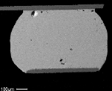
The Kirkendall effect
Motion of the boundary between a diffusion pair with different diffusion coefficients
“Kirkendall voiding is a phenomenon related to the intermetallic formation of a Cu/Sn alloy matrix. When the solder joints solidifies, the intermetallic becomes the bond mechanism between the bulk solder and the Cu pad on the circuit board. Over time, and particularly at elevated temperature, the Cu/Sn intermetallic will increase in thickness. This intermetallic growth is caused by the solid state diffusion of the Cu and the Sn into one another. The Cu diffuses into Sn much faster than Sn diffuses in Cu, which results in vacancies forming throughout the intermetallic bond area.”
Solder
© unknown
http://www.indium.com/blog/intermetallics-in-soldering.php
Notes:
The voids are in fact formed in Cu3Sn IMC layer rather than in Cu (see for example: http://www.materialenkennis.nl/dico/UserFiles/File/Zacht-solderen-18-jan-2007.pdf)

Slide 16
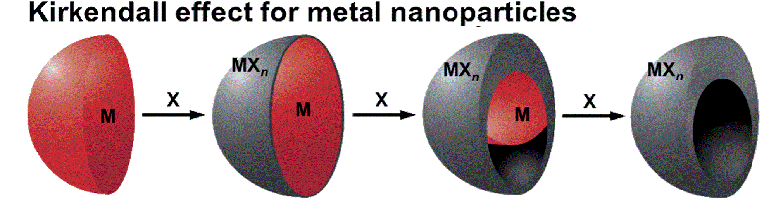
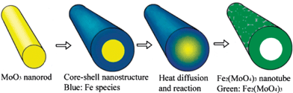
Kirkendall effect in nanomaterial synthesis
Nanoshell:
Nanotube:
Nanoscale 6, 12195 (2014); Chem. Commun. 12, 1565 (2009).

Slide 17
Convective flow: motion of crystal planes
Concentration of lattice sites
Flux of lattice sites (opposing to the vacancy flux)
Velocity of crystal plane motion
where

Slide 18
Diffusion in the laboratory reference frame
In the laboratory reference frame, both diffusion and convective flow contribute to atomic flux
Interdiffusion coefficient for a binary alloy
The diffusion coefficient of A approaches that of pure A (the solute) when A is dilute in B
Darken equation

Slide 19
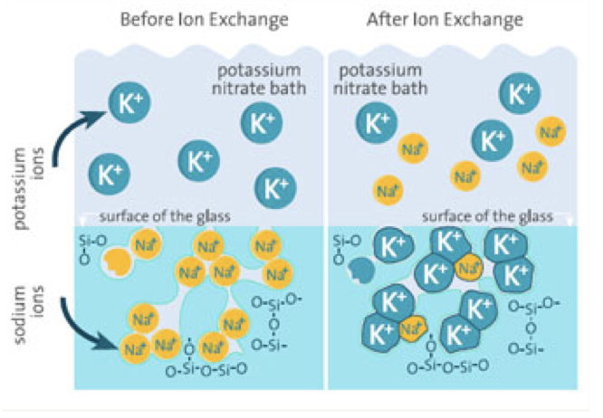
Interdiffusion in ionic solids
Ion exchange in salt bath
Interdiffusion process
Kinetics limited by slow-moving ion species
Nernst-Planck equation for diffusion in ionic crystals
© BCE
Charge neutrality at steady state
Notes:
There is no Kirkendall effect in ionic diffusion pairs because there is no net vacancy flux

Slide 20
Summary
Substitutional self-diffusion coefficient
Vacancy diffusion
Interdiffusion coefficient in binary metal alloys
Interdiffusion coefficient in binary ionic solids
in lattice reference frame
Darken equation
Nernst-Planck equation

Slide 21
In a diffusion pair where D_{A} < D_{B}
A
B
Lattice frame
Lab frame
B atom
A atom
Vacancy
Lattice plane

Slide 22
List of symbols
T – temperature
k – Boltzmann constant (1.38 × 10⁻²³ m² kg s⁻² K⁻¹)
m – mass of an atom
K – effective spring constant of the potential well where an atom is located
x_{v} – fraction of lattice sites occupied by vacancies
x_{A} / x_{B} – fraction of lattice sites occupied by atom A / B
n – number of vacancies in a solid
N – number of atoms in a solid
ΔS_{v} – vibrational entropy change due to formation of a vacancy

Slide 23
List of symbols
ΔH_{v} – enthalpy change due to formation of a vacancy
ΔG_{v} – defined as : the Gibbs free energy change due to formation of a vacancy minus the configurational entropy contribution
ΔG – total Gibbs free energy change due to formation of vacancies compared to a defect-free crystal
Z – coordination number
ν – vibrational frequency of an atom
ν_{h} – frequency of successful hops of an atom
E_{SD} – defined as : activation energy of substitutional diffusion

Slide 24
List of symbols
E_{a} – activation energy of atomic hopping
D – diffusivity, diffusion coefficient (of atoms)
α – hopping distance (distance between neighboring lattice sites for substitutional diffusion)
ν_{h,v} – frequency of successful hops of a vacancy
x – coordinate along the x-axis
J – diffusion flux of atoms measured in the lattice frame
J’ – diffusion flux of atoms measured in the laboratory frame
J_{v} – diffusion flux of vacancies

Slide 25
List of symbols
J_{s} – flux of lattice sites due to vacancy diffusion
C – number concentration of atoms (subscripts A, B, 0, v denote the concentrations of atom A, atom B, all lattice sites, and vacancies, respectively)
v – velocity of crystal plane motion due to the Kirkendall effect (note the difference with the Greek letter ν, which represents the atomic vibrational frequency)
– interdiffusion coefficient
D_{v} – diffusion coefficient of vacancies

