Slide 1
MIT 3.071
Amorphous Materials
13: Optical Properties
Juejun (JJ) Hu
hujuejun@mit.edu

Slide 2
After-class reading list
Fundamentals of Inorganic Glasses
  Ch. 19
Introduction to Glass Science and Technology
  Ch. 10

Slide 3
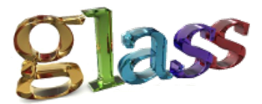
What's so special about ?

Slide 4
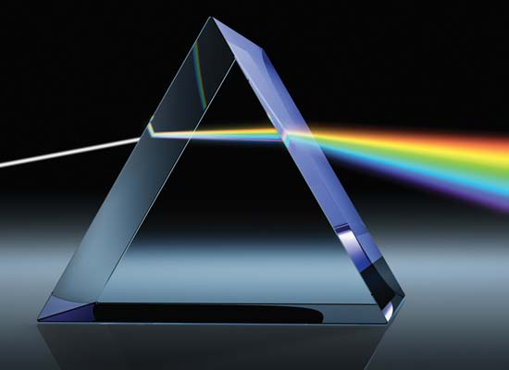
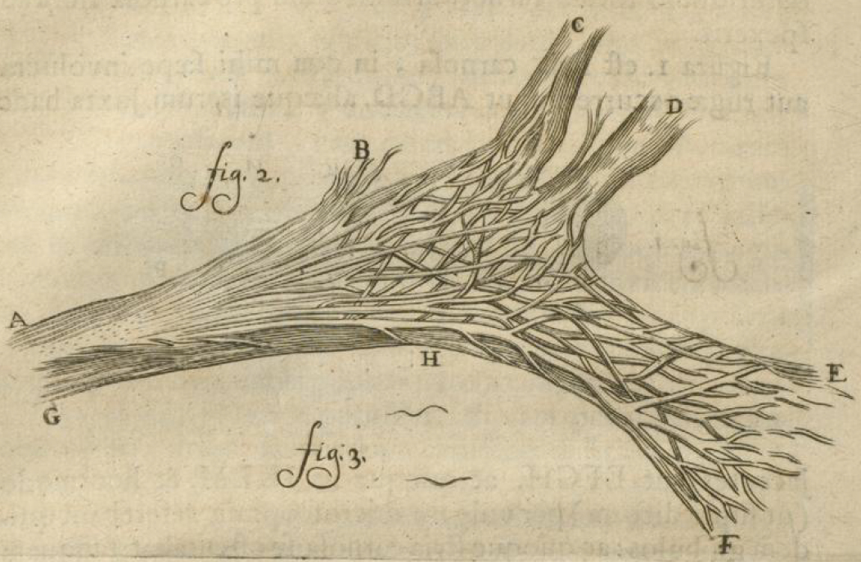
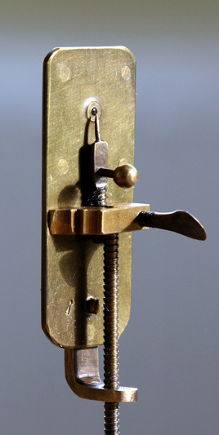
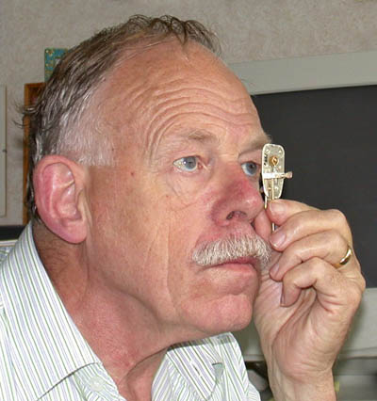
Refraction
A flesh-fiber, split and pressed flat
Leeuwenhoek Microscope

Slide 5

Transparency
‘People think that data is in the cloud, but it’s not. It’s in the ocean.’

Slide 6
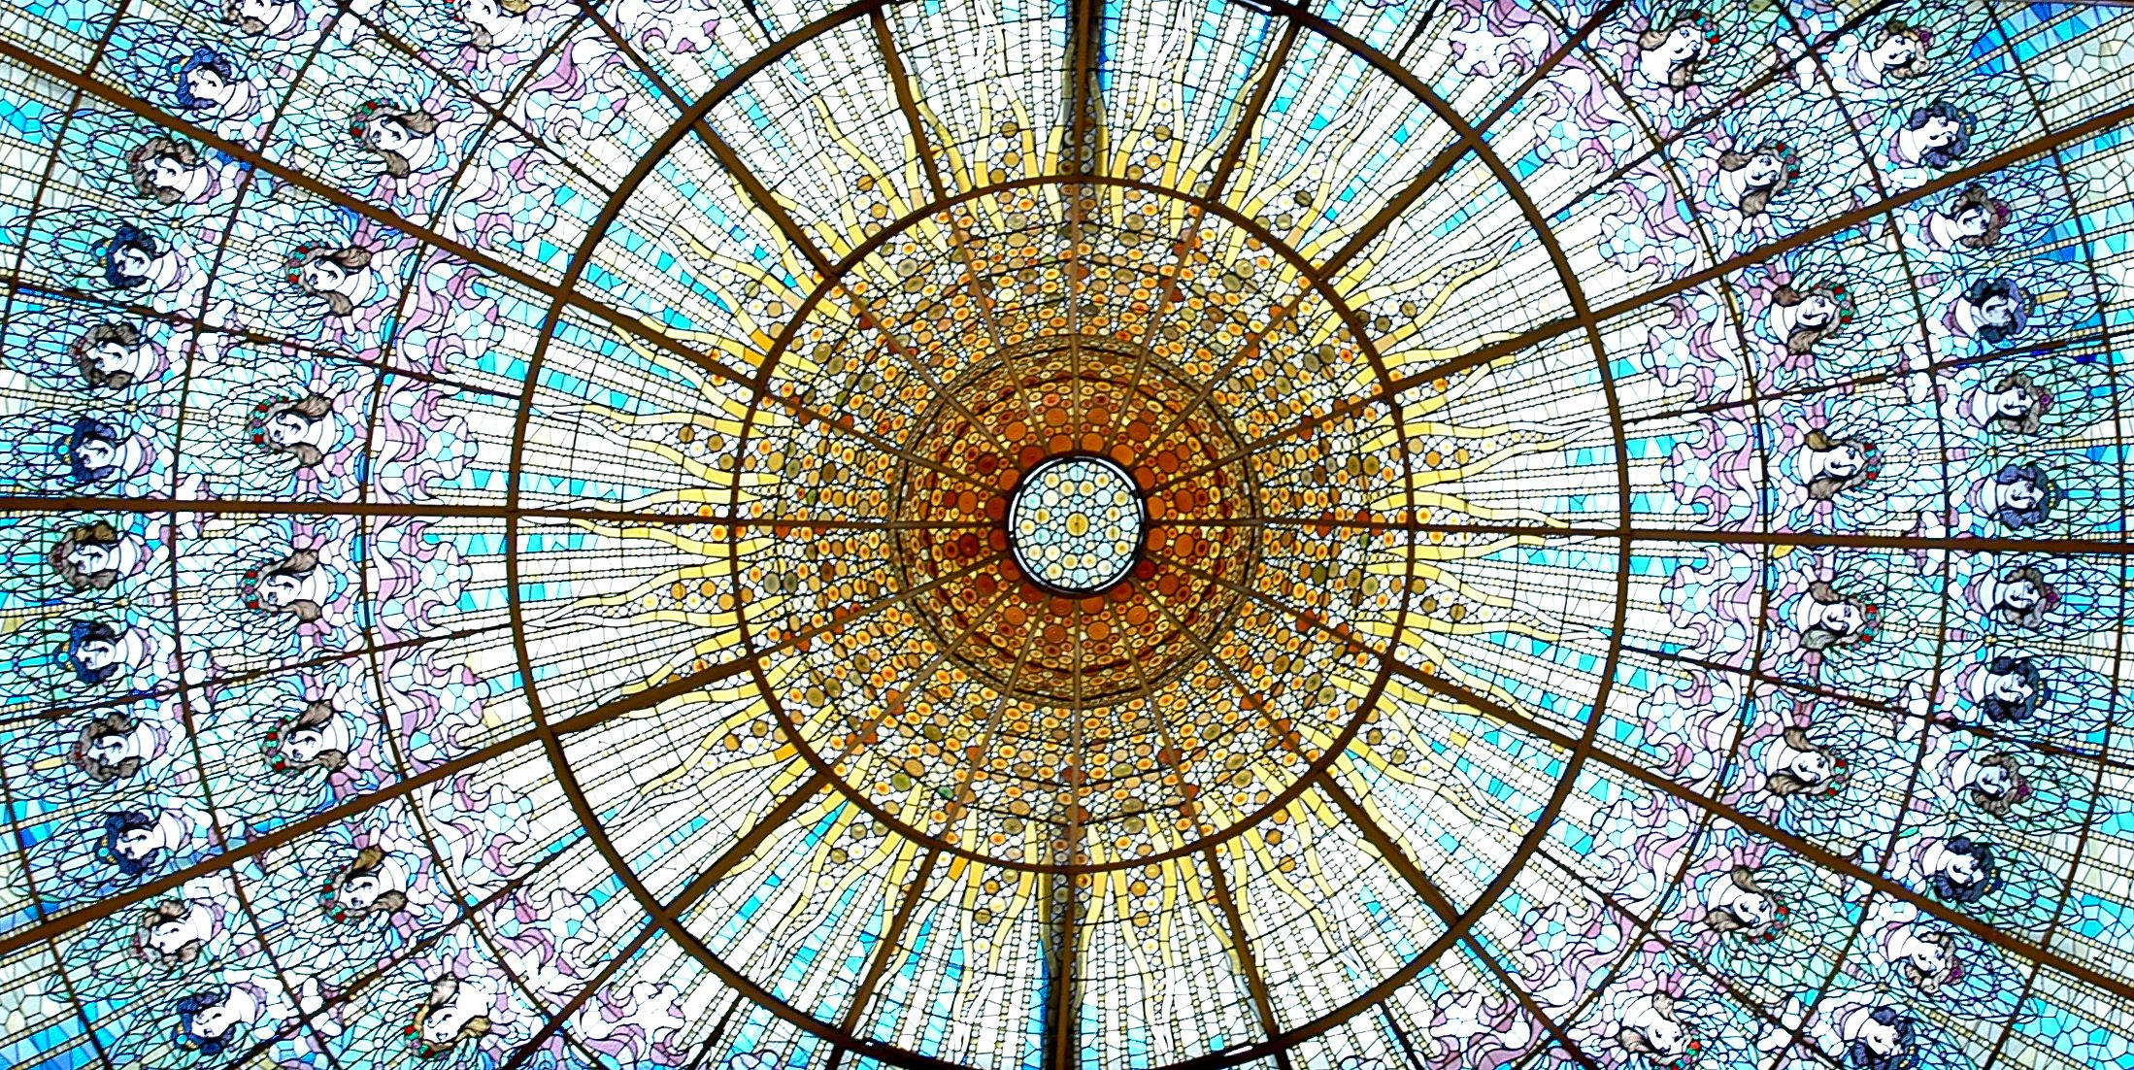
Color
Palau de la Musica Catalana, Barcelona

Slide 7
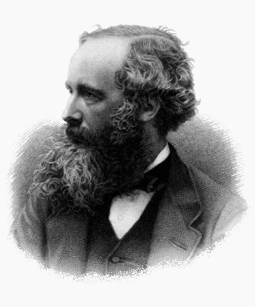
Maxwell Equations (‘macroscopic’ differential form)
Gauss’s Law:
Gauss’s Law for magnetism:
Faraday’s Law:
Ampere’s Law:
James C. Maxwell (1831-1879)
H | Magnetic field | B | Magnetic induction
E | Electric field | D | Electric displacement
J_{f} | Free current density | ρ_{f} | Free charge density

Slide 8
Constitutive relations in amorphous materials
General form for non-bianisotropic media:
Most amorphous materials are isotropic
  E and D (or B and H) always align in the same direction
  In most non-magnetic glasses, μ_{r} is close to 1 (μ = μ₀)
Linear media
Non-magnetic media
Non-magnetic media
Notes:
See J. A. Kong’s book for a complete discussion about bianisotropic media

Slide 9
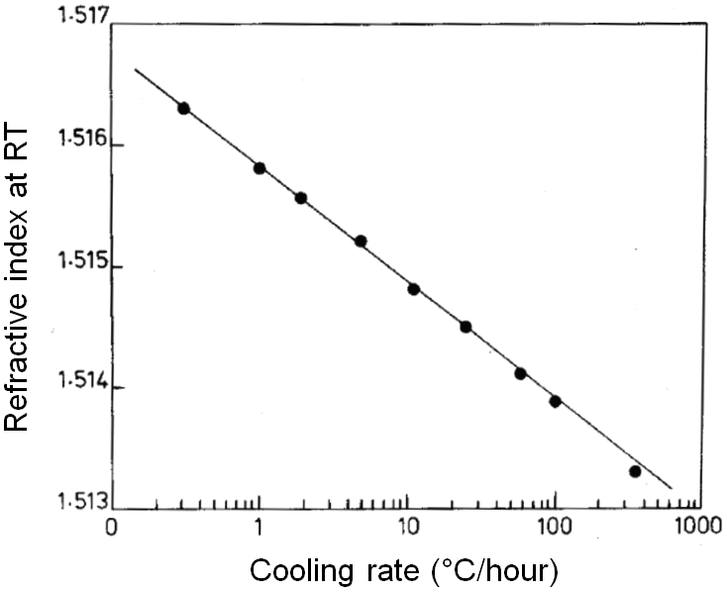
Refractive index of glass: general trends
Addition of heavy elements increases index
  Lead-containing glasses
Addition of alkali oxides increases index
  NBOs have larger polarizability than BOs
Fictive temperature (density) dependence
Rawson, Properties and Applications of Glasses (1980)

Slide 10
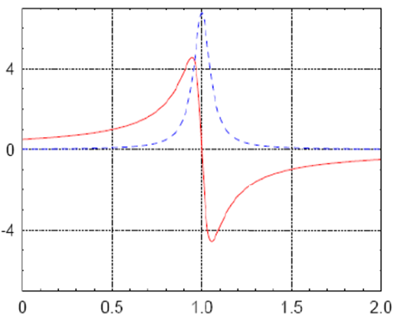
Kramers-Kronig (K-K) relation
Refractive index n and optical absorption α are not independent quantities!
α (ω)
n_{r} (ω) -1
ω / ω₀

Slide 11
Refractive index of glasses
Wavelength/frequency dependent (Lorentz oscillators)
α
Atomic/ionic absorption
Electronic absorption
n
Atomic/ionic polarizability
1
Electronic polarizability
λ
X-ray
UV
Visible
IR
Static

Slide 12
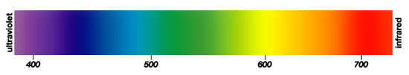
Chromatic dispersion of glasses
Abbe number (V-number):
  D, F and C spectral lines: 589.3 nm, 486.1 nm and 656.3 nm
F
D
C
n
Normal dispersion
Anormalous dispersion
1
λ
X-ray
UV
Visible
IR
Static
Notes:
Visually transparent glasses exhibit normal dispersion in the visible range
Large Abbe number means small dispersion

Slide 13
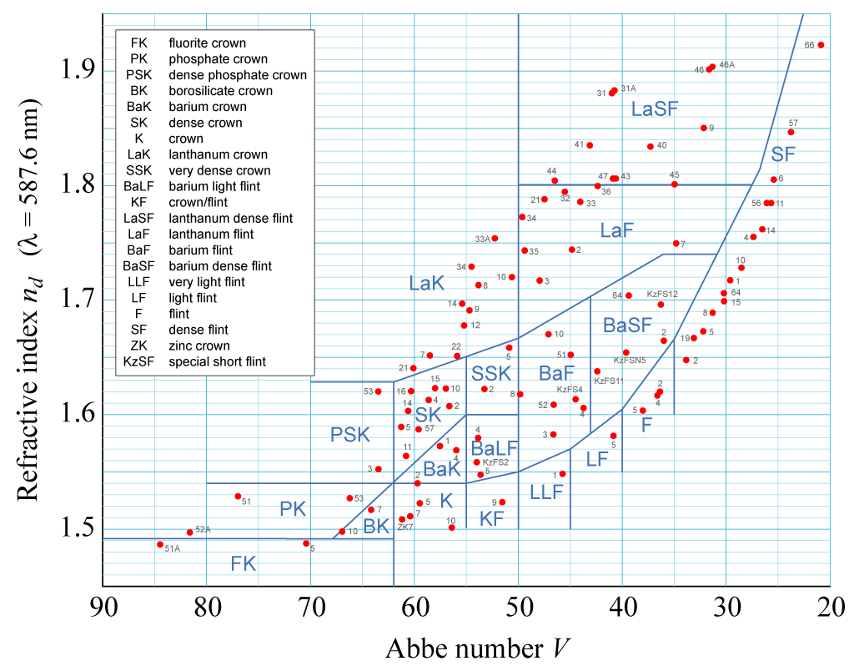

Chromatic dispersion of glasses
Abbe number (V-number):
Crown glass (“K”)
Soda-lime silicates
Low index
Low dispersion
Flint glass (“F”)
Lead glasses
High index
High dispersion
Optical polymers
Notes:
Note that n_d is different from n_D
‘Super ED’ or ‘FD’ glass made by Ohara in Japan with an Abbe Number of 94.94 − less expensive and easier to work with than CaF2 crystal with a very similar Abbe Number to calcium fluorite.

Slide 14
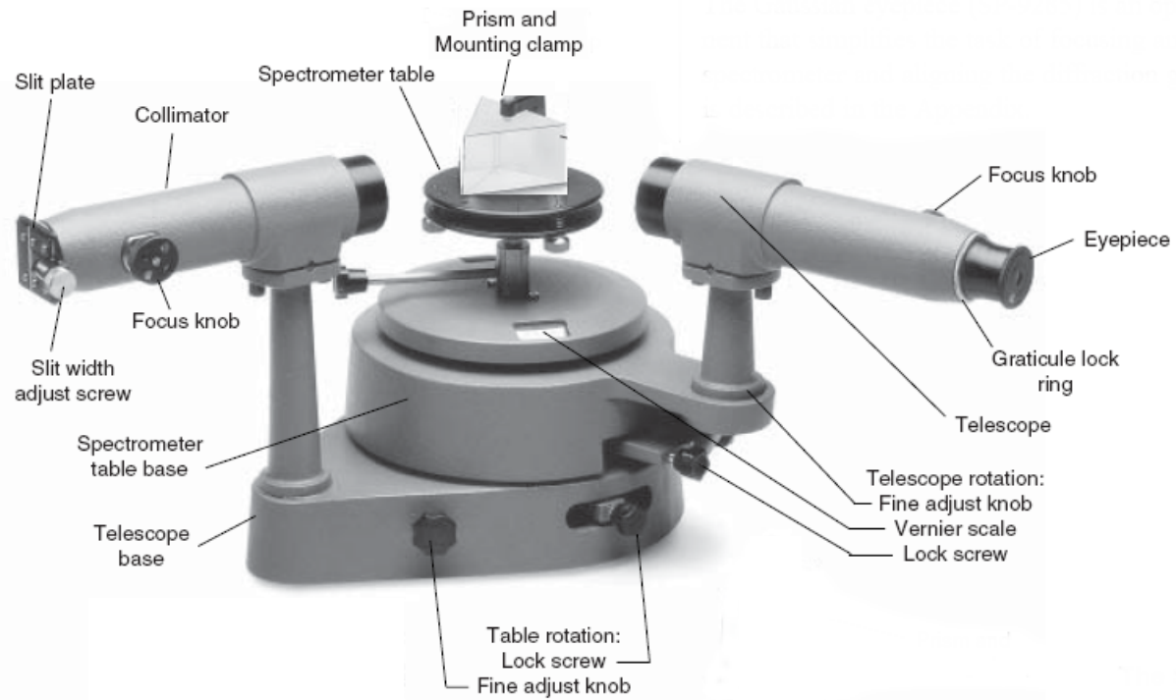
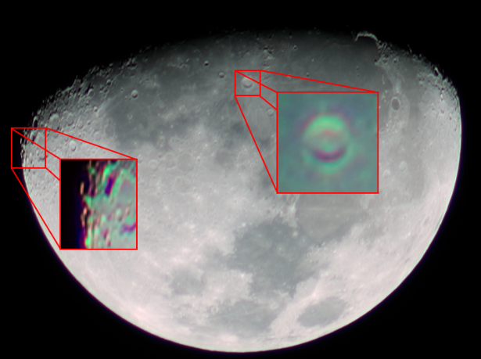
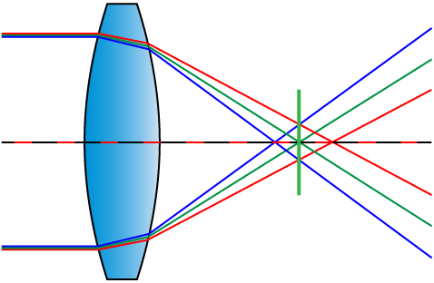
Chromatic dispersion of glasses
Prism dispersive spectrometer
Chromatic aberration

Slide 15
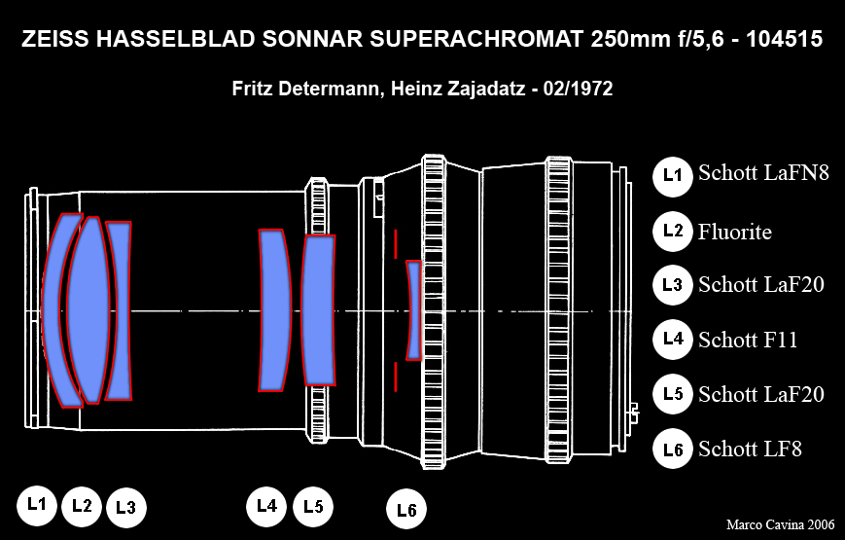

Slide 16
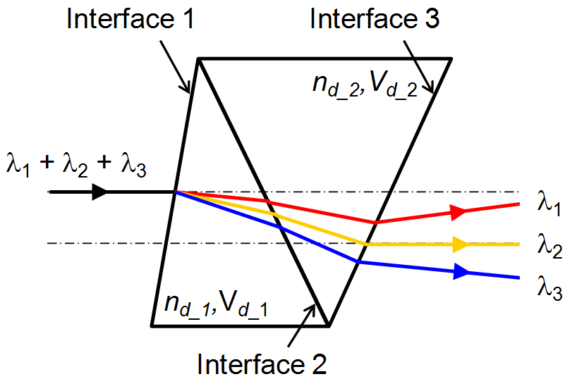
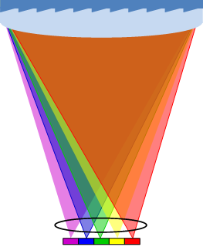
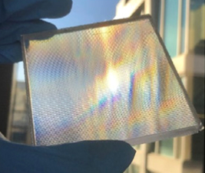

Dispersive concentrators for lateral solar spectrum splitting
Dispersive lens
Concentrating optics
Combining two materials (glass & polymer) with identical refractive index and different dispersion to split sunlight without bending optical axis
Lateral cell arrays
Opt. Lett. 44, 3274 (2019)

Slide 17
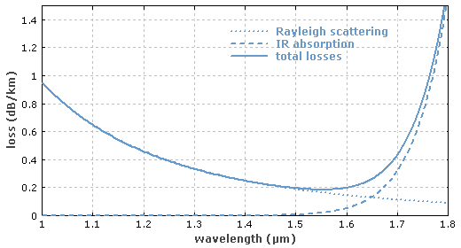
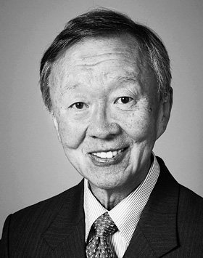
Optical loss in silica glass
The Nobel Prize in Physics 2009
Charles Kuen Kao
Prize motivation:
"for groundbreaking achievements concerning the transmission of light in fibers for optical communication"

Slide 18
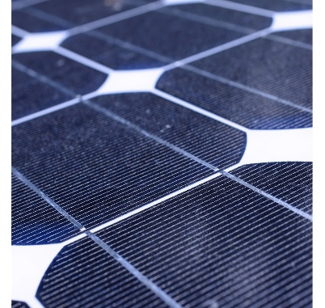
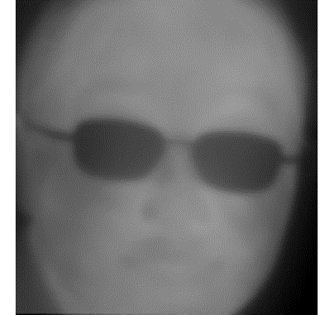
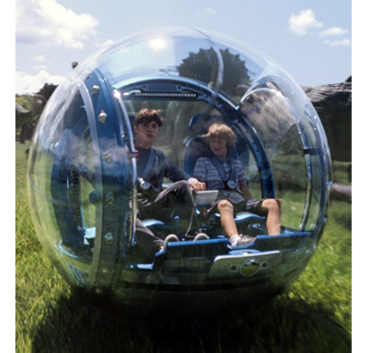
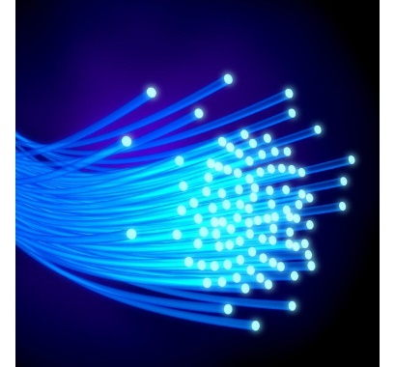
Optical loss / attenuation mechanisms
Semiconductor optoelectronics | Soda-lime glass in the infrared | Transparent ceramics | Fiber-optic glasses
Electronic absorption Absorption induced by electronic transitions | Phonon absorption Absorption resulting from atomic / ionic vibrations | Defect scattering Scattering by crystalline grains, grain boundaries, micro-voids, etc. | Rayleigh scattering Scattering due to density, structure or composition fluctuations

Slide 19
Optical loss mechanisms in glasses
Extrinsic absorption (impurities or dopants)
  Transition metal or rare earth ions
  Vibrational absorption
Intrinsic attenuation
  Band-to-band transitions
  Urbach tail absorption
  Mid-gap defect state absorption
  Free carrier absorption (FCA)
  Phonon (vibrational) absorption
  Rayleigh scattering
    Density fluctuation
    Structural moieties
Color codes:
Atomic/ionic absorption
Electronic absorption
Scattering

Slide 20

Electronic absorption in amorphous solids
E
  4
  1
Band-to-band transition
Urbach bandtail absorption
Defect state absorption
Free carrier absorption
Conduction band
  3
Urbach tail
Mid-gap states
  2
Mobility edge
Valence band
DOS

Slide 21
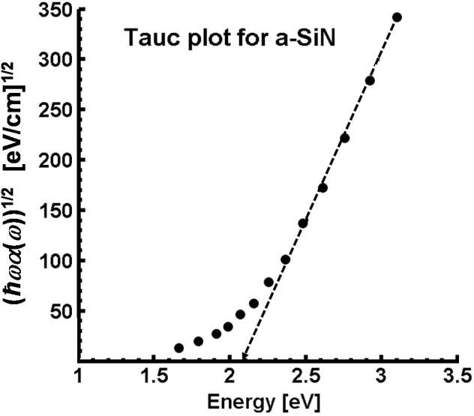
Electronic absorption in amorphous solids
E
  4
  1
Band-to-band transition
  3
E_{T} : Tauc gap
  2
Band-to-band transition
DOS
E_{T} = 2.1 eV
A. Stern, Photodiodes – World Activities in, 267 (2011).

Slide 22
Electronic absorption in amorphous solids
E
  4
  1
Band-to-band transition
Urbach bandtail absorption
  3
  2
Urbach tail absorption
DOS
A. Stern, Photodiodes – World Activities in, 267 (2011).

Slide 23
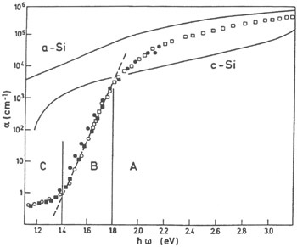
Electronic absorption in amorphous solids
E
  4
  1
Band-to-band transition
Urbach bandtail absorption
  3
  2
DOS
A: band-to-band
B: Urbach tail
C: Dangling bonds
L. Ley, The Physics of Hydrogenated Amorphous Silicon, 141 (1984).

Slide 24
Electronic absorption in amorphous solids
E
  4
  1
Band-to-band transition
Urbach bandtail absorption
Defect state absorption
  3
  2
DOS
A: band-to-band
B: Urbach tail
C: Dangling bonds
L. Ley, The Physics of Hydrogenated Amorphous Silicon, 141 (1984).

Slide 25
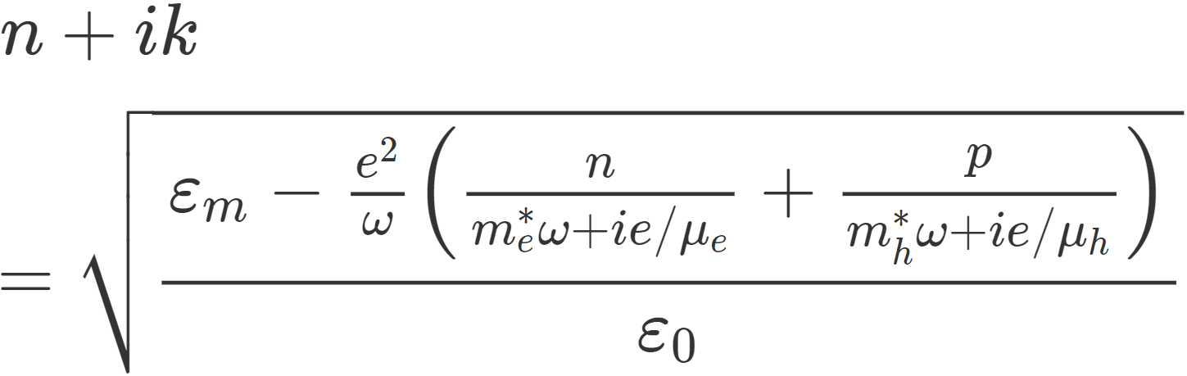
Electronic absorption in amorphous solids
E
  4
  1
Band-to-band transition
Urbach bandtail absorption
Defect state absorption
Free carrier absorption
  3
Drude model:
  2
DOS
Theory behind the generalized Drude (Plasma) model

Slide 26
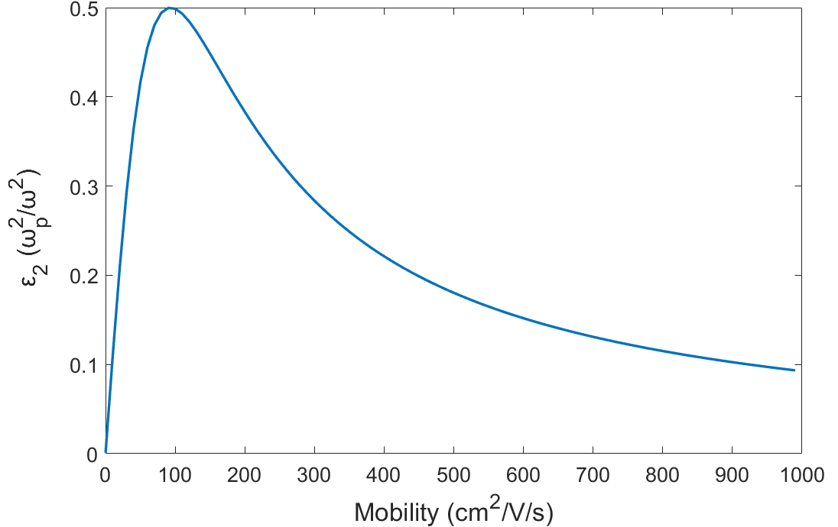
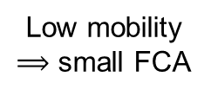
Electronic absorption in amorphous solids
E
  4
  1
Band-to-band transition
Urbach bandtail absorption
Defect state absorption
Free carrier absorption
  3
  2
DOS
Low mobility $⟹$ small FCA

Slide 27
Electronic absorption in amorphous solids
E
  4
  1
Band-to-band transition
Urbach bandtail absorption
Defect state absorption
Free carrier absorption
  3
  2
Absorption coefficient (cm⁻¹)
Band-to-band: > 10³
Bandtail and defect states: 1 – 10³
FCA: generally weak in amorphous solids
DOS

Slide 28
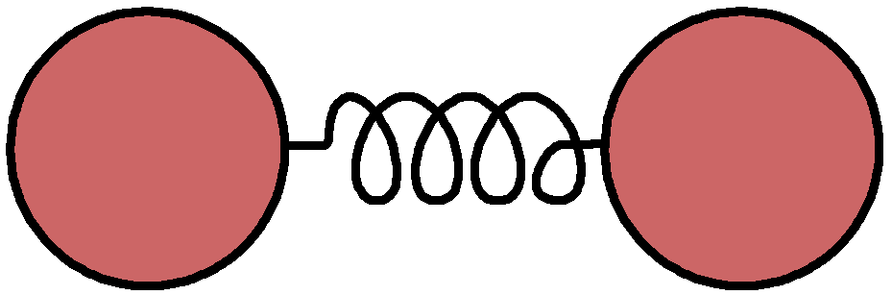
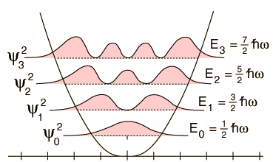
Vibrational absorption
Atom
Atom
Compound or functional group | Primary absorption bands (μm)
O-H | 2.92
S-H | 4.01, 3.65, 3.11, 2.05
P-H | 4.35
Ge-H | 4.95
As-H | 5.02
Si-O | 9.1 – 9.6
Ge-O | 12.8
H₂O | 6.3, 2.8
k
Harmonic oscillator
m
m
Bond
Energy
Atomic spacing
J. Optoelectron. Adv. Mater. 3, 341 (2001)

Slide 29
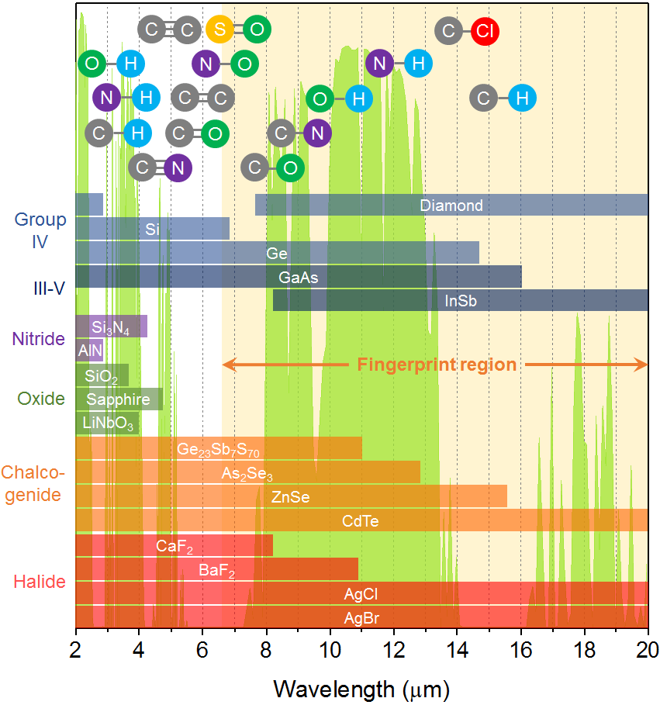
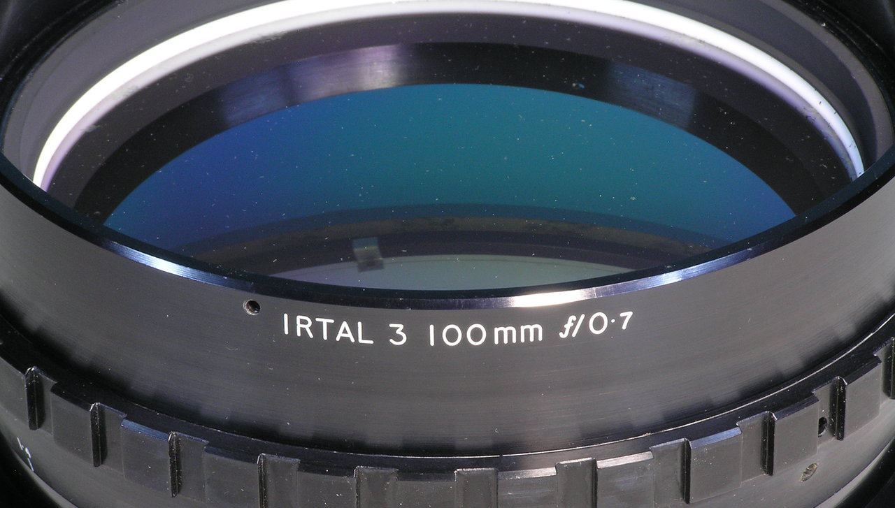
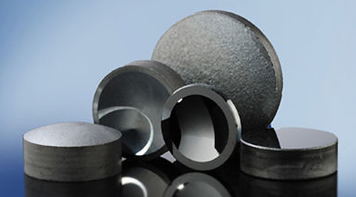
Infrared windows of common optical materials
Single-crystal germanium lens
Black diamond (BD-2): Ge₂₈Sb₁₂Se₆₀

Slide 30

Sources of Rayleigh scattering in glass
Local density fluctuation
  p : photoelastic constant
  β : isothermal compressibility
Concentration scattering
  Local composition fluctuation in multi-component glasses
Ann. Physik 33, 1275 (1910);
Ann. Physik 25, 205 (1908);
J. Appl. Phys. 55, 4052 (1984).
  Einstein-Smoluchowski scattering: density fluctuation of atmosphere

Slide 31
Intrinsic optical loss spectrum in glass
Rayleigh scattering limited
Phonon absorption limited
log(α)
Minimum loss window
log(λ)
Total loss:

Slide 32
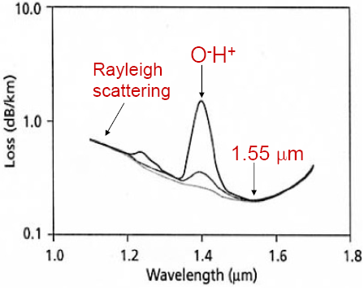
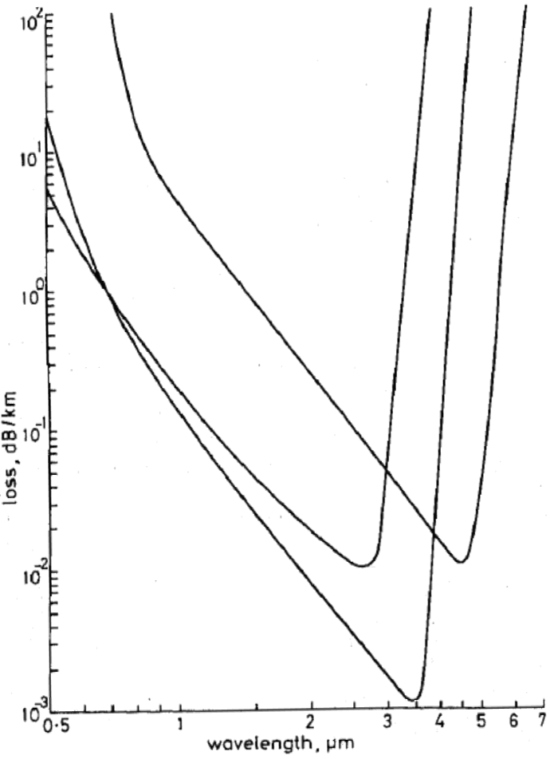
Total optical loss in glasses
SiO₂
Electron. Lett. 17, 775 (1981)
SiO₂
CaF₂-BaF₂-YF₃-AlF₄
GeS₃
Concentration scattering is not taken into account, resulting in unrealistically low loss values
BaF₂-GdF₄-ZrF₄

Slide 33
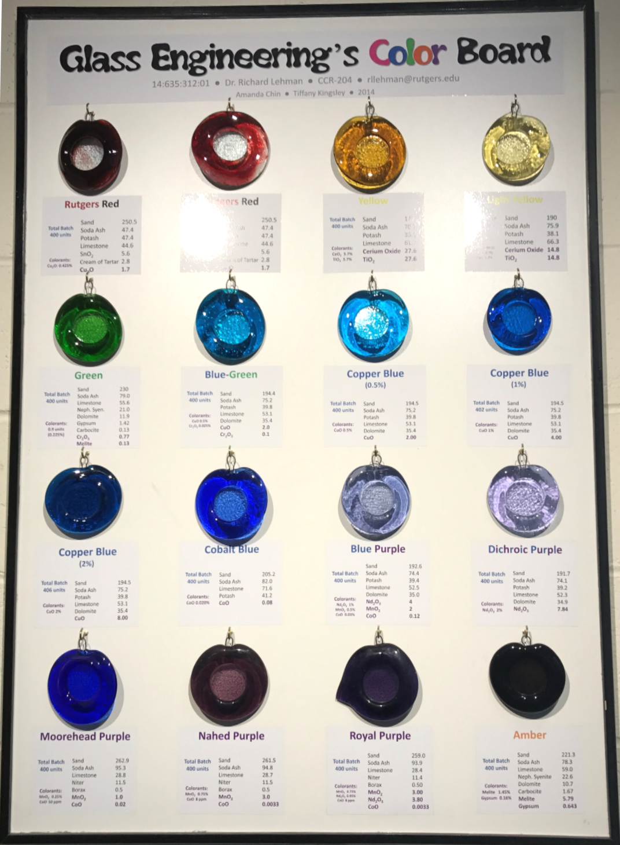
Photo taken at the
Corning Glass Science and Engineering Laboratory, Rutgers University

Slide 34
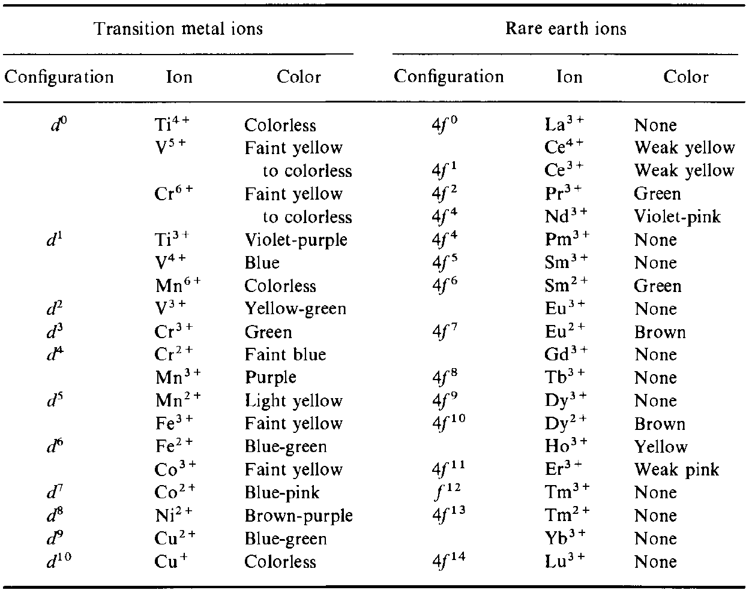
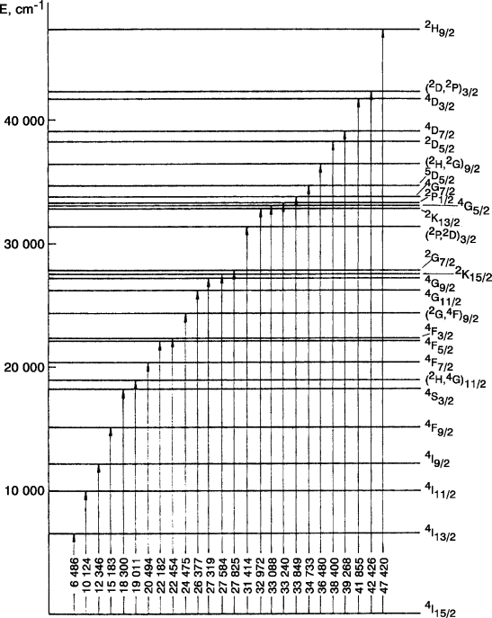
Transparent glass coloring: absorption
Transition metal or rare earth ion additives
Er³⁺ energy levels
Modern Aspects of Rare Earths and Their Complexes (2003)
Notes:
Erbium(III) with f11 configuration has 17 multiplet terms with 41 levels due to spin-orbit coupling.

Slide 35
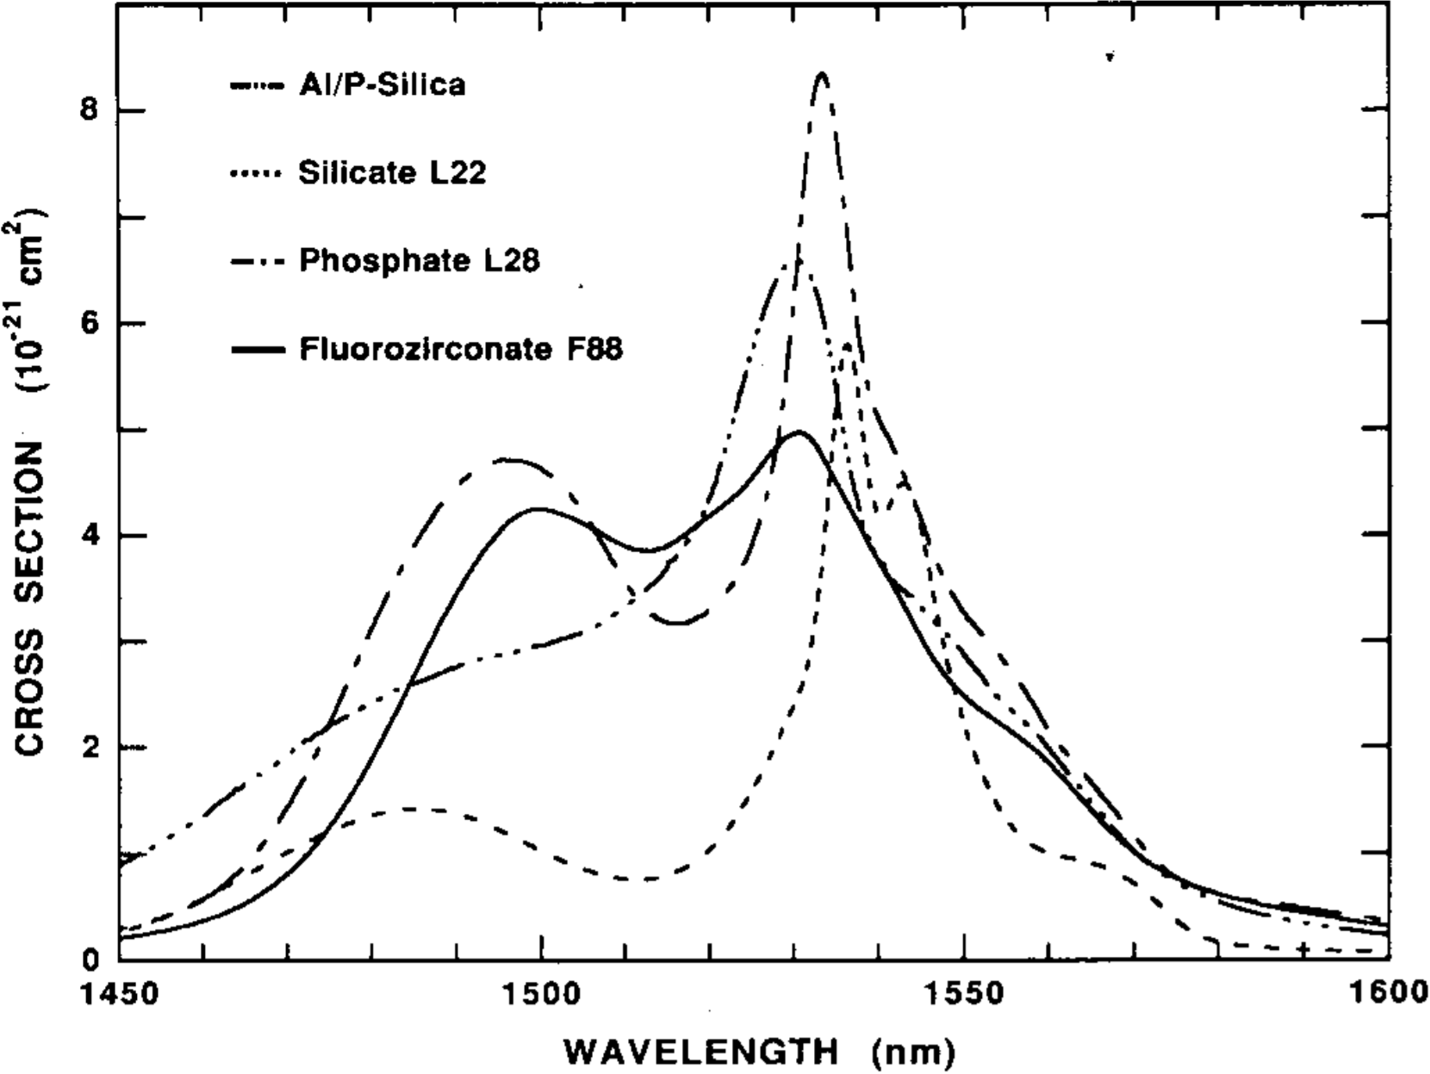
Transparent glass coloring: absorption
Transition metal or rare earth ion additives
Absorption spectra of Er³⁺ in different glasses
J. Lightwave Technol. 9, 234 (1991)

Slide 36
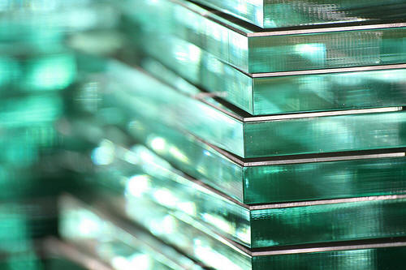
Transparent glass coloring: absorption
Transition metal or rare earth ion additives
Green tint due to Fe²⁺ ions
Glass decolorization:

Slide 37
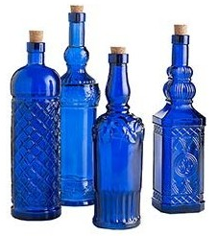
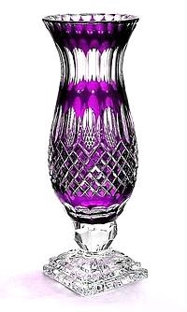
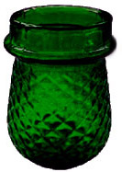
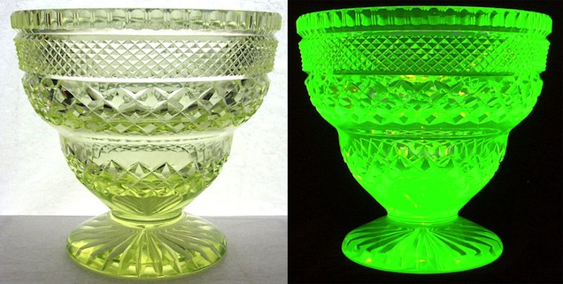
Examples of color glasses with ion additives
Cobalt blue
Chromium green
Uranium glass (Vaseline glass)
Manganese amethyst
Room light
UV illumination

Slide 38
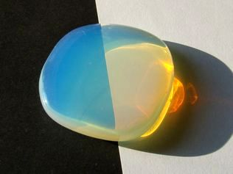
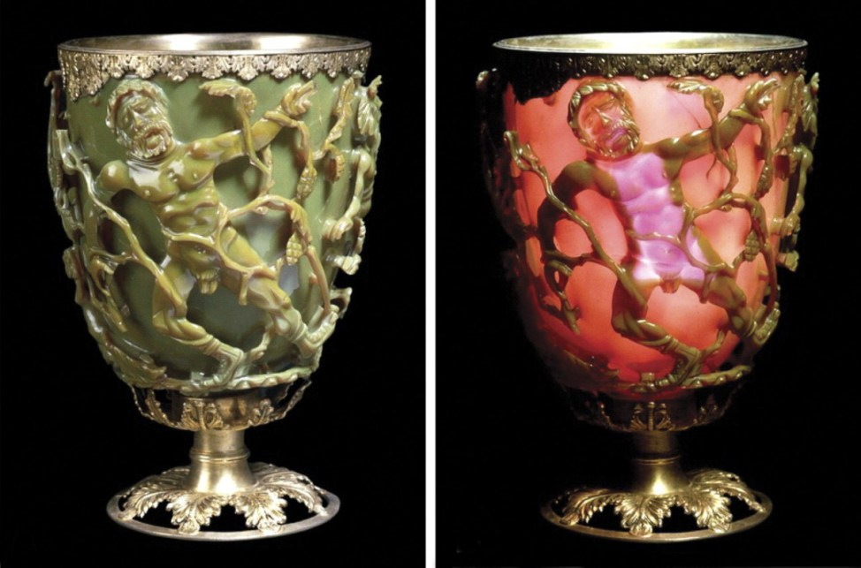
Transparent glass coloring: scattering
Precipitation of small crystals or metal nanoparticles
  Rayleigh scattering by nanocrystals
  Plasmon resonance of metal nanoparticles
Opalescent glass: nanocrystals
Lycurgus Cup: Au-Ag nanoparticles
Notes:
Cryolite glass image source: https://www.itp.uni-hannover.de/~zawischa/ITP/scattering.html

Slide 39

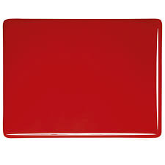
Striking colors
Coloring of glass via heat treatment
Example: gold-ruby striking
Annealing at 500 – 700 °C
O²⁻
Au nanoparticles (dia. 5 – 60 nm)
Unfired
Fired
Au⁺
Au⁺
Melt at 1400 °C and quench
Nature 407, 691 (2000)
Notes:
Blue/green colors in glasses (ions) are usually more stable than red/gold colors (NPs)

Slide 40
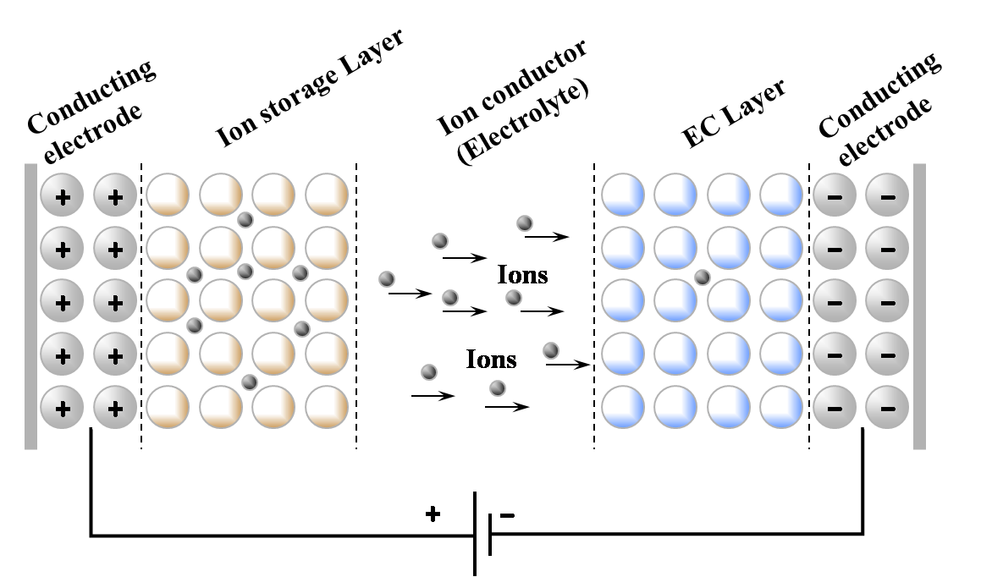
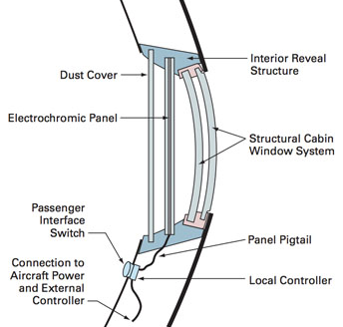
Photochromic and electrochromic glasses
Optical or electrical control of redox state of ions
© Gentex Corp
Notes:
By using viologens and phenlyenediamine as the electrochromic molecules and redox agent, Gentex Corporation has commercialized this type of device for auto-dimming rearview mirrors and smart windows in Boeing 787 aircraft.

Slide 41

Photochromic and electrochromic glasses
Optical or electrical control of redox state of ions
Carrier injection into transparent conductors to modulate FCA
Bleached transparent
Colored brown-gray
Nature 500, 323 (2013)

Slide 42

Photochromic and electrochromic glasses
Optical or electrical control of redox state of ions
Carrier injection into transparent conductors to modulate FCA
Nature 500, 323 (2013)

Slide 43
Summary
Refraction
  Microscopic origin of refraction and chromatic dispersion
  Composition dependence of refractive indices
  Abbe number
Attenuation
  Optical loss mechanisms in general materials
  Optical loss mechanisms in glasses
  Electronic, vibrational, and scattering losses
Coloring
  Ion additives
  Scattering by nanoparticles

