Slide 1
MIT 3.071 Amorphous Materials 14: Optical Fibers and Waveguides
Juejun (JJ) Hu
hujuejun@mit.edu

Slide 2
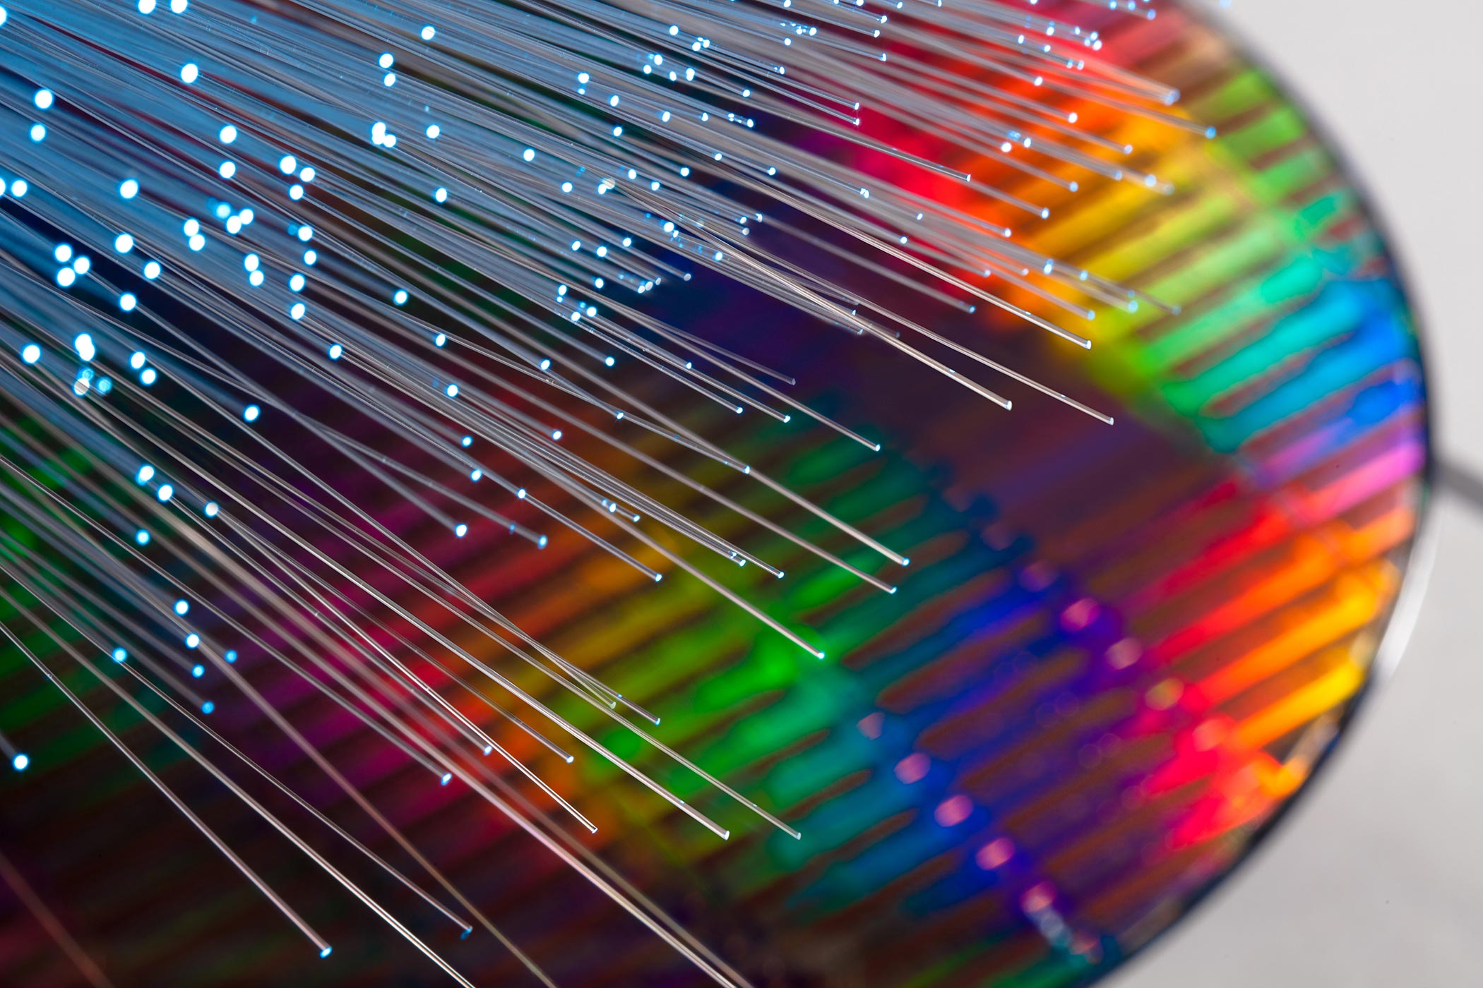
The masters of light
“If we were to unravel all of the glass fibers that wind around the globe, we would get a single thread over one billion kilometers long – which is enough to encircle the globe more than 25,000 times – and is increasing by thousands of kilometers every hour.”
2009 Nobel Prize in Physics
Press Release

Slide 3
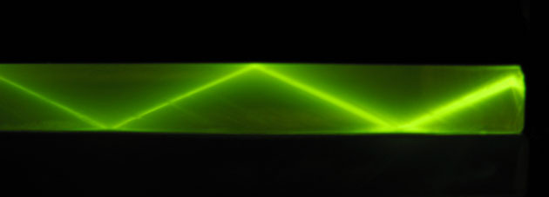
Light confinement via total internal reflection
n_{low}
Light
Condition for TIR:
n_{high}
θ
Core
n_{low}
Cladding
PMMA
Snell is right
by Ulrich Lohmann
Air

Slide 4
Waveguide cross-section geometries
2-d optical confinement
1-d optical confinement
cladding
n_{low}
core
n_{low}
n_{low}
core
n_{high}
n_{high}
n_{high}
cladding
n_{low}
cladding
n_{low}
Slab waveguide
Channel/photonic wire
waveguide
Rib/ridge waveguide
cladding
core
Step-index fiber
Graded-index (GRIN) fiber

Slide 5
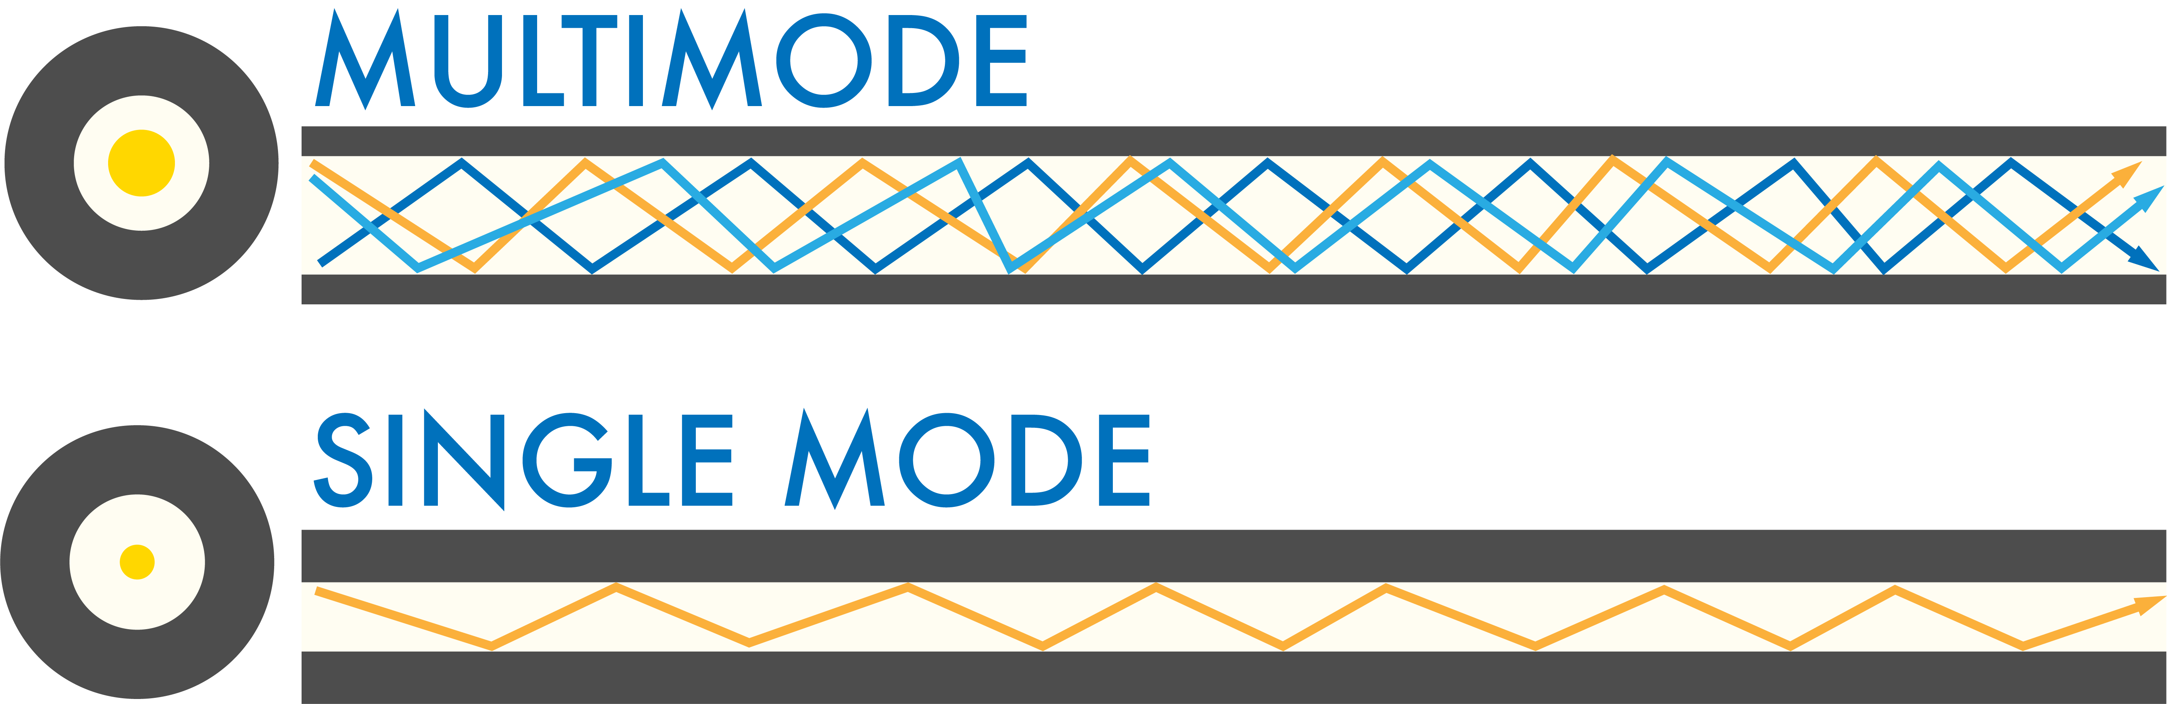
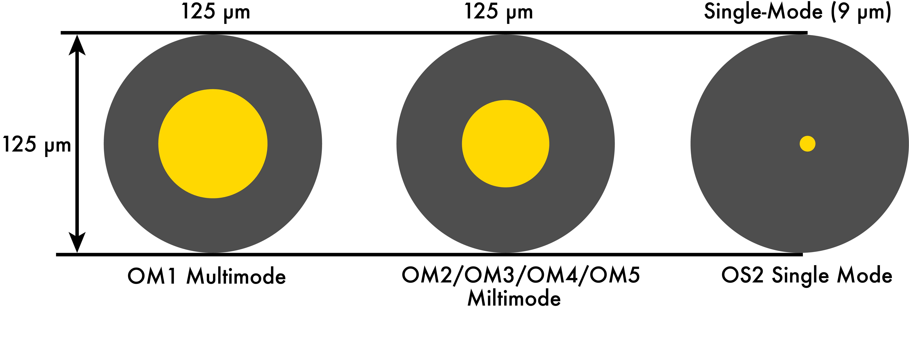
Single-mode vs. multi-mode light guiding

Slide 6
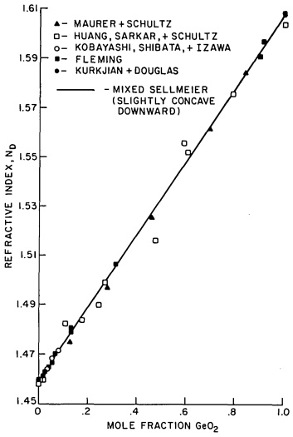
Optical fiber materials
Glasses: silica and other oxides, chalcogenides, halides, polymers
Metals, crystalline oxides and semiconductors, etc.
Dopants in silica glass
Increase index: GeO₂, P₂O₅, TiO₂
Decrease index: B₂O₃
Luminescent centers: rare earth (e.g. Er)
Refractive index n_{D} of SiO₂-GeO₂ glass
Appl. Opt. 24, 4486 (2004)

Slide 7
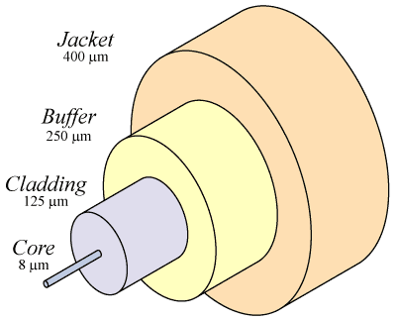
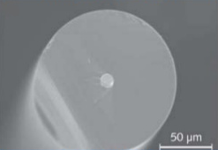
Standard single-mode silica optical fiber structure
Core/cladding: low loss light propagation
Buffer/jacket: protection against mechanical damage and the environment (UV radiation, humidity, etc.)
Cladding
Core

Slide 8
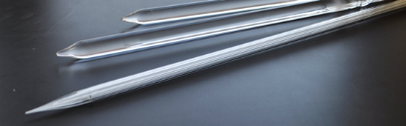
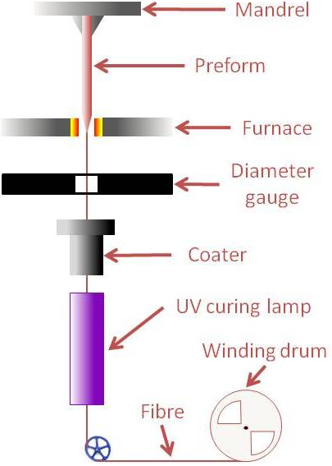
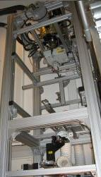
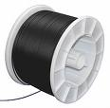
Fiber drawing process
Fiber preforms
Viscosity window for fiber drawing:
10⁴ to 10⁶ Pa·s
Drawing tower
Fiber spool
Notes:
https://www.technologyreview.com/s/401266/drawing-optical-fibers/

Slide 9
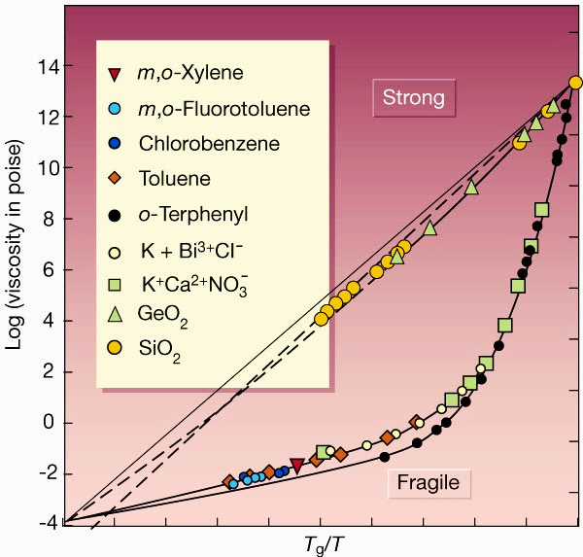
Glass properties impact fiber processing
Glass forming ability
Processing window
Liquid fragility
Fragility parameter
Temperature sensitivity

Slide 10
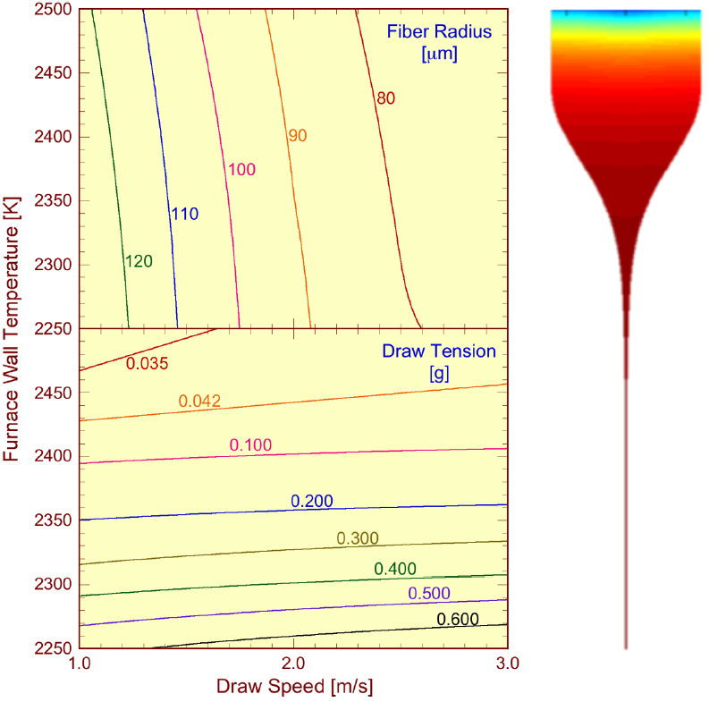
Fiber drawing: diameter control
Drawing tension:
Fiber diameter is determined by the drawing speed
Fiber diameter is feedback loop controlled in real time during drawing
Candy fiber drawing
Preform
A
Neck-down region
IEEE Photon. J. 2, 620 (2010)
J. Appl. Phys. 49, 4417 (1978)
F

Slide 11
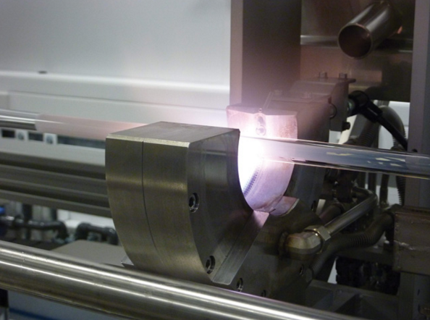
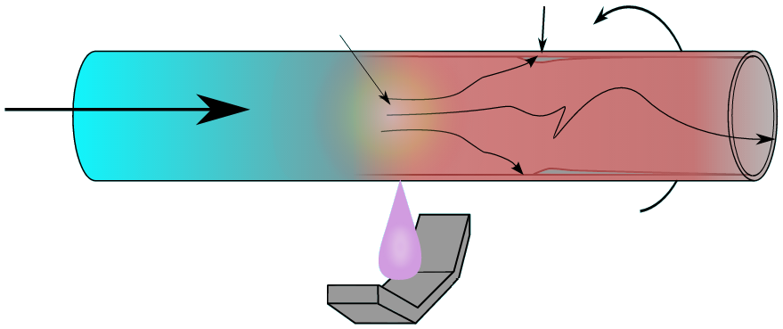
Standard silica fiber preform fabrication
Modified chemical vapor deposition (MCVD)
SiCl₄ + O₂ → SiO₂ (soot) + Cl₂
GeCl₄ + O₂ → GeO₂ + Cl₂
Layer composition and thickness controlled in each torch sweep
Water-free reaction: minimal -OH contamination
High temperature reaction zone
Soot
Reactant gases
Rotating silica tube
Traversing torch
MCVD lathe, University of Southampton
Notes:
Silicon tetrachloride has a boiling point (57.7 C) convenient for purification by repeated fractional distillation

Slide 12
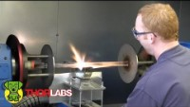
Optical fiber manufacturing and testing

Slide 13
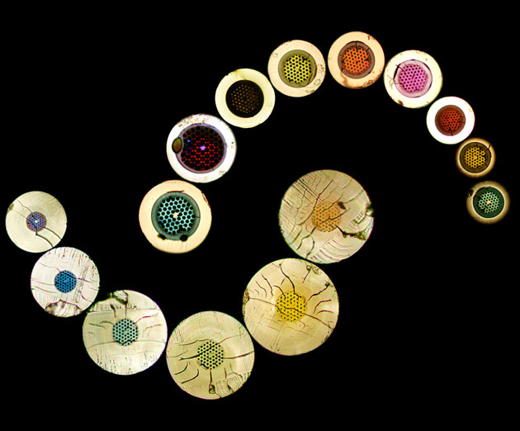
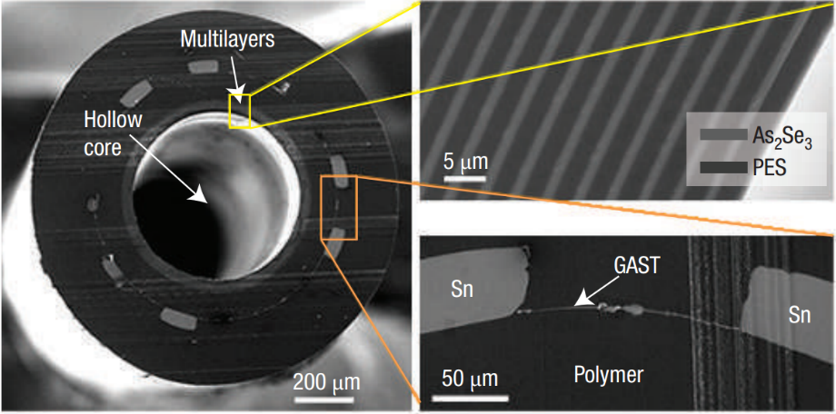
Multi-material, microstructured optical fibers
Nat. Mater. 6, 336, (2007)
Optical mode shaping
Dispersion engineering
Broadband transmission
Multi-functional sensing
Microstructured optical fibers: photonic bandgaps and various sizes of the rings give rise to the different colors
A. Argyros, the University of Sydney

Slide 14
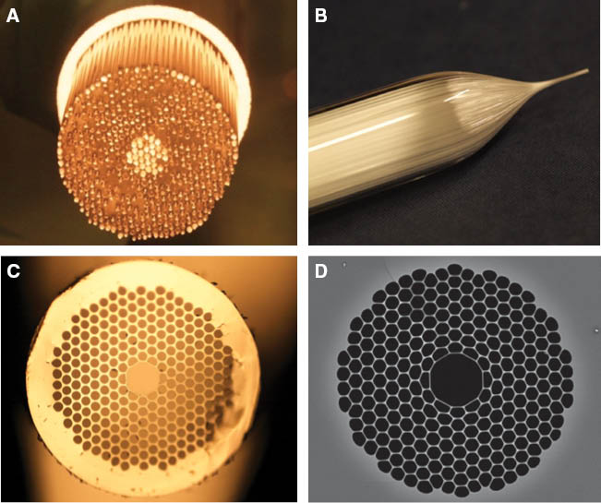
Multi-material, microstructured optical fibers
Nat. Mater. 6, 336, (2007)
Optical mode shaping
Dispersion engineering
Broadband transmission
Multi-functional sensing
Hollow-core photonic crystal fiber fabrication process flow using the stack-and-draw technique
Nanophotonics 2, 315-340 (2013)
Notes:
(A) Primary preform obtained by assembling a few hundred high purity, low-hydroxyl silica glass capillaries into an array with the required geometry tightly packed inside a glass tube; (B) first stage draw of the primary preform into a ~millimetre sized “cane”; (C) optical image of the cross-section of a HC-PBGF cane showing elimination of interstitial volumes and formation of the central core “defect”; (D) scanning electron microscope image of the microstructured region of the final fibre, showing a much increased diameter to pitch ratio of the cladding holes. The typical hole-to-hole spacing for operation at 1500 nm wavelength is in the range of 4–6 µm (depending on the air filling ratio of the cladding).

Slide 15
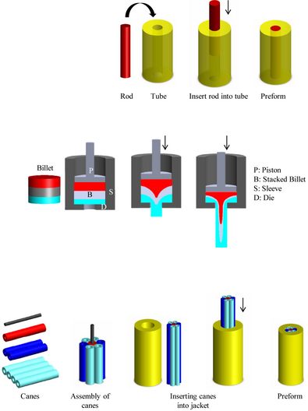
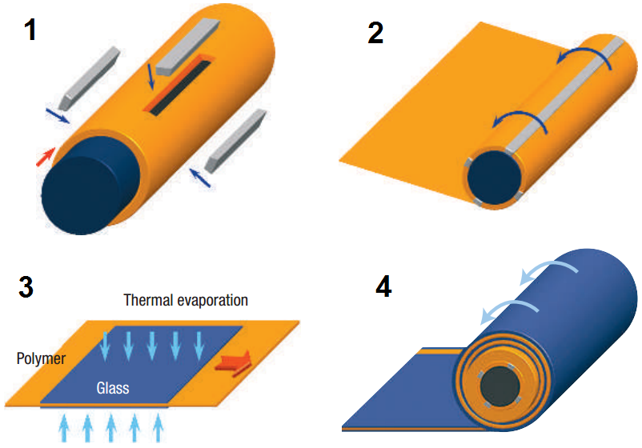
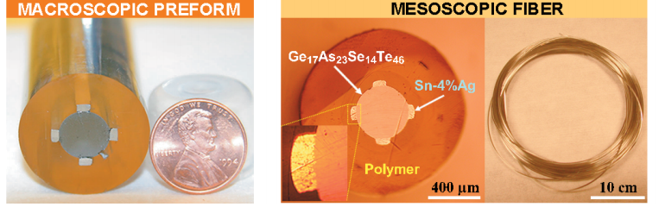
Multi-material, microstructured optical fibers
Rod-in-tube
Extrusion
Stack-and-draw
Int. J. Appl. Glass Sci. 3, 349 (2012)
Adv. Mater. 18, 845 (2006)

Slide 16
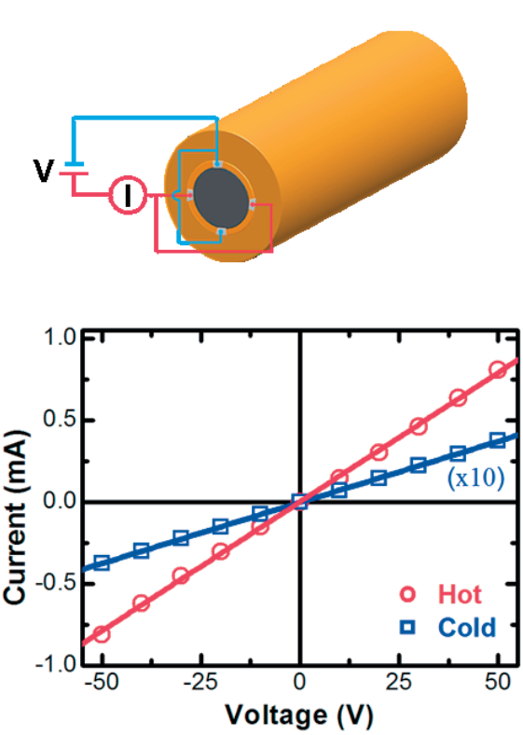
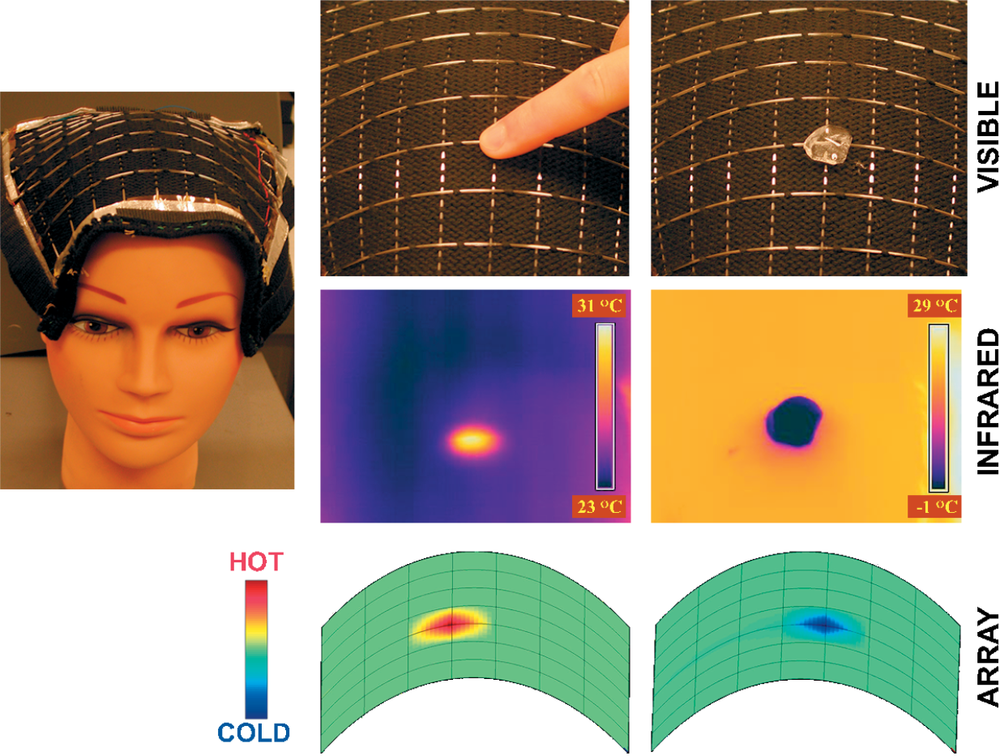
Multi-material, microstructured optical fibers
Thermal sensing fibers
Adv. Mater. 18, 845 (2006)

Slide 17
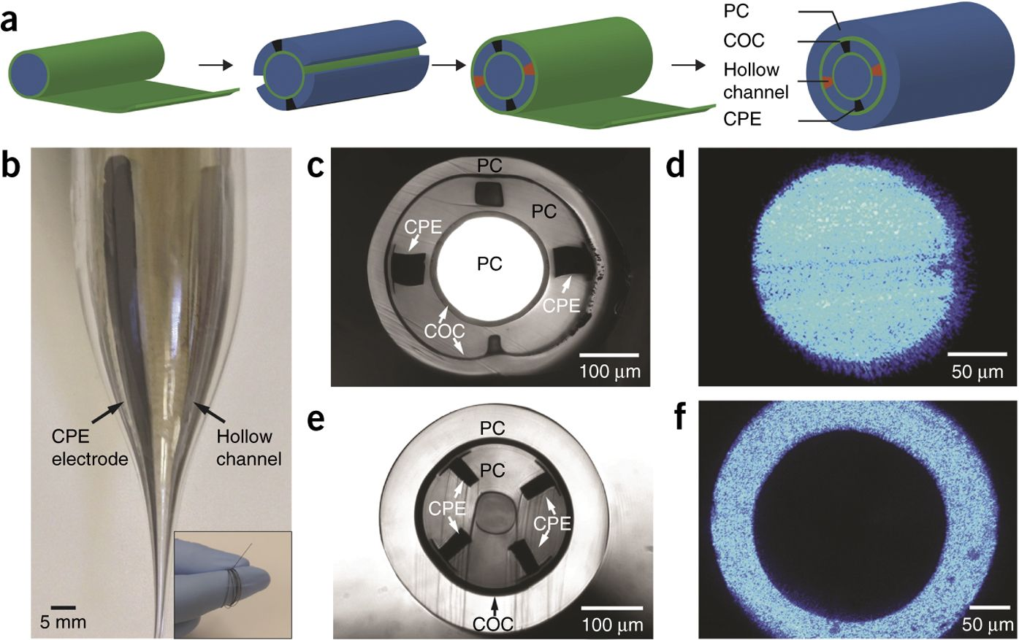
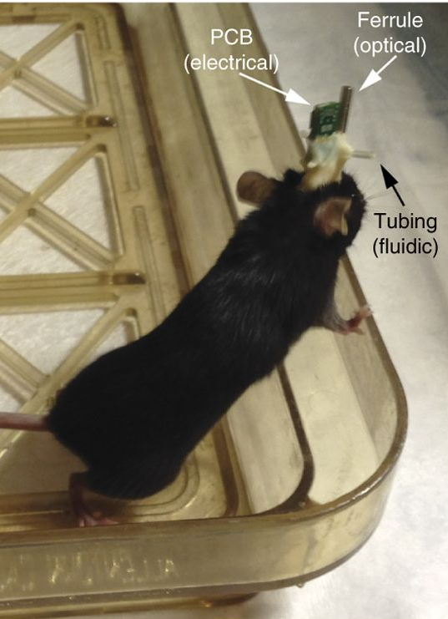
Multi-material, microstructured optical fibers
Multifunctional (optical, electrical and chemical) neural probes
Nat. Biotechnol. 33, 277 (2015)

Slide 18
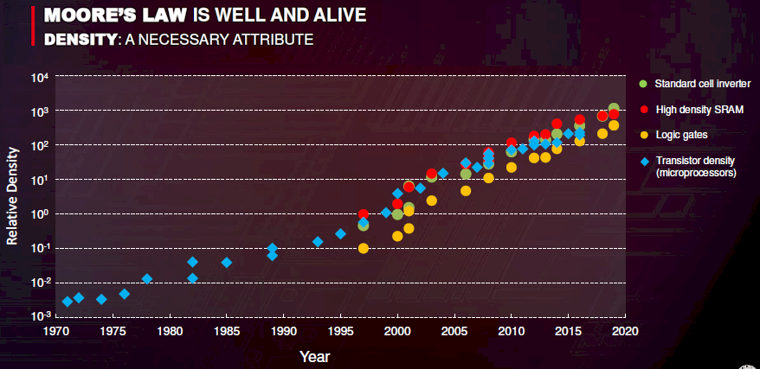
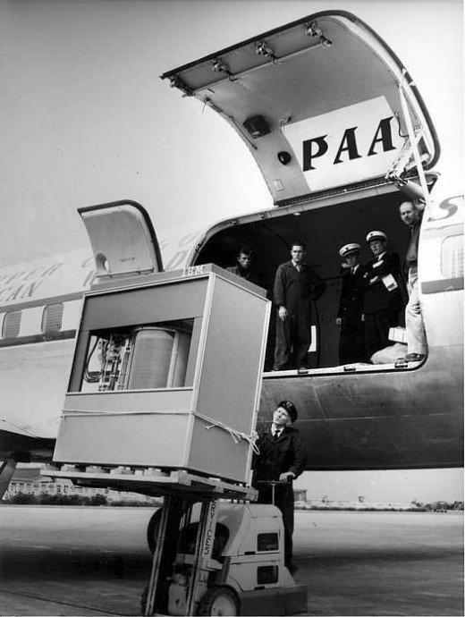
“Exponential growth is the most powerful force in the universe.”
© TSMC
A 5 MB hard disk (1956)

Slide 19
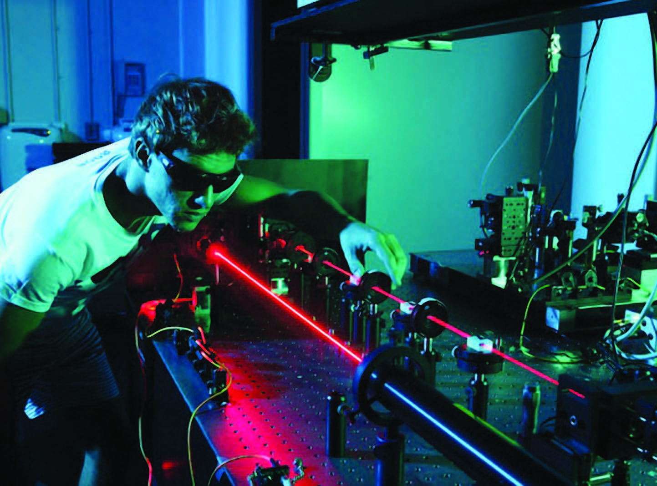
Benchtop optical systems based on discrete components

Slide 20
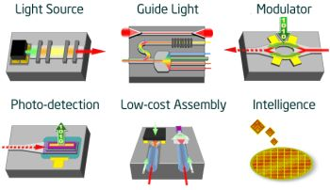
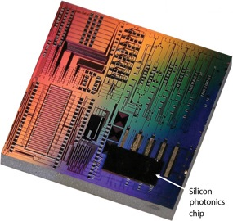
Photonic integrated circuits (PICs)
Photonic integration enables rugged and low-cost miniature optical systems

Slide 21



Value proposition for integrated photonics
Cost & scalability
Deployment flexibility
Power savings

Slide 22
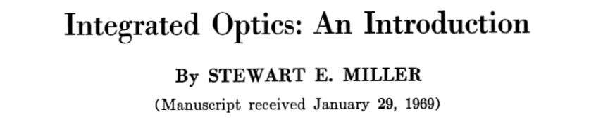
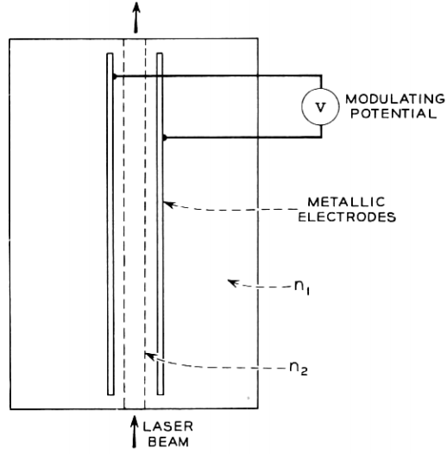
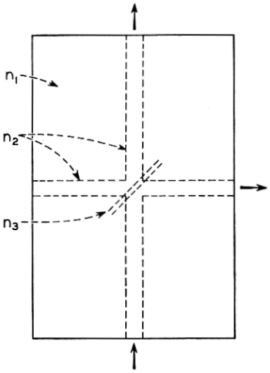
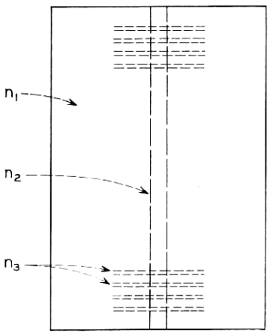
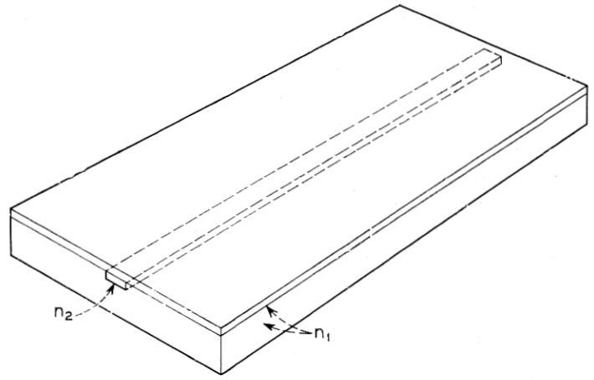
Waveguide
Waveguide
Laser cavity
Optical switch
Photodetector
All optical components integrated on a glass substrate

Slide 23
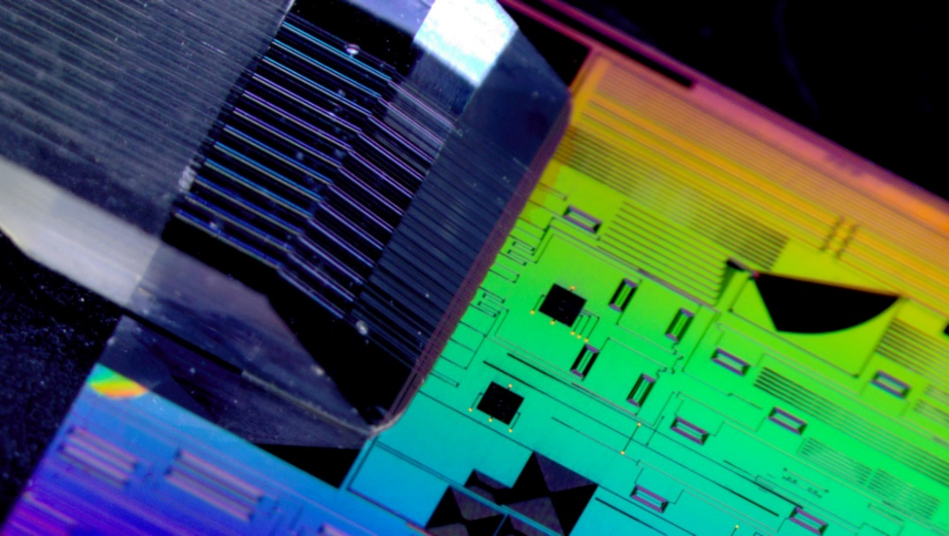
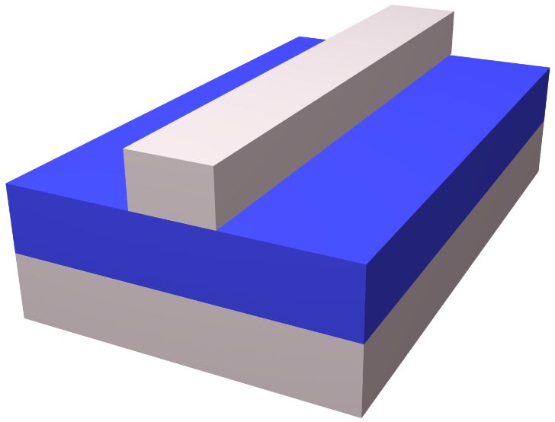
State-of-the-art integrated photonics
Light
Optical fiber interface
Core
Cladding
Substrate
Photonic chip
IMEC photonic chip & Tyndall fiber array packaging
Integrated planar waveguide
Substrate platforms: Si, III-V semiconductors, glass, LiNbO₃, polymer
Core material: c-Si, III-V, a-Si, SiO₂, SiN, ion exchange glass, polymer

Slide 24
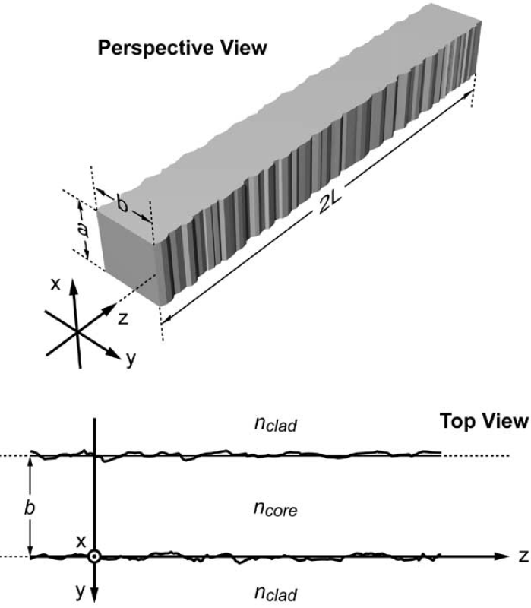
Optical loss in fibers and waveguides
Material attenuation
Surface roughness scattering
Optical fiber
Frozen surface capillary waves due to energy equipartition
Usually small in optical fibers
Planar waveguide
Surface roughness resulting from imperfect patterning
Often the main source of loss
σ : RMS roughness
J. Lightwave Technol. 23, 2719 (2005)

Slide 25
Planar waveguide fabrication: lithography
Substrate
Cladding layer
Core layer
Amorphous waveguide material: ease of deposition, low optical loss
Planar waveguide platform: massively parallel low-cost fabrication, geometry/material diversity, interfacing with other on-chip components

Slide 26
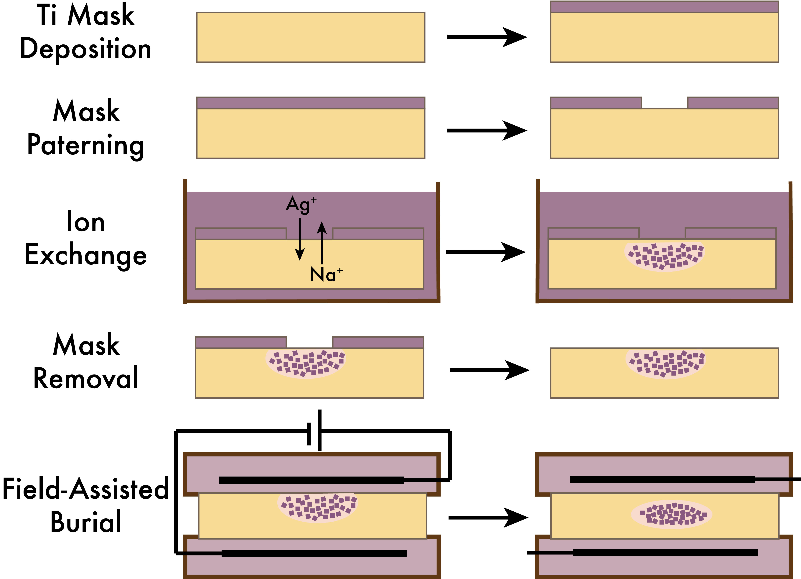
Planar waveguide fabrication: ion exchange
Scalable, simple lithographic processing
Low optical loss
Potential for adjustments with post-annealing

Slide 27
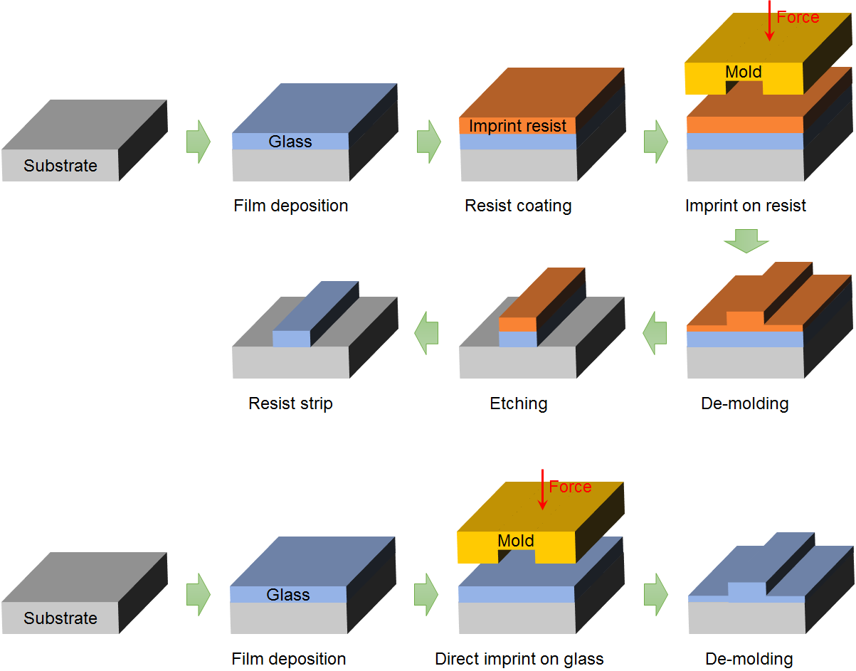
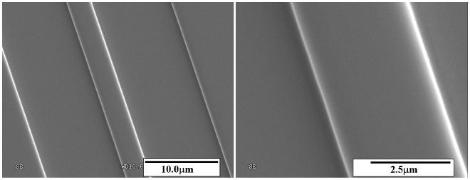
Planar waveguide fabrication: nanoimprint
As₂S₃ waveguide patterned using direct nanoimprint
Opt. Express 18, 19286 (2010)

Slide 28
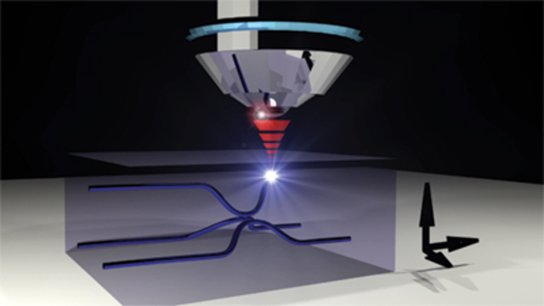
Planar waveguide fabrication: laser writing
Laser Direct Writing (LDW)
© Laser Focus World
Glass

Slide 29
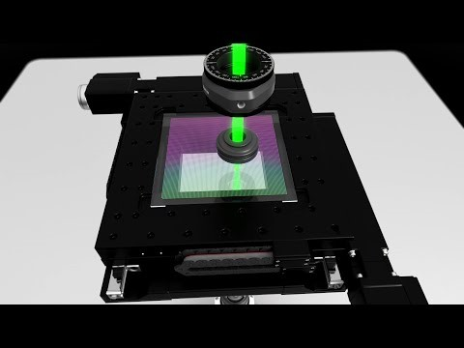
Beyond waveguide fabrication: LDW for data storage

Slide 30


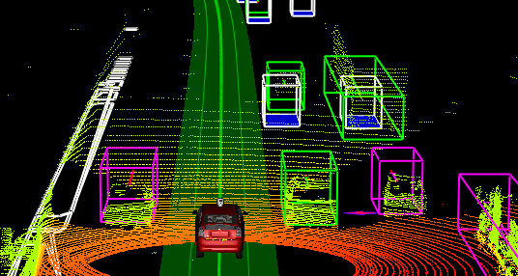

Communications
Augmented reality
Applications of integrated optics and photonics
LIDAR
Sensing

Slide 31


Optical communication system
0 = peace
1 = invasion

Slide 32
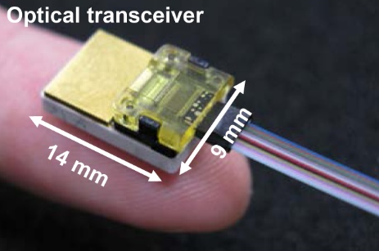
Optical communication system
1
0
1
0
1
Transmitter driver circuit
Optical transmitter (Tx) / transceiver
Electronic digital signal
1
0
1
0
1
Optical fiber / waveguide
Optical digital signal
1
0
1
0
1
Receiver circuit
Optical receiver (Rx) / transceiver
Electronic digital signal
Fiber ribbon
Opt. Express 19, B777 (2011)

Slide 33
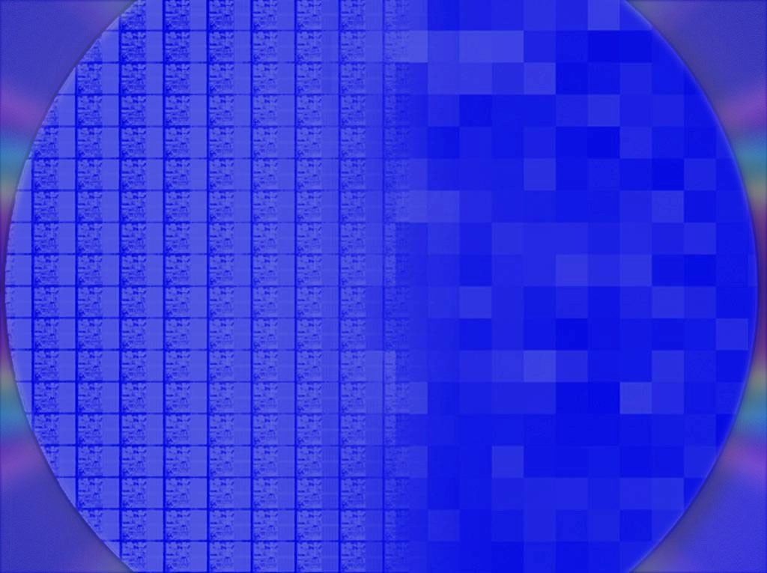
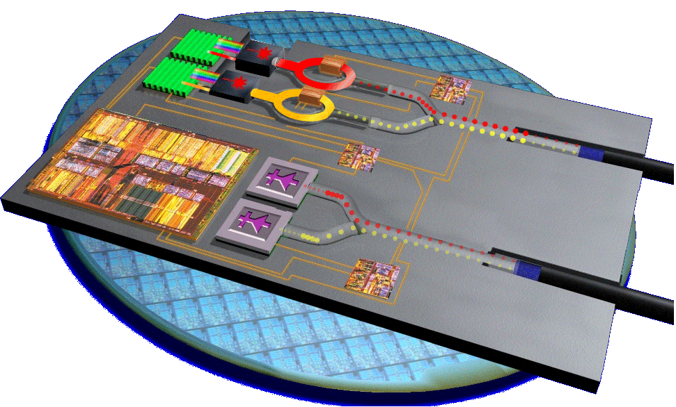

Electrical to optical interconnect
Enterprise Distance: 0.1-10km
Rack-Rack Distance: 1-100m
Board-Board Distance: 50-100cm
Chip-Chip Distance: 1-50cm
Integrated
photonics?
10G >= 40G
OPTICAL
3.125G 10G 40G
Optical Tech
3.125G 5-6G 10G 20G
Copper Tech
ELECTRICAL
Transition Zone
3.125G 5-6G 10G 15-20G
 | 2004 |  |  | 2010+

Slide 34
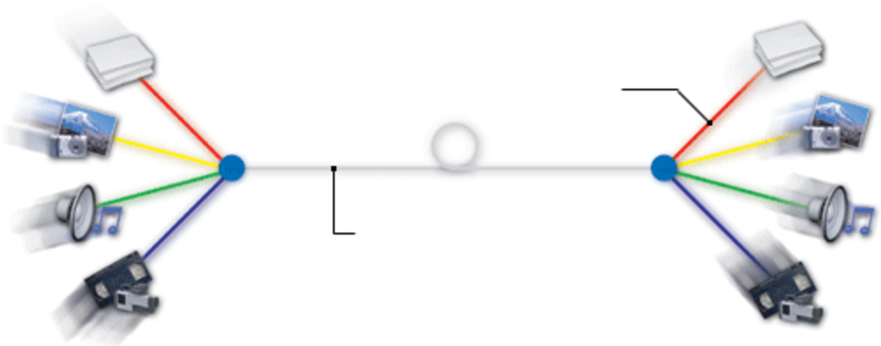
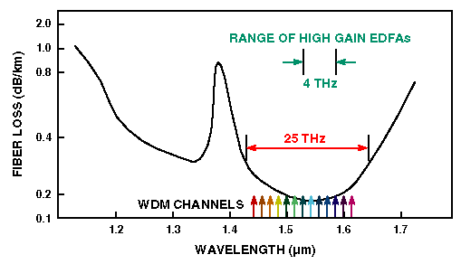
Wavelength division multiplexing (WDM)
World’s first petabit (10¹⁵) per second data transmission using a single-core fiber (2020):
382 wavelengths × 15 modes
Optical channel
Single optical fiber

Slide 35

See what the “FiOS boy” says about WDM!

Slide 36

Inside Google’s data center

Slide 37


Active optical cable (AOC)

Slide 38

Photonics for AI
© Effect Photonics
AI is communication-intensive
Optics enables high-bandwidth, low-latency, and power-efficiency interconnects

Slide 39

Co-Packaged Optics (CPO)
Image courtesy of ASE

Slide 40

Co-Packaged Optics for AI computing

Slide 41

Augmented reality (AR)

Slide 42


Augmented reality: how it works
© roadtovr.com

Slide 43
High refractive index glass for AR

Slide 44


High refractive index glass for AR
SCHOTT RealView® Datasheet

Slide 45

High refractive index glass for AR
Flint glass with high-index metal oxides (PbO, ZrO₂, TiO₂, etc.)

Slide 46
Summary
Device fabrication
Fiber drawing
Preform fabrication: MCVD process
Drawing parameter control: fiber diameter & draw tension
Multi-material fiber and microstructured fiber processing
Planar waveguide fabrication
Optical loss in fibers and waveguides
Material attenuation
Surface roughness scattering
Applications of integrated photonics
Digital communication systems & augmented reality

