Slide 1
MIT 3.071
Amorphous Materials
3: Glass Forming Theories
Juejun (JJ) Hu
hujuejun@mit.edu

Slide 2
After-class reading list
Fundamentals of Inorganic Glasses
  Ch. 3 (except Section 3.1.4 in the 1994 version)
Introduction to Glass Science and Technology
  Ch. 2
3.030 nucleation, precipitation growth and interface kinetics
Topological constraint theory
  M. Thorpe, “Continuous deformations in random networks”
  J. Mauro, “Topological constraint theory of glass”

Slide 3
Glass formation from liquid
V, H
Supercooled liquid
Liquid
Supercooling of liquid and suppression of crystallization
Glass transition: from supercooled liquid to the glassy state
Glass forming ability: the structural origin
Glass transition
Glass
Crystal
T_{f}
T_{m}
T

Slide 4
Glass forming theories
The kinetic theory
  Nucleation and growth
  “All liquids can be vitrified provided that the rate of cooling is fast enough to avoid crystallization.”
Laboratory glass transition
  Potential energy landscape
Structural theories
  Zachariasen’s rules
  Topological constraint theory

Slide 5
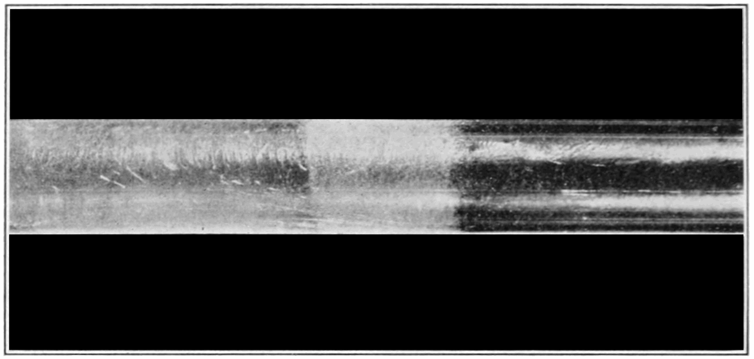
Crystallization is the opposite of glass formation
Crystallized
Amorphous
Suspended Changes in Nature, Popular Science 83 (1913).

Slide 6
Thermodynamics of nucleation
G
Liquid
Crystal
When T < T_{m},
Driving force for nucleation
T
T_{m}

Slide 7

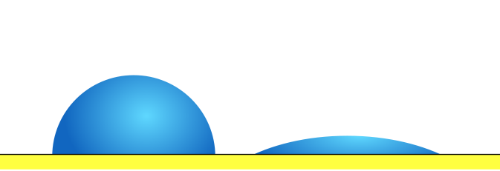
Thermodynamics of nucleation
ΔG
Homogeneous nucleation
Heterogeneous nucleation
W
Size
Surface energy contribution
Energy barrier for nucleation

Slide 8
Kinetics of nucleation
ΔG
Nucleation rate:
W
Size

Slide 9
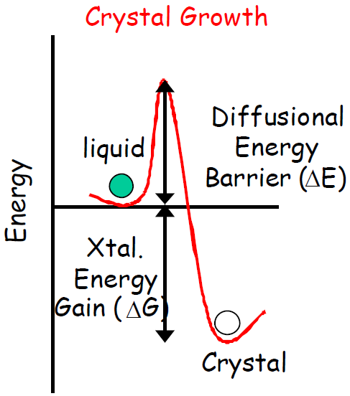
Kinetics of growth
Flux into the nucleus:
Nucleus
Atom
Flux out of the nucleus:

Slide 10
Kinetics of growth
Net diffusion flux:
Nucleus
Atom

Slide 11
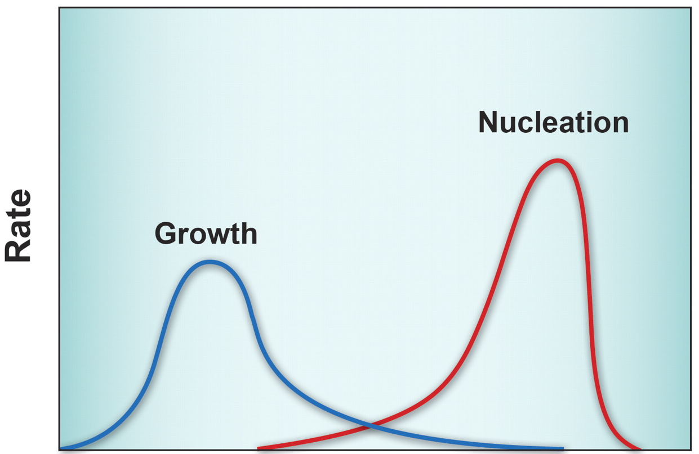
Crystal nucleation and growth
Metastable zone of supercooling
Crystallization
Driving force: supercooling
Both processes are thermally activated
T_{m}
Supercooling

Slide 12
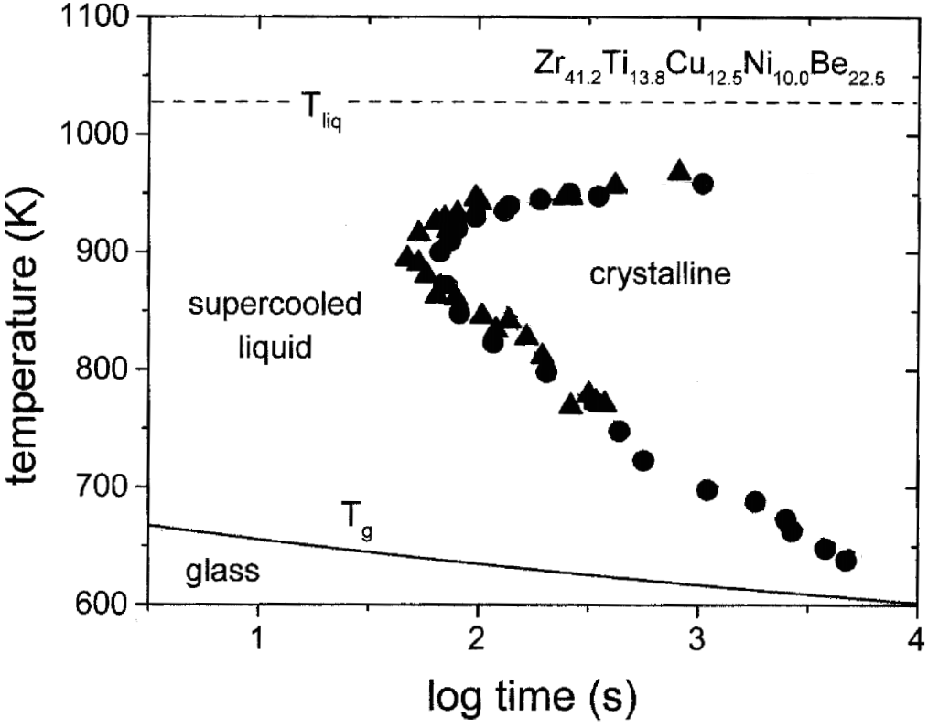
Time-temperature-transformation diagram
Driving force (supercooling) limited
Diffusion limited
Critical cooling rate R_{c}
R. Busch, JOM 52, 39-42 (2000)

Slide 13
Critical cooling rate and glass formation
Material | Critical cooling rate (°C/s)
Silica | 9 × 10⁻⁶
GeO₂ | 3 × 10⁻³
Na₂O·2SiO₂ | 6 × 10⁻³
Salol | 10
Water | 10⁷
Vitreloy-1 | 1
Typical metal | 10⁹
Silver | 10¹⁰
Technique | Typical cooling rate (°C/s)
Air quench | 1-10
Liquid quench | 10³
Droplet spray | 10²-10⁴
Melt spinning | 10⁵-10⁸
Selective laser melting | 10⁶-10⁸
Vapor deposition | Up to 10¹⁴
Maximum glass sample thickness:
α : thermal diffusivity

Slide 14
Glass formation from liquid
V, H
Supercooled liquid
Liquid
Increasing
cooling rate
Glasses obtained at different cooling rates have different structures
With infinitely slow cooling, the ideal glass state is obtained
3
2
1
T_{m}
T

Slide 15
Potential energy landscape (PEL)
The metastable glassy state
E
Metastable glassy state
Thermodynamically stable crystalline state
Structure

Slide 16
Potential energy landscape (PEL)
PE
Laboratory glass states
Ideal glass
Crystal
Atomic coordinates r₁, r₂, … r_{3N}

Slide 17
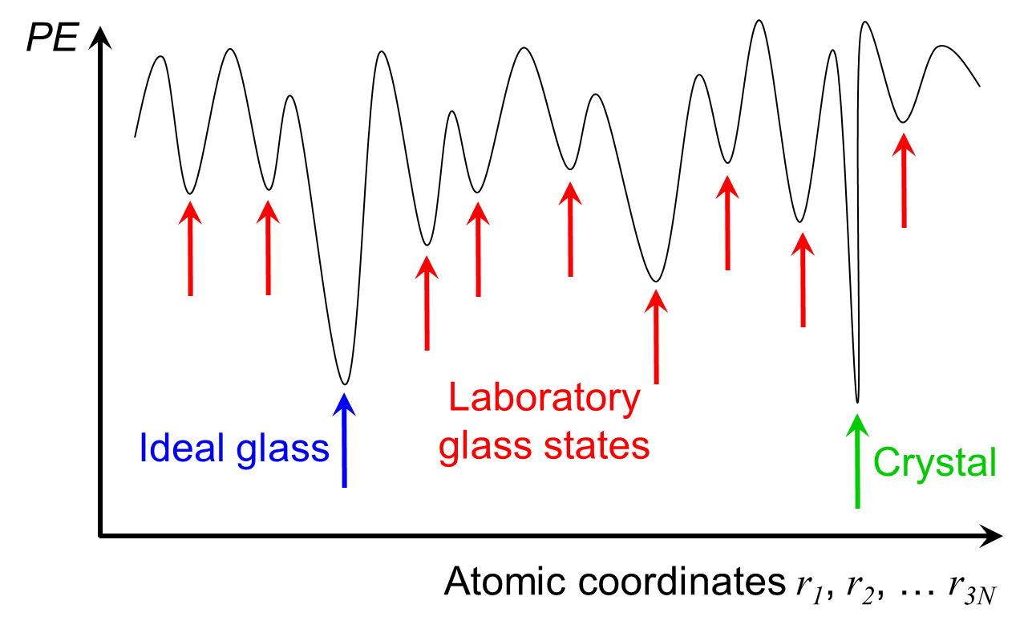
Laboratory glass transition
Liquid: ergodic
Glass: nonergodic, confined to a few local minima
Inter-valley transition time τ :
Glass
Liquid
B : barrier height
ν : attempt frequency

Slide 18
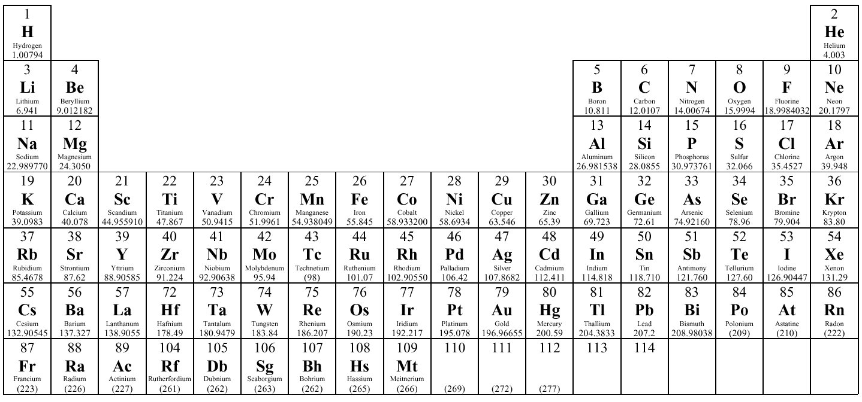
Glass former: high valence state, covalent bonding with O
Modifier: low valence state, ionic bonding with O
Network modifiers
Glass formers
Intermediates
Notes:
The traditional classifications of glass former and modifiers are based on quenching from glass forming liquids

Slide 19
Zachariasen’s rules
Rules for glass formation in an oxide A_{m}O_{n}
An oxygen atom is linked to no more than two atoms of A
The oxygen coordination around A is small, say 3 or 4
  Open structures with covalent bonds
  Small energy difference between glassy and crystalline states
The cation polyhedra share corners, not edges, not faces
  Maximize structure geometric flexibility
At least three corners are shared
  Formation of 3-D network structures
Only applies to most (not all!) oxide glasses
Highlights the importance of network topology

Slide 20
Classification of glass network topology
Floppy / flexible
Underconstrained
Isostatic
Critically constrained
Stressed rigid
Overconstrained
  # (constraints) < # (DOF)
  Low barrier against crystallization
  # (constraints) = # (DOF)
  Optimal for glass formation
  # (constraints) > # (DOF)
  Crystalline clusters (nuclei) readily form and percolate
PE
PE
PE
r₁, r₂, … r_{3N}
r₁, r₂, … r_{3N}
r₁, r₂, … r_{3N}

Slide 21
Number of constraints
Denote the atom coordination number as r
Bond stretching constraint:
Bond bending constraint:
  One bond angle is defined when r = 2
  Orientation of each additional bond is specified by two angles
Total constraint number:
Mean coordination number:

Slide 22
Isostatic condition / rigidity percolation threshold
Total number of degrees of freedom:
Isostatic condition:
Examples:
  Ge_{x}Se_{1-x}
  As_{x}S_{1-x}
  Si_{x}O_{1-x}
Phillips' “magic”
coordination number
Why oxides and chalcogenides make good glasses?
Notes:
Two-fold coordinated oxygen and chalcogen atoms easily create long, spaghetti-like molecular chains that easily entangle and prevent crystallization. Additional three-fold or four-fold coordinated atoms provide cross-linking sites to form a 3-D continuous network.

Slide 23
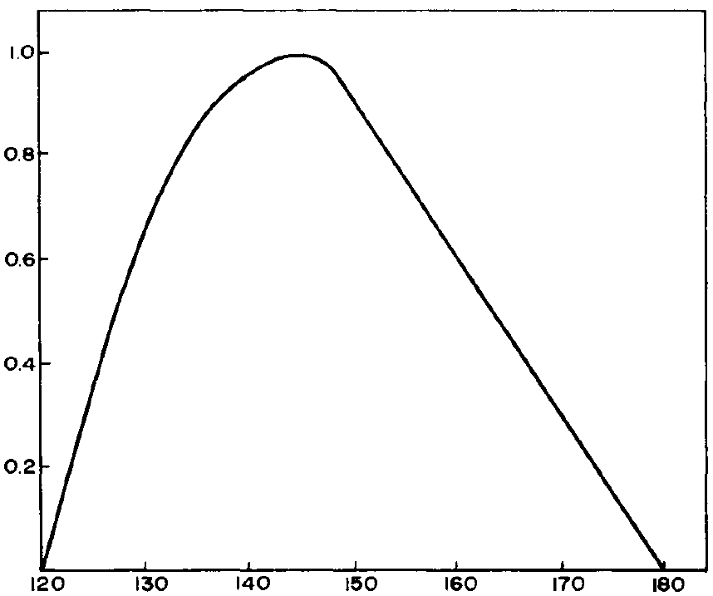
Temperature-dependent constraints
The constraint number should be evaluated at the glass forming temperature (rather than room temperature)
  Silica glass Si_{x}O_{1-x}
  Bond stretching
  O-Si-O bond angle
  Isostatic condition
Normalized distribution
  SiO₂
Si-O-Si bond angle in silica glass
Notes:
Tg for silica > 1,100 C

Slide 24
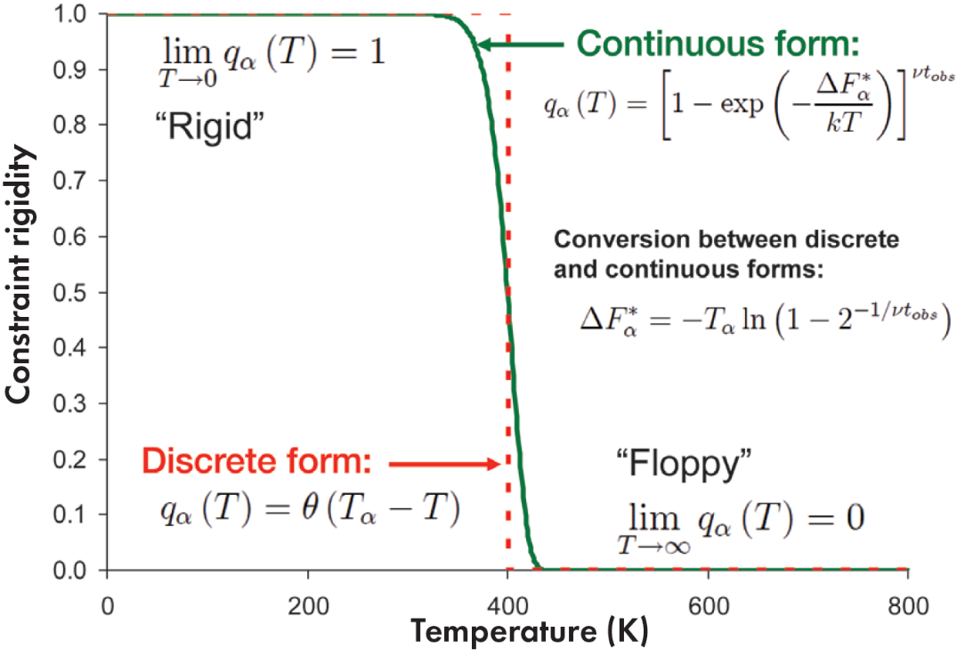
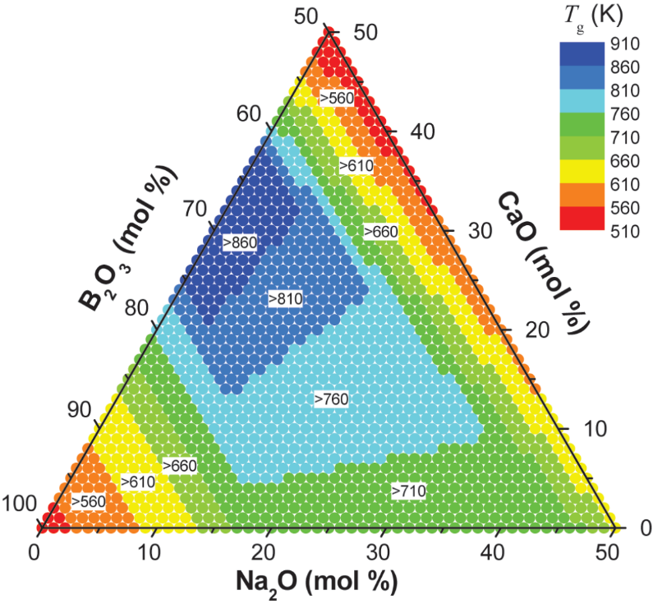
Temperature-dependent constraints
Each type of constraint is associated with an onset temperature above which the constraint vanishes
  “Topological constraint theory of glass,” ACerS Bull. 90, 31-37 (2011)
Notes:
Basic protocols of applying topological constraint theory for glass property prediction: 1) structural determination; 2) calculate constraints as a function of glass composition and temperature; 3) determine entropy associated with the network structure; 4) use statistical mechanics (e.g. Gibb-Adams theory) to correlate entropy with macroscopic properties.

Slide 25
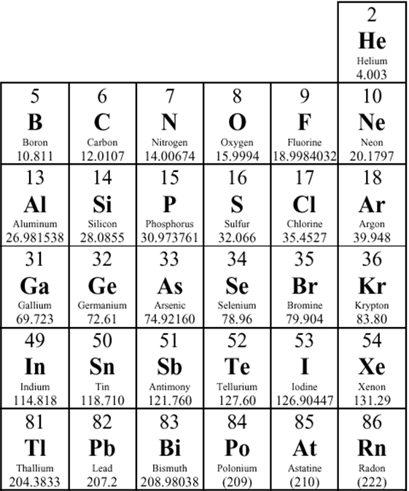
Enumeration of constraint number
Bond stretching constraints (coordination number):
8-N rule: applies to most covalently bonded nonmetals (O, S, Se, P, As, Si, etc.)
Exceptions: heavy elements (e.g. Te, Sb), boron anomaly
Bond bending constraints:
Glasses with low forming temperature:
Atomic modeling or experimental characterization required to ascertain the number of active bond bending constraints

Slide 26
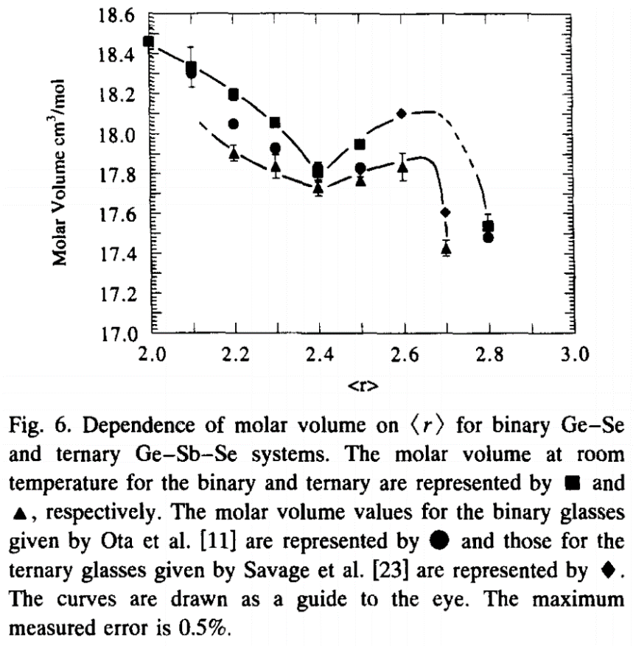
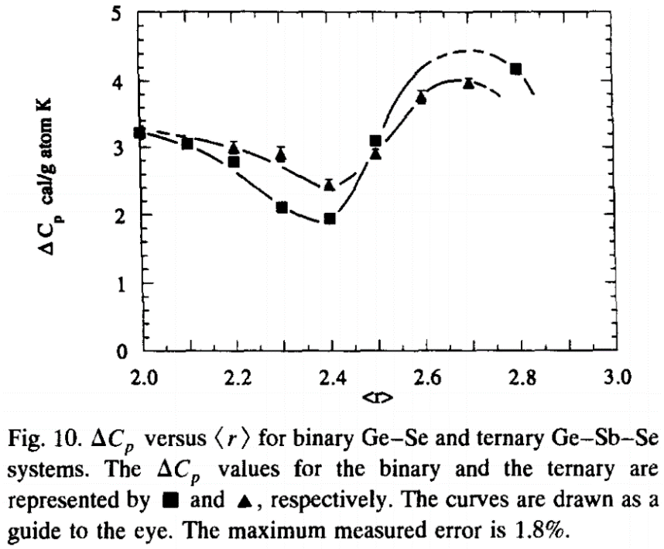
Property dependence on network rigidity
Many glass properties exhibit extrema or kinks at the rigidity percolation threshold
J. Non-Cryst. Sol. 185, 289-296 (1995).

Slide 27
Measuring glass forming ability
Figure of merit (FOM):
T_{x} : crystallization temperature
T_{g} : glass transition temperature
C_{P}
T_{g} is dependent on measurement method and thermal history
Alternative FOM:
Hruby coefficient
Heat capacity
T
T_{g}

Slide 28
Summary
Kinetic theory of glass formation
  Driving force and energy barrier for nucleation and growth
  Temperature dependence of nucleation and growth rates
  T-T-T diagram and critical cooling rate
Laboratory glass transition
  Potential energy landscape
  Ergodicity breakdown: laboratory glass transition
  Path dependence of glass structure
Glass network topology theories
  Zachariasen’s rules
  Topological constraint theory
Parameters characterizing glass forming ability (GFA)

