Slide 1
MIT 3.071
Amorphous Materials
4: Phase Change Data Storage
Juejun (JJ) Hu
hujuejun@mit.edu

Slide 2
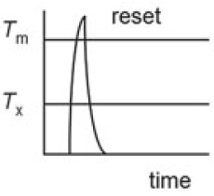
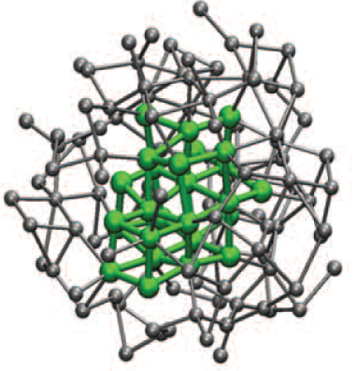
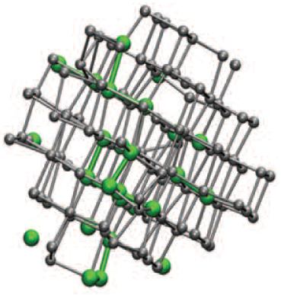
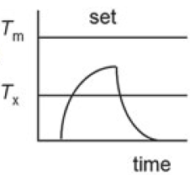
Phase change materials
Amorphous
Crystalline
Reset
Set
High electrical resistivity
Low electrical resistivity
Low optical reflectance
High optical reflectance

Slide 3
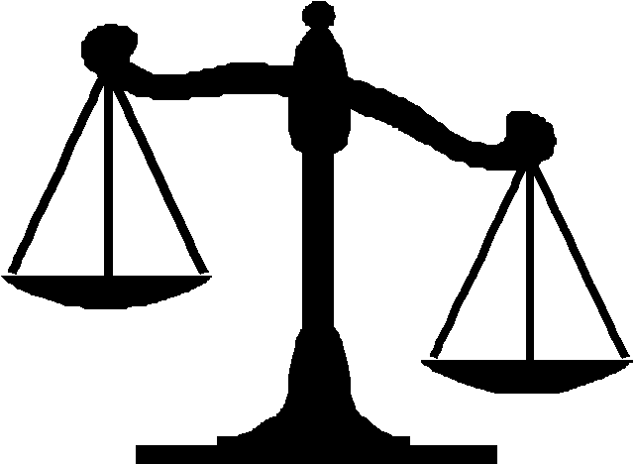
Key performance metrics
Data retention
Programming speed
Recording density
Endurance (cycle lifetime)
Power consumption
Good glass stability
Fast crystallization
Size dependence of material properties, driver size
Electromigration and phase stability
Enthalpy of melting, heat capacity
Low thermal conductivity
Trade-off

Slide 4
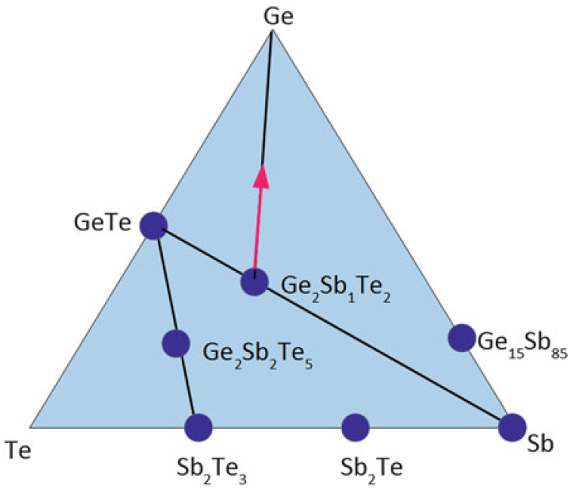
Ge-Sb-Te (GST) phase change alloy
Pseudo-binary alloy: (GeTe)_{x}(Sb₂Te₃)_{y}
  Main commercial composition
  Stressed rigid 3-D network
Fast switching compositions
  Ge₁₅Sb₈₅, Sb₂Te
High thermal stability alloys
  (Ge₂Sb₁Te₂)_{x}(Ge)_{y}
GeTe₄
Isostatic compositions
Amorphous: covalent
Crystal: resonant bonding
SbTe₄
Phys. Rev. B 81, 174206 (2010);
Solid-State Electron. 111, 27 (2015).

Slide 5
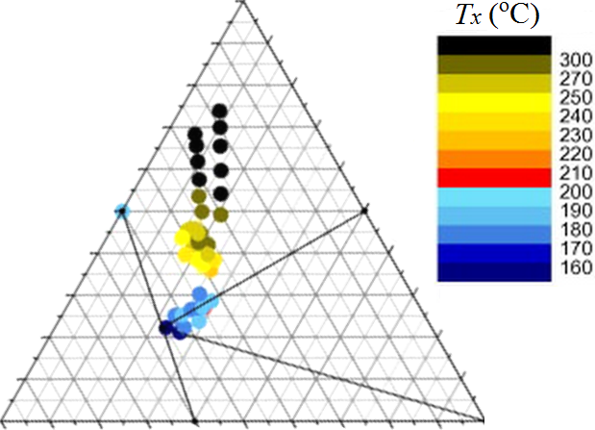
Ge-Sb-Te (GST) phase change alloy
Pseudo-binary alloy: (GeTe)_{x}(Sb₂Te₃)_{y}
  Main commercial composition
  Stressed rigid 3-D network
Fast switching compositions
  Ge₁₅Sb₈₅, Sb₂Te
High thermal stability alloys
  (Ge₂Sb₁Te₂)_{x}(Ge)_{y}
Ge
GeTe
Amorphous: covalent
Crystal: resonant bonding
Te
Sb₂Te₃
Sb
Phys. Rev. B 81, 174206 (2010);
Solid-State Electron. 111, 27 (2015).

Slide 6
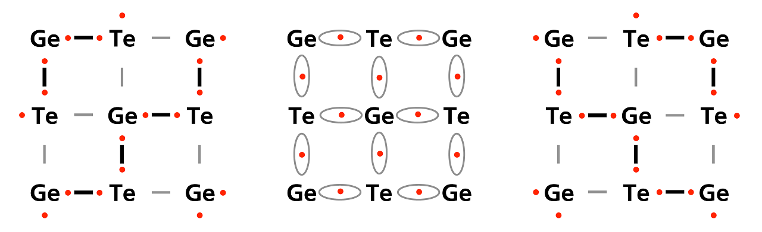
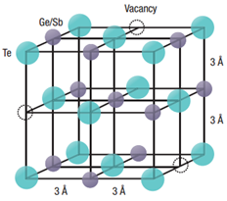
Structure of cubic Ge₂Sb₂Te₅ (225) alloy
Strong electron delocalization due to resonant (metavalent) bonding
Nat. Mater. 6, 824-832 (2007)
Adv. Mater. 32, 1908302 (2020)

Slide 7
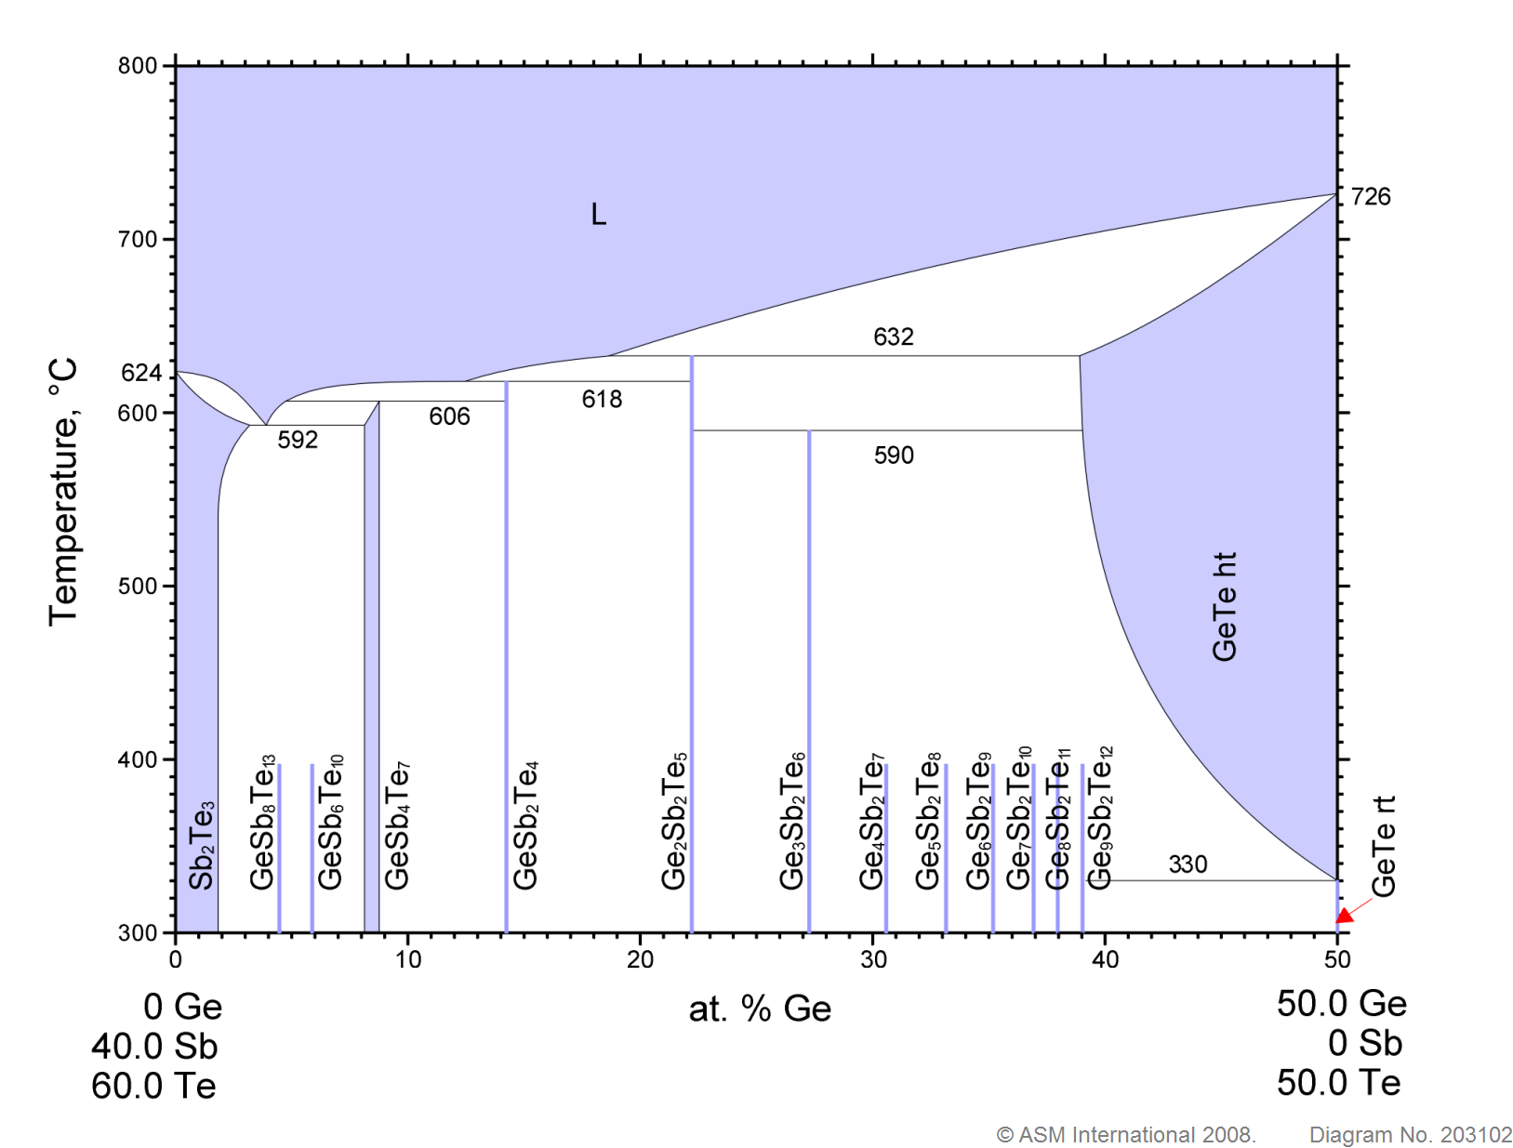
GeTe-Sb₂Te₃ pseudobinary phase diagram
Sb-rich liquid
Noncongruent melting results in compositional segregation
Ge-rich solid

Slide 8
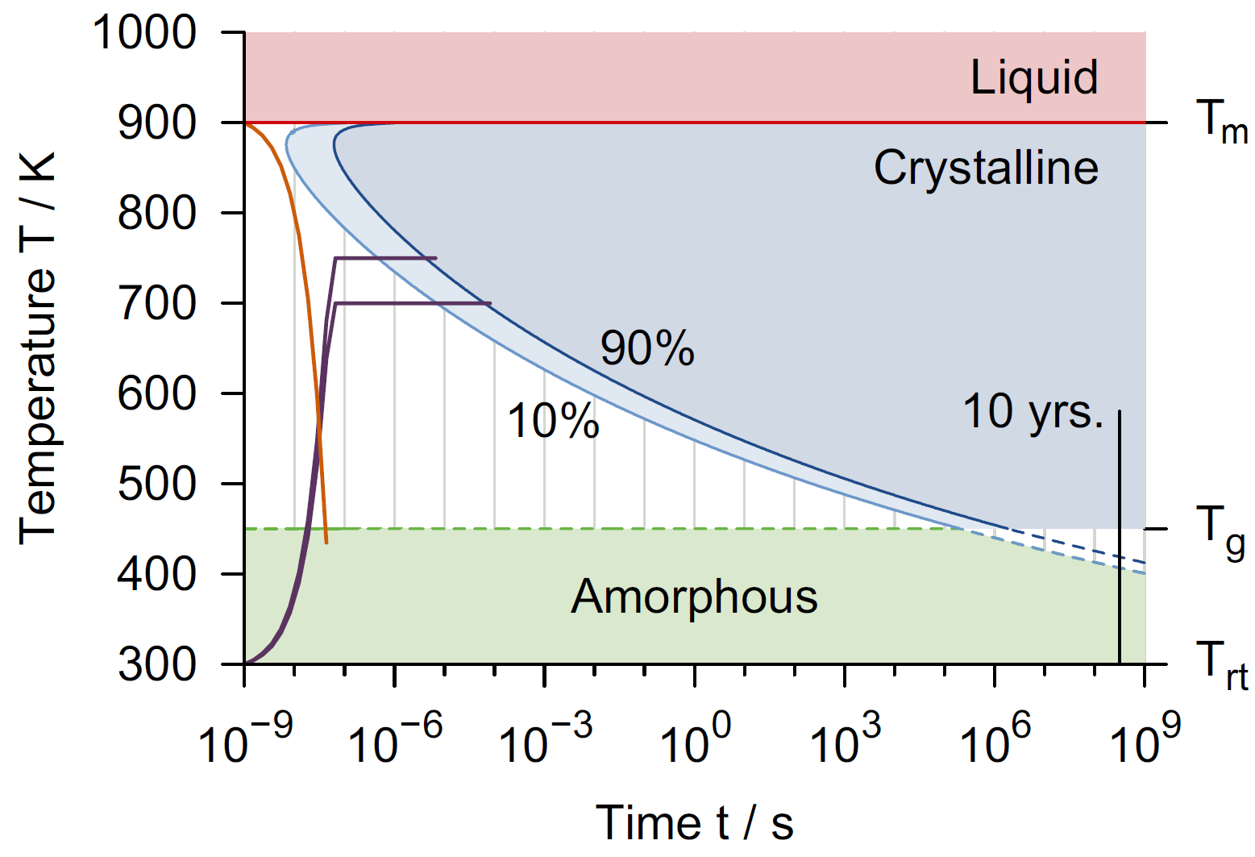
T-T-T diagram of GST phase change alloys
Emerging Non-Volatile Memories, Springer (2014)
Notes:
Typical quench rate to get amorphous GST phase is 1E10 K/s

Slide 9
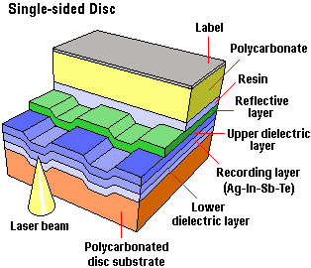
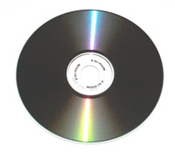
Re-writable CDs and DVDs
Modulation of optical reflectance via laser-induced phase change

Slide 10
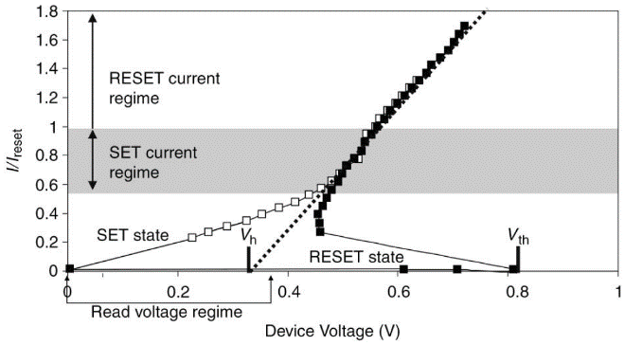
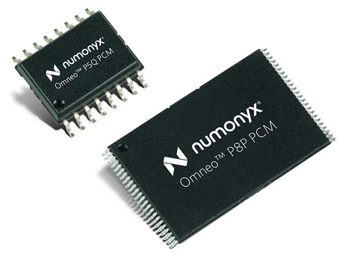
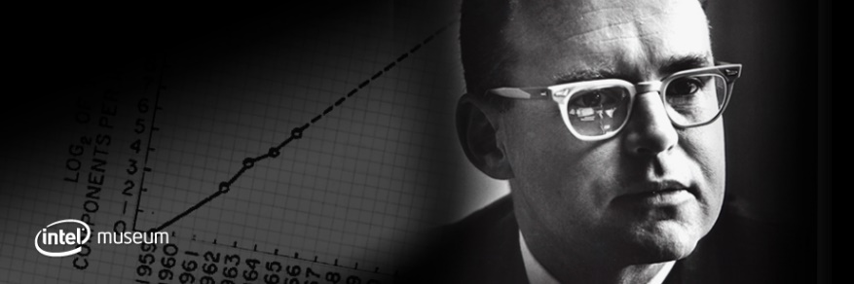
Phase change memory (PCM)
1970
Gordon Moore
IBM, Micron, Samsung, …
  Discovery of threshold switching in chalcogenides
  256-bit phase change memory demo
  Discovery of rapid switching pseudo-binary GST material
  Non-volatile phase change memory module commercialized
1968
Ovshinsky
1987
Yamada et al.

Slide 11
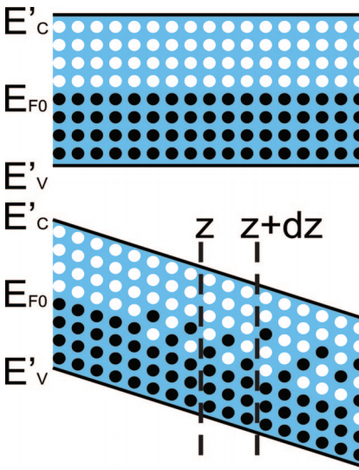
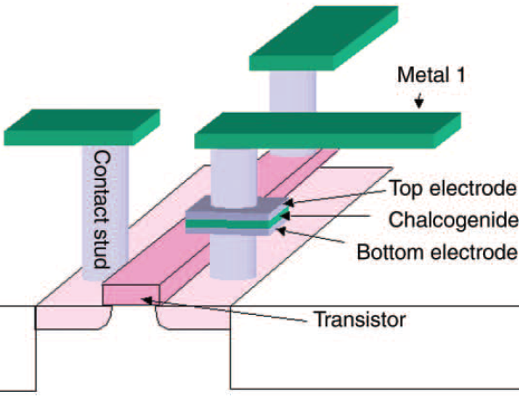

Phase change memory (PCM)
Electrodes used for both programming and read-out
Threshold switching: electric field driven bistability
  Transient behavior: electronic in nature, no structural change
  Contributes to reduced SET voltage
S. Hudgens and B. Johnson, MRS Bull. (2004); Phys. Rev. B 78, 035308 (2008).
Notes:
Threshold switching mechanism: in Poole-Frenkel conduction, the electric field increases the probability of a carrier that occupies one trap to get to another one nearby. At low fields, this requires extended states. At the threshold field, however, also direct tunneling becomes possible, leading to the conductivity increase. Another model presumes that threshold switching stems from a field- and carrier density-dependent generation mechanism, thus providing a positive feedback once a critical field is attained. At low fields, however, recombination counterbalances the generation. There are various possible microscopic models that could account for this phenomenological effect such as impact ionization.

Slide 12
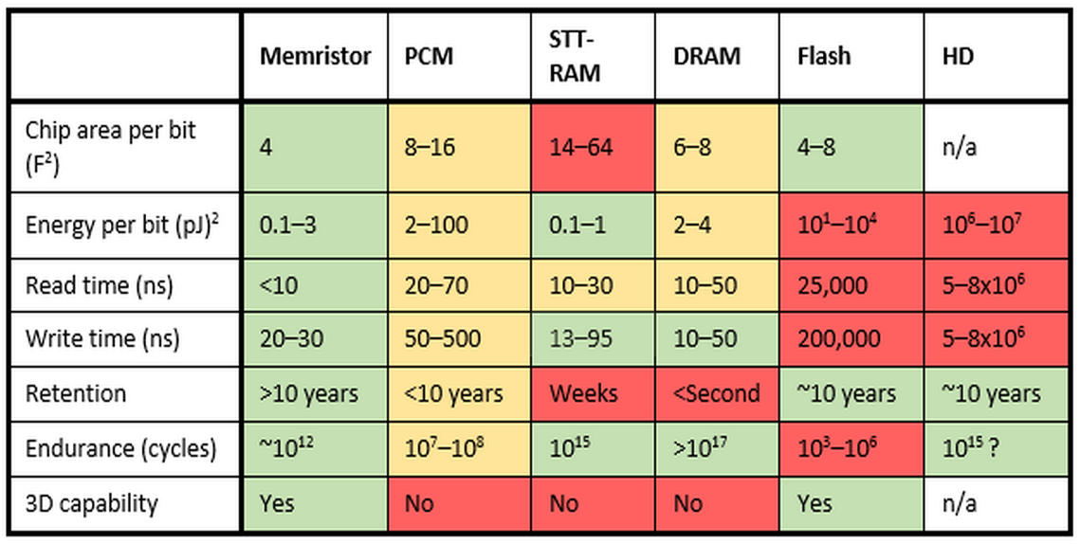
Where does PCM stand against competitors?
https://news.hpe.com/beyond-dram-and-flash-part-2-new-memory-technology-for-the-data-deluge/

Slide 13

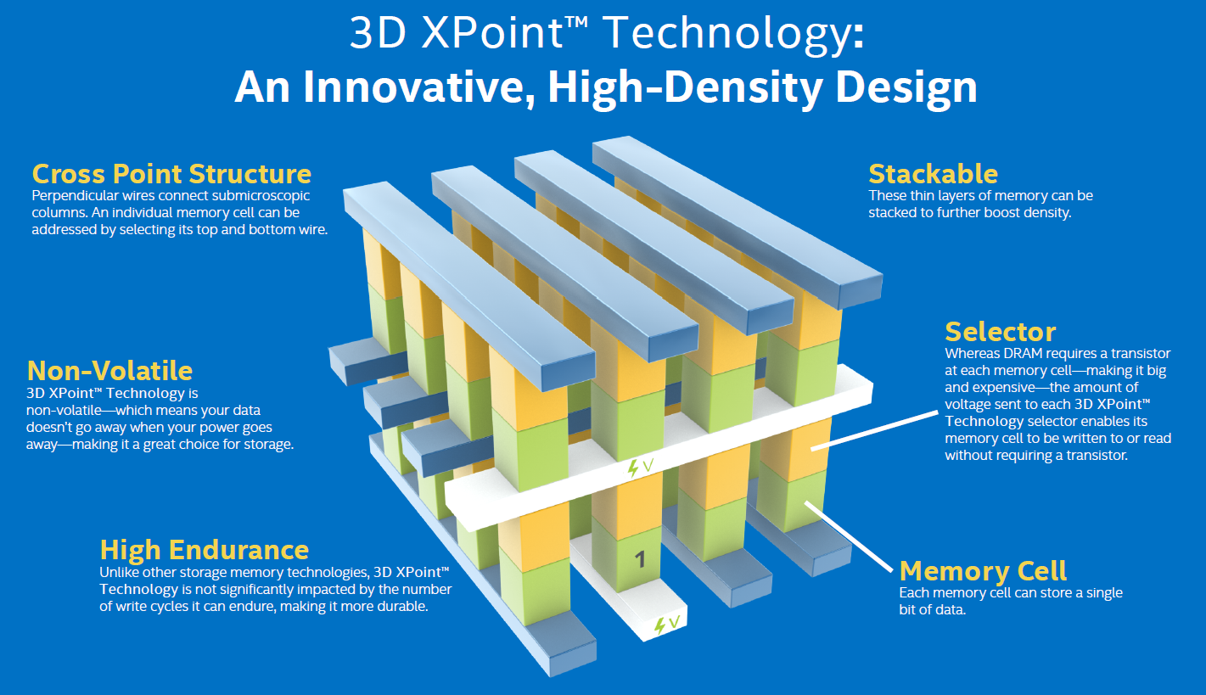
3D XPoint: a likely (?) PCM technology
https://www.intel.com/content/www/us/en/architecture-and-technology/optane-technology-animation.html

Slide 14
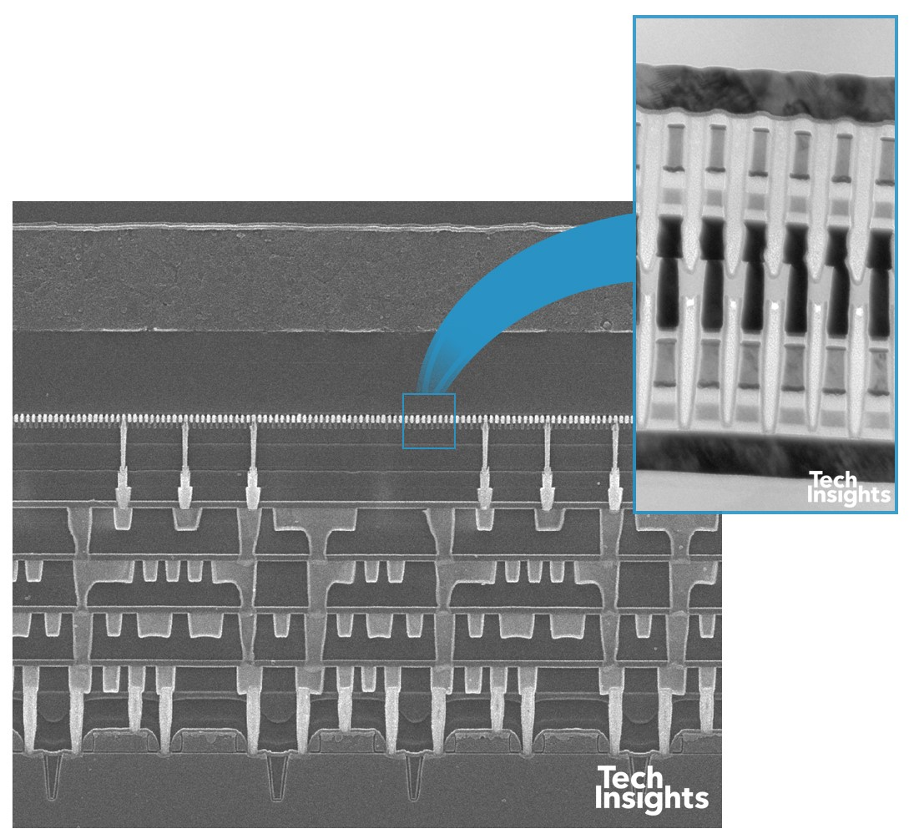
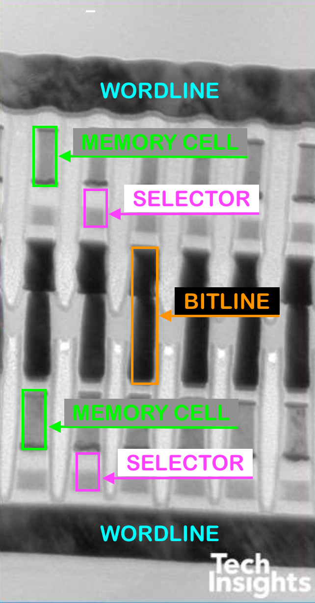
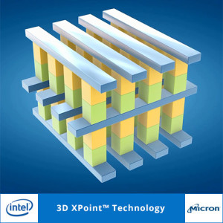
Reversing engineering reveals…
Both the memory and the selector are based on chalcogenide alloys

Slide 15
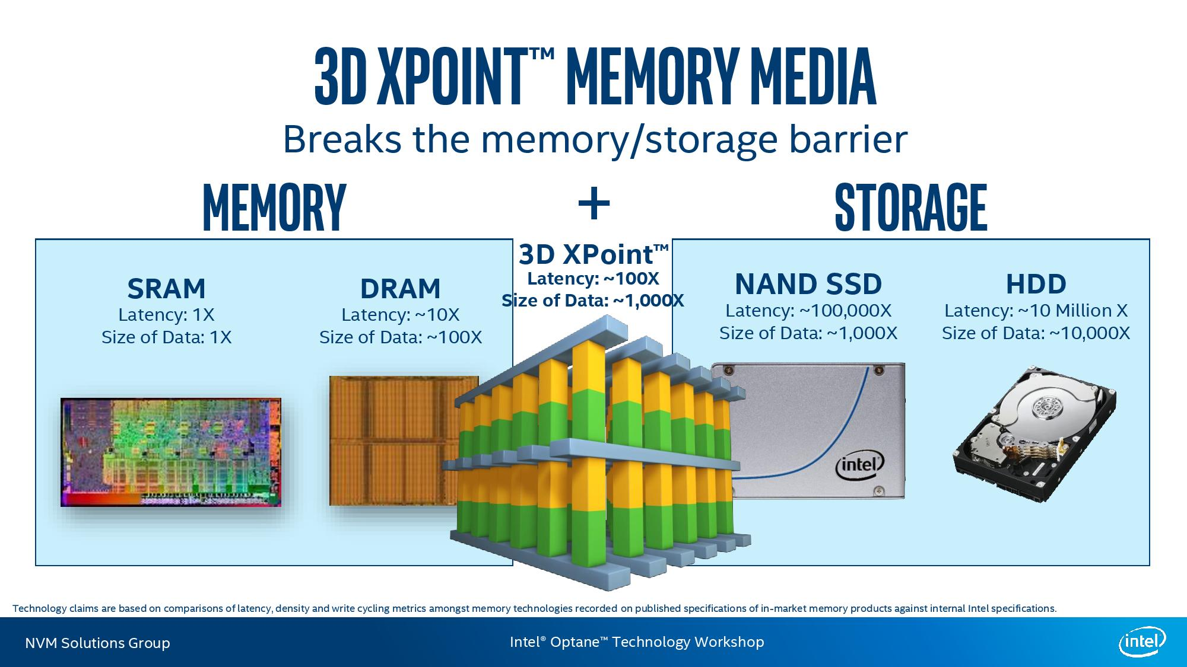
https://www.intel.com/content/www/us/en/products/docs/memory-storage/optane-persistent-memory/overview.html

Slide 16
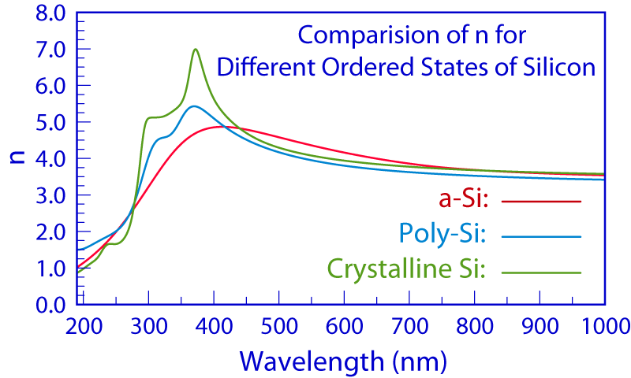
Applications beyond data storage: optics
Image courtesy of Wikipedia
Large optical property contrast in PCM due to change of bonding type from crystalline (resonance) to amorphous (covalent) phase, which is absent in most other materials

Slide 17
Optical properties of Ge₂Sb₂Te₅ (225) alloy
Amorphous state: low-index, reduced loss
Crystalline state: high-index, high loss
Data from Nat. Commun. 10, 4279 (2019)

Slide 18
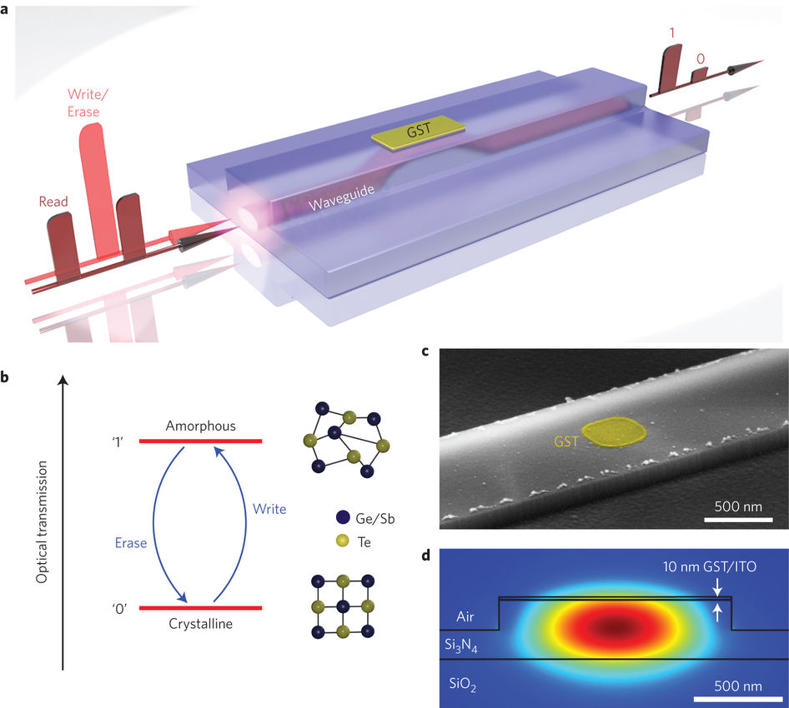
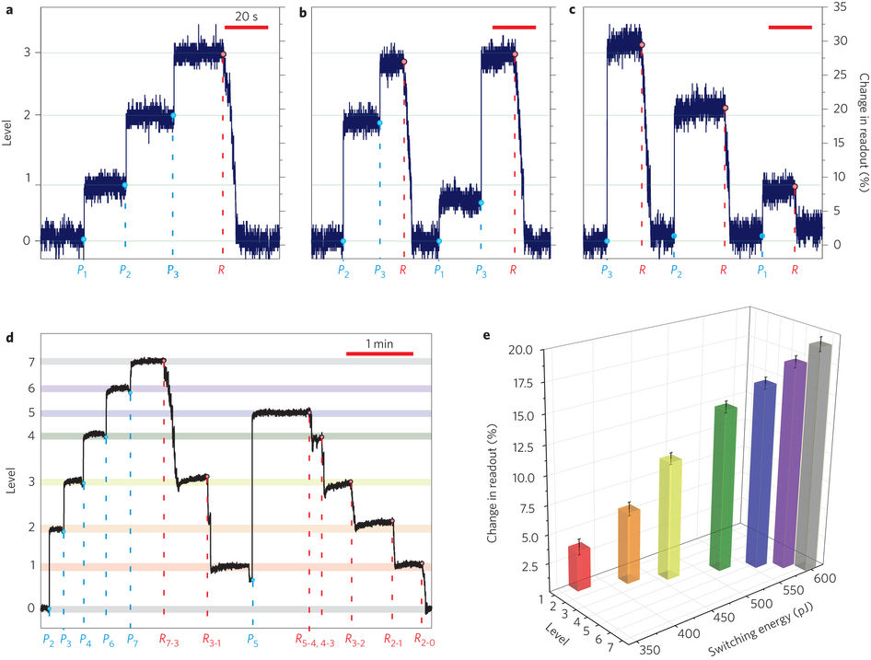
All-optical, multi-level on-chip memory
Nat. Photonics 9, 725 (2015)

Slide 19
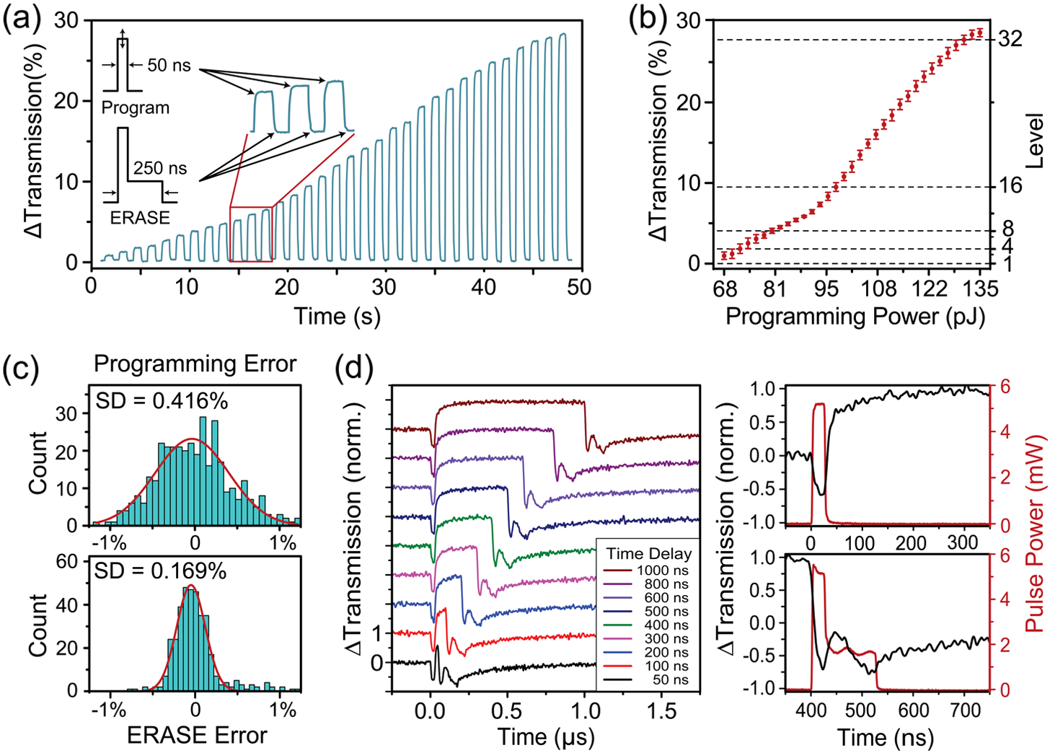
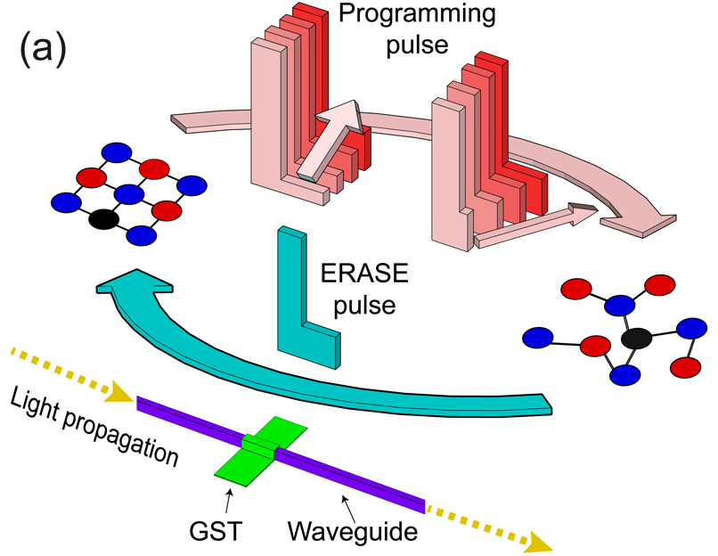
All-optical, multi-level on-chip memory
Optica 6, 1-6 (2019)

Slide 20
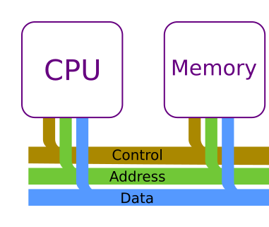
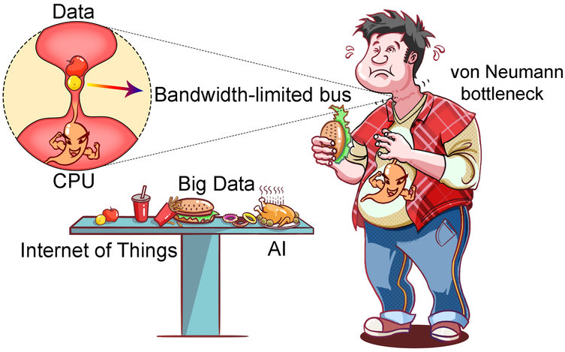
The von Neumann bottleneck
Communications between CPU and memory limits computing speed and energy efficiency
System bus
Chem. Rev. 120, 3941 (2020)

Slide 21
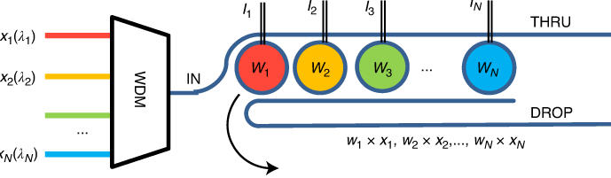
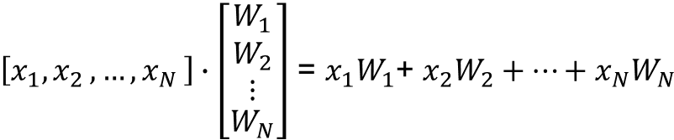
Optical matrix-vector multiplication and accumulation (MAC)
$\left[x_{1}{, x}_{2},…{, x}_{N}\right]∙\left[\begin{matrix}W_{1} \\ \begin{aligned}W_{2} \\ ⋮\end{aligned} \\ W_{N}\end{matrix}\right]$ = $x_{1}W_{1}$+ $x_{2}W_{2}+…+x_{N}W_{N}$
Input vector encoded by light power at different wavelengths
Weights encoded as transmission coefficients of wavelength-selective filters
Summation performed by adding up transmitted powers at different wavelengths
IEEE Photon. Technol. Lett. 28, 887 (2016)

Slide 22
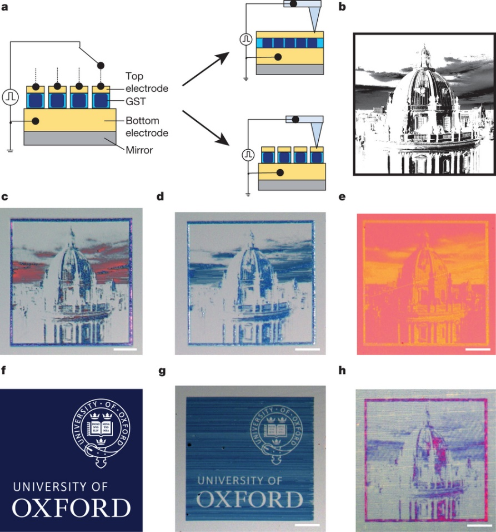
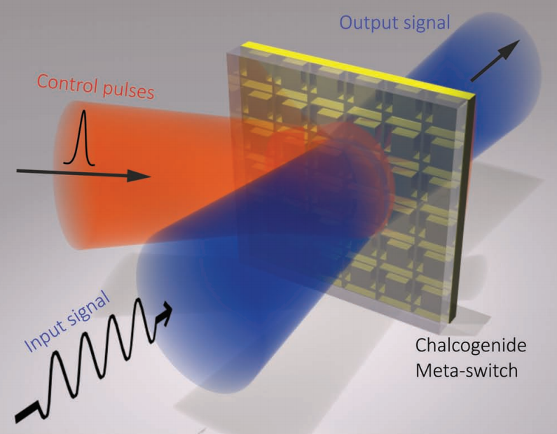
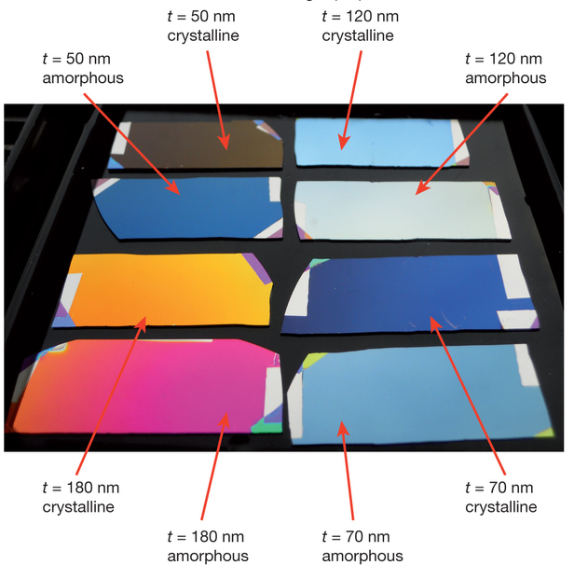
Optical switching and non-volatile display
Optical switch
Applications involving bistable states
Electronic paper display
Nature 511, 206 (2014); Adv. Mater. 25, 3050 (2013)

Slide 23
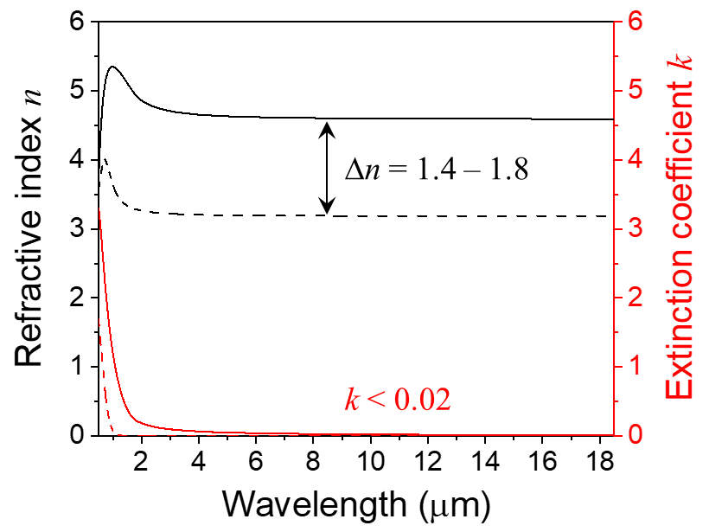
Optical properties of Ge₂Sb₂Se₄Te (GSST)
Broadband bi-state transparent PCM
Data from Nat. Commun. 10, 4279 (2019)

Slide 24
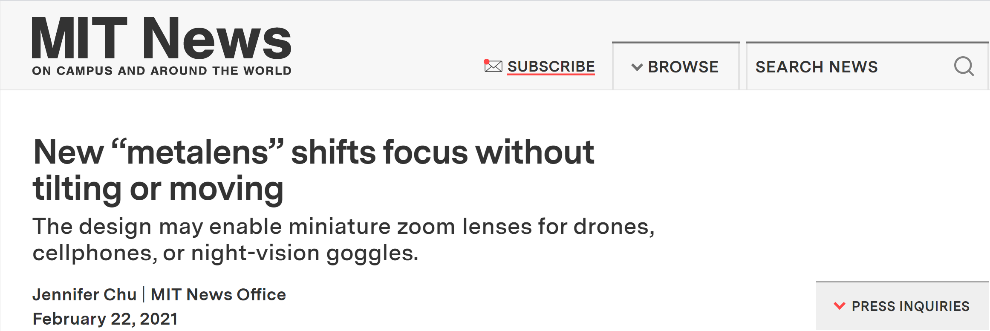
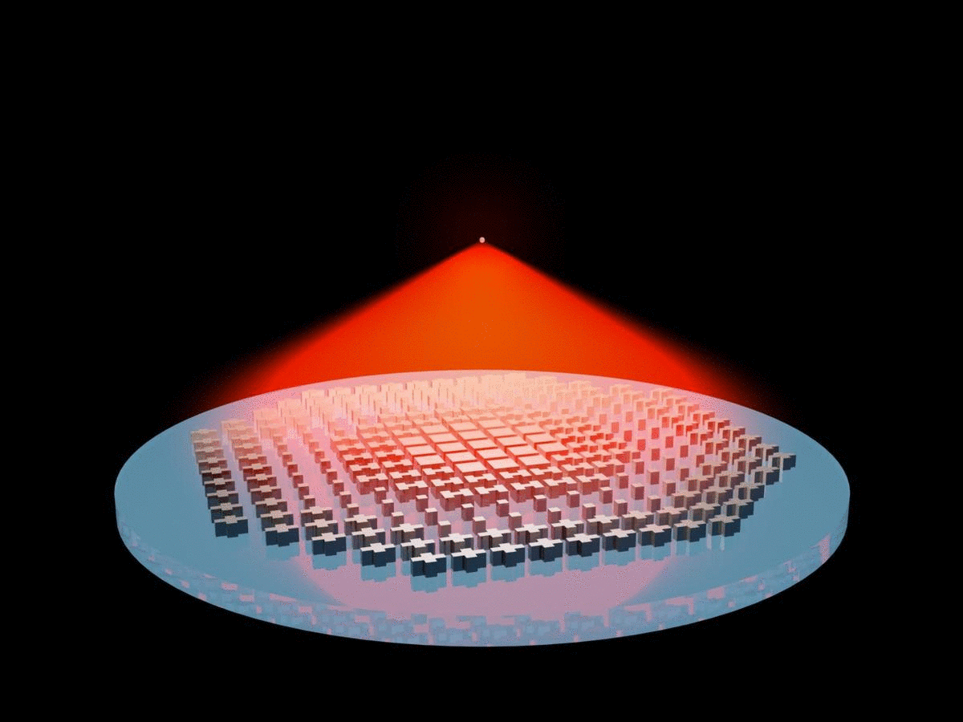
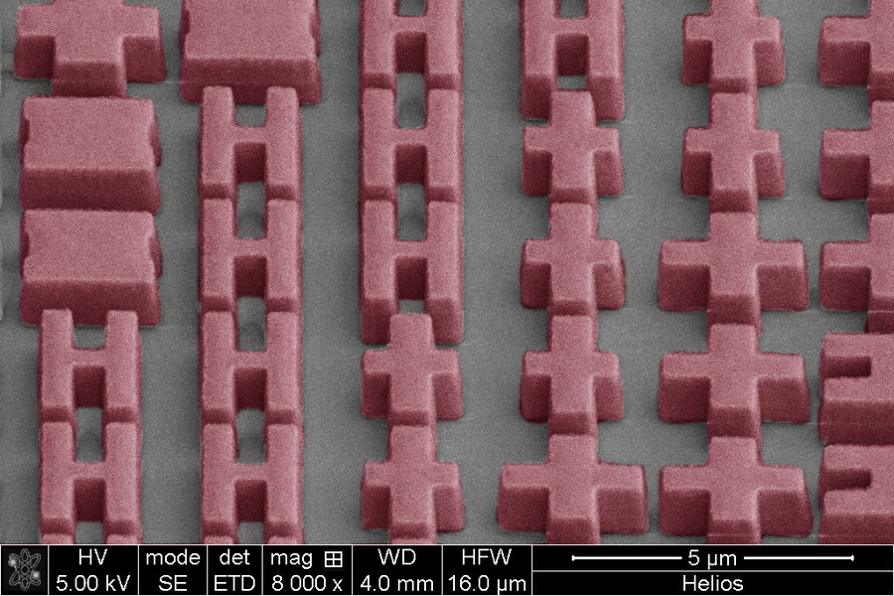
Nat. Commun. 12, 1225 (2021)

Slide 25
Further readings
Phase Change Materials: Science and Application, Springer (2009)
  Google book link
Emerging Non-Volatile Memories, Springer (2014)
  Download link (MIT certificate required)
“Phase change materials and phase change memory,” MRS Bull. 39, 703 (2014)
“Designing crystallization in phase-change materials for universal memory and neuro-inspired computing,” Nat. Rev. Mater. 4, 150-168 (2019)

