Slide 1
MIT 3.071 Amorphous Materials 5: Viscosity of Glass
Juejun (JJ) Hu
hujuejun@mit.edu

Slide 2
After-class reading list
Fundamentals of Inorganic Glasses
Ch. 9
Introduction to Glass Science and Technology
Ch. 6

Slide 3
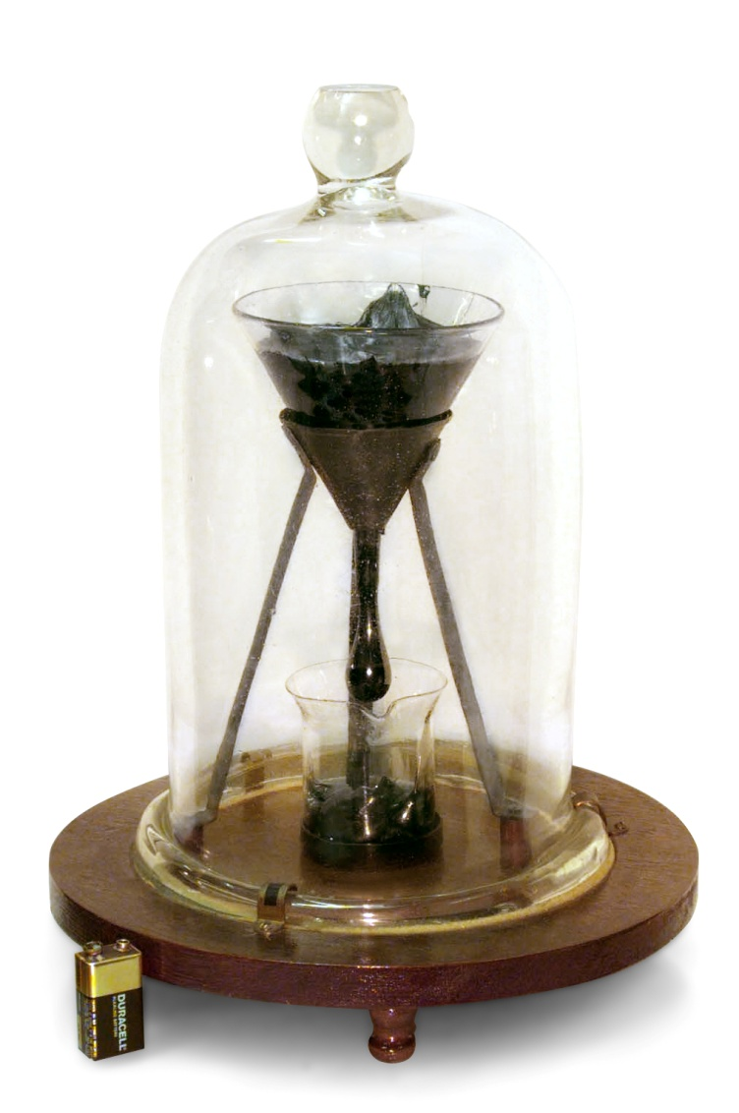
The pitch drop experiment
The pitch drop experiment is a long-term experiment which measures the flow of a piece of pitch (asphalt)
The most famous version of the experiment was started in 1927 by Professor Thomas Parnell of the University of Queensland in Brisbane, Australia. The ninth drop fell on 24 April 2014, allowing the experimenters to calculate that pitch has a viscosity approximately 230 billion times that of water.
Ig Nobel Prize in Physics, 2005

Slide 4
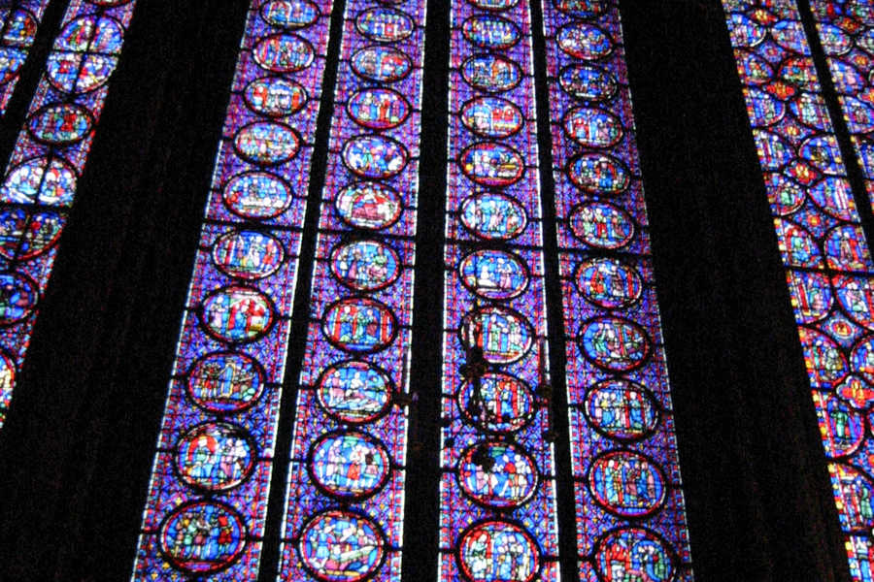
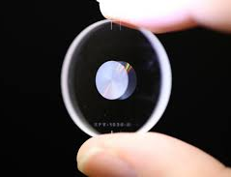
Is glass a solid or a viscous liquid?
“Successful read/write of digital data in fused silica glass with a recording density equivalent to Blu-ray Disc™, enabling both greater capacity using 100 recording layers and long storage life of 300 million years.”
Hitachi Ltd. Press Release 2014
“It is well known that panes of stained glass in old European churches are thicker at the bottom because glass is a slow-moving liquid that flows downward over centuries.”
Notes:
The question is asking about the rheological properties of glass – glasses are thermodynamically different from glass forming liquids as can be seen from the H-T diagram and the potential energy landscape.

Slide 5
Is glass a solid or a viscous liquid?
V
Solid
Elasticity
instantaneous, transient
Supercooled liquid
Liquid
Viscosity
time-dependent, permanent
Glass
E : Young’s modulus
G : shear modulus
η : viscosity (unit: Pa·s or Poise)
T_{m}
T
Notes:
Mathematically similar forms of shear deformation in elastic solid and viscous liquid lead to “viscosity-elasticity analogy”, a useful method for solving viscous flow or shear deformation problems.

Slide 6
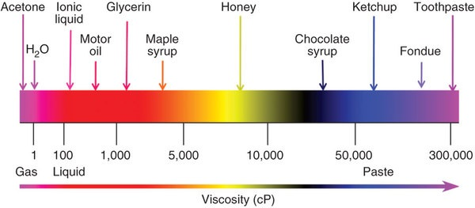
Microscopic origin of elasticity and viscosity
Elasticity: attractive and repulsive forces between atoms
Viscosity: motion of atoms/molecules relative to their neighbors (relaxation)
Conformation change of (macro)molecules
Vacancy diffusion
Dislocation motion
Different relaxation mechanisms have distinctive relaxation time scales
Strong inter-atomic/molecular bonds give rise to high viscosity
Notes:
1 Pa·s = 10 P (Poise) = 1,000 cP

Slide 7
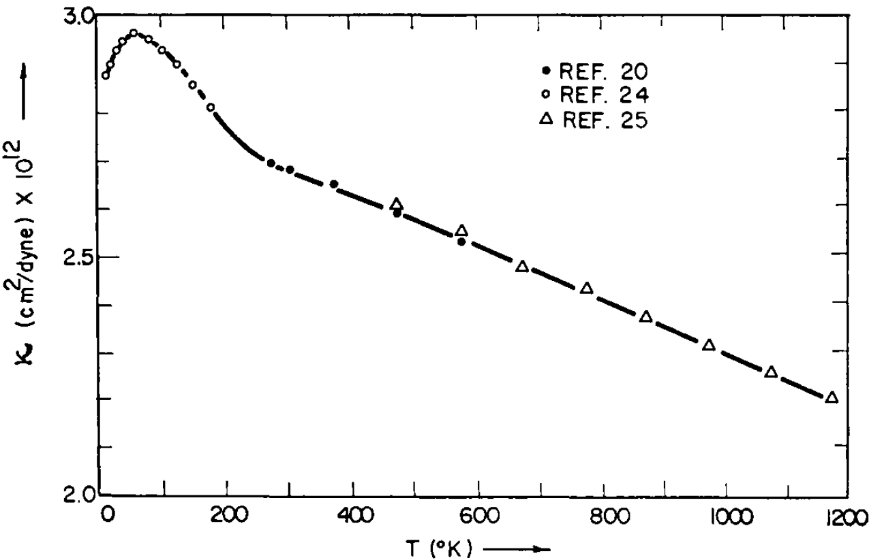
Temperature dependence of elasticity
Relatively weak temperature dependence
Temperature dependence of compressibility of silica
M. R. Vukcevich, J. Non-Cryst. Sol., 11, 25-63 (1972)

Slide 8
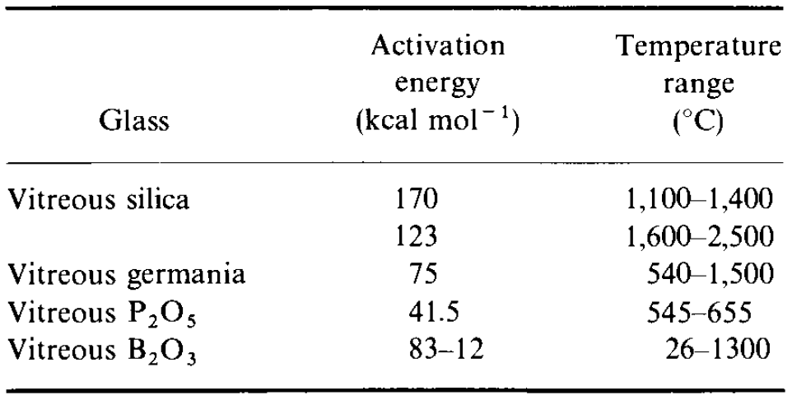
Temperature dependence of viscosity
Viscous flow is a thermally activated process
In general, the activation energy ΔE_{a} is temperature dependent

Slide 9
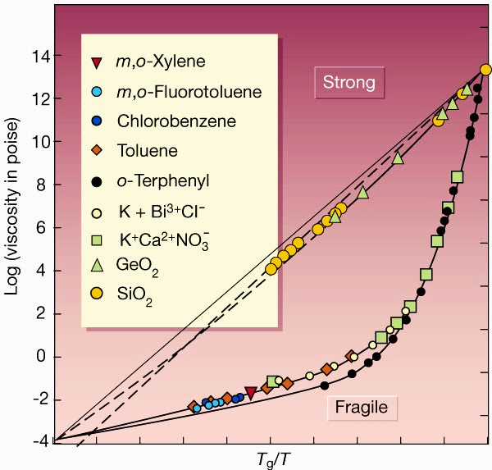
The Angell plot and fragility
Glass transition temperature T_{g}
Fragility parameter
Fragility has nothing to do with mechanical properties of glass!
0
1
Science 267, 1924-1935 (1995)
Notes:
Why does the Angell plot converge at high temperatures (at least for metals): https://www.osti.gov/scitech/servlets/purl/1185365; also see: Phys. Rev. B 83, 212202 (2011).

Slide 10
Strong vs. fragile glass forming liquids
Strong liquids
Arrhenius equation
Covalent glass forming liquids
Fragility often exhibits a minimum at the rigidity percolation threshold ( )
Fragile liquids
Vogel-Fulcher-Tammann (VFT) equation (Williams-Landel-Ferry equation)
Ionic and molecular liquids
Decrease of molecular cluster size as temperature rises
Notes:
The VFT/WLF equation is a consequence of time-temperature superposition
In an ionic glass or a molecular glass, the structure tends to collapse as soon as we pass above Tg.

Slide 11
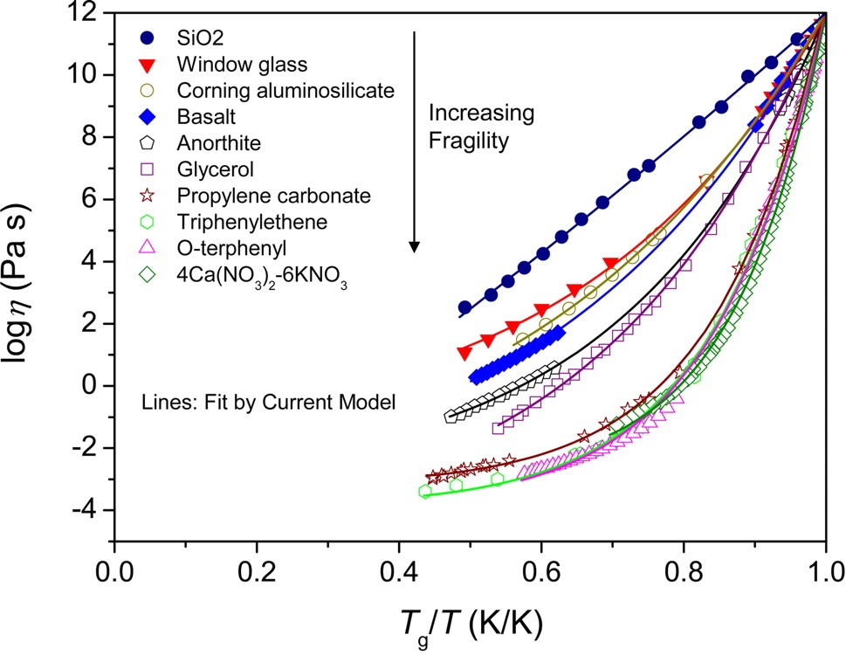
The MYEGA equation of viscosity
The VFT equation diverges at low temperature
The Mauro-Yue-Ellison-Gupta-Allan (MYEGA) equation:
Proc. Nat. Acad. Sci. U.S.A. 106, 19780-19784 (2009)

Slide 12
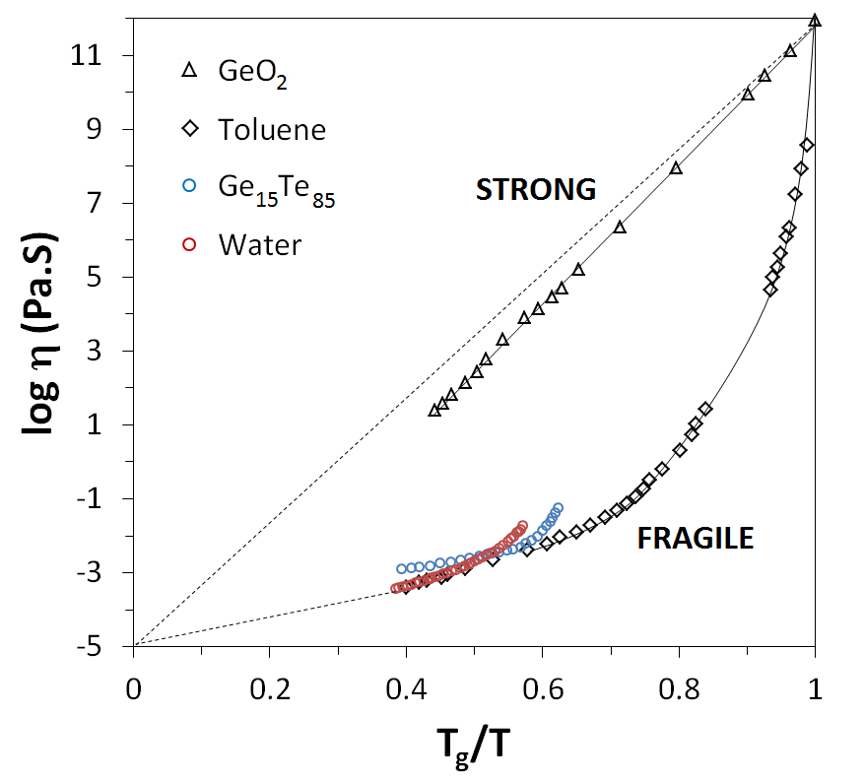
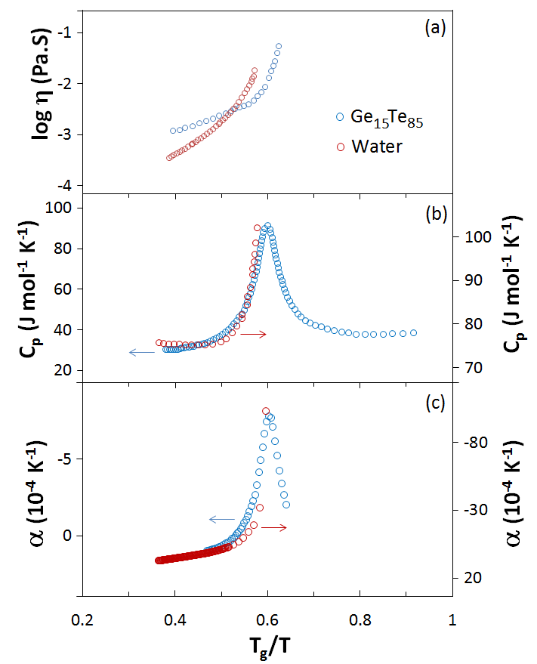
Viscosity anomaly: fragile-to-strong transition
Underlying liquid-liquid phase transition
J. Non-Cryst. Solids X 4, 100034 (2019)

Slide 13
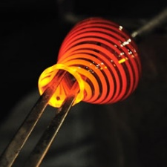
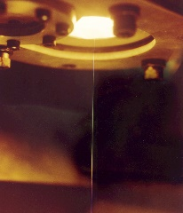
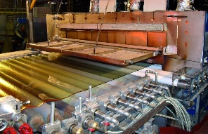
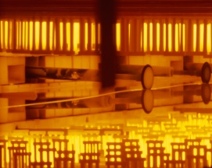
Viscosity reference points
Working range
Glass blowing
Lehr annealing
Fiber drawing
Float glass
Pitch: 2.3 × 10⁸
Chewing gum
10¹
10³
10^{6.6}
10¹²
10^{13.5}
η (Pa·s)
Melting point
Working point
Softening point
Annealing point (T_{g})
Straining point
Notes:
Chewing gum is non-Newtonian: https://sor.scitation.org/doi/10.1122/1.4874322

Slide 14
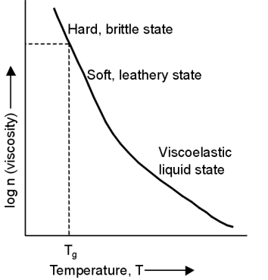
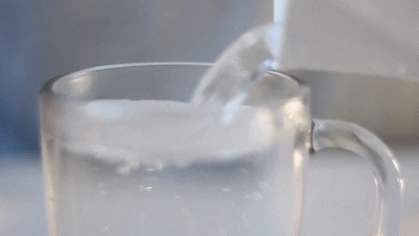
Temperature-dependent viscosity of polymers
All polymers with some level of an amorphous phase exhibit glass transition
Above T_{g}, there is a large-scale cooperative movement of polymer chain segments
Engineering T_{g} in polymers
Adding stiff chemical groups (e.g. benzene) increases T_{g}
Adding plasticizers decreases T_{g}
K. Budinski, Engineering Materials: Properties and Selection

Slide 15
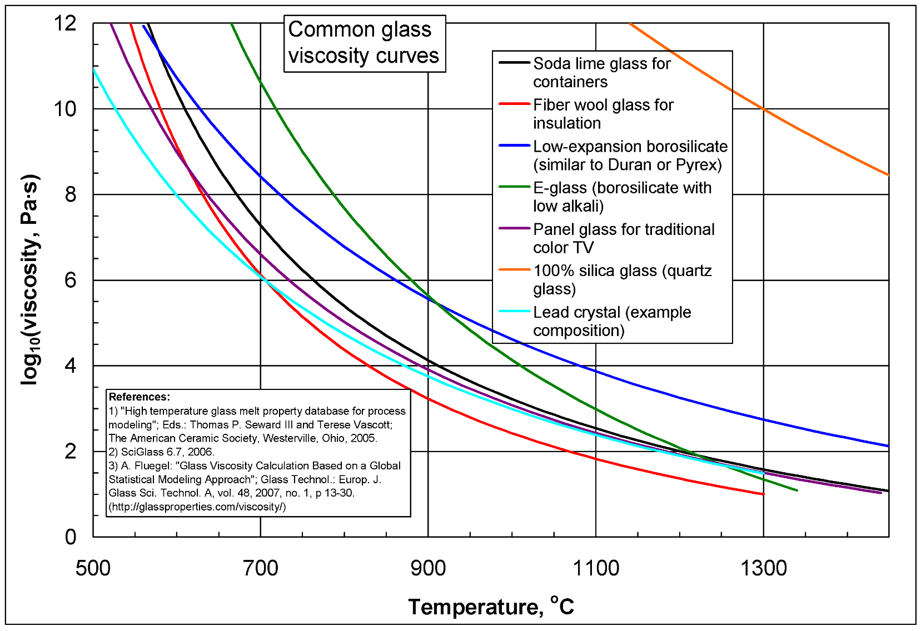
Composition dependence of viscosity
High network connectivity and strong bonds lead to high viscosity

Slide 16
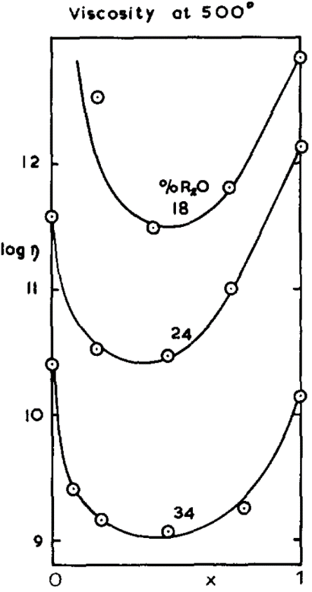
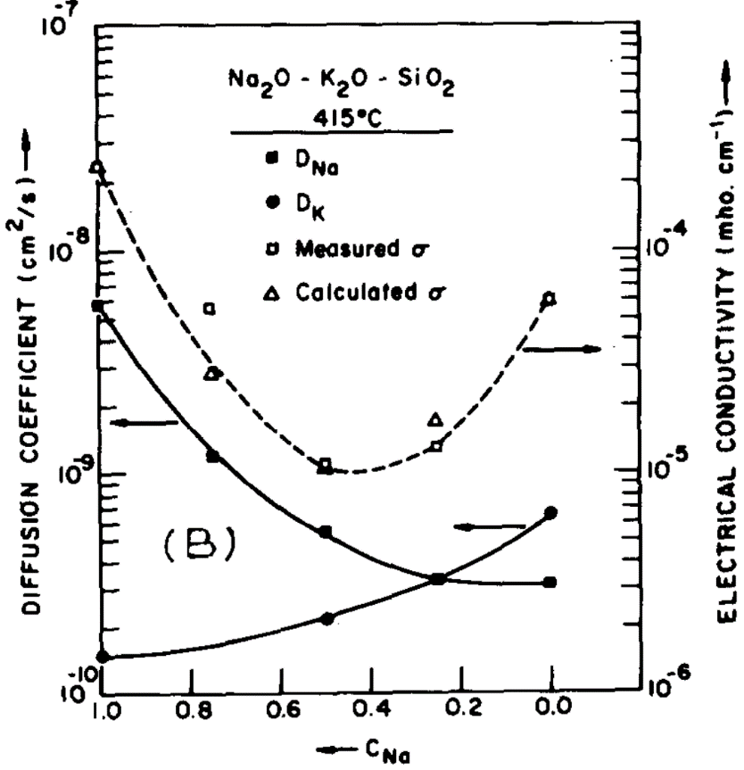
Mixed alkali effect (MAE)
Simultaneous presence of two alkali modifiers in glass leads to non-additive behavior (in particular transport properties)
Possible mechanism: mutual blocking of transport pathways by the two ions
J. Non-Cryst. Solids 1, 235 (1969);
J. Non-Cryst. Solids 21, 343 (1976);
Phys. Rev. Lett. 90, 155507 (2003).
Na₂O
K₂O
Na₂O
K₂O
Notes:
Note that viscosity decreases with mix ions although ionic conductivity increases with mixed ions

Slide 17
The thermometer effect
“In the last century and before, most thermometers were made of ‘Thüringer Glas’ which contains silica, lime and, more importantly, equal portions of (mobile) sodium and potassium ions. The problem with these thermometers was that they were rather inaccurate. If a calibrated thermometer was put into boiling water and later into ice of 0 °C, the thermometer did not show 0.0 °C, but about −0.5 °C. This so-called zero point depression took several months to vanish, if the thermometer was stored at room temperature. If it was heated up and cooled down, the effect occurred again. Weber found out in 1883 that this unwished relaxation effect could be diminished by a factor of 10 if only one type of alkali ion (sodium or potassium) was present in the glass, and little later Schott developed the first accurate Li-based thermometer.”
From Solid State Ion. 105, 1-13 (1998)

Slide 18
Non-Newtonian behavior
Shear stress σ
Rate dependent viscosity
Bingham plastic
Shear thinning
Newtonian fluid
Shear thickening
Shear rate

Slide 19
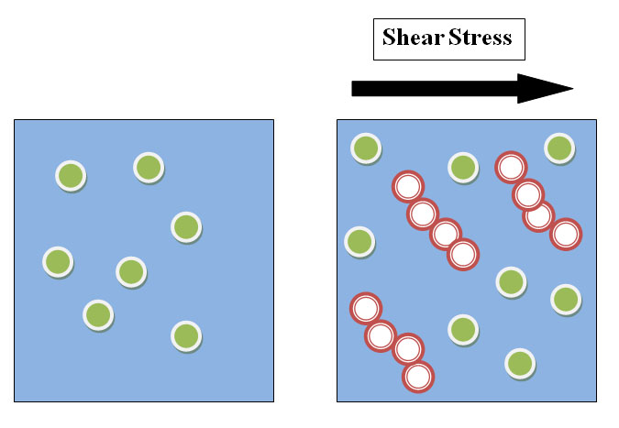
Non-Newtonian behavior
Viscosity η
Rate dependent viscosity
Bingham plastic
Shear thinning
Newtonian fluid
Shear thickening
Hydroclustering (Image from Wiki)
Shear rate

Slide 20
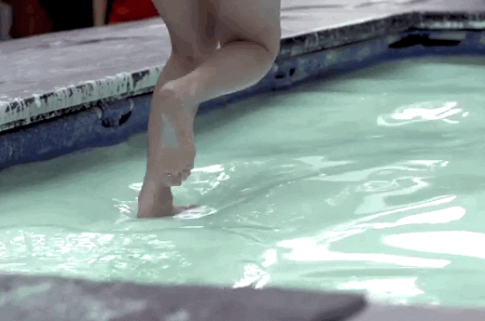
Non-Newtonian behavior
Viscosity η
Rate dependent viscosity
Bingham plastic
Shear thinning
Newtonian fluid
Shear thickening
Shear rate

Slide 21
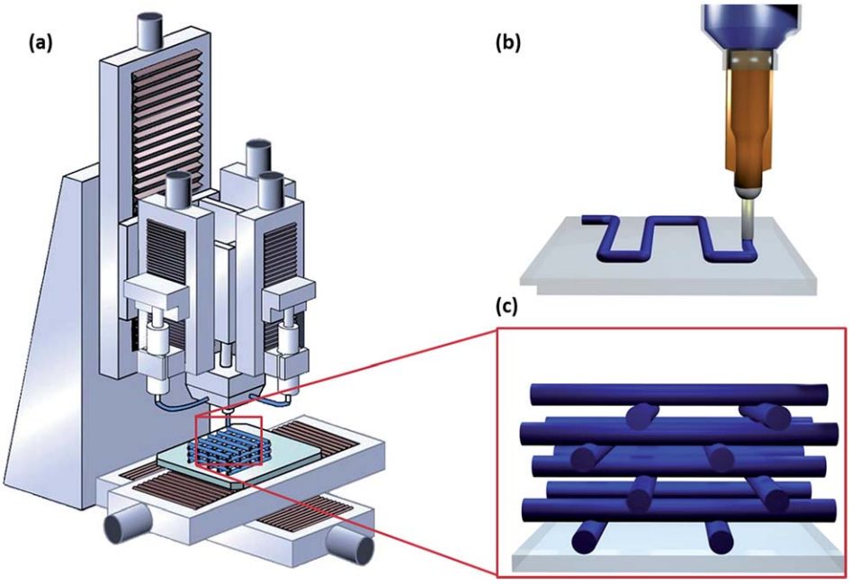
Non-Newtonian behavior
Viscosity η
Rate dependent viscosity
Bingham plastic
Shear thinning
Newtonian fluid
Shear thickening
Shear rate
Nanoscale 6, 10470 (2014)

Slide 22
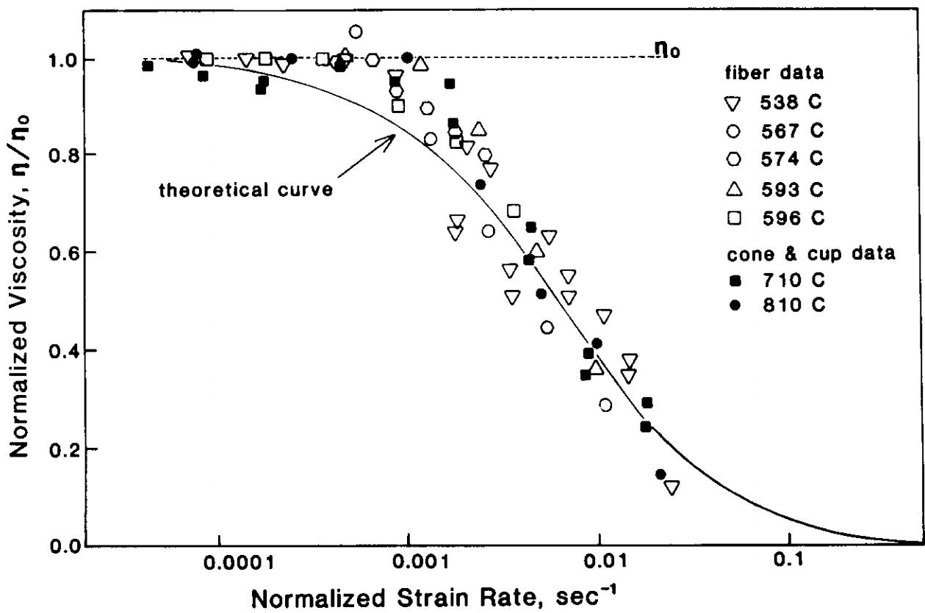
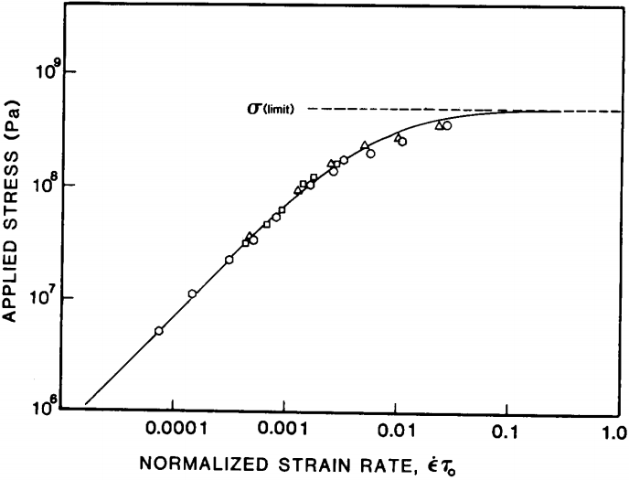
Non-Newtonian behavior of soda-lime glass
Shear thinning
J. Non-Cryst. Solids 105, 313-322 (1988)
Notes:
The limiting stress corresponds to the cohesive strength of glass

Slide 23
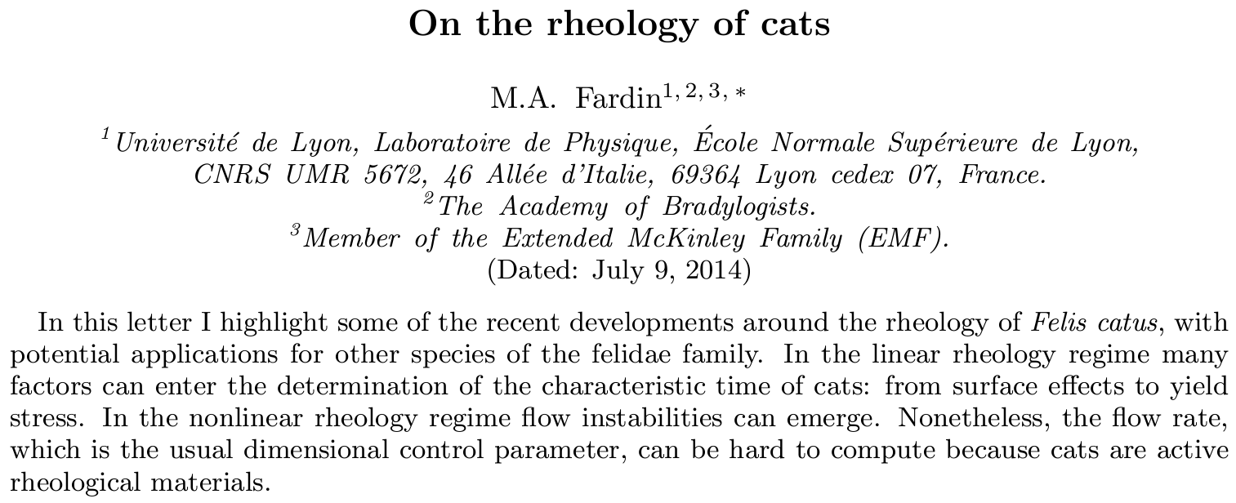
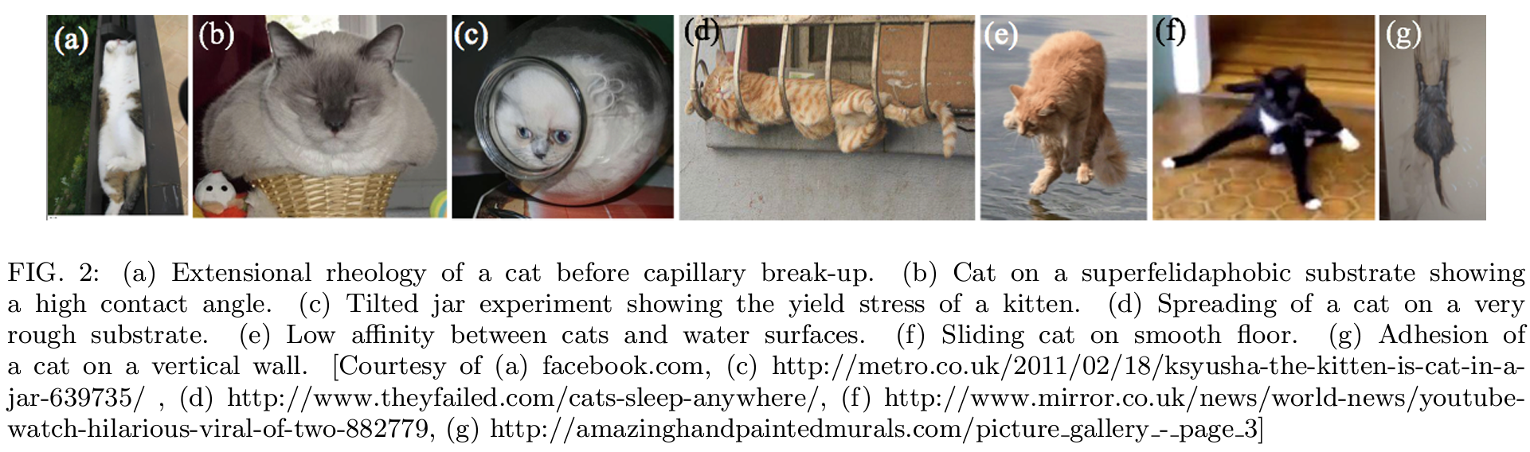
Non-Newtonian behavior of Felis catus
Ig Nobel Prize 2017: Why are cats liquid?

Slide 24
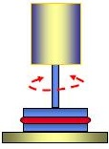
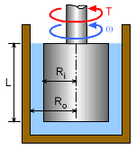

Viscosity measurement: viscometry
Parallel plate
10⁵
10⁹
Beam bending
Rotating cylinder
10⁶
10⁷
10¹³
10¹
10³
10^{6.6}
10¹²
10^{13.5}
η (Pa·s)
Melting point
Working point
Softening point
Annealing point (T_{g})
Straining point

Slide 25
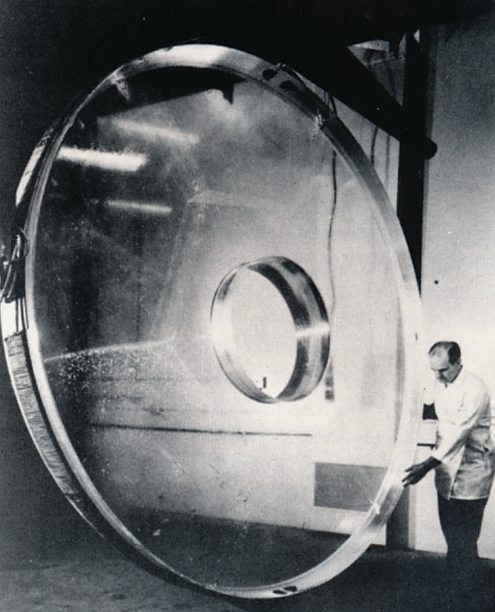
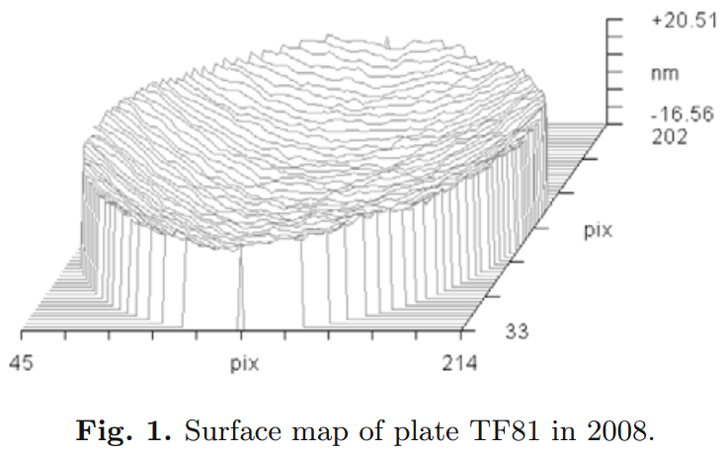
Precision viscometry based on optical interferometry
Corning Inc.
“… the data reported are related to a single fused silica plate whose absolute shape was monitored over a period of 6 years during which the plate maintained the same posture; … The deformations that have to be detected are at the scale of the nanometre, over a lateral size of 100-150 mm…”
M. Vannoni et al., Eur. Phys. J. E 34, 92 (2011)

Slide 26
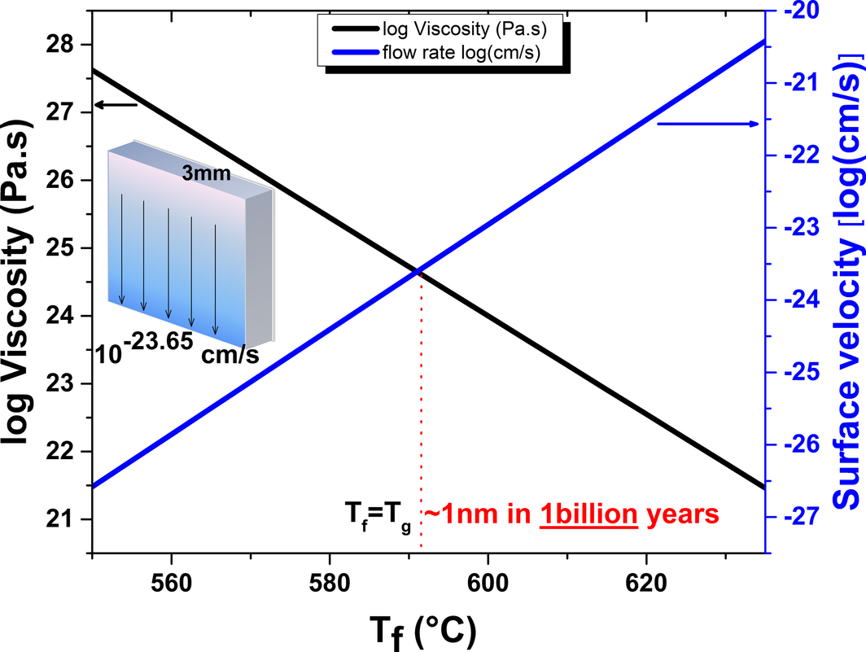
Is glass a solid or a viscous liquid?
“Chocolate Melts,
Flowers Wilt,
Diamonds are Forever”
“Depending on the thermal history of the glass, the room temperature viscosity is on the order of 10²⁴ to 10²⁵ Pa·s... Using analytical expressions to describe the glass flow over a wall, we calculate a maximum flow of ~1 nm over a billion years.”
Glasses
DOI: 10.1111/jace.15092

Slide 27
Summary
Constitutive relations for linear elasticity and Newtonian viscosity
Elastic deformation: instantaneous, transient
Viscous flow: time-dependent, permanent
Temperature dependence of elasticity and viscosity
Elasticity: results from interatomic forces with minimal temperature dependence
Viscosity: motion of atoms/molecules with respect to neighbors, thermally activated process

Slide 28
Summary (cont’d)
Fragility of glass forming liquids: temperature dependence of activation energy in viscous flow
Strong liquid: Arrhenius equation
Fragile liquid: VFT equation, size of collective motion units (molecular clusters) increases as temperature decreases
Composition dependence of viscosity
Mixed alkali effect
Non-Newtonian viscous flow
Viscometry techniques

