Slide 1
MIT 3.071
Amorphous Materials
6: Glass Shaping
Juejun (JJ) Hu
hujuejun@mit.edu

Slide 2
After-class reading list
Fundamentals of Inorganic Glasses
  Ch. 20
Introduction to Glass Science and Technology
  Ch. 13

Slide 3
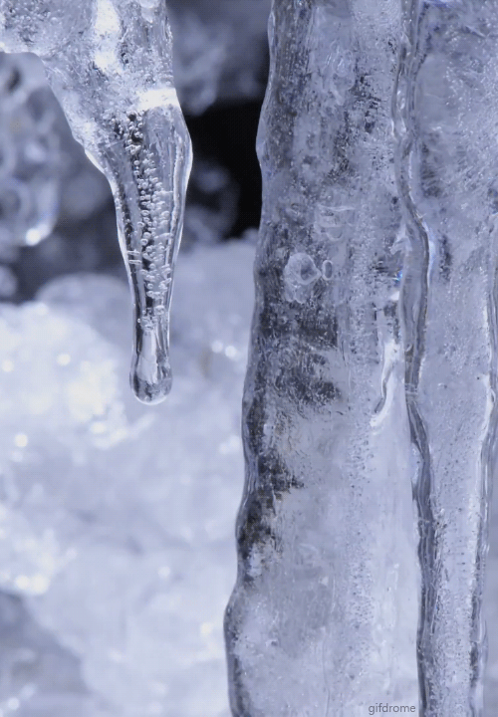
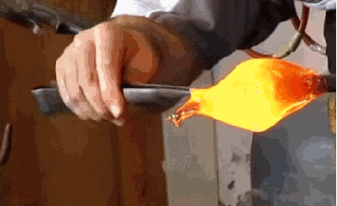
Continuous viscosity-temperature curve
Crystal
Glass
“Viscosity makes things happen essentially in slow motion. If you are trying to melt a crystalline solid (like ice or an aluminum oxide ceramic), as soon as you reach the melting point, a drop of liquid forms and falls away from the melting surface. Glass, on the other hand, … gradually transforms from a hard solid to a slowly softening liquid. This soft liquid gradually stiffens as it cools (because of its increasing viscosity), allowing glass blower time to shape and manipulate the glass.”
http://madsci.org/posts/archives/2007-09/1188944613.Ph.r.html

Slide 4

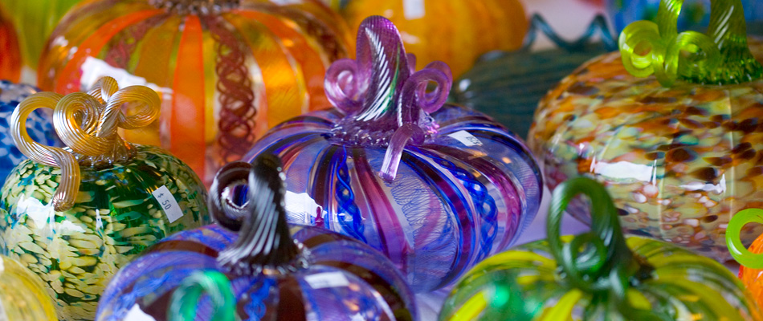
“Viscosity makes things happen essentially in slow motion. If you are trying to melt a crystalline solid (like ice or an aluminum oxide ceramic), as soon as you reach the melting point, a drop of liquid forms and falls away from the melting surface. Glass, on the other hand, … gradually transforms from a hard solid to a slowly softening liquid. This soft liquid gradually stiffens as it cools (because of its increasing viscosity), allowing glass blower time to shape and manipulate the glass.”
http://madsci.org/posts/archives/2007-09/1188944613.Ph.r.html

Slide 5
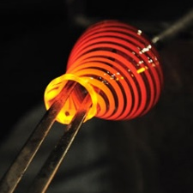
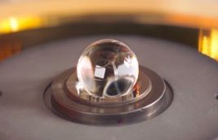
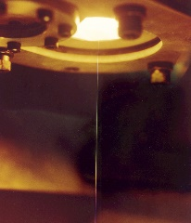
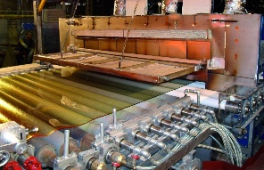
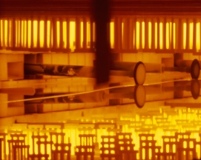
Viscosity reference points
Working range
PGM
Glass blowing
Lehr annealing
Fiber drawing
Float glass
Pitch: 2.3 × 10⁸
Chewing gum
10¹
10³
10^{6.6}
10¹²
10^{13.5}
η (Pa·s)
Melting point
Working point
Softening point
Annealing point (T_{g})
Straining point

Slide 6
Basic properties of common silicate glasses
 | Soda-lime | Borosilicate | Fused silica
CTE (ppm/°C) | 9.2 | 3.2 | 0.5
Working point (°C) | 1005 | 1252 | N/A
Softening point (°C) | 696 | 821 | 1650
Annealing point (°C) | 510 | 560 | 1140
Strain point (°C) | 475 | 510 | 1070

Slide 7
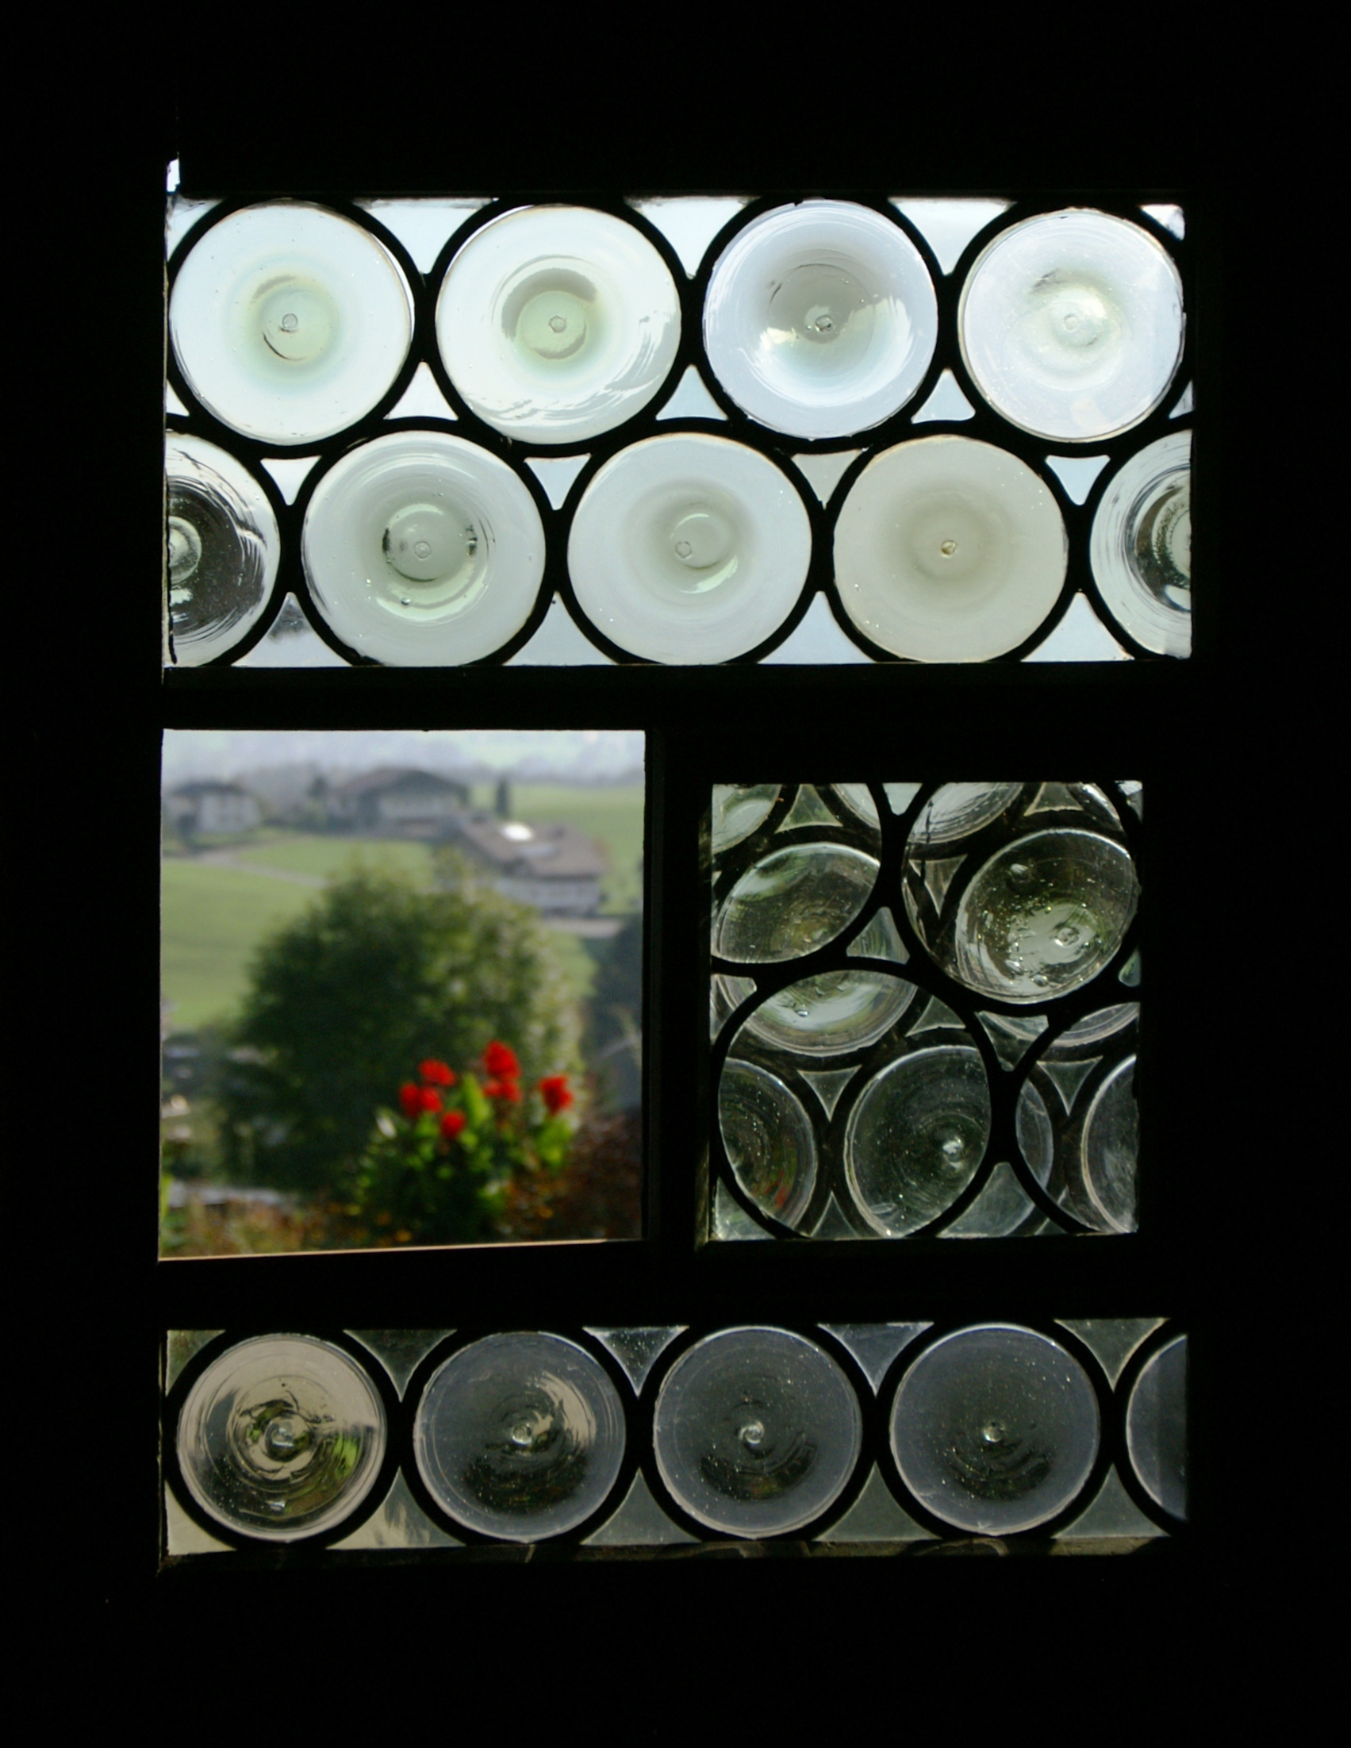
Early flat glass process: crown glass
Crown glass was produced by making a hole in a molten glass bubble, then spinning the glass to create a flat, circular sheet with a distinctive “bulls-eye” pattern

Slide 8
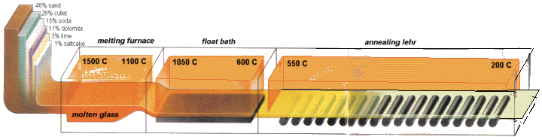
Flat glass manufacturing: float glass process
Forming of a continuous ribbon of glass using a molten tin bath
  Melting and refining (homogenization and bubble removal)
  Float bath: glass thickness controlled by flow speed
  Annealing: stress release
  Inspection, cutting and shipping
10¹ Pa·s
10^{2.5} Pa·s
10¹² Pa·s
> 10¹⁵ Pa·s
Notes:
A typical float-glass line produces 500-700 tons of glass per day, with the largest plants producing 1000 tons per day

Slide 9
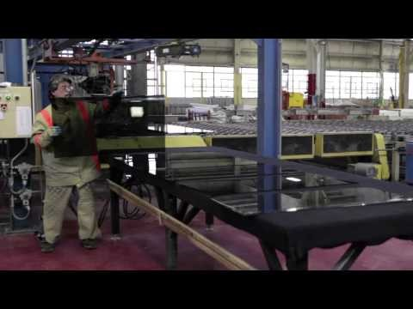
Notes:
Glass cullets form an early liquid phase and help to expedite reactions between other raw materials

Slide 10
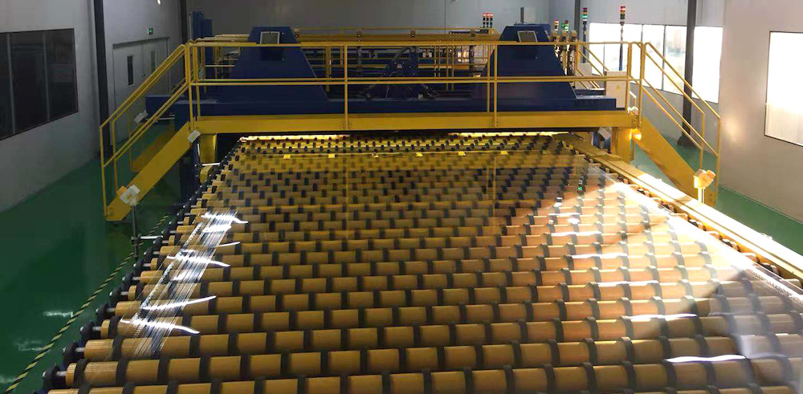
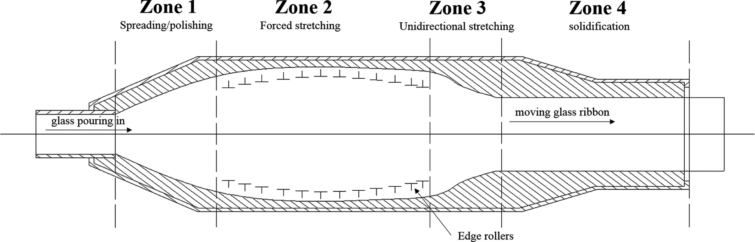
Ultra-thin, ultra-wide glass by float stretching
0.12 mm thick, 4 m wide float glass
Int. J. Appl. Glass Sci. 10, 275 (2019)
Notes:
The top surface shows a root mean square (RMS) roughness value of 1.81 nm. The RMS roughness of the bottom surface slightly increased to 3.57 nm.

Slide 11
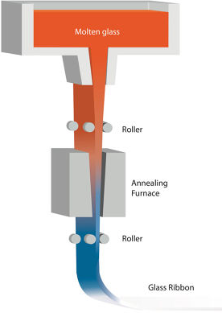
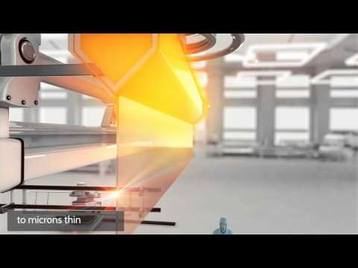
Flat glass manufacturing: down-draw methods
Preserves pristine surfaces: no subsequent polishing required
Broad range of thicknesses from millimeter to tens of microns
Mostly used for flat panel display glasses
© SCHOTT
Notes:
THE LONG ROAD TO SUCCESS: FUSION DRAW GLASS: http://www.cmog.org/article/long-road-success-fusion-draw-glass

Slide 12
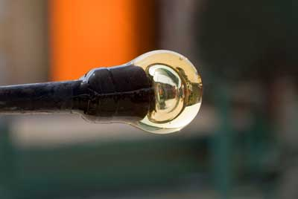
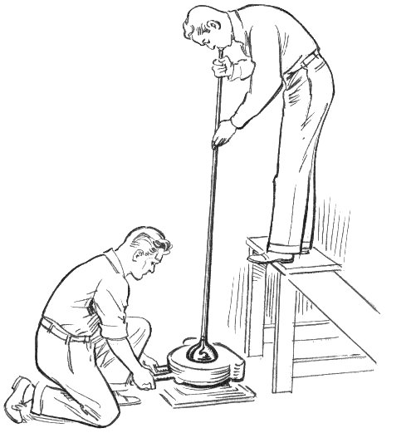
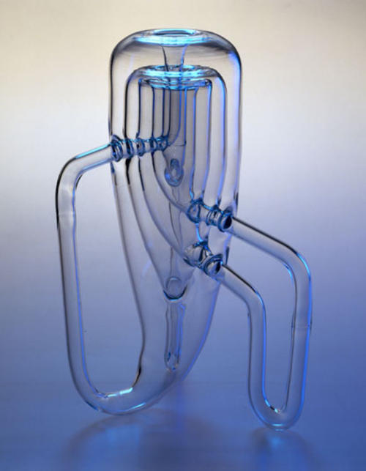
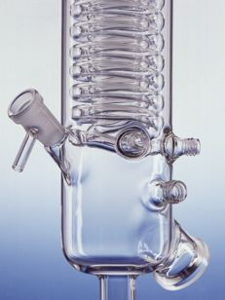
Glassblowing
Gaffer
Parison
Blow pipe
Notes:
Wall thickness uniformity

Slide 13
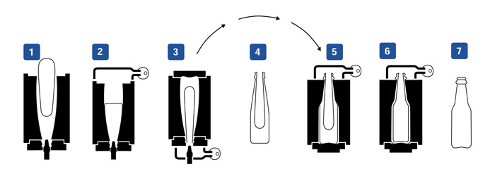
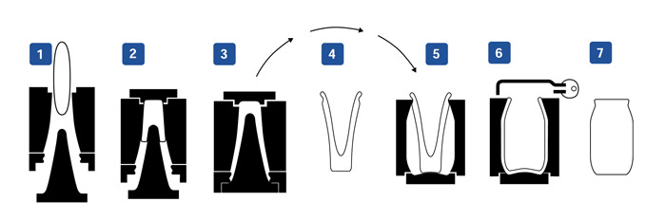
Glass container production
Narrow-neck containers (e.g., bottles): blow-and-blow process
Wide-mouthed jars: press-and-blow process
http://www.beatsonclark.co.uk/
Notes:
Avoids the frictional stick forces experienced by conventional shaping techniques by engineering the expansion of a parison such that substantially all of the lateral strain required to form the final article is accomplished prior to the outer surface of the parison contacting the surface of the shaping mold

Slide 14
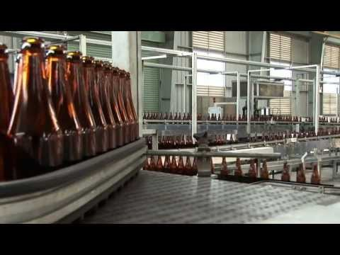
Glass container production
Notes:
De-alkalization: use SO2 or SO3 to remove Na2O and CaO from glass surface to improve chemical resistance
Dual-end coating process:
Hot-end coating (> 450 C): thin (~ 10 nm) tin oxide to improve wear resistance and also adhesion of the polymer coating
Cold-end coating: (~ 100 nm) polymer to reduce friction and enhance scratch resistance; also acts as a diffusion barrier to mitigate aqueous chemical attack
https://www.lehigh.edu/imi/teched/GlassProcess/Lectures/Lecture10_Pantano_Surface_Treatments.pdf

Slide 15
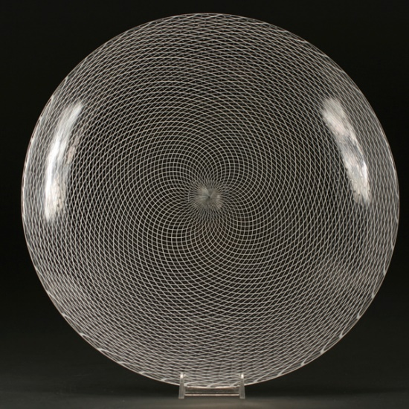
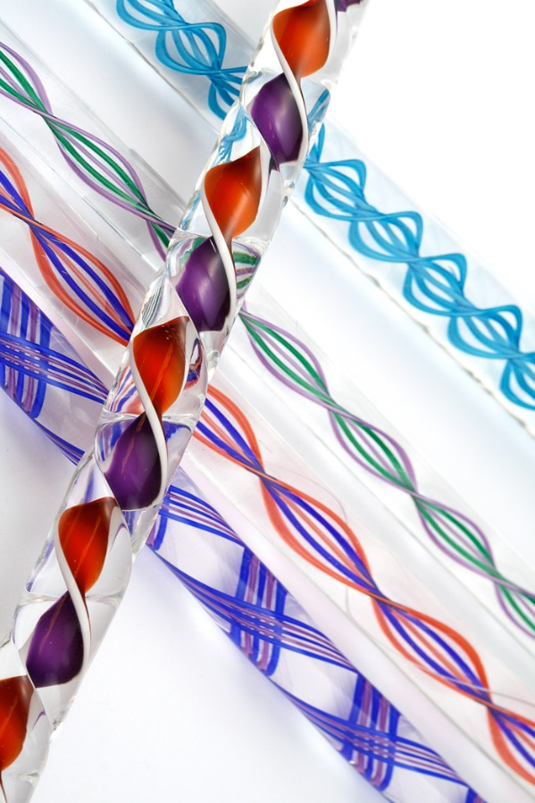
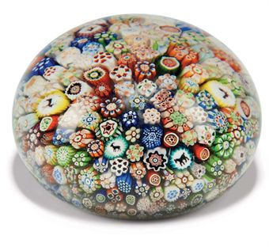
Glass caneworking
Reticello
Zanfirico
Millefiori

Slide 16
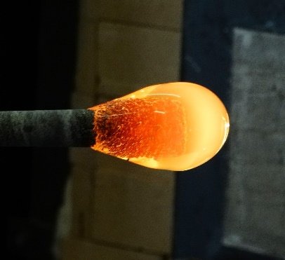
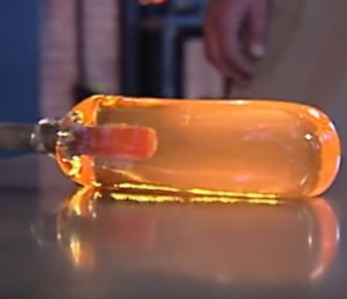
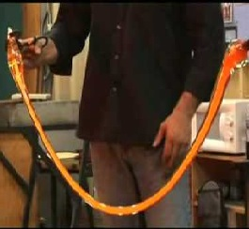
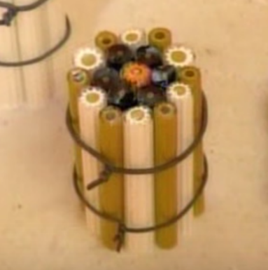
Glass caneworking
Canes: thin glass rods (often with color); can be of a single color, or contain multiple strands arrayed in a pattern (murrine)
Basic glass work technique for adding intricate stripe patterns to glassware or blown glass
Gather glass with pontil
Gob shaping on marver
Cane drawing
Stack and bundle

Slide 17
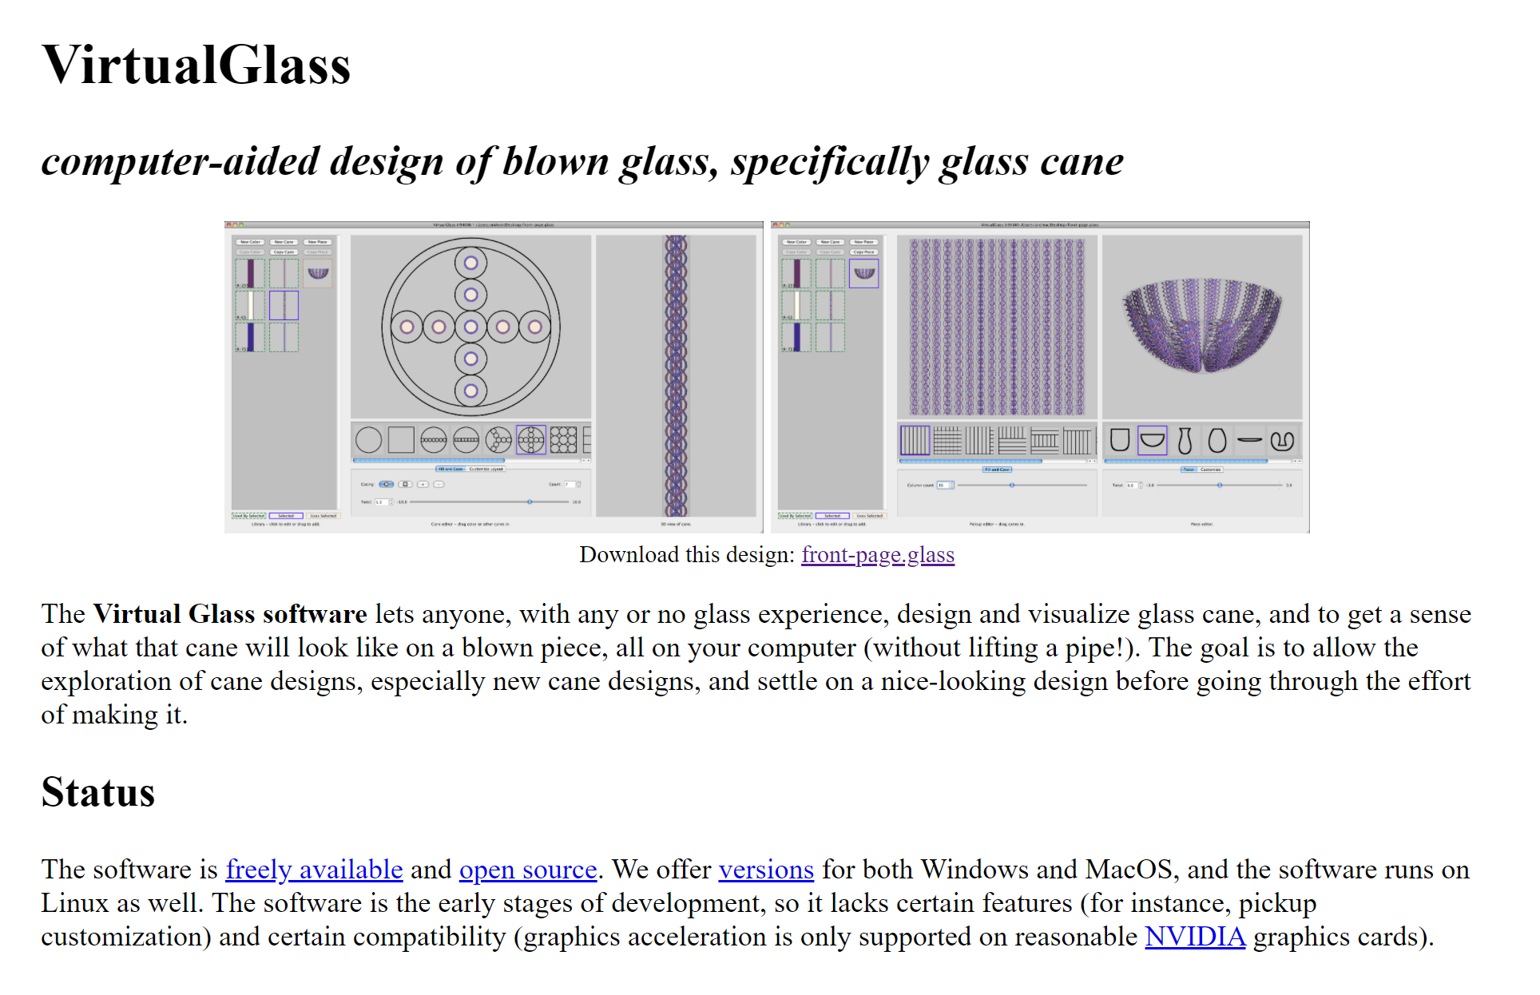
virtualglass.org

Slide 18
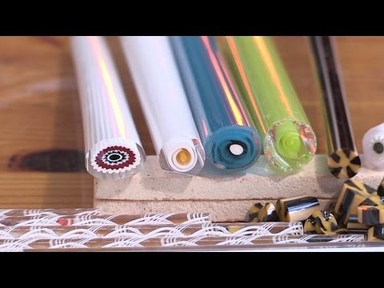
Millefiori – “1,000 flowers”

Slide 19
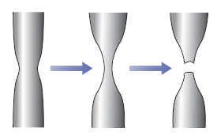

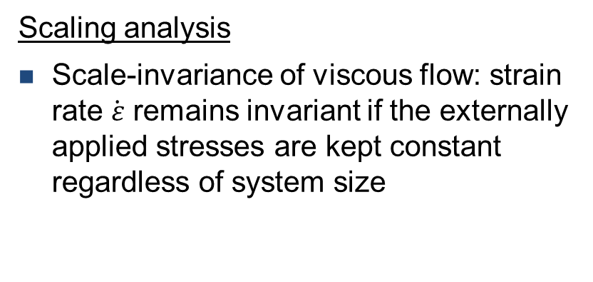
Stability of drawn cane structures
Scaling analysis
Scale-invariance of viscous flow: strain rate $\dot{ε}$ remains invariant if the externally applied stresses are kept constant regardless of system size
Are you breaking my lovely canes?
σ
σ
λ-times system size
Same strain rate!
σ
σ

Slide 20
Stability of drawn cane structures
Cane diameter D change:
Necking develops if viscosity is independent of diameter D
Are you breaking my lovely canes?
F, σ
F, σ
λ-times system size
F, σ /λ²
F, σ /λ²

Slide 21
Stability of drawn cane structures
Stability threshold:
Are you breaking my lovely canes?
F, σ
F, σ
λ-times system size
F, σ /λ²
F, σ /λ²

Slide 22
Stability of drawn cane structures
Now consider heat dissipation:
Radiative heat transfer dominates
Stefan-Boltzmann law
Temperature change rate
Viscosity dependence on temperature
Heat flux:
e : emissivity
Are you breaking my lovely canes?
σ = 5.67 × 10⁻⁸ W/m²K⁴
High T range

Slide 23
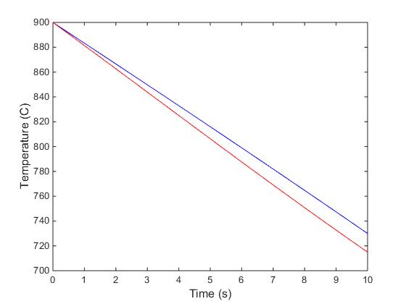
Modeling outcome
Assumptions:
Uniform temperature distribution along the cane cross-section
No heat or mass exchange between cane sections
Only considers radiative heat transfer from glass cane to the surroundings
Constant drawing speed
F
T₁
T₂
F
T₁
T₂

Slide 24
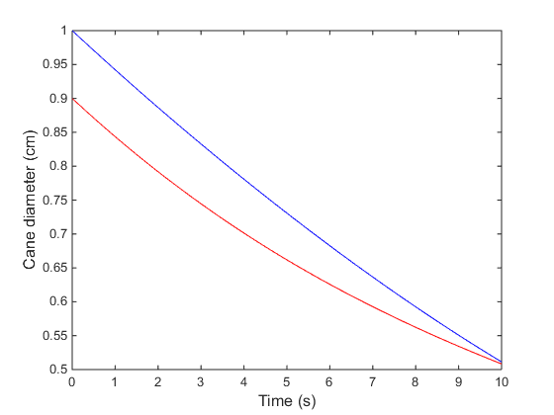

Modeling outcome
Conclusions:
Thinner section cools faster
Viscosity increase in thinner section prevents necking
Cane diameter non-uniformity damps out
F
D₁
D₂
F
D₁
It works beautifully!
D₂

Slide 25
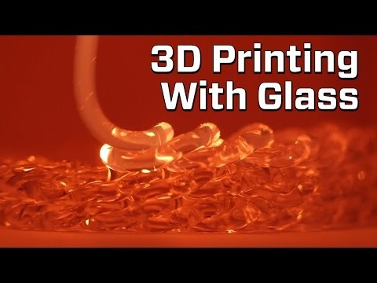
3-D glass printing

Slide 26
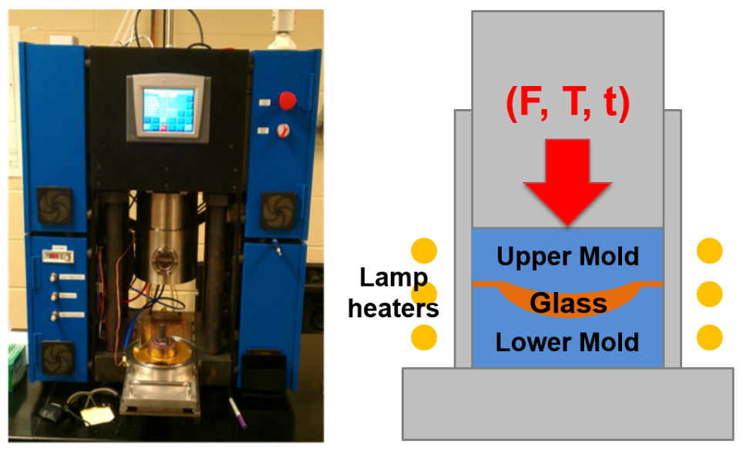
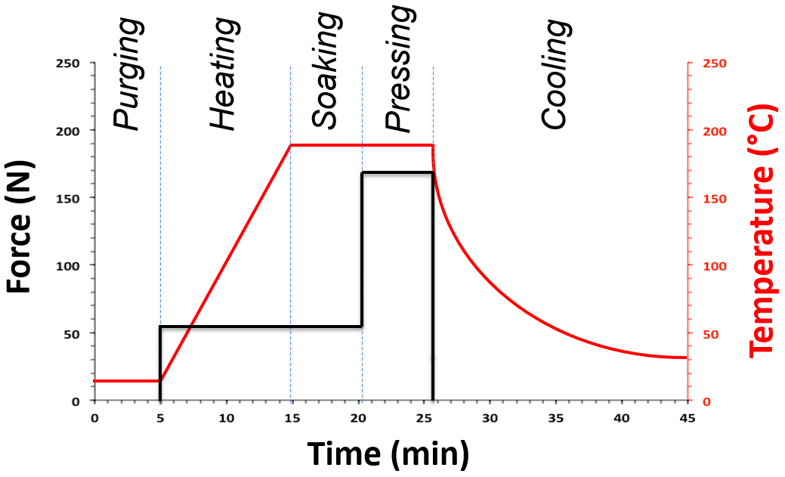
Precision glass molding (compression molding)
Viscosity: 10^{6.6} – 10⁸ Pa·s; pressure: ~ MPa
Mold sticking and damage: TiN or SiC low friction coatings
Non-uniform temperature distribution
Post-molding deformation: thermal shrinkage, viscoelasticity
http://www.rpoptics.com/wp-content/uploads/2015/01/Precision-Glass-Molding-Technical-Brief_21.pdf
Notes:
The mold material chosen must have a CTE that falls within an acceptable CTE range for the glass in use to avoid excessive thermal stress

Slide 27
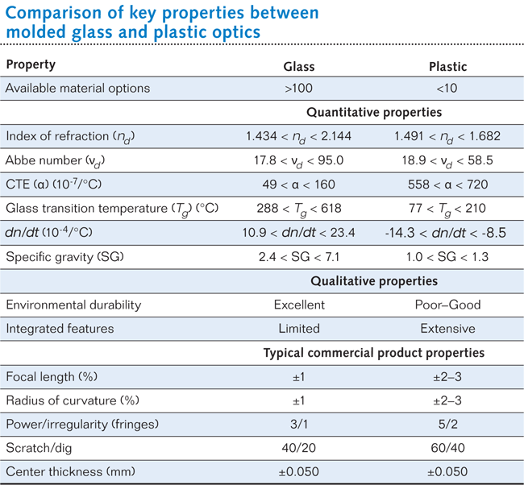
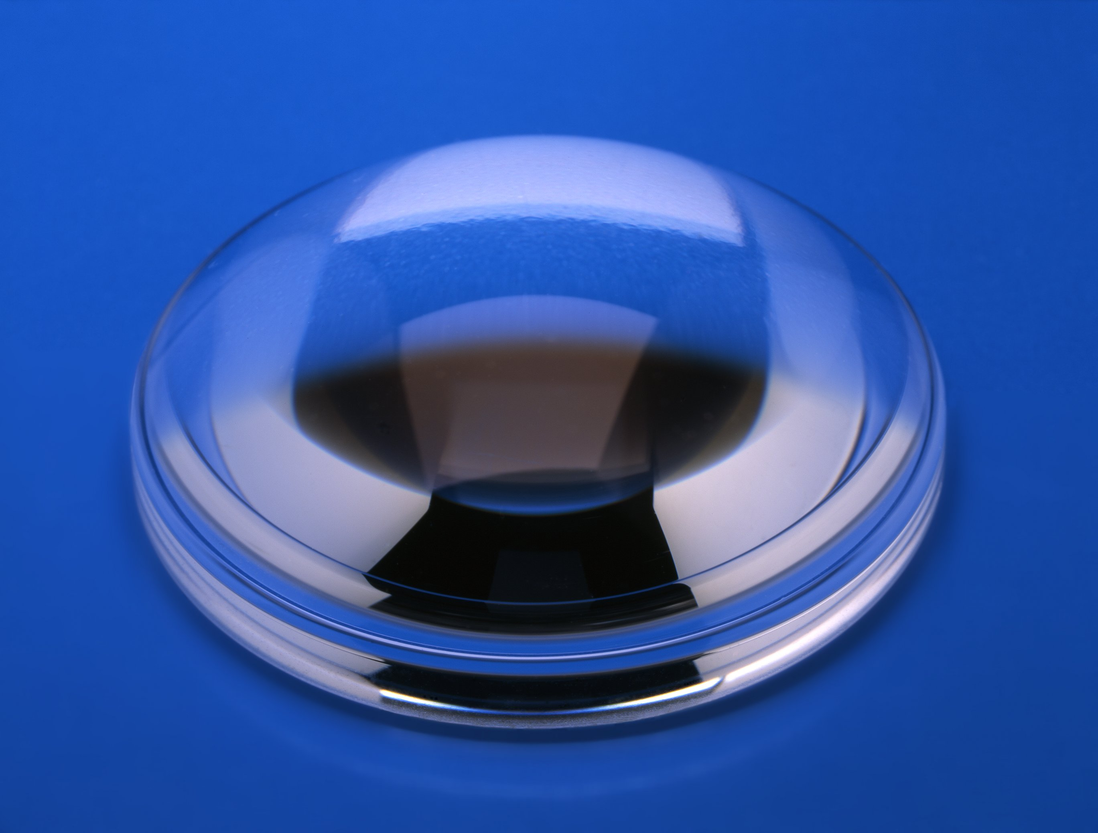
PGM glass asphere lens
LFW 47, 42-45 (2011)

Slide 28
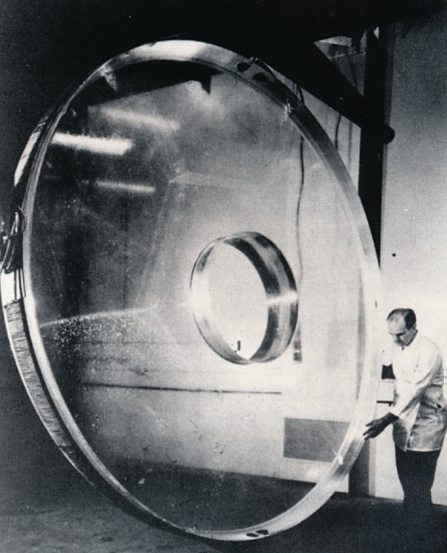
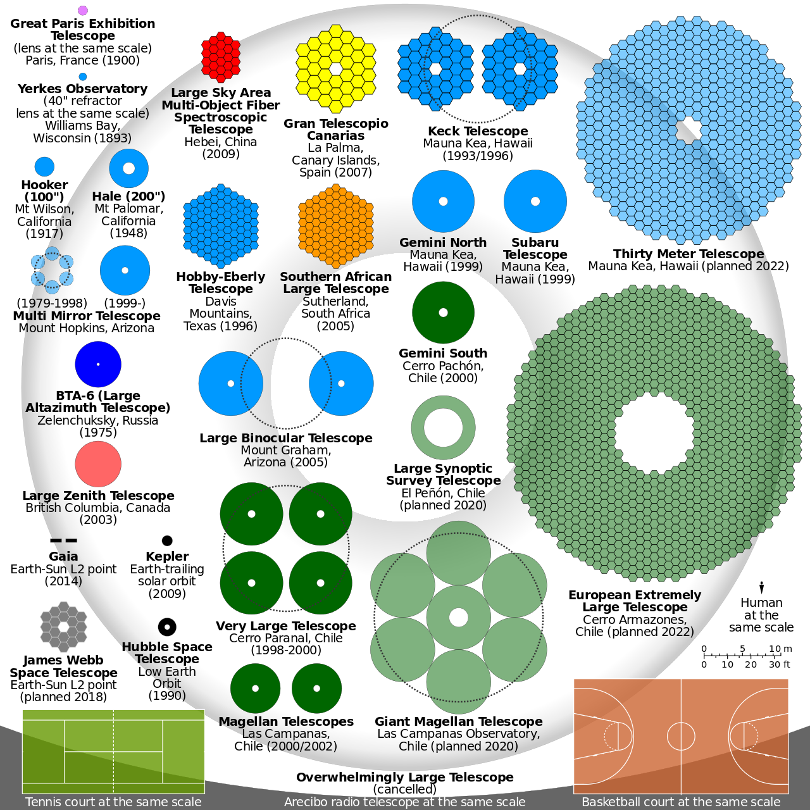
Making extremely large telescope mirrors
Corning Inc.
Image from Wikipedia
Notes:
Image: Corning manufactured this 2.7-meter hex-sealed fused silica primary blank for the McDonald Observatory in 1965. Credit: Am. Ceram. Soc. Bull. 1990, 69(12):1922–24

Slide 29
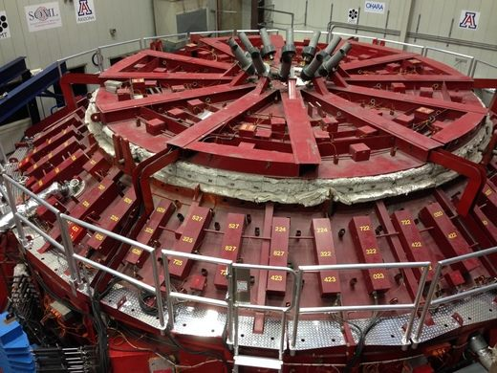
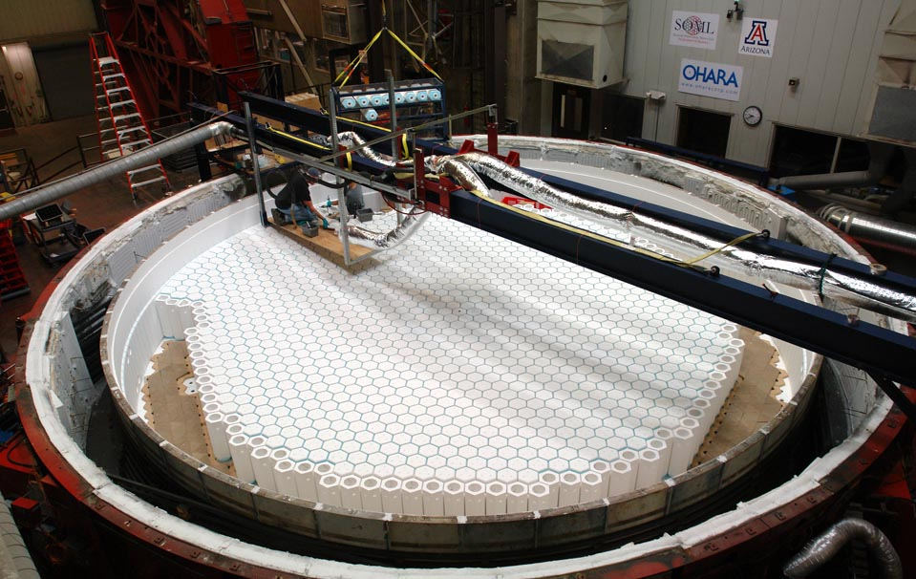
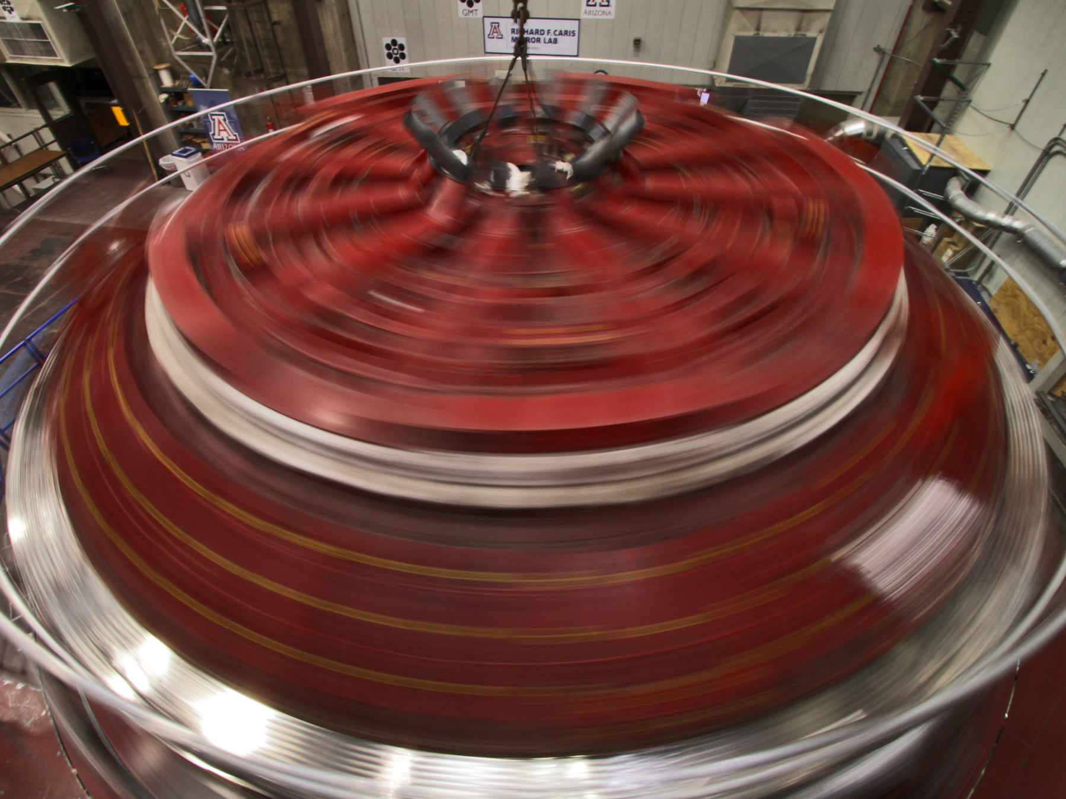
Making extremely large telescope mirrors
© University of Arizona, Richard F. Caris Mirror Laboratory
Initial paraboloidal shape is formed by casting the mirror in the spinning furnace, followed by milling and polishing down to 25 nm accuracy
A honeycomb mirror structure leads to low weight and high stiffness
Notes:
https://mirrorlab.arizona.edu/content/faq

Slide 30
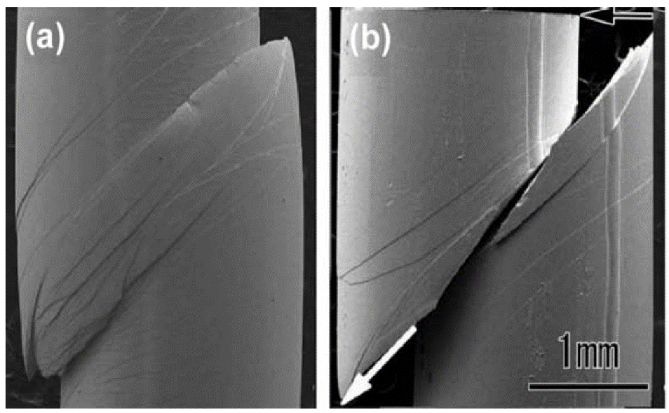
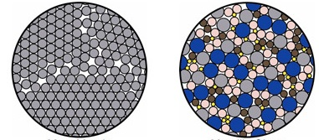
Mechanical properties of bulk metallic glass (BMG)
Polycrystalline metal
Amorphous metal
Grain boundaries
Crystal planes
Metals 3, 1 (2013)
Absence of dislocations and slip planes/directions in BMG
  Large elastic limit and high yield strength (2% and 2 GPa in Zr-based BMGs)
  Poor global plasticity: absence of strain hardening, strong tendency towards shear localization
Cold working is not a viable processing solution
Notes:
Yield strength of A36 steel: 0.25 Gpa
Shear localization results from stress-coupling between shear transformation zones (STZs) and free volume redistribution
Shear localization leading to shear band formation is generally recognized to be a consequence of the absence of a strain-hardening mechanism, whereas strain softening due to the creation of free volume during the shearing precedes localization of shear.

Slide 31
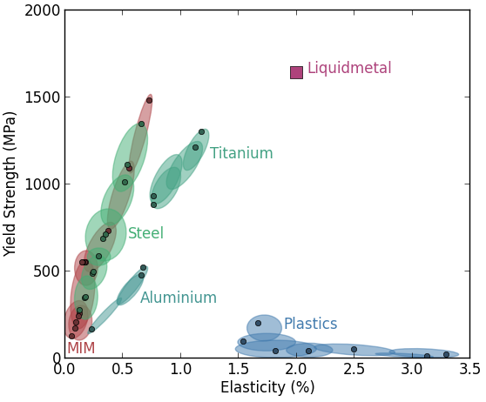
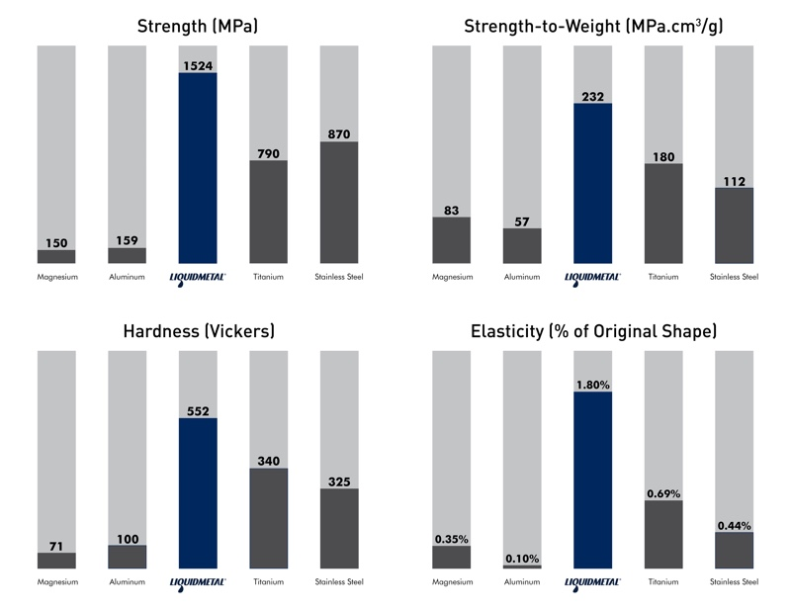
Mechanical properties of a commercial BMG
Data from Liquidmetal® Technologies
High yield strength, hardness, and elasticity

Slide 32
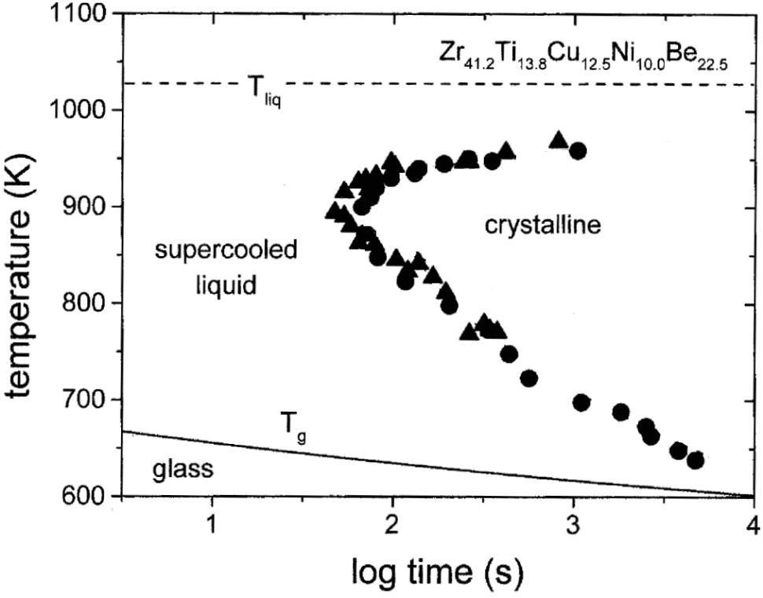

BMG process design
Casting
Data from Liquidmetal® Technologies
Casting: suction casting, die casting
  Reduced volume shrinkage (< 1%): net-shape forming
  Cooling rate control: mold filling and crystallization mitigation

Slide 33

BMG process design
Thermoplastic forming (TPF)
Scripta Mater. 60, 160 (2009)
Thermoplastic forming: compression & injection molding, extrusion, rolling, blow molding, 3-D printing
  Thermal embrittlement: free volume decrease
Notes:
Typical viscosity values for TPF: injection molding 1E3 Pas, extrusion 1E7 Pas, blow molding 1E6 Pas

Slide 34

BMG process design
Thermoplastic forming (TPF)
Adv. Mater. 22, 1566 (2010)
Glass-forming liquid fragility
  Liquids with low fragility have better temperature tolerance
Notes:
Fragility varies widely among BMG formers; BMG has improved temperature tolerance in TPF compared to polymers due to their low fragility

Slide 35

Compression molding
Sample size | Shape | Aspect ratio | Issues
mm to cm | Open structures | 1 to 10 | Mold release and mold wear
Adv. Mater. 22, 1566 (2010)

Slide 36


Injection molding
Sample size | Shape | Aspect ratio | Issues
mm to cm | Open structures | 1 to 10 | Mold release and mold wear
Notes:
Unlike MIM (metal injection molding), there are no debinding or sintering processes required after the injection

Slide 37



Blow molding
Parison
Final shape
Sample size | Shape | Aspect ratio | Issues
10 μm to cm | Hollow shapes | 10 to 1,000 | Temperature control, mold sticking
Mater. Today 14, 14 (2011)
Notes:
Typical maximum strain for traditional metals: 25%
Maximum strain of BMG is limited by onset of crystallization
Any unwanted temperature gradient within the blow-mold setup translates significantly faster into a temperature gradient in the BMG than in polymers

Slide 38


3-D printing of BMG
Continuous softening behavior of BMGs enables extrusion-based 3-D printing through fused filament fabrication (FFF)
Mater. Today 21, 697 (2018)

Slide 39

3-D printing of BMG
Mater. Today 21, 697 (2018)

