Slide 1
MIT 3.071
Amorphous Materials
7: Viscoelasticity and Relaxation
Juejun (JJ) Hu
hujuejun@mit.edu

Slide 2
After-class reading list
Fundamentals of Inorganic Glasses
  Ch. 8, Ch. 13, Appendix A
Introduction to Glass Science and Technology
  Ch. 9 (does not cover relaxation)

Slide 3

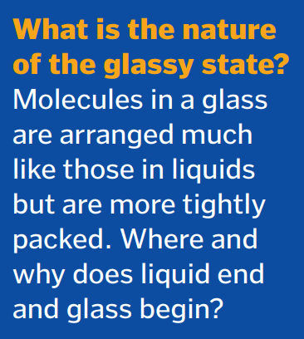
“The Nature of Glass Remains Anything but Clear”
“What don’t we know?” Science 309, 83 (2005)

Slide 4
“There are more theories of the glass transition than there are theorists who propose them.”
David Weitz, Harvard University

Slide 5
Is glass a solid or a viscous liquid?
V
Solid
Elasticity
instantaneous, transient
Supercooled liquid
Liquid
Viscosity
time-dependent, permanent
Glass
E : Young’s modulus
G : shear modulus
η : viscosity (unit: Pa·s or Poise)
T_{m}
T

Slide 6
Structural relaxation in glass
V
Supercooled liquid
Glass transition
Glassy state
T
Elastic regime
Viscoelastic regime
Viscous regime
All mechanical and thermal effects only affect atomic vibrations
Glass structure and properties are history-dependent
Structural changes are instantaneous: equilibrium state can be quickly reached
Ergodicity breakdown

Slide 7
Structural relaxation in glass
V
Supercooled liquid
Glass transition
Glassy state
T
Elastic regime
Viscoelastic regime
Viscous regime
Deborah number (DN):
“… the mountains flowed before the Lord…”
Prophetess Deborah (Judges 5:5)

Slide 8
Viscoelasticity: complex shear modulus
Consider a sinusoidally varying shear strain
Elastic response:
Viscous response:
In a general viscoelastic solid:
Loss modulus
G* : complex shear modulus
Shear/storage modulus

Slide 9
Phenomenological models of viscoelastic materials
Elasticity: Hookean spring
Viscosity: Newtonian dashpot
Models assume linear material response or infinitesimal stress
Each dashpot element corresponds to a relaxation mechanism
Notes:
Refer to Appendix I in Vashneya’s book for a more rigorous treatment involving the concepts of dilatational and deviatoric components

Slide 10
The Maxwell element
Serial connection of a Hookean spring and a Newtonian dashpot
Total stress:
Total strain:

Slide 11
The Maxwell element
Constant stress (creep):
Constant strain (stress relaxation):
Relaxation time

Slide 12
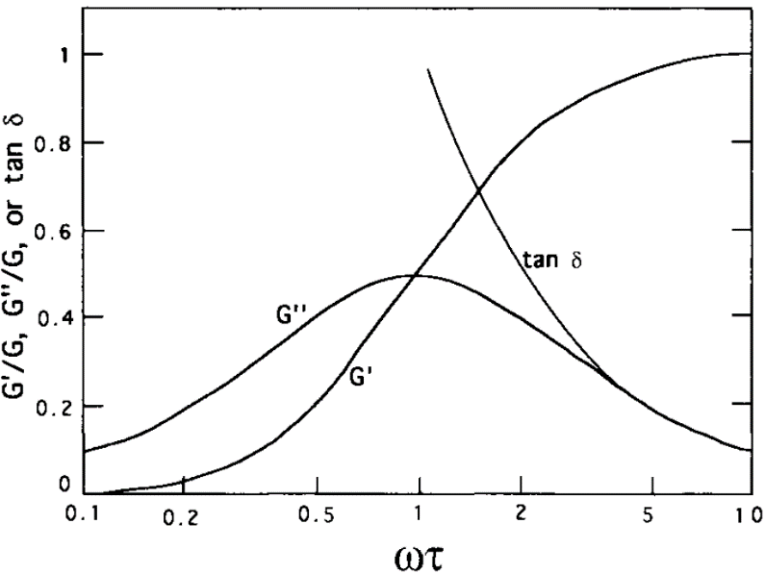
The Maxwell element
Oscillatory strain:
Notes:
Energy loss per cycle: loss tangent; energy loss per unit time: 1/tau

Slide 13
The Voigt-Kelvin element
Parallel connection of a Hookean spring and a Newtonian dashpot
Total stress:
Total strain:
Constant strain:
Constant stress:
Oscillatory strain:

Slide 14
Generalized Maxwell model
For each Maxwell component:
Total stress:
…

Slide 15
Generalized Maxwell model
Stress relaxation:
Prony series:
…
In real solids, a multitude of microscopic relaxation processes give rise to dispersion of relaxation time (stretched exponential)
Notes:
When beta < 1, the stretched exponential can be written as a sum of exponentials with different decay time scales

Slide 16
Elastic, viscoelastic, and viscous responses
Stress
Stress
Stress
t
t
t
Elastic strain
Viscoelastic strain
Viscous strain
t
t
t

Slide 17
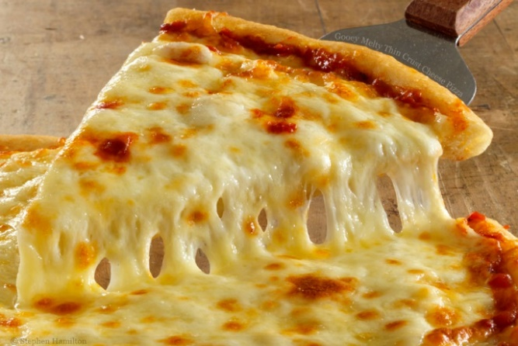

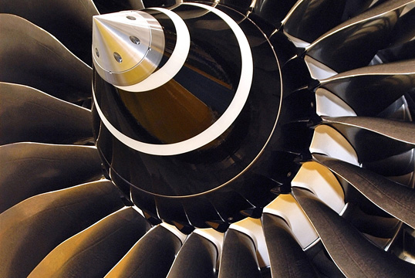
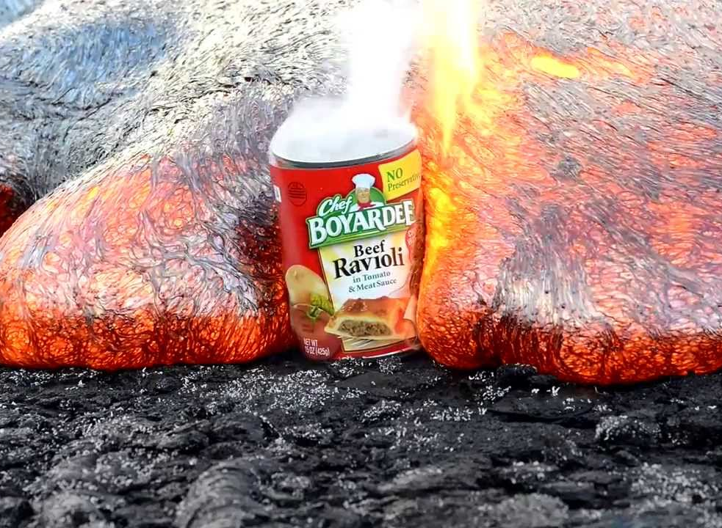
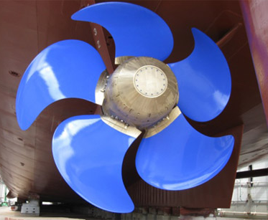
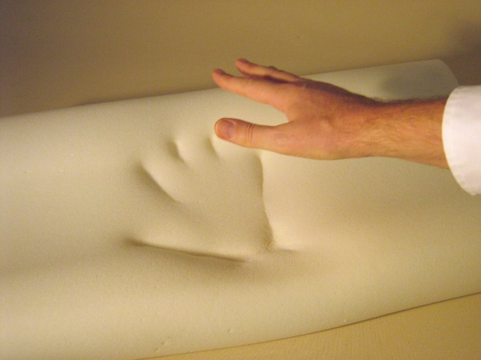
Viscoelastic materials
Mozzarella cheese
Human skin
Turbine blades
Volcanic lava
Naval ship propellers
Memory foams

Slide 18


Boltzmann superposition principle
In the linear viscoelastic regime, the stress (strain) responses to successive strain (stress) stimuli are additive
Strain
Strain
Strain
t
t
t
t₁
t₂
Stress
Stress
Stress
t
t
t
t₁
t₂

Slide 19
Boltzmann superposition principle
In the linear viscoelastic regime, the stress (strain) responses to successive strain (stress) stimuli are additive
Strain
Viscoelastic response is history-dependent
Relaxation function Ψ dictates time-domain response
t
Stress
t

Slide 20
Comparing stress relaxation and structural relaxation
V
T
“Equilibrium” state
  Zero stress state
Driving force
  Residual stress
Relaxation kinetics
  Exponential decay with a single relaxation time
  Relaxation rate scales with driving force
“Equilibrium” state
  Supercooled liquid state
Driving force
  Free volume
Relaxation kinetics
  Exponential decay with a single relaxation time
  Relaxation rate scales with driving force

Slide 21
Free volume model of relaxation (first order kinetic model)
V
Relaxation kinetics at constant temperature
T
Temperature dependence of relaxation

Slide 22
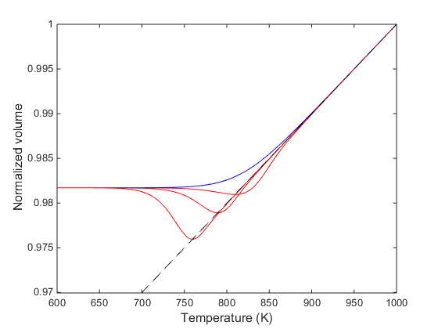
Model predicted relaxation kinetics
Cooling rate: 10 °C/s
Slope: volume CTE of supercooled liquid
Varying reheating rate
10 °C/s
1 °C/s
0.1 °C/s

Slide 23
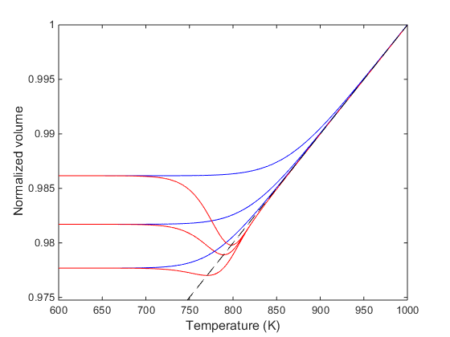
Model predicted relaxation kinetics
Varying cooling rate
Reheating rate: 1 °C/s
100 °C/s
Fictive temperature and glass structure are functions of cooling rate
10 °C/s
1 °C/s

Slide 24
Tool’s Fictive temperature theory
V, H
Supercooled liquid
Fictive temperature T_{f} : the temperature on the supercooled liquid curve at which the glass would find itself in equilibrium with the supercooled liquid state if brought suddenly to it
With increasing cooling rate:
  T_{f1} < T_{f2} < T_{f3}
A glass state is fully described by thermodynamic parameters (T, P) and T_{f}
Glass properties are functions of temperature and T_{f} (structure)
Increasing
cooling rate
3
2
1
T_{f1}
T_{f2}
T_{f3}
T

Slide 25
Tool’s Fictive temperature theory
V, H
Supercooled liquid
Glass property change in the glass transition range consists of two components
  Temperature-dependent property evolution without modifying glass structure
  Property change due to relaxation (T_{f} change)
Increasing
cooling rate
3
Volume:
2
Enthalpy:
1
T_{f1}
T_{f2}
T_{f3}
T
Volume:
Enthalpy:

Slide 26
Tool’s Fictive temperature theory
V, H
Supercooled liquid
Glass property change in the glass transition range consists of two components
Increasing
cooling rate
3
2
1
T_{f1}
T_{f2}
T_{f3}
T
Notes:
With Tool’s equation, the first equation reduces to the free volume relaxation model

Slide 27
Predicting glass structure evolution due to relaxation: Tool’s equation
Consider a glass sample with Fictive temperature T_{f}
P (V, H, S, etc.)
Take time derivative:
Supercooled liquid
Assume first-order relaxation:
Glass
P_{g} - P_{e}
T_{f} - T
Tool’s equation
T
T_{f}
Notes:
Note that in general the relaxation time depends on Tf (in addition to its apparent dependence on T) as well!

Slide 28
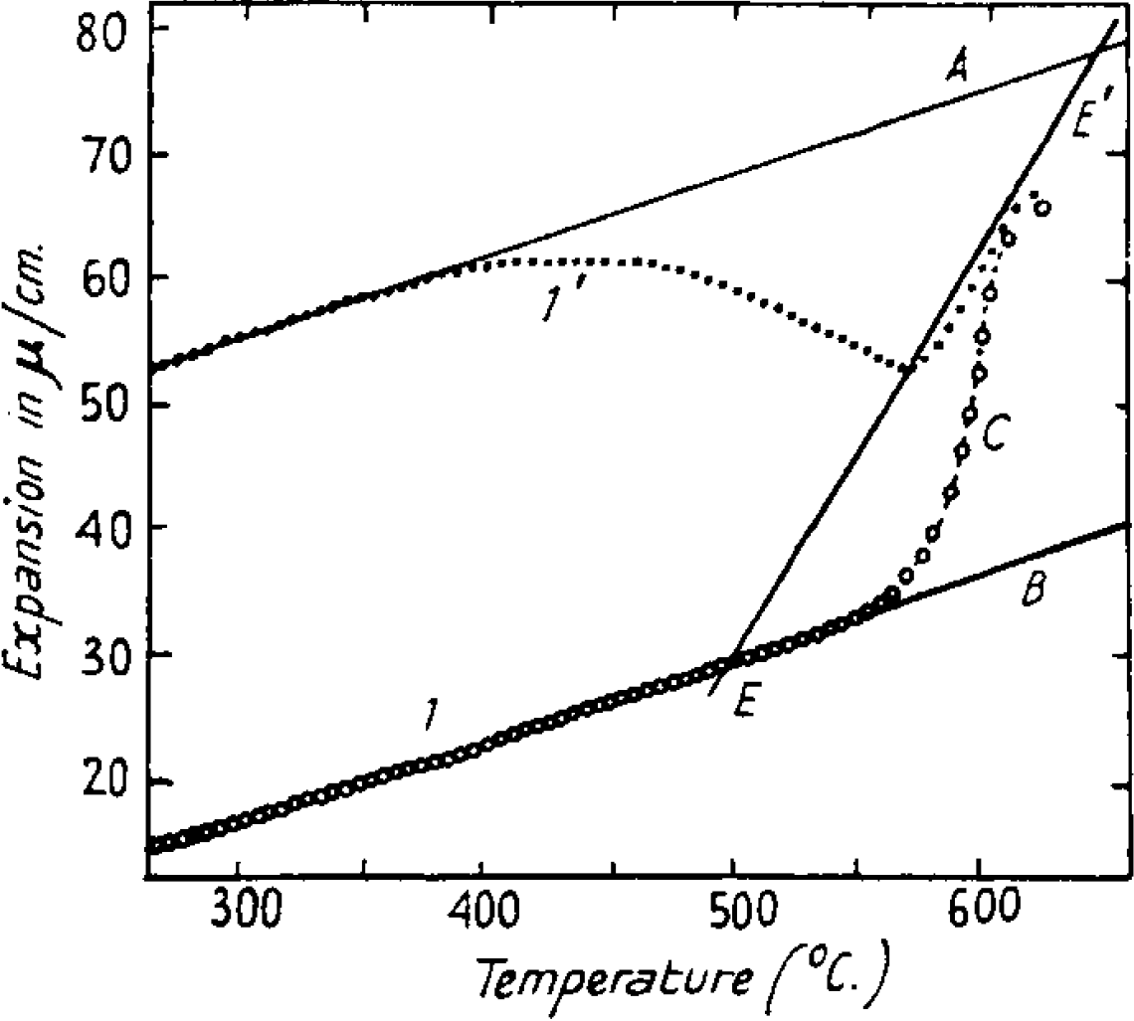
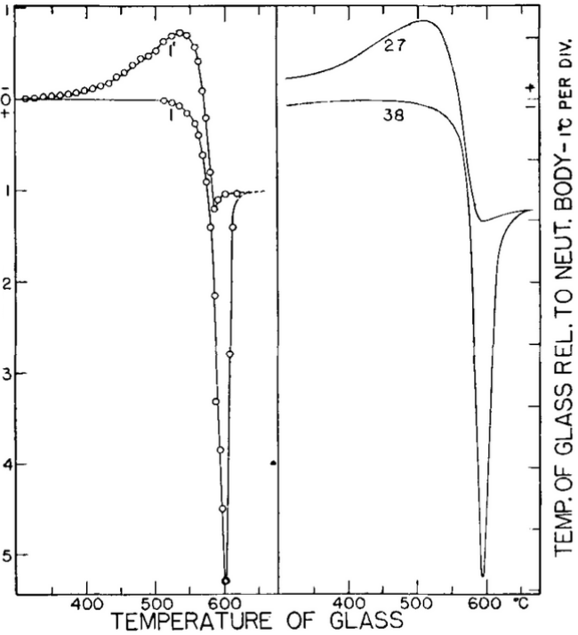
Tool’s Fictive temperature theory
J. Am. Ceram. Soc. 29, 240 (1946)

Slide 29
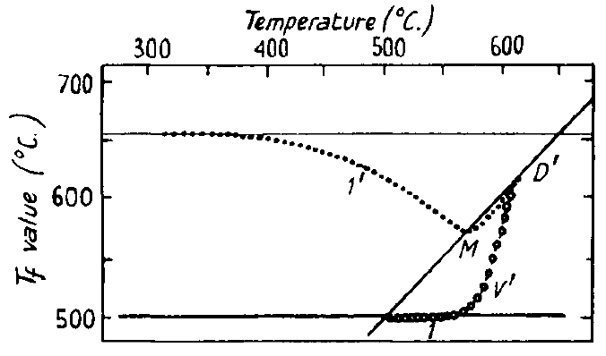
Tool’s Fictive temperature theory
Tool’s equation
J. Am. Ceram. Soc. 29, 240 (1946)

Slide 30
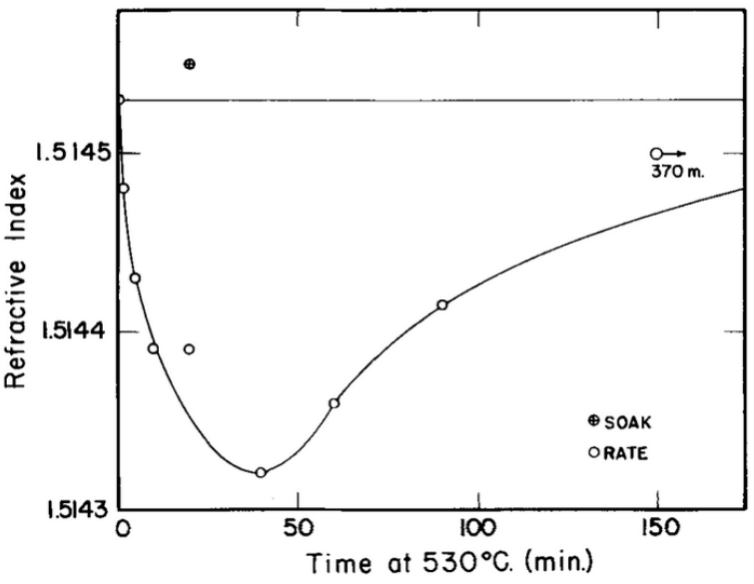
Difficulties with Tool’s T_{f} theory
Ritland experiment: two groups of glass samples of identical composition were heat treated to obtain the same refractive index via two different routes
  Group A: kept at 530°C for 24 h
  Group B: cooled at 16°C/h through the glass transition range
Both groups were then placed in a furnace standing at 530°C and their refractive indices were measured as a function of heat treatment time
Glass structure cannot be fully characterized by the single parameter T_{f}
J. Am. Ceram. Soc. 39, 403 (1956)

Slide 31

Explaining the Ritland experiment
n
t
Structural relaxation in glass involves multiple structural entities and is characterized by a multitude of relaxation time scales
Tool-Narayanaswamy-Moynihan (TNM) model

Slide 32

What is relaxation?

Slide 33
Relaxation: return of a perturbed system into equilibrium
Examples
  Stress and strain relaxation in viscoelastic solids
  Free volume relaxation in glasses near T_{g}
  Glass structural relaxation (T_{f} change)
Time-dependent, occurs even after stimulus is removed
Debroah Number:
  DN >> 1: negligible relaxation due to sluggish kinetics
  DN << 1: system always in equilibrium
  DN ~ 1: system behavior dominated by relaxation

Slide 34

Modeling relaxation
Driving force
Relaxation rate
Maxwellian relaxation models
Boltzmann superposition principle in linear systems

Slide 35
Glass transition as a relaxation phenomenon: models
Free volume relaxation theory
Tool’s Fictive temperature theory
  Uses a single parameter T_{f} to label glass structure
  Tool’s equation (of T_{f} relaxation)
Structural relaxation in glass involves multiple structural entities and is characterized by a multitude of relaxation time scales
  The Ritland experiment

