Slide 1
MIT 3.071
Amorphous Materials
8: Mechanical Properties
Juejun (JJ) Hu
hujuejun@mit.edu

Slide 2
After-class reading list
Fundamentals of Inorganic Glasses
  Ch. 18
Introduction to Glass Science and Technology
  Ch. 9

Slide 3
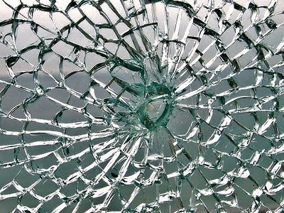



Glass = fragile?
Material | Iron | Structural steel | Glass fiber
Ultimate tensile strength | 35 MPa | 550 MPa | 4890 MPa
Iron man
Glass

Slide 4
Strength and toughness
Strength: applied stress a material can withstand
Toughness: energy absorbed by (work performed to) a material per unit volume before fracture
σ
σ
Ultimate strength
Fracture strength
Ultimate strength
×
×
Yield strength
W/V
ε
W/V
ε
Linear limit
Elastic limit
Linear limit

Slide 5
Theoretical strength of a brittle material
Theoretical strength is determined by the cohesive force between atoms
Work W performed to separate the solid equals to the energy of the fresh surfaces created during fracture
σ
σ
σ_{m}
W/V
ε
σ
0
λ

Slide 6
Theoretical strength of a brittle material
Theoretical strength is determined by the cohesive force between atoms
Work W performed to separate the solid equals to the energy of the fresh surfaces created during fracture
When σ << σ_{m}, σ = E ε
σ
σ_{m}
Work W performed:
W/V
ε
0
λ

Slide 7
Theoretical strength of a brittle material
Consider silica glass
  γ = 3.5 J/m², E = 70 GPa, a₀ = 0.2 nm
Material | Glass | Silica glass | Silica nanowire
Ultimate tensile strength | ~ 30 MPa | 110 MPa | 26000 MPa†
Practical strength of engineering materials is much less than their theoretical strength
† “The Ultimate Strength of Glass Silica Nanowires,” Nano Lett. 9, 831 (2009)

Slide 8
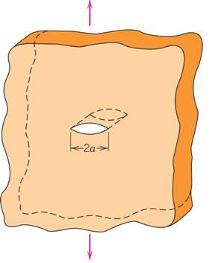
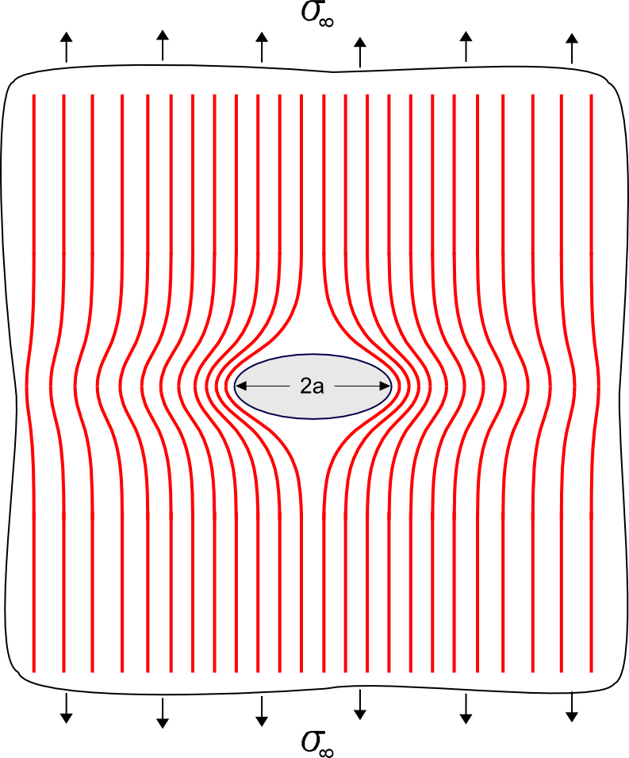
Griffith’s theory
Strength of practical materials is limited by stress concentration around tiny flaws (Griffith cracks)
σ∞
σ∞
Notes:
In the case of a surface crack, a represents the full crack length

Slide 9
Griffith’s theory
Strength of practical materials is limited by stress concentration around tiny flaws (Griffith cracks)
Stress concentration factor:
Fracture strength of a flawed material:

Slide 10
Griffith’s theory
Strength of practical materials is limited by stress concentration around tiny flaws (Griffith cracks)
In flawed silica glass:
A. Griffith, “The Phenomena of Rupture and Flow in Solids,” Philos. Trans. Roy. Soc. London, A 221, 163 (1921)
Notes:
The divergence between theoretical strength and experimental strength is usually ascribed to surface damage.

Slide 11
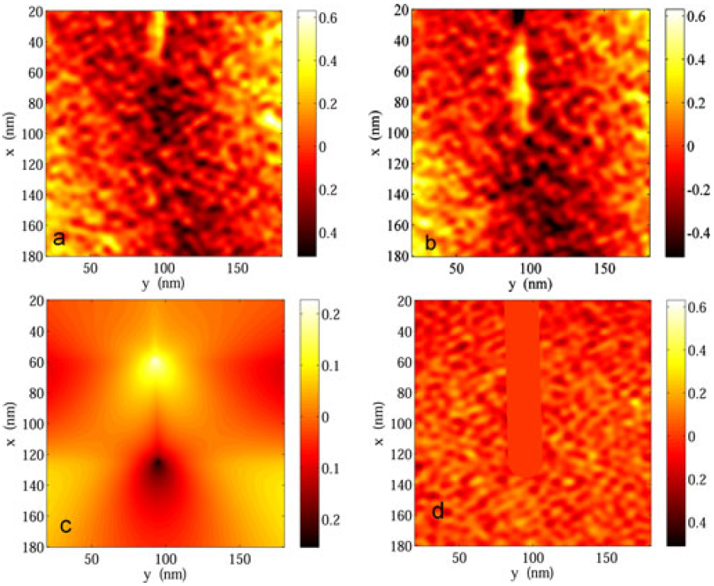
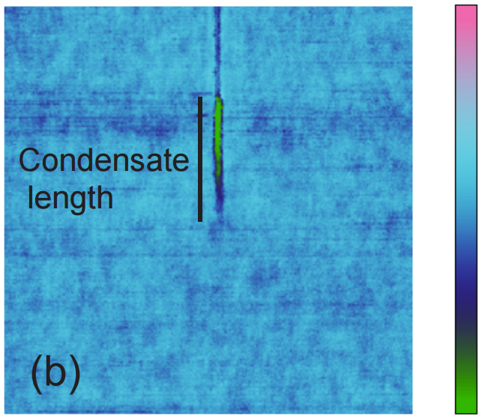
Visualizing Griffith cracks in glass
5 nm
AFM phase image
Water condensation at crack tip
Displacement field near a crack tip
Europhys. Lett. 89, 66003 (2010)
J. Am. Ceram. Soc. 94, 2613 (2011)
Notes:
Left image: a) and b) AFM images prior to and after deformation; c) theoretical calculation of displacement field; d) residual value of DIC analyzed displacement subtracted from c). The residuals are all less than approximately 0.2 nm, which is the order of atomic distances in the glass being studied, suggesting that at distances >10 nm from the crack tip, surface displacements surrounding the crack tip are elastic to within the experimental scatter given by the residuals of the measurement.

Slide 12
Stress intensity factor and fracture toughness
Stress intensity factor (tensile):
Strain energy release rate (plane stress):
Fracture condition:
critical stress intensity factor
work of fracture
K_{Ic} is a material constant and is independent of crack length
Notes:
The strain energy release rate is the energy dissipated during fracture per unit newly created fracture surface area

Slide 13
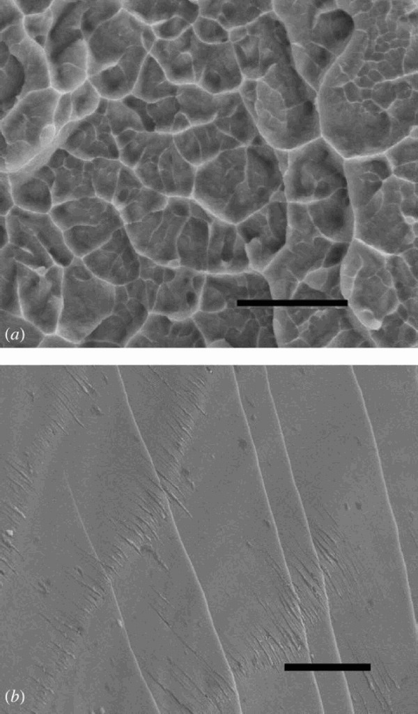
Intrinsic plasticity in amorphous metals
Lack of global plasticity
Intrinsic plasticity
When G/B < 0.42: plastic; G/B > 0.42: brittle (G: shear modulus; B: bulk modulus)
Phil. Mag. Lett. 85, 77 (2006)
5 μm
5 μm
As-cast Vitreloy-1
Annealed at 350 °C for 12 h

Slide 14
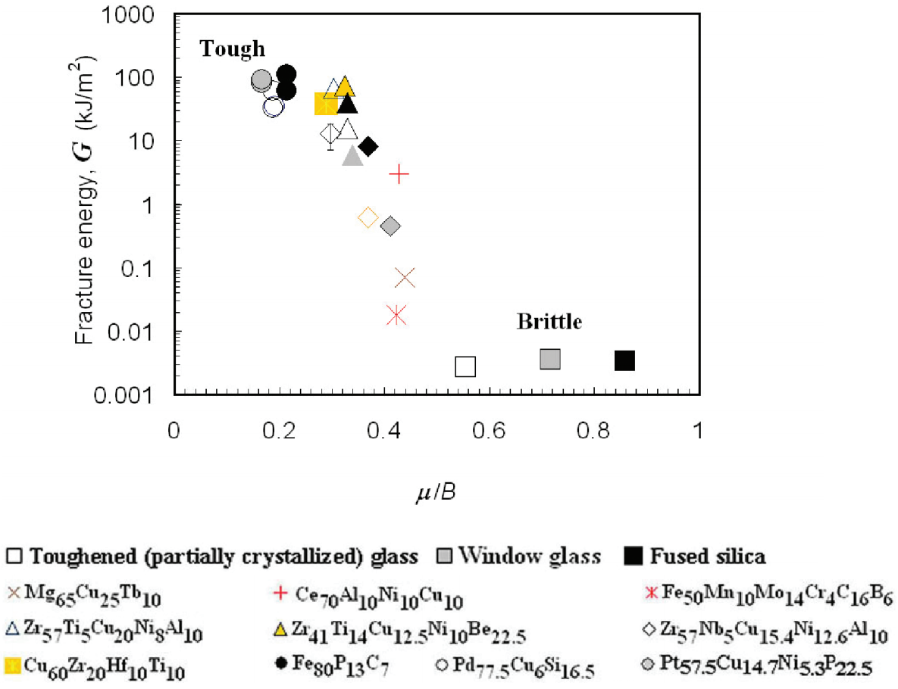
Intrinsic plasticity in amorphous metals
G/B = 0.42
Fracture Energy (kJ/m²)
G/B
Phil. Mag. Lett. 85, 77 (2006)

Slide 15
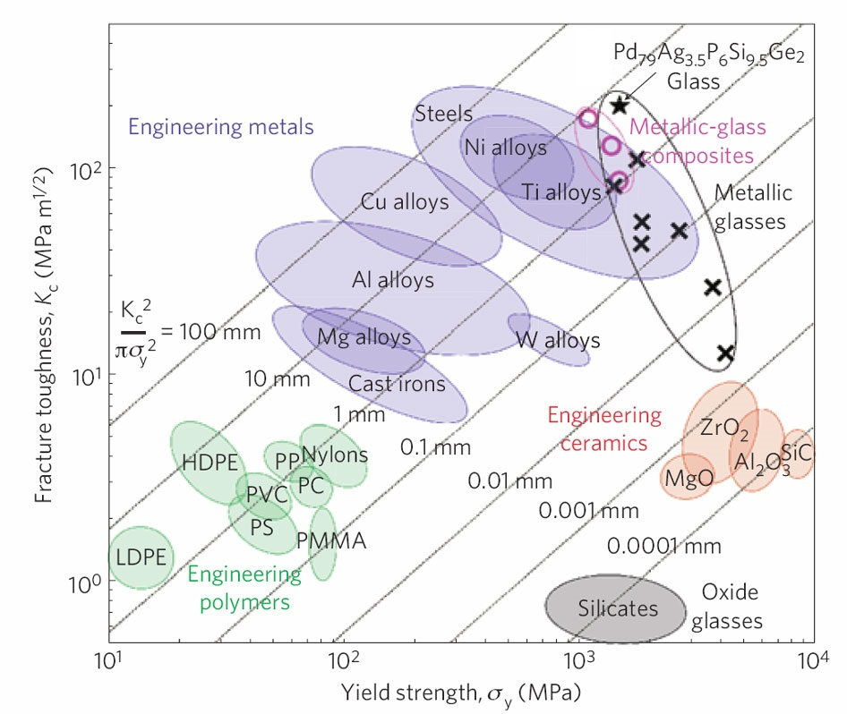
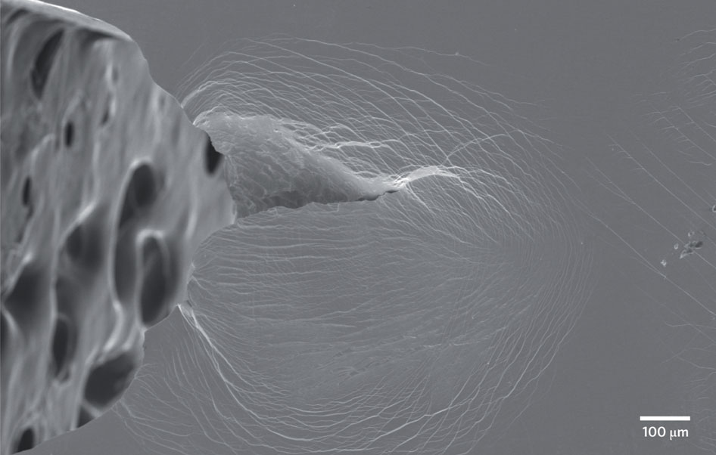
Crack tip in PdAgPSiGe BMG
Nat. Mater. 10, 123 (2011)
Notes:
Trade-off between yield strength and fracture toughness: diagonal lines show the plastic-zone size, K_{c}²/πσ_{y}², where K_{c} is the fracture toughness and σ_{y} the yield strength.

Slide 16
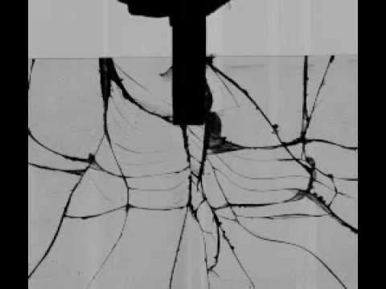
Brittle fracture of glass
When a crack exceeds the critical length, the crack becomes unstable and propagates catastrophically through the material
Crack propagation velocity:
1540 m/s
J. Am. Cer. Soc. 22, 302-307 (1939)
Glass cracking at 231,000 fps
Notes:
Glasses are sensitive to surface defects

Slide 17

Brittle fracture of glass
Ceramic Tech Today article link
Notes:
In a perfectly brittle material stressed in tension, you could see crack propagation occurring at—or above—the speed of sound (sound velocity in glass ~ 5 km/s). But materials are rarely perfectly brittle and stressed in tension. It is more likely you will see crack propagation ranging between 0.01 to 4 kilometers per second, depending on strain-energy distribution.

Slide 18
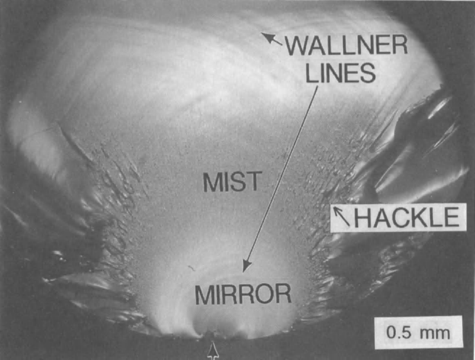
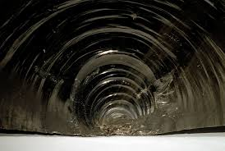
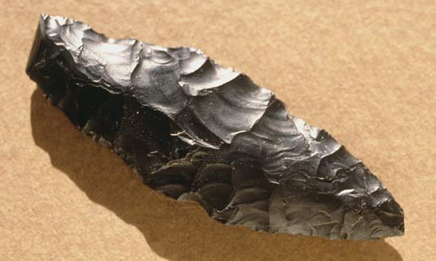
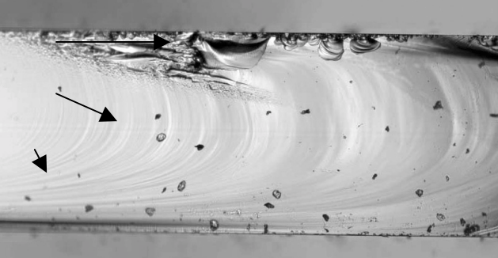
Fractography
Conchoidal fracture
Image from "Fracture analysis, a basic tool to solve breakage issues"
Notes:
https://books.google.com/books?id=fzO2yCNxLioC&lpg=PP1&pg=PA103
The ratio of the fracture mirror radius to the critical flaw size has been found to be constant within a material. The ratio reported is 12.5 for fused silica and 10.0 for borosilicate glass.

Slide 19
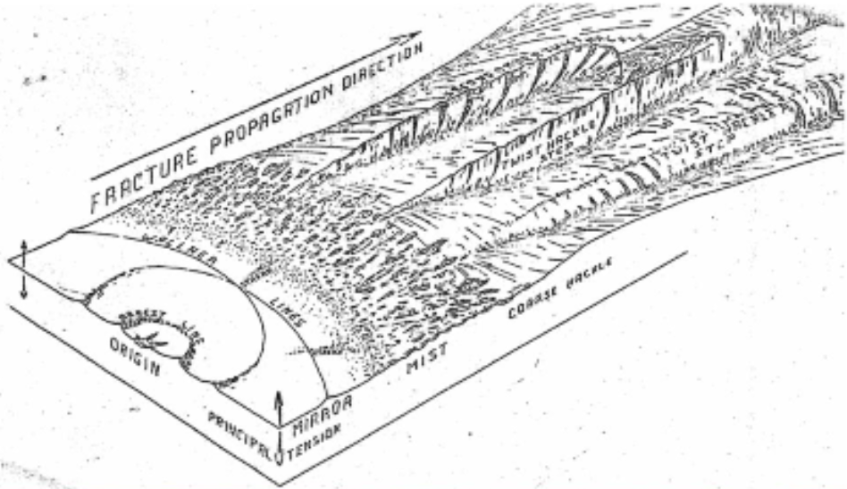
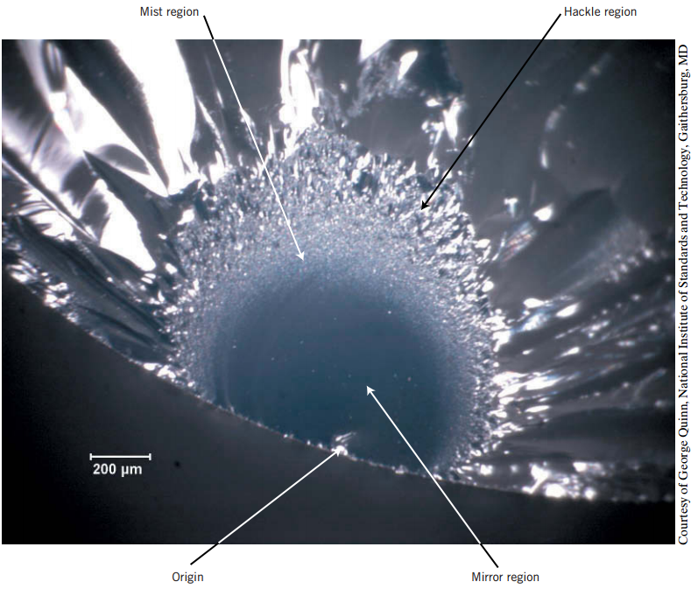
The fractured surface of glass
Peter L. Bocko, Cornell University & Corning Glass Technologies
Notes:
Wallner lines, which result from the interaction between the propagating crack front and shear waves emanating from a secondary source, can be used to determine the crack speed, see for example: https://www.sciencedirect.com/science/article/pii/S1359645414005424

Slide 20
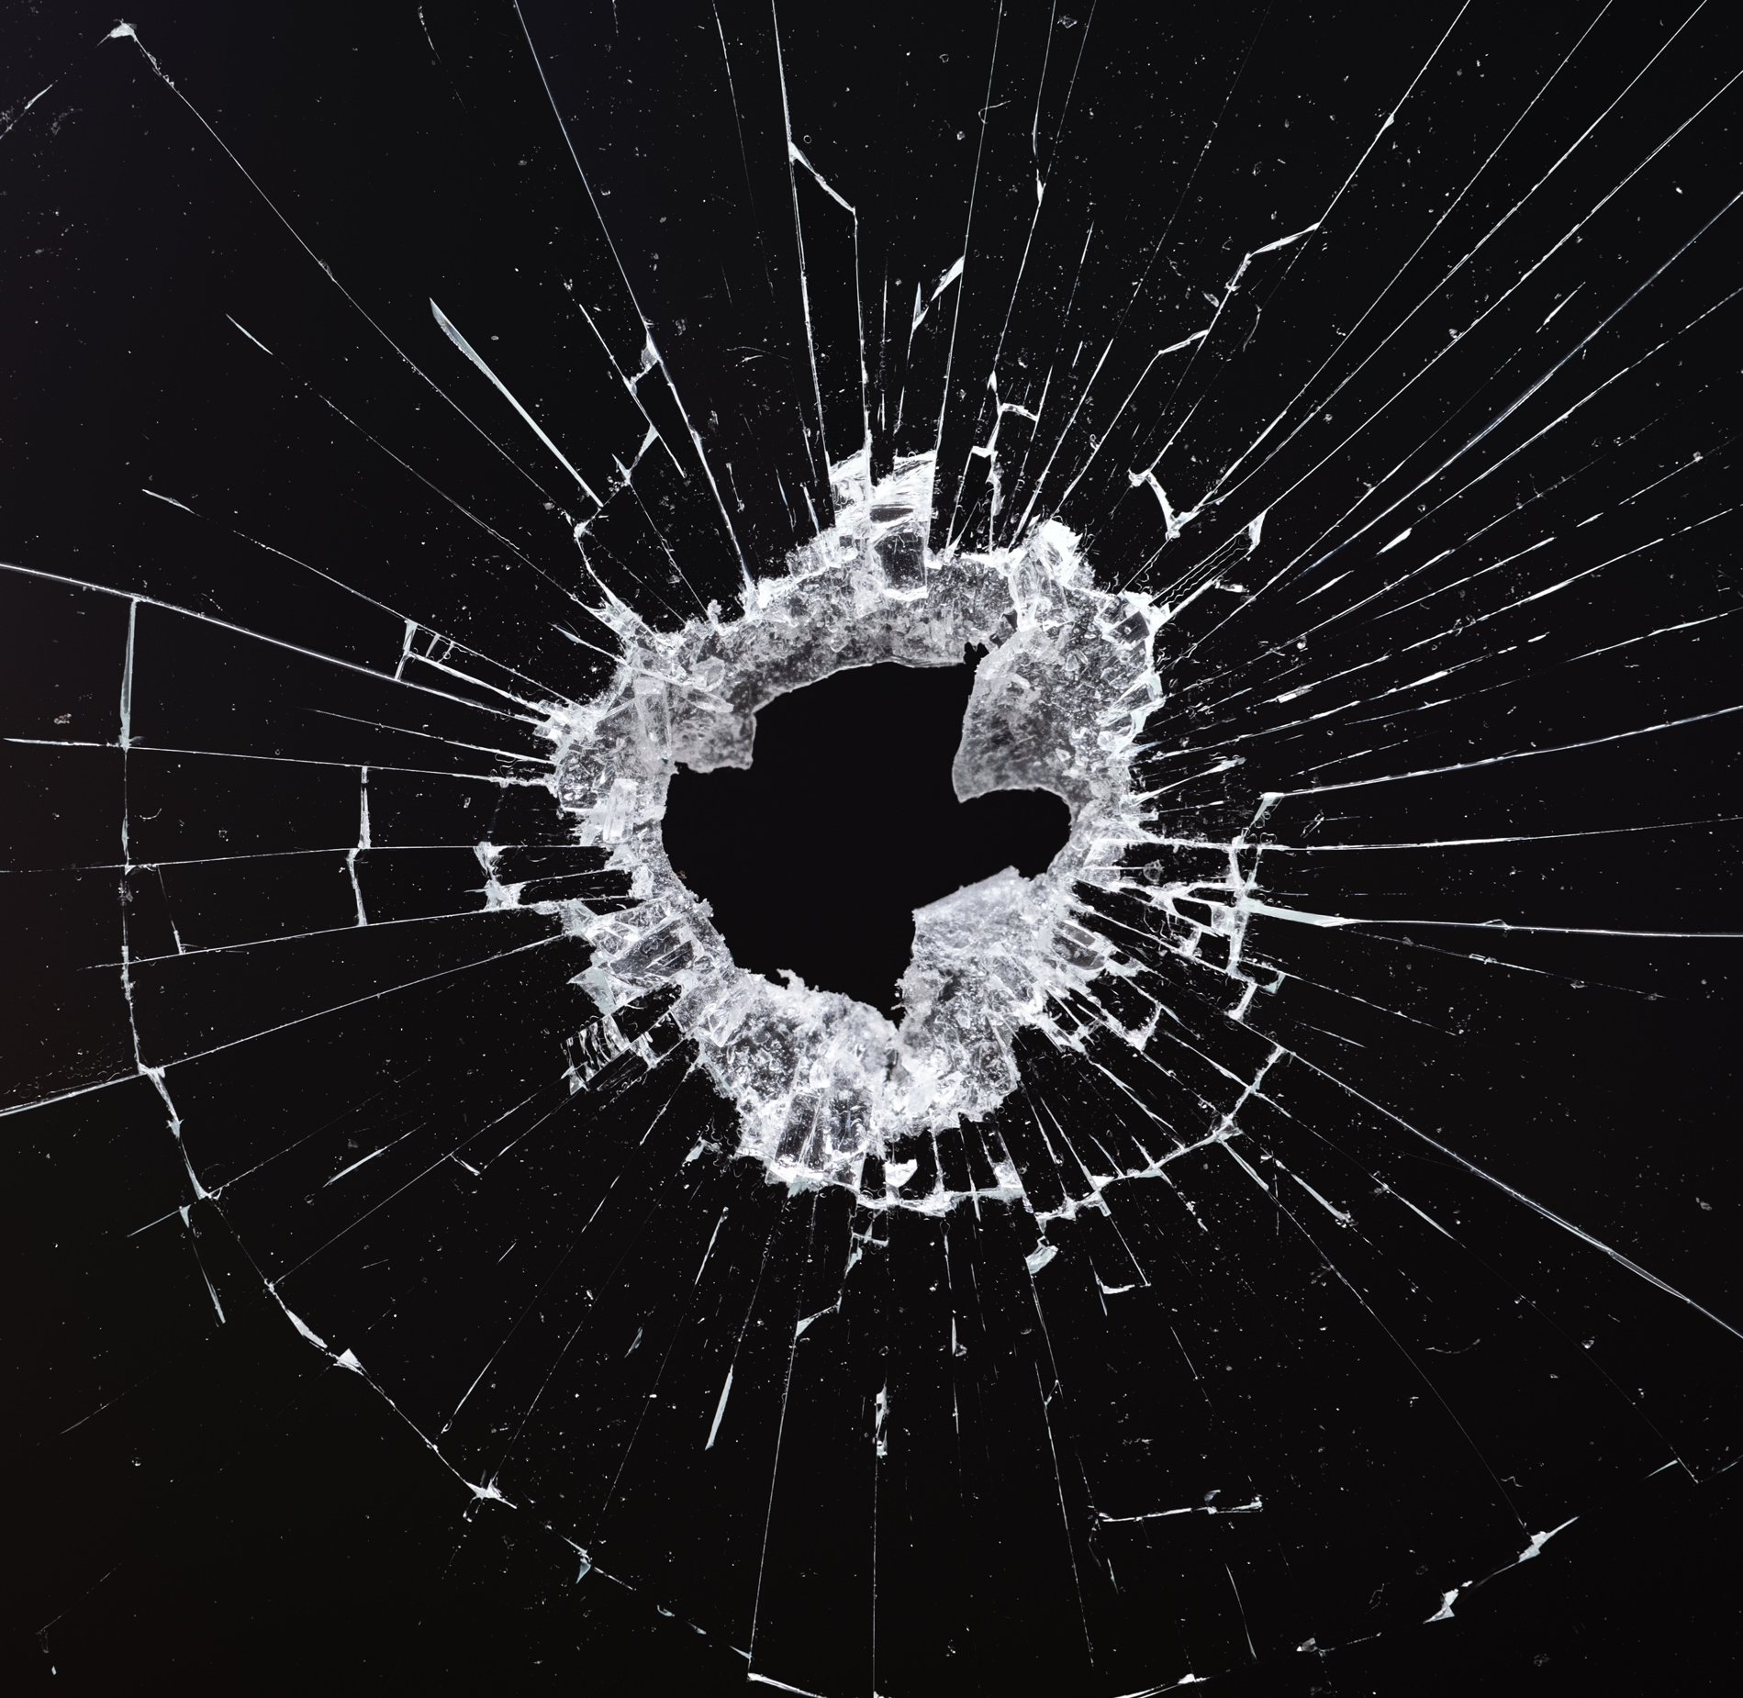
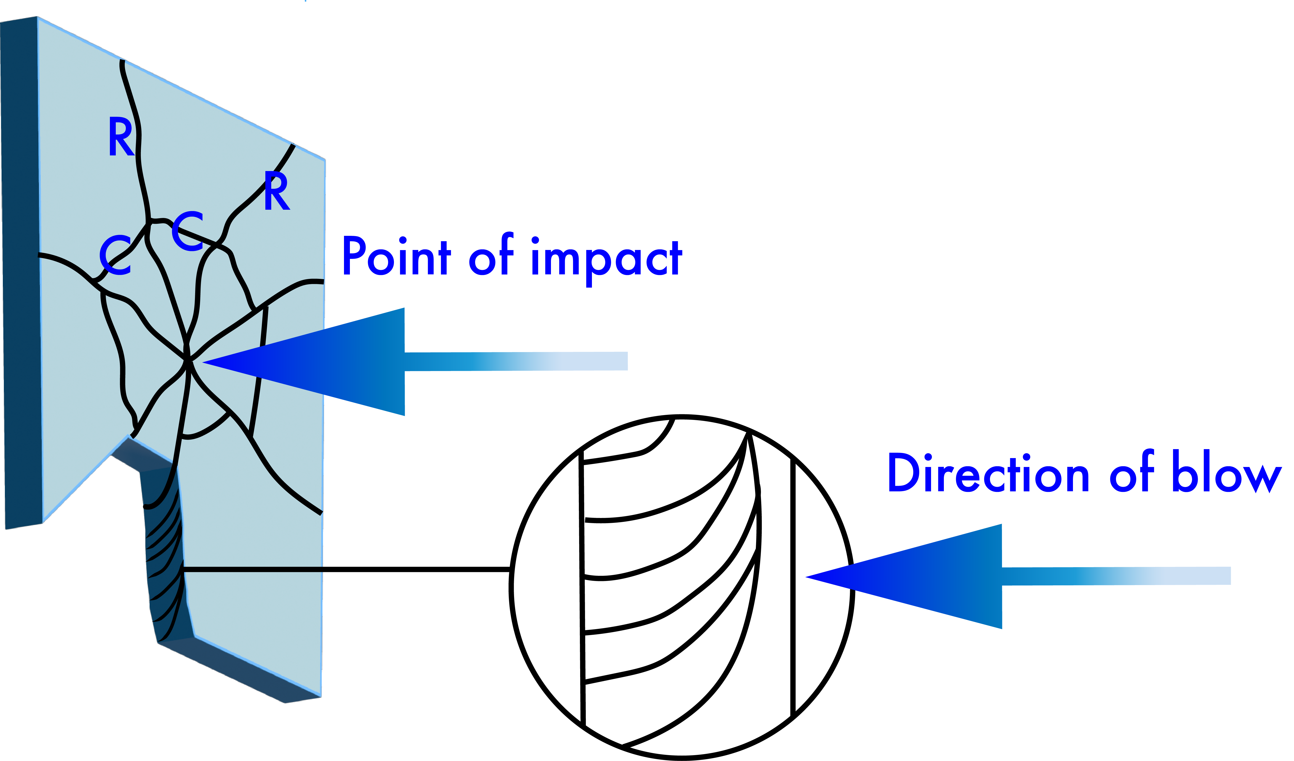
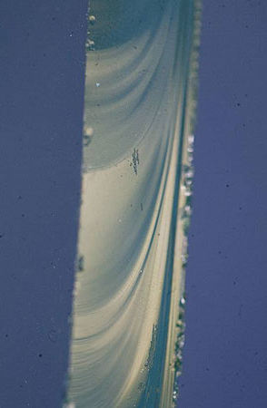
The 4R rule
Fracture propagation direction
The 4R Rule: Ridge lines on Radial fractures are at Right angles to the Rear
K. Hess, and C. Orthmann, Criminal Investigation, Cengage Learning (2016)
Notes:
Wallner lines are formed through an interaction of the crack front with stress waves and are perpendicular to crack propagation directions

Slide 21
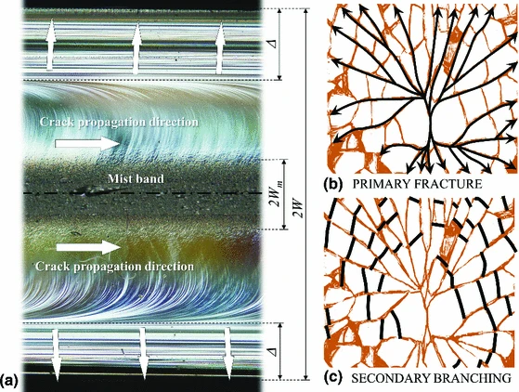
Fractured surface of tempered glass
Int. J. Fract. 190, 75-86 (2014)
Notes:
The fracture surface of thermally tempered glass has distinct characteristics. There are two sets of Wallner lines (which indicate the crack travel direction) separated by a band of mist hackle. In addition, near the surfaces there are parallel markings indicating the surface compressive stresses.

Slide 22
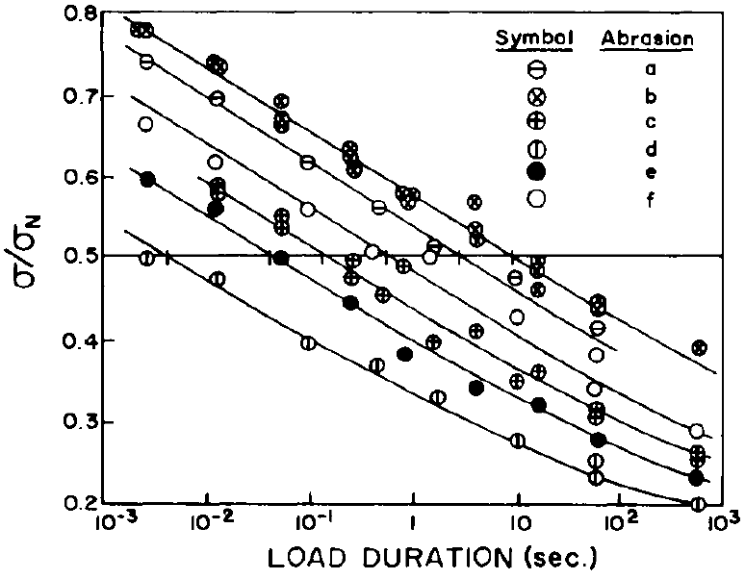
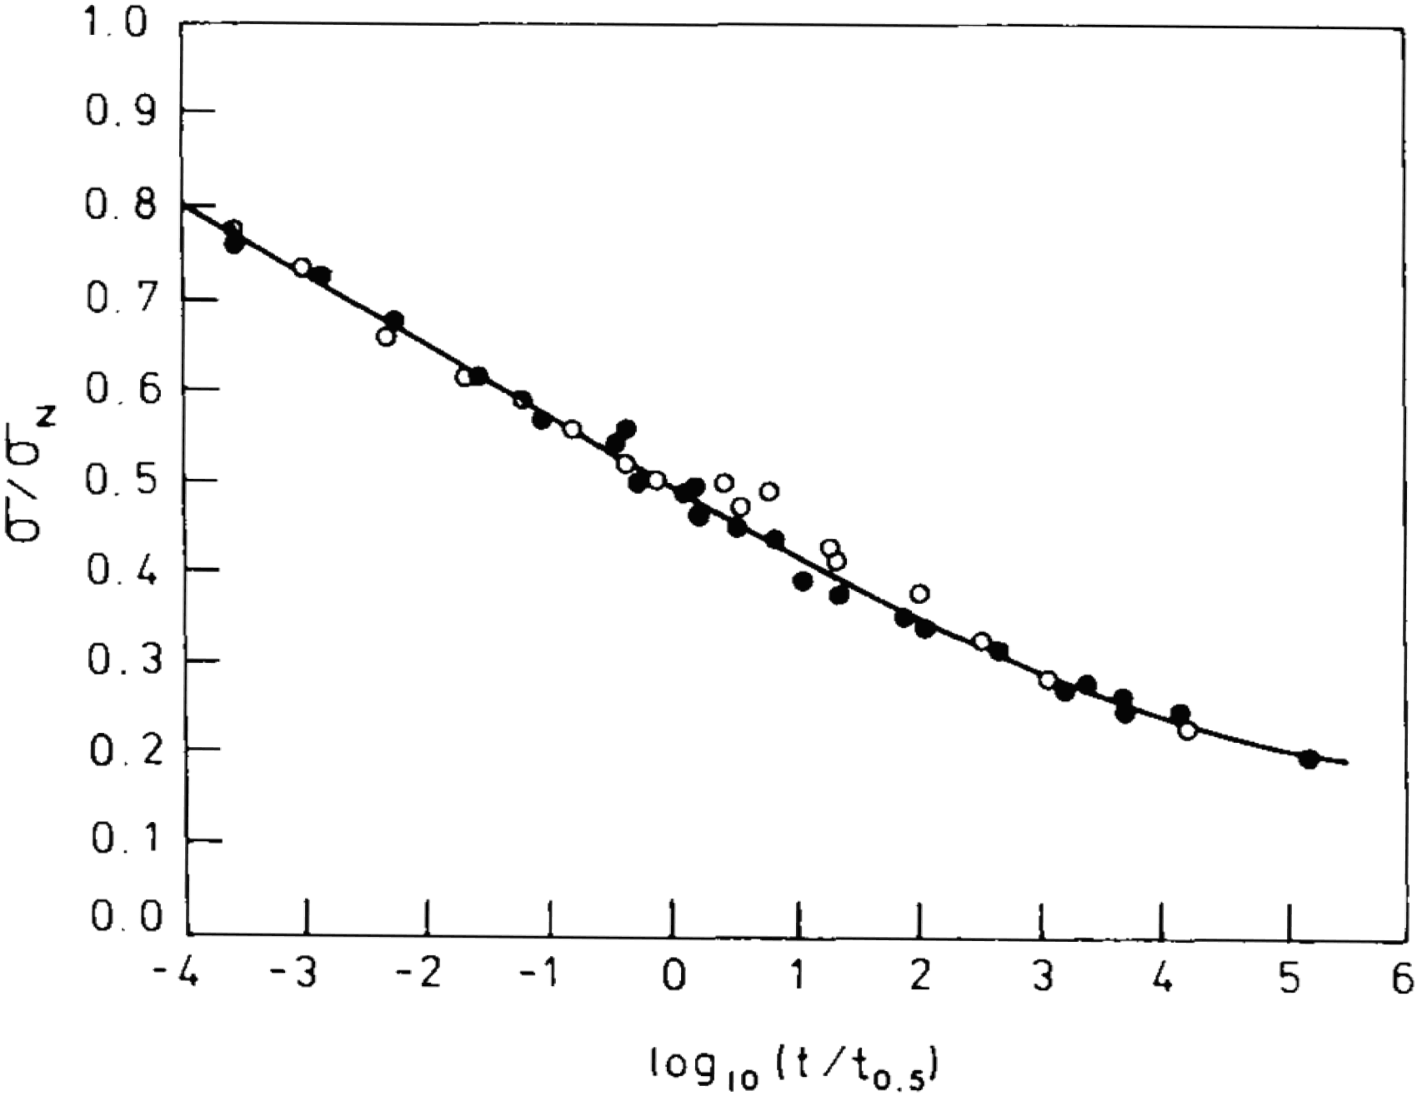
Static fatigue in glass
Under constant load, the time-to-failure varies inversely with the load applied in a logarithm scale
Universal static fatigue curve
Sub-critical crack growth: crack length increases over time even when σ∞ < σ_{f}
σ∞ / σ_{f}

Slide 23
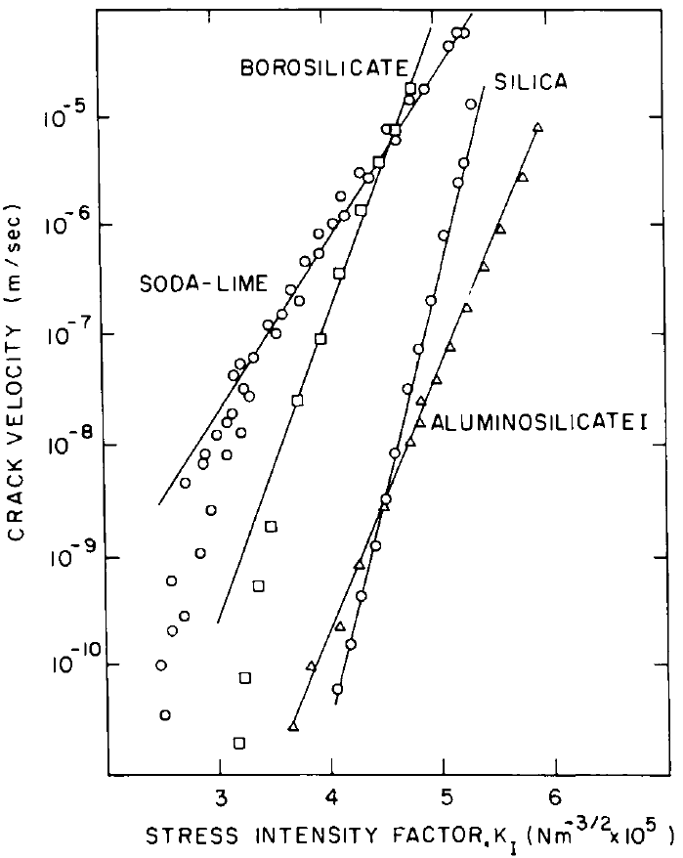
Stress corrosion
Reaction at crack tip:
Higher alkaline content generally reduces fatigue resistance
Higher susceptibility to stress corrosion in basic solutions
Thermally activated process
J. Non-Cryst. Solids 316, 1 (2003)
J. Am. Ceram. Soc. 53, 544 (1970)
Notes:
Region I: thermally activated stress corrosion; Region II: kinetics limited by water transport to crack tip

Slide 24
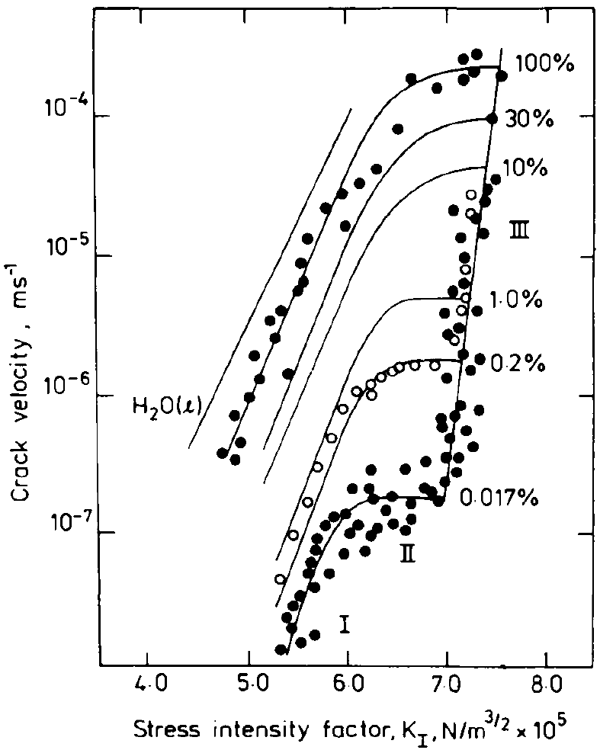
Stress corrosion
Reaction at crack tip:
Higher alkaline content generally reduces fatigue resistance
Higher susceptibility to stress corrosion in basic solutions
Thermally activated process
J. Non-Cryst. Solids 316, 1 (2003)
J. Am. Ceram. Soc. 53, 544 (1970)
Notes:
Region I: thermally activated stress corrosion; Region II: kinetics limited by water transport to crack tip

Slide 25
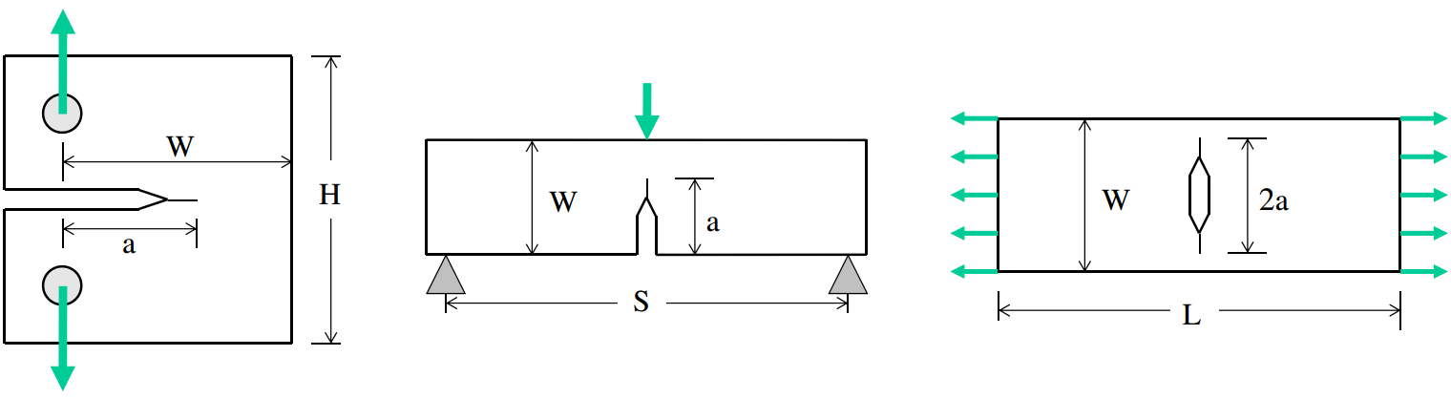
Fracture toughness measurement
ASTM Standard E1820-15: Standard Test Method for Measurement of Fracture Toughness
Standard specimen geometries to obtain load-displacement plot
Compact tension specimen
Single edge-notched bend specimen (for three-point bending)
Middle-cracked tension specimen
Eng. Fract. Mech. 85, 1 (2012)
Notes:
All specimens shall be precracked by fatigue. Optical crack measurements are utilized to obtain both the initial and final physical crack sizes.

Slide 26
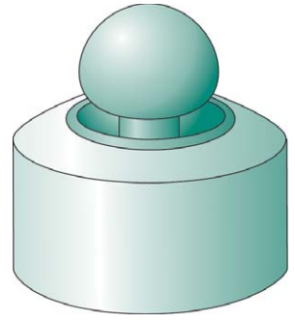
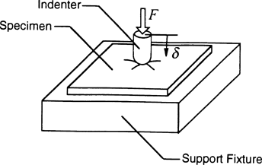
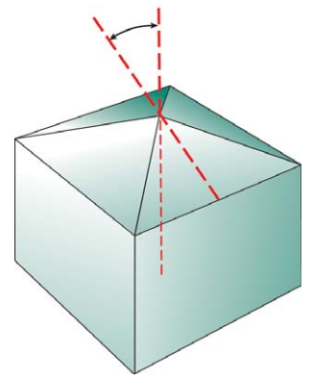
Indentation of glass samples
Mechanical properties evaluated through indented crack size or crack-opening displacement based on empirical equations
Poor correlation with conventional test results can be a concern
Hertzian (sphere) indenter tip
Vickers indenter tip
J. Mech. Behav. Biomed. Mater. 2, 384 (2009)

Slide 27
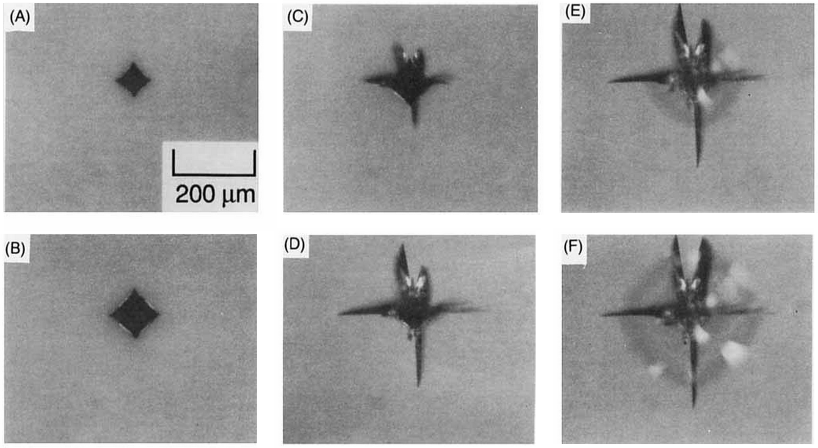
Indentation of glass samples
Vickers indentation of soda-lime glass
Loading, 50% F_{max}
Unloading, 68% F_{max}
Unloading, 2% F_{max}
Loading, 100% F_{max}
Unloading, 11% F_{max}
Unloading, 0% F_{max}
J. Am. Ceram. Soc. 73, 787 (1990)
Notes:
The radial cracks are nucleated by flaws at the deformation zone boundary and are driven by the residual stress field arising from the strain mismatch of the plastically deformed zone (densified zone) embedded in the surrounding elastically restraining matrix.

Slide 28
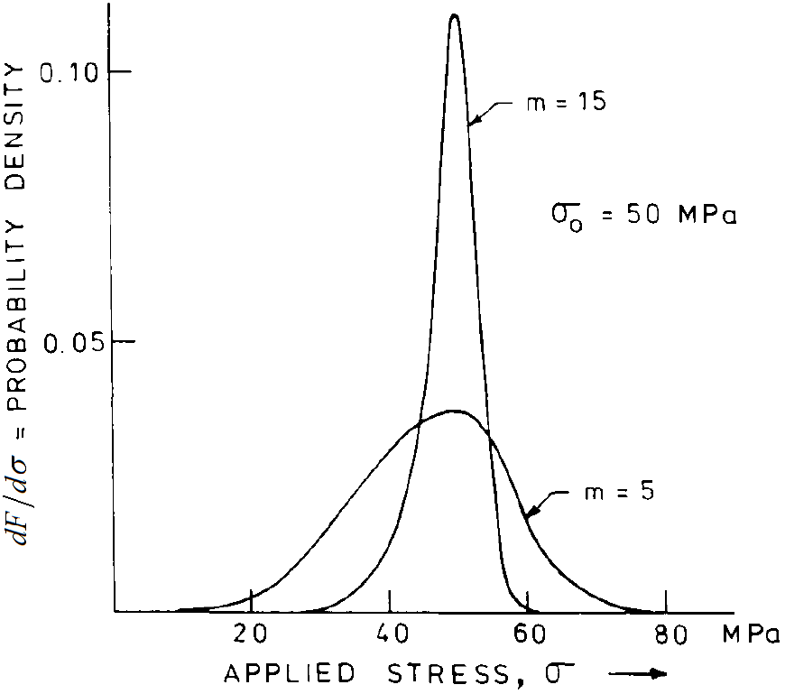
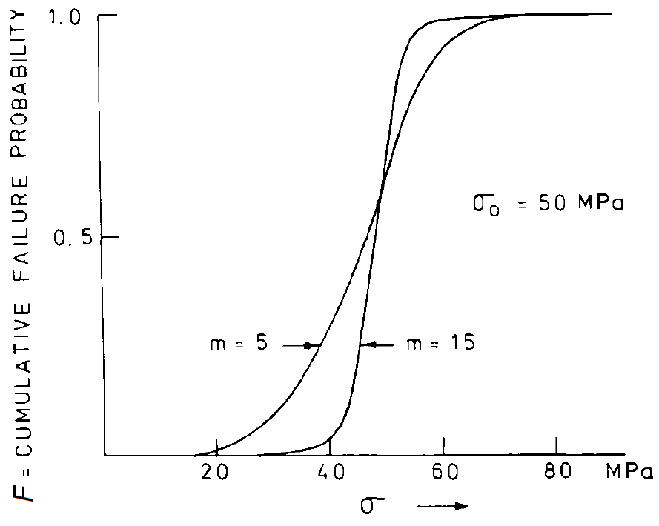
Fracture statistics
Experimental results of fracture strength can often be described by the Weibull distribution
The fraction F of samples which fracture at stresses below σ is given by:
m : Weibull modulus
Probability density
  Probability of samples fracture at stress σ

Slide 29
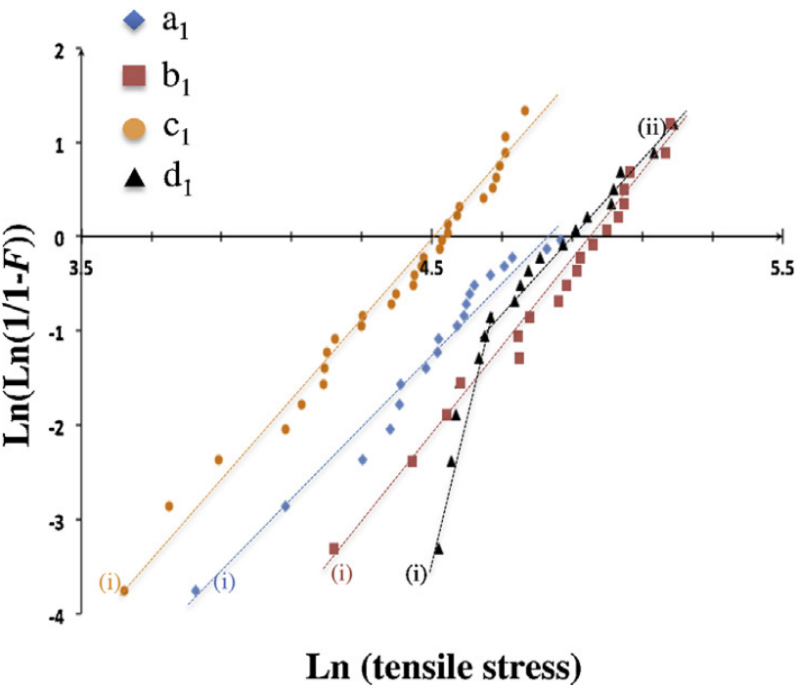
Weibull plot
m : slope of the Weibull plot
σ₀ : intercept with horizontal axis
Mater. Res. Bull. 49, 250 (2014)
Notes:
The fiber d1 yields two straight-line sections, indicative of a bi-modal distribution of flaws

Slide 30
Summary
Theoretical and practical strengths of materials
  Practical strength of brittle materials is usually much lower than the theoretical strength due to the presence of defects
  Oxide glasses are extremely sensitive to surface defects
  Intrinsic ductility in select BMGs contributes to high toughness
Basics of fracture mechanics
  Griffith crack theory
  Fracture toughness
Fatigue and stress corrosion
Fracture toughness measurement
Fracture statistics: Weibull plot

