Slide 1
MIT 3.156/3.46
Photonic Materials and Devices
13: Modulators and Switches
Juejun (JJ) Hu
hujuejun@mit.edu

Slide 2
References
Fundamentals of Photonics
  Ch. 18 & 21
Photonics: Optical Electronics in Modern Communications
  Ch. 9
Handbook of Silicon Photonics
  Ch. 9, Marris-Morini et al.

Slide 3
Optical modulators vs. optical switches
Optical modulator
  A device that can be used to manipulate a property of light
  Intensity modulator, phase modulator, polarization modulator, spatial light modulator (SLM), etc.
  Electro-optic modulator, electroabsorption modulator, acoustic-optic modulator, optomechanical modulator, etc.
Optical switch
  A device that establishes and releases connections among transmission paths
  Electro-optic switch, acoustic-optic switch, optomechanical switch, magneto-optic switch, etc.

Slide 4
(Intensity) modulator characteristics
Contrast/extinction ratio:
Insertion loss (IL):
Power/energy consumption
Speed
  3-dB bandwidth
  Eye diagram
Light intensity (dB)
Time t
3-dB bandwidth
1.5 dB
Extinction ratio
Modulation frequency (Hz)

Slide 5
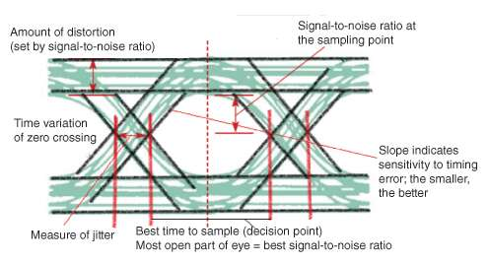
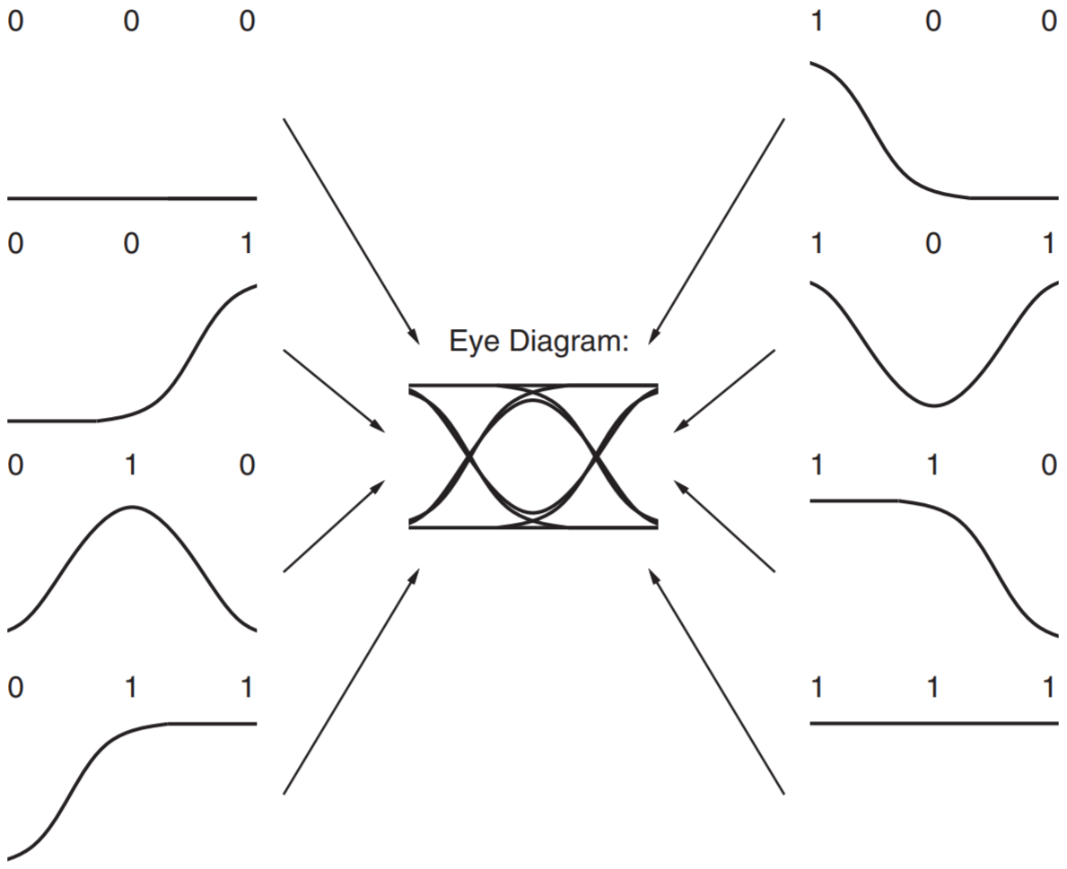
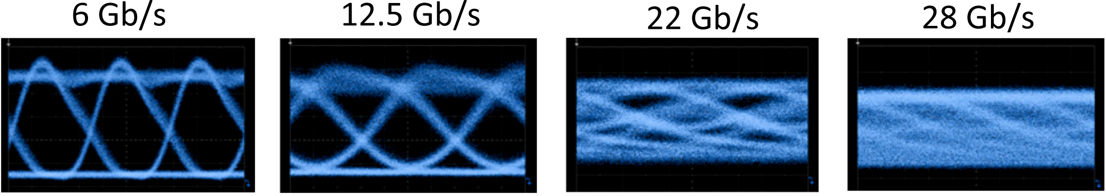
Eye diagram
www.edn.com/eye-diagram-basics-reading-and-applying-eye-diagrams/;
DOI:10.1002/9781119264422
Opt. Express 21, 9722 (2013)

Slide 6
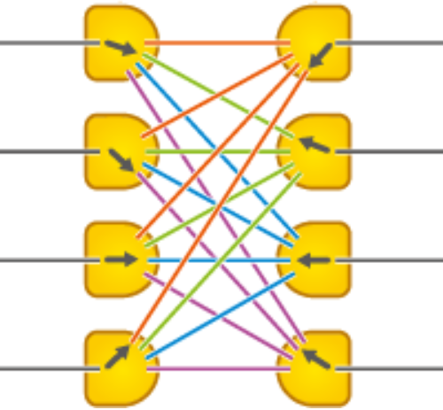
Optical switch metrics
m × n switch
Insertion loss (IL):
Crosstalk
  Ratio of transmitted power from the target output port over the maximum leaked power from a “non-target” port
Power/energy consumption
Speed
m input ports
n output ports
2 × 2 switch
Bar state
Cross state

Slide 7
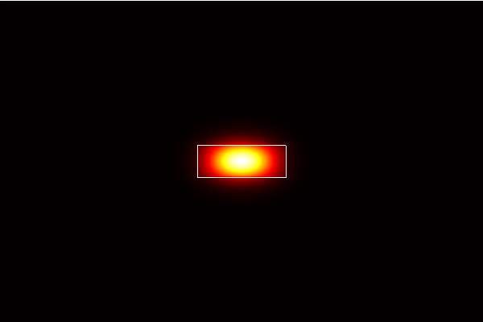
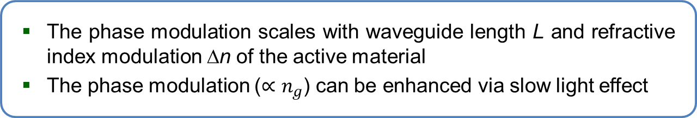
Waveguide phase shifter/modulator
Input mode
Output
Refractive index n
Refractive index n + Δn
Unmodulated phase delay:
Phase modulation:
Opt. Express 16, 16659 (2008)
The phase modulation scales with waveguide length L and refractive index modulation Δn of the active material
The phase modulation ($∝n_{g}$) can be enhanced via slow light effect

Slide 8
Thermo-optic waveguide phase shifter
Metal vias
Resistive heater
Core
Core
Cladding
Cladding
Metal heater
Doped waveguide heater
Simple structure
Applicable to all waveguide platforms
Increased thermal mass: large P_{π}·τ
Complex fabrication
Only available in semiconductors
Superior heating efficiency

Slide 9
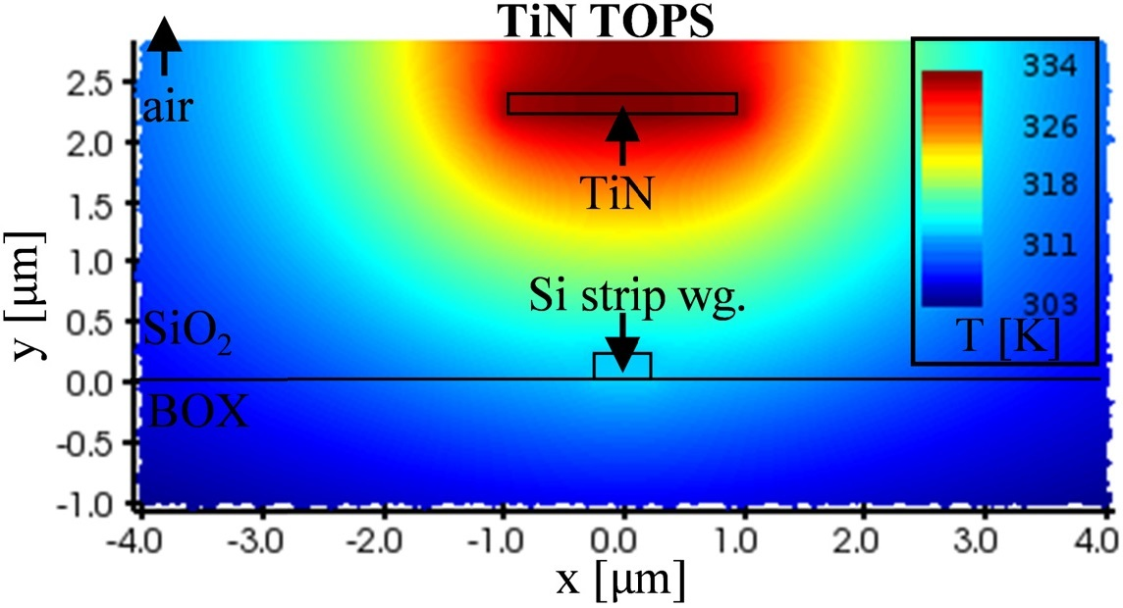
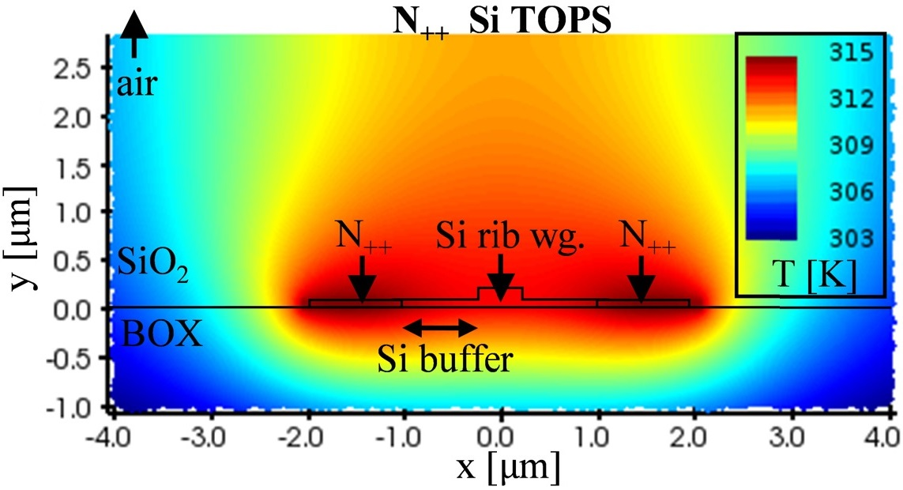
Thermo-optic waveguide phase shifter
Opt. Express 27, 10456 (2019)
Metal heater
Doped waveguide heater
Simple structure
Applicable to all waveguide platforms
Increased thermal mass: large P_{π}·τ
Complex fabrication
Only available in semiconductors
Superior heating efficiency

Slide 10
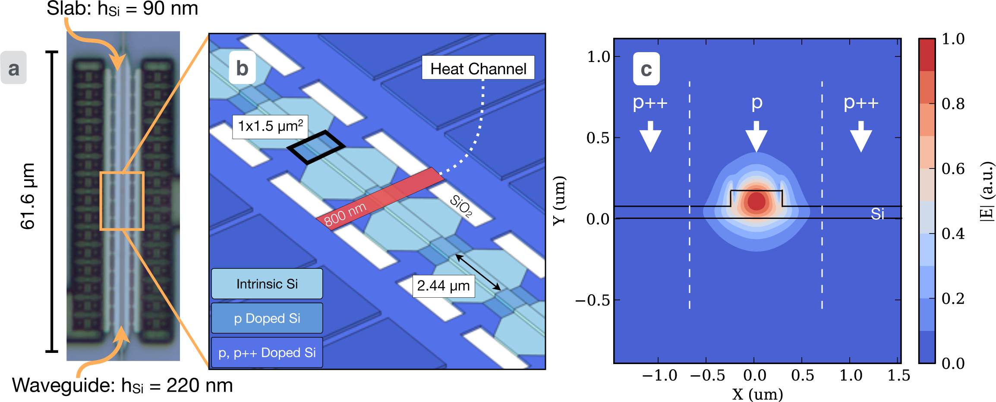
Thermo-optic waveguide phase shifter
L = 61.6 μm, P_{π} = 25 mW, τ = 1.2 μs, f_{3dB} = 130 kHz, IL = 0.23 dB
Opt. Express 22, 10487 (2014)

Slide 11
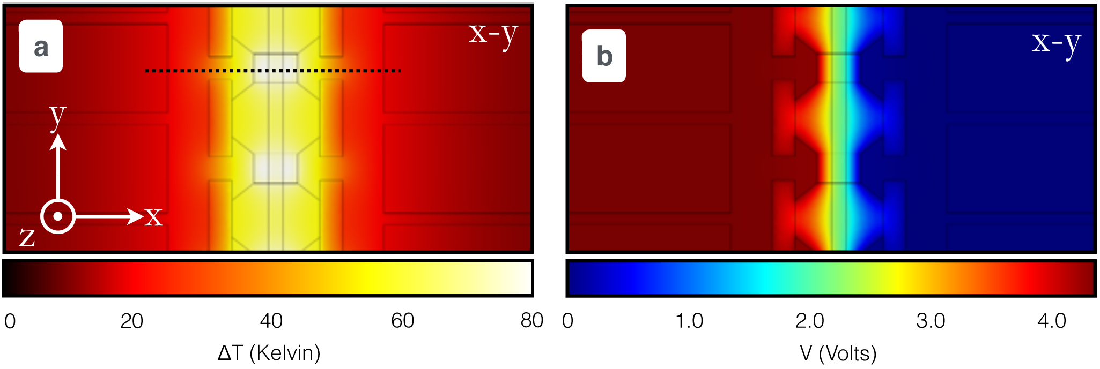
Thermo-optic waveguide phase shifter
Temperature profile
Voltage map
L = 61.6 μm, P_{π} = 25 mW, τ = 1.2 μs, f_{3dB} = 130 kHz, IL = 0.23 dB
Opt. Express 22, 10487 (2014)

Slide 12
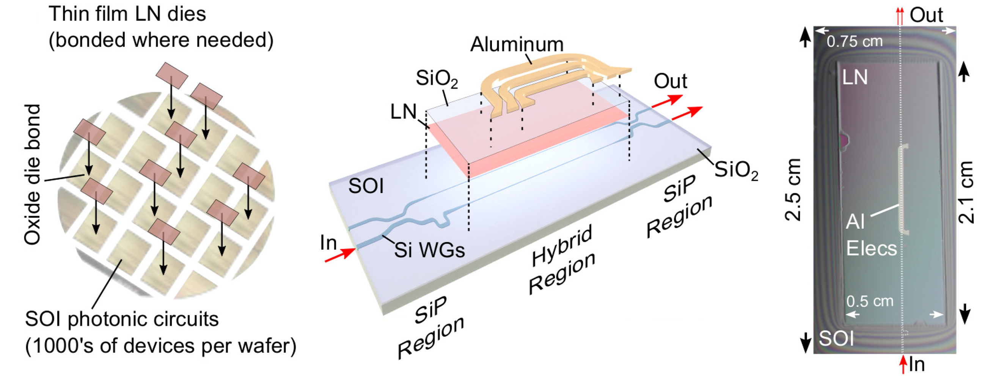
Electro-optic phase shifter: Pockels effect
LiNbO₃-on-Si electro-optic phase shifter
V_{π}·L = 6.7 V·cm
High-speed operation (> 100 GHz), potential for low optical loss
Opt. Express 26, 23728 (2018)

Slide 13
Free carrier plasma dispersion effect: Drude model
Free carrier plasma dispersion effect
Free carrier absorption
Figure of merit

Slide 14
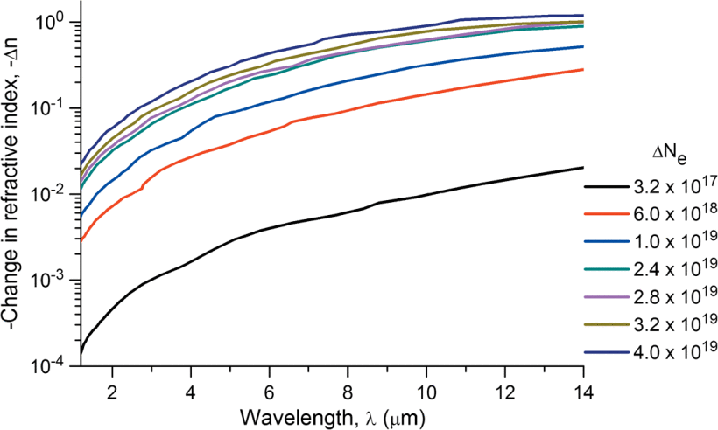
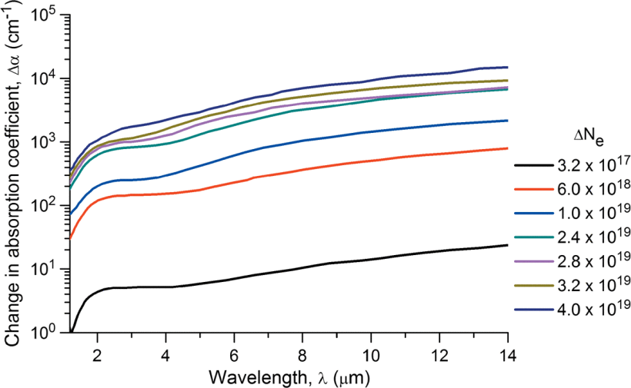
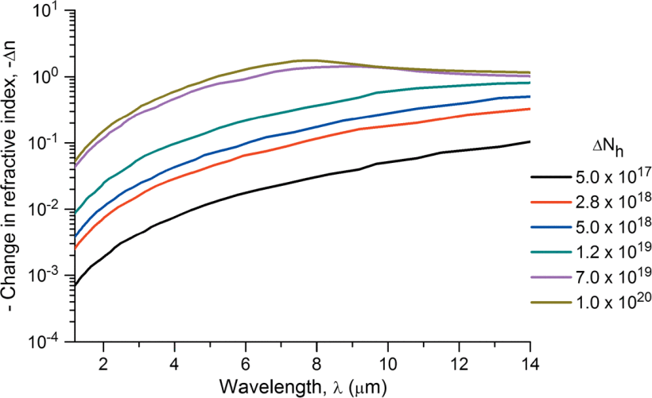
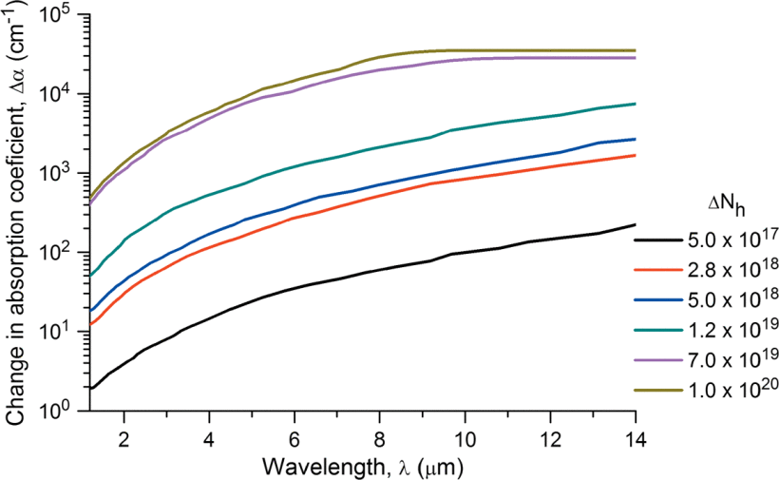
Free carrier plasma dispersion effect in Si
IEEE Photonics J. 3, 1171 (2011)

Slide 15
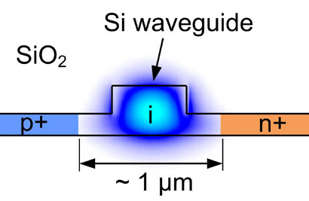
Si phase shifters based on free carrier effect
Reverse biased Si p-i-n modulators are used for high-speed operation despite their high losses
 | Forward bias | Reverse bias
Index change Δn | ~ 10⁻³ | ~ 10⁻⁴
Insertion loss (Δϕ = π) | ~ 2 dB @ 1550 nm | ~ 5 dB @ 1550 nm
Bandwidth | ~ 1 GHz* | > 30 GHz
*Opt. Express 21, 11869 (2013)
Notes:
It is possible use forward-bias modulators for high data rate transmission (e.g. 50 Gb/s), although the performance (in terms of Vpi*L) is severely compromised limited by the intrinsic device bandwidth.

Slide 16
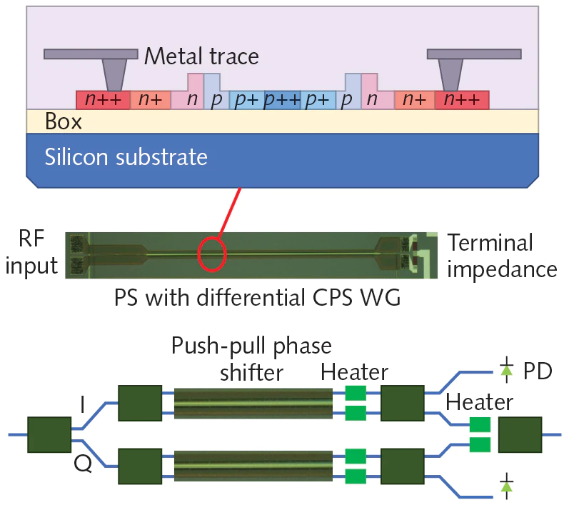
High-speed Si modulators
Multiple doping levels to minimize electrical resistance while avoiding high optical losses
OFC 2019, Tu2H.2

Slide 17
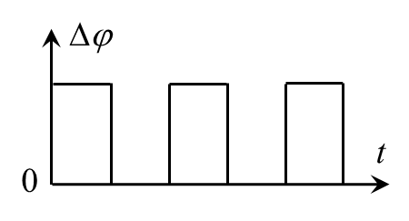
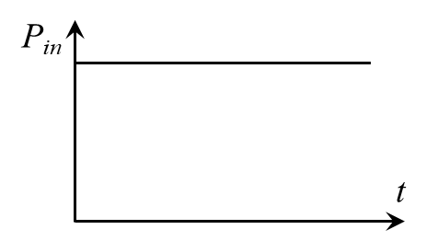
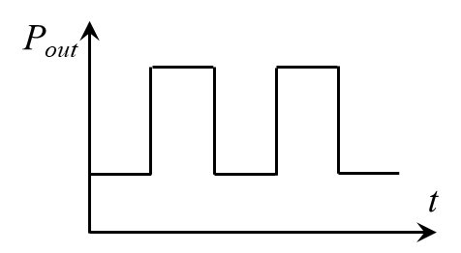
Device platforms: interferometer modulator
Phase shifter
Mach-Zehnder interferometer (MZI)
Broadband operation; large footprint and power consumption
Traveling wave design: group velocity matching of microwave and optical signals
In Si p-i-n modulators, the applied phase shift is often < π

Slide 18
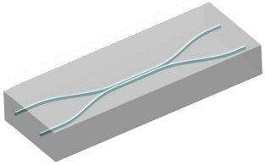
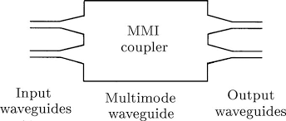
Device platforms: 2 × 2 interferometer switch
Phase shifter
2 × 2 coupler
2 × 2 directional coupler
2 × 2 multimode interferometer (MMI)

Slide 19
Device platforms: 2 × 2 interferometer switch
ϕ = 0
Δϕ = 0
ϕ = 0
Phase shifter
Cross state
ϕ = π/2
ϕ = π/2
ϕ = 0
Δϕ = π
ϕ = π
Phase shifter
Bar state
ϕ = π/2
ϕ = π/2

Slide 20

Device platforms: micro-ring modulator
All-pass resonator
Resonant condition:
Light into waveguide

Slide 21
Device platforms: micro-ring modulator
All-pass resonator
Resonance shift:
Light into waveguide
Small footprint, low power consumption
Narrowband operation: demands temperature stabilization

Slide 22
Device platforms: 2 × 2 micro-ring switch
Drop port
Add port
Through port
On resonance
Off resonance
Small footprint, low power consumption
Narrowband operation: demands temperature stabilization

Slide 23
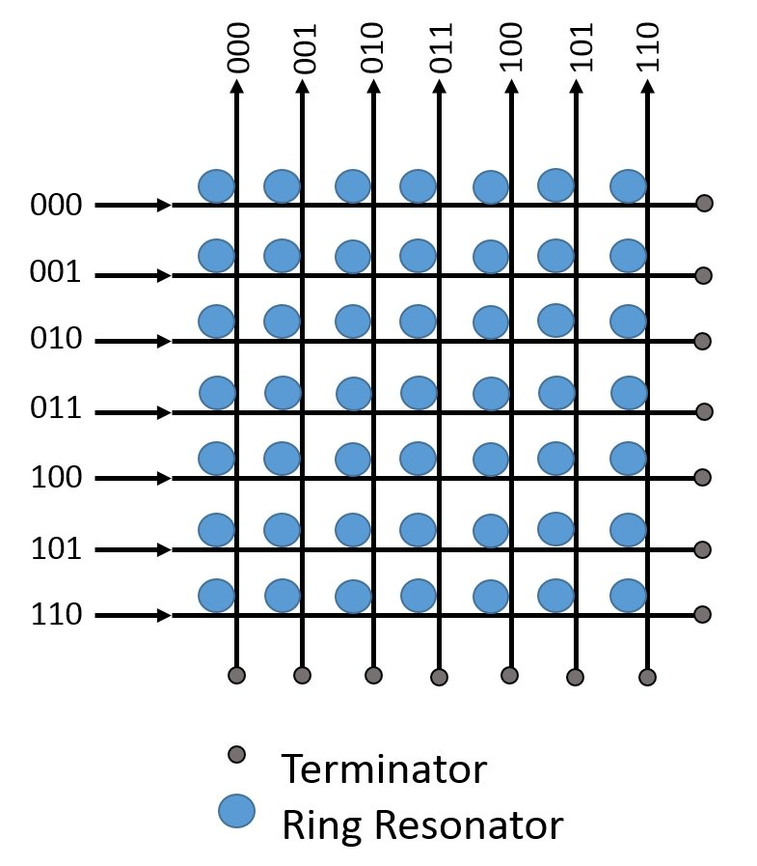
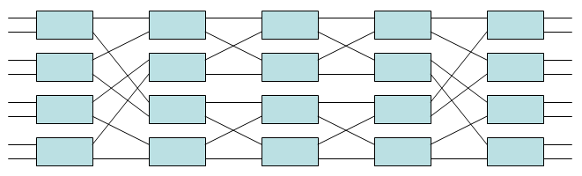
Building an N × N switch network
 | Cross-bar | Benes
Element count | N ² | N log₂N − N/2
Contact count | 2N | 2N log₂N − N
Non-blocking? | No | Yes
Benes network
Cross-bar network
DOI: 10.1109/SMC.2015.152

Slide 24
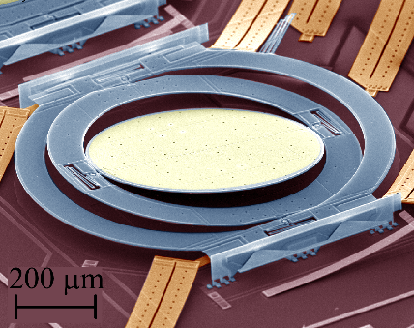
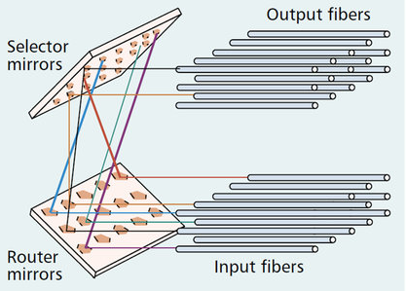
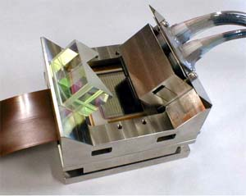
Building an N × N switch network
Opt. Express 26, 16022 (2018)
© Lucent Technologies
MEMS micro-mirror
Scalable, mature technology
Low crosstalk
Relatively slow (~ ms)
© Fujitsu

Slide 25
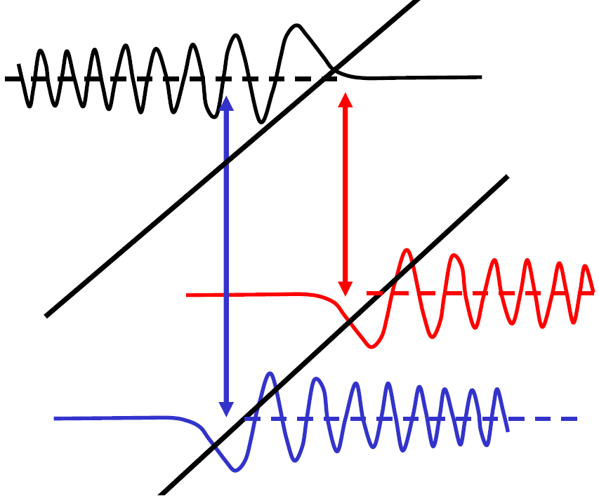
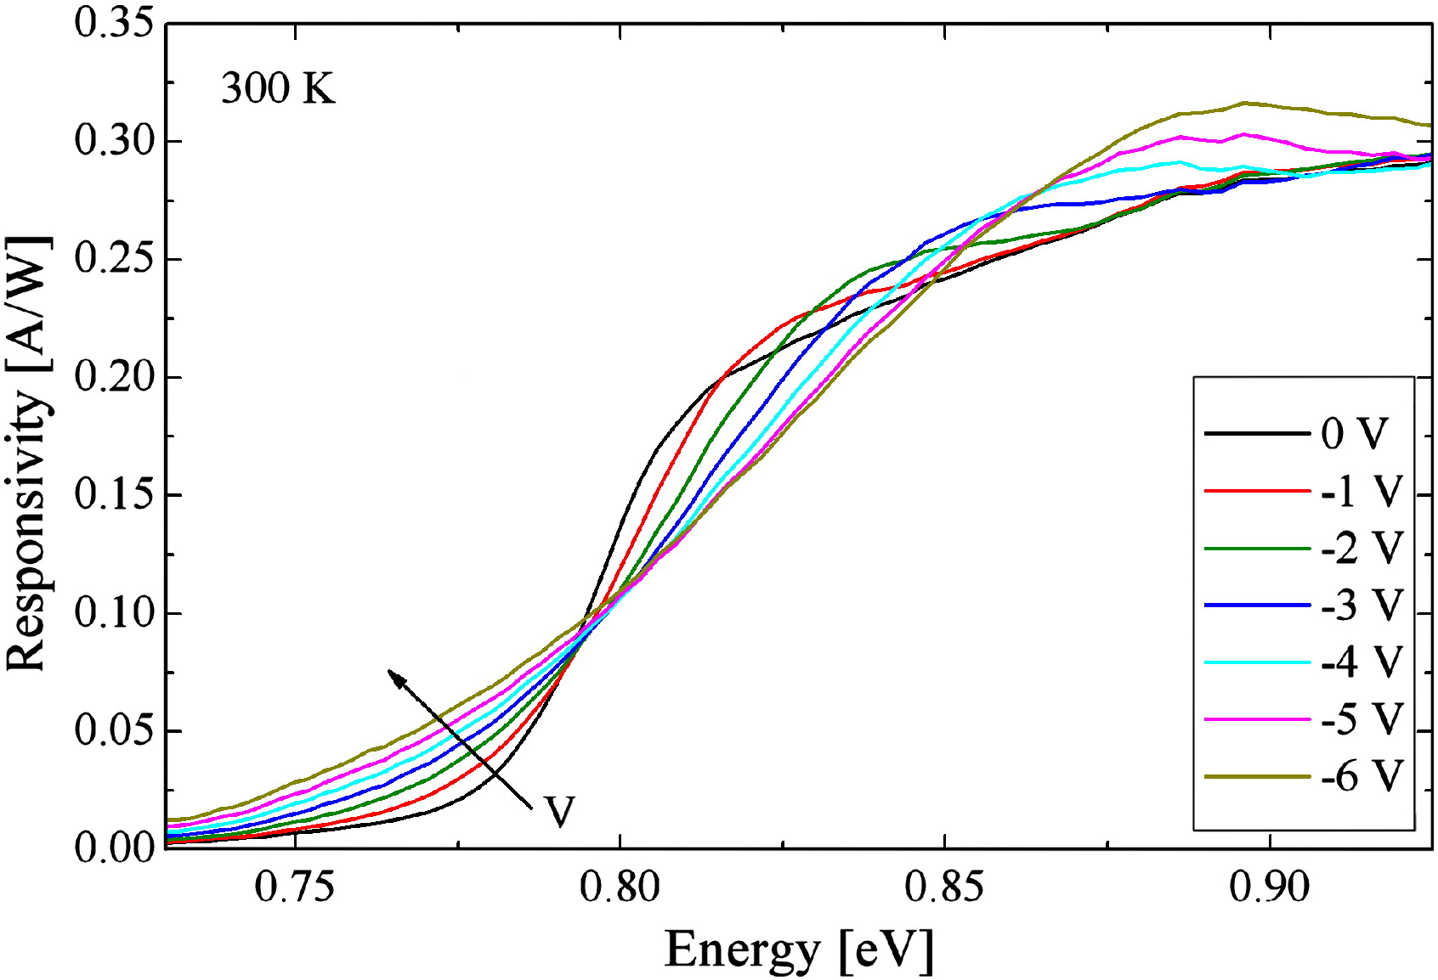
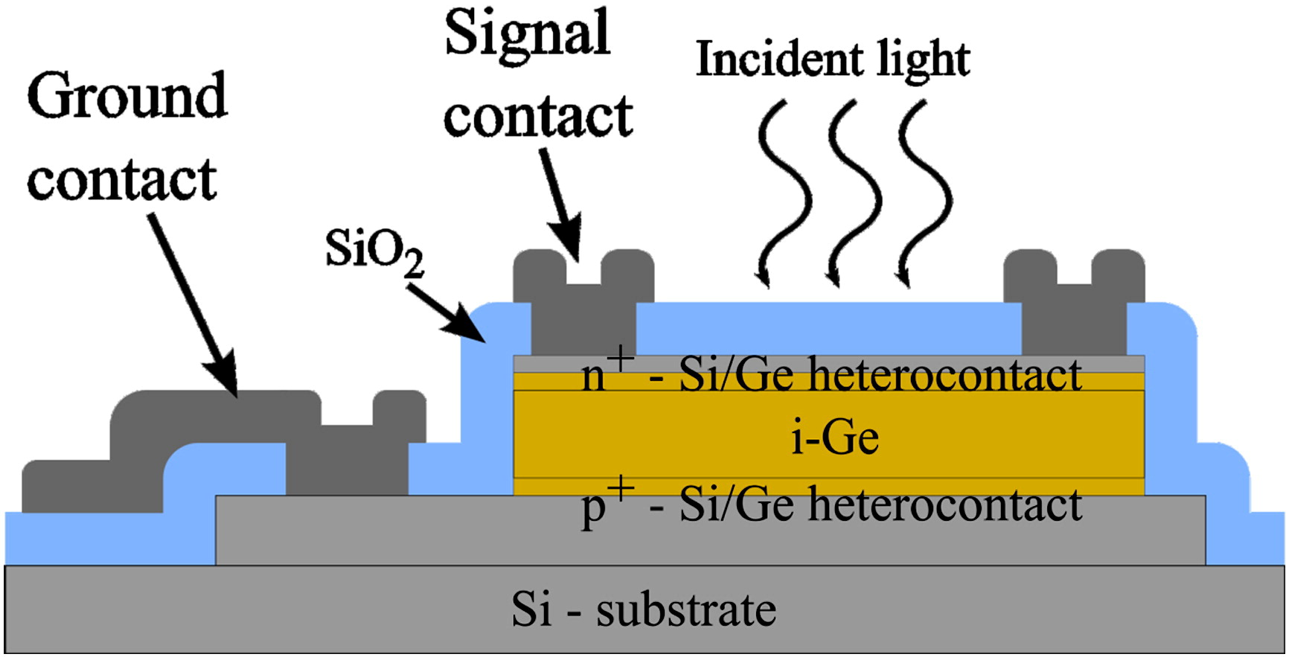
Electroabsorption modulator (EAM): Franz-Keldysh effect (FKE)
E_{C0}
E_{V0}
Energy
FKE in Ge
Thin Solid Films 525, 110 (2012)
Position
FKE takes place in uniform bulk semiconductors
Sub-gap absorption tail and above-gap absorption oscillation
Field-induced effect: ultrafast (sub-fs time scale)
Notes:
Oscillations in above-bandgap absorption caused by overlap variations between electron standing waves

Slide 26
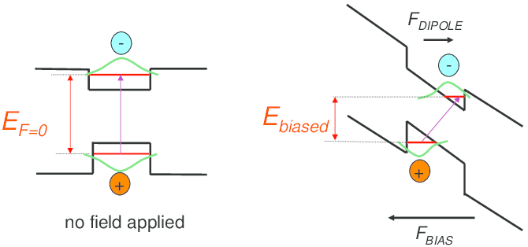
Electroabsorption modulator (EAM): quantum-confined Stark effect (QCSE)
QCSE takes place in quantum wells (QWs)
Decreased transition energy and recombination efficiency
Field-induced effect: ultrafast (sub-fs time scale)

Slide 27
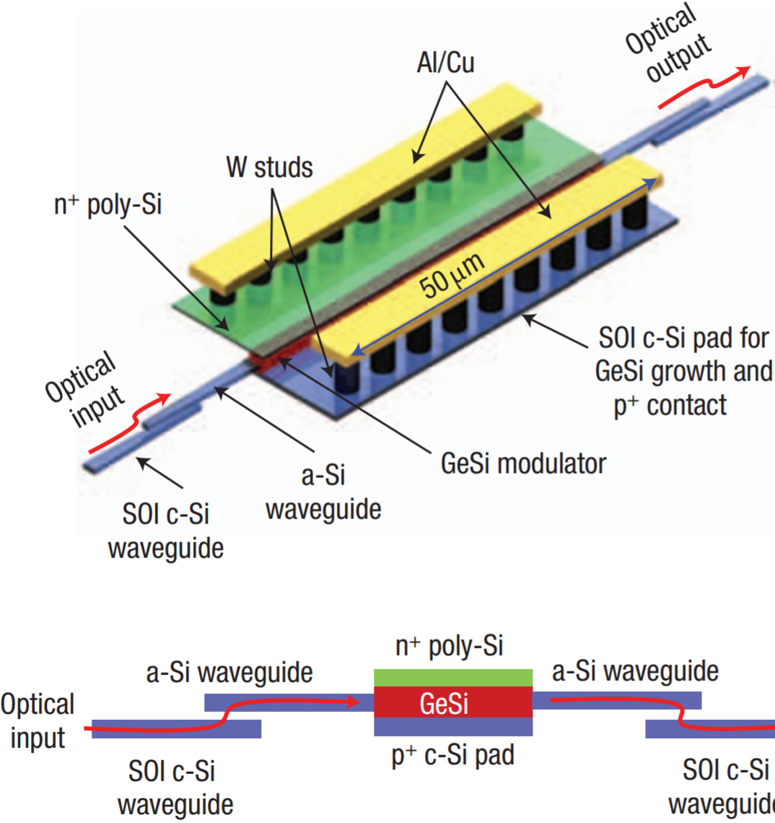
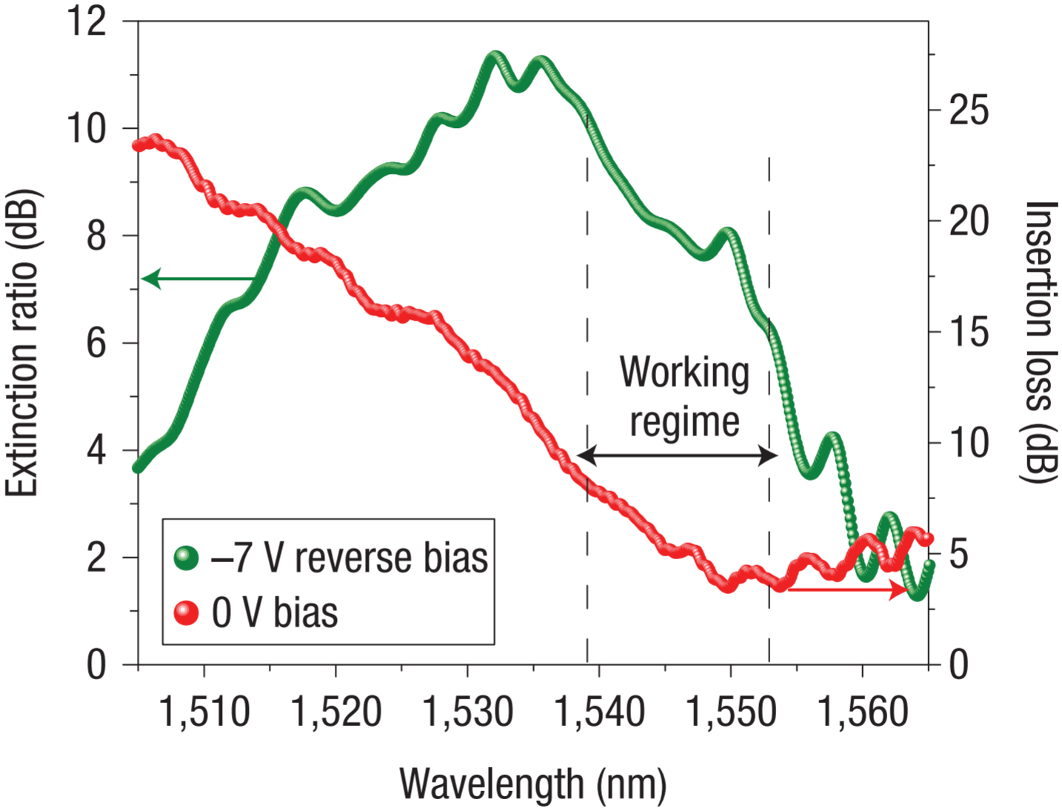
High-speed Ge EAM based on FKE
Small footprint, low energy consumption
IL limited by indirect gap absorption
Nat. Photonics 2, 433 (2008)

Slide 28
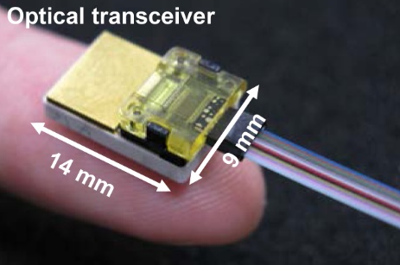
Applications: high-speed communications
1
0
1
0
1
Transmitter driver circuit
Optical transmitter (Tx) / transceiver
Electronic digital signal
1
0
1
0
1
Optical fiber / waveguide
Optical digital signal
1
0
1
0
1
Receiver circuit
Optical receiver (Rx) / transceiver
Electronic digital signal
Fiber ribbon
Opt. Express 19, B777 (2011)

Slide 29
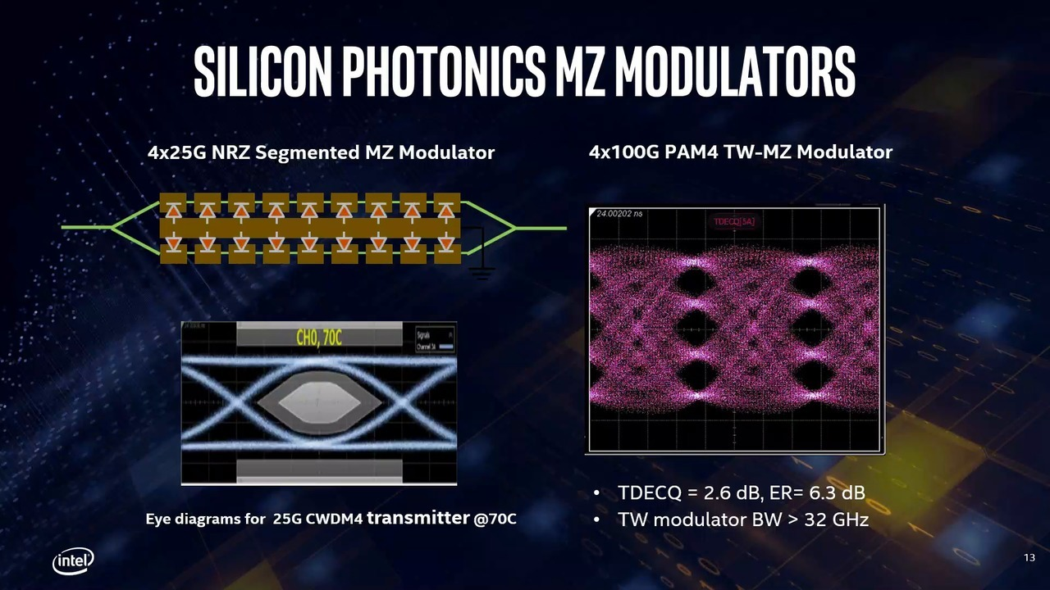
Applications: high-speed communications

Slide 30
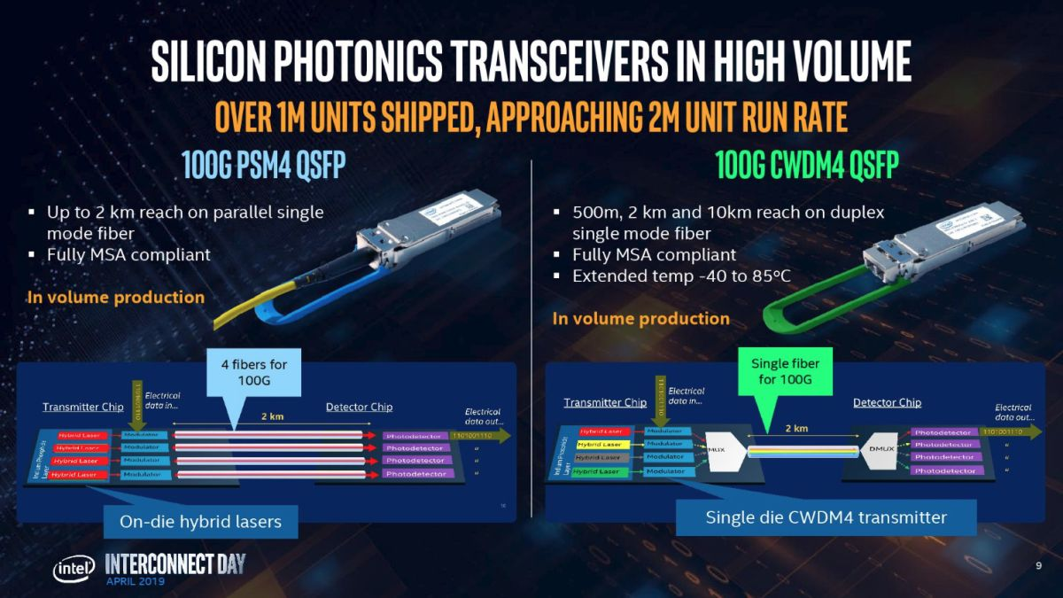
Applications: high-speed communications

Slide 31
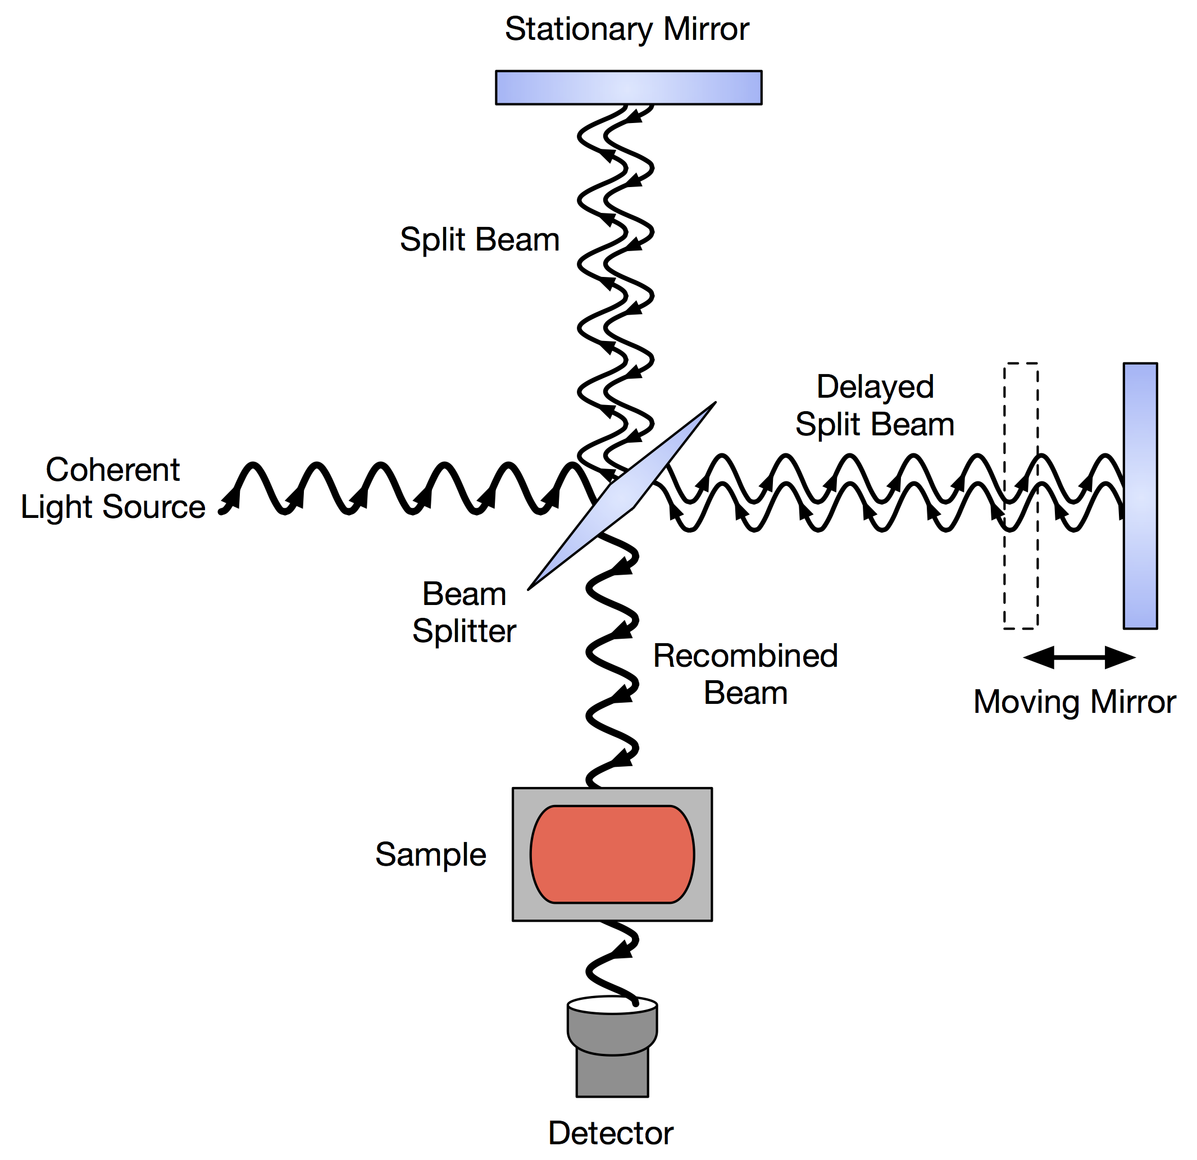
Applications: optical spectroscopy
Tunable arm
Variable delay ΔL
Signal
Detector
Static arm
Rayleigh limit:
Linear scaling: resolution scales with optical path length difference

Slide 32
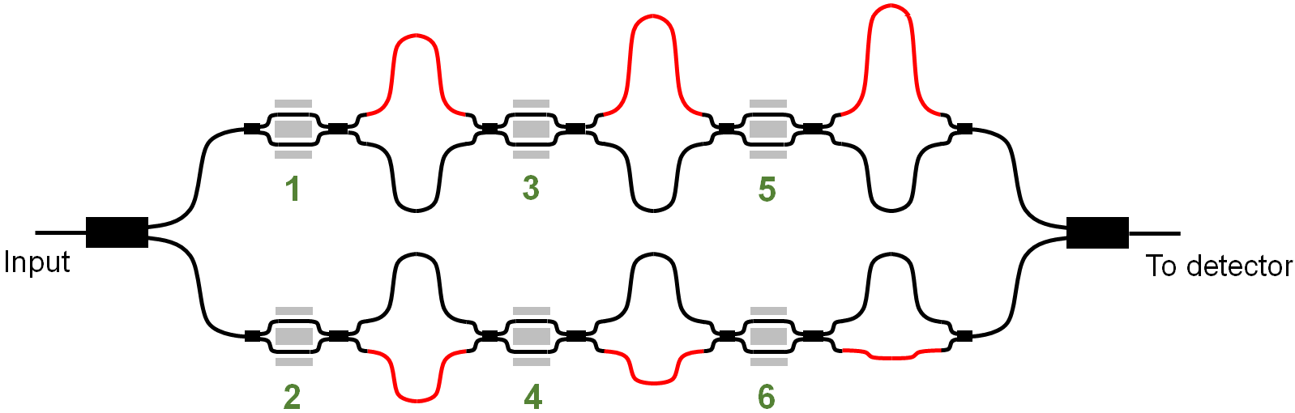
Applications: optical spectroscopy
dL
2² dL
2⁴ dL
DOWN
UP
DOWN
DOWN
input
detection
DOWN
UP
UP
UP
-2 dL
-2³ dL
-2⁵ dL
Unique exponential scaling enables high performance within a chip-scale platform
IEEE J. Sel. Top. Quantum Electron. 23, 5900110 (2017)

Slide 33
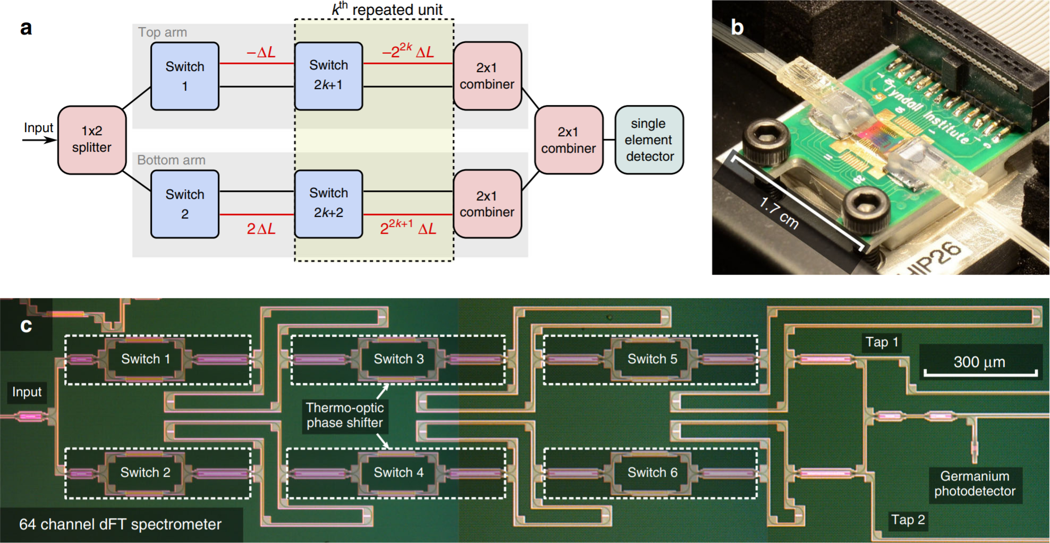
A “plug-and-play” on-chip spectrometer
Nat. Commun. 9, 4405 (2018)

Slide 34
List of symbols
R_{on/off} – contrast/extinction ratio of intensity modulator
P_{out} (V_{on}) / P_{out} (V_{off}) – instantaneous optical output power from an intensity modulator at its on / off state
P_{in} – input optical power into the intensity modulator
IL – insertion loss
λ₀ – free-space wavelength
β – propagation constant
L – phase shifter length
k₀ – wave number in free space
n_{eff} – waveguide effective index

Slide 35
List of symbols
n_{g} – waveguide group index
n – refractive index of the active material
Δn – refractive index change of the active material
ϕ – optical phase
Δϕ – phase modulation
Γ – confinement factor in the active material
γ – fraction of electric field energy confined in the active material
f_{3dB} – 3-dB bandwidth
τ – time constant of modulation or switching

Slide 36
List of symbols
P_{π} – power required to achieve π phase shift
V_{π} – voltage required to achieve π phase shift
Δk – change of imaginary part of refractive index in the active material
Δα – absorption coefficient change of the active material
E_{g} – band gap energy
E_{C0} / E_{V0} – energy of conduction / valence band edge
N – optical channel count
j – number of optical switches

