Slide 1
MIT 3.156/3.46
Photonic Materials and Devices
14: Lasers
Juejun (JJ) Hu
hujuejun@mit.edu

Slide 2
References
Fundamentals of Photonics
  Ch. 14 & 16
Photonics: Optical Electronics in Modern Communications
  Ch. 15
Handbook of Silicon Photonics
  Ch. 8, Anopchenko et al.

Slide 3
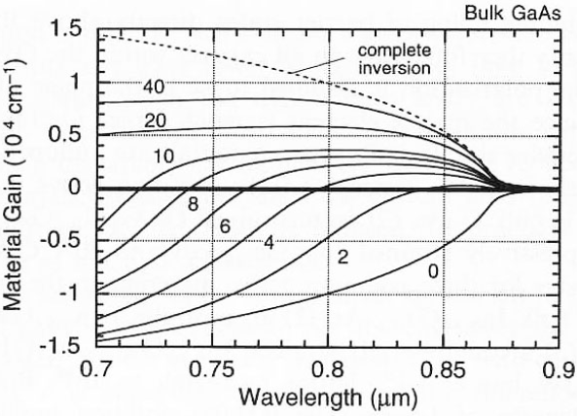
Net gain and optical amplification
Net gain = gain – loss
In practical applications, additional loss sources (scattering, FCA, etc.) need to be considered in the loss term as well
Population inversion
L. A. Coldren and S. W. Corzine, Diode Lasers and Photonic Integrated Circuits

Slide 4
Laser: an optical oscillator
Gain medium
Optical resonator
Coherent output
Spontaneous emission
An amplifier with a gain-saturation mechanism: gain medium
An optical feedback system: optical resonator
A frequency-selection mechanism: optical resonator
An optical output coupling scheme: mirror loss of the resonator

Slide 5
Losses in a laser cavity
Gain medium
Optical resonator
Coherent output
R₁
Spontaneous emission
R₂
Cavity round-trip loss
Effective distributed loss
Propagation loss
Mirror loss

Slide 6
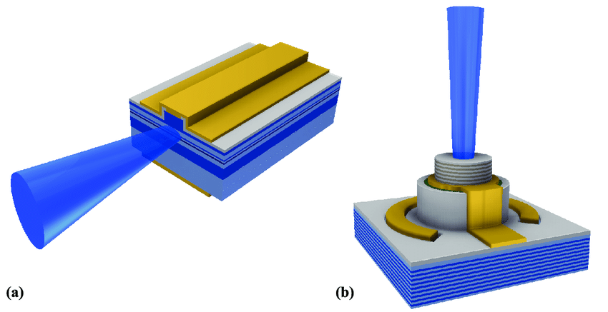
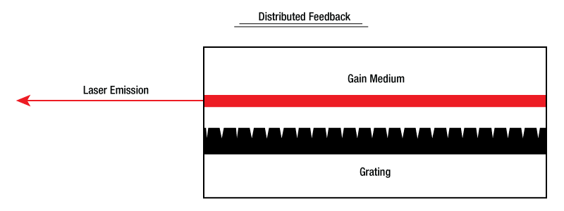
Semiconductor lasers
Edge-emitting laser
VCSEL
© Thorlabs
DOI: 10.5075/epfl-thesis-5675

Slide 7
Laser threshold
Threshold
Below threshold
Spontaneous emission into multiple cavity modes dominates
Gain < loss
Incoherent output
Above threshold
Stimulated emission into usually a single mode dominates
Gain ~ loss
Coherent output
Light intensity (L)
Current (I)
1/β
Light intensity (L)
log(L)
Light intensity (L)
× 100
Wavelength (λ)
Current (I)
Wavelength (λ)
Notes:
Even above threshold the gain is still slightly smaller than loss due to the presence of spontaneous emission

Slide 8
Laser threshold
Threshold condition: small-signal gain ~ total cavity loss
Gain
Threshold population inversion
α₀
Notes:
The threshold condition is an approximation since spontaneous emission is neglected

Slide 9
Above laser threshold: steady-state operation
Gain clamping:
Above threshold, additional injected electrons convert to photons in the cavity, which expedite stimulated emission and “clamp” the carrier density and gain
gain ~ total cavity loss
Light intensity
f_{C} - f_{V}
Carrier density
I_{th}
Injection current

Slide 10
Steady-state operation: rate equations
Injected carriers convert to stimulated emission photons into the lasing mode
Laser output power
Current injection efficiency
Mode confinement
Threshold current
Cavity loss

Slide 11
Laser optimization
Wall-plug efficiency
Current injection efficiency
Mode confinement
Threshold current
Cavity loss
Non-radiative recombination
Mode propagation loss
η_{i} I
Laser output
Injected current
L
I
Mirror loss
Cavity feedback
Spontaneous emission into non-lasing modes
Current leakage

Slide 12
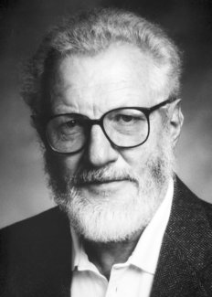
Double heterostructure laser
Herbert Kroemer
“A colleague – Dr. Sol Miller – gave a research colloquium on the new semiconductor diode laser. He reported that experts had concluded that it was fundamentally impossible to achieve a steady-state population inversion at room temperature, because the injected carriers would diffuse out at the opposite side of the junction too rapidly. I immediately protested: “But that’s a pile of … ; all you have to do is give the outer regions a wider energy gap.” I wrote up the idea and submitted the paper to Applied Physics Letters, where it was rejected. I was talked into not fighting the rejection, but to submit it to the Proceedings of the IEEE, where it was published, but ignored.”
The Nobel Prize in Physics 2000
"for developing semiconductor heterostructures used in high-speed- and opto-electronics"

Slide 13
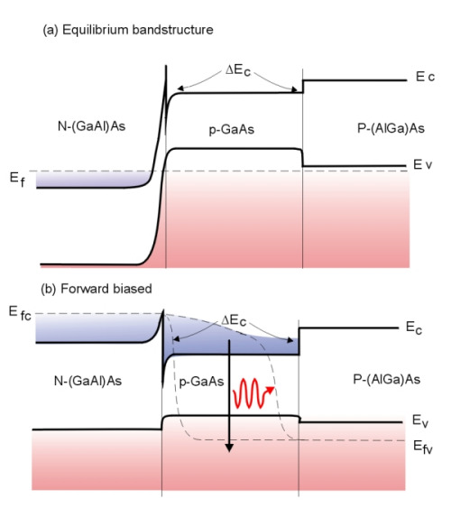
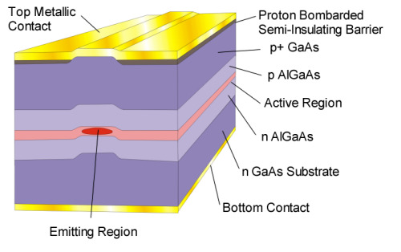
Double heterostructure laser
Simultaneous electronic and optical confinement
After Semiconductor Laser Diodes

Slide 14
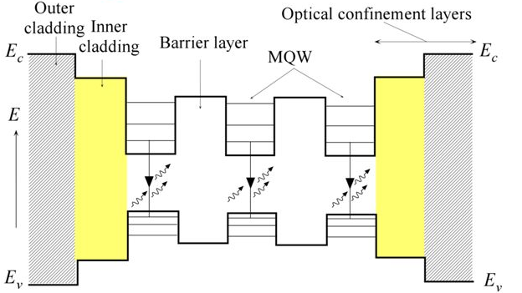
(Multiple) quantum well lasers
Reduced density of states
Lower optical confinement
Low threshold current
Improved efficiency

Slide 15
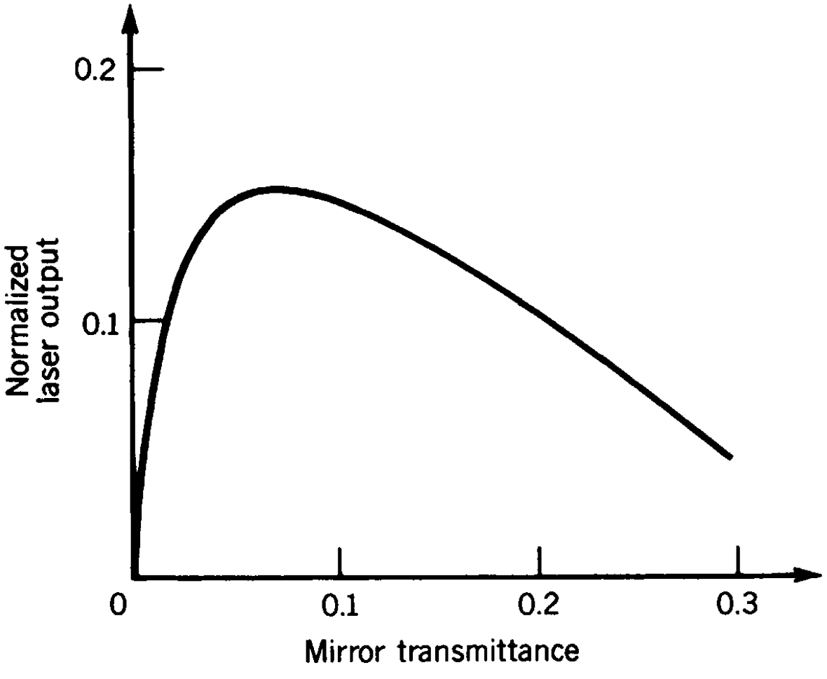
Laser optimization
Wall-plug efficiency
Current injection efficiency
Mode confinement
Threshold current
Cavity loss
Slope efficiency
After Fundamentals of Photonics
Increasing mirror loss increases laser threshold but improves slope efficiency

Slide 16
Laser optimization
Wall-plug efficiency
Current injection efficiency
Mode confinement
Threshold current
Cavity loss
Parameter | Wall-plug efficiency | Threshold
Γ ↑ | ↑ | ↓
η_{i} ↑ | ↑ | ↓
α_{s} ↓ | ↑ | ↓
α_{m} ↓ | ? | ↓

Slide 17
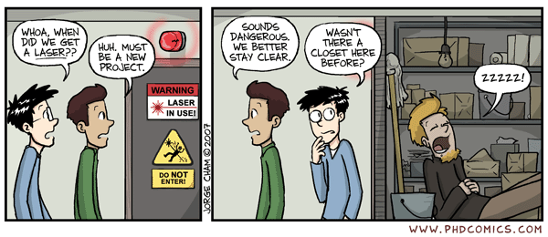
Applications of lasers
Lasers in Medicine
Lasers are used for bloodless surgery.
Lasers are used to destroy kidney stones.
Lasers are used in cancer diagnosis and therapy.
Lasers are used for eye lens curvature corrections.
Lasers are used in fiber-optic endoscope to detect ulcers in the intestines.
The liver and lung diseases could be treated by using lasers.
Lasers are used to study the internal structure of microorganisms and cells.
Lasers are used to produce chemical reactions.
Lasers are used to create plasma.
Lasers are used to remove tumors successfully.
Lasers are used to remove the caries or decayed portion of the teeth.
Lasers are used in cosmetic treatments such as acne treatment, cellulite and hair removal.
Lasers in Communications
Laser light is used in optical fiber communications to send information over large distances with low loss.
Laser light is used in underwater communication networks.
Lasers are used in space communication, radars and satellites.
Lasers in Industries
Lasers are used to cut glass and quartz.
Lasers are used in electronic industries for trimming the components of Integrated Circuits (ICs).
Lasers are used for heat treatment in the automotive industry.
Laser light is used to collect the information about the prefixed prices of various products in shops and business establishments from the bar code printed on the product.
Ultraviolet lasers are used in the semiconductor industries for photolithography. Photolithography is the method used for manufacturing printed circuit board (PCB) and microprocessor by using ultraviolet light.
Lasers are used to drill aerosol nozzles and control orifices within the required precision.
Lasers in Science and Technology
A laser helps in studying the Brownian motion of particles.
With the help of a helium-neon laser, it was proved that the velocity of light is same in all directions.
With the help of a laser, it is possible to count the number of atoms in a substance.
Lasers are used in computers to retrieve stored information from a Compact Disc (CD).
Lasers are used to store large amount of information or data in CD-ROM.
Lasers are used to measure the pollutant gases and other contaminants of the atmosphere.
Lasers helps in determining the rate of rotation of the earth accurately.
Lasers are used in computer printers.
Lasers are used for producing three-dimensional pictures in space without the use of lens.
Lasers are used for detecting earthquakes and underwater nuclear blasts.
A gallium arsenide diode laser can be used to setup an invisible fence to protect an area.
Lasers in Military
Laser range finders are used to determine the distance to an object.
The ring laser gyroscope is used for sensing and measuring very small angle of rotation of the moving objects.
Lasers can be used as a secretive illuminators for reconnaissance during night with high precision.
Lasers are used to dispose the energy of a warhead by damaging the missile.
Laser light is used in LIDAR’s to accurately measure the distance to an object.
www.physics-and-radio-electronics.com/physics/laser/applicationsoflasers.html

Slide 18
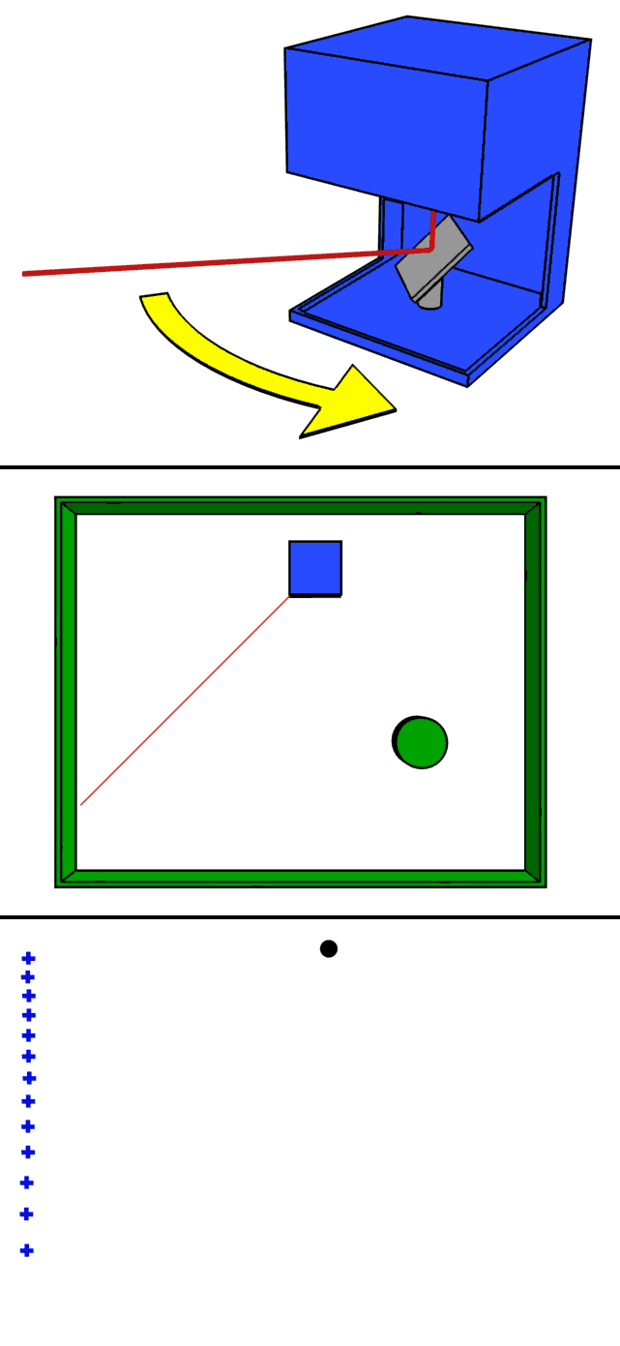
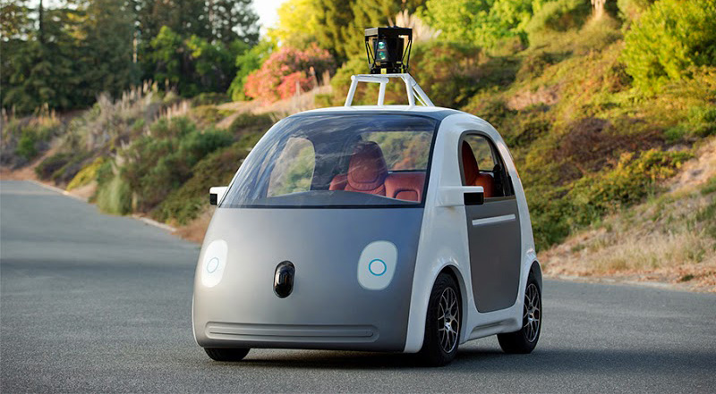
LIDAR: Light Detection And Ranging
LIDAR
© Google
LIDAR uses laser pulses to measure ranges (variable distances) via sensing reflected optical signals

Slide 19

“Seeing” the streets of London with LIDAR

Slide 20
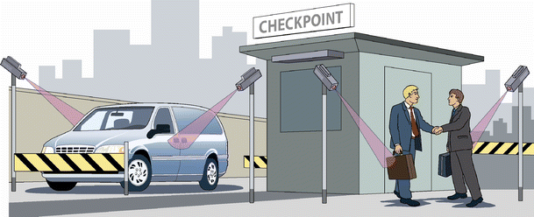
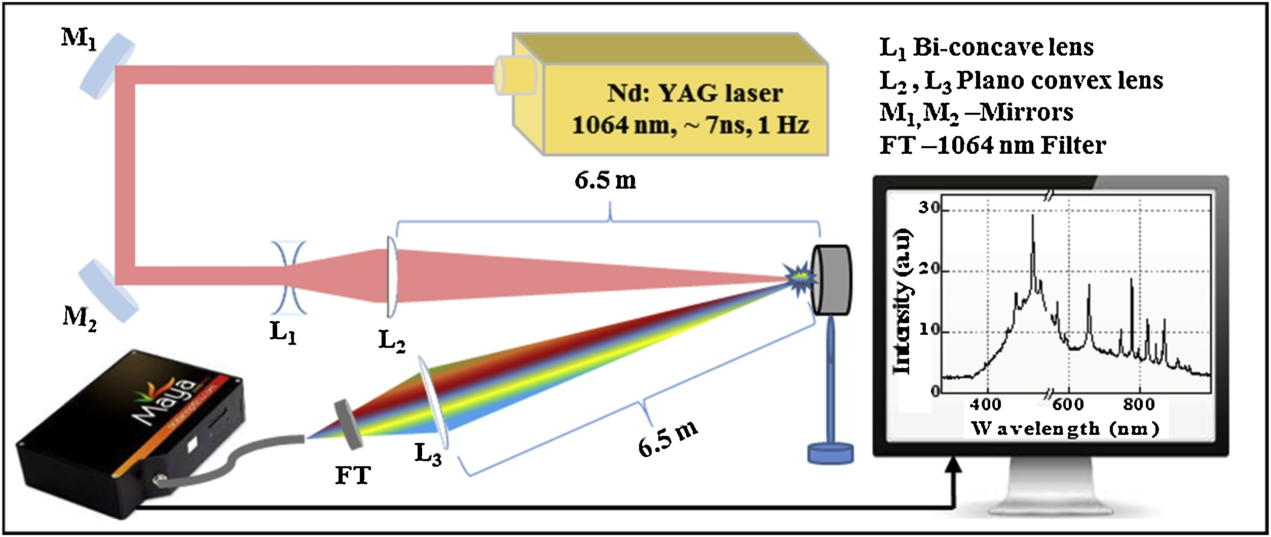
Laser-based standoff chemical detection
Laser Induced Breakdown Spectroscopy (LIBS)
Anal. Bioanal. Chem. 395, 259 (2009)
Optik 204, 163946 (2020)

Slide 21
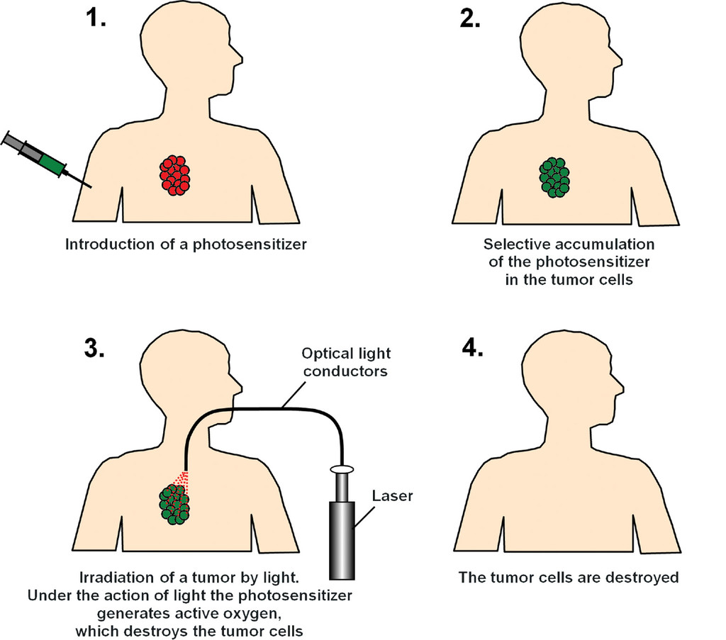
Photodynamic therapy (PDT)
PDT treatments can be precisely targeted at the cancer tissue with minimal harm on normal tissues
Int. J. Nanomed. 8, 173 (2016)

Slide 22
List of symbols
α – absorption coefficient
s – gain coefficient
g – net gain coefficient
ћ – reduced Planck constant, 1.055 × 10⁻³⁴ J·s
ω – angular frequency of light
ρ_{j} – joint density of state
f_{C} / f_{V} – occupation probability in conduction / valence band
E_{Fn} / E_{Fp} – quasi-Fermi level for conduction / valence band

Slide 23
List of symbols
α_{r} – total effective distributed loss in laser cavity
α_{s} – light propagation loss in laser cavity
α_{m} – distributed mirror loss in laser cavity
R₁ / R₂ – reflectance of mirror 1 / 2
d – laser cavity length
L – laser emission intensity
β – spontaneous emission factor, the fraction of spontaneous emission radiated into the lasing mode
I – injection current
Γ – confinement factor in the gain medium

Slide 24
List of symbols
α₀ – semiconductor absorption at zero inversion
I_{th} – threshold current
N_{p} – photon density in laser cavity at steady state
v_{g} – group velocity of lasing mode
η_{i} – current injection efficiency
e – elementary charge, 1.602 × 10⁻¹⁹ C
V_{a} – active volume of laser
η – wall-plug efficiency
V – applied voltage bias on laser
E_{C} / E_{V} – energy of conduction / valence band edge

Slide 25
List of symbols
η_{s} – slope efficiency

