Slide 1
MIT 3.156/3.46 Photonic Materials and Devices 4: Fiber Optics
Juejun (JJ) Hu
hujuejun@mit.edu

Slide 2
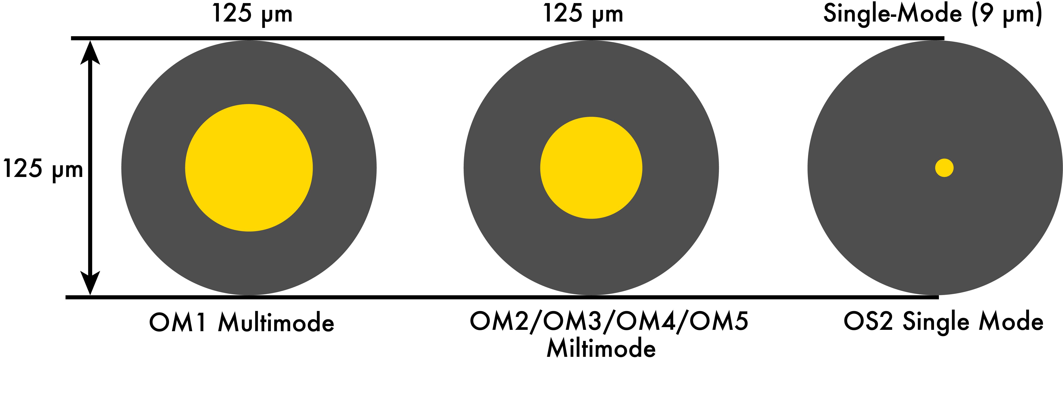
Optical fibers
1 μm
Cylindrical waveguide
(Typically) made of glasses
Low index contrast
Large core size
Single-mode fiber core
Silicon waveguide

Slide 3
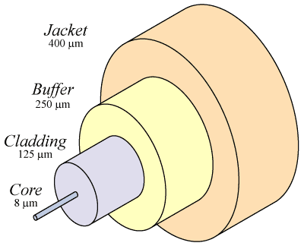
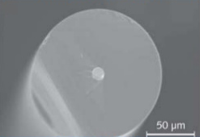
Standard single-mode silica optical fiber structure
Core/cladding: low loss light propagation
Buffer/jacket: protection against mechanical damage and the environment (UV radiation, humidity, etc.)
Cladding
Core

Slide 4
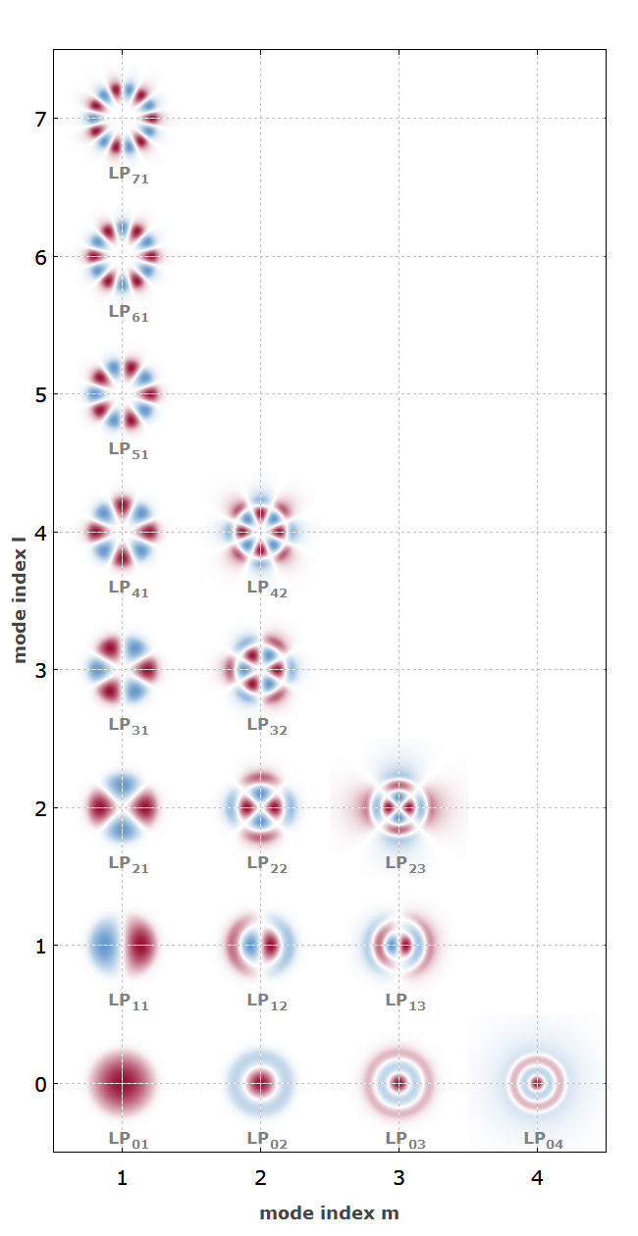
Linearly polarized (LP) fiber modes
Solutions to the Helmholtz equation in a cylindrical coordinate system
QM analog: 2-D hydrogen atom
m : principal quantum number
l : angular quantum number
Angular index l
Radial function
Angular function
www.rp-photonics.com/lp_modes.html
Radial index m

Slide 5
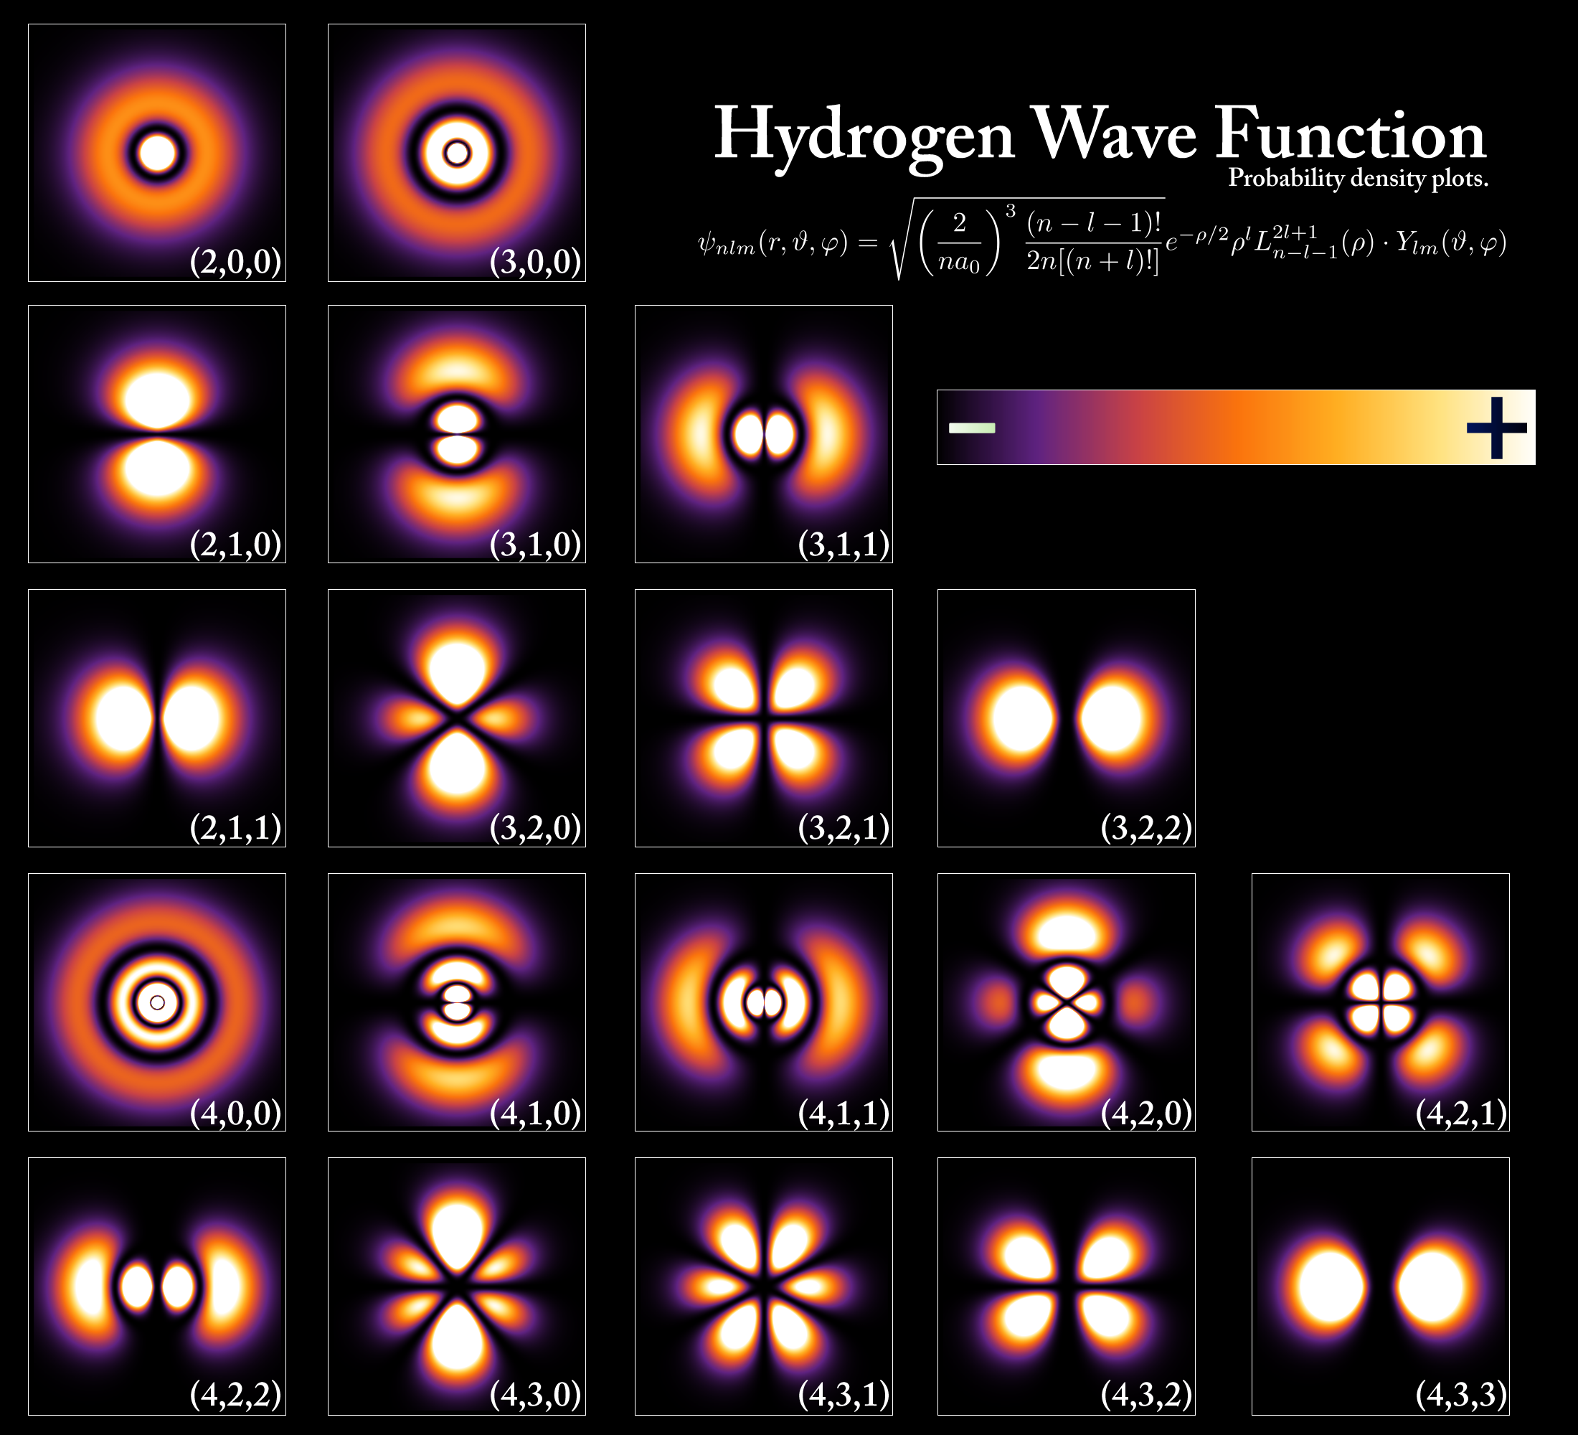
Linearly polarized (LP) fiber modes
Angular index l
Radial index m

Slide 6
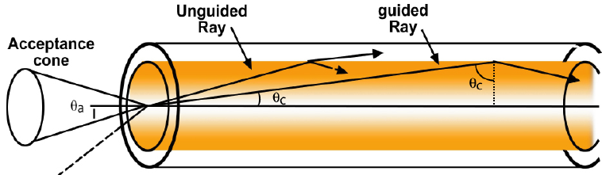
Numerical aperture (NA)
Δn = n_{core} – n_{clad} << 1, typical Δn = 0.001 ~ 0.02
Numerical Aperture
Light gathering power θ_{a}
For a silica fiber with n_{core} = 1.46 & n_{clad} = 1.44, θ_{a} = 11.9º, NA = 0.209

Slide 7
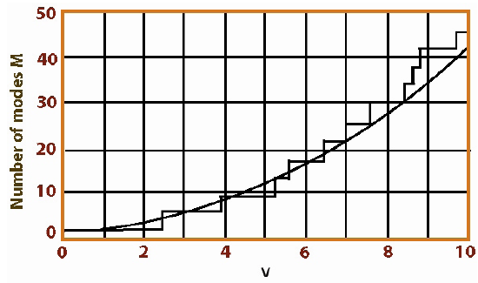
Single-mode step-index fiber design: V-parameter
V-parameter (V-number)
Single-mode condition: V < 2.405
Δn = 0.003, single-mode fiber d_{core} ~ 10 μm
Number of modes M
M ~ 4V²/π² ~ 0.4V²
v

Slide 8
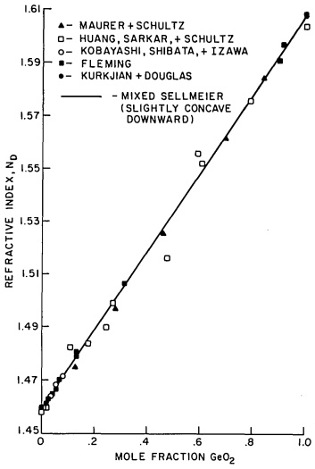
Optical fiber materials
Glasses: silica and other oxides, chalcogenides, halides, polymers
Metals, crystalline oxides and semiconductors, etc.
Dopants in silica glass
Increase index: GeO₂, P₂O₅, TiO₂
Decrease index: B₂O₃
Luminescent centers: rare earth (e.g. Er)
Refractive index n_{D} of SiO₂-GeO₂ glass
Appl. Opt. 24, 4486 (2004)

Slide 9
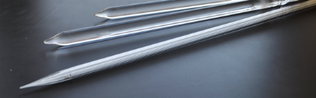
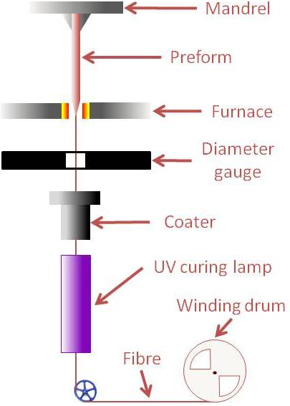
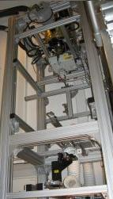
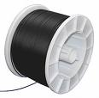
Fiber drawing process
Fiber preforms
Viscosity window for fiber drawing:
10⁴ to 10⁶ Pa·s
Drawing tower
Fiber spool
Notes:
https://www.technologyreview.com/s/401266/drawing-optical-fibers/

Slide 10
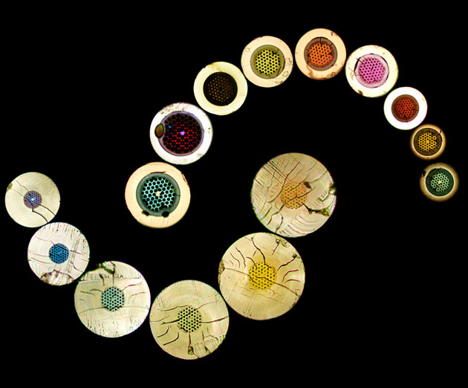
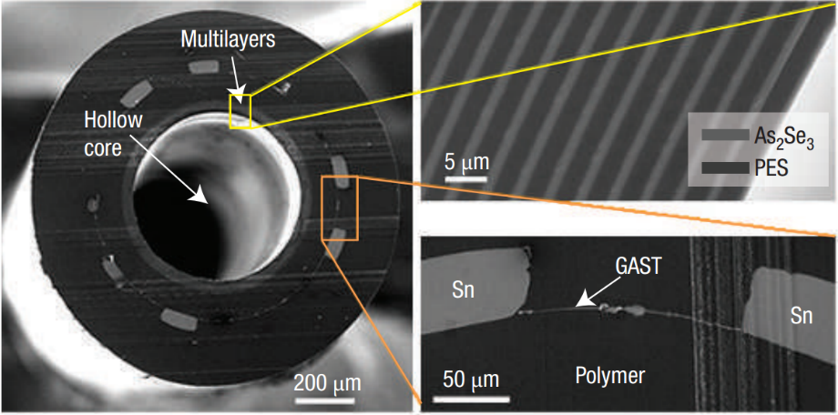
Multi-material, microstructured optical fibers
Nat. Mater. 6, 336, (2007)
Optical mode shaping
Dispersion engineering
Broadband transmission
Multi-functional sensing
Microstructured optical fibers: photonic bandgaps and various sizes of the rings give rise to the different colors
A. Argyros, the University of Sydney

Slide 11
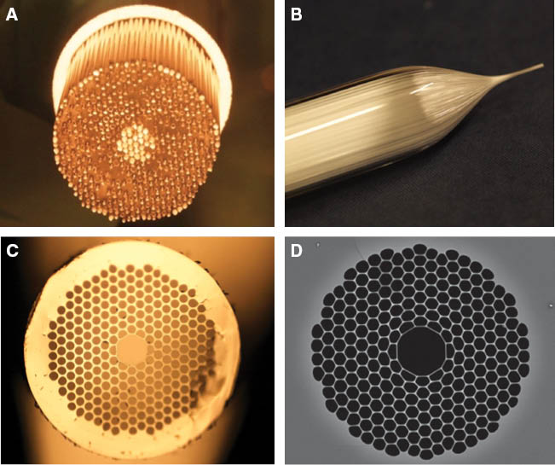
Multi-material, microstructured optical fibers
Nat. Mater. 6, 336, (2007)
Optical mode shaping
Dispersion engineering
Broadband transmission
Multi-functional sensing
Hollow-core photonic crystal fiber fabrication process flow using the stack-and-draw technique
Nanophotonics 2, 315-340 (2013)
Notes:
(A) Primary preform obtained by assembling a few hundred high purity, low-hydroxyl silica glass capillaries into an array with the required geometry tightly packed inside a glass tube; (B) first stage draw of the primary preform into a ~millimetre sized “cane”; (C) optical image of the cross-section of a HC-PBGF cane showing elimination of interstitial volumes and formation of the central core “defect”; (D) scanning electron microscope image of the microstructured region of the final fibre, showing a much increased diameter to pitch ratio of the cladding holes. The typical hole-to-hole spacing for operation at 1500 nm wavelength is in the range of 4–6 µm (depending on the air filling ratio of the cladding).

Slide 12
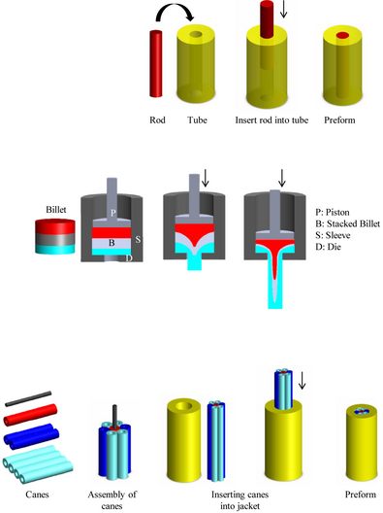
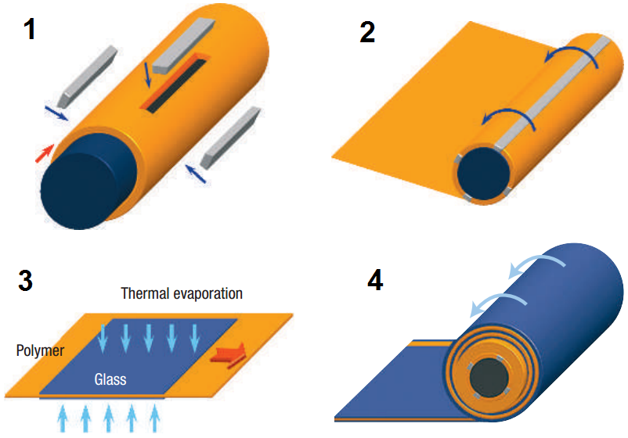
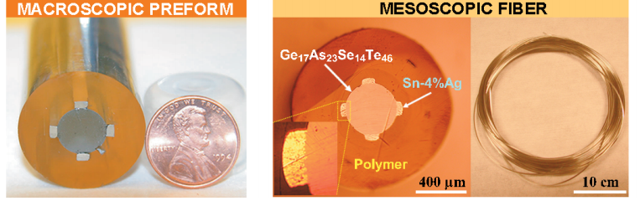
Multi-material, microstructured optical fibers
Rod-in-tube
Extrusion
Stack-and-draw
Int. J. Appl. Glass Sci. 3, 349 (2012)
Adv. Mater. 18, 845 (2006)

Slide 13
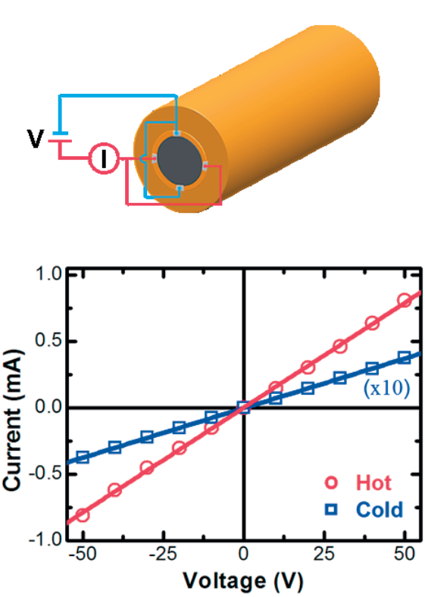
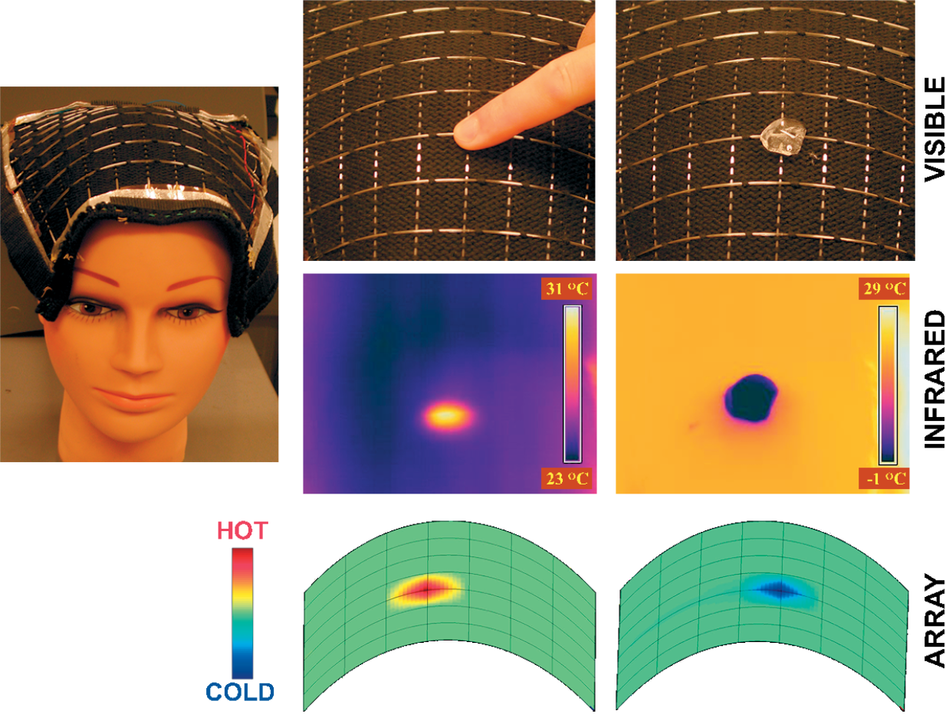
Multi-material, microstructured optical fibers
Thermal sensing fibers
Adv. Mater. 18, 845 (2006)

Slide 14
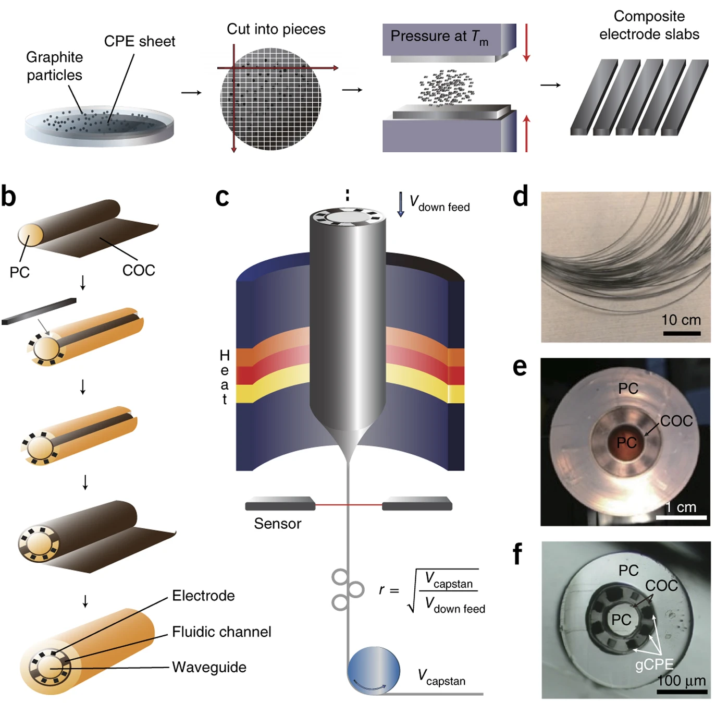
Multi-material, microstructured optical fibers
Multifunctional fibers for simultaneous optical, electrical and chemical interrogation of neural circuits
Nat. Biotechnol. 33, 277 (2017)

Slide 15
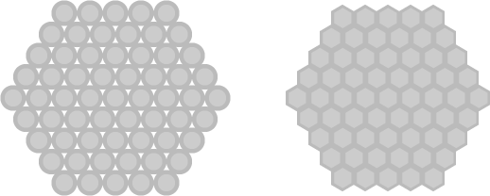
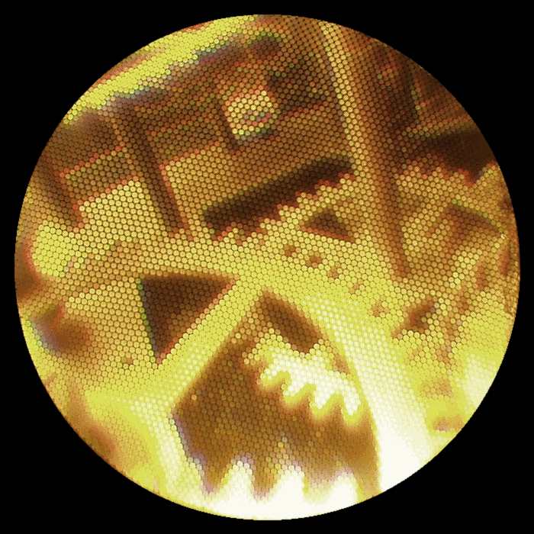
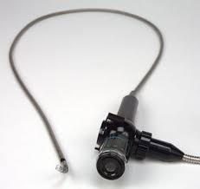
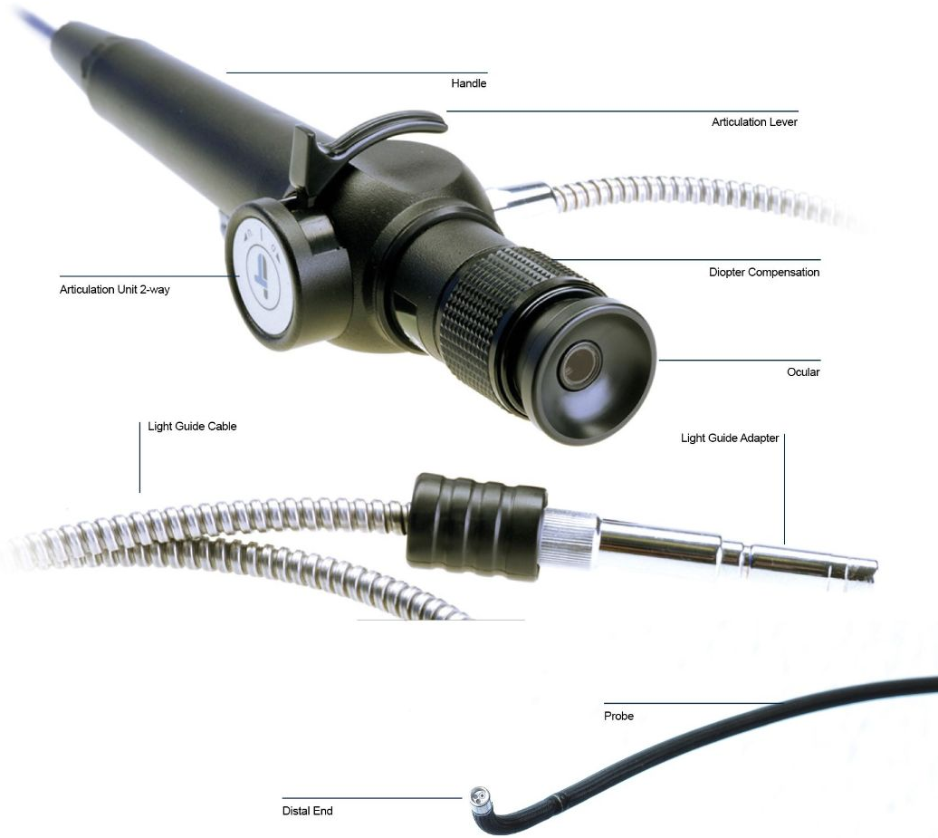
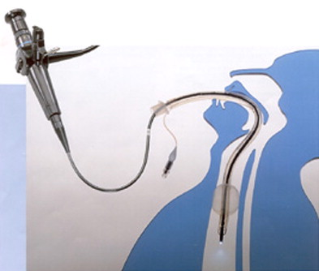
Fiber-optic bundles: from TV rocks to endoscopy
© Wikipedia
Fusion
https://itconceptsworld.com/iflex/

Slide 16
List of symbols
E – electric field
r – radial coordinate
ϕ – angular coordinate
m – radial modal index
l – angular modal index
d_{core} – diameter of fiber core
n_{core} / n_{clad} – refractive index of fiber core / cladding
NA – numerical aperture
θ_{a} – acceptance angle
V – V-parameter, V-number

