Slide 1
MIT 3.156/3.46
Photonic Materials and Devices
8: Optical Scattering
Juejun (JJ) Hu
hujuejun@mit.edu

Slide 2

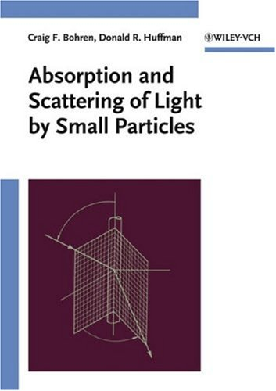
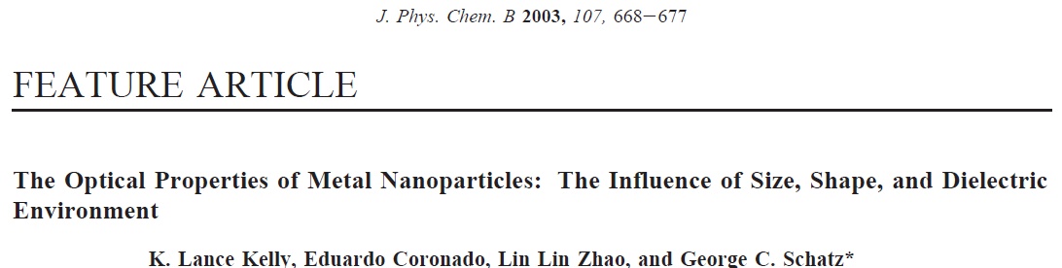
References
Principles of Nano-optics, Ch. 12
Electromagnetic Wave Theory, Ch. 6
  J. A. Kong, Wiley & Sons
Light Scattering by Small Particles
  H. van de Hulst, Dover Publications
Absorption and Scattering of Light by Small Particles
  C. Bohren and D. Huffman, Wiley-VCH

Slide 3
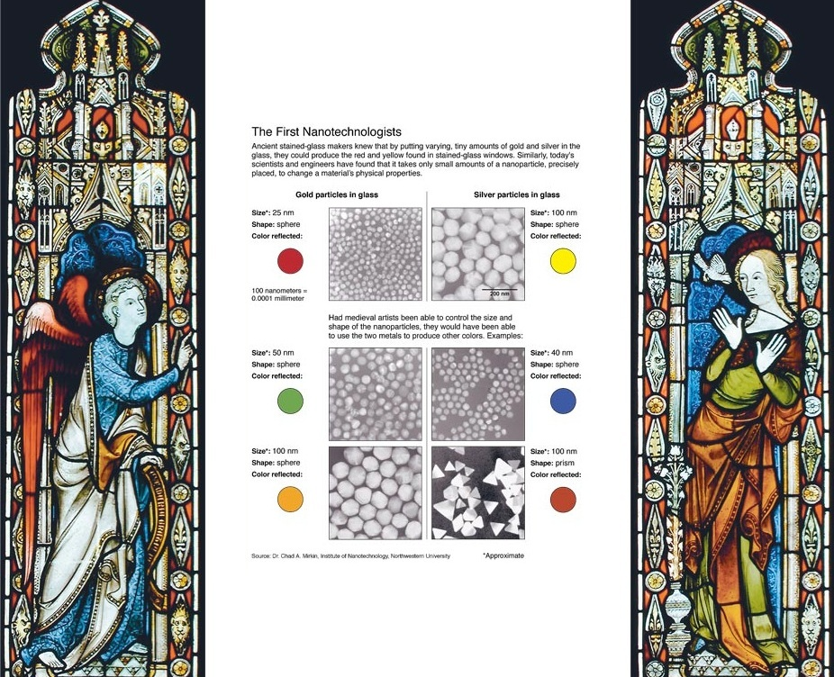

Slide 4

The Lycurgus Cup

Slide 5
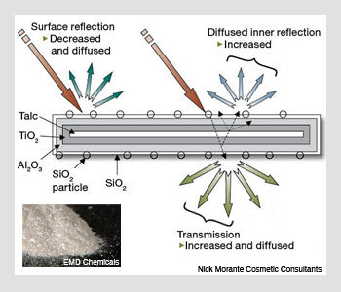

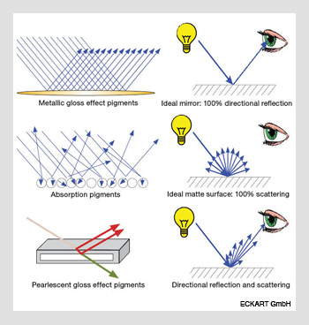
Optics & Photonics News 21, 42-48 (2010)

Slide 6

How to see around corners
Nat. Commun. 3, 745 (2012)

Slide 7
Rayleigh theory of optical scattering
Small particles (a << λ): quasi-static approximation
The fields inside (E₁) and outside (E₂) the sphere may be found from the scalar potentials and
ε₂
r
The initially uniform field
Is distorted by introduction of the sphere
ε₁
θ
(potential )
E₀ (constant)
z
a

Slide 8
A sphere in a uniform static field: the solution
Laplace’s equations in source-free domains:
Boundary conditions:
Solution:

Slide 9
Field of an electric dipole
Dipole moment:
If the charges are embedded in a uniform unbounded medium with permittivity ε₂ , then the potential at any point P is given by:
ε₂
P
r₋
r
r₊
-q
θ
q
-
+
z
d
Ideal (Hertzian) dipole:

Slide 10
A sphere in a uniform static field: the solution
Electric potential inside and outside the sphere:
A sphere in an static field is equivalent to an ideal dipole
Dipole moment:
Dipole polarizability:

Slide 11
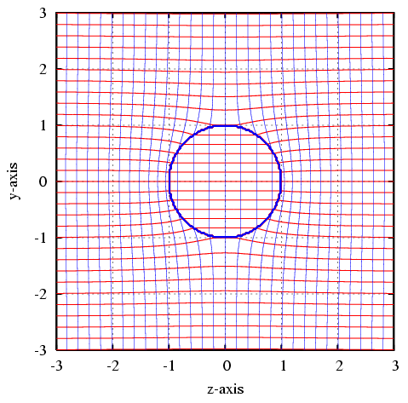
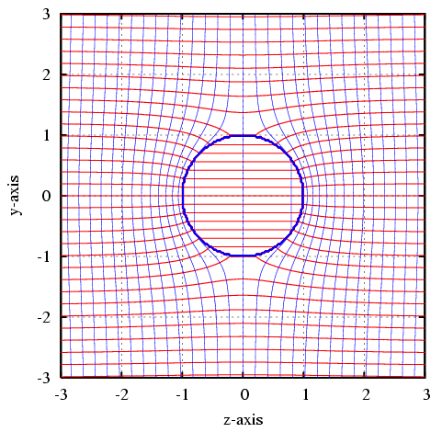
ε₁ = 2.2, ε₂ = 1
ε₁ = 10, ε₂ = 1
Equipotentials
Field lines
http://wiki.4hv.org/index.php/Dielectric_Sphere_in_Electric_Field

Slide 12
Scattering by small spherical particles
The field of an oscillating dipole
Far-field radiation: scattered field in the quasi-static limit
static field
(near-field)
induction field
(near-field)
radiation field
(far-field)

Slide 13
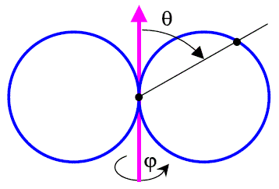
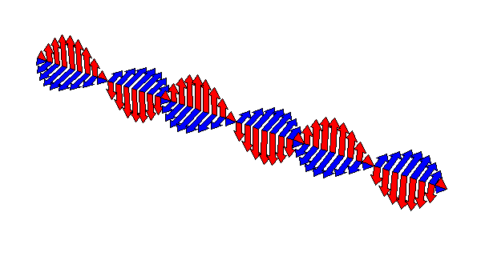
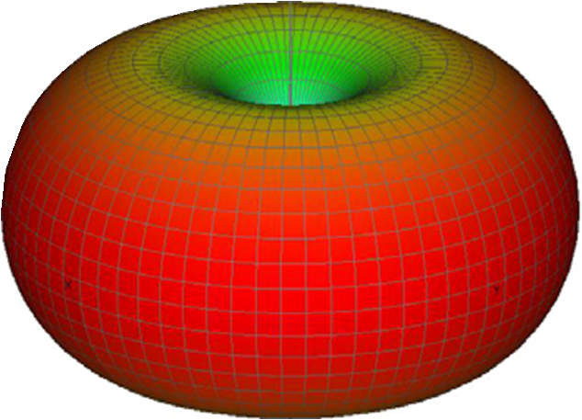
Rayleigh scattering (a << λ)
p
Scattering: induced dipole radiation
Scattered sunlight is highly polarized at a scattering angle of 90° (θ = 0°)
|E_{s}|
p
E
Scattered field
Particle
H
k

Slide 14
Rayleigh scattering (a << λ)
Total scattered power (linearly polarized light):
Scattering cross-section σ_{s} and scattering efficiency Q_{s} :
Short wavelength light is preferentially scattered
(dimensionless number)
Notes:
The scattered light intensity scales with the scatterer’s volume square due to coherent scattering.

Slide 15

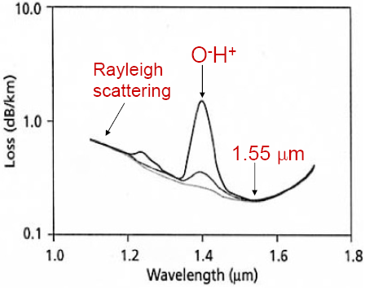

Rayleigh scattering in gas and glass
Density fluctuation results in non-zero Rayleigh scattering
S. Shibata et al., "Prediction of Loss Minima in Infrared Optical Fibers," Electron. Lett. 17, 775 (1981).
Notes:
In a uniform medium scattering from different parts of the medium cancels out due to destructive interference, resulting in zero total scattering

Slide 16
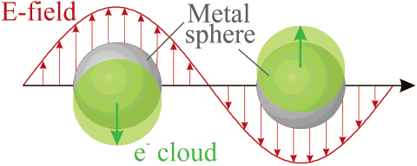
Scattering by small spherical particles (cont’d)
The particle polarizability diverges when
In practical materials, polarizability is always a finite number due to the non-vanishing imaginary part of ε₁
Significantly enhanced scattering at the dipole resonance wavelength when
Localized surface plasmon resonance (LSPR): enhanced collective oscillation of free electrons
t

Slide 17
Optical absorption and extinction of spheres
Absorption cross-section σ_{a} :
Extinction = scattering + absorption
The contribution to extinction due to optical absorption is more significant for smaller nanoparticles
Optical absorption is also significantly boosted at the dipole resonance wavelength

Slide 18
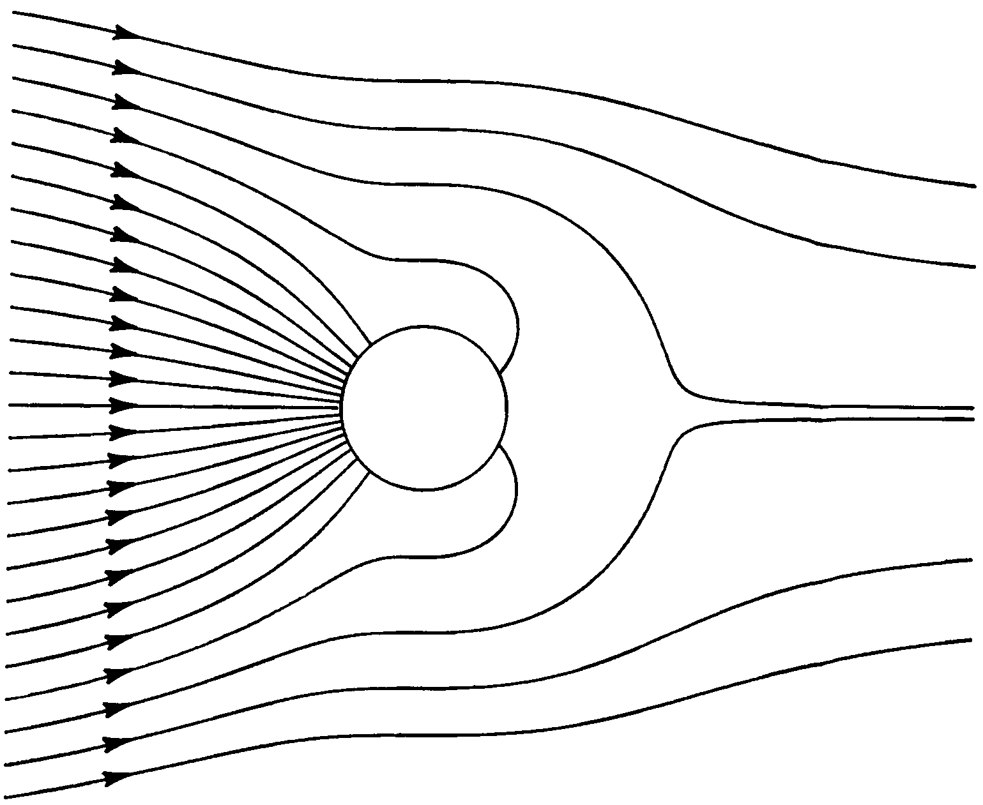
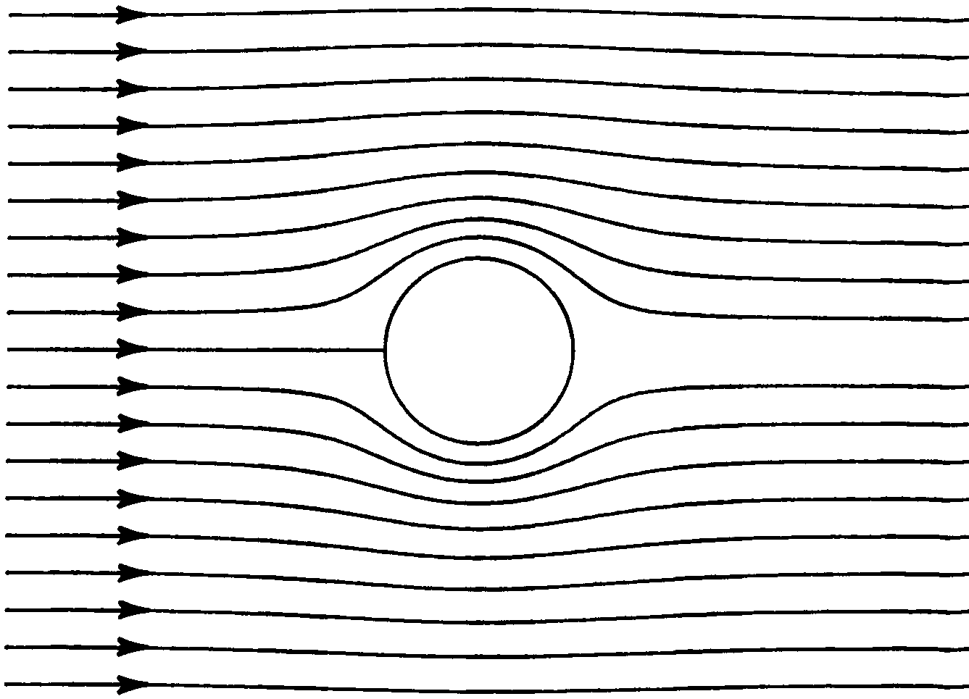
Extraordinarily large optical absorption cross-section at the LSPR wavelength
Field lines of Poynting vector around an aluminum sphere at the LSPR resonance wavelength of 141 nm where Q_{a} = 18 (left) and at a non-resonant wavelength of 248 nm where Q_{a} = 0.1 (right).
Absorption and Scattering of Light by Small Particles, C. Bohren and D. Huffman, Wiley-VCH

Slide 19
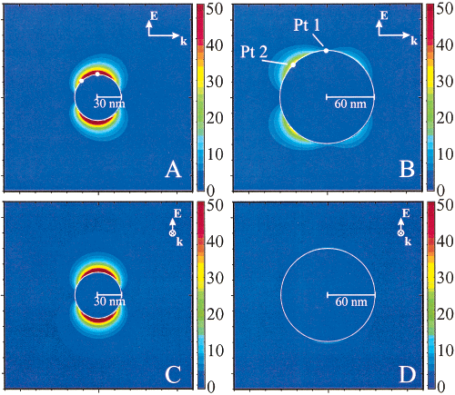
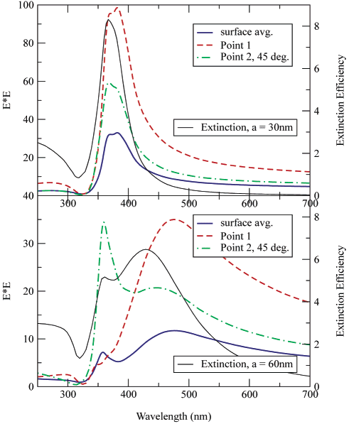
Field enhancement at LSPR resonance
a = 30 nm Ag NP
dipole resonance
a = 60 nm Ag NP
quadrupole resonance
J. Phys. Chem. B 107, 668-677 (2003).

Slide 20
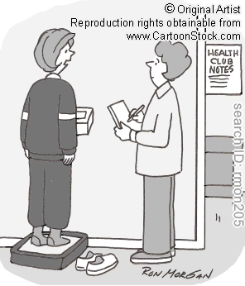
Different conventions and unit systems
Sometimes, unit conversion in electromagnetism can be tricky
According to the convention we use here:
In some books and papers, polarizability is defined as:
In Gaussian unit system:
“I like the metric system. My weight in kilograms is so much less than my weight in pounds.”

Slide 21
Beyond the Rayleigh theory
Classical modifications
Quantum effects
Geometric effects: non-spherical particles
Finite size effects
Surface damping: mean free path limitation
Quantum plasmon resonance
Nanoshells and ellipsoids in the quasi-static limit (a << λ)
Discrete Dipole Approxi-mation (DDA)
Modified Long Wavelength Approxi-mation (MLWA)
Multi-pole expansion: high order Fröhlich modes
Mie scattering theory

Slide 22
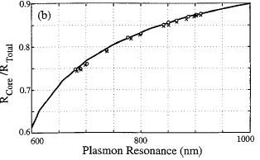
Nanoshells in the quasi-static limit
Nanoshell polarizability
Nanoshell dipole resonance:
Geometrically tunable resonant λ
shell
r₂
core
r₁
where
Averitt et al., J. Opt. Soc. Am. B, 16, 1824-1832 (1999).
Au-coated Au₂S nanoshells

Slide 23
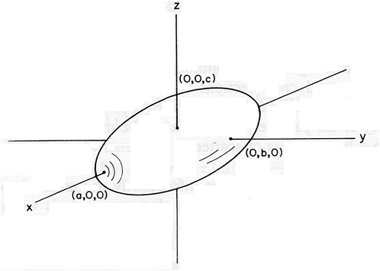
Ellipsoids in the quasi-static limit
Surface of ellipsoid:
For incident field polarized along the x-axis:
where
C. Noguez, J. Phys. Chem. C 111, 3806-3819 (2007).
Absorption and Scattering of Light by Small Particles, C. Bohren and D. Huffman, Wiley-VCH
For incident field with random polarization:

Slide 24
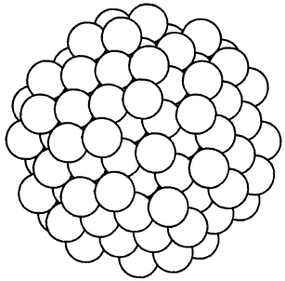
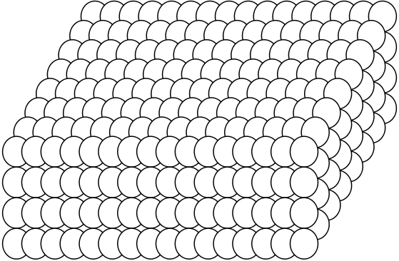
Discrete Dipole Approximation (DDA)
Represented the arbitrary shaped particle as a cubic lattice of N polarizable small subunits (<< λ) with polarizability α_{su}
Induced electric dipole moment of each subunit:
α_{su} is given either by the Clausius-Mosotti relation with the radiative reaction term or the Doyle expression
C. Dungey and C. Bohren, "Light scattering by nonspherical particles: a refinement to the coupled-dipole method," J. Opt. Soc. Am. A 8, 81-87 (1991).
E. Purcell and C. Pennypacker, "Scattering and absorption of light by nonspherical dielectric grains," Astrophys. J. 186, 705-714 (1973).

Slide 25
Discrete Dipole Approximation (DDA)
Local electric field at the i th subunit is the sum of external field E₀ and the dipole field E_{ij} (i ≠ j) of all other subunits at the location r_{i} of the i th subunit
Solve the 3N coupled linear equations for and cross-sections of the particle
A list of DDA computer codes
where

Slide 26
Modified Long Wavelength Approximation (MLWA)
In MLWA, radiative reaction effect and dynamic depolarization are taken into account by adding a radiative correction field term:
Redshift of LSPR peak in larger particles
where
Resonance condition:
“The discrete dipole approximation and its application to interstellar graphite," Astrophys. J. 333, 848 (1988).
“Enhanced fields on large metal particles: dynamic Depolarization,” Opt. Lett. 8, 581-583 (1983).

Slide 27
Multi-pole expansion
-
+
+
-
+
-
+
-
+
-
+
-
+
-
+
Monopole
Dipole
Quadrupole
Octupole
Expanding the scattered field by the particle into high order spherical harmonics: radiation by multi-poles
Quadrupole scattering intensity scales with quadrupole polarizability β
Dipole term
Quadrupole term
quadrupole resonance when

Slide 28
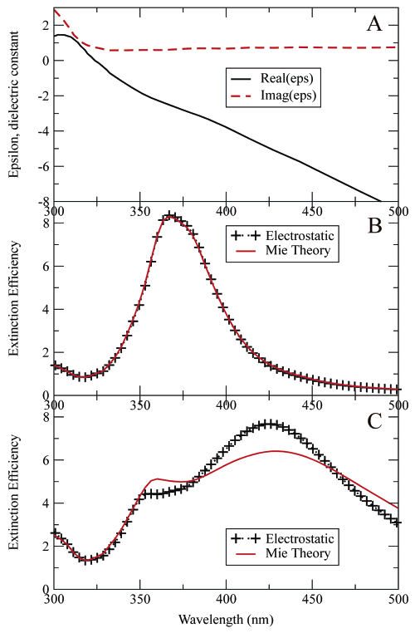
Quadrupole LSPR
Dielectric constant of Ag
a = 30 nm Ag NP
Dipole resonance
Quadrupole resonance
a = 30 nm Ag NP
dipole resonance
a = 60 nm Ag NP
quadrupole LSPR
a = 60 nm Ag NP
Redshift of dipole resonance peak in a =
60 nm particles due to depolarization (MLWA)

Slide 29
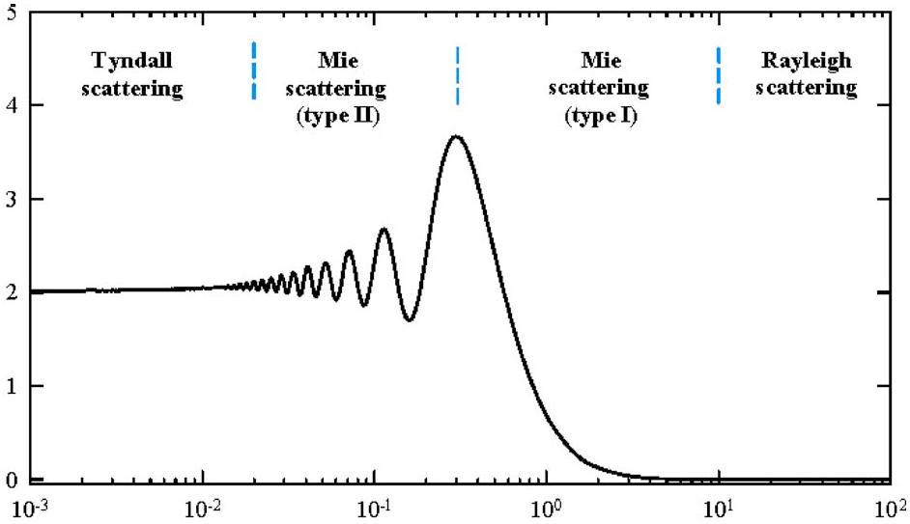
Mie scattering (a ~ λ)
Mie theory deals with scattering by isotropic spheres or cylinders with radii a in a homogeneous medium
Q_{s} → 2 :
extinction paradox
Scattering efficiency
σ_{s} → λ ⁻⁴
Polystyrene microspheres in water
J. Appl. Phys. 105, 023110 (2009).
λ / 2a

Slide 30
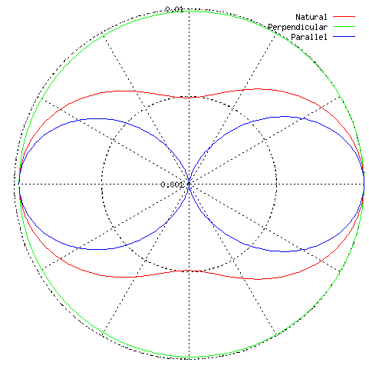
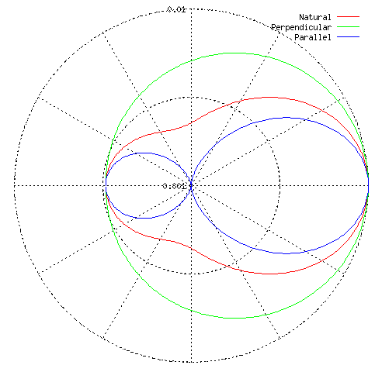
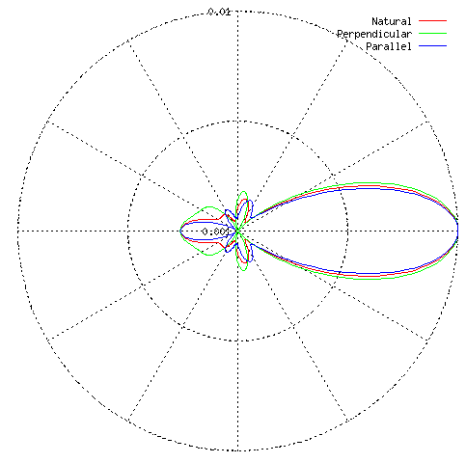
Scattering field pattern by a dielectric sphere
λ / a = 20
λ / a = 4
λ / a = 1
Forward scattering is pronounced in Mie scattering
Plots generated using an online Mie Scattering Calculator

Slide 31

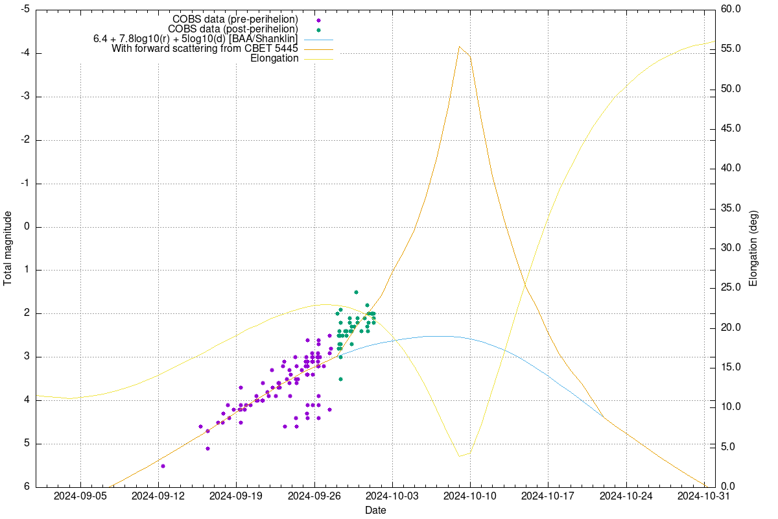
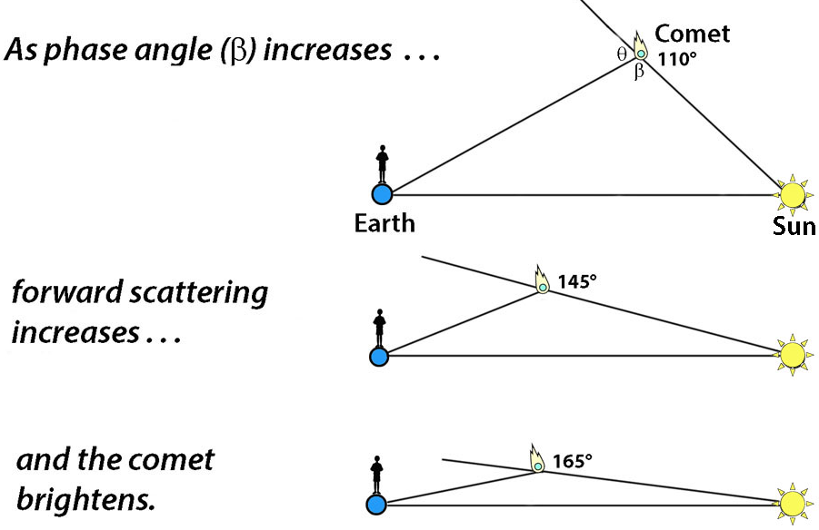
Forward scattering and comet brightness
Tsuchinshan–ATLAS Comet on 10/17/2024
Notes:
https://britastro.org/section_news_item/comet-c-2023-a3-tsuchinshan-atlas-looking-good-for-october

Slide 32
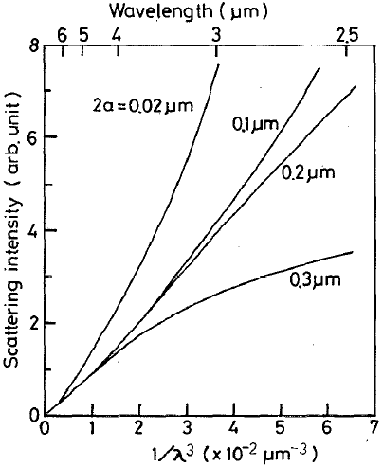
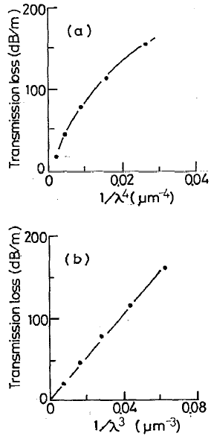
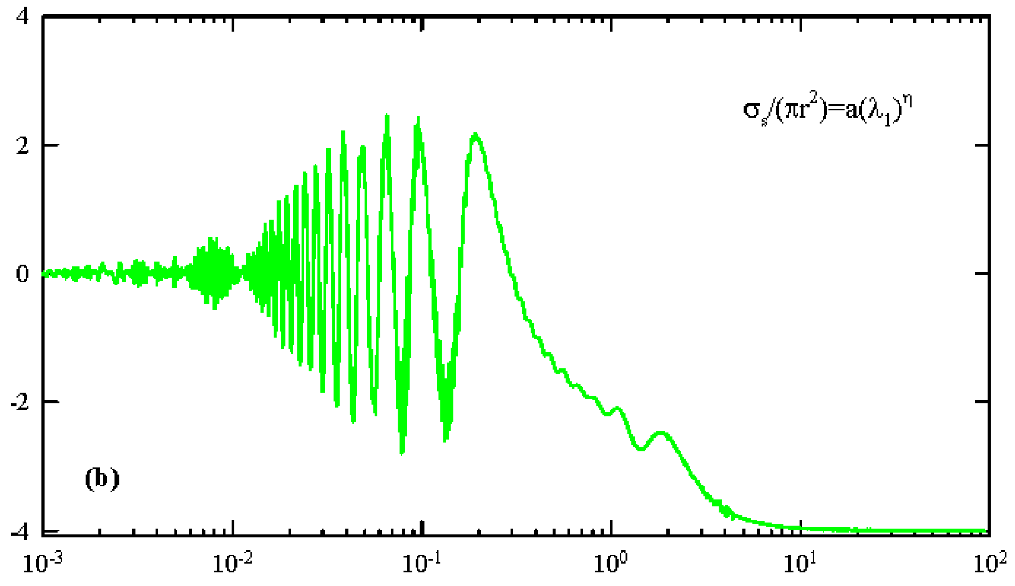
Mie scattering in optical fibers
Power factor η
λ / 2a
Mie scattering by crystalline precipitates
Crystal size estimated based on wavelength dependence of scattering loss
T. Katsuyama and H. Matsumura, J. Appl. Phys. 76, 2036 (1994).

Slide 33
Electron mean free path limitation in nanoparticles
In metal particles smaller than the mean free path of conduction electrons in bulk metal, the mean free path is limited by collisions with the particle boundary
Drude-Sommerfeld model:
Surface damping mainly increases the imaginary part of permittivity
where is the electron velocity at the Fermi surface
is the mean free path for collisions at the surface
For Ag NPs:
U. Kreibig et al., J. Phys. F, 4, 999 (1974).
Notes:
In the last equation, a is given in nm and the equation applies to 405 nm wavelength

Slide 34
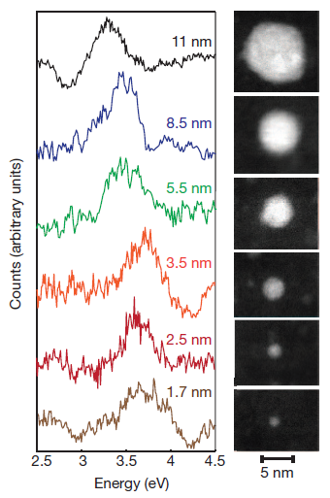
Quantum plasmon resonance
Blue shift of LSPR peak in small (a < 5 nm) metal nanoparticles
Discrete energy levels due to the small number of atoms in a particle
Each transition corresponds to a new bound electron oscillation term in the Lorentz-Drude model
E
Energy band
2a

Slide 35
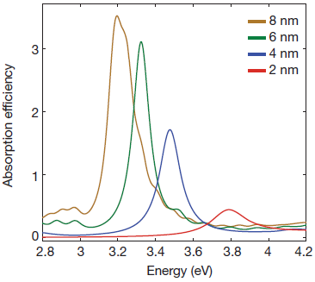
Quantum plasmon resonance
Blue shift of LSPR peak in small (a < 5 nm) metal nanoparticles
Discrete energy levels due to the small number of atoms in a particle
J. Sholl et al., Nature 483, 421-428 (2012).

Slide 36
Applications of LSPR in metal nanoparticles
Small resonance mode volume
  Refractive index sensing: cavity perturbation scales inversely with mode volume
Local field enhancement
  Absorption enhancement in solar cells
  Surface Enhanced Raman Scattering (SERS)
Coupling between metal nanoparticles

Slide 37
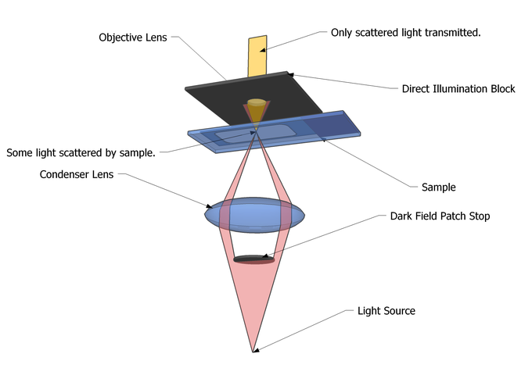
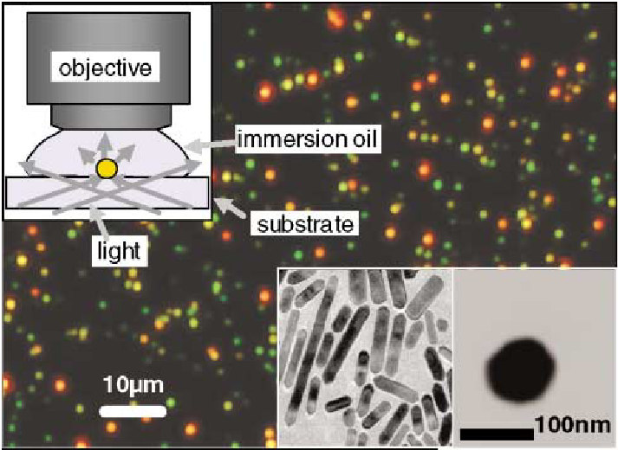
Dark field imaging for scattering measurement
True color image of gold nanorods (red) and gold nanospheres (green)
Phys. Rev. Lett. 88, 077402 (2002).

Slide 38
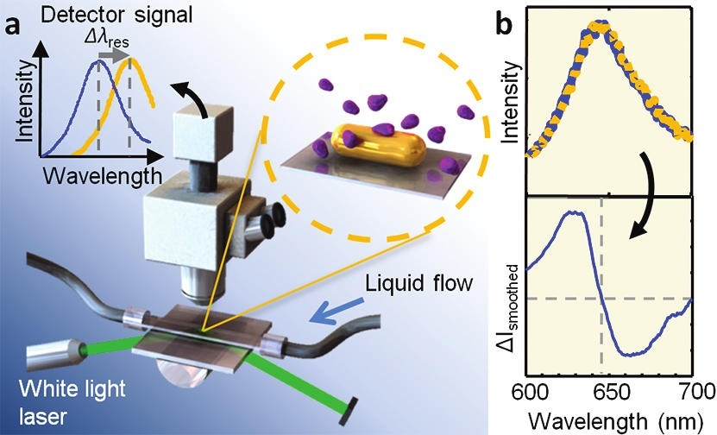
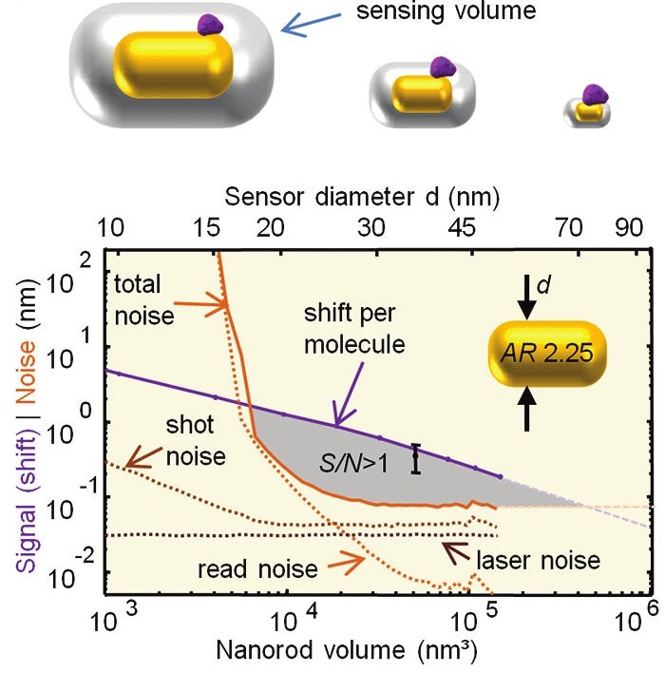
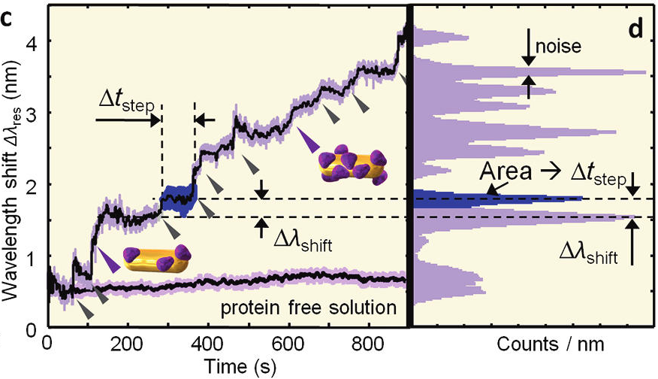
Single protein molecule detection
“Single Unlabeled Protein Detection on Individual Plasmonic Nanoparticles,” Nano Lett. 12, 1092-1095 (2012).

Slide 39
Surface Enhanced Raman Spectroscopy
Raman scattering
  Raman scattering is characterized by “its feebleness in comparison with the ordinary scattering” – C. Raman
  Raman scattering cross sections are typically 14 orders of magnitude smaller than those of fluorescence
SERS: dramatic enhancement of Raman signal on the surface of noble metal nanostructures
  Chemical enhancement factor: ~ 100
  Electromagnetic enhancement factor: 10⁴ up to 10¹¹
Electromagnetic Enhancement Factor (EF):
Chem. Phys. Lett. 423, 63-66 (2006).

Slide 40
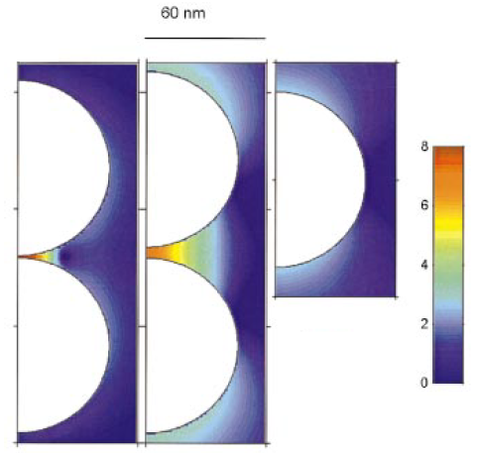
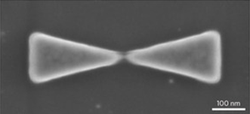
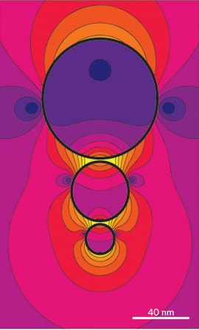
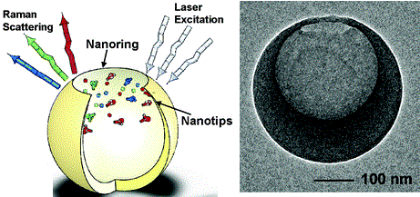
Surface Enhanced Raman Spectroscopy
Field enhancement is most significant at small gaps and sharp tips: the “lightning rod” effect
Bowtie
Trimers
Nanocrescent
Dimers
Phys. Rev. E 62, 4318-4324 (2000). Nat. Photonics 5, 83-90 (2011).
Nano Lett. 5, 119-124 (2005). Chem. Commun. 47, 3769-3771 (2011).

Slide 41
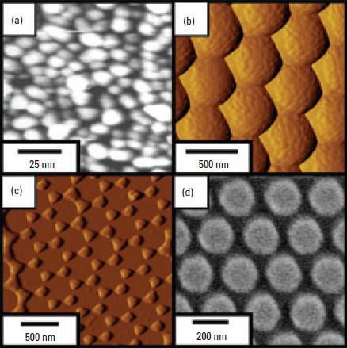
SERS substrates and “hot spots”
The majority of Raman signal is generated by molecules at locations where the field intensity peaks: hot spots
Self-assembly and top-down fabrication
EF up to 10¹⁵
Challenges:
  Hot spot areal density
  Statistical fluctuation
Phys. Rev. Lett. 76, 2444 (1996).
Science 275, 1102 (1997).
Hot spot
Anal. Chem. 77, 338A-346A (2005).

Slide 42
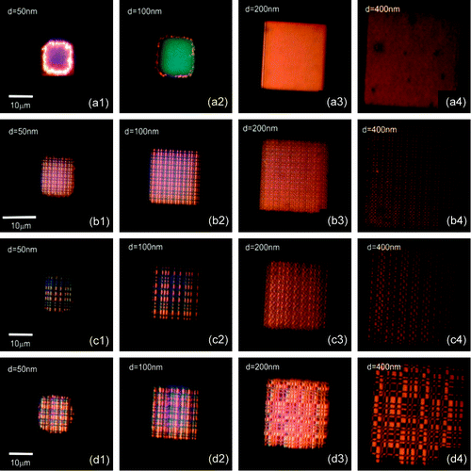
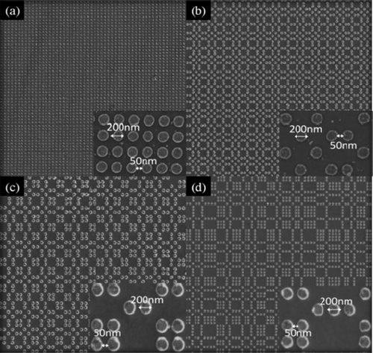
SERS substrates and “hot spots”
The majority of Raman signal is generated by molecules at locations where the field intensity peaks: hot spots
Self-assembly and top-down fabrication
EF up to 10¹⁵
Challenges:
  Hot spot areal density
  Statistical fluctuation
Phys. Rev. Lett. 76, 2444 (1996).
Science 275, 1102 (1997).
Nano Lett. 8, 2423 (2008).

Slide 43
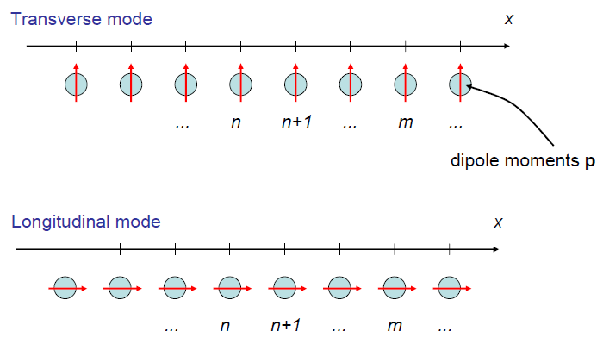
Coupling between nanoparticle resonances

Slide 44
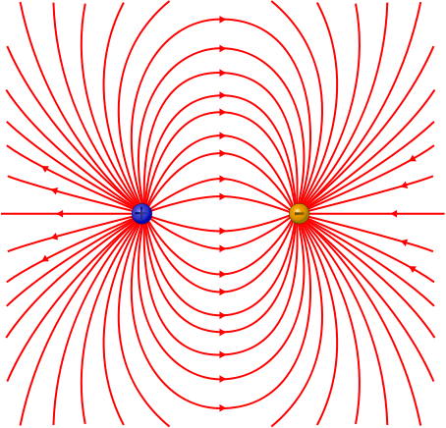
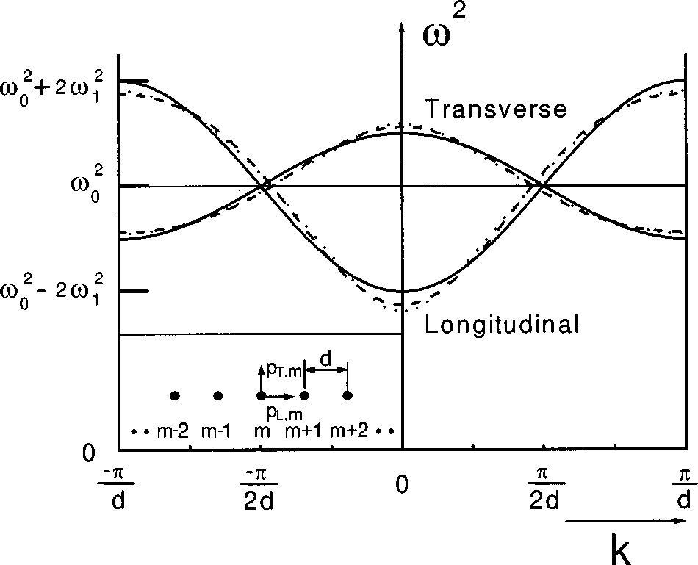
Coupling between nanoparticle resonances
Longitudinal mode: field from neighboring particles reinforces each other
(red shift of resonance)
Transverse mode: field from neighboring particles opposes each other
(Blue shift of resonance)
Brongersma et al., Phys. Rev. B 62, R16356 (2000).

Slide 45
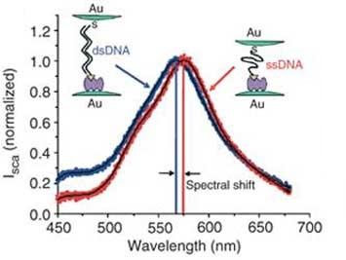
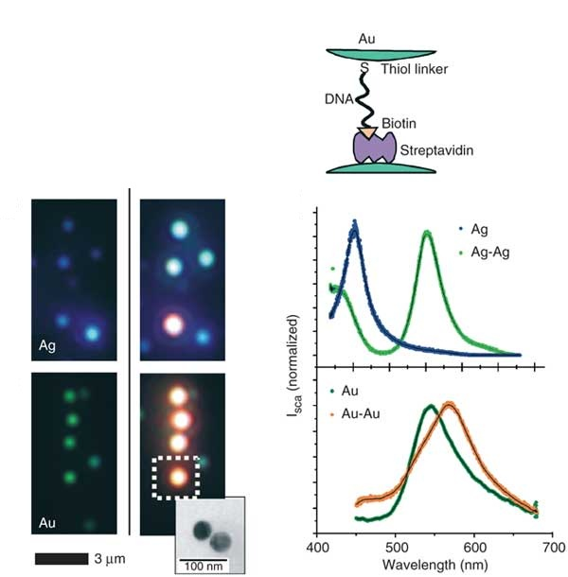
A molecular ruler
Red shift
Single particle
Dimer
With 40 nm particles and a 0.1 nm spectral resolution, it is possible to measure particle separations with 1 nm resolution
Nat. Biotechnol. 23, 741 (2005)

Slide 46
List of symbols
a – spherical particle radius
λ – wavelength
E₀ – incident (applied) electric field amplitude
E₁ / E₂ – electric field amplitude inside / outside the particle
Φ₁ / Φ₂ – electric potential inside / outside the particle
ε₁ / ε₂ – permittivity inside / outside the particle
r – radial coordinate
θ – angular coordinate
q – electric charge

Slide 47
List of symbols
p – electric dipole moment
d – spacing between charges
α – dipole polarizability
V – volume of scatterer
E – electric field (vector)
H – magnetic field (vector)
k – wave number
k – wave vector
P_{s} – scattered power
μ₀ – vacuum permeability

Slide 48
List of symbols
σ_{s} – scattering cross-section
Q_{s} – scattering efficiency
σ_{a} – absorption cross-section
σ_{ext} – extinction cross-section
γ – damping coefficient
ω – angular frequency of oscillating electric field
ω_{p} – plasma frequency
v_{F} – electron velocity at Fermi surface
L – mean free path for electrons due to surface collision
ε_{r} – relative permittivity (dielectric constant)

Slide 49
List of symbols
V_{mode} – resonant mode volume
ω₀ – angular frequency of light at resonance
Δω₀ – resonant frequency change due to perturbation
EF – SERS enhancement factor
λ_{E} – Raman excitation wavelength
λ_{S} – Raman scattering (Stokes) wavelength

