Slide 1
MSEG 803 Equilibria in Material Systems 1: Introduction
Prof. Juejun (JJ) Hu
hujuejun@udel.edu

Slide 2


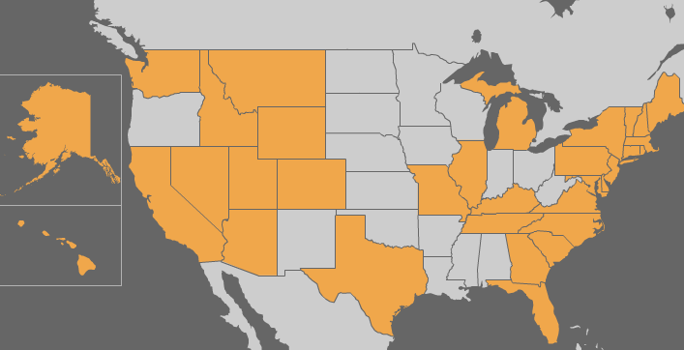
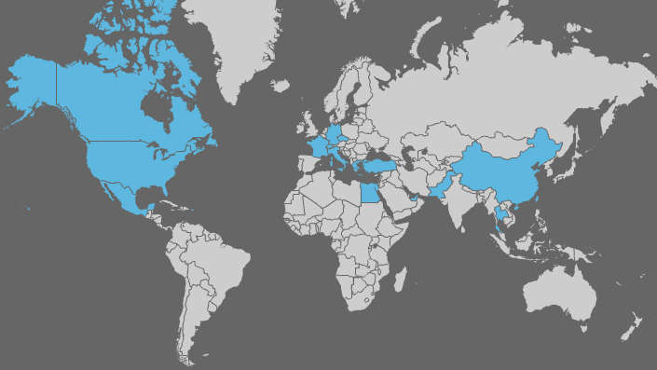
About myself
Ph.D. MIT (2010), joined UD 2010
NanoPhotonic Glass Laboratory
http://udel.edu/~hujuejun/
Office: DuPont Hall 305
E-mail: hujuejun@udel.edu
Hobbies: soccer, reading, traveling
33 states
20 countries

Slide 3
Textbooks
Thermodynamics and an Introduction to Thermostatistics
H. B. Callen, John Wiley & Sons
Fundamentals of Statistical and Thermal Physics
F. Reif, McGraw-Hill

Slide 4
References
Statistical Mechanics
D. McQuarrie, University Science Books
Statistical Physics of Materials
L. Girifalco, John Wiley & Sons
Thermodynamics of Solids
R. Swalin, Wiley-Interscience H. B. Callen, John Wiley & Sons

Slide 5
Grading policies
Two hourlies (mid-terms): 25% each
One final: 35%
Homework assignments: 15%
Discussions are allowed and encouraged; but you are supposed to complete the assignments independently!

Slide 6
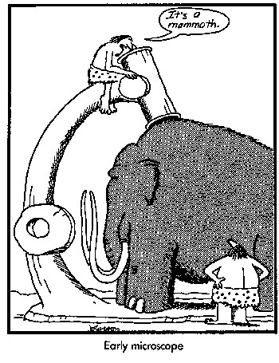
Exams
Exams will be closed book (no Internet, laptop, cell phones, etc.): no phone calls, texting, or collaboration will be allowed. However, you will be allowed to bring one (mid-terms) or three (final) A4 sheets to the exam.
You may print/write whatever you want on the A4 sheets (equations, formulae, definitions, drawings, etc.)
No font/margin requirement
Magnifying lenses or microscopes (!!!) prohibited

Slide 7
Course Sakai site
Lecture slides will be uploaded promptly after classes
Assignments will be uploaded to the site and the homework may either be submitted via Sakai or using paper copies

Slide 8
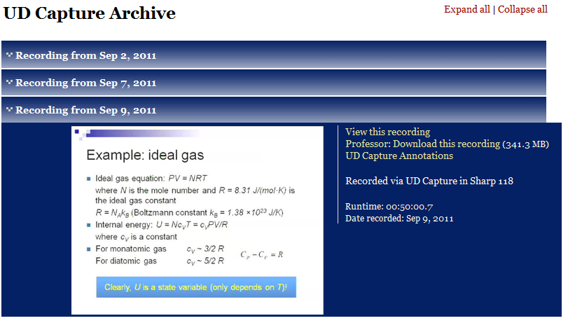
Introducing tablet PC in UD Capture
http://udcapture.udel.edu/2012f/mseg803-010/

Slide 9
Course & exam coverage
Classical thermodynamics
Exam 1
Statistical mechanics
Exam 2
Phase equilibrium
The final exam covers all three modules
Special topics on thermodynamic?

Slide 10
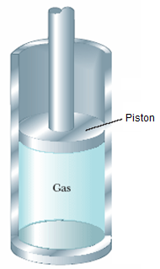
Consider one mole of Ar gas in a container
The classical deterministic approach:
6 × 10²³ atoms: 3 × 6 × 10²³ degrees of freedom (DOF)
Two parameters (coordinate q and momentum p) associated with each DOF at any instant of time
If we know all these 2 × 3 × 6 × 10²³ parameters at a given time, in principle we can use classical mechanics to predict the evolution
Need to know the initial conditions exactly!
P = mg/A
Notes:
Tossing a single dice: deterministic approach

Slide 11
Three-body problem and the butterfly effect
Three-body gravitational interaction
http://www.upscale.utoronto.ca/PVB/Harrison/Flash/Chaos/ThreeBody/ThreeBody.html
Extreme sensitivity to initial values
Chaos theory
“One flap of a seagull's wings could change the course of weather forever…”
Rapidly amplifies any measurement/computation error

Slide 12
Consider one mole of Ar gas in a container
P = mg/A
The statistical mechanics approach:
Ensemble:
A large number of mental copies of a system, each of which represents a possible state that the real system might be in subjecting to certain constraints
Derive the statistical (“average”) behavior of gas molecules based on the law of mechanics
Notes:
Gambling and probability theory: the MIT Blackjack team

Slide 13
Classical thermodynamics
Phenomenological, macroscopic theory
Generality: predicts basic properties of materials even with minimal specific information
We know how, but do not know why
We know that there is such thing as entropy that increases -- what is the thing entropy though?
Length scale: > microns to enable statistical averaging
Building on a number of fundamental postulates to derive generic relations
Notes:
Working substance selection for refrigerator: thermo and stat are complementary

Slide 14
Consider one mole of Ar gas in a container
P = mg/A
A thermodynamic description:
The gas is fully characterized by a set of macroscopic parameters in equilibrium:
Pressure P, temperature T, volume V
These parameters are called state functions
Microscopically, these parameters have specified very little information about the system (gas)!
Notes:
Non-equilibrium: resistive heating of gas

Slide 15
Equilibrium state
In all systems, there is a tendency to evolve towards states in which the properties are determined by intrinsic factors and not by previously applied external influences. Such terminal states are, by definition, time independent. They are called equilibrium states.
Relaxation time
Operational definition
One macroscopic equilibrium state may correspond to many microscopic states of the system
Notes:
This is a fundamental postulate of thermo, relaxation, time scale, application to glasses, operational definition of equilibrium

Slide 16
State functions
Examples: P, V, T, N
Macroscopic in nature
State functions are path independent
Not all state functions are independent
Ideal gas equation: PV = NRT
where N is the mole number and R = 8.31 J/(mol·K) is the ideal gas constant
State functions are path independent
For cyclic process
Notes:
Ideal gas example: path integration of volume change

Slide 17
Extensive and intensive parameters
Extensive parameters: dependent on the size of the system; additive for sub-systems in a composite system
Volume V, mole number N, magnetization M, electric polarization p
Intensive parameters: independent on the size of the system
Pressure P, Temperature T, Magnetic field B, electric field E
Molar quantities: molar volume v = V/N

Slide 18
Quasi-static process
Reif: A process carried out so slowly that the system remains arbitrarily close to equilibrium at all stages of the process
Callen: A quasi-static process is a dense succession of equilibrium state on a locus in the thermodynamic configuration space
An infinitely slow process: the system is always in equilibrium
The time scale involved in all stages of a quasi-static process must be significantly larger than relaxation time of the system towards equilibrium
A quasi-static process, in contrast to a real process, does not involve considerations of rates, velocities, or time
Notes:
First describe what is a “process”; relaxation time: density wave in gas, solidification of liquid into crystals or glasses

Slide 19
Different processes
Isothermal: constant temperature T
Isobaric: constant pressure P
Isochoric: constant volume V
These processes can either be quasi-static or non-quasi-static
Isothermal quasi-static expansion of ideal gas
Isothermal free expansion of ideal gas

Slide 20
Walls (boundaries) and constraints
A wall that constrains an extensive parameter of a system to have a definite value is said to be restrictive with respect to that parameter
If the piston and the cylinder are rigidly fixed, they constitute a wall restrictive with respect to volume
A wall impermeable to a chemical component is restrictive with respect to the mole number of that component
An adiabatic wall is restrictive with respect to heat flow (a diathermal wall is non-restrictive to heat flow)

Slide 21
Composite systems and sub-systems
Example: a gas cylinder
(a composite system)
separated into two
compartments (sub-systems)
by a piston (constraint)
The nature of the constraint determines the state variables in sub-systems
A central problem in thermodynamics is solving the final equilibrium state in a composite system after removal of a constraint
T₁, P₁, V₁
T₂, P₂, V₂

