Slide 1
MSEG 803
Equilibria in Material Systems
10: Heat Capacity of Materials
Prof. Juejun (JJ) Hu
hujuejun@udel.edu

Slide 2

Heat capacity: origin
Molar heat capacity:
Internal energy of solids:
  Lattice vibration: collective motion of interacting atoms
  Electron energy (metals)
  Other contributions: magnetic polarization, electric polarization, chemical/hydrogen bonds, etc.
This mole has a large molar heat capacity

Slide 3
Material | Molar heat capacity c_{v} (J/mol K) | c_{v}/R | Type |  | Degrees of freedom
He | 12.5 | 1.5 |  | Monatomic gas | 3 translational Total 3
Ne | 12.5 | 1.5
Ar | 12.5 | 1.5
Gases
H₂ | 20.2 | 2.43 |  | Diatomic gas | 3 translational 2 rotational Total 5
O₂ | 20.2 | 2.43
N₂ | 19.9 | 2.39
H₂S | 26.7 | 3.22 |  | Triatomic gas | Depends on molecular geometry
CO₂ | 28.5 | 3.43
H₂O (100 °C) | 28.0 | 3.37
Non-metal solids
Arsenic | 24.6 | 2.96 |  | Atomic solid | 3 translational 3 vibrational Total 6
Antimony | 25.2 | 3.03
Diamond | 6.1 | 0.74
Copper | 24.5 | 2.95
Silver | 24.9 | 3.00
Metal solids
Mercury | 28.0 | 3.36 |  | Liquid | ?
H₂O | 75.3 | 9.06
Gasoline | 229 | 27.6
Liquids
The values are quoted for 25 °C and 1 atm pressure for gases unless otherwise noted

Slide 4
Heat capacity of a harmonic oscillator
Energy:
Partition function:
Mean energy:
Heat capacity:
Classical
Quantum mechanical

Slide 5
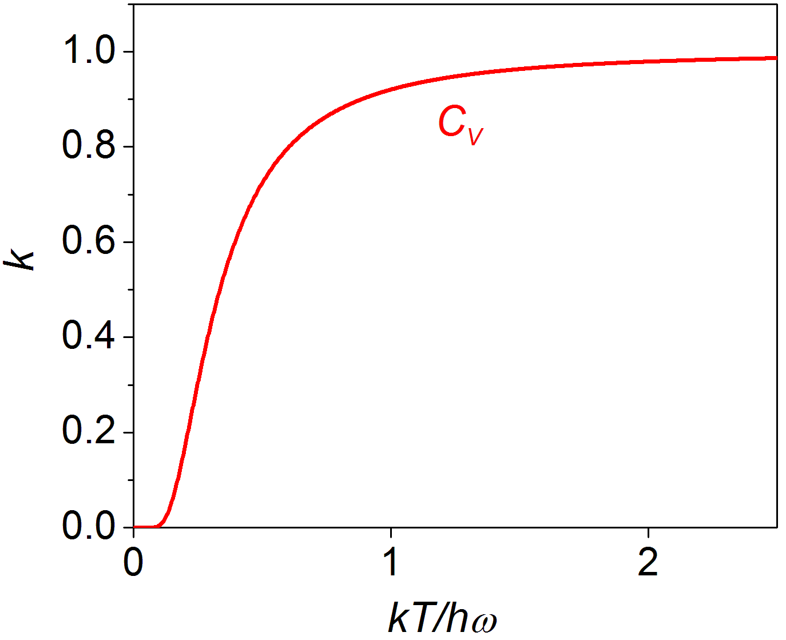
Heat capacity of a harmonic oscillator
High T limit
Low T limit
Notes:
High temperature limit obeys the energy equipartition theorem: there are two quadratic terms in the Hamiltonian of a harmonic oscillator (each should contribute 0.5 k heat capacity according to the theorem), and therefore the heat capacity is 2*0.5*k = k.

Slide 6
Heat capacity of polyatomic gas
“Freeze-out” temperature of harmonic oscillators:
When T < T_{f}, the DOF hardly contributes to C_{v}
Generally, T_{f} is defined as the temperature at which kT is much smaller than the energy level separation
Translational degrees of freedom: energy level very closely spaced (particles in a box)
Rotational degrees of freedom:
Bond stretching degrees of freedom:
At RT, only translational and rotational DOFs contributes to C_{v}
Notes:
Translational and rotational DOFs in fact cannot be described using the harmonic oscillator model – but the statement that when the energy separation between the quantum mechanical levels well exceeds kT, the DOF stops contributing to Cv is generally applicable.

Slide 7
Lattice vibration energy in solids
Construct generalized coordinates
The energy (Hamiltonian) is decomposed into a set of independent harmonic oscillators
Solve the partition function
The product of n harmonic oscillator partition functions, where n = 3N is the DOF
Calculate mean energy and heat capacity
High temperature and low temperature limits
Apply models of phonon density of states
Debye approximation

Slide 8
Lattice vibration energy in solids
Consider a solid consisting of N identical atoms
Kinetic energy:
Potential energy:
Define generalized coordinates:
Normal modes

Slide 9
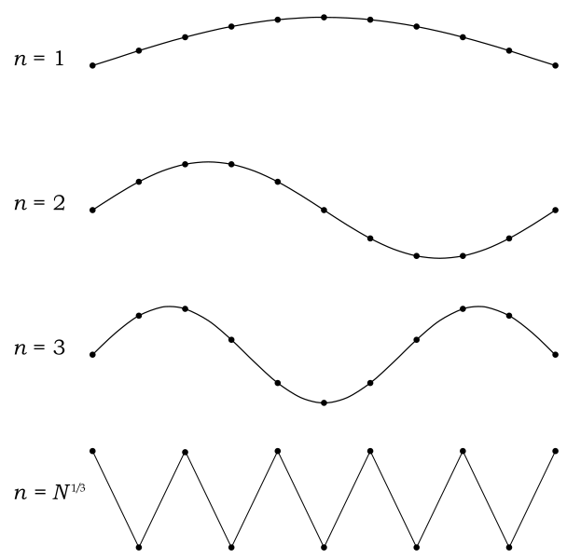
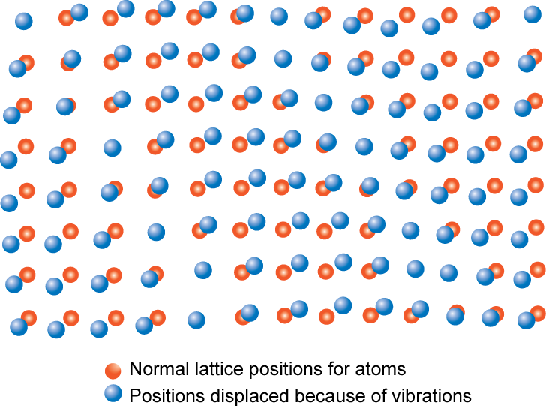
Normal modes (lattice waves)
Lattice waves can be decomposed to different normal modes: Fourier analysis
Normal modes of lattice wave:
in analogy to “particle-in-a-box”

Slide 10
Energy associated with normal modes
3N harmonic oscillators:
Energy of each mode:
Total energy:
Partition function:
phonons

Slide 11
Partition function and heat capacity
Define the phonon density of state : the number of normal modes with frequency between ω and ω + dω
Mean energy:
Heat capacity:

Slide 12
High temperature limit: the Dulong-Petit law
Heat capacity:
When
Total number normal modes:
Molar heat capacity: 3R (the Dulong-Petit law)

Slide 13
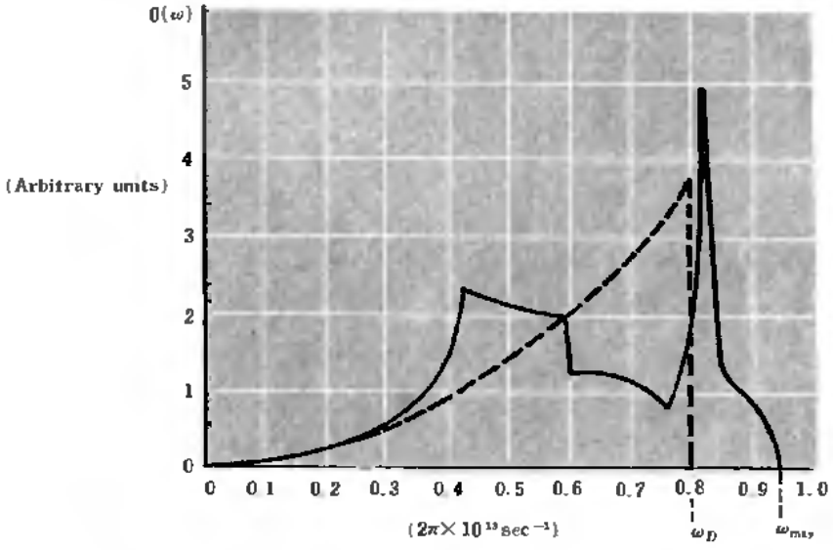
Debye approximation
Normal modes are treated as acoustic waves in continuum mechanics
DOS of acoustic waves:
Debye frequency
sound wave velocity
wave vector

Slide 14
Debye heat capacity
Debye heat capacity
Debye function:
Debye temperature:
At high ,
At low ,

Slide 15

Debye heat capacity
• Heat capacity
-- increases with temperature
-- for solids it reaches a limiting value of 3R (Dulong-Petit law)
-- at low temperature, it scales with T³
R = gas constant
3R
C_{v} = constant
= 8.31 J/mol-K
C_{v}
0
T (K)
0
Θ
D
Debye temperature
)
(usually less than RT

Slide 16
Electron heat capacity
Fermi-Dirac distribution:
Mean energy of electron gas:
Heat capacity:
Only significant at very low temperature
Factor 2: spin degeneracy
μ₀ : Fermi surface at 0 K
E₀ : electron gas energy at 0 K

Slide 17
Other contributions
Magnetization in paramagnetic materials:
Hydrogen bonds
  Hydrogen-containing polar molecules like ethanol, ammonia, and water have intermolecular hydrogen bonds when in their liquid phase. These bonds provide another place where heat may be stored as potential energy of vibration, even at comparatively low temperatures

Slide 18
THE FOLLOWING PREVIEW HAS BEEN APPROVED FOR
ALL MSEG 803 PARTICIPANTS
R | RESTRICTED
 | VIEWERS WHO HAVEN’T TAKEN THERMODYNAMICS REQUIRES ACCOMPANYING MSEG 803 STUDENTS
STRONG PHYSICS AND MATHEMATICS COMPONENTS
®
www.thermoratings.com
www.physicsgeeks.org

Slide 19

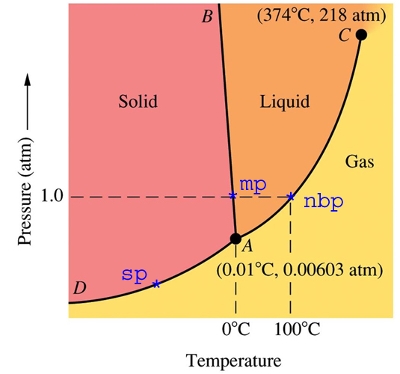
We proudly present to you
the thermodynamic magic show
and it is all about phase transition

