Slide 1
MSEG 803 Equilibria in Material Systems 2: First Law of TD
Prof. Juejun (JJ) Hu
hujuejun@udel.edu

Slide 2
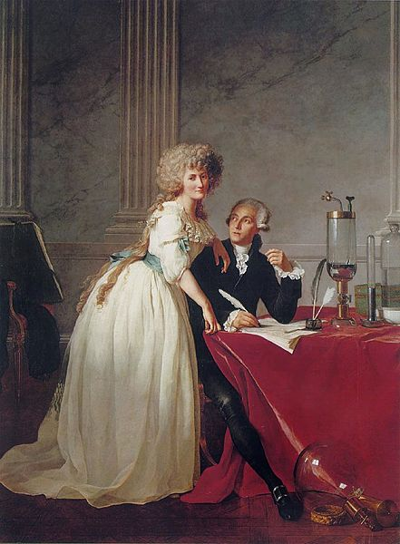
Early theory of heat: the caloric fluid
Developed by Antoine Lavoisier in 1783
‘The substance of heat is a subtle fluid called caloric… the quantity of this substance is constant throughout the universe, and it flows from warmer to colder bodies.’
The caloric fluid was listed as an element in the first table of elements made by Lavoisier, along with hydrogen, oxygen, sulfur, etc. and light.

Slide 3
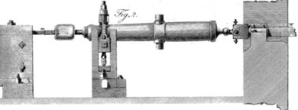
Rumford’s experiment
Boring cannons (1798): the friction of the iron bit on the brass generated heat… LOTS of heat!
‘… the source of the heat generated by friction, in these experiments, appeared evidently to be inexhaustible.’
Heat is not a conserved quantity
Heat is NOT a substance
Notes:
Rumford carefully collected these fragments and found them to be identical to the ordinary metal in heat capacity, etc., they didn’t seem to have lost anything. Then he measured the heat production for an extended period, by having the brass cylinder immersed in water, and insulated. After extended grinding, the water (two gallons) began to boil.
Lavoisier, founder of the caloric theory, was beheaded by French revolutionaries in 1794, leaving a very attractive widow. Rumford married her in 1805. Perhaps not too surprisingly, the marriage didn’t go well.
http://www.uh.edu/engines/epi1673.htm

Slide 4
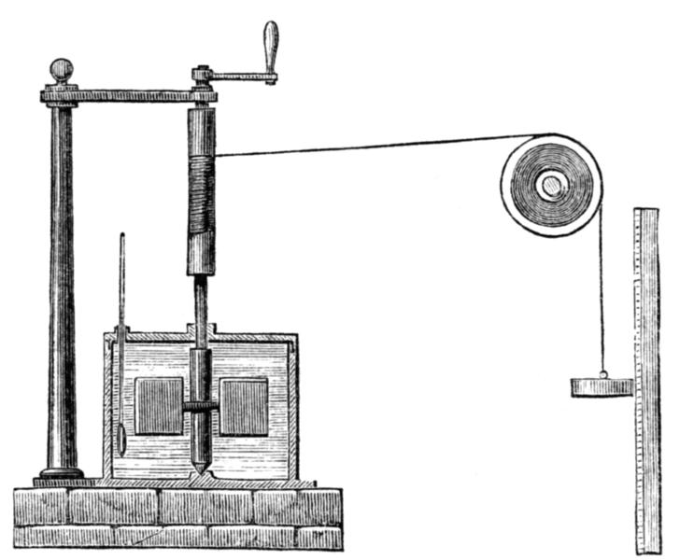
Joule experiment
(1)
Enclosed by an adiabatic wall
Mechanical work W
Water (system)
Water (system)
(2)
Enclosed by a rigid, diathermal wall
Q and W can equivalently change the state of the system!
Water (system)
Water (system)
Heat flux Q

Slide 5
First law of thermodynamics (the conservation of energy)
The change in the internal energy of a system equals the sum of heat flux into the system and work done on the system in the process.
ΔU = ΔQ + ΔW dU = δQ + δW = δQ - PdV
δQ and δW are related to a process but not a state
δQ and δW : inexact/imperfect differentials
Path dependence:
- PdV = δW only for quasi-static processes in simple systems
- dV is an exact differential but - PdV is not (Reif 2.11)!
Consequence of the translational symmetry of time
Ch. 21 Callen book
Notes:
Sign convention
Micro free expansion; constant P -> change V and then constant V -> change P vs. flipping order;
Internal energy change resulting from work and heat is not distinguishable

Slide 6
Internal energy U
Extensive state variable: path independent
u = U/N : the internal energy of a system of one mole (intensive)
Only relative values of U (i.e. internal energy change) matters!
Forms:
Kinetic energy;
Potential energy (e.g. gravitational potential energy);
Conservation of mechanical energy
Thermal energy (atomic motion and vibration);
Electric polarization energy;
Magnetic polarization energy;
Relativistic rest-mass energy;
…
Notes:
dW = delta (1/2 mv^2)
For a cyclic process, dU = 0 but dW and dQ might not vanish

Slide 7
Generalized “work”
Change of electric polarization energy:
Change of magnetic polarization energy:
intensive
extensive
Notes:
Note the negative sign of – PdV!

Slide 8
Different quasi-static processes
Adiabatic: δQ = 0, dU = dW = - PdV
Isochoric: dV = 0, δW = 0, dU = dQ
Isobaric: P = constant
Enthalpy: H = U + PV Also a state variable!
Enthalpy change in an isobaric process is equal to heat taken in or given out from the simple system

Slide 9
Enthalpy of phase change
Vaporization
The difference in enthalpy per mole of molecules between the gaseous and liquid states of a substance is called the enthalpy of vaporization, ΔH_{vap}
Fusion/melting
The difference in enthalpy per mole of molecules between the liquid and solid states of a substance is called the enthalpy of fusion, ΔH_{fus} ~ ΔU_{fus}
Sublimation
The difference in enthalpy per mole of molecules between the gaseous and solid states of a substance is called the enthalpy of sublimation, ΔH_{sub}
ΔH_{sub} = ΔH_{vap} + ΔH_{fus}

Slide 10
Heat capacity
(Molar) heat capacity C is the ratio of heat absorbed or given off (by one mole of substance) to the resulting change in temperature
Note: C is usually not used when phase change is involved (instead ΔH is invoked)
Heat capacity is extensive while molar heat capacity is intensive

Slide 11
Heat capacity (cont’d)
Temperature in itself does not specify the final state; generally heat capacity is defined when a second state variable (e.g. V, P) is held constant:
For most materials, C_{P} > C_{V}
At constant pressure, extra work is done by the system due to volume expansion
Notes:
Example: ideal gas Cp – Cv = R

Slide 12
Material | Molar heat capacity c_{v} (J/mol K) | c_{v}/R | Type |  | Degrees of freedom
He | 12.5 | 1.5 |  | Monatomic gas | 3 translational Total 3
Ne | 12.5 | 1.5
Ar | 12.5 | 1.5
Gases
H₂ | 20.2 | 2.43 |  | Diatomic gas | 3 translational 2 rotational Total 5
O₂ | 20.2 | 2.43
N₂ | 19.9 | 2.39
H₂S | 26.7 | 3.22 |  | Triatomic gas | Depends on molecular geometry
CO₂ | 28.5 | 3.43
H₂O (100 °C) | 28.0 | 3.37
Non-metal solids
Arsenic | 24.6 | 2.96 |  | Atomic solid | 3 translational 3 vibrational Total 6
Antimony | 25.2 | 3.03
Diamond | 6.1 | 0.74
Copper | 24.5 | 2.95
Silver | 24.9 | 3.00
Metal solids
Mercury | 28.0 | 3.36 |  | Liquid | ?
H₂O | 75.3 | 9.06
Gasoline | 229 | 27.6
Liquids
The values are quoted for 25 °C and 1 atm pressure for gases unless otherwise noted

Slide 13
Example: ideal gas
Ideal gas equation: PV = NRT
where N is the mole number and R = 8.31 J/(mol·K) is the ideal gas constant
R = N_{A}k_{B} (Boltzmann constant k_{B} = 1.38 ×10²³ J/K)
Internal energy: U = Nc_{V}T = c_{V}PV/R
where c_{V} is a constant
No interactions between ideal gas molecules
For monatomic gas c_{V} ~ 3/2 R
For diatomic gas c_{V} ~ 5/2 R
Clearly, U is a state variable (only depends on T)!

Slide 14
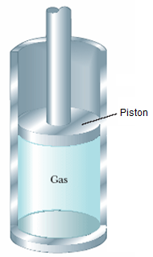
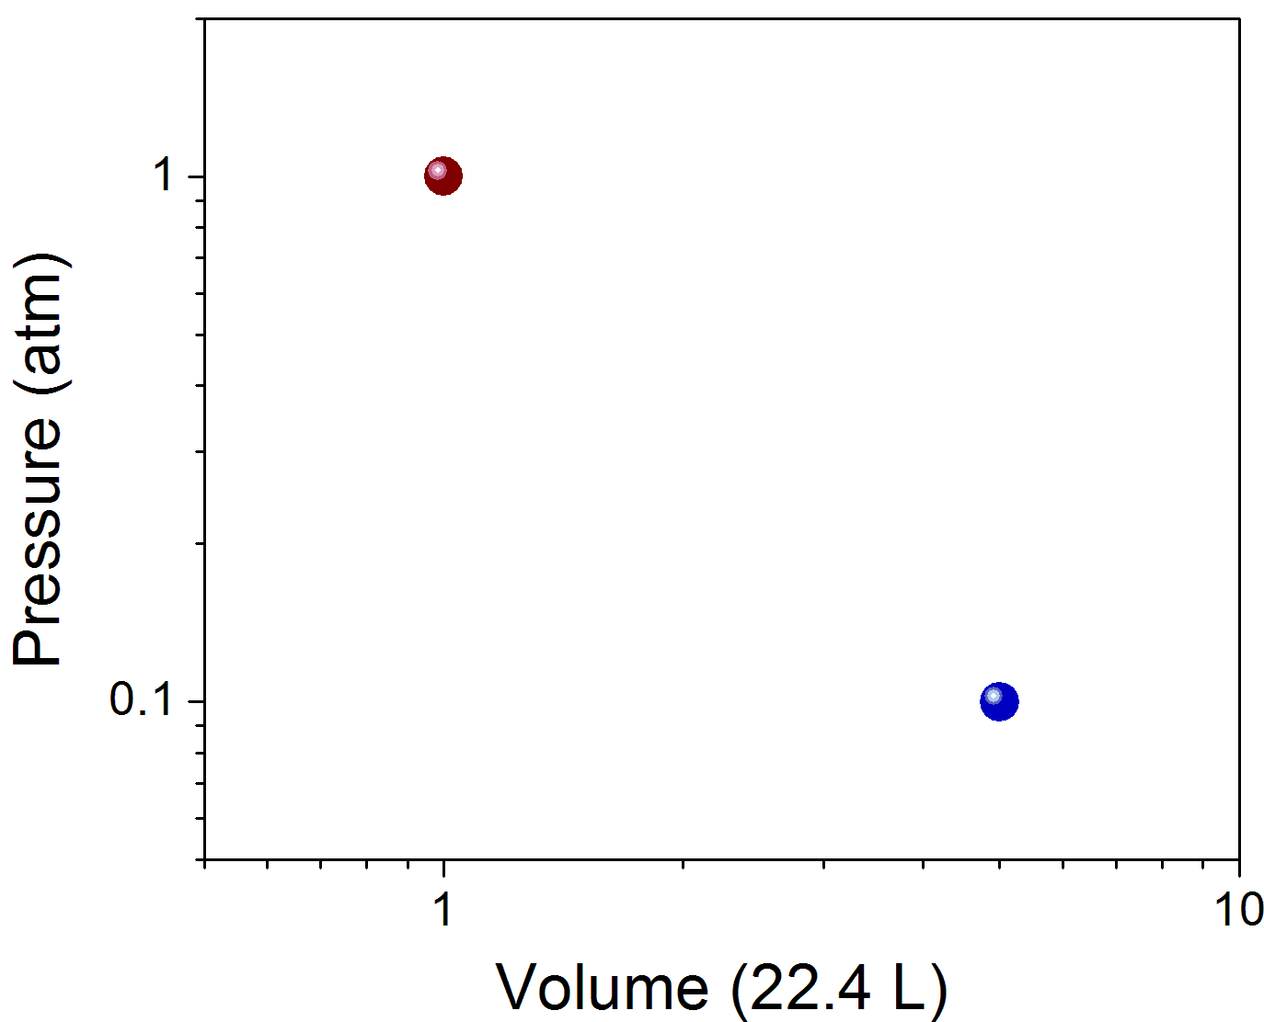
Consider one mole of monatomic gas characterized by the equations in the last slide.
Calculate ΔU, ΔW and ΔQ when the gas quasi-statically change from state A: P = 1 atm (10⁵ Pa), V = 22.4 L to state B: P = 0.1 atm, V = 112 L along the curves;
Derive the equations of isotherms and adiabats in the P-V plane.
A
C
P³V⁵ = constant
D
B
E
Notes:
Quasi-static adiabat always lies below the isotherm on the P-V plot

Slide 15
Quasi-static isothermal and adiabatic processes of ideal gas
Isothermal process
T = T₀ (constant), PV = NRT₀
U = Nc_{V}T₀ (constant), i.e. dU = 0
Adiabatic process
δQ = 0, dU - δW = 0
For monatomic gas:
For diatomic gas:
Notes:
Basic approach: first determine the state function that is kept constant; then use this condition in conjunction with the first law of TD to determine the functional relation between different state variables

Slide 16
Adiabatic free expansion (non-quasi-static)
Removal of constraint
T, P, V_{i}
T, P, V_{i}
Vacuum
Constraint with respect to volume
Free expansion usually occurs so rapidly that heat transfer is negligible in the process: δQ = 0
Rigid walls: δW = 0
dU = 0, T = constant for ideal gas (for non-ideal gas T may change!)
Different from adiabatic quasi-static expansion where δW < 0 !
Notes:
Joule’s experiment to verify dT = 0 in adiabatic free expansion

Slide 17
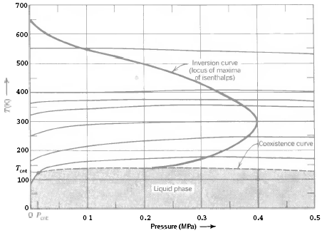
Joule-Thomson (throttling) process
Isenthalpic curves
P₁
P₂
dH = 0 (i.e. U + PV = constant) in a Joule-Thomson process
For ideal gas, dT = 0
For real gas, dT can either be greater or smaller than zero
Inversion point:
P > P_{inv}, J-T process leads to heating
P < P_{inv}, J-T process leads to cooling
Notes:
Throttling process is not quasi-static: the intermediate states of gas are not in equilibrium so even H is not well-defined. Here we only refer to H of initial and end states.

Slide 18
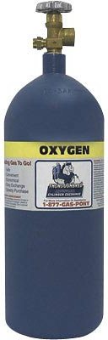
Releasing gas from a compressed air cylinder
T change?
P₁
P₂
Gas passing through the valve: dH = 0
Gas remaining in the cylinder: δQ = 0, δW < 0, dU < 0
Notes:
Quantitative example: T^Cv = N^R

