Slide 1
MSEG 803
Equilibria in Material Systems
9: Ideal Gas Quantum Statistics
Prof. Juejun (JJ) Hu
hujuejun@udel.edu

Slide 2
Ideal gas: systems consisting of particles with negligible mutual interactions
Classical ideal gas (Maxwell-Boltzmann MB statistics)
  All particles are distinguishable
Quantum statistics
  Indistinguishable particles: interchanging two particles does not lead to a new state
  Particles with integral spin (Bosons in Bose-Einstein BE statistics)
  Particles with half-integral spin (Fermions in Fermi-Dirac FD statistics): one single particle state can only be occupied by one particle (Pauli exclusion principle)

Slide 3
Microscopic states of ideal gas systems
Example: a 2-particle system with 3 single particle states
Single particle states are different from microscopic states of a multi-particle system!
MB Statistics
BE Statistics
FD Statistics
State 1 | State 2 | State 3
AB
 | AB
 |  | AB
A | B
B | A
A |  | B
B |  | A
 | A | B
 | B | A
State 1 | State 2 | State 3
AA
 | AA
 |  | AA
A | A
A |  | A
 | A | A
State 1 | State 2 | State 3
A | A
A |  | A
 | A | A
There is a greater tendency for particles to bunch together in the BE case
Notes:
Define Social Clustering Index SCI = # of states where particles share a single level / total # of states – Bosons have the highest SCI and Fermions the smallest

Slide 4
Classical case: Maxwell-Boltzmann distribution
Take an individual system in a canonical ensemble as one single classical ideal gas particle. The probability of finding the particle in a specific single-particle level with energy E_{r} (in this case also the energy level of the system) is given by the canonical probability distribution function:
Assumptions: no interactions between particles (ideal gas), all particles are distinguishable

Slide 5
Two methods of deriving distribution functions
Model the systems as canonical ensembles
Model the systems as micro-canonical ensembles
Fix temperature
Calculate partition function Z
Calculate average particle # which minimizes Z
Fix internal energy
Calculate # of states Ω
Calculate average particle # which maximizes Ω
Notes:
The two methods are in close analogy with the derivation of equivalence between internal energy minimization & entropy maximization principles

Slide 6
Quantum statistics: problem formulation
Quantum states/levels of a single particle: r, s
Energy of single particle levels r or s: ε_{r} or ε_{s}
Number of particles in state r or s: n_{r} or n_{s}
Quantum state of the entire ideal gas system: R
Energy of the system in state R :
Canonical partition function:
Mean number of particles in a single particle state r :

Slide 7
Fermi-Dirac distribution
n_{s} = 0 or 1, ; define:
In macroscopic systems:

Slide 8
Fermi-Dirac distribution: alternative derivation
The different number of ways to distribute n_{i} particles over g_{i} degenerate sub-levels of an energy level ε_{i} :
The total number of ways the set of occupation numbers { n_{i} } can be realized:
Maximizing Ω subjected to the constraints:
Notes:
http://www.ece.rutgers.edu/~maparker/classes/582-Chapters/Ch08-StatMech/Ch08S05DerivFermiDirac.pdf

Slide 9
Partition function of Fermion ideal gas
Constraint:
Define sharply peaking at N’ = N

Slide 10
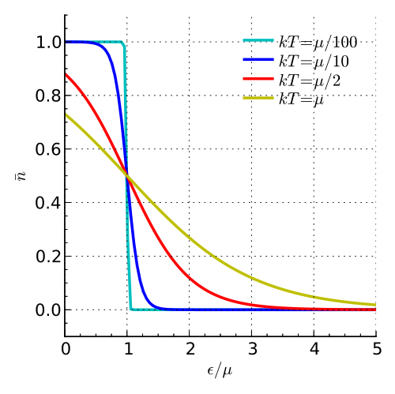
Properties of Fermi-Dirac distribution
At T = 0 K, FD distribution is a step function and the chemical potential defines the Fermi surface
  Electrons in metals
When , FD distribution can be approximated by the classical MB distribution
  Electrons in the conduction band of semiconductors or insulators

Slide 11
Bose-Einstein distribution
n_{r} can be any positive integer,
Chemical potential μ is determined by
For a system comprised of conservative Bosons, μ is always lower than any single-particle energy level
Partition function:
Notes:
Entropy becomes negative if the chemical potential as average Gibbs free energy is higher than any single-particle energy level; note that the PV term is negligible in a system of macroscopic size (a simple example is the particle in a box model)

Slide 12
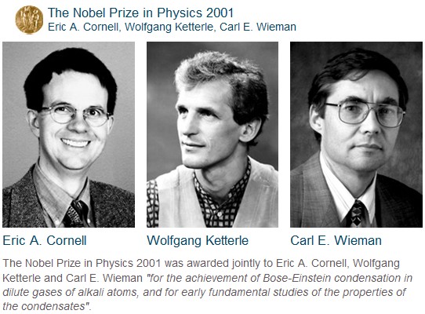
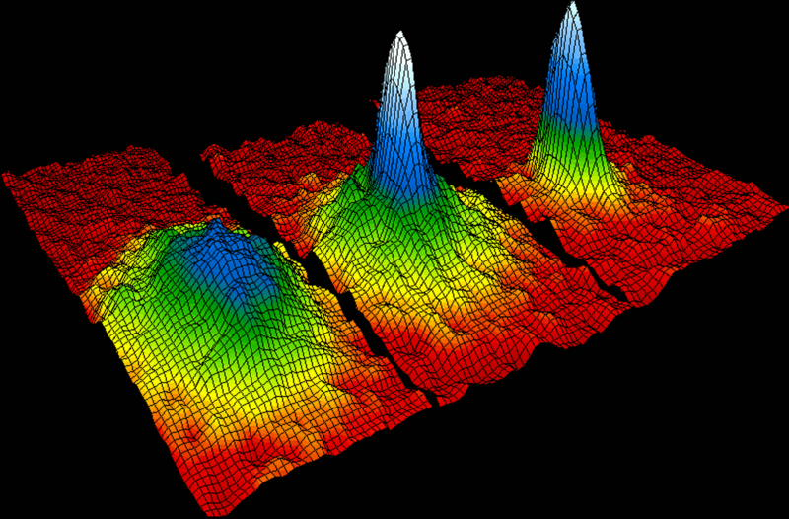
Bose-Einstein condensate (BEC)
At low temperature, Bosons tends to cluster at the lowest energy quantum mechanical state
Velocity-distribution data of a gas of Rb atoms. Left: just before the appearance of BEC. Center: just after the appearance of BEC. Right: nearly pure BEC.

Slide 13
Photon statistics (Planck statistics)
Photons are Bosons
The total number of photons is NOT conserved: μ = 0
In equilibrium:
Note that the condition μ = 0 only applies to photons in thermal equilibrium with a blackbody!

Slide 14
Statistics of blackbody radiation
Blackbody: an idealized physical body that absorbs all incident electromagnetic radiation
Wave vector quantization condition:
Photon energy:
L

Slide 15
Statistics of blackbody radiation (cont’d)
The volume each state occupies in the phase space:
Photon Density of States (PDOS):
k_{y}
E + dE
E
k_{x}

Slide 16
Statistics of blackbody radiation (cont’d)
Total # of photons with energy between E to E + dE :
Total number of photons with frequency between ν to ν + dν per unit volume:
Total energy of photons having frequencies between ν to ν + dν per unit volume:

Slide 17
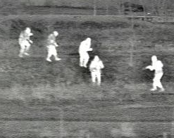

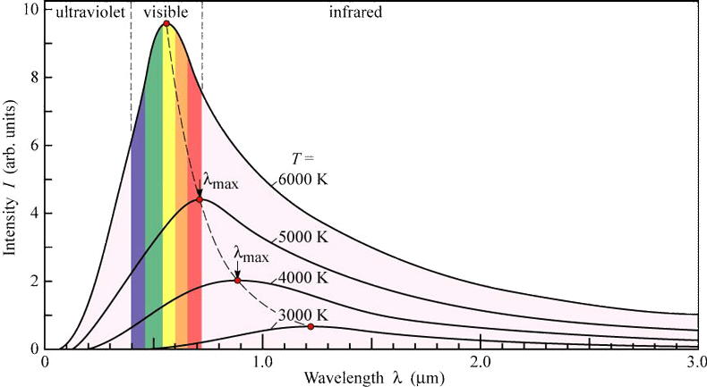
Planck’s law and the Stefan-Boltzmann law
Blackbody spectral irradiance:
Total energy emitted from a blackbody per unit area per unit time:
a = 7.57 × 10⁻¹⁶ J·m⁻³·K⁻⁴

Slide 18
Heaven is hotter than Hell – a thermodynamic proof
The Bible, Isaiah 30:26:
  “Moreover, the light of the moon shall be as the light of the sun and the light of the sun shall be sevenfold as the light of seven days.”
The Bible, Revelations 21:8:
  “But the fearful and unbelieving... shall have their part in the lake which burneth with fire and brimstone.“
  A lake of sulfur (brimstone):
Appl. Opt. 11(8), A14 (1972).

Slide 19
Classical limit of quantum distribution
In a dilute ideal gas,
Partition function
Maxwell-Boltzmann partition function

Slide 20
Thermodynamic properties of ideal gas: MB classical treatment
Internal energy of monatomic gas:
Single molecule partition function

Slide 21
Thermodynamic properties of ideal gas: MB classical treatment (cont’d)
Partition function:
Pressure:
Internal energy:
Entropy:
where
Ideal gas equation

Slide 22
Thermodynamic properties of ideal gas: classical limit of quantum statistics
Partition function:
Internal energy:
Entropy:
where

Slide 23


Gibbs paradox
Mixing two parts of ideal gas of identical composition
Maxwell-Boltzmann statistics
Before mixing:
After mixing:
Quantum statistics in the classical limit
Before mixing:
After mixing:

Slide 24
Vapor-solid phase equilibrium
Equilibrium condition:
Partition function of vapor:
Chemical potential of vapor:
Chemical potential of solid:
Different from MB !

Slide 25
Vapor-solid phase equilibrium (cont’d)
Chemical potential of solid:

Slide 26
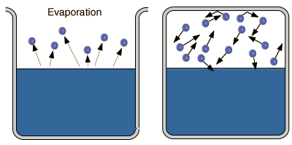
Vapor-solid phase equilibrium (cont’d)
Equilibrium condition:
Equilibrium vapor pressure:
Saturated vapor (equilibrium):
the rate of molecules impinging on the solid/liquid surface = the rate of vaporization from solid/liquid

Slide 27
Density of states for single-particle levels
Consider ideal gas occupying a volume V
Plane wave solution time-independent Schrödinger equation:
Periodic boundary condition:
Quantization of wave vector k :
Density of states:
L_{x}

