Slide 1
MINI PROJECT Mission 2017 September 30, 2013
The Grand Ethiopian Renaissance Dam
(formally known as Millenium Dam and Hidase Dam)

Slide 2
Who Owns the Nile? Egypt, Sudan, and Ethiopia’s History-Changing Dam

Slide 3
Dam facts
Dam site is is in the Benishangul-Gumez region of Ethiopia, about 40 km (25 mi) east of the border with Sudan.
When complete it will generate 6000 MW and will be largest hydro-electric plant in Africa and will hold an estimated 63 billion cubic meters of water.
Spanning more than 4,200 miles, it is the longest river in the world. The volume of water which flows through the Nile is relatively small—a mere 2% in volume of the Amazon and 15% of the Mississippi—and mostly (86%) from Ethiopia.

Slide 4
Dam Facts
Thousands of years of history of “discussion” and use of river (from at least 3050 B.C.E.)!
Irrigation projects of the 19th century Ottoman ruler Mohammad Ali allowed year-round cultivation, causing population growth from 4 to 10 million. Since the opening of the Aswan High Dam in 1971 Egypt’s population has increased from about 30 to 83 million

Slide 5
Dam Facts
Ethiopia's decision to construct the dam challenges a colonial-era agreement that had given Egypt and Sudan rights to the Nile water, with Egypt taking 55.5 billion cubic meters and Sudan 18.5 billion cubic meters of 84 billion cubic meters, with 10 billion lost to evaporation.
That agreement, first signed in 1929, took no account of the eight other nations along the 6 700-kilometre (4,160-mile) river and its basin, which have been agitating for a decade for a more equitable accord.

Slide 6
More Dam Facts
The site for the Grand Ethiopian Renaissance Dam was identified by the U.S. Bureau of Reclamation between 1956 and 1964.
The Ethiopian Government surveyed the site in 2009 and 2010. In November 2010 a design for the dam was submitted. On 31 March 2011, a day after the project was made public, a US$4.8 billion contract was awarded without competitive bidding and construction started

Slide 7
Even more dam facts
Much controversy surrounds dam Egypt has threatened sabotage
Upriver countries Ethiopia, Kenya, Uganda, Rwanda, Burundi, and Tanzania argue that they too need the water that originates on their land
Saudi Arabia and Israel concerned

Slide 8
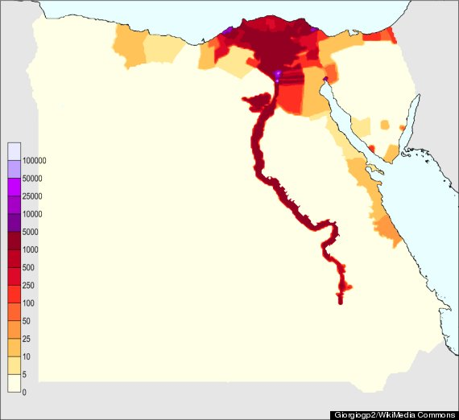
EGYPT’s POPULATION DISTRIBUTION
Persons/square kilometer

Slide 9
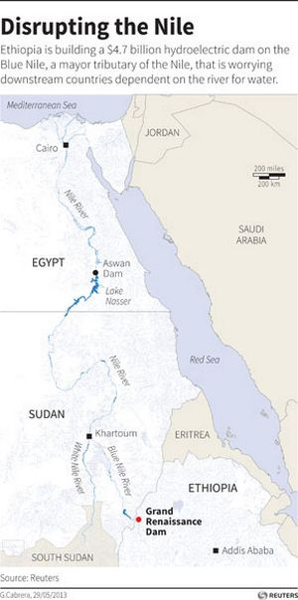

Slide 10
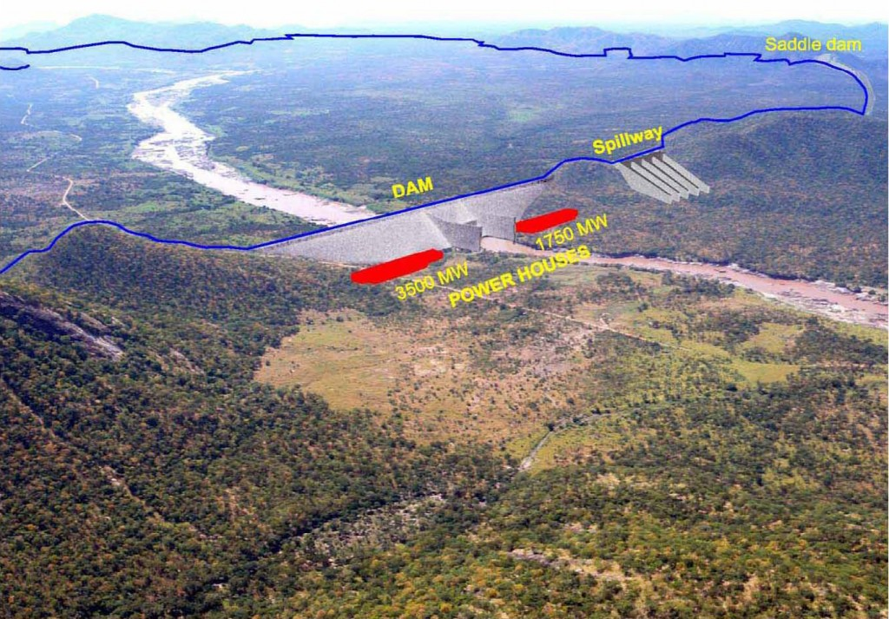

Slide 11
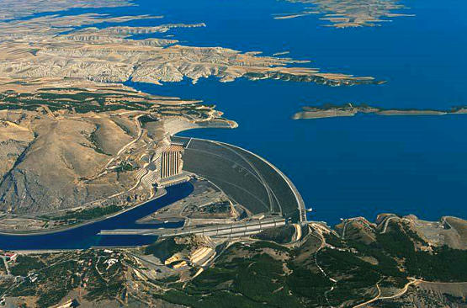

Slide 13
I have asked MIT's Mission 2017 to prepare a report summarizing the issues surrounding the The Grand Ethiopian Renaissance Dam
-- we need their help!

Slide 14
Mini Mission
Today the United Nations has asked Mission 2017 for urgent help in evaluating the sustainability of the Ethiopian Renaissance Dam Project. The UN fears that a regional resource war could erupt and needs a reliable review done very quickly.
A presentation before a panel is needed on October 9th to review the dam and its implications for Ethiopia, Sudan, Egypt and other surrounding countries.
The UN would like recommendations and likely outcomes if the dam is built.

Slide 15
You should clearly state the issues for these countries including water and energy budgets, population, environmental considerations including climate change projections, as well as funding issues.
Many countries and organizations outside of Africa also have interests in the outcome including Saudia Arabia, China, USA, Israel: as well as NGOs, religious-based groups

Slide 16
Getting started
Can framework of existing teams provide information? If not do new teams need to be assembled for this project?
Remember you have a limited time frame—how best to summarize the issues and make recommendations
TEAMWORK

