Slide 1
Special Talk Monday September 15 Malte Ahrens (Mission 2017)
“Ending poverty with knowledge, money and power? Reflections on a summer fellowship with the World Bank”

Slide 2
“We have to consider our energy consumption and how it will increase dramatically in the next couple of decades, for two reasons: industrialization of "unindustrialized" countries and population growth. Do we need to think about how to lower our energy consumption? Or is it more important to focus on implementing renewable energy sources?”

Slide 3
“I think that the general public needs to be more informed about the state of the world's energy crisis in order for changes to be possible. While many people do acknowledge that pollution/greenhouse gases and the limited supply of fossil fuels (which we rely on largely in our everyday lives) are a rising problem, there is still a large section of people who are unaware of how critical these problems are in our future, and many more who do not believe that these issues are real.”

Slide 4
“One of the largest problems with all forms of energy production is the efficiency with which that energy is produced. Coal, thermal, and gas-fired plants run at a current efficiency of around 40%. All renewables (wind, solar, etc.) run around a 20% efficiency.”

Slide 5
“One problem is that the mindsets of people tend to be reactionary, only reacting to the immediate problems at hand, and not looking for long term solutions… The imminent end of fossil fuels need to be recognized by the world, and long term measures to switch to alternative fuels need to be instituted to prevent an political and social disaster. ”

Slide 6
“I think that a pressing issue for the global energy crisis is how quickly people look to the future to solve issues, and how slow we are to look at today's realities… I believe a long term plan is necessary, but I also think that a short term plan, looking at the realities of our technology today, needs to be part of that. Global energy security is threatened by our attitude that some futuristic innovation will solve present energy issues.”

Slide 7
“In addition to the global energy security issues previously mentioned, we have to take into account how it is going to be feasible to get a decent majority of the world to agree with whatever plans that have come up. There are very fragile governments that are fighting for control of their own country, how can we ensure that they go green or become more energy efficient?”

Slide 8
“The fact that the United States consumes orders of magnitude more energy than any other country is problematic in several ways. First, U.S. citizens enjoy a lifestyle that uses a lot of energy per capita, and although many (if not most) of them realizes the importance of conserving energy and water, very few would be willing to significantly cut their energy use for the sake of the rest of the world. Also, other countries look towards the U.S. and argue that they, too, have the right to a high-energy-consumption lifestyle.”

Slide 9
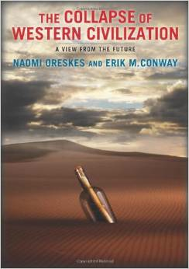
Readings
I have ordered 10 copies-
Debra will have them and you can check them out

Slide 10
Collapse of western Civilization: a view from the future
The year is 2393, and the world is almost unrecognizable. Clear warnings of climate catastrophe went ignored for decades, leading to soaring temperatures, rising sea levels, widespread drought and -- finally -- the disaster now known as the Great Collapse of 2093, when the disintegration of the West Antarctica Ice Sheet led to mass migration and a complete reshuffling of the global order. Writing from the Second People's Republic of China on the 300th anniversary of the Great Collapse, a senior scholar presents a gripping and deeply disturbing account of how the children of the Enlightenment -- the political and economic elites of the so-called advanced industrial societies -- failed to act, and so brought about the collapse of Western civilization.

Slide 11
Planetary Opportunities: A Social Contract for Global Change Science to Contribute to a Sustainable Future (DeFries et al 2012 )
The global change research community needs to renew its social contract with society by moving beyond a focus on biophysical limits and toward solution-oriented research to provide realistic, context-specific pathways to a sustainable future. A focus on planetary opportunities is based on the premise that societies adapt to change and have historically implemented solutions—for example, to protect watersheds, improve food security,
and reduce harmful atmospheric emissions. Daunting social and biophysical challenges for achieving a sustainable future demand that the global change research community work to provide underpinnings for workable solutions at multiple scales of governance.

Slide 12
DeFries et al --continued
Global change research must reorient itself from a focus on biophysically oriented, global-scale analysis of humanity’s negative impact on the Earth system to consider the needs of decision makers from household to global scales.

Slide 13
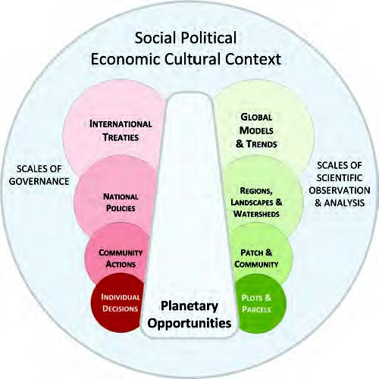

Slide 14
World bank
Towards a more Sustainable Future
● The magnitude of the change required in the global energy system will be huge
● The challenge is to find a way forward that addresses simultaneously climate change, security, equity and economics issues.
● Paradigm change is needed: radical improvements in energy end-use efficiency, new renewables, advanced nuclear and carbon capture and storage.
● Needs to be globally integrated but with maximum support of countries and local levels.
● In the best spirit of science: fact-based and peer-reviewed

Slide 17
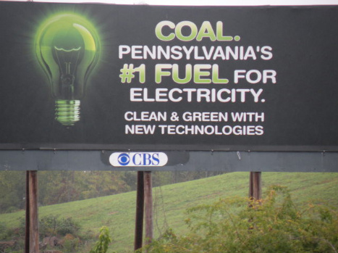
Team 1
Future of Fossil Fuels (oil, gas and coal)
Reserves, cost, implications for CO2
CO2 sequestration?
“Peak Oil” ?
Global economies

Slide 18
TEAM 2 NUCLEAR POWER--Pro
Is Nuclear Power the solution? (Short Term vs Long Term)
History, successes? Failures?
Learn from mistakes and move on

Slide 19
Team 3 Nuclear Power--Con
Not a long term solution
Waste disposal
Security
Radiation exposure

Slide 20
TEAM 5
Renewable energy: Part 1
Solar—how expansive could it get? adaptation of deserts
New technology—transmission?
Biomass : Competition with food production for fertile land and water; loss of existing uses for biomass wastes; biodiversity loss.
Existing, potential, advantages, disadvantage

Slide 21
TEAM 6
Renewable energy: Part 2
Hydropower
Wind
Tidal
Geothermal
Exisiting & Potential Resources
Advantages and disadvantages

Slide 22
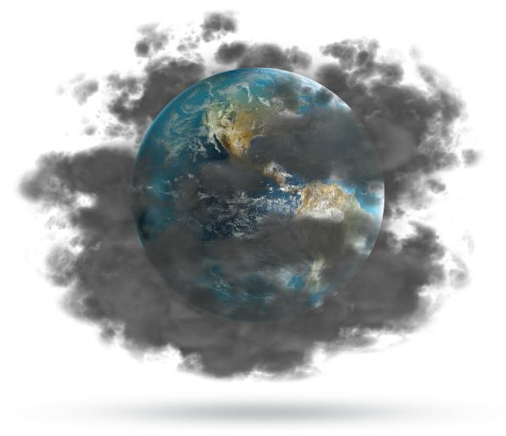
TEAM 7
Articulating the problem
Continued burning of fossil fuel-climate change, sea-level rise, environmental degradation
Time for action is now
Implementation??
Minimizing Waste and Aggressive Conservation
How effective?
How to implement globally

