Slide 1
Wednesday September 17th
A Crash Course in Nuclear Power
The Good the Bad and the Ugly
Ruaridh Macdonald
Ph.D Student in Nuclear Science and Engineering
Mission 2012

Slide 2
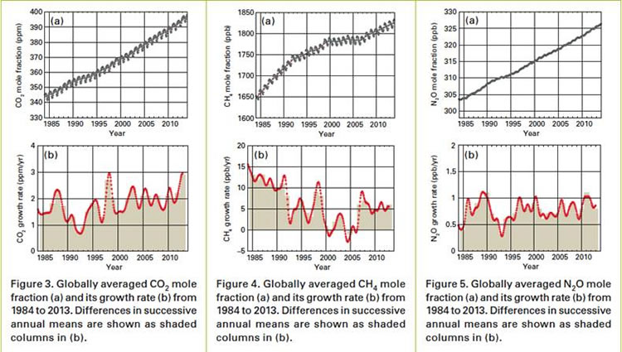
Record Greenhouse Gas Levels Impact Atmosphere and Oceans

Slide 4
