Slide 1
Introduction to Stata
17.871
Spring 2012

Slide 2
The role of statistical packages in research
Obvious answer
Manage data
Carry out appropriate statistical tests
Assist in displaying data
Less obvious answer
Channel the type of research you are likely to do
Limitations as to variables and cases
Types of analysis is sometimes guided by choice of package

Slide 3
Analysis -> Packages
Baby exercises
Minitab, spreadsheets
Time series
TSP
Cross-sectional
SPSS, SAS
Time series & cross-sectional
Stata, R

Slide 4
Logic of quant research in this class
Notes:
Terms to go over: dependent variable, independent variable, functional form, level of observation/analysis

Slide 5
Logic of data setup:
 | V₁ | V₂ | … | V_{j}
Obs₁
Obs₂
…
Obs_{i}
Notes:
Make V/1 a unique identifyer.

Slide 6
Example, VRS Data
HRHHID GESTCEN PES1 PES8
199960521980910 63 2 4
160916068405549 63 2 -3
941159210626002 63 2 6
941159210626002 63 2 6
941159210626002 63 2 6

Slide 7
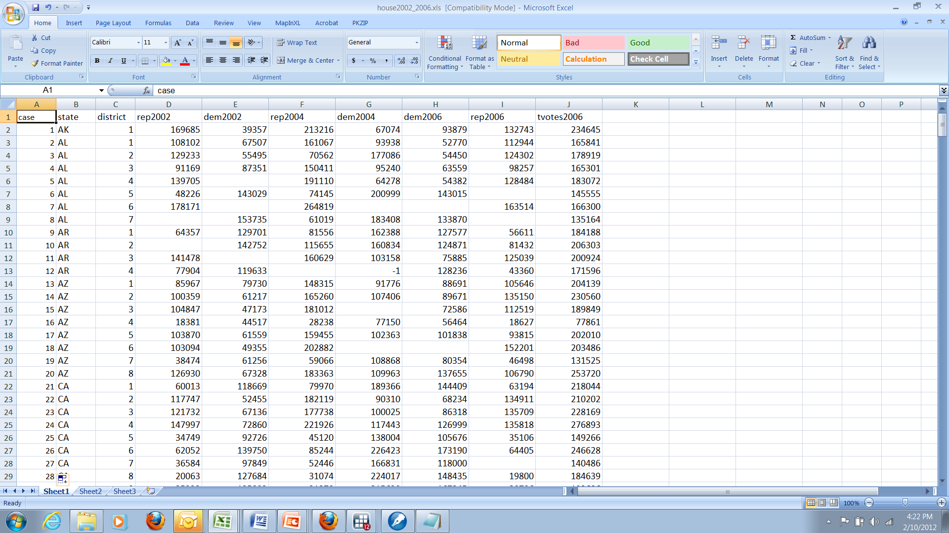
Example, House Elections

Slide 8
Using Stata to Analyze Data in Matrix Form
Question: Did Ron Paul do better in Iowa in 2012, compared to 2008 in counties with college students?
Data sources:
2008: Des Moines Register web site, (http://caucuses.desmoinesregister.com/data/iowa-caucus/caucus-history-gop/)
2012: Iowa Republican Party, Google Doc (https://www.google.com/fusiontables/DataSource?dsrcid=2475248)

Slide 9
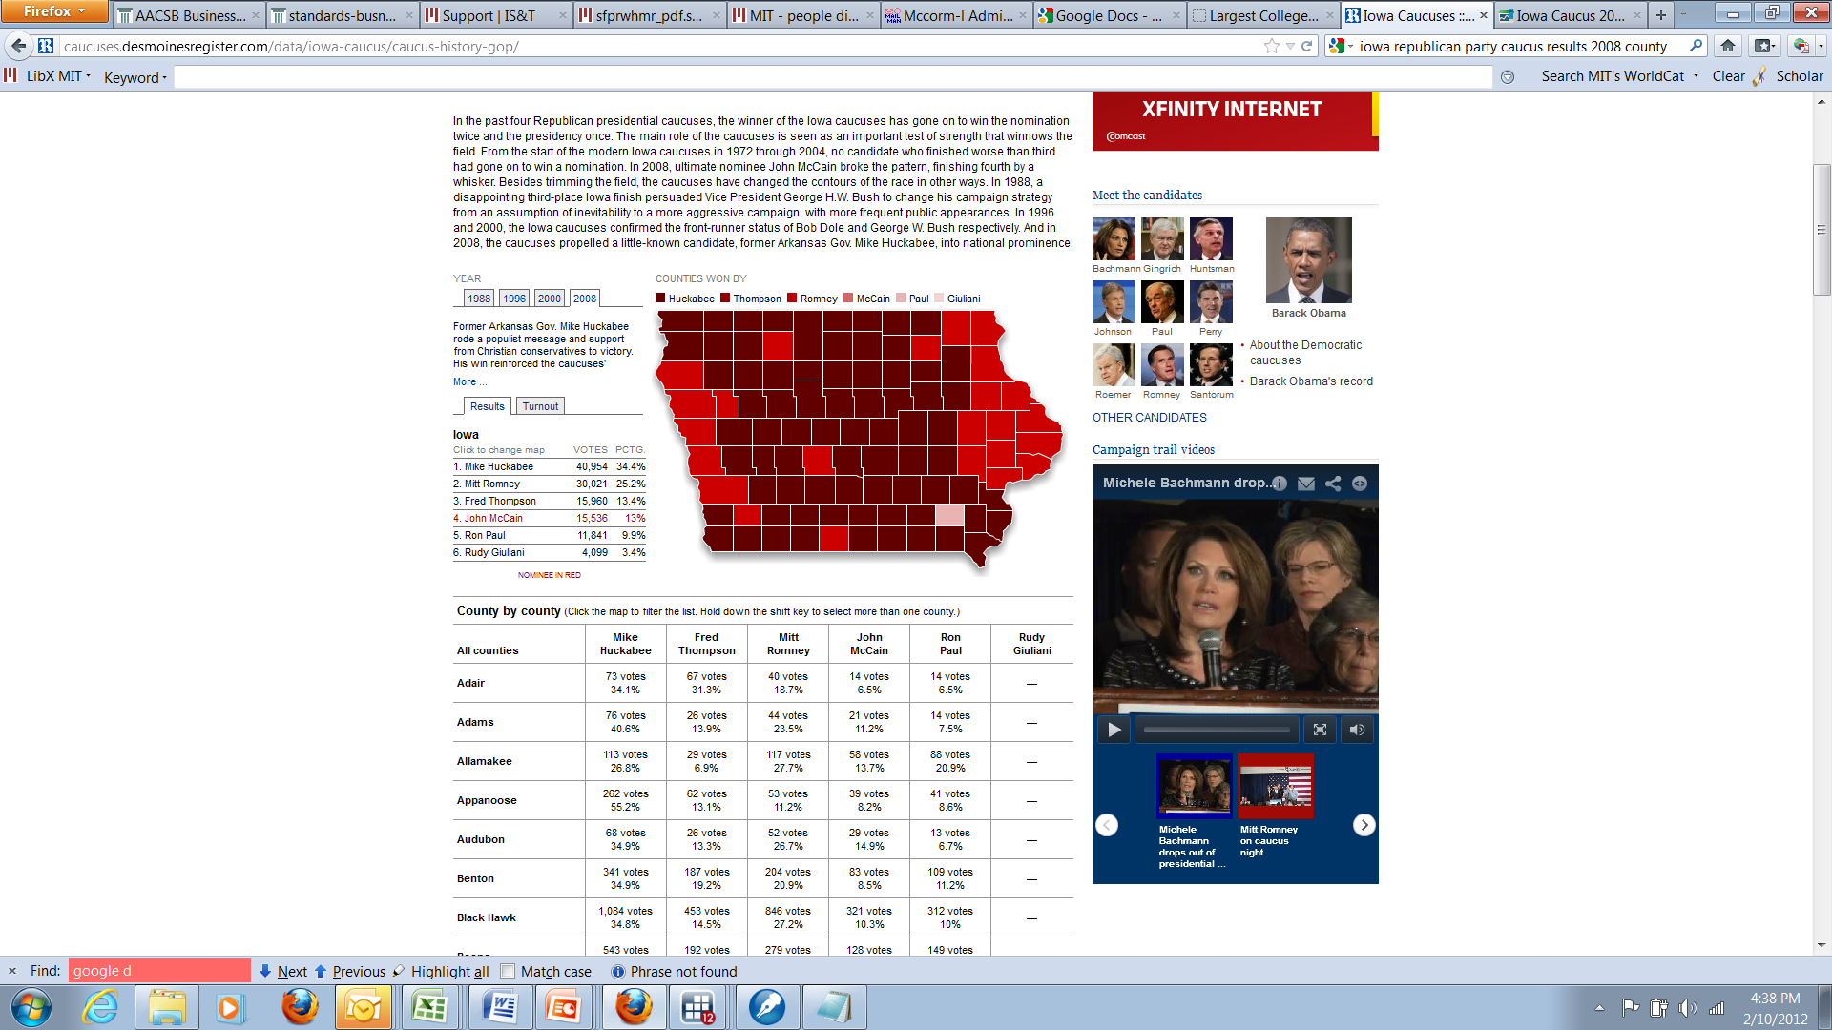
2008

Slide 10
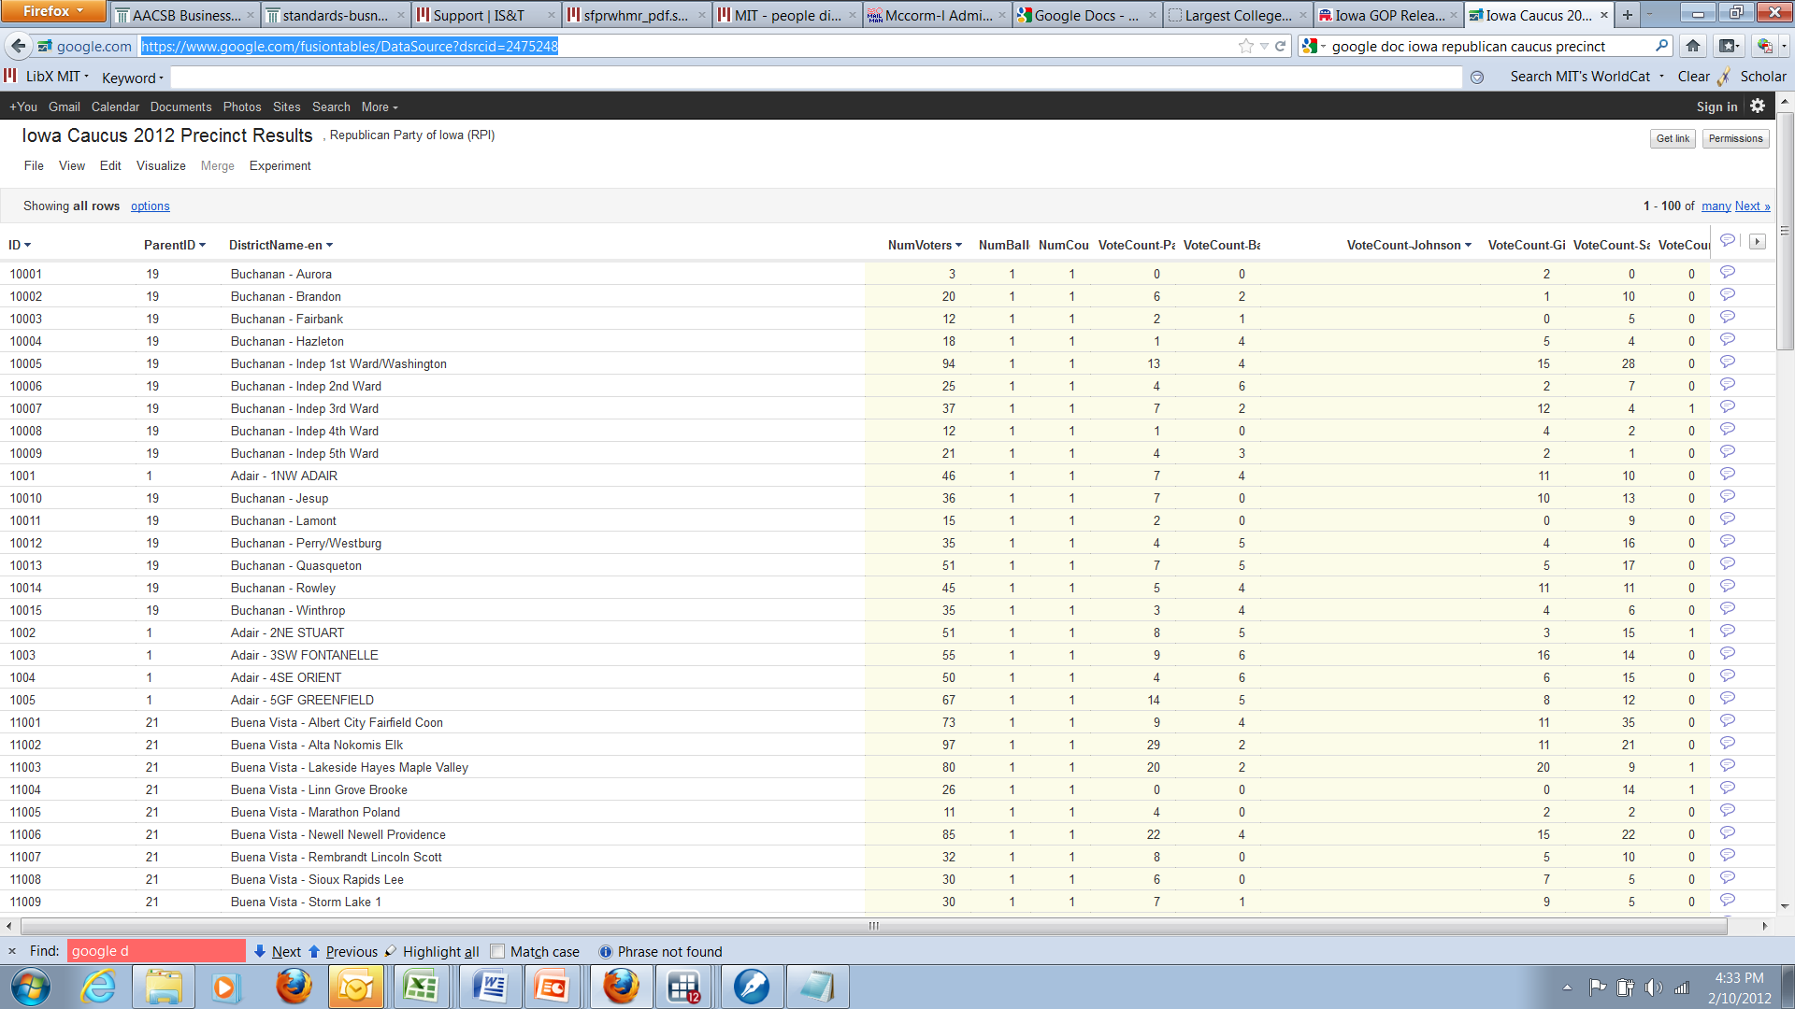
2012
Notes:
https://www.google.com/fusiontables/DataSource?dsrcid=2475248

Slide 11
Switch over to Stata run-through

Slide 12
Return from Stata run-through
Why would you use different input commands?

Slide 13
insheet
Data is output from a spreadsheet into “csv” or “comma-delimited” format
Data is a simple I x J matrix, and all the variables are separated either by a tab or comma
Stata is now smart enough to figure out that the first line of the file contains the variable names

Slide 14
insheet
Assume the following file was created by outputting a file from Excel in csv format:
HRHHID GESTCEN PES1 PES8
199960521980910 63 2 4
160916068405549 63 2 -3
941159210626002 63 2 6
941159210626002 63 2 6
941159210626002 63 2 6
insheet using filename

Slide 15
infile
Data is not in Stata format, is in an ASCII file, but is not separated only by a tab or comma (e.g., by a space)

Slide 16
insheet
Assume the following file was created using an ASCII text editor (e.g., EMACS), and that spaces separate the variables:
199960521980910 63 2 4
160916068405549 63 2 -3
941159210626002 63 2 6
941159210626002 63 2 6
941159210626002 63 2 6
infile HRHHID GESTCEN PES1 PES8 using filename
Or
infile str HRHHID GESTCEN PES1 PES8 using filename

Slide 17
infix
Data is in an ASCII file, but you cannot rely on spaces, commas, or other standard “delimeters” to separate variables
Datasets may have observations on more than one line

Slide 18
infix
Assume the following file was created using an ASCII text editor:
1 2
123456789012345678901
---------------------
19996052198091063 2 4
16091606840554963 2-3
94115921062600263 2 6
94115921062600263 2 6
94115921062600263 2 6
Handy label, not in dataset
Dataset
infix HRHHID 1-15 GESTCEN 16-17 PES1 18-19 PES8 20-21 using filename
Or
infile str15 HRHHID 1-15 GESTCEN 16-17 PES1 18-19 PES8 20-21 using filename

Slide 19
House Roll Call votes in the 27th Cong.
01R327031200290003401ADAMS 165555616661661111222226261116611966116116116666
02R327031200290003401ADAMS 666161116111666116666166111166116116191611666666
03R327031200290003401ADAMS 661166611116611666661191661116611699161116161611
04R327031200290003401ADAMS 161166616166119169911116616116611661616616611611
05R327031200290003401ADAMS 166666616111619166161161666666661611116666161111
06R327031200290003401ADAMS 166666161116161166111111661666661126611661666666
07R327031200290003401ADAMS 696661616666611169111611111161166611111161611616
08R327031200290003401ADAMS 119166666666166666611166666999991161661169999161
09R327031200290003401ADAMS 666616111161116666966161611166111666616661611119
10R327031200290003401ADAMS 611616661161661616661161161111111116161119919966
11R327031200290003401ADAMS 116191666161161166696616111616661161166911691666
12R327031200290003401ADAMS 611166699661616661166161116166111161116611666661
13R327031200290003401ADAMS 611666116616161666616616961666611666166661666611
14R327031200290003401ADAMS 116161111161166611611166661666166616616616661166
15R327031200290003401ADAMS 611616611616111161161111161661116611166111666166
16R327031200290003401ADAMS 161116619116666616611616166661966661611616616611
17R327031200290003401ADAMS 661116161111611666166661666611116161616666611111
18R327031200290003401ADAMS 111666991616661616661111661616611616116116161666
19R327031200290003401ADAMS 166616611161161161116611161666666111666111911611
20R327031200290003401ADAMS 616616616119161666166196666119666611661666111116
21R327031200290003401ADAMS 61111161111161
01R327449800320009111ALFORD 655555996616916165555256511116116111911199199999
02R327449800320009111ALFORD 916916661169611661661161999911611611111161169999

Slide 20
1 2 3 4 5 6 7 8
12345678901234567890123456789012345678901234567890123456789012345678901234567890
01R327031200290003401ADAMS 165555616661661111222226261116611966116116116666
02R327031200290003401ADAMS 666161116111666116666166111166116116191611666666
03R327031200290003401ADAMS 661166611116611666661191661116611699161116161611
04R327031200290003401ADAMS 161166616166119169911116616116611661616616611611
05R327031200290003401ADAMS 166666616111619166161161666666661611116666161111
06R327031200290003401ADAMS 166666161116161166111111661666661126611661666666
07R327031200290003401ADAMS 696661616666611169111611111161166611111161611616
08R327031200290003401ADAMS 119166666666166666611166666999991161661169999161
09R327031200290003401ADAMS 666616111161116666966161611166111666616661611119
10R327031200290003401ADAMS 611616661161661616661161161111111116161119919966
11R327031200290003401ADAMS 116191666161161166696616111616661161166911691666
12R327031200290003401ADAMS 611166699661616661166161116166111161116611666661
13R327031200290003401ADAMS 611666116616161666616616961666611666166661666611
14R327031200290003401ADAMS 116161111161166611611166661666166616616616661166
15R327031200290003401ADAMS 611616611616111161161111161661116611166111666166
16R327031200290003401ADAMS 161116619116666616611616166661966661611616616611
17R327031200290003401ADAMS 661116161111611666166661666611116161616666611111
18R327031200290003401ADAMS 111666991616661616661111661616611616116116161666
19R327031200290003401ADAMS 166616611161161161116611161666666111666111911611
20R327031200290003401ADAMS 616616616119161666166196666119666611661666111116
21R327031200290003401ADAMS 61111161111161
01R327449800320009111ALFORD 655555996616916165555256511116116111911199199999
02R327449800320009111ALFORD 916916661169611661661161999911611611111161169999
VAR # 0004 WIDTH = 0002 MD=0 DK 01 COL 07-08 H27
STATE:
......
NEW ENGLAND BORDER STATES
........... .............
01. CONNECTICUT 51. KENTUCKY
02. MAINE 52. MARYLAND
03. MASSACHUSETTS 53. OKLAHOMA

Slide 21
1 2 3 4 5 6 7 8
12345678901234567890123456789012345678901234567890123456789012345678901234567890
01R327031200290003401ADAMS 165555616661661111222226261116611966116116116666
02R327031200290003401ADAMS 666161116111666116666166111166116116191611666666
03R327031200290003401ADAMS 661166611116611666661191661116611699161116161611
04R327031200290003401ADAMS 161166616166119169911116616116611661616616611611
05R327031200290003401ADAMS 166666616111619166161161666666661611116666161111
06R327031200290003401ADAMS 166666161116161166111111661666661126611661666666
07R327031200290003401ADAMS 696661616666611169111611111161166611111161611616
08R327031200290003401ADAMS 119166666666166666611166666999991161661169999161
09R327031200290003401ADAMS 666616111161116666966161611166111666616661611119
10R327031200290003401ADAMS 611616661161661616661161161111111116161119919966
11R327031200290003401ADAMS 116191666161161166696616111616661161166911691666
12R327031200290003401ADAMS 611166699661616661166161116166111161116611666661
13R327031200290003401ADAMS 611666116616161666616616961666611666166661666611
14R327031200290003401ADAMS 116161111161166611611166661666166616616616661166
15R327031200290003401ADAMS 611616611616111161161111161661116611166111666166
16R327031200290003401ADAMS 161116619116666616611616166661966661611616616611
17R327031200290003401ADAMS 661116161111611666166661666611116161616666611111
18R327031200290003401ADAMS 111666991616661616661111661616611616116116161666
19R327031200290003401ADAMS 166616611161161161116611161666666111666111911611
20R327031200290003401ADAMS 616616616119161666166196666119666611661666111116
21R327031200290003401ADAMS 61111161111161
01R327449800320009111ALFORD 655555996616916165555256511116116111911199199999
02R327449800320009111ALFORD 916916661169611661661161999911611611111161169999
VAR # 0005 WIDTH = 0002 MD=0 DK 01 COL 09-10 H27
DISTRICT NUMBER:
................
CODED BLANK FOR SENATE.
AT-LARGE DISTRICTS ARE CODED 98,97,96, ACCORDING TO
ALPHABETICAL ORDER OF NAMES OF OCCUPANTS. NO DISTINCTION
BETWEEN THE VARIOUS KINDS OF AT-LARGE DISTRICTS IS MADE.
DUE TO REPLACEMENTS WITHIN A CONGRESS, TWO MEMBERS MAY
LEGITIMATELY HAVE THE SAME DISTRICT NUMBER WITHIN A STATE.

Slide 22
1 2 3 4 5 6 7 8
12345678901234567890123456789012345678901234567890123456789012345678901234567890
01R327031200290003401ADAMS 165555616661661111222226261116611966116116116666
02R327031200290003401ADAMS 666161116111666116666166111166116116191611666666
03R327031200290003401ADAMS 661166611116611666661191661116611699161116161611
04R327031200290003401ADAMS 161166616166119169911116616116611661616616611611
05R327031200290003401ADAMS 166666616111619166161161666666661611116666161111
06R327031200290003401ADAMS 166666161116161166111111661666661126611661666666
07R327031200290003401ADAMS 696661616666611169111611111161166611111161611616
08R327031200290003401ADAMS 119166666666166666611166666999991161661169999161
09R327031200290003401ADAMS 666616111161116666966161611166111666616661611119
10R327031200290003401ADAMS 611616661161661616661161161111111116161119919966
11R327031200290003401ADAMS 116191666161161166696616111616661161166911691666
12R327031200290003401ADAMS 611166699661616661166161116166111161116611666661
13R327031200290003401ADAMS 611666116616161666616616961666611666166661666611
14R327031200290003401ADAMS 116161111161166611611166661666166616616616661166
15R327031200290003401ADAMS 611616611616111161161111161661116611166111666166
16R327031200290003401ADAMS 161116619116666616611616166661966661611616616611
17R327031200290003401ADAMS 661116161111611666166661666611116161616666611111
18R327031200290003401ADAMS 111666991616661616661111661616611616116116161666
19R327031200290003401ADAMS 166616611161161161116611161666666111666111911611
20R327031200290003401ADAMS 616616616119161666166196666119666611661666111116
21R327031200290003401ADAMS 61111161111161
01R327449800320009111ALFORD 655555996616916165555256511116116111911199199999
02R327449800320009111ALFORD 916916661169611661661161999911611611111161169999
VAR # 0020 SESSION 1 WIDTH = 0001 MD=0 DK 01 COL 42-42 H27
G-10- -27A J 27-1-39 JUNE 7, 1841
H271004 Y=66 N=149 MALLORY, VA.
TO ADJOURN, IN ORDER TO END DEBATE ON THE ADOPTION OF THE
HOUSE RULES. ADOPTION OF THE RULES WOULD PREVENT RECEIVING
ANY ABOLITION PETITIONS. (P. 27-2)

Slide 23
Enter data yourselves
Notes:
Got this far after 1.5 hours. Also, was only able to get about 2/3 the way through the Stata demonstration.

Slide 24
Return again to Stata run-through

Slide 25
merge command
Used when you want to add data to a pre-existing data set, or you have more than one dataset that has all the variables you need for analysis.
Most important thing: each dataset must have (at least) one identifier that links observations, and allows merging.
Second thing: both datasets must be sorted on the common identifier(s)

Slide 26
Example: one-for-one match
Election results, election_results.dta
county | cand1 | cand2 | cand2
A | 10 | 20 | 30
B | 40 | 50 | 60
C | 70 | 80 | 90
Z | 500 | 40 | 30
Demographics, demographics.dta
county | income | educ | catholic
A | 10,000 | .2 | .3
B | 40,000 | .5 | .6
C | 70,000 | .8 | .9
Z | 5,000 | .95 | .3

Slide 27
merge command results
[assume both datasets have previously been sorted on county, by typing the command sort county]
use election_results.dta
merge county using demographics.dta OR
merge 1:1 county using demographics.dta

Slide 28
Voila!
county | cand1 | cand2 | cand2 | income | educ | catholic
A | 10 | 20 | 30 | 10,000 | .2 | .3
B | 40 | 50 | 60 | 40,000 | .5 | .6
C | 70 | 80 | 90 | 70,000 | .8 | .9
Z | 500 | 40 | 30 | 5,000 | .95 | .3

Slide 29
many-to-one merge
Demographic data, demographic_data.dta
county_code | town | income | education
A | Aville | 50000 | .3
A | Bobville | 60000 | .4
B | Candiceville | 70000 | .5
B | Dogville | 80000 | .5
C | Catville | 100000 | .5
County code mapping, county_code_mapping.dta
county_code | county_name
A | Adams
B | Brooks
C | Calhoun

Slide 30
merge command
[make same sorting assumptions as before]
use demographic_data.dta
merge m:1 county_code using county_code_mapping.dta

Slide 31
Voila!
county_code | town | income | education | county_name
A | Aville | 50000 | .3 | Adams
A | Bobville | 60000 | .4 | Adams
B | Candiceville | 70000 | .5 | Brooks
B | Dogville | 80000 | .5 | Brooks
C | Catville | 100000 | .5 | Calhoun

Slide 32
collapse command
county | DistrictName-en | voters | Paul | Bachmann | Johnson | Gingrich | Santorum | Huntsman | Other | Roemer | Romney | Perry | Cain
Adair | Adair - 1NW ADAIR | 46 | 7 | 4 |  | 11 | 10 | 0 | 0 | 0 | 8 | 6 | 0
Adair | Adair - 2NE STUART | 51 | 8 | 5 |  | 3 | 15 | 1 | 0 | 0 | 6 | 13 | 0
Adair | Adair - 3SW FONTANELLE | 55 | 9 | 6 |  | 16 | 14 | 0 | 0 | 0 | 3 | 7 | 0
Adair | Adair - 4SE ORIENT | 50 | 4 | 6 |  | 6 | 15 | 0 | 0 | 0 | 13 | 6 | 0
Adair | Adair - 5GF GREENFIELD | 67 | 14 | 5 |  | 8 | 12 | 0 | 0 | 0 | 13 | 15 | 0
Adams | Adams – Carbon | 28 | 7 | 0 |  | 5 | 12 | 0 | 0 | 0 | 3 | 1 | 0
Adams | Adams - Corning 1A | 19 | 7 | 0 |  | 1 | 6 | 0 | 0 | 0 | 4 | 1 | 0
Adams | Adams - Corning 1B | 3 | 3 | 0 |  | 0 | 0 | 0 | 0 | 0 | 0 | 0 | 0
Adams | Adams - Corning 2A | 9 | 2 | 0 |  | 2 | 0 | 0 | 0 | 0 | 5 | 0 | 0
Adams | Adams - Corning 2B | 8 | 5 | 1 |  | 0 | 1 | 0 | 0 | 0 | 0 | 1 | 0
Adams | Adams - Corning 3A | 12 | 4 | 0 |  | 0 | 0 | 0 | 0 | 0 | 6 | 2 | 0
Adams | Adams - Corning 3B | 19 | 9 | 0 |  | 1 | 6 | 0 | 0 | 0 | 1 | 2 | 0
Adams | Adams – Nodaway | 10 | 1 | 1 |  | 5 | 0 | 0 | 0 | 0 | 2 | 1 | 0
Adams | Adams – Prescott | 32 | 21 | 3 |  | 2 | 1 | 0 | 0 | 0 | 3 | 2 | 0
Adams | Adams – Quincy | 22 | 7 | 0 |  | 2 | 8 | 0 | 0 | 0 | 3 | 2 | 0
Adams | Adams - SE Adams | 38 | 8 | 4 |  | 6 | 13 | 0 | 0 | 0 | 5 | 2 | 0
Allamakee | Allamakee - FV/TL/HF CITY | 28 | 7 | 0 |  | 6 | 9 | 0 | 0 | 0 | 6 | 0 | 0
Allamakee | Allamakee - LF/CN/LS/LS CITY | 64 | 20 | 2 |  | 21 | 7 | 0 | 0 | 0 | 4 | 10 | 0
Allamakee | Allamakee - PC/LT/WV CITY | 42 | 20 | 0 |  | 7 | 9 | 0 | 0 | 0 | 5 | 1 | 0
Allamakee | Allamakee - PO/FK | 20 | 4 | 1 |  | 5 | 3 | 0 | 0 | 0 | 6 | 1 | 0
Allamakee | Allamakee - PV CITY | 35 | 7 | 1 |  | 2 | 3 | 0 | 0 | 0 | 21 | 1 | 0
Allamakee | Allamakee - UC/IA/NA CITY | 31 | 4 | 1 |  | 3 | 4 | 0 | 0 | 0 | 16 | 3 | 0
Allamakee | Allamakee - UP/MK/FC/JF/LL | 122 | 53 | 2 |  | 18 | 14 | 0 | 0 | 0 | 28 | 7 | 0
Allamakee | Allamakee - WK 1 CITY | 33 | 8 | 1 |  | 6 | 12 | 0 | 0 | 0 | 5 | 1 | 0
collapse (sum) voters-Cain,by(county)

Slide 33
county | voters | Paul | Bachmann | Johnson | Gingrich | Santorum | Huntsman | Other | Roemer | Romney | Perry | Cain
Adair | 269 | 42 | 26 | 0 | 44 | 66 | 1 | 0 | 0 | 43 | 47 | 0
Adams | 200 | 74 | 9 | 0 | 24 | 47 | 0 | 0 | 0 | 32 | 14 | 0
Allamakee | 518 | 157 | 18 | 0 | 82 | 77 | 0 | 0 | 0 | 155 | 28 | 0
Appanoose | 537 | 77 | 25 | 0 | 71 | 174 | 1 | 0 | 12 | 87 | 90 | 0
Audubon | 223 | 41 | 17 | 0 | 32 | 54 | 0 | 0 | 0 | 48 | 31 | 0
Benton | 1042 | 202 | 66 | 0 | 121 | 290 | 5 | 1 | 0 | 184 | 168 | 4
Black Hawk | 3642 | 870 | 262 | 0 | 596 | 783 | 29 | 0 | 4 | 835 | 259 | 1
Boone | 1344 | 276 | 104 | 0 | 160 | 400 | 4 | 0 | 0 | 230 | 170 | 0
Bremer | 933 | 194 | 57 | 0 | 98 | 215 | 14 | 2 | 0 | 246 | 105 | 0
Buchanan | 459 | 66 | 40 | 0 | 77 | 133 | 1 | 2 | 0 | 78 | 62 | 0
Buena Vista | 716 | 169 | 26 | 0 | 128 | 154 | 3 | 0 | 0 | 124 | 110 | 2
Butler | 552 | 99 | 41 | 0 | 71 | 157 | 4 | 0 | 0 | 92 | 87 | 0
Calhoun | 435 | 75 | 31 | 0 | 54 | 131 | 2 | 2 | 0 | 69 | 71 | 0
Carroll | 716 | 133 | 32 | 0 | 145 | 168 | 2 | 0 | 1 | 146 | 85 | 1
Cass | 674 | 116 | 32 | 0 | 147 | 170 | 2 | 0 | 0 | 141 | 66 | 0
Cedar | 711 | 188 | 34 | 0 | 84 | 167 | 4 | 1 | 0 | 165 | 67 | 0
Cerro Gordo | 1571 | 304 | 100 | 0 | 235 | 345 | 5 | 1 | 0 | 408 | 170 | 2
Cherokee | 537 | 95 | 20 | 0 | 78 | 155 | 0 | 0 | 0 | 126 | 63 | 0
Chickasaw | 443 | 142 | 14 | 0 | 53 | 72 | 3 | 0 | 0 | 85 | 74 | 0
Clarke | 367 | 98 | 42 | 0 | 46 | 51 | 1 | 2 | 0 | 65 | 62 | 0
Clay | 733 | 150 | 40 | 0 | 137 | 165 | 4 | 2 | 0 | 149 | 75 | 0
Clayton | 625 | 205 | 28 | 0 | 72 | 122 | 1 | 0 | 0 | 116 | 81 | 0
Clinton | 1384 | 295 | 62 | 0 | 149 | 354 | 9 | 0 | 0 | 437 | 73 | 5
Crawford | 437 | 72 | 22 | 0 | 84 | 101 | 0 | 0 | 0 | 93 | 64 | 0

Slide 34
Do-files
Do-files are the Stata scripting language to automate analysis.
Here is how the first five lines of the Iowa exercise would look in a do-file:
#delimit;
insheet using iowa_example_csv.dat;
list;
generate paulpct08=paul08/tvotes08;
generate paulpct12=paul12/tvotes12;

