Slide 1
observation
team: write your team name here
location: write where observation was made here
issue: describe the issue here
place your picture here
user adaptation:
describe how users make adaptations/compensate for issue here
product opportunity:
write what you think the product opportunity is here

Slide 2
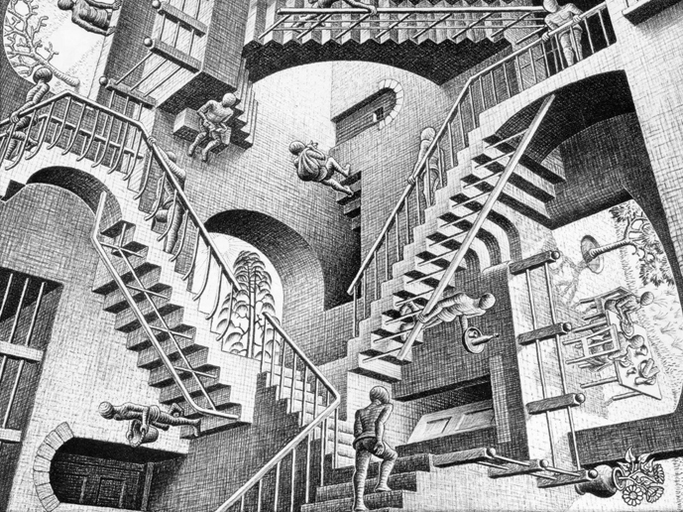
observation (example)
team: myteam
location: MIT Stata center
issue: visitors getting lost in the building
user adaptation:
enter offices randomly to ask for directions
product opportunity:
mobile map application for walking directions inside MIT buildings

