Slide 1
Lecture 5: Follow-up Material & Careers Paths
Hadronic Physics, Accelerators, and Detectors
Douglas W. Higinbotham
15 July 2022

Slide 2
Thank you all for the great discussions!
My background:
College of William & Mary ( BS Physics ) 1988 – 1992
University of Virginia ( PhD Nuclear Physics ) 1992 – 1999
Massachusetts Institute of Technology ( Postdoc ) 1999-2001
Jefferson Lab: 2001 – today
Worked my way up from Staff Scientist I -> II -> III -> Senior Staff
I have been spokesperson of more then ten experiments at Jefferson Lab
Currently Director of the Jefferson Lab EIC Center
Scheduler and Accelerator Coordinator of the Experiments in the Four Halls

Slide 3
Follow-up Material From Yesterday’s Discussions
3

Slide 4
Magnetic Moments
Proton = 2.793 𝝻_{N} where 𝝻_{N} = eℏ/2m_{p}
Neutron = -1.913 𝝻_{N}
³He = -2.128 𝝻_{N}
Examples of 3He Magnetic Moment Calculations:
Shell Model = -1.913 𝝻_{N}
Quark Model = -2.005 𝝻_{N}
QCD Model = -2.291 𝝻_{N}
n
≃
n
p
p
Calculations from https://doi.org/10.1016/j.rinp.2017.07.065

Slide 5
³He Used As Effective Neutron Target
For Example: Measurements of DIS neutron spin asymmetry A₁^{n}
X. Zheng et al., Phys .Rev. Lett. 92 (2004) 012004 and Phys. Rev. C70 (2004) 065207.
Main source of the systematic error is uncertainty of the proton and neutron polarization.
Also impacts form factor and structure function experiments that use polarized ³He.
Statistical errors,
predicted for 12GeV
E-12-06-112
Notes:
.

Slide 6
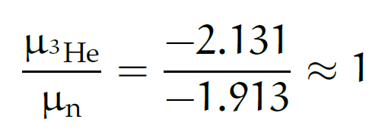
³He ground-state wave-function
S
1.) Spatially symmetric state S (90%):
Spin is dominated by spin of neutron, thus can be used as an effective polarized neutron target:
2.) State D (8%):
Generated by tensor component of NN force
3.) Mixed symmetry state S’ (2%):
Reflects (spin-isospin)-space correlations
n
p
p
(L=0)
D
n
p
p
(L=2)

Slide 7
Results for ³He(e,e’d)p
M. Mihovilvic et al., Phys. Rev. Lett. 113 (2014) 232505
Measured asymmetries are of order of 1%.
Theories reasonably well describe behavior of the data. Hannover (Bonn), Bochum (AV18), Pisa (AV18 + Urbana IX)
Calculations underestimate the measured asymmetries.
Hard to determine what is causing the discrepancy: FSI, SRC, 3NF and/or ?? but clearly state-of-the-art calculations don’t agree with the data.

Slide 8
Comparison (e,e’p) with the theories
M. Mihovilovic et al., Phys. Lett. B 788 (2019) 117.
Theories from Krakow-Bochum (AV18) and Hanover-Lisbon (Bonn).
Calculations averaged over the acceptance and weighted with cross section ratios.
Theory qualitatively describes behavior of the data.
The calculated amplitudes are too small; zero crossing at wrong positions.
This is a bit disconcerting as low we need theory to extract neutron information from DIS, QE, etc.
This is why tagging at the EIC is awesome!

Slide 9
All Models Are Wrong
“The most that can be expected from any model is that it can supply a useful approximation to reality: All models are wrong; some models are useful.” - George Box (1919 – 2013)
“An ever increasing amount of computational work is being relegated to computers, and often we almost blindly assume that the obtained results are correct.” - Simon Širca & Martin Horvat

Slide 10
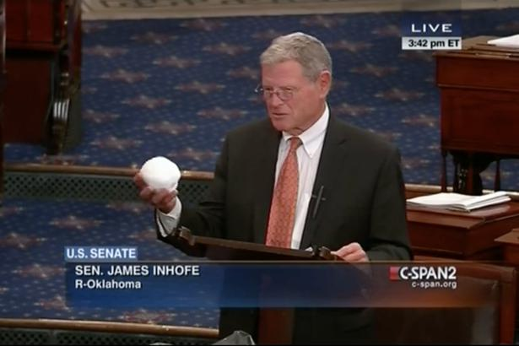
Warning: Danger of Confirmation Bias
In psychology and cognitive science, confirmation bias is a tendency to search for or interpret information in a way that confirms one's preconceptions, leading t statistical errors.
https://www.youtube.com/watch?v=3E0a_60PMR8

Slide 11
Statistical notes on the problem of experimental observations near an unphysical region
What happens when everyone knows that the neutrino mass must be positive yet the uncertainties on the experiments huge?!
https://doi.org/10.1103/PhysRevD.44.299
Image being the student who walks into the professor’s office with the negative results.
Now image the sum of the effect of everyone being pushed to report the “physical” result instead of quoting unbiased results.
The solution is of course to report both, but if you can only do one publish what you actually measured!!

Slide 12
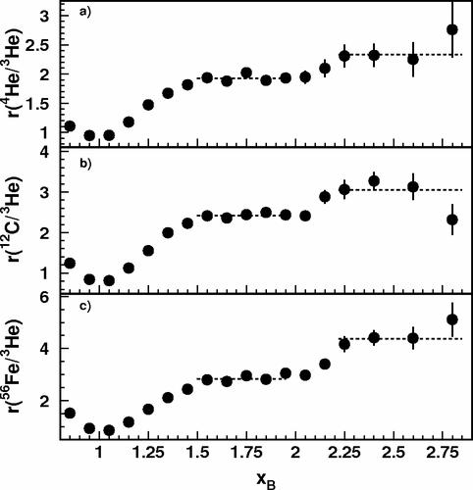
CLAS x_{B} > 2 Three Nucleon Plateau
I used to show this Hall B plot at conferences all the time and tell a story about 2 and 3 nucleon correlations.
https://doi.org/10.1103/PhysRevLett.96.082501
When new Hall C results agreed beautifully with the x_{B} < 2 data and didn’t agree x_{B} > 2, Or Hen and I thought hard about how that was possible.

Slide 13
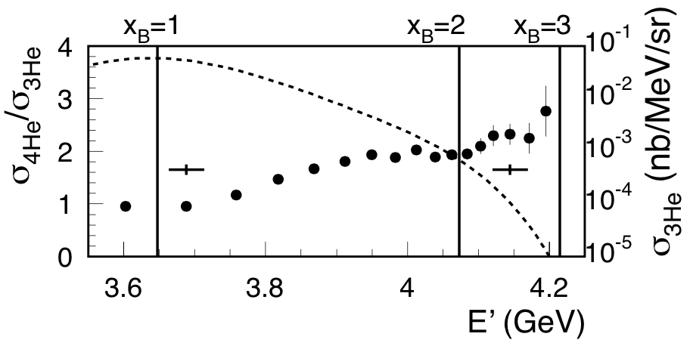
Plotting Hall B Results vs. E’ instead of x_{B}
D. H. and O. Hen, Phys. Rev. Lett. 114 (2015) 169201. (a PRL from checking a result on the back of an envelope )
https://doi.org/10.1103/PhysRevLett.114.169201

Slide 14
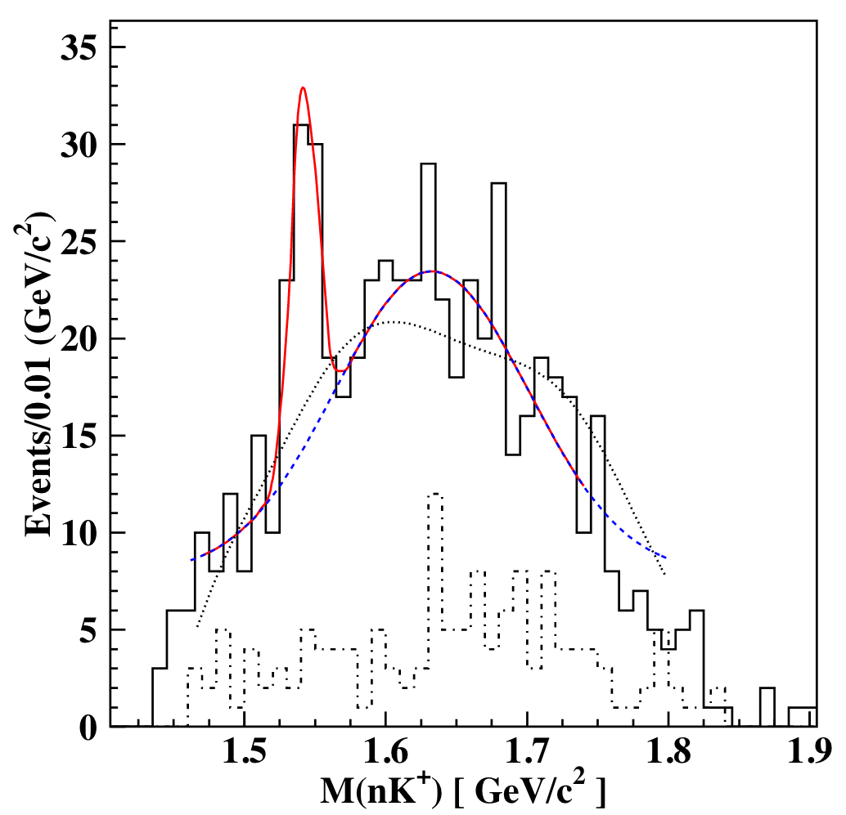
And with over 300 citations, the Hall B Pentaquark
Shown is the data claiming the observation of a light pentaquark particle.
https://doi.org/10.1103/PhysRevLett.91.252001
Cuts were made until a peak they were searching for was emphasized and the crime was then quoting an error as if it was a frequentist result. This is known as the ”look elsewhere effect” where where an apparently statistically significant observation may have actually arisen by chance because of the sheer size of the parameter space to be searched.
This can be taken into account but dramatically reduces statistical significance.
What was good science was repeating the experiment and using the same cuts and not seeing a peak.

Slide 15
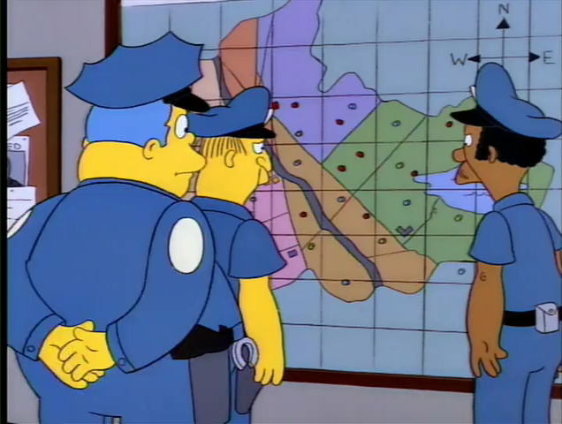
The Simpson’s Example

Slide 16
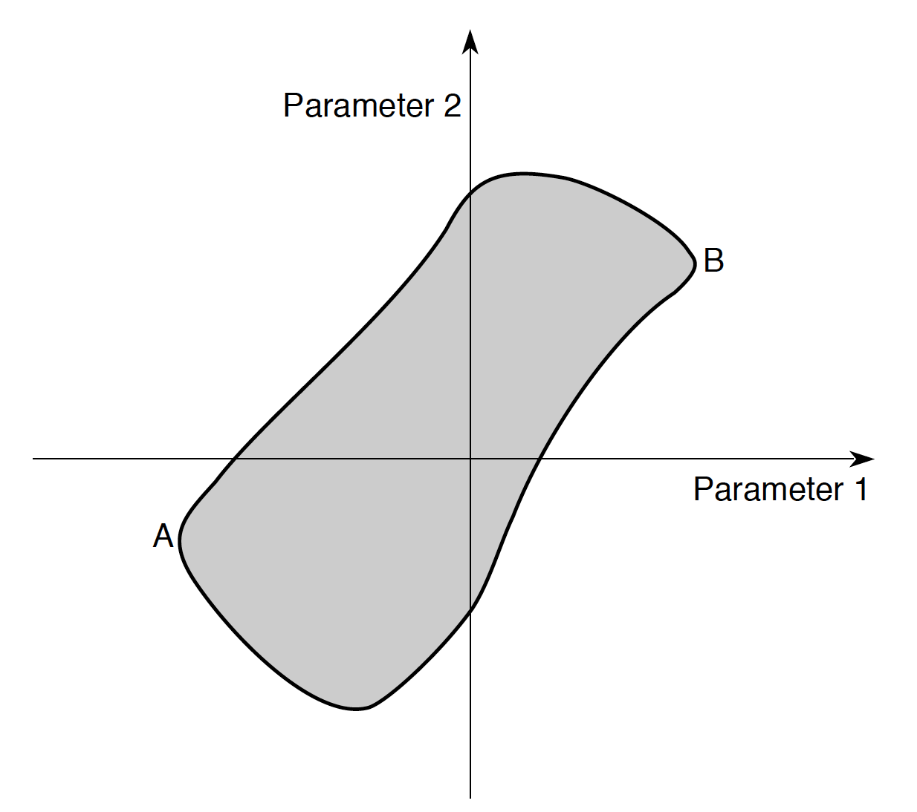
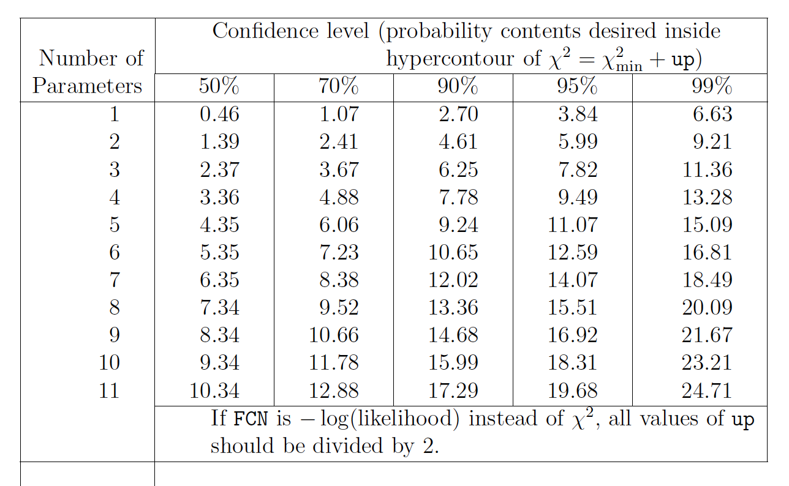
Multivariate Errors
As per the particle data handbook, one should
be using a co-variance matrix and calculating the
probably content of the hyper-contour of the
fit. Default setting of Minuit of “up”(often call Δχ2 )is one.
Also note standard Errors often underestimate true
uncertainties. (manual of gnuplot fitting has an
explicate warning about this)
The Interpretation of Errors in Minuit (2004 by James)
http://seal.cern.ch/documents/minuit/mnerror.pdf
In ROOT: SetDefaultErrorDef(real #)
Default is 1 and doesn’t change unless you change it!

Slide 17
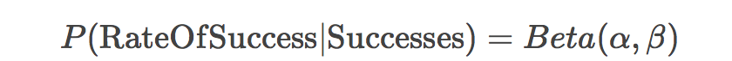
Bayesian Priors (The Star Wars Example)
https://www.countbayesie.com/blog/2015/2/18/hans-solo-and-bayesian-priors
C3PO can calculate the odds of a pilot navigating an asteroid field (20,000:1)
But Han Solo is one of the best pilots in the galaxy. (i.e. C3P0 ignored a Bayesian Prior)
So C3PO actually correctly predicts that average pilots will not successfully navigate the field while incorrectly predicting Han’s chances. (estimated as 75% in the article)
Ignoring A Bayesian Prior Can Lead To Wrong Conclusions

Slide 18

Mistakes Happens, BUT Sometimes It Isn’t A Mistake
The LANCET is a top tier medical journal and this is a highly cited article (>1.4k citations).
https://doi.org/10.1016/S0140-6736(97)11096-0
The red retracted was added by the journal, but the damage has been done.
MANY people know the news story of the original publication, but few know it has been retracted.
This author’s work led to a decline in vaccination rates in the United States, United Kingdom and Ireland and a corresponding rise in measles and mumps resulting in serious illness and deaths.
“A lie can travel half way around the world while the truth is putting on its shoes.” – attributed to Mark Twain but that too is a lie

Slide 19
Now Back To The Focus of Today’s Lecture
19

Slide 20

Careers Paths
Thanks to Midhat Farooq and Crystal Bailey at the APS for providing many of these slides.

Slide 21
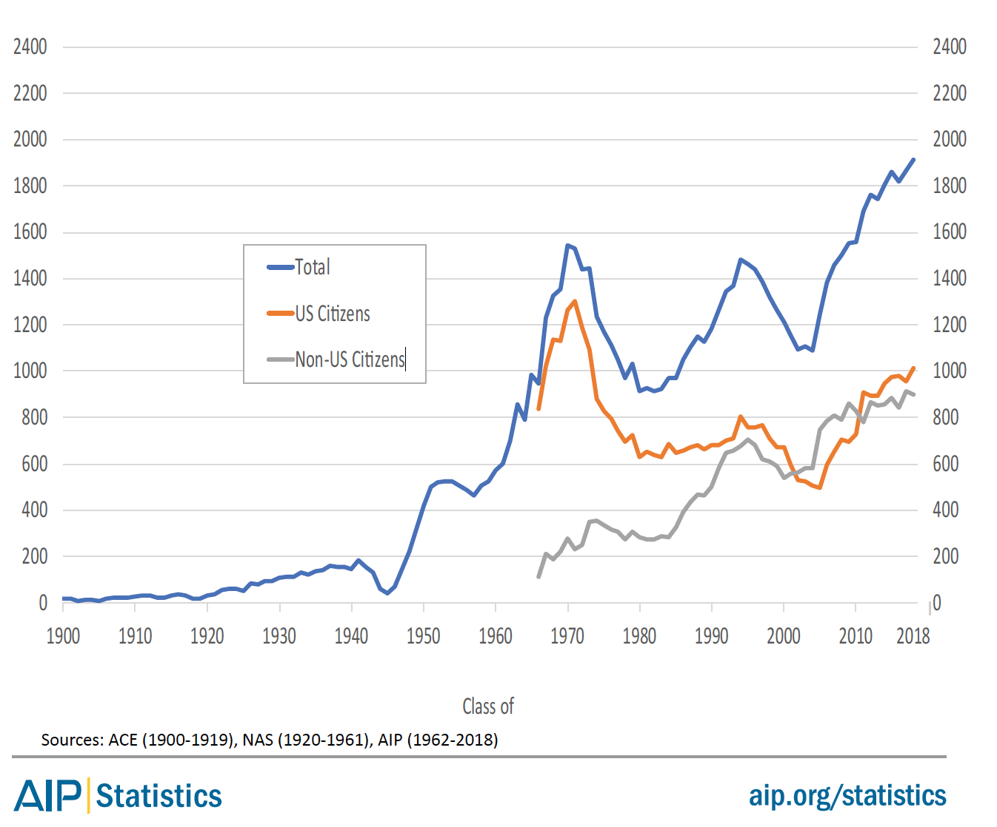
How many PhDs are there?
The number of Physics PhDs granted in the U.S. has almost doubled over the last two decades.
Number of US Physics PhDs
~1600 physics PhDs go into the U.S. job market every year
Class of

Slide 22
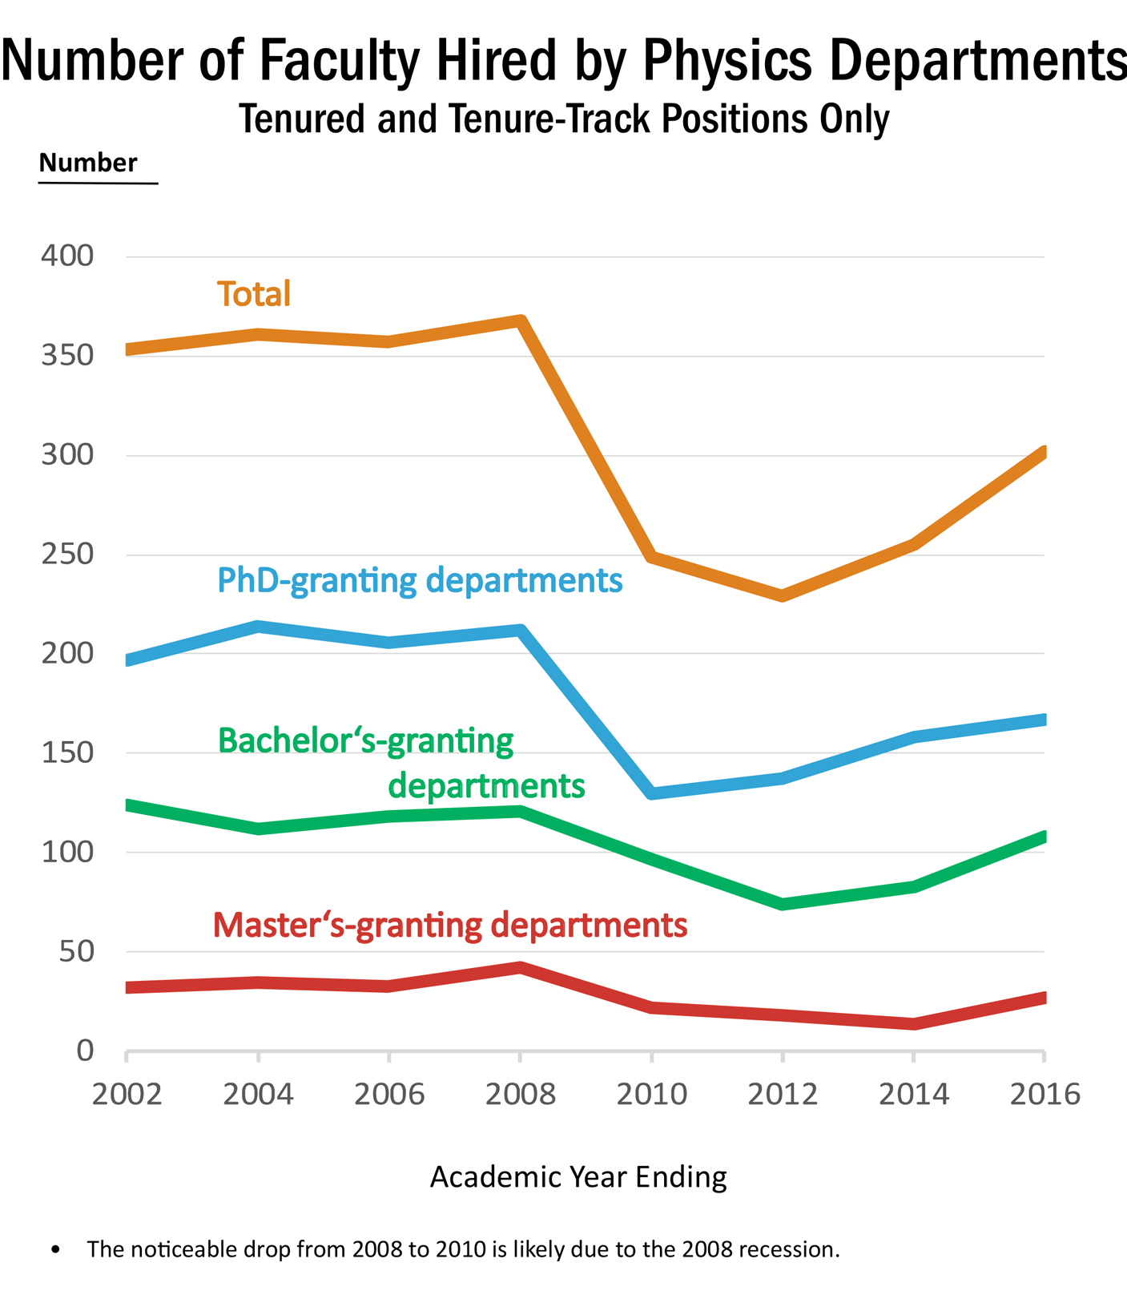
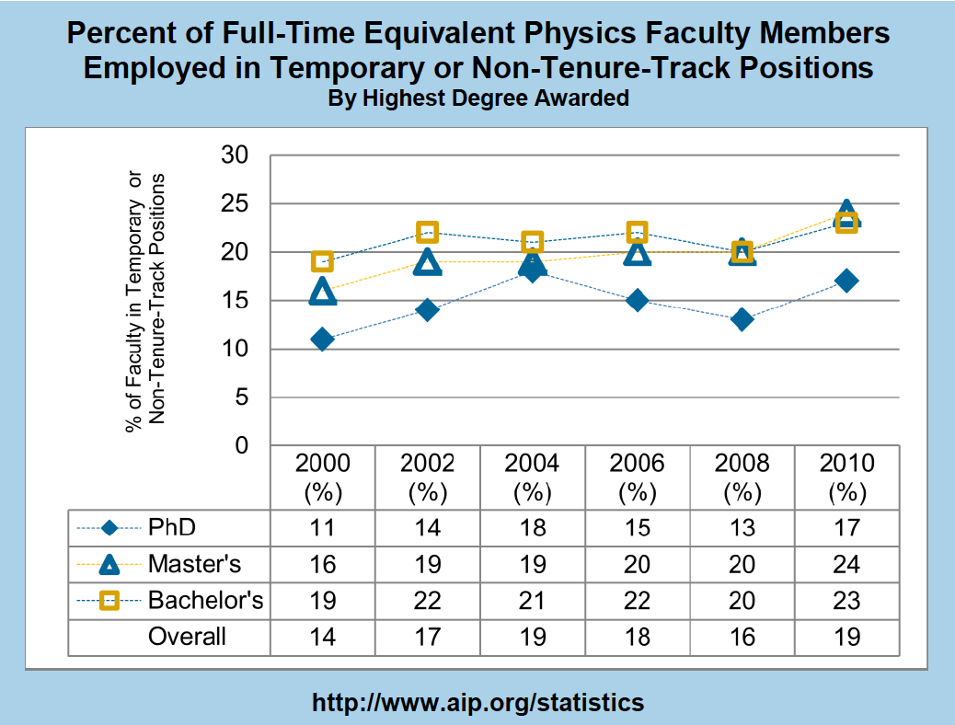
Academic sector demand
About ~300 new hires (2016 data)
But ~1600 PhDs looking for jobs every year
Typically, ~19% of faculty positions were temporary or non-tenure-track.
Slide from Crystal Bailey (bailey@aps.org)

Slide 23
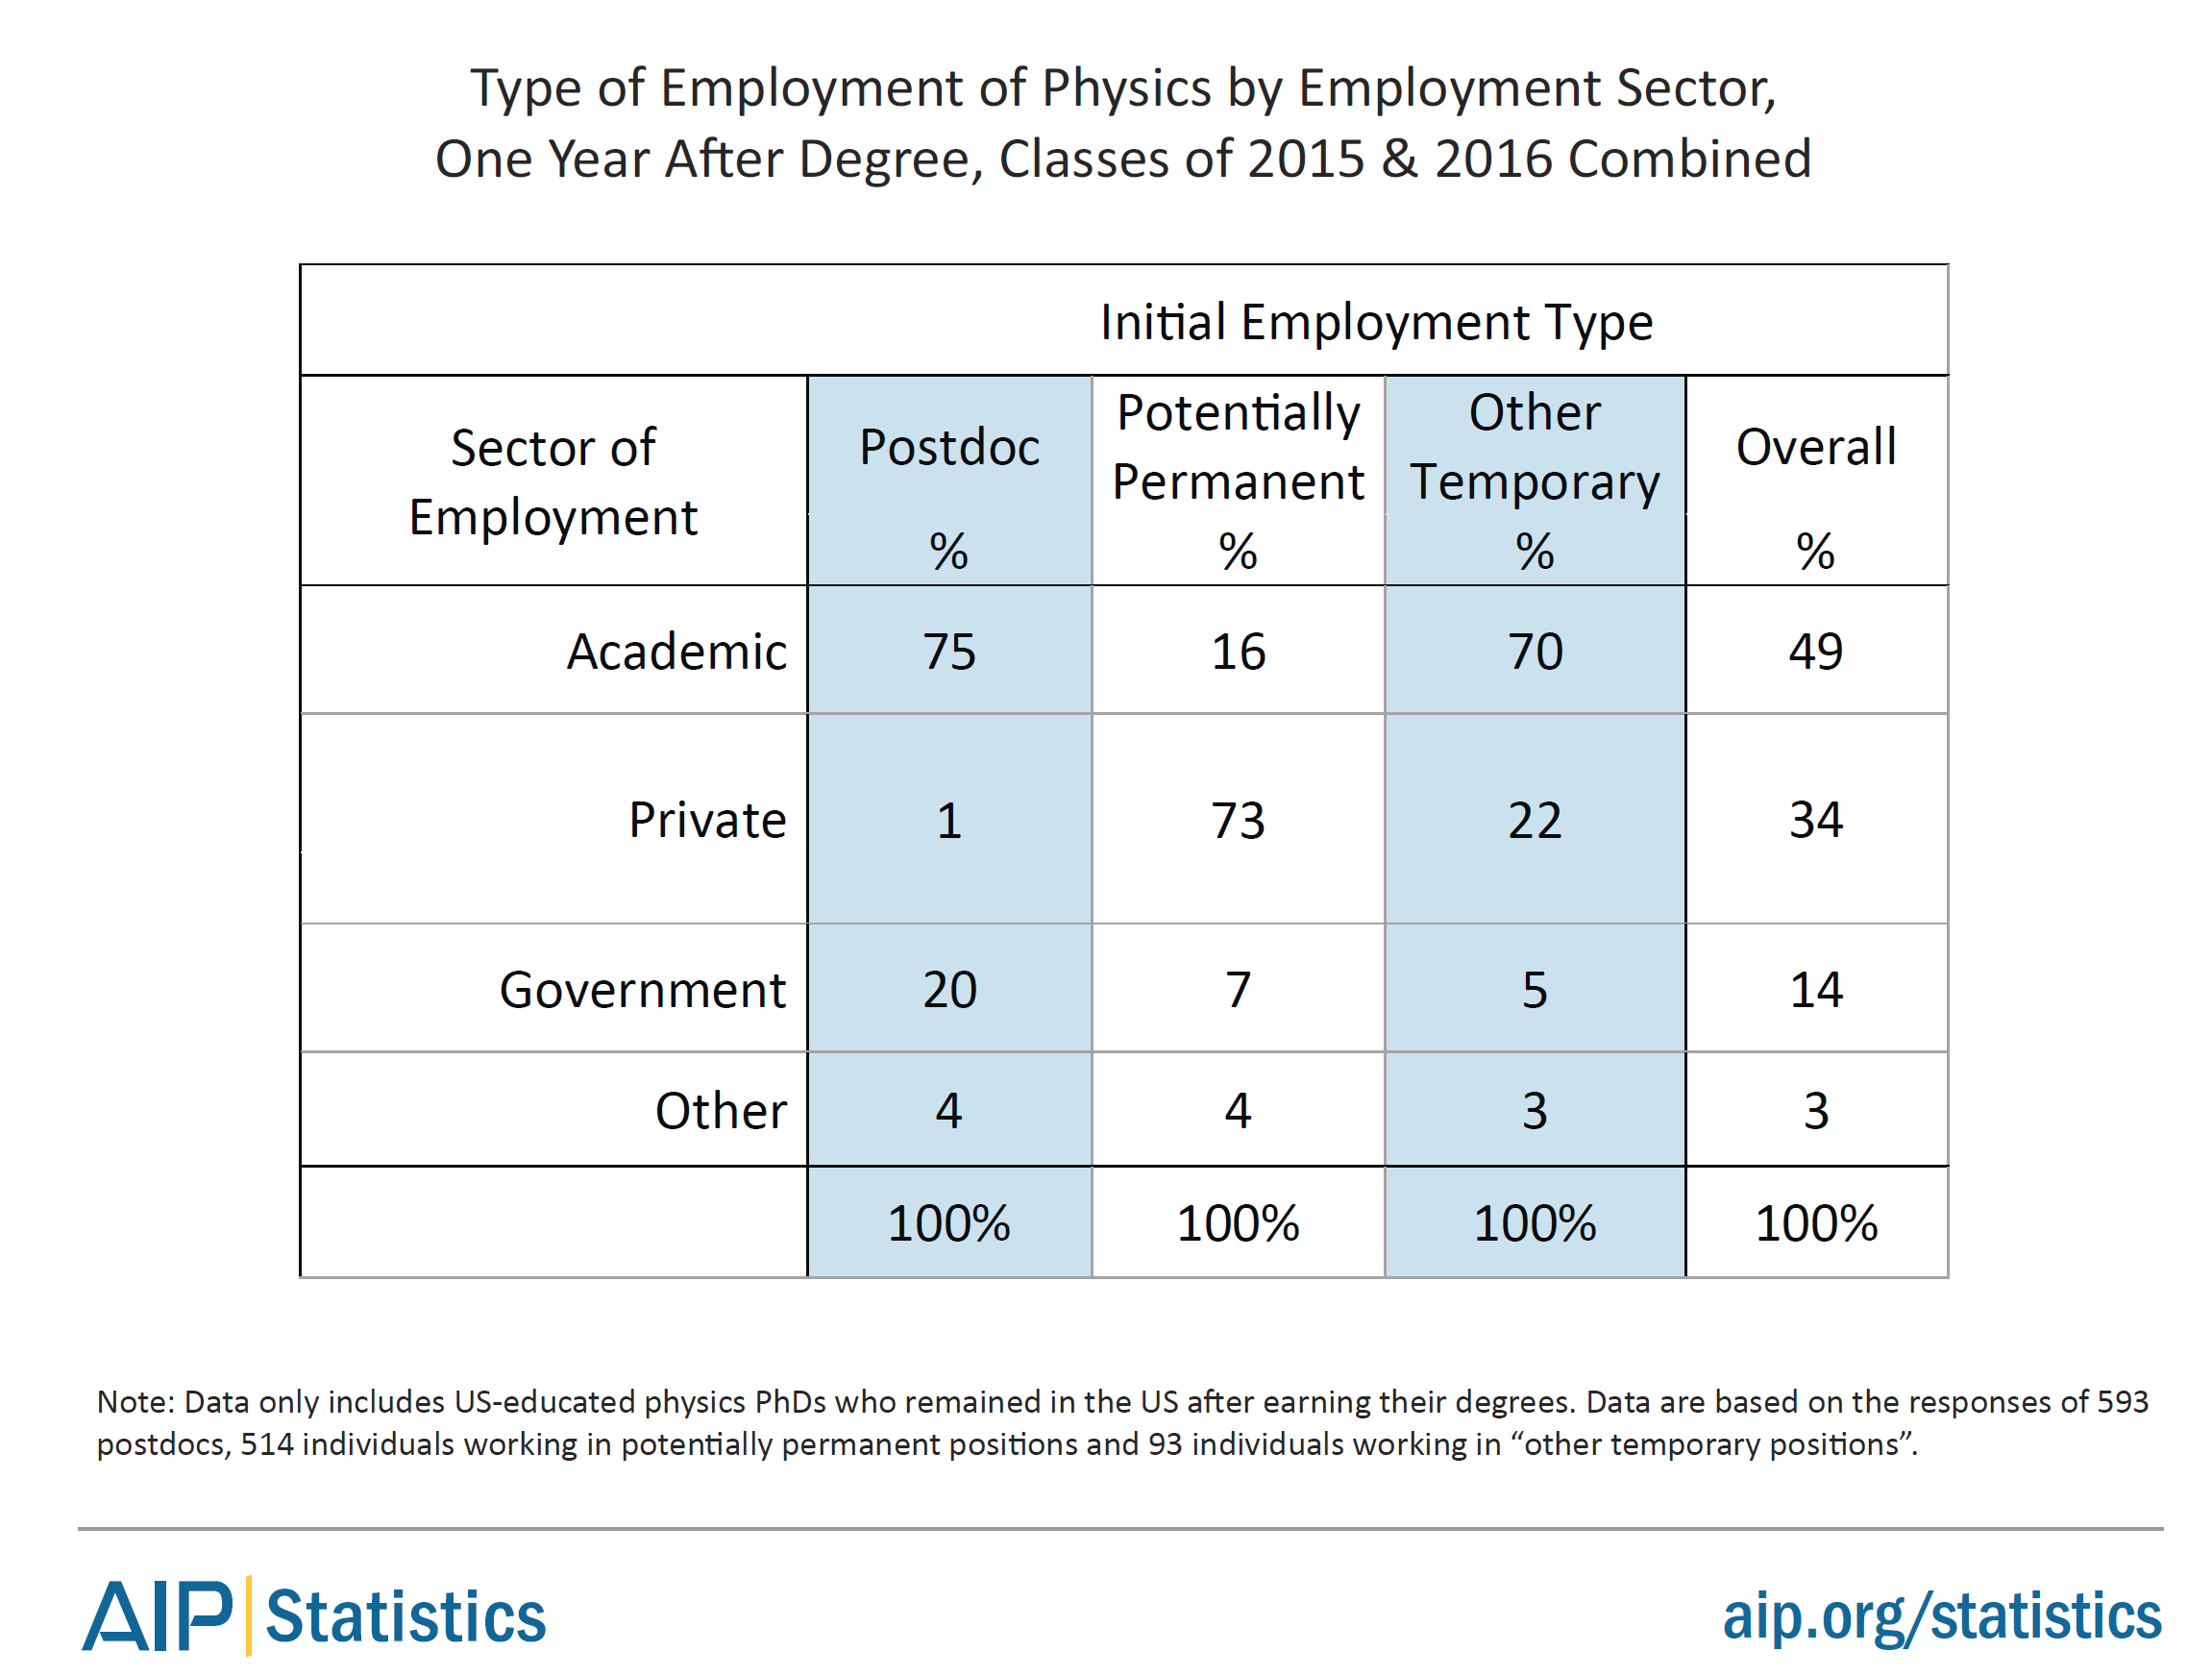
What are they doing (PhDs)?
2015-2016 graduates: 1 year after PhD
About half of physics PhDs are initially employed in the academic sector.
However, ~73% of the potentially permanent jobs are in the private sector.

Slide 24
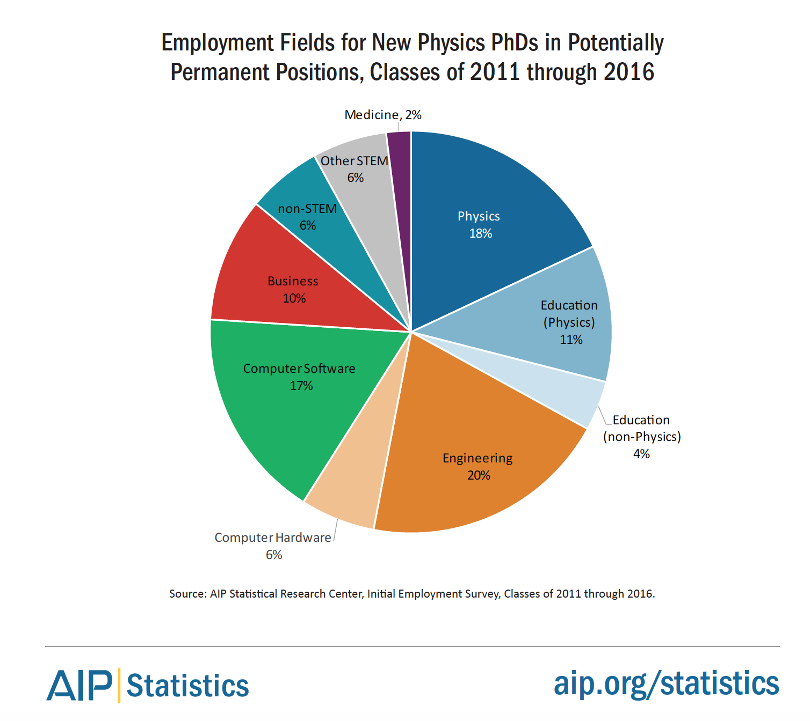
Who employs physics PhD’s?

Slide 25
What are they (PhD and MS) doing?
Source: AIP Statistical Research Center Report Common Careers of Physics PhDs in the Private Sector, June 2015
RESEARCH!

Slide 26
Bottom line: the largest initial employment sector for physics graduates is the private sector.

Slide 27
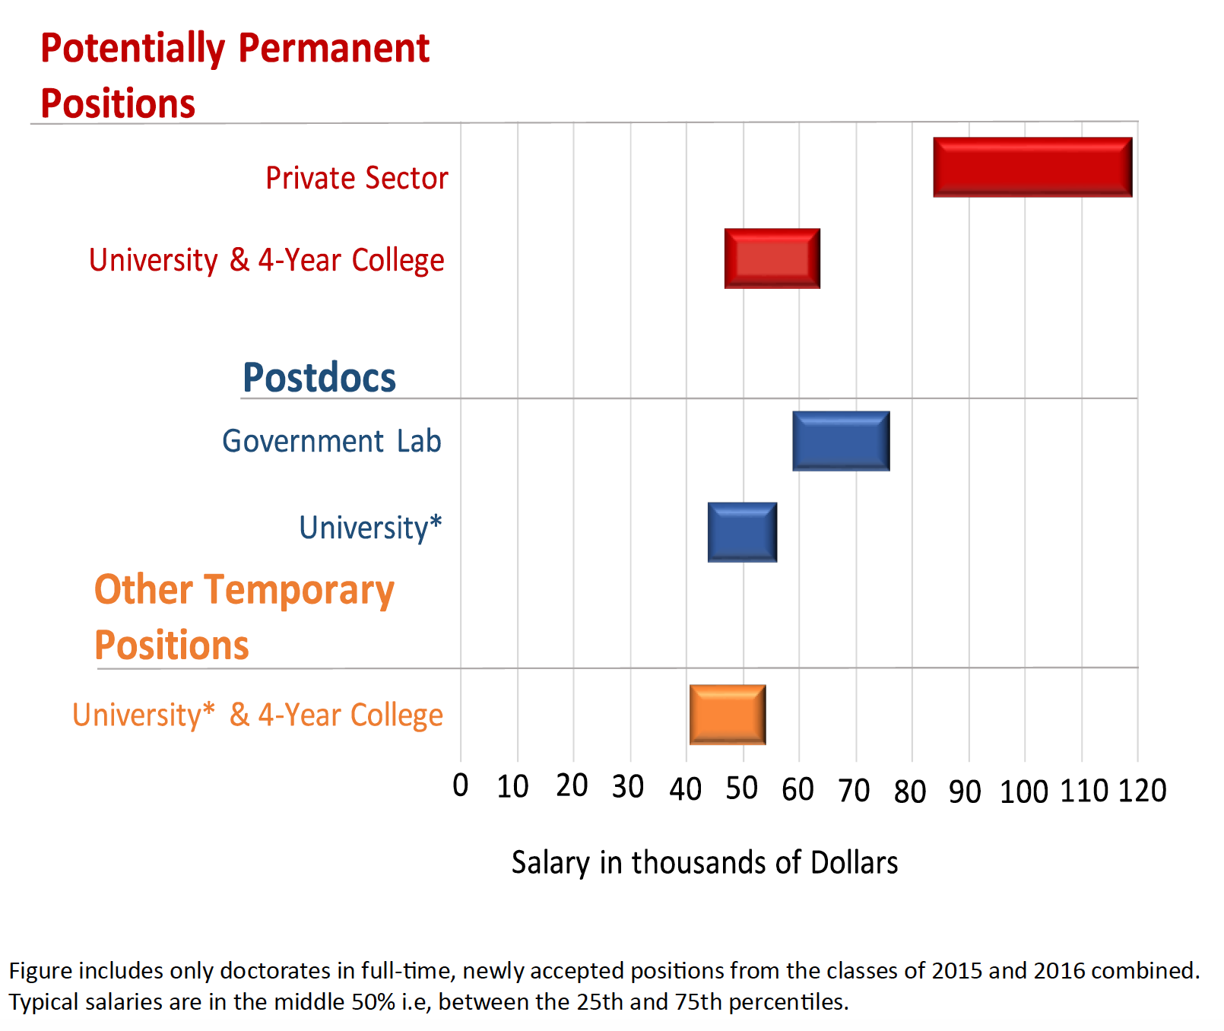
How much do physics PhDs earn?

Slide 28
United States CV vs. Resume
https://www.aps.org/careers/guidebook/resume.cfm
In the United States job market, CVs are:
comprehensive - they include most professional relevant details of your life
general - they do not specifically emphasize a particular area of experience or expertise
lengthy - a CV can be several pages long
Resumes in the United States are:
limited - they describe a limited subset of your expertise
focused - they include skills and experiences that are relevant to a specific job description
short - ideally a resume is one page long
Goal of both of these documents is to get you an interview!

Slide 29
Read The Job Carefully and Customize
There is no one perfect CV or Resume.
Ideally you customize to highlight your skills that match what the job is looking for.
(i.e. it is a JLab job looking for a DAQ expert, you want that information up-front and easy to find and hidden on page 10 of your 20 page CV)
Again, CV and Resume are typically part of the documents that get you an interview. Letters are also important.

Slide 30
Who Gets A Job Offer Strongly Depends On Who Applies and What Skills Employer Is Looking For
Please do not beat yourself up when you don’t get a particular job!
I know this is easy to say and harder in practice; but better to keep trying, looking, and improving then to focus on things that are out of your control.

Slide 31
Summary
Many physics degree holders entering job market every year
Majority find careers in private sector
I know many of your wish to stay in academia and please reach for you goal!!
I would encourage you to keep your eyes open for other opportunities as academic jobs are limited while public sector job are more available ( and often pay MUCH better ).
Just because it is public sector, doesn’t mean you cannot find a research position!
https://www.aps.org/careers/

Slide 32
RESEARCH THE POSITION YOU ARE APPLYING TO AND CUSTOMIZE YOUR DOCUMENTS !!
When someone hands me their CV or resume to review, the first question I will ask
them is what job are they applying to. There is no single perfect CV or resume!

