Slide 1

6.033: Intro to Computer Networks
Layering & Routing
Dina Katabi & Sam Madden
Some slides are contributed by N. McKewon, J. Rexford, I. Stoica

Slide 2
The Internet is an Exciting Place

Slide 3
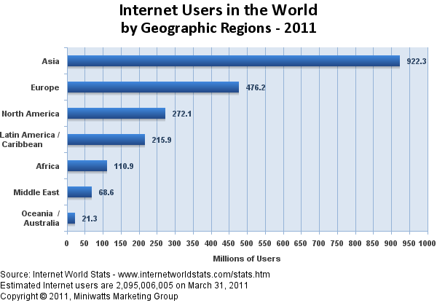
Two Billion Internet Users
~5 Billion Devices
(PCs, laptops, smart phones, etc.)

Slide 4
The Internet is a Tense Place

Slide 5

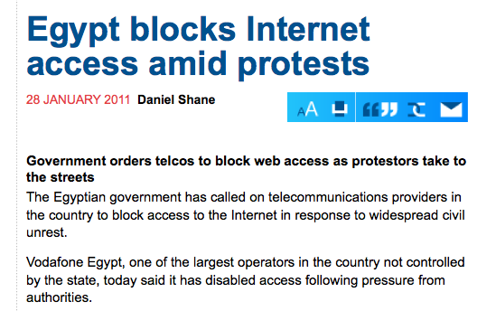

Slide 6
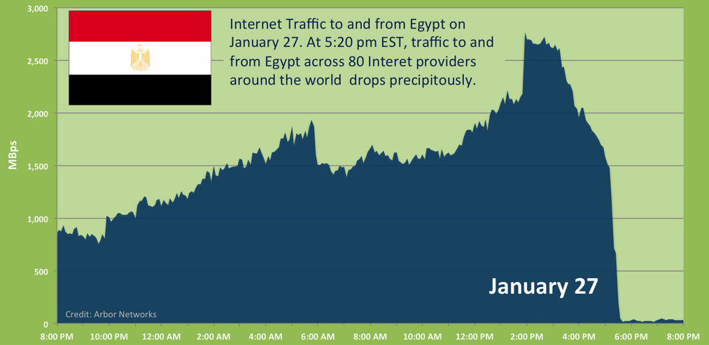
Internet Traffic to/from Egypt

Slide 7
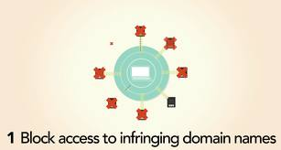



Stop Online Piracy Act (SOPA)

Slide 8


Network Neutrality
FCC Rules Against Comcast P2P Throttling
The U.S. Federal Communications Commission has ordered Comcast to stop interfering with peer-to-peer traffic on its broadband network…

Slide 9

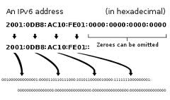
IP Address Space Exhaustion
“Currently, the Internet is built using IPv4, but on February 3, 2011, the global supply of unassigned IPv4 Internet addresses was exhausted. On that date, the Internet Assigned Numbers Authority has distributed the final five blocks of approximately 16 million IPv4 addresses among the five Regional Internet Registries.”

Slide 10
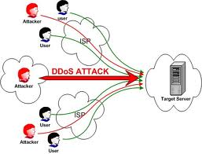




Cyber Attacks

Slide 11
What is the Internet?
3 guiding principles!

Slide 12
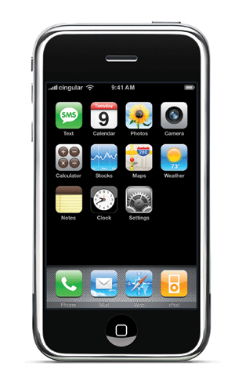
“Best-Effort Packet Delivery Service”
THE
INTERNET
packets

Slide 13
“Power at the Edge”
End-to-End Principle
Whenever possible, communications protocol operations should be defined to occur at the end-points of a communications system.
Keeps the network simple and scalable
Allows for easy introduction of new services at the edges

Slide 14


“A Network of Networks”
THE
INTERNET
4
3
5
2
7
6
1
Web server
Client
Browser

Slide 15
“A Network of Networks”
4
3
5
2
7
6
1
Web server
Client
Browser

Slide 16
How the Internet is Organizing?
Layering

Slide 17
Layering
Layering is a particular form of abstraction
The system is broken into a vertical stack of functions/protocols
The service provided by one layer is based solely on the service provided by layer below
  This is the “up/down” interface

Slide 18
Layering in the Internet
End-to-End Layer
HTTP, FTP, SMTP,
BitTorrent, …
Everything else!
Reliability, integrity,
packet ordering,
congestion control, …
Application
Transport
TCP, UDP
IP
Network
Forwarding & routing
Data Link
Physical
Framing, coding,
channel access
Modulation/demodulation
Ethernet, WiFi, …

Slide 19
Switch (Router)
Host
Host
Application
Application
Transport
Transport
Network
Network
Network
Datalink
Datalink
Datalink
Physical medium
Link and network layers are implemented everywhere
The end-to-end layer (i.e., transport and application) is implemented only at hosts

Slide 20
An Example
mypc.mit.edu
web.mit.edu
Browser
GET “6.033/index.html”
E-mail
Server
OK; file data
FTP
File
News
Reliable data transfer
TCP
TCP
SCTP
UDP
IP
Wireless
Ethernet
IP
Optical
T3
IP
IP
IP
Router
Router
Router

Slide 21
The Internet “Hourglass”
Applications
Web
FTP
Mail
News
Video
Audio
ping
napster
Transport protocols
TCP
SCTP
UDP
ICMP
IP
Ethernet
802.11
Power lines
ATM
Optical
Satellite
Bluetooth
Link technologies
Many applications, transports, and link protocols
All use IP at the network layer: universal network layer

Slide 22
Routing (figuring out the routes)
&
Forwarding (sending the packets)
Network Layer

Slide 23
How Does a Router Forwards the Packets?
Destination of blue packets
Router
Destination of red packets
Router
Destination of green packets
A router has input links and output links
A router sends an input packet on the output link leading toward the packet’s destination node
A router does not care of who generated the packet

Slide 24
How does the router know which output link leads to a packet destination?
Router
to B
A
Link 1, input
Forwarding Table
Link 1, output
Destination Out-link
A out-link 1
B
Link 2, input
Link 2, output
B out-link 2
C out-link 3
C
Link 3, input
Link 3, output
Router
D out-link 3
D
Packet header has the destination
Router looks up the destination in its table to find output link
Table is built using a routing protocol

Slide 25
Basic Requirements of a Routing Protocol
Finds a path from source to destination
Optimizes some metric (delay, cost, etc.)
Has no (permanent) loops

Slide 26
Distance Vector Routing
Initialize
  Distance to self is zero and next hop is self
  Distance to anyone else is infinity
Announce: Every T seconds
  Tell neighbors distances to all destinations
Update route to dst. upon message from j
  Distance via j = j’s distance + weight of link to j
  If distance via j is shorter than current distance, update routing table to go via j

Slide 27
Example
Objective: Determine the route from (R₁, …, R₇) to R₈
that minimizes the distance
R₁
1
R₂
1
R₄
4
R₆
2
2
3
2
R₇
3
R₅
2
R₃
4
R₈

Slide 28
Solution is simple by inspection... (in this case)
R₁
1
1
4
R₂
R₄
R₆
3
2
2
R₇
2
R₅
2
3
R₃
4
R₈
The shortest paths from all sources to a destination (e.g., R₈)
is the spanning tree routed at that destination.

Slide 29
Distance Vector Routing
Example
R₁
1
R₂
1
R₄
4
R₆
2
2
3
2
R₇
3
R₅
2
0
R₃
4
R₈
Initial State: All routers except R8 set their route length to ∞. R8 sets its route length to 0.

Slide 30
Distance Vector Routing
Example
R₁ | Inf
R₂ | Inf
R₃ | 4, R₈
R₄ | Inf
R₅ | 2, R₈
R₆ | 2, R₈
R₇ | 3, R₈
2
R₁
1
R₂
1
R₄
4
R₆
2
2
3
3
2
2
R₇
3
4
R₅
2
R₃
4
R₈
Every T seconds, Router i tells its neighbors about its current lowest-cost path to R8
Each router updates its distance as min(current distance, received distance + link weight)
Note, routing tables have both the next-hop and the distance

Slide 31
Distance Vector Routing
Example
R₁ | 6, R3
R₂ | 4, R5
R₃ | 4, R₈
R₄ | 6, R7
R₅ | 2, R₈
R₆ | 2, R₈
R₇ | 3, R₈
6
4
6
2
R₁
1
R₂
1
R₄
4
R₆
2
2
3
3
2
2
R₇
3
4
R₅
2
R₃
4
R₈
Repeat until no distance change

Slide 32
Distance Vector Routing
Example
R₁ | 6, R3
R₂ | 4, R5
R₃ | 4, R₈
R₄ | 6, R7
R₅ | 2, R₈
R₆ | 2, R₈
R₇ | 3, R₈
6
4
6
2
R₁
1
R₂
1
R₄
4
R₆
2
2
3
3
2
2
R₇
3
4
R₅
2
R₃
4
R₈
R₁ | 5, R2
R₂ | 4, R5
R₃ | 4, R₈
R₄ | 5, R2
R₅ | 2, R₈
R₆ | 2, R₈
R₇ | 3, R₈
Final Iteration
5
4
5
2
R₁
R₂
1
R₄
R₆
2
2
3
2
2
R₇
3
4
R₅
2
R₃
4
R₈

Slide 33
Summary
Internet architecture is based on layering
  E2E Layer
  Network Layer
  Link Layer
Job of Network Layer is Routing & Forwarding
  Routers build routing tables using routing protocol
  Routers forward packets based on the packet’s header and the routing table

