Slide 1
Strategy
Sam Powers

Slide 2
Pace Yourself!

Slide 3
Explore the Field
Wall follow
Random walk
Map (dangerous)
Find Balls
Vision
Luck
Approach Balls
Vision
Gyro/QP encoders
Luck
Collect Balls
Roller
Claw
Passive opening
Find Goals/Wall
Vision
Approach Goals/Wall
Vision
Gyro/QP encoders
Score!

Slide 4
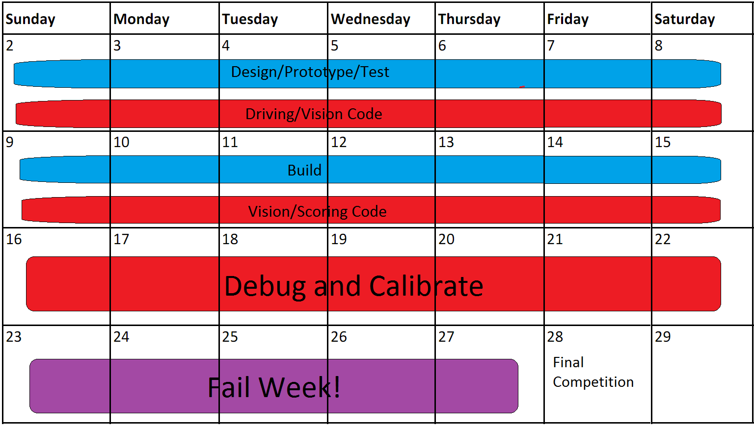
Basic Design Calendar

Slide 6
Scheduling Summary
Allow for as much parallelizing as possible
Build by day (when the machine shops are open)
Code by night
Leave time for failure!
If something is taking too long, do it differently or just move on
If you try to do too much, you might end up with nothing at all.

Slide 7
Mechanical

Slide 8
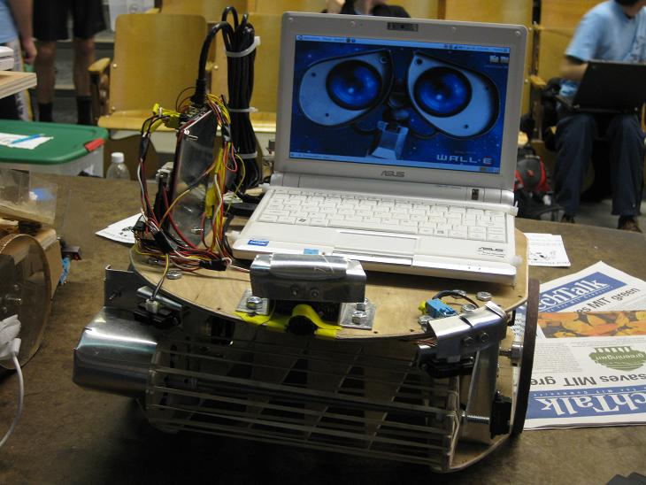
2009: Team Five

Slide 9
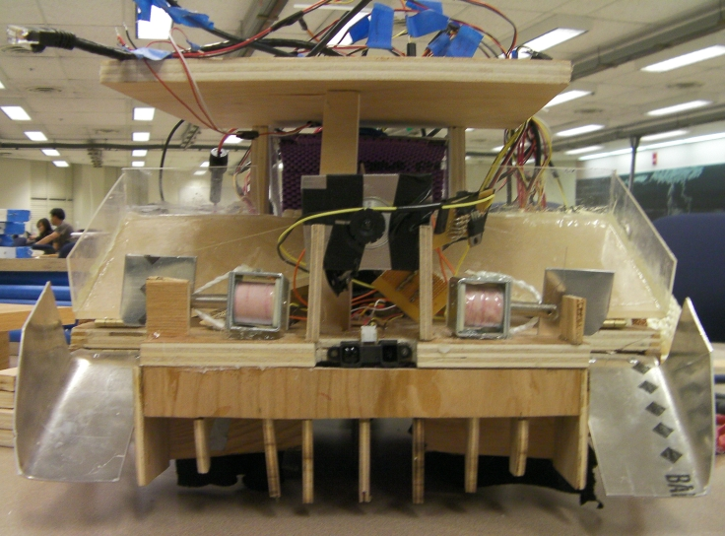
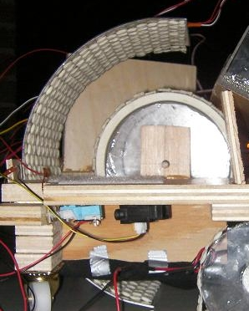
2009: Echo Pie Fist

Slide 10
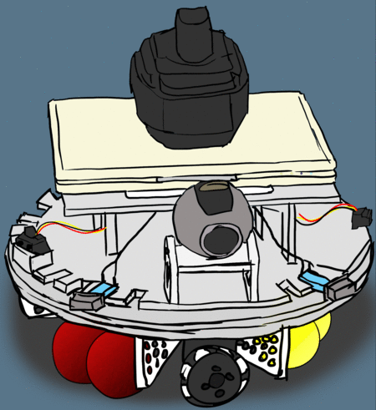
2010: Team MESS

Slide 11
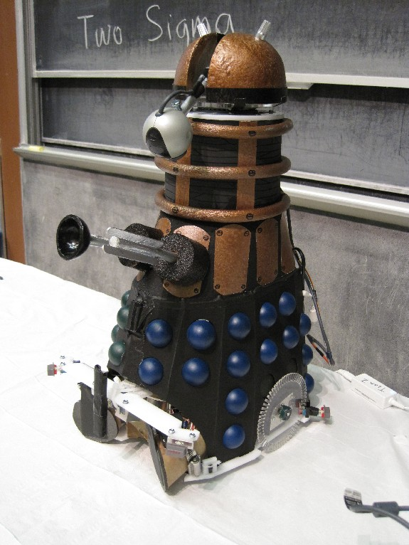
2010: Team Two

