Slide 1
Vision
Geza Kovacs
Maslab 2011

Slide 2
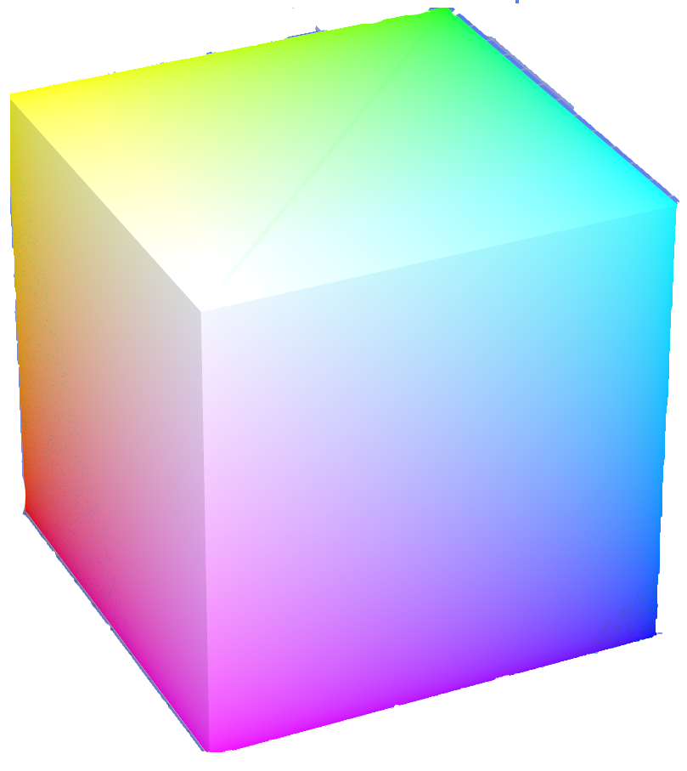
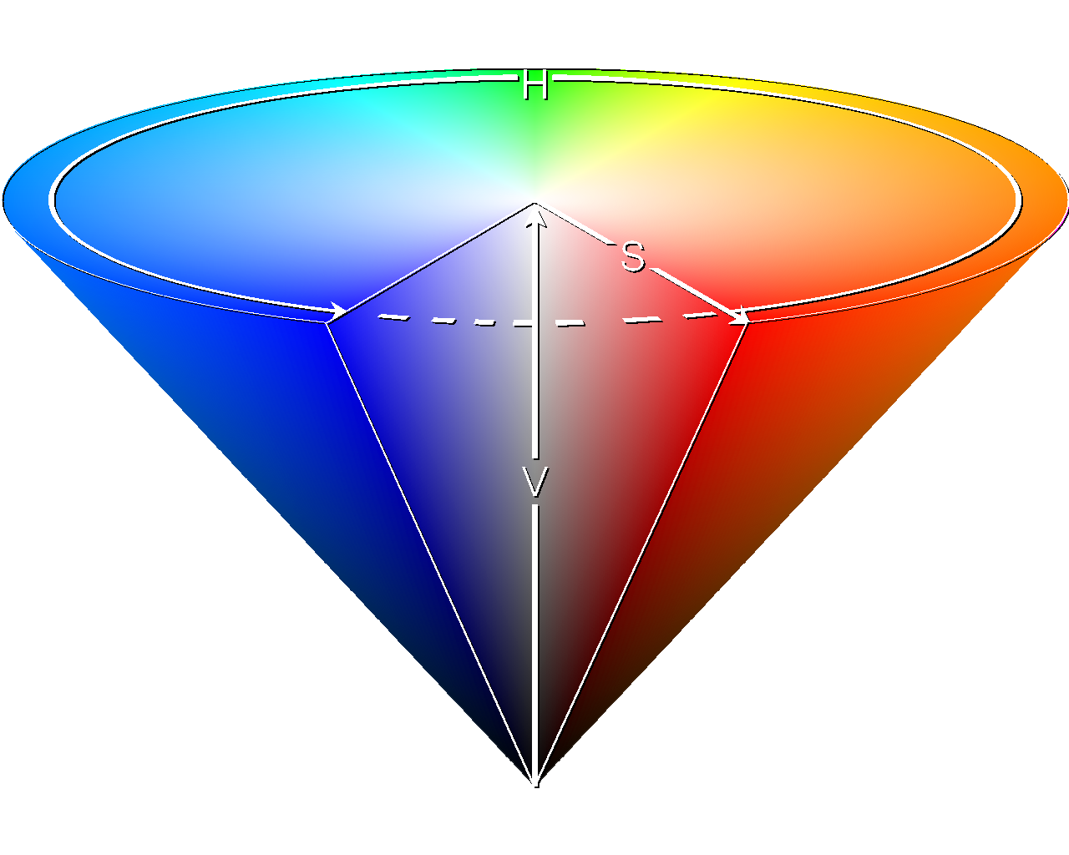
Colorspaces
RGB: red, green, and blue components
HSV: hue, saturation, and value
Your color-detection code will be more resilient to lighting conditions if you use HSV
RGB: 212, 45, 45
HSV: 0, 201, 212
RGB: 102, 0,0
HSV: 0, 255, 102
RGB: 255, 105,105
HSV: 0, 105, 255
RGB: 212, 45, 45
HSV: 0, 201, 212
RGB: 102, 22, 22
HSV: 0, 201, 102
RGB: 102, 0, 0
HSV: 0, 255, 102

Slide 3
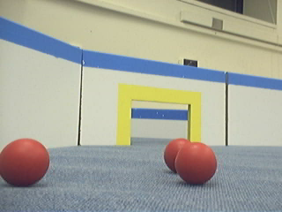
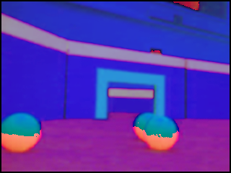
Colorspaces
hue=255
hue=0
Note that because the hue in HSV wraps around, red is both h=255 and h=0
See Tutorial for more info on HSV

Slide 4
Representation of Color in Bytes
BufferedImage img = …;
img.getRGB(x, y) returns a 32-bit (4-byte) integer
0x00FF0000

Slide 5
Representation of Color in Bytes
Alpha channel: basically transparency, not of interest
0x00FF0000

Slide 6
Representation of Color in Bytes
Red
0x00FF0000
Red: 0xFF=255

Slide 7
Representation of Color in Bytes
Green
0x00FF0000
Red: 0xFF=255 Green: 0x00=0

Slide 8
Representation of Color in Bytes
Blue
0x00FF0000
Red: 0xFF=255 Green: 0x00=0 Blue: 0x00=0

Slide 9
Representation of Color in Bytes
0x00FF0000
0x0000FF00
R: 0xFF=255
G: 0x00=0
B: 0x00=0
R: 0x00=0
G: 0xFF=255
B: 0x00=0
0x000000FF
0x00C20E9F
R: 0x00=0
G: 0x00=0
B: 0xFF=255
R: 0xC2=194
G: 0x0E=14
B: 0x9F=159

Slide 10
Extracting out R, G, B components
BufferedImage img = …;
int rgb = img.getRGB(x,y);
int r = (rgb & 0x00FF0000) >> 16;
int g = (rgb & 0x0000FF00) >> 8;
int b = (rgb & 0x000000FF);
rgb = b + (g << 8) + (r << 16)
Also works if the image is in HSV format; just replace r with h, g with s, and b with v
See Vision tutorial for more info

Slide 11
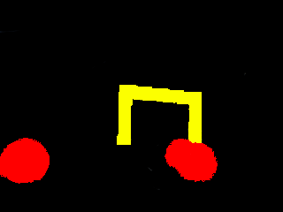
By using color thresholds, (checking that hue is in a certain range), can classify pixels as being Red, Yellow, or other

Slide 12
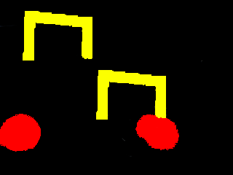
Connected Component Labeling
As a first step in detecting balls and goals, we want to group connected yellow pixels, and connected red pixels into “blobs of interest”
  That is, label each pixel with a number indicating the connected component it belongs to
1
2
3
4

Slide 13
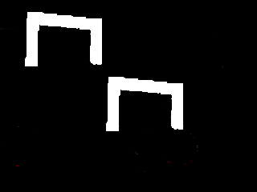
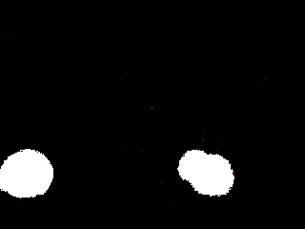
Connected Component Labeling
Various efficient algorithms exist for finding connected components of white pixels in binary images
We can use these algorithms if we consider colors one at a time
1
2
1
2
1
2
3
4

Slide 14

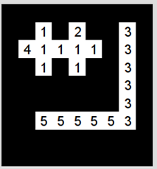
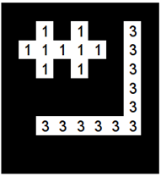
2-pass algorithm for Connected Component Labeling on Binary Images
Pass 1:
If all 4 neighbors are black or unlabeled, assign a new label to current point
If only one neighbor is white, assign its label to current point
If more than one of the neighbors are white, assign one of their labels to current point, and note equivalence of their labels
Pass 2:
Merge labels which were marked as equivalent in the first pass

Slide 15
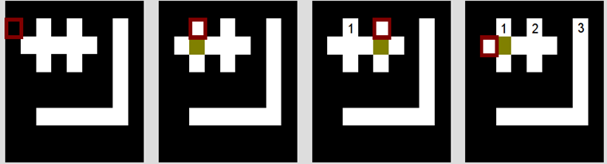
Pass 1:
If all 4 neighbors are black or unlabeled, assign a new label to current point
If only one neighbor is white, assign its label to current point
If more than one of the neighbors are white, assign one of their labels to current point, and note equivalence of their labels
Current point is not white ->
Do nothing
No labeled white neighbors ->
Create label 1
No labeled white neighbors ->
Create label 2
No labeled white neighbors ->
Create label 4

Slide 16
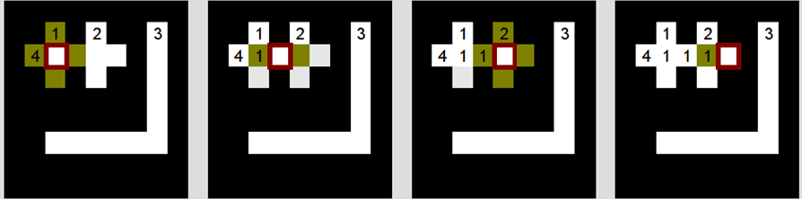
Pass 1:
If all 4 neighbors are black or unlabeled, assign a new label to current point
If only one neighbor is white, assign its label to current point
If more than one of the neighbors are white, assign one of their labels to current point, and note equivalence of their labels
2 white labeled neighbors: 1, 4 ->
Mark 1=4, assign 1
1 white neighbor with label 1 ->
Assign 1
2 white labeled neighbors: 1, 2 ->
Mark 1=2, assign 1
1 white neighbor with label 1 ->
Assign 1

Slide 17
At the end of the first pass, we have marked labels 1, 2, and 4 as equivalent, and have marked labels 3 and 5 as equivalent
In the second pass, we replace all 2s and 4s with 1s, and replace all 5s with 3s

Slide 18
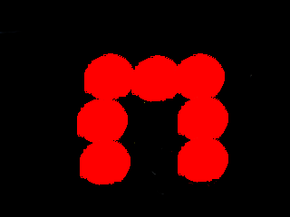
Colors aren’t always enough for segmenting objects
Note that at edges of objects, there is a change in pixel value
Use edge detection for segmenting objects

Slide 19
Image Convolution
Determines pixel value based on neighboring values (relation described by a kernel matrix)
Used in blurring, sharpening, edge detection, etc
0 | 1/6 | 0
1/6 | 1/3 | 1/6
0 | 1/6 | 0
11 | 4 | 13 | 8
7 | 1 | 3 | 9
0 | 5 | 10 | 6
2 | 15 | 12 | 14
Kernel
Source Image (single-chanel, greyscale)
 | 1/3 + 4/6 + 7/6 + 3/6 + 5/6 = 21/6 | 3/3 + 13/6 + 1/6 + 9/6 + 10/6 = 39/6
 | 5/3 + 1/6 + 0/6 + 10/6 + 15/6 = 36/6 | 10/3 + 3/6 + 5/6 + 6/6 + 12/6 = 46/6
Result of convolution
Various workarounds for determining the edge pixels

Slide 20
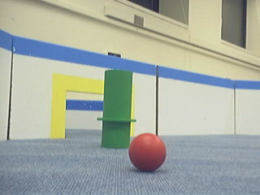
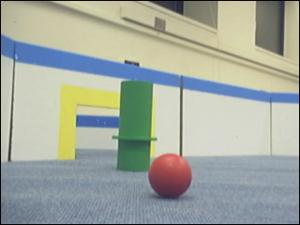
import java.awt.image.*;
BufferedImage simpleBlur(BufferedImage src) {
float[] matrix = new float[] {
0.0f, 1.0f/6, 0.0f,
1.0f/6, 1.0f/3, 1.0f/6,
0.0f, 1.0f/6, 0.0f,
};
Kernel kernel = new Kernel(3, 3, matrix);
return new ConvolveOp(kernel).filter(src, null);
}
0 | 1/6 | 0
1/6 | 1/3 | 1/6
0 | 1/6 | 0
Source Image
Kernel
Result of convolution (slightly blurred image)

Slide 21
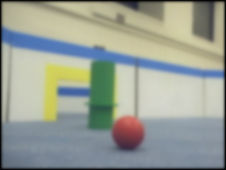
import java.awt.image.*;
BufferedImage simpleBlur(BufferedImage src) {
float[] matrix = new float[] {
0.0f, 1.0f/6, 0.0f,
1.0f/6, 1.0f/3, 1.0f/6,
0.0f, 1.0f/6, 0.0f,
};
Kernel kernel = new Kernel(3, 3, matrix);
return new ConvolveOp(kernel).filter(src, null);
}
0 | 1/6 | 0
1/6 | 1/3 | 1/6
0 | 1/6 | 0
Source Image
Kernel
Result of convolution applied 20 times (more blurred image)

Slide 22
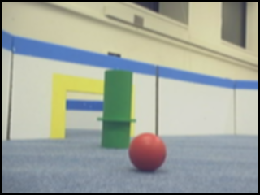
Gaussian Blur
A common preprocessing step before various operations (edge detection, color classification before doing connected component labeling, etc)
2/159 | 4/159 | 5/159 | 4/159 | 2/159
4/159 | 9/159 | 12/159 | 9/159 | 4/159
5/159 | 12/159 | 15/159 | 12/159 | 5/159
4/159 | 9/159 | 12/159 | 9/159 | 4/159
2/159 | 4/159 | 5/159 | 4/159 | 2/159
Kernel
Source Image
Result of convolution with gaussian kernel

Slide 23
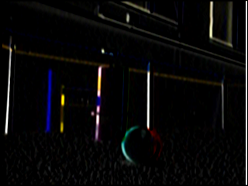
Detecting Horizontal Edges
Use the Sobel operator G_x
-1 | -2 | -1
0 | 0 | 0
1 | 2 | 1
Kernel
Source Image
Result of convolution with sobel operator G_x

Slide 24
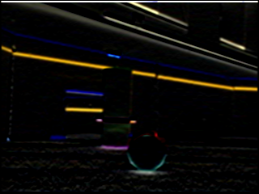
Detecting Vertical Edges
Use the Sobel operator G_y
-1 | -2 | -1
0 | 0 | 0
1 | 2 | 1
Kernel
Source Image
Result of convolution with sobel operator G_y

Slide 25

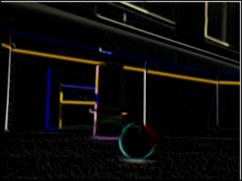
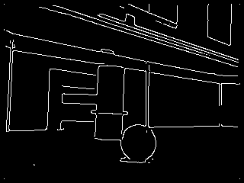
Edge Detection
Get matrices representing horizontal edges (G_x) and vertical edges (G_y) (via convolution with sobel operator)
Then, assign each pixel squareroot(value in the horizontal edge squared + value in vertical edge squared)
Use more elaborate preprocessing and postprocessing to get nicer results

Slide 26
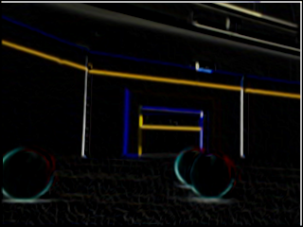
Segmenting Objects
Group same-colored regions using connected component labeling, and use edges to segment objects further?
  Fit lines or curves to edges?
3
1
2

Slide 27
Classifying Objects as Goals or Balls
Consider the shape: rounded boundary, vs straight boundary
Consider the region around the center: red/yellow or not?
Consider special cases: goals with balls in the middle, goals observed at an angle, etc

Slide 28
Estimating Distances to Objects
Note that all balls have the same size. Likewise with goals, wall heights, etc
By making some measurements and using some trig, you can estimate distance to objects from your image data
Observed Distance ~= k/(width in pixels)
Actual Distance

Slide 29
Testing Advice
Keep a collection of images which you can use unit tests on
Test detection of balls and goals from different angles, and arrange in various ways
Make sure to test your vision code (especially color detection) in different lighting conditions

Slide 30
Other Resources
Connected Component Labeling: http://homepages.inf.ed.ac.uk/rbf/HIPR2/label.htm
Edge Detection: http://www.pages.drexel.edu/~weg22/can_tut.html
Various lectures from previous years also have info on camera details, performance optimizations, stereo vision, rigid body motion, etc
  http://web.mit.edu/6.186/2010/lectures/vision.pdf
  http://web.mit.edu/6.186/2007/lectures/vision/maslab-vision.ppt
  http://web.mit.edu/6.186/2006/lectures/Vision.pdf
  http://web.mit.edu/6.186/2005/doc/basicvision.pdf
  http://web.mit.edu/6.186/2005/doc/morevision.pdf
  http://courses.csail.mit.edu/6.141/spring2008/pub/lectures/Vision-I-Lecture.pdf

