Slide 1
SEMI-CLASSICAL TRANSITION STATE THEORY APPLIED TO MULTIWELL
CALCULATIONS ON THE OH+CO →H+CO₂ REACTION
Ralph E. Weston Jr.ª, Thanh Lam Nguyen^{b}, John F. Stanton^{c}, and John R. Barker^{b}
ª Chemistry Department, Brookhaven National Laboratory, Upton, NY
^{b} Department of Atmospheric, Ocean and Space Sciences, University of Michigan, Ann Arbor, MI
^{c} Department of Chemistry and Biochemistry, University of Texas, Austin, TX

Slide 3
■ Ab initio calculations
■ SCTST calculations of rate constants
■ Multiwell solutions of Master Equation
■ Results and Discussion
■ Conclusions

Slide 4
Ab initio calculations
Energies: CCSD(T) method extrapolated to
complete basis set
CCSD(T)/CBS(aVDZ,aVTZ,aVQZ) (∓ 0.5 kcal)
Dunning, 1999
Geometries and harmonic frequencies:
CCSD(T,full)/aug-cc-pVTZ
Anharmonic constants:
CCSD(T)/ANO
CFOUR program (Stanton,2009)

Slide 5
Local potential energy surface

Slide 6
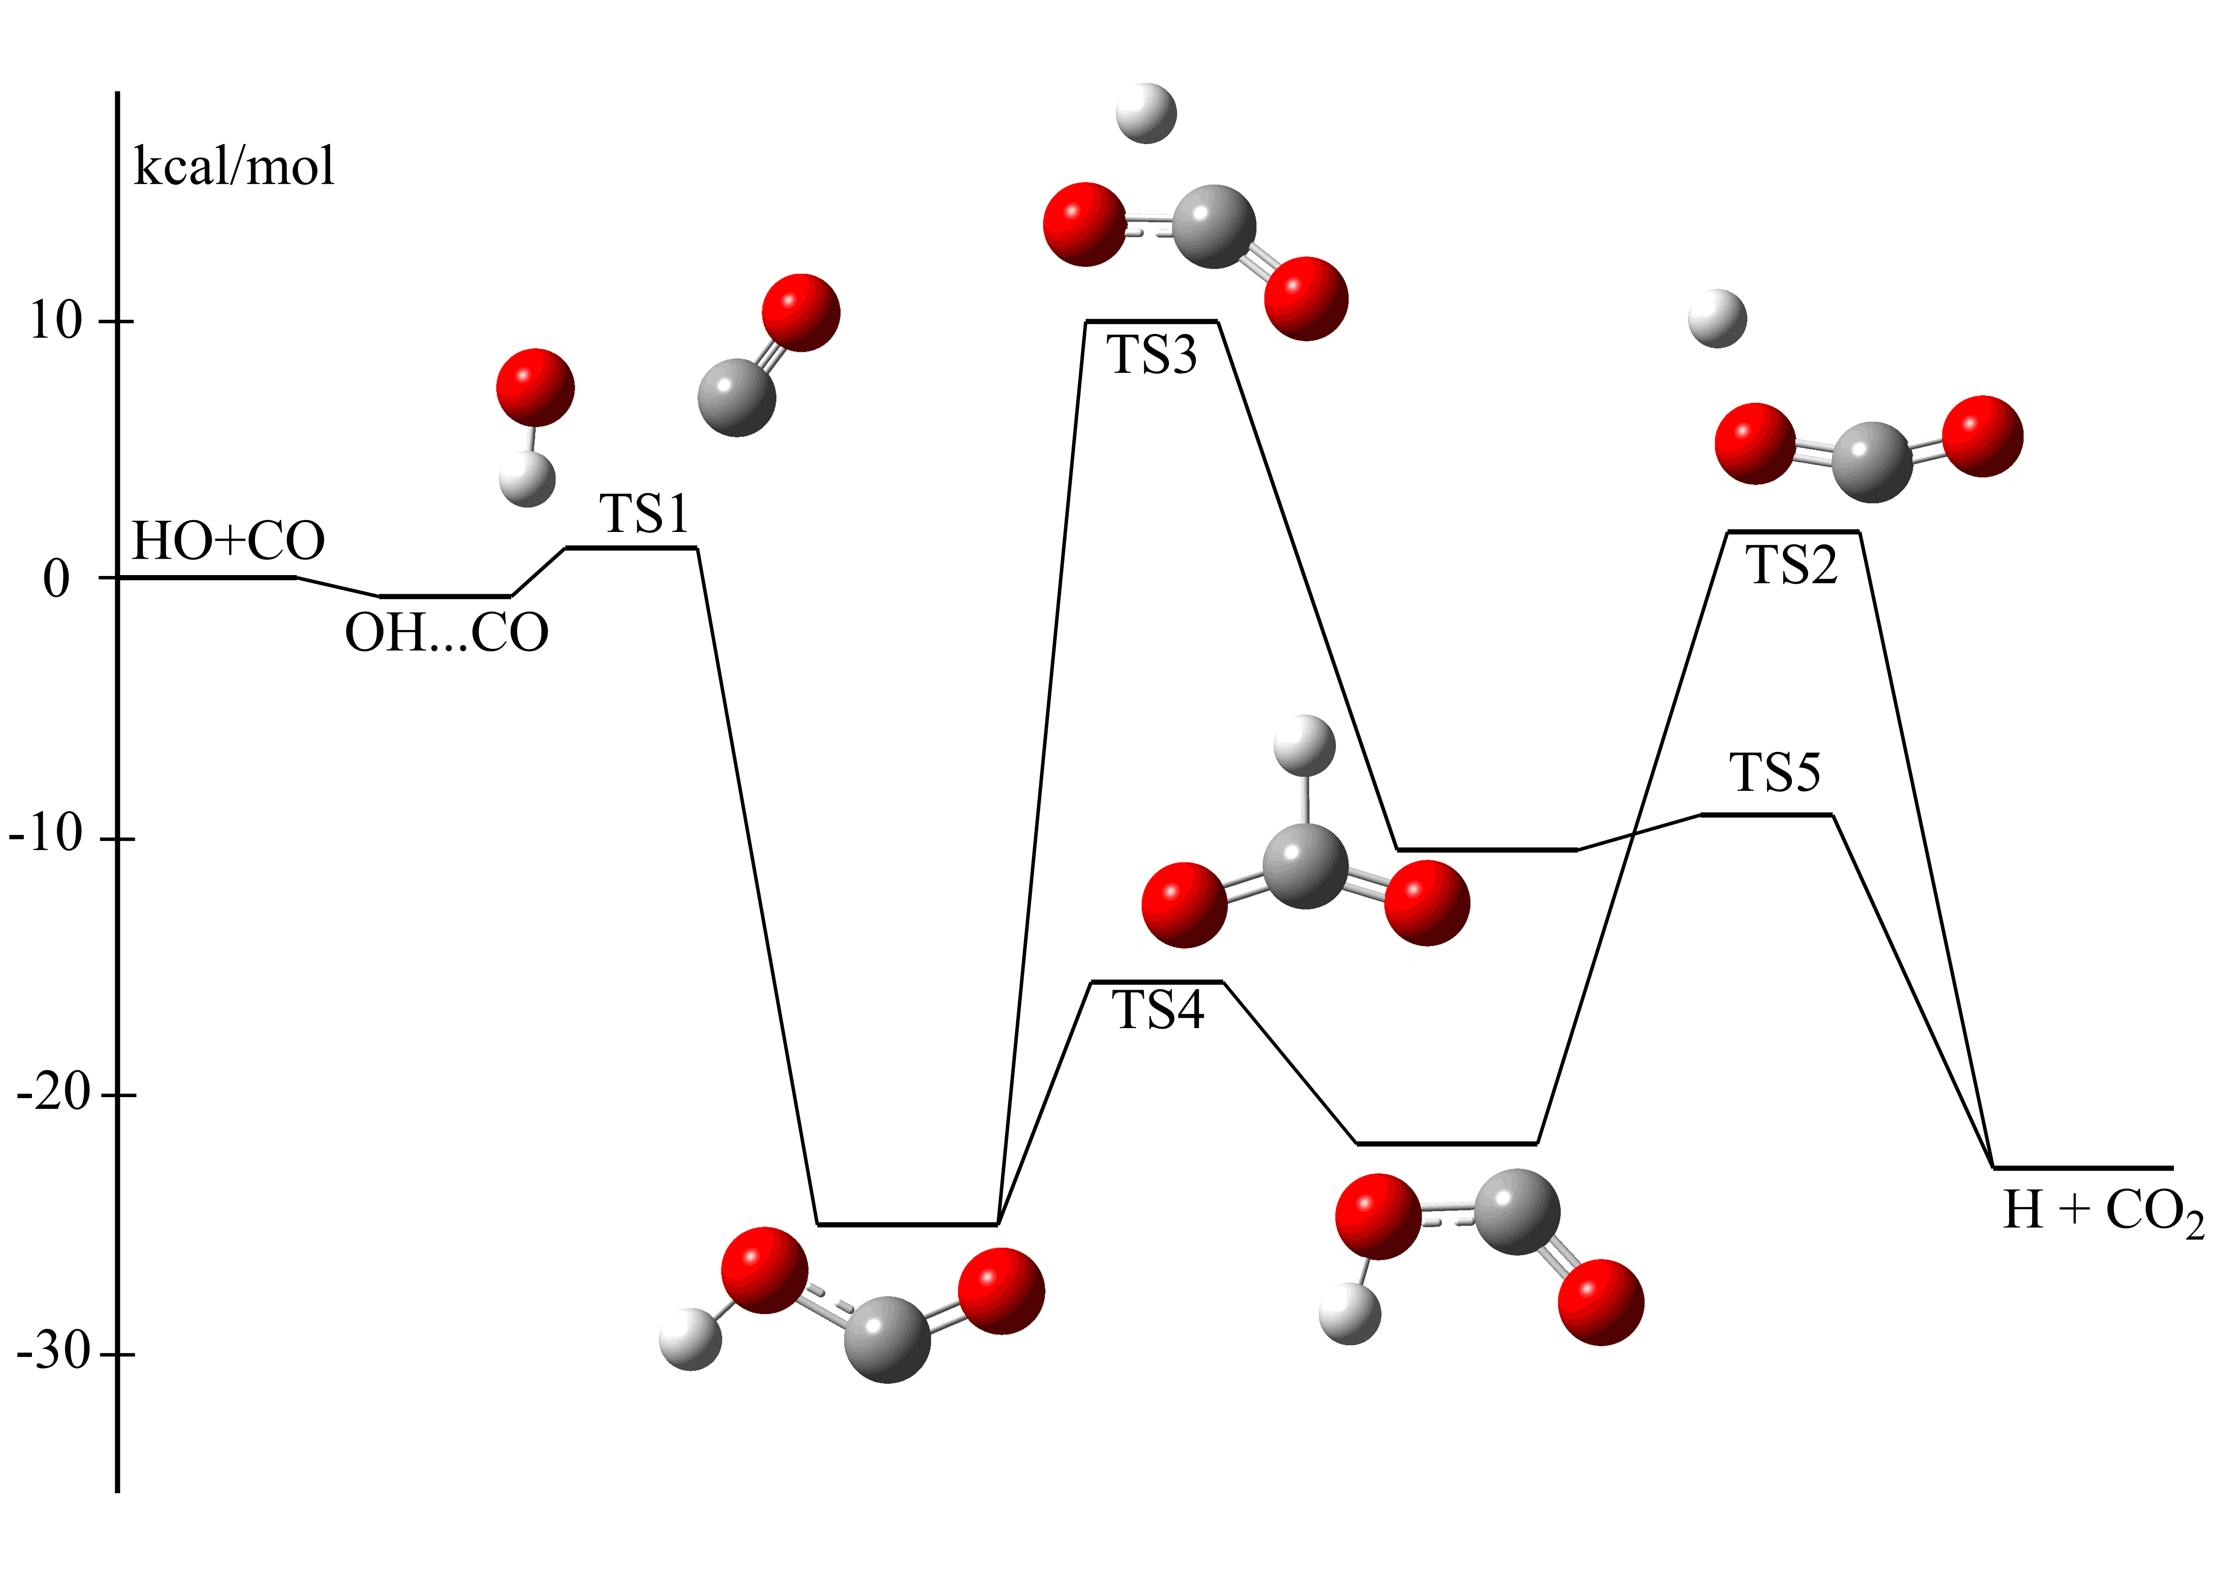

Slide 7
SCTST calculations
Miller (1975, 1990)
Nguyen, Stanton, Barker (2010)
ZPE’s include harmonic frequencies, anharmonic
constants, G₀ (involving normal coordinate f.c.),
SO correction
DBOC was NOT included; may be important in
OD isotope effect

Slide 8
SCTST calculation of k(E)
SCTST method has previously been applied to
calculate canonical rate constants k(T)
In this application it is use to obtain micro-
canonical rate constants k(E) for use in
master equation calculations

Slide 9
Multiwell calculations
Barker, et al.
Stochastic method
dX/dt = rates of formation and removal+energy transfer
P(E,E’) = N exp [-(E-E’)/α] α = 100—200 cm-1

Slide 16
Conclusions
This is work in progress: how far must we go in choosing basis functions for a priori calculations?
Even with a large basis set, a priori calculations are not in close agreement with experimental results
Ad hoc adjustment of barrier heights gives results in good agreement with experiment at
T = 98-819K and P up to ~1000 bar

