Slide 2
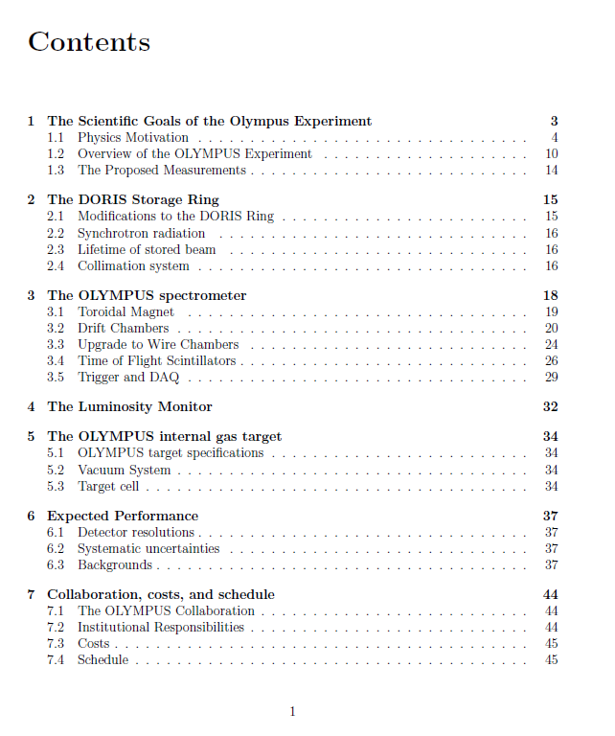
M. Kohl, R.M.
F. Brinker, A. Schmidt,….
J. Hauschildt, J. Kelsey,….
D. Hasell, J. Calarco, Bonn
M. Kohl
J. Kelsey, R.M., E. Steffens, …
E. Tolley, D. Hasell, A. Schmidt, ..
U. Schneekloth, D. Hasell

Slide 3
Proposed Schedule
Drafts requested by Friday August 21st
DRAFT TDR document to review committee by Monday August 31st
Anticipate feedback from review committee before Tuesday September 15th
Discuss document at DESY meeting
Finalize TDR by November 1st

