Slide 1
Olympus Target, Beam Line and Vacuum System
Jim Kelsey

Slide 2
Specifications
Target cell is a 27mm x 9 mm ellipse x 60 cm long. It will be made of 100 micron thick pure aluminum.
Target cell will be connected to a frame that will be attached to a mounting flange so that entire system can be mounted in one operation.
Target cell and frame will be attached to a cold head so that system can be cooled to 30 K.
Target cell will be protected by an upstream tungsten collimator that is 10 cm thick with a 25mm x 7mm opening.
Gas feed system will accommodate flows of Hydrogen from 1.5 x 10¹⁷ Atoms/sec. to 1.5 x 10¹⁵ Atoms/sec.

Slide 3
More Specs.
Window opening will accommodate in plane angles from 80° to 20° from ±20 cm from the target origin. It will accommodate 10° from the origin as well as ± 18° out of plane.
Scattering Chamber windows will be 254 micron thick Aluminum.
Windows and target flange will be attached to chamber utilizing o-rings for a seal.
Scattering Chamber will be made out of 6061 Aluminum utilizing Atlas aluminum to SS conflat flanges.
Beam line and pumpouts will be all stainless steel. Supports will be 6061 aluminum.

Slide 4
More Specs.
Vacuum system will be pumped using 5 stages of a “dry” system of Maglev turbos and hook and claw roughing pumps. It will also include 2000 l/s NEG modules on final pumping stations.
Nominal vacuum will be in the 10e-8 scale at the end of these stages.
Beam line will be smooth bore throughout utilizing thin wakefield suppressors at transitions and in the pumping tees.
Appropriate ports and larger beam pipe added for Moller measurement.

Slide 5
Alignment
Target cell will be bore sighted in its “cold” state. We can then transfer these coordinates to the fiducials on the scattering chamber. We can then align the chamber to the interaction point and along the beam.
Vacuum beam line can be surveyed at flanges and positioned to be centered on beam.

Slide 6
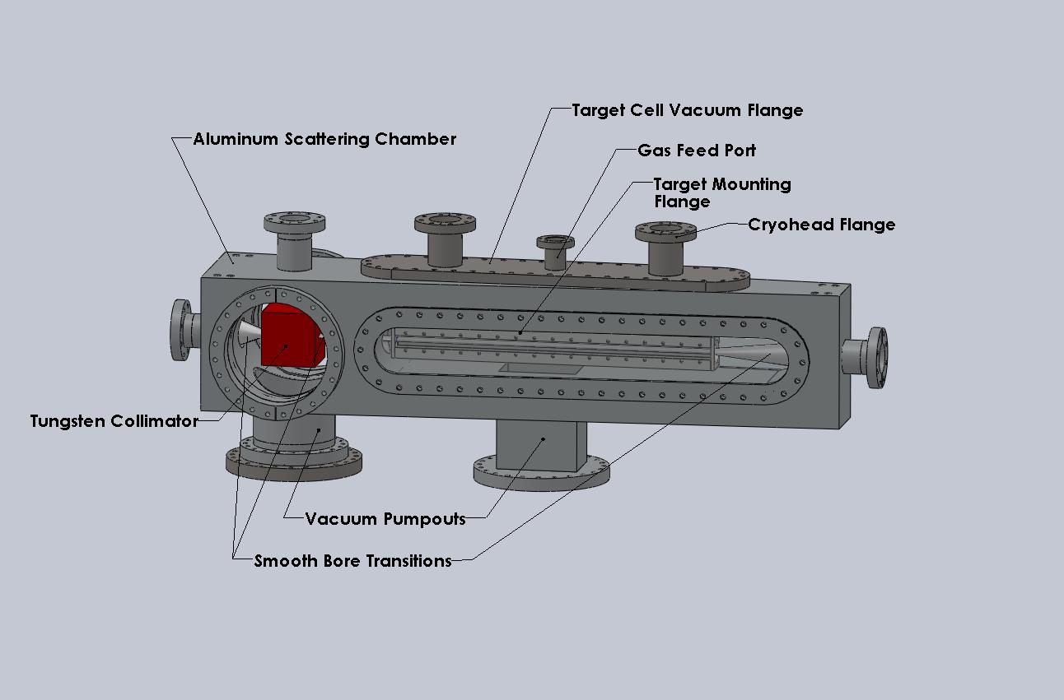

Slide 7
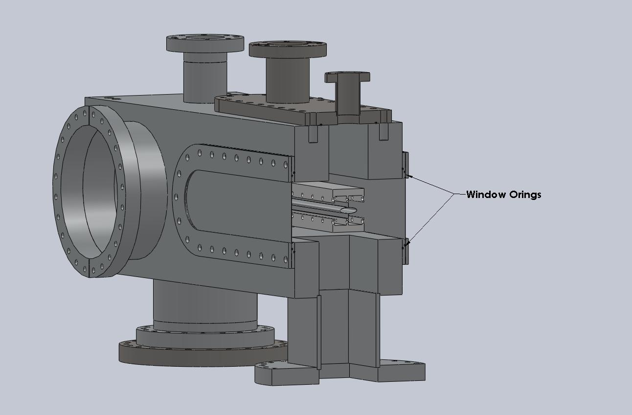

Slide 8
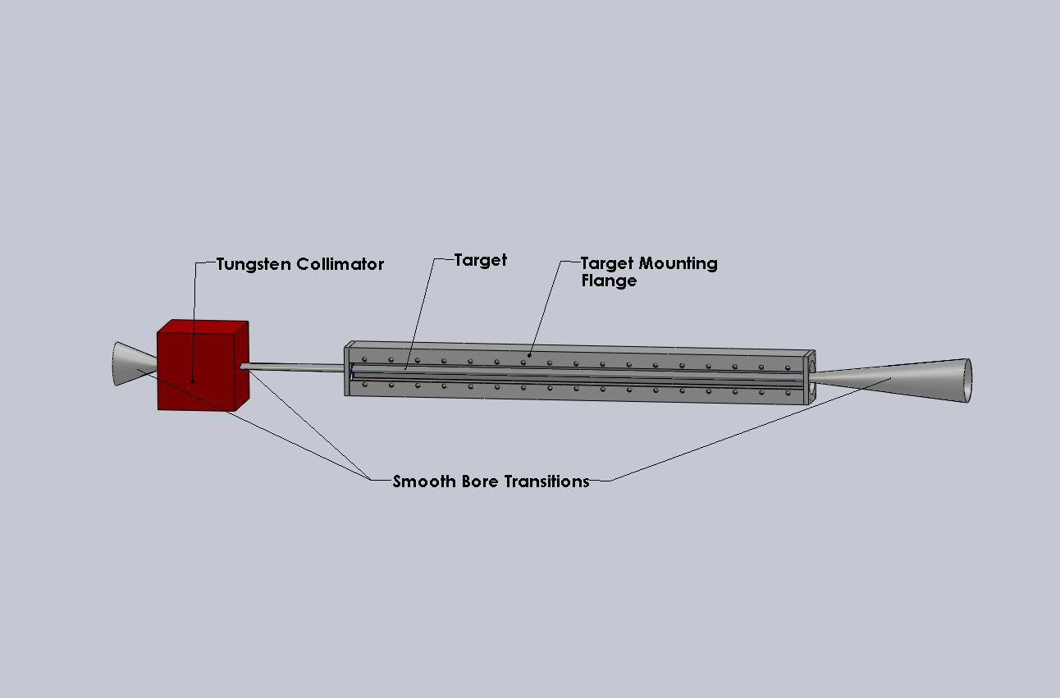

Slide 9
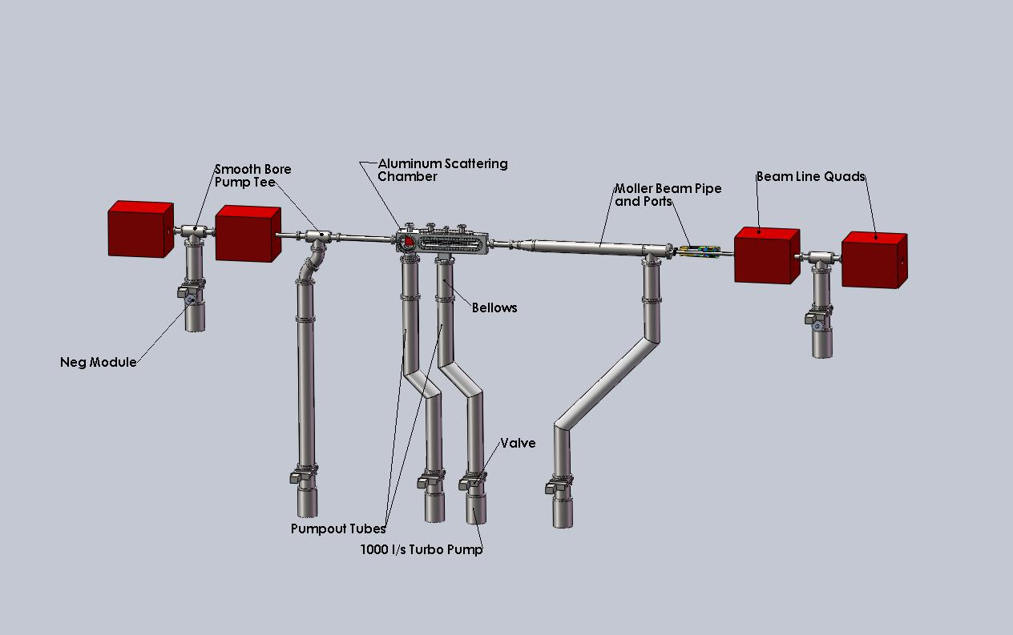

Slide 10
In Conclusion
Scattering Chamber design is complete.
Drafting and bid process will begin now.
Beam Line design is complete and we will begin procurement process.
Target system design is well along but still needs work. Will be next task.
Gas feed system exists and we are beginning the process of re-conditioning.
Still need to design Scattering chamber and beam line supports.

