Slide 1
Olympus Delivery and Updates
Jim Kelsey

Slide 2
Target Updates
Target cell and frame will be attached to a cold head so that system can be cooled to 25 K with load of 20 Watts.
Target cell will be protected by an upstream tungsten collimator that is 15 cm thick with a 25mm x 7mm opening.

Slide 3
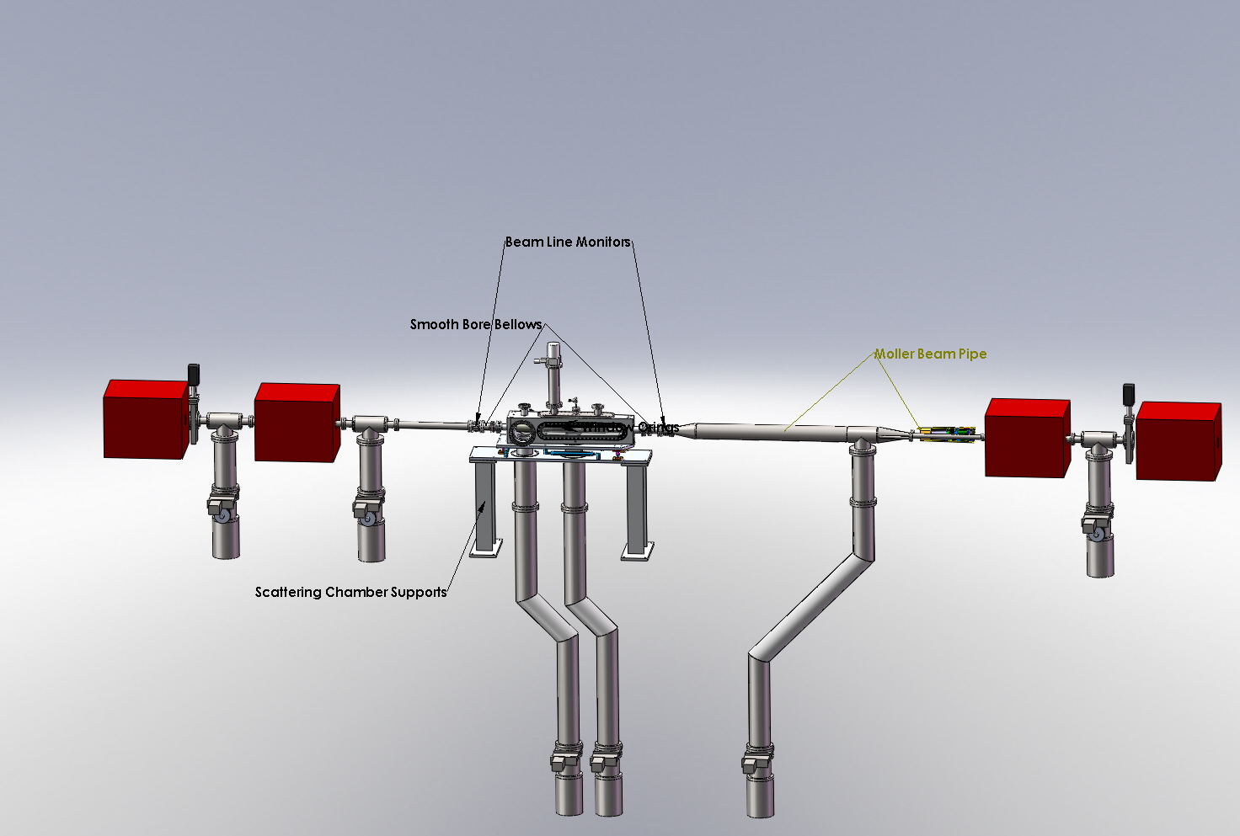

Slide 4
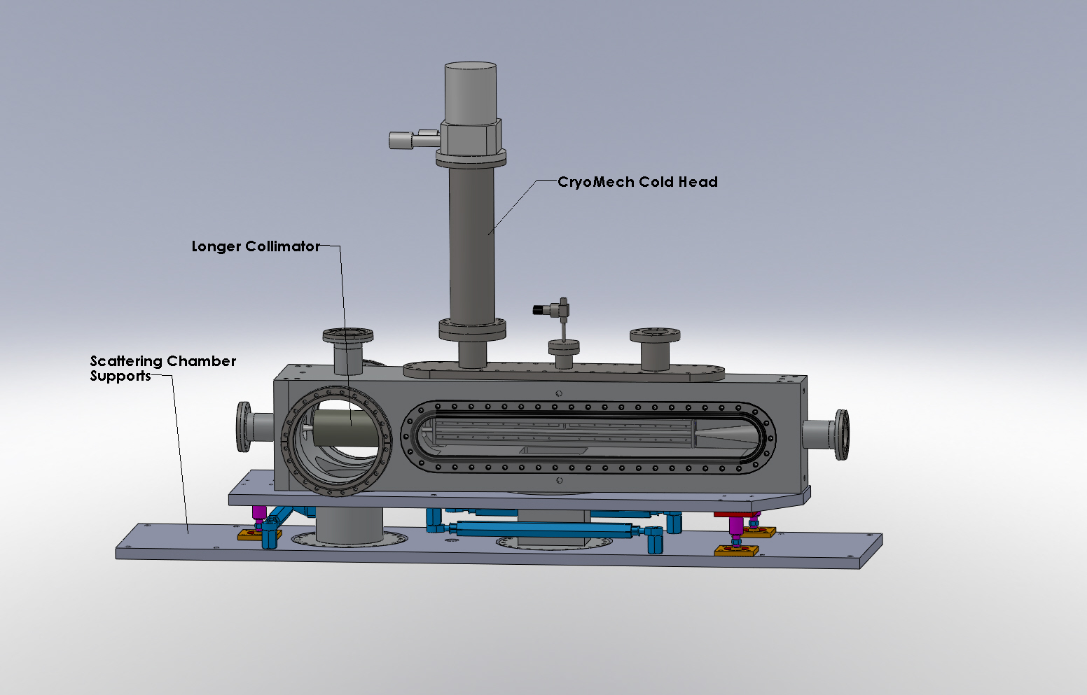

Slide 5
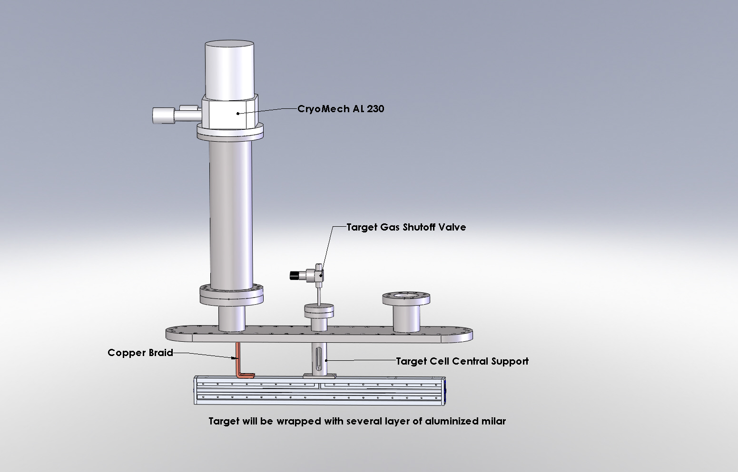

Slide 6
Shipping
Set to package and ship Wire Chambers, TOF’s, and detector subframes in 3 weeks.
Current plan is to ship Coils, mainframe and other components within 7 weeks in two shipments.

Slide 7
In Conclusion
Scattering Chamber design has been sent out for manufacture. Delivery in 10-12 weeks.
Beam Line design is tentatively complete and we will begin procurement process.
Target system design is well along.
Gas feed system exists and we in the process of re-conditioning.
Scattering chamber support designed still need to work on beam line supports.
Lots of activity packaging and preparing for shipping.

