Slide 1
Olympus Delivery and Updates
Jim Kelsey

Slide 2
Target Updates
Target cell, frame and mounting flange design is mature.
Material has been purchased for target frame and support.
Material has been ordered for Collimator.
Investigating transition from wakefield suppressors to target. Current design uses EMI gaskets.
Gauges are out for bid.
Drafting of rest of vacuum system to commence as manpower becomes available.

Slide 3
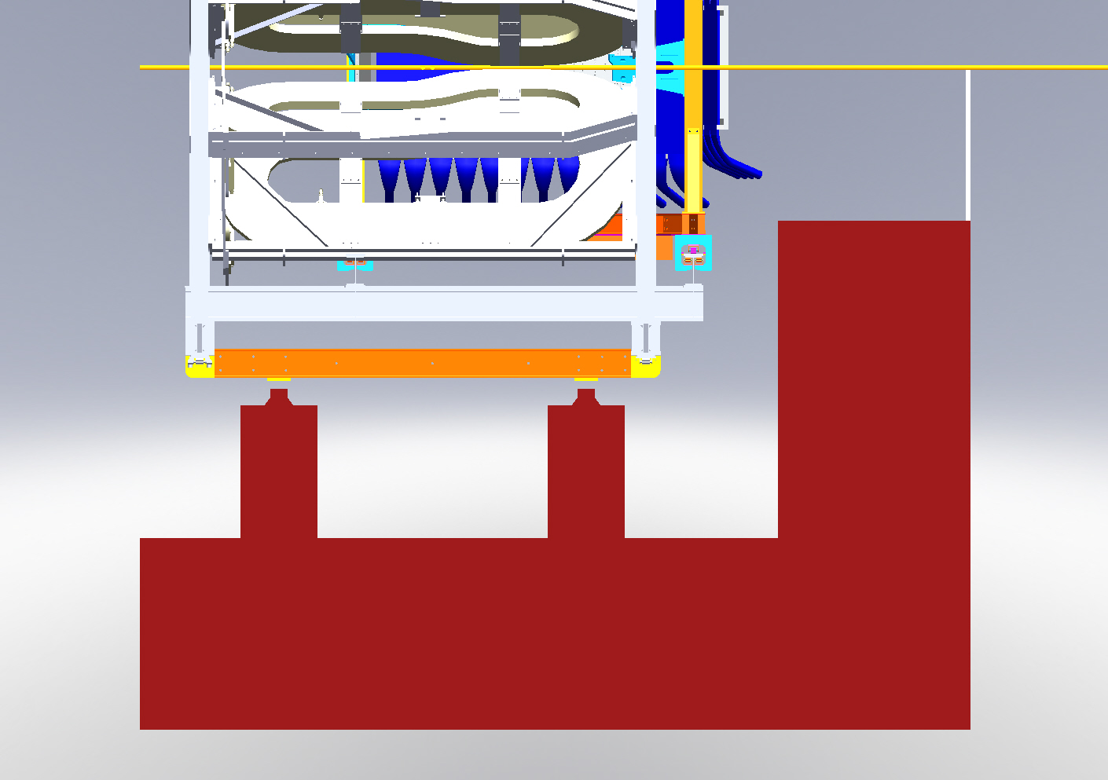
Olympus Detector Frame Intermediate Support

Slide 4
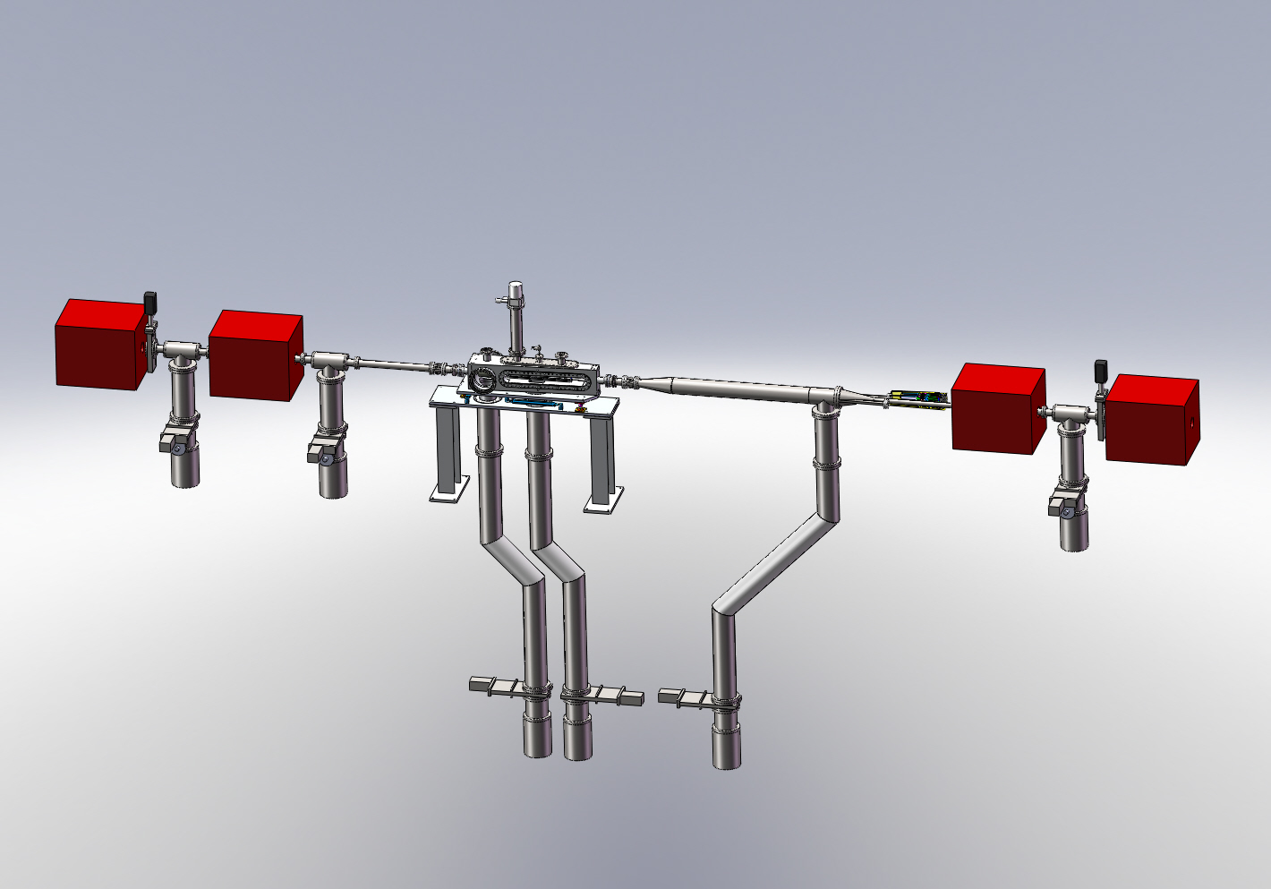

Slide 5
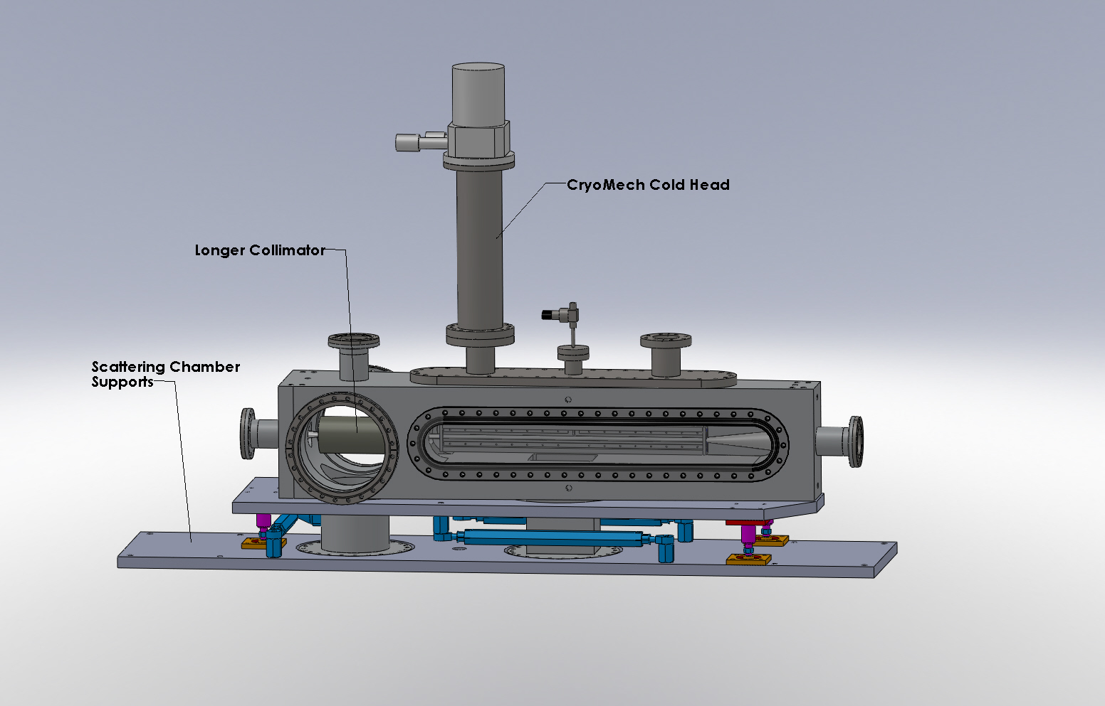

Slide 6
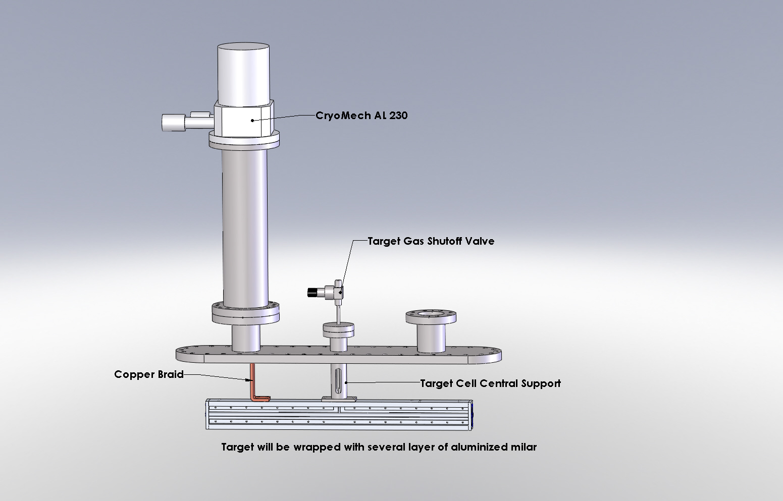

Slide 7
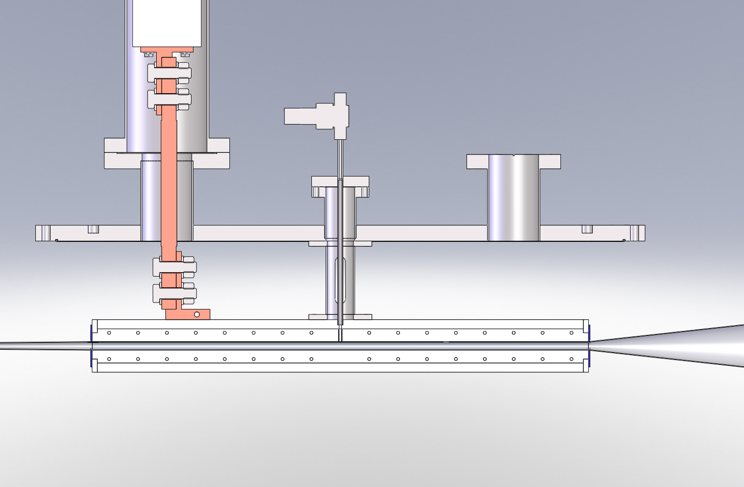

Slide 8
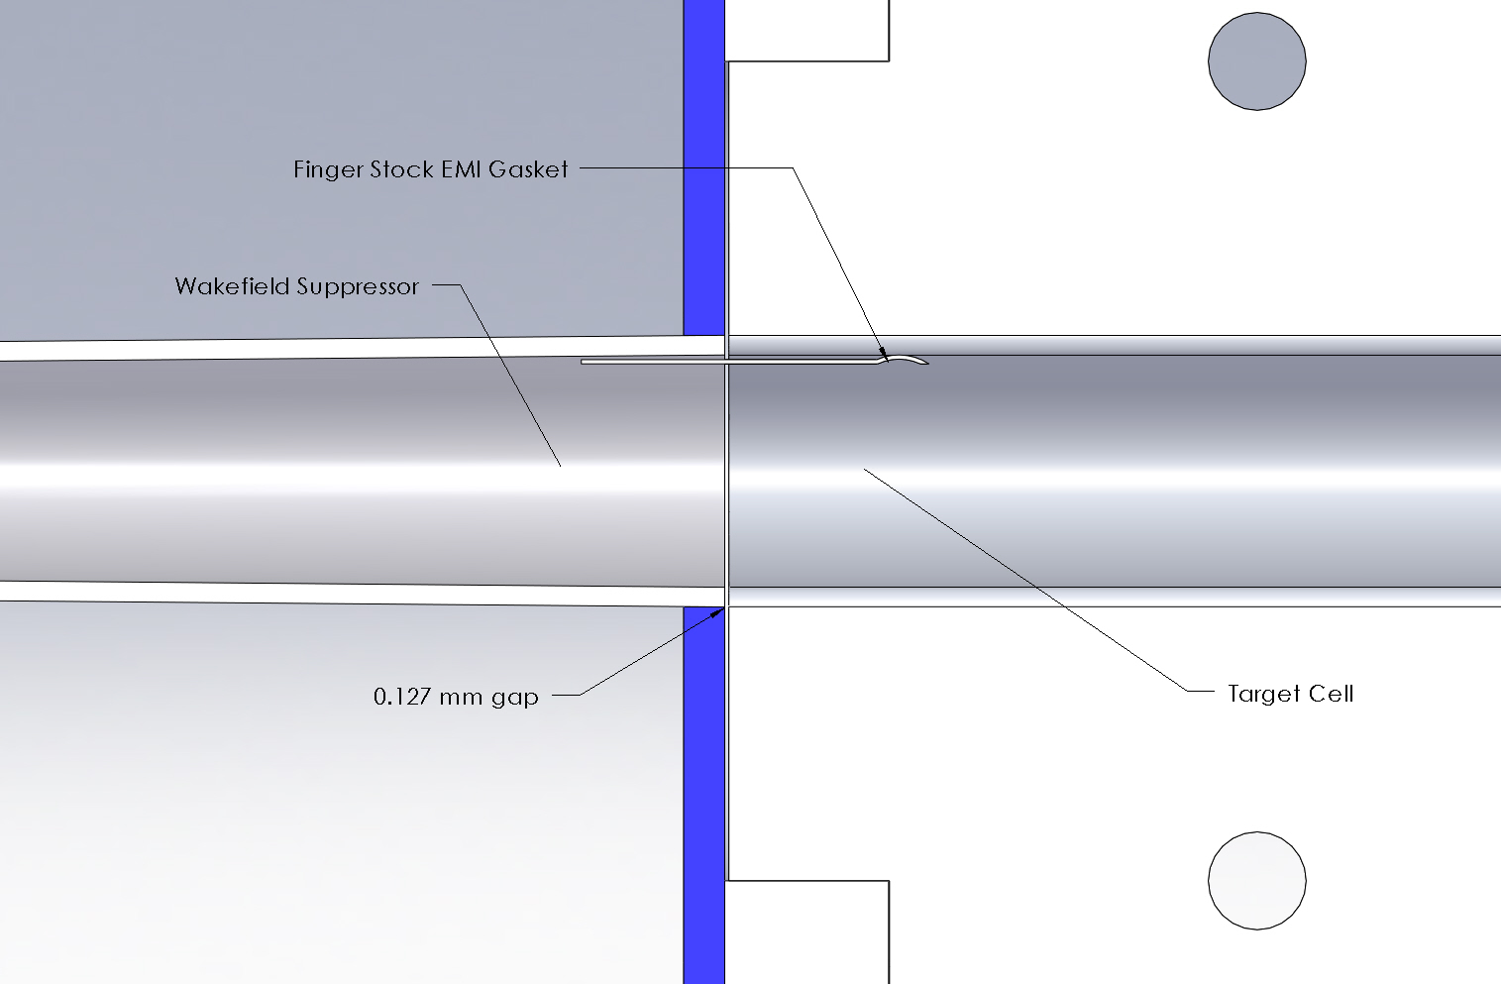

Slide 9
Shipping
All Olympus frame, detector, and electronic components will be shipped as of the end of this week. We may have one more small shipment of misc. components.

Slide 10
In Conclusion
Scattering Chamber manufacturer has indicated that they are on schedule for delivery at the end of July.
Will resolve wakefield suppressor to target transition design.
Continuing with Beam Line drafting and procurement process.
Gas feed system will be finished and tested over the next month.
Scattering chamber support designed still need to work on beam line supports.

