Slide 1
Moller Vacuum Region
Several spool pieces already welded and ready for cleaning and leak test.
Remaining parts are being machined and will be welded this week.
Shipment scheduled for July 1.

Slide 2
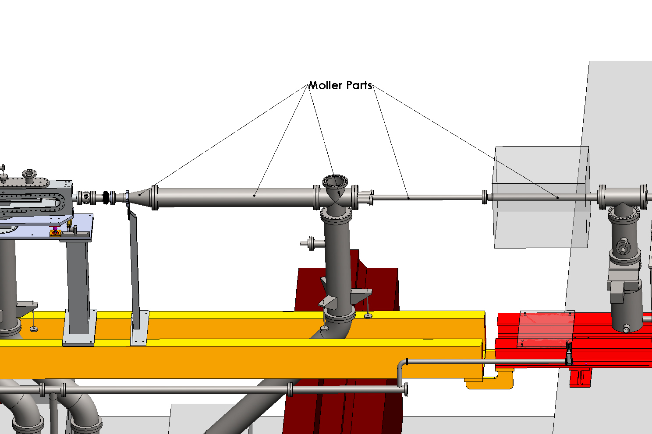
Moller Vacuum Region

