Slide 1
Lecture 2: Review of 14th and 15th C
8 January 2014
Ann T. Orlando

Slide 2
Introduction
Historical Review:
A running start into the 16th C
The Troubled 14th C
More Troubled 15th C
Intellectual and Theological Developments
Readings

Slide 3
Historical-Political Review Before 14th C (What happens in 14th and 15th C)
1. European Developments: Development and Strengthening of Countries; conflicts with Papacy
Normans (Merged with France or England in this period)
England
France
Holy Roman Empire (Germany, Austria, Spain, Netherlands)
2. Pope-King relations summarized throughout Middle Ages as: ‘Who’s in charge, Pope or King?’ (Which King, Which Pope??)
3. Western Christendom attempts to recapture Holy Land from the Muslims to guarantee safety of Christian pilgrimages (Crusades) (Western Europe barely able to defend itself from Ottoman Turks)
4. Eastern and Western Christianity become increasingly at odds with each other (Eastern Christian Roman Empire ceases to exist)

Slide 4
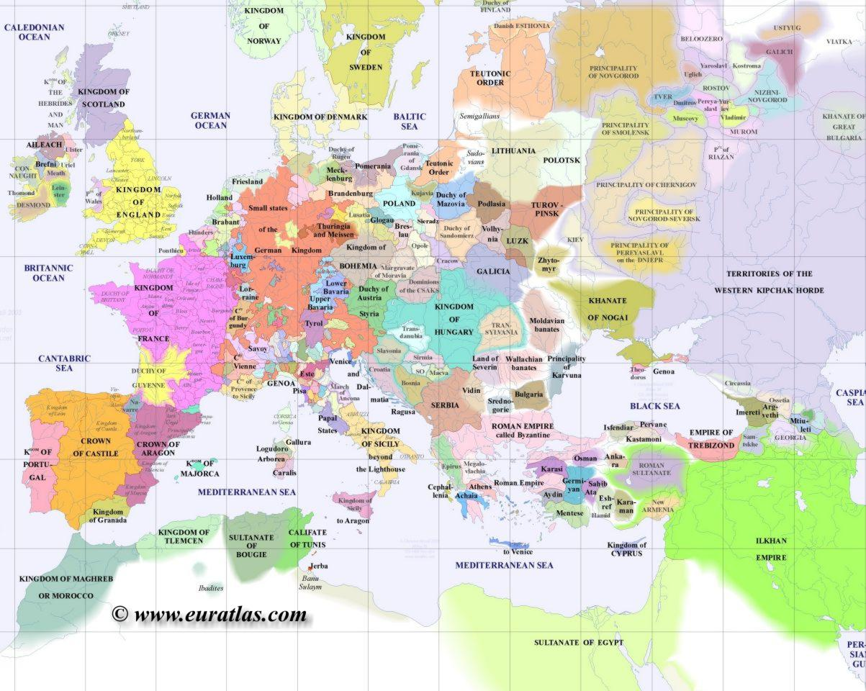
Map of Europe 1300

Slide 5
14th C Social Review: Famine and Plague
12th and 13th C were period of population growth; agriculture could not keep pace
Severe Famine in early 14th C
Part of population moves to cities
Poor sanitation
Concentration of fleas and rats
Increased trade led to less desirable imports
Plague started in Asia; Spread to Europe in 1347
Approximately 1/3 of Asians, Indians, Europeans died in 14th C
Young more susceptible than old
Effected every country in Europe between 1347-1348; sporadic outbursts throughout 14th C
Search for a cause: “the Jews poisoned the wells”
The Pope tries (unsuccessfully) to protect Jews from persecution

Slide 6
Papal Status as of 1303
Pope Boniface VIII
Unam Sanctam
Philip IV of France ignores Encyclical;
Captures Boniface and humiliates him
Boniface dies 1303
Boniface’s successor
Tension between Roman families and French over who should be Pope; political/economic driver is control over Papal States (from Pepin the Short in 750)
Clement V was elected through French influence and lived in France, beginning of Avignon Papacy

Slide 7
Avignon Papacy
During this period (1309-1377), Papacy dependent on France
Some of Popes in this period were guilty of nepotism as well as simony
Catherine of Sienna (1347-1380)
Mystic who was very popular; educated by Dominicans
Able to end warring family factions in Italy
Pressured Pope Gregory XI to return to Rome, which he did in 1377
Declared a doctor of Church in 1970
Bridget of Sweden (1303-1373)
Mother of Queen Catherine of Sweden
After becoming a widow, moved to Rome, founded an order (Brigittines) devoted to poor of Rome and politics of returning Pope to Rome

Slide 8
Great Western Schism
Urban VI succeeded Gregory XI
Managed to alienate both French and Romans
Cardinals who had elected Urban abandoned him and elected a new pope, Clement VII who moves back to Avignon
Everyone in Western Europe chooses sides
France, Scotland back Clement
England and HRE (Germany and Spain) back Urban
Italian city states changed sides frequently
Rival Popes needed funds
Simony
Sale of indulgences

Slide 9
Conciliar Movement
In 1394 theologians at University of Paris suggest a council to elect Pope
Council gathers at Pisa in 1409, and both Popes are asked to resign
Takes steps against simony
Elects Alexander V
Now there are three Popes: Rome, Avignon, Pisa
Another Council at Constance in 1414-1418
Haec Sancta: Council of Bishops pre-eminent over Pope
Elect Martin V, end of Great Schism
Council of Ferrara-Florence 1438-1445
Constantinople under threat from Ottoman Turks seeks help
Formula for reunion of East and West
Leads to enhanced stature of Pope Eugene IV in Rome
Pius II (1458-1464) issues Execrabilis, that no council is over the Pope, repudiates Council of Constance

Slide 10
Political Situation: France
Philip IV (Fair) 1285-1314
Enemy of Boniface VIII
Strengthen French throne
Hundred’s Year War Between England and France 1339-1453
Continuation of dispute over who is proper successor to French throne
Joan of Arc, 1412-1431
Rallied French behind Charles VII; crowned in Rheims
Captured and burned as a heretic by English Inquisition
Francois I 1515-1547
At war with Holy Roman Emperor Charles V over southern France and eastern France
French-German wars lasted until 20th C

Slide 11
Political Situation: England
Edward I 1272-1307
Annexed Wales and Scotland
Edward III 1327-1377
Starts 100 Years War with France
Henry V, Battle of Agincourt 1415
War of Roses (civil war) 1455-1485
Henry VII and House of Tudor finally successful
Henry VIII 1491-1547

Slide 12
Political Situation: Holy Roman Empire
14th C period of weakened HRE (German monarchy), elected by duchies (Bohemia, Saxony, Luxemburg, Bavaria, Moravia, Austria)
Three families vie for power, Bohemia, Luxemburg, Hapsburg
Sigismund last of Luxemburg’s to rule all of Germany; called Council of Constance
Eventually Hapsburg rule dominates
Maximilian I (Hapsburg) 1493-1519
Son, Philip the Handsome, marries Spanish heiress (Joanna the Mad, daughter of Ferdinand and Isabella)
Their son in Charles V
Charles V reigns 1516-1556
King of Spain starting in 1516; HRE in 1519, but only after making significant concessions to Fredrick the Wise of Saxony
Abdicates in 1556; son Phillip II rules Spain and Netherlands; and brother Ferdinand I becomes HRE, rules Germany and Austria

Slide 13
Political Situation: Spain
Throughout 14th C and 15th C Christian kingdoms of northern Spain fight against Muslims
Queen Isabel of Castile and King Ferdinand of Aragon succeed in expelling Muslims from Spain in 1492
Charles V (their grandson) becomes king of Spain in 1516

Slide 14
Political Situation: Eastern Mediterranean
Mongol expansion in 13th and 14th C in Asia pushes Ottomon Turks Westward
Ottomon Turks succeed Seljuk Turks for control of Persia, Syria, Egypt
Mohammed II captures Constantinople 1453
Other than a few priests, West sent no aid to Constantinople after Council of Florence
Day before final battle, Eastern Church repudiates Council of Florence
Mohammed II renames Constantinople Istanbul; Hagia Sophia becomes a mosque
Suleyman Magnificent becomes sultan 1520
Ottoman expansion is checked at Battle of Vienna 1533 and by Spanish at Battle of Lepanto 1571

Slide 15
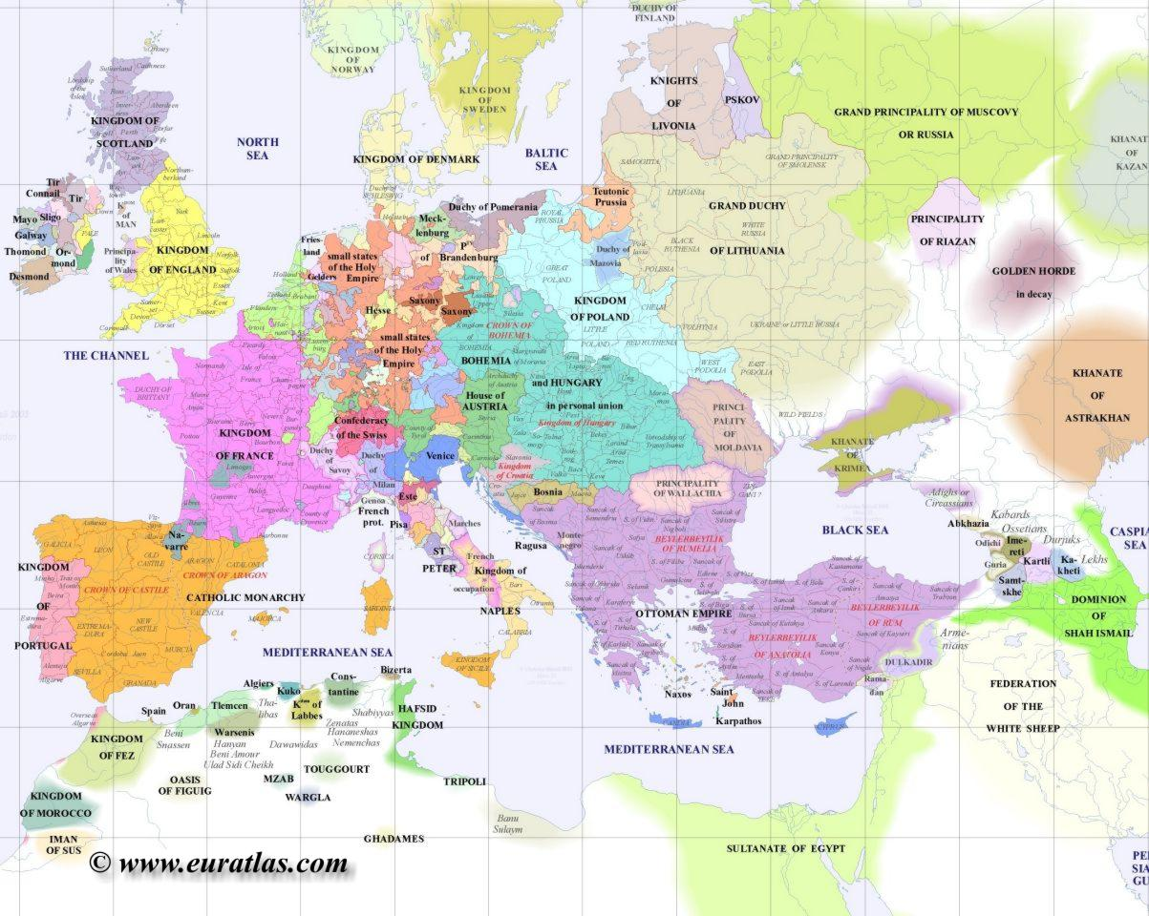
Europe 1500

Slide 16
Intellectual Developments
Reaction Against Scholasticism
Early Church Reformers
Printing Press

Slide 17
Reactions Against Scholasticism
Duns Scotus, Franciscan (1265-1308)
Man comes to knowledge only by illumination from God
Divine will takes precedence over divine intellect; known as volunteerism
William of Ockham, Franciscan (1285-1347)
‘Ockham’s razor’ there should be no hypotheses that are not directly necessary; man is saved by direct action of God’s grace without any intermediary action
Nominalism; that is, universals are not necessary
Attacked wealth of clergy

Slide 18
Early Reformers
John Wycliffe, Wyclif, Wycliff (1324-1384)
Englishman, denounced Papal control over Church property
Church as spiritual not a political society
Emphasis on Scripture and priesthood of all believers
Opposed to indulgences
Lollards remained active in England promoting Wycliffe’s theology
Wycliffe condemned by Council of Constance, 1415
John Hus (1369-1415)
Bohemian, influenced by Wycliffe
Did not accept priesthood of all believers; otherwise in general agreement with Wycliffe
Condemned and burned at stake by Council of Constance
Leader of Bohemian national movement

Slide 19
New Technologies
Printing Press
Last great information leap forward was codex rather than papyrus in 3rd C
15th C development of Printing Press allowed rapid communication my ‘instantly’ creating multiple copies of a work
Guttenburg assembled multiple technical advances to create an efficient press
Spurred increase in literacy
To get some feel for impact: think how email and web in last 10 years have effected information creation and distribution
European Voyages of Discovery

Slide 20
Assignments
Review Hitchcock Ch 7

