Slide 1
Lecture 12: Rise of Islam
25 September 2013

Slide 2
Introduction
Review of historical situation in 7th C
Rise of Islam
Western Efforts to oppose Islam
Eastern Efforts to oppose Islam
Review Readings

Slide 3
Historical Situation in Early 7th C in West
City of Rome is a desolate ruin with poor sanitation and filled with very poor people; under direct authority of Pope
Pope St. Gregory the Great rebuilds sanitation and water supply
Feeds the hungry
Bishops are often the only real source of learning, administration and civil justice
Irish and Roman missionaries have some success in converting pagan and Arian tribes
Visigoths rule Spain; Vandals rule North Africa; Lombards rule northern Italy; Byzantine control of Southern Italy and Sicily, Franks rule Western France; Anglo-Saxons in England; Alamani in Germany

Slide 4
Historical Situation in Early 7th C in East
Unified politically under control of Byzantine Emperor from Egypt to Danube
But monophysites in Egypt and Nestorians in Syria undermine religious unity
Primary contact between East and West is through the Pope
Ecclesial authorities are subordinate to civil
Eastern Empire will see itself as the continuation of ancient Roman Empire until the fall of Constantinople in 1453

Slide 5
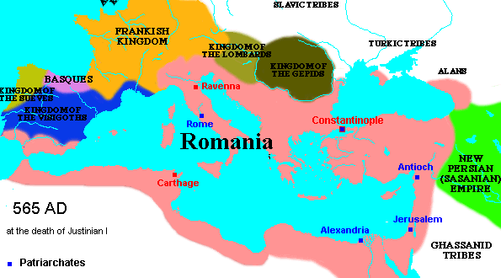
Mediterranean at death of Justinian

Slide 6
Muhammad 570 - 632
Muhammad (570-632)
The flight from Mecca to Medina (622) is beginning of Muslim calendar
Qur’an is revelation given to Muhammad; its language, Arabic, is part of that revelation
Founded a religious and political movement aimed at uniting all Arab tribes.
By 716 all of North Africa, Sicily and the Iberian peninsula was under Muslim control
By 730 France and Constantinople were threatened

Slide 7
Key Points of Islamic Theology
Qur’an is revealed word of God (must be in Arabic, a translation Is not really the Qur’an)
Jews and Christians are considered people of The Book
Mohammed is greatest prophet, although prophets of Old Testament and Jesus are also important
God is one, no Trinity
Images are an affront to God
Shari’a “Islamic Law”; based on Qur’an; rules for how the community of Muslims should live

Slide 8
Five Pillars of Islam
Faith (Shahada) Expressed through the fundamental statement of faith: “There is no god but Allah, and Muhammad is His prophet.”
Prayer (Salat) Praying 5 times a day in a prescribed manner
Charity (Zakat) All things belong to God, and wealth is therefore held by human beings in trust.
Fasting (Sawm) Fasting is especially observed during the holy month of Ramadan.
The Pilgrimage to Mecca (The Hajj)

Slide 9
Two Major Branches of Islam
Sunni
Ruler should be by a virtuous Muslim who followed the sunna (practice) of Mohammed as recorded in the hadiths (traditions)
Authority was with ulama or imam, wise men but not infallible, who preached the Qur’an
Defense of Qur’an through rational argument
Shia
Rule should be through the family of Mohammed Came to be known as Shia, or followers, of Ali (killed at Karbala)
Authority was found in infallible imams as interpreters of the Qur’an

Slide 10
Early Islamic Political Leadership
First four caliphs, Rashidun, rightly guided
Umayyads (Damascus, Cordoba)
Abbasids (Baghdad)
Fatimids (Cairo)
Like Hellenistic kingdoms after Alexander and then the Romans, Arab Muslims found territory too large to rule consistently by one power

Slide 11
Early Muslim Expansion in Two Movements
Under first four caliphs (632-656)
Conquest of Arab tribes in Egypt, Syria and Iraq, including Jerusalem and Alexandria
Common cultural background of conquered peoples
Early conflict with Byzantine Empire and Sassanid Persian Empire
Under Umayyads (692-750)
Expansion West and East against non-Arab lands
Destruction of Persian Empire
Threat to Constantinople
Conquest of Latin North Africa, Spain and incursions into France
In Ninth C. Muslim armies would conquer (briefly) Sicily, southern Italy, Crete

Slide 12
Early Islamic Culture
New Capital Cities
Damascus, old city but new capital
Baghdad
Cairo
Cordoba
Dome of Rock, first great Islamic building, on Temple Mount in Jerusalem, 692
Inscriptions are earliest written record from Qur'an
Entreats readers to recognize that God is One and not Three
Arabic becomes the common language
Replaces Greek in Southern Mediterranean, Persia
Replaces Latin in North Africa, Spain as common language

Slide 13
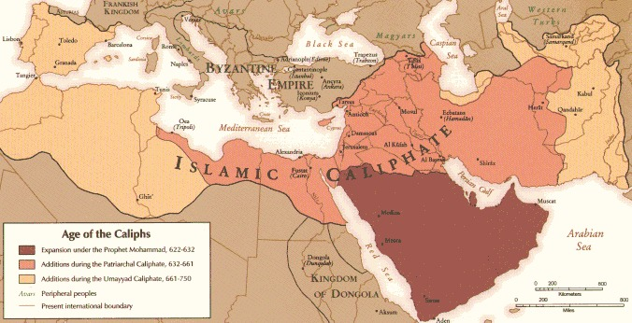
Rise of Islam 7th C

Slide 14
Military Defense Against Muslim Armies
Western Cavalry
Development of stirrup, molded saddle and armor
Stirrup came to Western Europe via Hungary from India
Effective edge to Charles Martel and his grandson Charlemagne in battles against Muslims
Eastern Greek Fire
Naval weapon of exploding incendiary ‘bomb’
Effective Byzantine edge in early battles for Constantinople

Slide 15
Eastern Theological Responses to Islam
Monotheolite Controversy
Christ had one will (divine)
St. Maximus the Confessor argued against this
Iconoclasm
Destruction of images
St. John of Damascus argued against this

Slide 16
Monothelete Controversy
To try to bring Monophysites back under imperial control against Arabs
Patriarch of Constantinople, Sergius proposes ‘monothelete’ Christology or that Christ had one will
Pope Honorius (625-638) goes along with this
Pope Martin I at First Lateran Council in Rome rejects this in 649, in opposition to Emperor and much of Eastern Church
In any case Monophysites also reject this
Maximus the Confessor (580 – 662) Eastern theologian who supported Chalcedon
Gave deepest theological arguments in support of two complete natures, against monothelete
Was persecuted and tortured by Emperor Heraclius
As was his supporter, Pope Martin I who was captured in Rome in 653 and died of mistreatment
Eventually Eastern Church returns to Chalcedonian formula in Third Council of Constantinople (680)

Slide 17
Iconoclast Controversy
Byzantine Emperors Leo III (717-741), Constantine V (741-763)
Supported “image breaking” iconoclasm as a way to attract Muslims to Christian orthodoxy
Historical Note: Emperor Leo III dropped all military support of Papacy against Lombards, forcing Pope Stephen II into an alliance with Pepin the Short (Charlemagne’s father)
Monks vehemently opposed iconoclasts
St. John Damascene (675-749)
Monk at St. Sabas near Jerusalem
Strong theological defense of icons
Differentiated types of worship and honor
Eventually Eastern Church officially embraces honor of icons at Seventh Ecumenical Council, Second Nicene Council (787)

Slide 18
Assignments
Maximus the Confessor, from Letter II, available at http://www.vatican.va/spirit/documents/spirit_20010328_massimo-confessore_en.html
John of Damascus, In Defense of Icons, available at http://www.fordham.edu/halsall/source/johndam-icons.html

