Slide 1
Lecture 12: Franks and Early Europe
Dr. Ann T. Orlando
25 September 2013

Slide 2
Introduction
Merovingians
Germanic Control of Italy
Carolingians
Eighth Century political and military situation

Slide 3
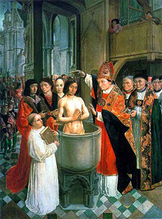
Beginning of Christianity Among Franks
Conversion of Chlodwech (Clovis) 496 in Rheims as a Catholic Christian
Clovis is beginning of Merovingian dynasty in France
Baptized by St. Remigius (437-533; Feast Day 1 October), bishop of Rheims
After Clovis, there are close ties between Frankish king and the papacy
Clovis’ kingdom divided among his sons

Slide 4
Merovingian Dynasty (496-741)
Real power was with wealthy land owners, especially Mayor of Palace,
Attached to king by oaths of loyalty and promise to provide troops
Bishops take an increasingly secular role; judicial and military
Also large land owners
Custom develops that the king appoints bishops
Merovingian kings become weak and ineffective rulers
Transition from Roman system to early feudalism

Slide 5
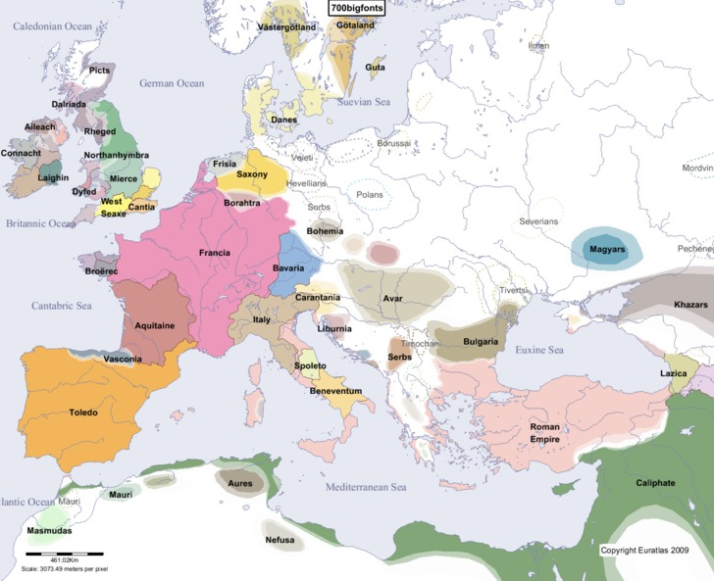
Franks and Papacy Have Common Enemies
Arabs
Muslims
Other Germanic Tribes
Arians or pagans
Byzantines
Beginning of separation of ‘Orthodox’ East and ‘Catholic’ West

Slide 6
Muslim Armies in Western Europe
Umayyad Muslim armies advance against weak Visigoths in Spain in 711
By 720 had crossed the Pyrenees and captured most of southern France
Most of southern France remained under Muslin control until 750
Many of the Visigoth (Arian) Christians supported Umayyads over Catholic Franks

Slide 7
Rise of Carolingians: Charles Martel (The Hammer)
Largest land owners, and Mayor of Palace, in early 8th C was family of Charles Martel (688-741)
Charles became increasingly powerful
Defeat of some neighboring tribes (Saxons)
Alliances with others (required conversion to Catholic Catholicism)
Establishing bishops and monasteries as internal political allies
Charles Martel stopped the Muslim army at Tours in 732
The Battle of Tours is considered one of the most important battles of European history

Slide 8
Pepin the Short and the Beginning of Carolingians
Balance of power within Frankish kingdom is
Charles’ son, Pepin (Pippin) the Short (714-758), asks Pope Zachary if incompetent rulers should rule, Zachary says no
Pepin overthrows last Merovingian ruler, Childric the Stupid;
Pope Stephen II goes to France to anoint Pepin king (note: St. Boniface anointed him first)
Pepin invades Italy and rescues the Papacy from Lombards and threats from Muslims in Sicily

Slide 9
Germanic Kingdoms in Italy
First Germanic king of Italy was Odoacer (453-493)
With support from Byzantium, Theodoric the Ostrogoth (471-526) invades Italy and establishes a new Germanic kingdom in Italy
Murders Odoacer
Theodoric establishes a strong Italian kingdom, taking as his capital the Byzantine city of Ravenna
Theodoric like most Germans is an Arian
Accuses Boethius of treachery and murders him
Justinian the Great (527 – 565) briefly manages to recapture Italy fro Byzantines
Lombards invade 568; rule northern and central Italy until 774

Slide 10
Papacy and ‘European’ Politics
Pepin gave central Italy to the Pope in 754; beginning of Papal States (lasted until 19th C)
Problem: Constantinople had a claim to Italy
Papacy justifies its land holdings with one of most famous forgeries of all time: Donation of Constantine
This document claimed that Constantine gave control of Western Empire to Pope
Accepted as genuine until 15th C
Basis for Papal claims to political power in Europe
King nominates bishops, but appointed by Pope

Slide 11
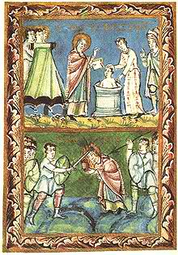
Frankish Encouragement of Continuing Missionary Activities
Boniface, aka Winifred, 672-755
Influenced by Irish monasticism
Goes to Rome in 717 to get approval of Pope Gregory II; gets mission to preach north of Rhine
May have crowned Pepin the Short, Charlemagne’s father
Martyred in northern Holland, 755
Feast Day June 5

Slide 12
Readings
Donation of Constantine
Read all carefully
What land, rights, powers, symbols of office does Constantine give?
From what you know already of history of church and history of doctrine, why might you be suspicious of this document?

