Slide 1
Lecture 3: Early Roman Imperial History
Dr. Ann T. Orlando
4 Sept. 2013

Slide 2
Introduction
Alexander the Great and Greek kingdoms
Establishment of Roman Empire
History in New Testament
Two cities, and was Rome ever a commonwealth?

Slide 3
Alexander the Great and Greek Kingdoms
Alexander the Great (356-323 BC)
  Son of Philip of Macedonia; Student of Aristotle
  Conquers the ‘world’ by age of 33
  Founds Alexandria, Egypt center of learning for next 600 years
  Dies in 323 BC; leaving his generals in charge of various parts of his conquests
Hellenistic (Greek) Empires 323 – 31 BCE
  Macedonians: Greece, Sicily, southern Italy
  Seleucids: Asia Minor, Syria and Mesopotamia
  Ptolemies: Egypt and Cyrene
  As a result of this extended period of Greek rule, the ‘lingua franca’ of the Mediterranean was Greek from the 4th C BC until the 5th C AD in the West and the 15th C in the East
Israel between two major competing Empires: Seleucid and Ptolemy

Slide 4
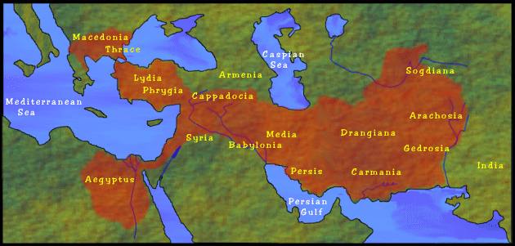
Map of Conquests of
Alexander Great http://library.thinkquest.org/10805/alexmap.html

Slide 5
Rome
Traditional founding date of 753 BC
  Brothers Romulus and Remus
Started as a Republic ruled by Senate
Two Punic Wars,
  Rome conquers and destroys Carthage 202 BC
  Rome becomes dominant power in Western Mediterranean
Maccabees ask Rome for help against Seleucids 160 BC
Julius Caesar conquers Gaul 80 BC
Octavian defeats Anthony and Cleopatra (last Ptolemy ruler of Egypt) at Actium in 31 BC;
  Roman Empire established
  Roman Empire existed in some form between 31 BC and 1453 AD

Slide 6
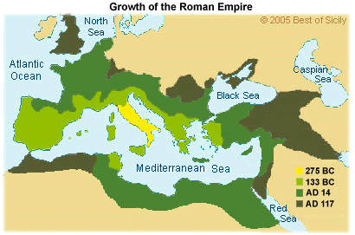
Expansion of Roman Empire

Slide 7
Hellenism
The dominance of Greek language, learning, philosophy, culture in Mediterranean
  Begins with Alexander the Great
  Ends with rise of Islam (Latin and Arabic replace Greek)
Dominance is bolstered by Roman imperial power
Jewish response
  Complete rejection by orthodox Judaism
  Complete assimilation by Alexandrian and Greek Jews
Orthodox Christianity will completely assimilate Hellenism
See Benedict XVI Regensburg Speech 12 Sept. 2006

Slide 8
Roman Society
Roman religion was a public, civic obligation;
  NOT a way to have a personal relationship with Divine
  ‘mystery religions’ became very popular in 1st through 3rd Century Roman Society (Cults of Mithra; Isis and Osiris; Dionysius)
  Anyone who did not offer sacrifice for the good of the state was considered an atheist
Roman Emperor increasingly was a general who was ‘adopted’ by current Emperor (Octavian Augustus adopted by Julius Caesar).
Cult of Roman Emperor as god in his lifetime was started by Nero
Roman household was composed of patron (father) and clients (wife, children, slaves, business associates dependent upon him)
  Father had complete control of clients
  Adoption was very common
  Owning property was far more prestigious than commerce
Excellent road and mail system throughout the Empire
Note that the most Latin (least Greek) part of the Empire was North Africa

Slide 9
Importance of Battle of Actium
Before Octavius Augustus, Rome was a Republic ruled by Senate
  Octavius was the adopted son of Julius Caesar
After Battle of Actium (31 BC) Octavius Augustus becomes emperor and dictator.
  His descendents will rule Roman Empire until the murder of Nero (68 AD)
Battle of Actium also marks end of Ptolemais in Egypt
  Cleopatra last Ptolemy
  Tried to maintain her rule in Egypt first by being consort of Julius Caesar, then Mark Antony
  Cleopatra commits suicide after Battle of Actium is lost

Slide 10
First Century Roman Emperors
Julio-Claudian Emperors (31 BC to 68 AD)
  Starts with Augustus, ends with Nero’s suicide
  Consolidation of Empire won by Augustus
  Succession hereditary; intra-family rivalries, often deadly
  After Augustus, increasingly demonic emperors; Nero worst of all (read I,Claudius for a fictionalized but accurate account)
Flavian Emperors (Vespasian and his sons Titus and Domitian)
  Destruction of Jerusalem Temple, 70
  Vespasian built the Coliseum
  Domitian was particularly ruthless against enemies, real and imagined
NB Nero and Domitian were the only emperors that the Senate of Rome did NOT declare gods

Slide 11
Herod the Great (73 to 4 BC)
His father, Antipater, was placed in power by Romans
Herod grew up (‘hostage’) in Rome
Friend with both Octavian and Antony
Becomes client king of Romans
Exerts great power in Palestine, including massive building projects
  Second Temple precinct
  Cities of Caesarea and Tiberius
  Palaces in Jerusalem, Masada
When he dies, Romans divide his kingdom among his sons with a Roman administrator

Slide 12
Brief History of First Century AD Roman Provence of Palestine
Friction among Herod’s sons (Herod Anipater, Herod Antipas, Archelaus)
Friction among various Jewish groups over relation with Rome
  Priests and aristocracy in Jerusalem
  Pharisees
  Essenes
  Zealots
Frictions make Palestine a contentious place, with several localized tax rebellions
One major First Century War: First Jewish War 66 – 73 AD
  Starts in Galilee, but spreads throughout Palestine
  Nero appoints Vespasian and his son Titus as Roman generals
  Destruction of Second Temple in 70 AD
  Fall of Masada in 73 AD

Slide 13
Luke: History of Church in
New Testament
Paul’s disciple, Luke, writes an ‘ordered account’ in two Books, the Gospel and Acts of the Apostles
  Written in an ancient historical style;
Some important historical references in Luke
  Note references to Herod the Great and Augustus; Luke 1 and 2
  Prophesy of destruction of Temple; Luke 19:41-44, 21:20-24
  Jesus condemned for political insurrection; Luke 23:1-4
Some important historical references in Acts
  Pentecost, the ‘birthday of Church;’ Acts 2
  Reference to St. Stephen and the Hellenists; Acts 6-7
  Council of Jerusalem in which Paul’s position that Gentiles do not need to convert to Judaism is affirmed; Acts 15
  Paul arguing with Athenian philosophers; Acts 17:16-33
  Story of how the Church was spread by Paul’s missionary activity to the ends of the earth (i.e., Rome)

Slide 14
Assignment
CoG, XV.5: Cain as the founder of city of man
CoG, XIX.21, 24-28: Was Rome ever a true commonwealth?

