Slide 1
Lecture 4 Early Christian Martyrs
Dr. Ann T. Orlando
10 September 2013

Slide 2
Outline
Review of Roman History
Roman religion
Roman persecution

Slide 3
First Century Roman Empire after Augustus
Series of relatives of Augustus become Emperor, ending with Nero, murdered 68 AD (Claudio-Julian line)
Succeeded by Vespasian, general in Judea
Vespasian, Titus, Domitian known as the Flavians
Coliseum built by Vespasian

Slide 4
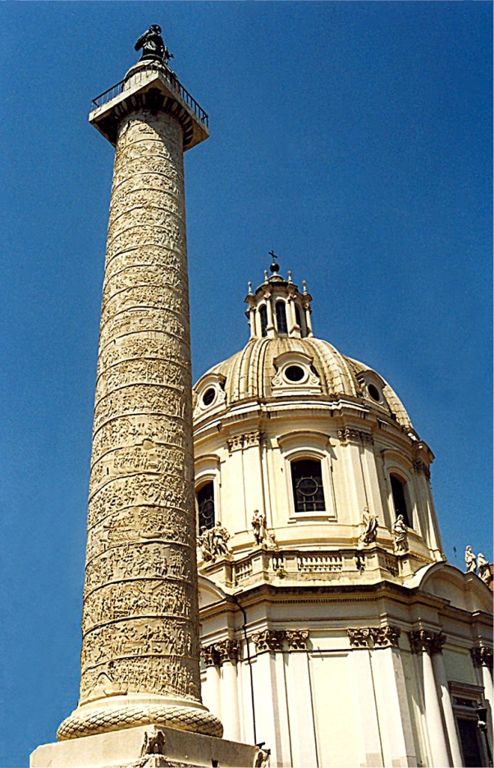
Second Century, “Five Good Emperors”
After Domitian, Nerva and then
Trajan, 98-117
Hadrian, 117-138
Antonius Pius, 138-161
Marcus Aurelius, 161-180
Policy of adopting a suitable successor, not relying on a relative
Policy of appointing excellent administrators for provinces (Pliny the Younger in Asia Minor)
The Empire was peaceful and prosperous
www.edupic.net/Images/SocialStudies/trajan's_column01.jpg

Slide 5
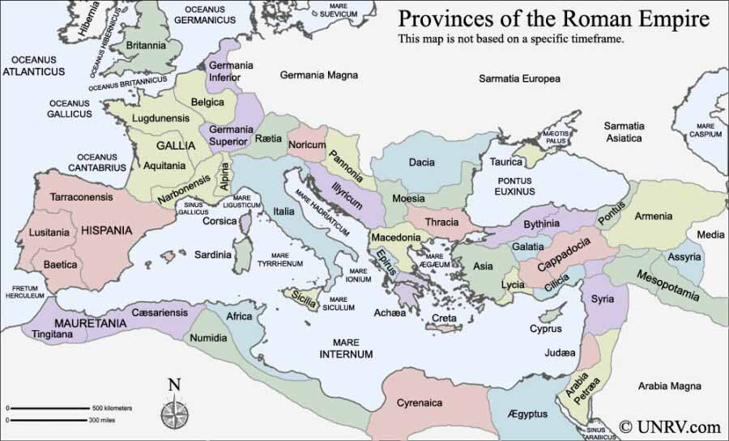
Roman Provinces www.unrv.com/roman-empire-map.php

Slide 6
Third Century, Turmoil and Famine
Marcus Aurelius’s son, Commodus (180-192), was vicious, paranoid
Strangled in his bath, then stabbed; end of Antonnines
After a period of civil war, Septimus Severus (193-211) becomes Emperor
War against Persians
Revamped Roman military and law
Died in York, England; succeeded by sons Caracalla (211 – 217) and Geta
Series of Severides and other generals of brief reign throughout Third Century
Decius (249-251), major Christian persecution
Attempt to re-unify Empire with renewed adherence to ancient religion
Made people buy a libellus to prove they had sacrificed to gods
Diocletian 284-305
Greatest persecution of Christians

Slide 7
Roman Religion
Roman religion was a public, civic obligation;
NOT primarily a way to have a personal relationship with Divine
Anyone who did not offer public sacrifice for the good of the state was considered an atheist
Impiety was a sin against both gods and the family
Nero started Cult of Roman Emperor as god in his lifetime
But Nero and Domitian are only two emperors Roman Senate did not deify
Rome links its gods with Greek gods through Virgil’s Aeneid
‘mystery religions’ became very popular in 1st through 3rd Century Roman society (Cults of Mithra; Isis and Osiris; Dionysius)
Romans very tolerant of other beliefs
A wealthy paterfamilia would sometimes set aside space for slaves and clients for their own mystery cults
San Clemente

Slide 8
Roman Family
Roman household was composed of paterfamilia (father) and clients (wife, children, slaves, business associates dependent upon him)
Father had complete control of clients until he died
Adoption, including adult adoption, was common among wealthy families
All sons treated equally as heirs (no primogeniture)
Exposure of unwanted infants, at discretion of father
Duty (fortitude) to family and state was one of the most important Roman virtues
Family was a state within a state
Notes:
Mark Nero on timeline

Slide 9
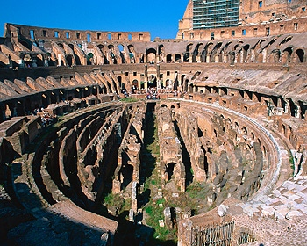
Roman Games
Romans loved blood sports
Gladiators were sports stars of the Roman world
Important part of criminal and slave trade was supporting circuses
Typical day at the Coliseum (60,000 spectators; note Circus Maximus held 250,000)
Morning: animal fights
Lunch: execution of criminals
Afternoon: gladiators
wwwdelivery.superstock.com/WI/223/1397/PreviewComp/SuperStock_1397R-33003.jpg

Slide 10
Christian Responses to Persecution
1. Intellectual: Apologies written to justify Christianity to Roman authorities
2. Facing torture and death without apostasy; often even looking forward to martyrdom eagerly as a proof of solidarity with Jesus
3. But, if you believed that Jesus only appeared to be human (docetists), then there seemed little reason to be a martyr yourself
4. Some did not have the courage when accused, and so apostatized and/or paid others for their libelli

Slide 11
1. Response to Persecution: Apologies
Type of literature that often had the form of a legal defense
It was intended for a highly educated pagan (i.e., philosophical) audience; often drew heavily on philosophical concepts to explain Christianity
Tried to establish antiquity and respectability of Christianity
It tried to show that Christianity was not to be feared, but encouraged good citizenship
St. Justin Martyr wrote two Apologies; Tertullian wrote an Apology

Slide 12
2. Response to Persecution: Martyrdom and Christianity
Martyr comes from Greek word for witness
Did not actually have to die to be a martyr, but to suffer for faith (slavery, prison, mines)
Note: Romans tried to avoid creating Christian martyrs; accused were given several opportunities to offer sacrifice
In 3rd Century, Roman authorities started issuing a receipt, or libellus to those who sacrificed; authorities also attacking Christianity as such, destroying Scripture

Slide 13
Martyrs
Real desire to prove the totality of Christian faith (e.g., Origen On Martyrdom)
Those who died were (still are) considered heroes of the faith
Pilgrimage to place of burial
Remembering their sacrifice in “Acts”; Peter (Quo vadis); Polycarp; Perpetua and Felicity; Justin Martyr
Those who suffered but did not die (also known as confessors) were popularly considered able to forgive sin of apostasy
Problem for 3rd C bishops

Slide 14
3. Response to Persecution: Docetists (Gnostics)
Heavily influenced by Platonism
Believed that Jesus was God, and therefore could not suffer
Physical was not important; one should try to rise above the physical to the spiritual
Martyrdom had little value
Knowledge (gnosis) of faith was a secret revealed by God to individual, not taught and open to all
Docetists were bitterly fought by ‘orthodox’ Christians, especially bishops

Slide 15
4. Christian Response to Persecution: Apostates (or Lapsed)
Very often, after persecution subsided, apostates wanted to return to Church
Some sought forgiveness from martyrs
Some Churches refused to allow them to return; Church only for pure: Donatists
Some wanted them to be rebaptized
Church needed a uniform policy

Slide 16
Early Papal Controversies
Issues of lapsed came to a head in Third Century
Two important papal controversies occur over this issue:
Early Third Century Pope St. Callistus (d. 223) vs. St. Hippolytus (d. 223)
Mid-Third Century Pope St. Stephen and St. Cyprian (d. 258)
Pope in these controversies is almost always more lenient than opposition

Slide 17
Callistus and Hippolytus
Callistus was a slave, but also a deacon, caring for Christian cemeteries in Rome (catacombs); he was sent to the mines; freedom bought by Roman Church
Hippolytus was well educated presbyter; ran a Christian school in Rome; opposed Callistus becoming Pope
Hippolytus became schismatic when Pope Callistus allowed lapsed and sinners to return to Church with appropriate penance
Eventually Hippolytus reconciled with Callsitus; both martyred

Slide 18
Cyprian and Stephen
Key figure was St. Cyprian, Bishop of Carthage, and his relation with Rome
Cyprian was Bishop of Carthage; disciple of Tertullian
In regards to lapsed, Cyprian wrote supporting primacy of Pope; Rome as principal church
Rome’s more lenient view of lapsed was correct against the Donatist (Novatian in particular)
However, Cyprian believed that schismatic needed to be rebaptized. This is opposed by Pope Stephen. Stephen’s position eventually accepted; Cyprian reconciled with Stephen’s successor, Pope Sixtus II

Slide 19
‘Voluntary’ Martyrdom
Bishops actively discouraged Christians from ‘volunteering’ as martyrs
If accused, then Christians should not renounce the faith, but should not flaunt it for purpose of being martyred
This would be suicide, not in accordance with God’s will
Neither should Christians take up arms to defend themselves
There is no recorded instance of any Christian rising in armed rebellion against the Romans
In distinction to earlier Judaism or later Islam
See, for example, Clement of Alexandria, Stromata IV.10

Slide 20
Assignments
CoG I.35, V.16, VIII.27, XXII.9-10
Hitchcock, Ch. 2

