Slide 1
Lecture 5 Christianity and Scripture
Dr. Ann T. Orlando
11 Sept. 2013

Slide 2
Outline
Judaism and Scripture
Types of early Christianity and Relation to Canon and Scriptural interpretation:
Gnosticism
Montanists
Third Century Giants
Tertullian
Origen

Slide 3
First Century Judaism in Alexandria
Center of Diaspora (Greek) Judaism
Old Testament translated in Greek by 72 Jewish scholars “Septuagint” (LXX) to be included in library
Letter of Aristeas (200 BC)
Sibylline Oracles
Septuagint became the defining canon for Greek Jews
Included works written in Greek as well as Greek translation of Hebrew books

Slide 4
Philo of Alexandria (10 BC – 50 AD)
Most influential ancient Jewish philosopher: Philo of Alexandria, contemporary of Jesus and Paul
Leader of Jewish School in Alexandria
Also ‘political’ leader
Philosopher of ‘middle Platonism’
Combines aspects of Platonism and Stoicism
Logos, wisdom, of God begotten of God from the beginning of creation
Seed of Logos found in philosophy (see also Justin Martyr)
Moses older than Plato (Justin Martyr)
Adopts Stoic allegorical techniques to Biblical interpretation
Philo calls philosophy the handmaid of all sciences, including theology (Preliminary Studies XXV.145)

Slide 5
Example of Philosophy in Biblical Interpretation: Virtue
Virtue in not a Biblical concept (in either Old or New Testament)
Biblical morality is most often described as walking the right path or way
Read CAREFULLY 1 Cor 12:31- 1 Cor 13:13.
Virtue is a Greek philosophical concept
Philo uses allegory to interpret Scripture as referring to Virtue
On the Posterity and Exile of Cain XXXIX (133)
Interpretation of Genesis 24

Slide 6
Development of Rabbinic Judaism
Out of Roman-Jewish War, only two types of ‘Judaism’ survived: Christianity and Rabbinic Judaism
The Pharisees were the group out of which rabbinic Judaism grew in the 2cd and 3rd C CE.
Reestablished contact with the Mesopotamian Jews and their theology;
Rabbinic Judaism rejects all things Roman and Greek, especially Greek philosophy
Only books written in Hebrew are part of the Jewish canon (Torah)
Rejected LXX
Interpretive methods look to Babylonian Talmud and midrashim
Compilation of Mishnah

Slide 7
Issues Surrounding Canon of Christian Scripture
The OT (Septuagint): in or out?
Relation of creator God to Father of Jesus Christ
How can there be suffering if the creator God is a good God? (theodicy problem)
Is God anthropomorphic; as OT might indicate?
Relation to Judaism
What is in NT?
Paul primary or Gospels
What literature about Jesus is sacred
What writings of early believers is in/out (e.g., First Letter of Clement, Epistle of Barnabas, Shepherd of Hermes)
Answers to these questions determined which books considered authoritative by various Christian groups
In this era many Christian groups selected books to support their theology; Canon is from Greek word for rule or measure

Slide 8
2nd C Gnosticism
Gnosticism is really a ‘catch all’ term for several groups of early Christians which shared some beliefs, usually with a Platonic philosophical background
Gnostic is from Greek, gnosis, knowledge
Most Gnostic Christians believed:
Jesus was divine, not human (docetism);
Jesus was the son of Sophia, Wisdom and God the Father
Physical, material world was, at best, irrelevant, at worst evil
Believers have special, secret, knowledge of divine things
Notes:
Very complex mythologies about Jesus
Draw timeline

Slide 9
2nd C Gnosticism: Scripture and Gnosticism
Gnostics rejected the OT
God of OT was evil, creator God
God of OT was anthropomorphic, not spiritual
Gnostics accepted many different types of literature about Jesus
Gospel of Truth, Gospel of Thomas, Gospel of Philip;
Recent discovery (1945) of many Gnostic texts at Nag Hammadi, Egypt
Key Gnostic: Valentinus, early 2nd C, Alexandria and Rome

Slide 10
2nd C Marcion: OT Out; only Paul, Luke In NT
Most important impetus for development of Scriptural canon was Marcion (c. 110-160)
Wealthy sea captain, who carefully studied Christian literature
Initially part of orthodox Roman church
Decided that only Paul and parts of Luke were canonical
Opposed to Judaism and so rejected OT
Left Roman church to start his own church; spread very rapidly around Mediterranean; Marcionites in West for next 200 years; in East much longer
Notes:
Orthodox: right belief

Slide 11
2nd C: Montanists Continuing Prophecy In ‘NT’
Started by Montus, Prisca, Maximillia late 2cd Century in Asia Minor
Believed in continuing prophecy and revelation led by Holy Spirit
Believed apocalypse immanent
Believed that once Baptized, sins could not be forgiven (similar to Donatists); Church only for pure
Seemed to encourage voluntary martyrdom

Slide 12
Establishment of the Christian Canon
By early 4th Century, most orthodox Christians accepted canon of Scripture
Septuagint basis for OT
NT as we currently have it
But how to interpret what is there
Literal (historical, moral??)
Allegorical (philosophical??)
Both the canon and its interpretation will be revisited during the Reformation

Slide 13
Types of Interpretation, Hermeneutics, Exegesis
Textual
Analysis of texts, comparisons of multiple versions of same text
Effort to determine which is the ‘real’ text; Origen’s Hexapla
Literal Sense CCC 116
Text as literally true
Spiritual Sense CCC 117
Allegorical or typological: OT prefigures or is a type of Christ (we read the OT this way almost every Sunday)
Moral: Scripture teaches how to follow The Way
Anagogical: Scripture leads us to our proper end
Spiritual: admits multiple levels of meaning (hermeneutics)

Slide 14
Tertullian: A Literalist
Born c. 160 in Carthage
Convert to Catholic Christianity
Many of his works are extant;
Dominant theologian in the West before Augustine
First theologian of significance to write primarily in Latin
Well aware of the works of other theologians: Irenaeus, Justin Martyr
Some common (mis)conceptions about Tertullian
Lawyer
Presbyter
Apostatized to Montanism
Died (a martyr?) in 225;
Never declared a saint, although St. Cyprian considered him the ‘master’ and read him everyday

Slide 15
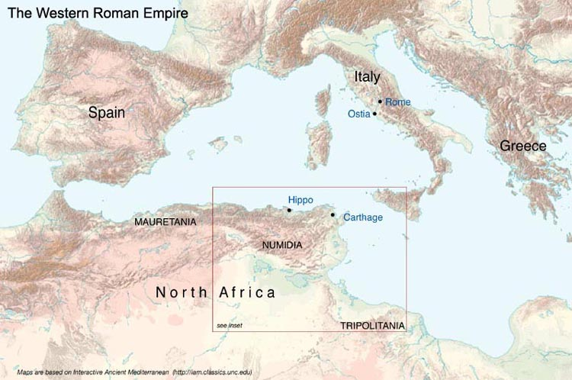
Map of Western Roman Empire

Slide 16
Tertullian and Philosophy
Tertullian did use philosophical terms and was quite familiar with the leading philosophies of the day: Stoicism and Epicureanism
Yes, he did say “What has Athens to do with Jerusalem?” Prescriptions Against Heretics 7
But he also used many concepts from Stoicism, especially from Seneca
So if for Tertullian, “our instruction comes from the porch of Solomon” (Heretics, 7) he also looked to “Seneca whom we so often find on our side” (Treatise on Soul, 20).

Slide 17
Typology and Allegory (Both Spiritual Senses)
Almost all Christians who accept the OT (whether in antiquity or now) use typology to understand the OT
Makes connection between OT and NT
Even Christian literalists usually accept this
Allegory goes beyond typology
Use signs and symbolism to make connections between OT and philosophy
Catholics, Orthodox

Slide 18
Christian ‘Systematic’ Theologian: Origen (185-254)
Born in Alexandria; towering giant over Eastern theology; many subsequent debates trace to how to interpret Origen
Relied heavily on Philo for interpretative methods
Wrote:
An apology, Contra Celsum
Many Biblical commentaries, including on OT books
Biblical scholarship: Hexapla comparing Hebrew, and several different versions of Greek OT (not extant)
Different ways to interpret Bible, especially OT allegorically
‘systematic’ presentation of Christianity: On First Principles
Suffered persecution during Decius reign, eventually died from wounds
Not declared a saint because of controversies about his ideas after he died

Slide 19
Origen and Textual Analysis
Tried to determine the ‘correct’ text of the OT
Issue: multiple Greek and Hebrew versions in use by different Christian and Jewish communities
Origen consulted with Jewish school in Caesarea
Origen’s school most famous Christian school of his time
Developed Hexapla (now lost)
Six versions of Greek OT (including LXX)
Compared with Hebrew
Greatest textual critic of antiquity;
St. Jerome in the West being a close second.
Jerome seems to have used Origen’s Hexapla to translate the OT into Latin (Vulgate)

Slide 20
Origen and Literal Exegesis
Reason for Origen’s extensive textual work was to determine what was the correct literal sense
Origen believed that the literal sense was the starting place for understanding Scripture
But he also believed that some parts of Scripture had little or no literal meaning

Slide 21
Origen and Spiritual Interpretation
Based on Philo
Uses philosophy as a tool to understand the deeper meanings of Scripture
Moral
Christological/Theological
Anagogical
Origen’s philosophical ‘tools’: Stoicism and Platonism
Augustine's philosophical tools: NeoPlatonism

Slide 22
The Latin Bible (Vulgate)
Pope Damasus (d. 384) asked Jerome to provide a unified Latin (Vulgate from vulgar) translation
For two centuries non-Greek speaking Christians had used the ‘Old Latin’ Bible
Jerome spent years and travelled widely to analyze the best texts
Time in Origen’s library in Caesarea
Bethlehem ‘home base’ for Jerome
Controversy between Jerome and Augustine over correct text of Old Testament: LXX or Hebrew
Jerome used a combination

Slide 23
Assignments
CoG X.25, XVIII.41-44, XX.28
Hitchcock, Ch. 4

