Slide 1
Lecture 6 Constantine the Great
Dr. Ann T. Orlando
11 September 2013

Slide 2
Introduction
Review of Third Century
Importance of Constantine
Social and Ecclesial Changes Precipitated by Constantine

Slide 3
Review of Third Century
Increased pressure on Rome from Persia and northern barbarians
Political instability; murder and succession of generals as emperors
  Between Decius and Diocletian, average reign < one year
Empire-wide persecution of Christians under Decius
Many Martyrs; also many lapsed
Order and stability restored under Diocletian

Slide 4
Political Situation in early
Fourth Century: Diocletian
Diocletian becomes emperor in 284.
  Very strong ruler
Decides that best way to protect Empire is to divide it between two Augusti (East and West) supported by two appointed Caesars (Augusti in waiting)
  Modeled on Five Good Emperors of Second Century
Unleashes worst persecution of all; Great Persecution 303 - 311
Manages to retire and force his co-Augutus, Maximian, to retire with him (305)
  Leads to renewed tensions in Empire
  Briefly returns to power in 308 to try and restore order

Slide 5
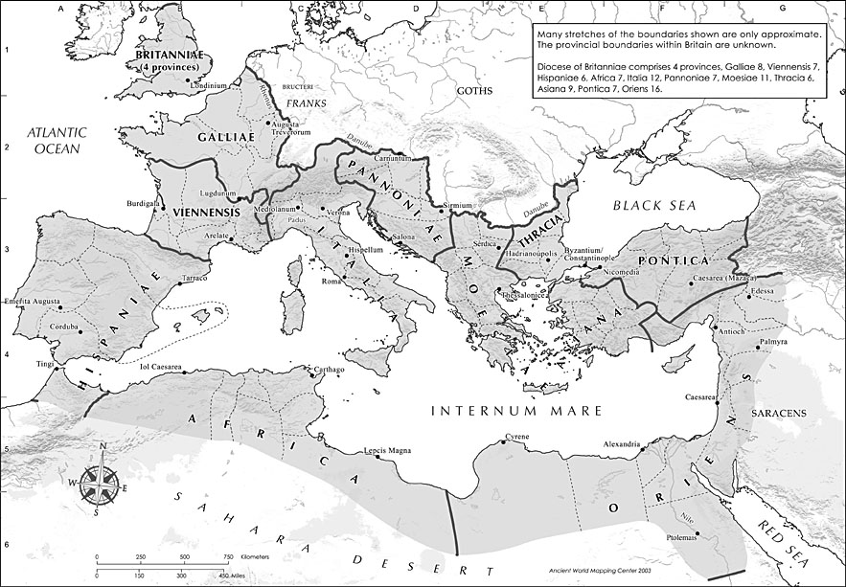
Map of Roman Empire: Diocletian’s Divisions http://www.unc.edu/awmc/awmcmap45.html

Slide 6
After Diocletian
A few problems with Diocletian’s plan:
  Both Augusti and both Caesars headed their own armies and areas of influence
  Except for Diocletian himself, the three other members of this tetrarchy saw this scheme as a way to take over the Empire when Diocletian died
When Diocletian retires, political intrigues and battles break about among the successors:
  Constantius, Augustus, controlled England and Gaul, father of Constantine
  Severus, Caesar, ruled Rome
  Maximius, Caesar in Greece
  Galerius, Augustus, in East
When Constantius dies, his troops proclaim his son, Constantine, Augustus (c. 310)

Slide 7
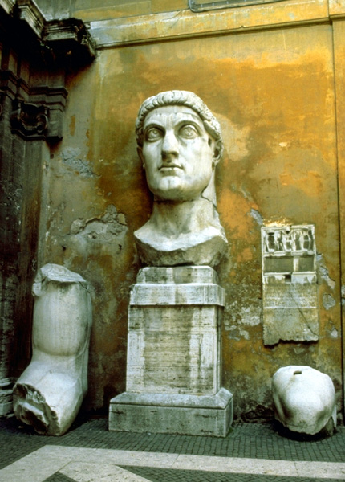
Constantine the Great (c. 280-337)
Key battle in Constantine’s take-over of entire Empire was battle of Milvian bridge over Tiber in Rome against Maxentius, son of Maximian in 312.
  Constantine credits his victory to a vision he had in which he was told to go into battle with the Christian symbol
  Troops carry chi-rho on their shields
By 313 Constantine has captured all of the Empire and officially declared that Christianity was to be tolerated (Edict of Milan)
http://harpy.uccs.edu/roman/constant.jpg

Slide 8
Constantine and Church in Rome
Before he leaves, he ‘gives’ most of Rome to the Pope
  That is, he gives the land and buildings of his enemies to Pope
  Most important of these is the Lateran Palace (St. John Lateran)
  Eighth Century Donation of Constantine
Church overnight becomes the most important landholder in Rome
  Converts pagan temples into Christian churches (for example, Pantheon)
  Builds new Churches, especially at site of martyrdoms with money from Constantine (for example, Vatican)

Slide 9
Constantine the Great and the Church
Builds Churches, with his mother Helen, in Holy Land (Church of Holy Sepulcher in Jerusalem, Church of Nativity in Bethlehem)
Moves against the Donatists in North Africa
Calls Council of Nicea to resolve the Arian controversy: The Nicene Creed
Establishes ‘New Rome’: Constantinople
Dies in 337 (after murdering his wife and eldest son); baptized by an Arian bishop shortly before he dies
  Considered a saint in the East
Initial reaction of Church is that the Christian kingdom has arrived

Slide 10
Major Social Changes in 4th C Due to Constantine and his Successors
Christian clergy given tax relief
Churches could receive legacies
Sunday as a day of rest
Bishops could act as judges in their diocese (Roman administrative province)
Christian could not charge another Christian interest on a loan (sin of usury)
Crucifixion prohibited
No branding of prisoners because mars image of God

Slide 11
Major Issues Within the Church
Who are heroes now that there are no longer martyrs?
How to deal with new members who may be joining Church because it is politically expedient?
What is relation between bishops and civil rulers?
  Evolves very differently in the East and West

Slide 12
4th Century Christological and Trinitarian Controversies
Who was Jesus Christ? What was the relationship between His divinity and humanity?
  What happened at the Incarnation?
  Recall that earliest heresy denied His humanity (docetism)
How to describe the relationship of the “persons” in the Trinity?
  Three Gods?
  One God with three aspects?
Controversies used technical philosophical language
Controversies hinged on proper interpretation of Scripture:
  Proverbs 8:22 ff
  Genesis 1-3
  John 1:1-14

Slide 13
Background to Nicene Creed
Council of Nicea called by Constantine in 325
  to resolve Arian controversy and
  bring unity to Church, and
  therefore unity to Empire
Virtually all Eastern bishops and some Western bishops attended
Bishop Alexander of Alexandria succeeded in routing the Arian bishops

Slide 14
Nicene Creed
Based on various “Rules of Faith”
  Lex orandi, lex credendi; the law of prayer is the law of faith
  What the Church prays is what the Church believes
Based on Scripture, but wanted to be philosophically precise
  Used a word not found in Scripture: homoousia
  According to Eusebius, Constantine approved use of homoousia
  In anathemas treated homoousia and hypostasis as equivalents
  Later councils will distinguish between them; hypostasis as person; hypostatic union

Slide 15
Arianism after Nicea
Continued to be a very potent heresy
Also, politically well connected: Constantine may have been baptized by an Arian bishop
His son, Constanstius, d. 360 took side of Arians;
  Sent Arian missionaries to Germany
  Alaric and the Goths who sacked Rome in 410 were Arian Christians
His cousin, Julian the Apostate, d. 363 tried to return the Empire to paganism
Of the claimants to Empire after Julian
  Valantinian I in West, pro-Nicene (although his mother was an Arian)
  Valens in East was a semi-Arian
Finally ‘settled’ with Theodosius the Great,
  Council of Constantinople, 381, promulgates Nicene-Constantinople Creed,
  What we now have
  Note structure of CCC

Slide 16
Eastern Roman Emperors
Constantine
  Council of Nicaea
Theodosius I, Great (379-395)
  Council of Constantinople I
  Conflicts with Ambrose
  Last Emperor of East and West
Arcadius (son of Theodosius) and Eudoxia in East (395-408)
  Conflicts with John Chrysostom
Theodosius II (408-450)
  Son of Arcadius
  Council of Ephesus
Pulcharia and Marcion (450-457)
  Pulcharia daughter of Theodosius II
  Council of Chalcedon

Slide 17
The Ecumenical Councils
Nicea I, 325, called by Constantine the Great
  Condemned Arianism
  Son of one substance with the Father
  Nicene Creed
Constantinople I, 381, Called by Theodosius the Great
  Affirmed divinity of Holy Spirit
  Modified Creed; what we have now
Ephesus, 431, called by Theodosius II
  Condemned Nestorius, Patriarch of Constantinople
  Jesus was not two separate persons, but one person both human and divine
  Mary as ‘Theotokos’ Mother of God
Chalcedon, 450, called by Empress Pulcharia at request of Pope St. Leo I (the Great)
  Condemned monophysites: single nature
  Christ has two natures: human and divine (Leo’s Tome
Second Council of Constantinople, 553, Called by Justinian
  Condemned Theodore of Mosuestia
Third Council of Constantinople, 680
  Called by Emperor Constantine Pogonatus
  Condemned Monothelete and Pope Honorius

Slide 18
Assignments
CoG V.24-26, XIX.4-8 (required)
Hitchcock, Ch.3
Tanner on early councils, pp 41-80.
Prepare paper and discussion (required)

