Slide 1
Lecture 10: Moral Life and Vocations
15 April 2020
Dr. Ann T. Orlando

Slide 2
Outline
Why celibacy v. marriage becomes an issue in the 4th C
Jerome’s “Letter to Eustochium”
On Goods of Marriage
On Holy Virginity
On Continence
On Marriage and Desire I.1-23

Slide 3
Martyrs
The heroic witness unto death formed the fundamental way in which the Church understood herself before 312
The sacrifice of the martyrs was often written in imitation of Jesus’ passion and death
And since sacrifice is the definitive priestly act, so martyrs by their self-sacrifice are priests
But acts of the martyrs often filled with Eucharistic references, thus emphasizing their priestly sacrifice
See especially Martyrdom of Polycarp
Willingness to suffer martyrdom is the ultimate sign of a Christian
Regardless of marital status
Regardless of social position

Slide 4
Example: Passion of Perpetua
Recounts martyrdom of a group of young Christians c 203
Some parts of story written by Perpetua while in prison, then redacted by Tertullian
Significant scholarly debate concerning language of origin: Greek or Latin
Recounts how the direct action of the Holy Spirit guides and sanctifies Perpetua and her companions
The witness of their sacrifice is given equal status to Scripture

Slide 5
Ascetic Twins: Chastity and Poverty
From earliest time in the Church evangelical counsels or the counsels of perfection
Take on special significance after time of martyrs
Will be viewed as the ultimate effort to live the Christian life
Especially linked were poverty and chastity
Sacrifice of physical, material aspects of this life
Raised issues of the place of marriage and wealth in Church
Can the married (rich) be saved?

Slide 6
Jerome (347-419) “What Jerome is ignorant of, no man has ever known” St. Augustine
Born into a wealthy pagan family; baptized in 365; ordained in Antioch, good friends with Gregory Nazianzus
Along with Origen, greatest Biblical scholar of Patristic era
Pope Damasus commissions Jerome to produce an authoritative Latin translation of Bible
Jerome uses Origen, plus additional materials, especially Hebrew.
Jerome does not accept Septuagint as most authoritative
His prickly character led him to disputes with almost everyone, including Augustine
Forced to leave Rome, goes to Bethlehem to live as a semi-hermit
St. Paulina follows him and establishes a convent in Bethlehem
In addition to authoritative Latin translation of Bible, Jerome wrote lengthy commentaries on almost all books of Scripture; many letters; Lives of Illustrious Men
Nowhere is Jerome’s prickly character more evident than in his battle with Jovinian over sex and marriage

Slide 7
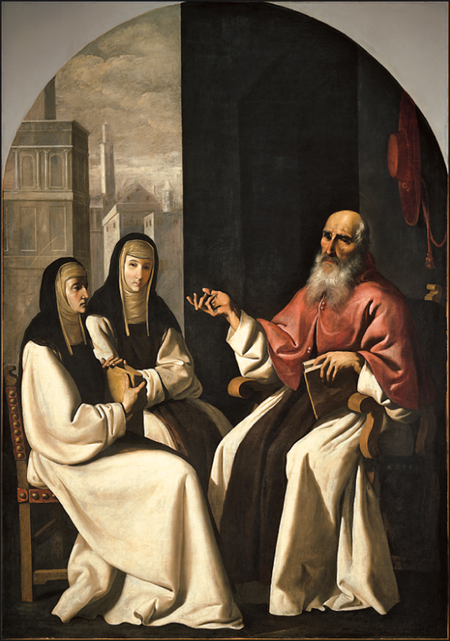
Jerome to Eustochium
Letter 22 (c. 384) probably most famous of all Jerome’s letters
Eustochium is a young teenager
Jerome trying to reinforce her commitment to virginity and holy poverty
Eustochium was a daughter of a friend of Jerome, Paula
St. Paula and St. Eustochium leave Rome to establish a monastery for the support of pilgrims (and Jerome) in Bethlehem
Letter 22 written just before the issues with Jovinian

Slide 8
Key Points in Letter 22, Jerome to Eustochium
Find online at http://www.newadvent.org/fathers/3001022.htm
Marriage is miserable with pregnancy, screaming children and unfaithful husband. You are fleeing from Sodom (2)
Cautions against drink, food, comfortable surroundings (5-10)
I praise marriage but it is because they give me virgins (20)
If any of your handmaids share your vocation, do not lift up yourself against them or pride yourself because you are their mistress. You have all chosen one Bridegroom; you all sing the same psalms; together you receive the Body of Christ (29)

Slide 9
Jovinian
Monk in Rome
He denied that there was any special merit in either fasting or celibacy
Pope Siricius, Bishop Ambrose and others denounced Jovinian.
In 398 he was prosecuted by Theodosius, flogged and exiled
According to Jerome, Jovianian and his followers held:
Married, widowed, virgins are of equal merit after baptism if they do the same work
Those who have been baptized cannot be overthrown by the devil
No difference in fasting and receiving food with thanks
There is one reward for all in the kingdom of heaven

Slide 10
Jerome’s Response to Jovinian
While in Jerusalem, Jerome writes a refutation of Jovinian
Available at http://www.newadvent.org/fathers/30091.htm
Jovinian is a Christian Epicurean whom Jerome wants to crush (1)
Adam and Eve were virgins in Paradise (4)
Applauds Lucretia for taking her life rather than lose her virginity (46)
Uses very harsh and crude language throughout, not only against Jovinian, but marriage in general

Slide 11
Reaction to Jerome
Jerome’s strident anti-marriage polemic was shocking, even to Jerome’s friends
Several of Jerome’s allies tried to confiscate copies circulating in Rome
Other friends ask Jerome to write a more balanced attack on Jovinian
Jerome continued his assault against marriage
The issue of celibacy vs marriage is a major controversy in the later 4th C

Slide 12
Augustine Enters the Frey on Marriage and Sex
Augustine wrote On the Goods (Excellence) of Marriage (De Bono Conjugali) c. 401 as the middle way between Jerome and Jovinian
While viewing virginity as the better way of life, Augustine also recognized several types of ‘goods’ in marriage:
Procreation
Good of fidelity
Sacrament
Sexual lust is a result of Fall
Sin of Adam and Eve infected human nature
Set stage for Pelagian controversy

Slide 13
Augustine, On Holy Virginity (De Sancta Virginitate)
Written immediately after On the Good of Marriage
Meant to be a companion piece addressed to those who chose virginity as a way of life.
Virginity as a way of life is a gift of God
Virgins should model in their bodies the virginity of the Church (2.2)
What we extol is not that they are virgins but that they are consecrated in holy chastity to God. (11.11)
Virgin should beware of pride (33.34)
No one would dare to consider virginity superior to martyrdom (44.47)
Married women may be ready to suffer for Christ while virgin is not (44.47)

Slide 14
Continence
In antiquity not just about sex
A broad sense that to be continent meant to be able to control inappropriate impulses and appetites
Word
Deed
Note distinction with cupidity, which is disordered love
Continence is related to temperance in that temperance is not merely controlling impulses but a temperate man does not have the impulses (see Thomas, Summa II-II.143 a.1)

Slide 15
Transition to Pelagianism
Issues regarding marriage were part of the charge of Pelagians against Augustine
Basically that Augustine was a closet Manichaean and denigrated the material world
On Marriage and Desire
Written c. 420 as a defense by Augustine against Pelagian charges
Emphasizes the three good of marriage (procreation, fidelity, sacrament)
NB discussion of original sin and unbaptized infants

Slide 16
Sermon 51
Likely preached at Octave of Christmas on Epiphany, 418
Joseph and Mary become the context for discussion of marriage and duties within family

Slide 17
Assignments
On the Goods of Marriage (attached to email)
On Holy Virginity (attached to email)
Sermons 51 in Essential Sermons

Slide 18
Some Works Consulted
Kelly, J.N.D. Jerome. Peabody: Hendricks, 1975.
Hunter, David, G. Marriage, Celibacy, and Heresy in Ancient Christianity: The Jovinianist Controversy. Oxford: Oxford University Press, 2007.
Haflidson, Ron. “Outward, Inward, Upward: Why Three Goods of Marriage for Augustine?” Studies in Christian Ethics 2016, Vol. 29 (1) 51-68.
Burns, J. Patout. “Marital Fidelity as a remedium consupiscentiae: An Augustinian Proposal,” Augustinian Studies 44:1 (2013) 1-35.
Otten, Willemien. “Augustine on Marriage, Monasticism, and the Community of the Church,” Theological Studies 59 (1998), 385-407.

