Slide 1
Lecture 3: Shepherd of Hermas
Dr. Ann T. Orlando
31 January 2013

Slide 2
Outline
Roman society and economy Second Century
Christian community in Rome
Background on author of Hermas
Structure of Text
Key points
Assignments
Special reference:
Osiek, Carolyn. Rich and Poor in the Shepherd of Hermas, An Exegetical-Social Investigation. Washington, D.C.: Catholic Biblical Association of America, 1983.

Slide 3
Roman Society Second Century
‘Golden Age’ of Rome
Five Good Emperors
Rome reaches maximum extent of empire under Hadrian
Citizenship available to many who pledged allegiance to Rome
Rome prided itself on being a ‘just’ society
Ruling philosophy: Stoicism

Slide 4
Wealth and Poverty in Roman Empire
Land was primary source of wealth, at least honorable wealth and power
Commerce and trade seen as province of freed men and commoners
Artisans
Engineers and builders
Merchants
Small farmers
Soldiers
Slaves (some)
Destitute
Slaves (most)
Beggars

Slide 5
Taxes in Roman Empire
Wealthy Roman land owners did not pay taxes on land
However, expected to support civic infrastructure through building projects
Type of sales tax, per capita tax, import tax, special tax on conquered peoples (e.g., Jewish Temple tax)
No ‘IRS’ tax collection a Roman imperial contract for which collector received a fee
Need for a census every 15 years
Roman imperial government also obtained funds from its own enterprises
Emperor largest land owner
Mines
‘Free’ labor from prisoners

Slide 6
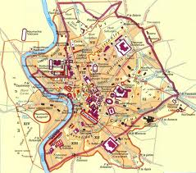
Second Century Rome

Slide 7
Christian Community in Rome Late 1st Century
In mid-first century, probably founded by disciples of James, part of large Jew community in Rome
Both Peter and Paul travel to Rome and martyred
By end of 1st Century Rome unquestioningly capital of Christianity
Martyrdom of greatest apostles
Capital of Empire
Jerusalem’s destruction
NB in 1st through 3rd C Christian community in Rome was Greek-speaking

Slide 8
Church In Rome in 2nd Century
Composed of Greek-speaking foreigners
Diaspora Jews
Gnostics
‘Orthodox’ led by bishop of Rome; who was likely quite ‘poor’
Important ‘international’ Christian school led by Justin Martyr; Irenaeus, Tatian
Some members were quite wealthy, but not among landed nobility
Marcion
Deacons administered Church property for good of the community
Gatherings to celebrate the Eucharist in private homes; especially associated with widows

Slide 9
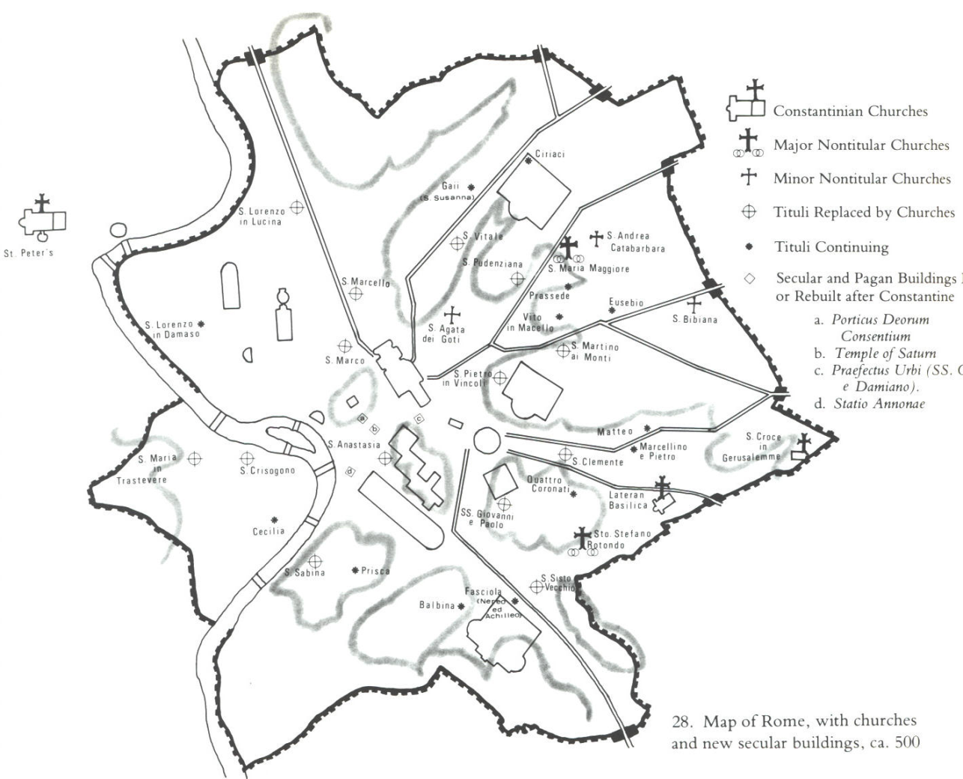
Christian Titular Churches in Rome http://faculty.cua.edu/pennington/religion402/Architecture/RomanChurches.htm

Slide 10
The Marcion Controversy
Marcion (c.100-160)
Wealthy sea captain and merchant
Convert of ‘orthodox’ Church in Rome
Very large donations to Rome
Theological Issues led to split from Church
Scripture, only Paul and parts of Luke
Dual gods to solve theodicy problem
Marcion expelled from Church by Pope Pius c. 145
But also issues of wealth
Church returned Marcion’s large donations
Marcion wins many converts to his version of Christianity
All ‘orthodox’ Christian authors of 2nd and 3rd C write against Marcion (Justin, Irenaeus, Tertullian, Clement of Alexandria, Origin, Cyprian, etc.)

Slide 11
Background on Author (Hermas)
May be the brother of Pius, bishop of Rome (c. 140-155) according to Muratorian Fragment
Hermas was an abandoned child, collected by Rhoda to be raised as her slave, according to Vision 1
At some point, he became a freedman
He had become wealthy (artisan, shop keeper?) but has now lost much of his wealth

Slide 12
Muratorian Fragment
‘Discovered’ in 18th C by Muratori and published by him
Fragment has the earliest list of NT Canon
Likely dated to 170, based on the following:
The Pastor, moreover, did Hermas write very recently in our times in the city of Rome, while his brother bishop Plus sat in the chair of the Church of Rome. And therefore it also ought to be read; but it cannot be made public in the Church to the people, nor placed among the prophets, as their number is complete, nor among the apostles to the end of time. (from ANF Vol. 5)

Slide 13
Alternate Views of Hermas
Also ancient Christian tradition that Hermas was the Hermas mentioned by Paul in Romans
So Origen, Eusebius, and Jerome
Given canonical status in later 2nd, 3rd Century
Irenaeus and Clement of Alexandria quote from it as Scripture
Sometimes found bound with other works of New Testament, including Codex Siniaticus
Fell from favor in the 5th C; officially excluded from the canon by Pope Gelasius (494)

Slide 14
Structure of Shepherd of Hermas
Audience: the wealthy (or at least well-off), not the poor
Three Books
Visions
Commandments
Similitudes
Visions, apocalyptic setting
Vision 1 – Encounter with Rhoda
Vision 2 – Hermas receives a book revealing only one chance for repentance after Baptism
Vision 3 – Vision of a Tower built on seashore; good members of Church make up stones of Tower beckoning others to join
Vision 4 – Continuation of Vision 3, only single minded faith will save one from great sea monster
Vision 5 – Hermas encounters an angel who instructs him to write down commandments and parables (similitudes)

Slide 15
Commandments (Mandates) in Hermas
12 Commandments structured as laws and aphorisms
1: Faith in God
2: Sincerity
3: Truthfulness
4: Purity
5: Patience
6: Faith
7: Holy Fear
8: Single-mindedness
9: Avoid double-mindedness
10: Freedom from attachments
11: Removing evil sexual desires
12: Removing evil material covetousness

Slide 16
Similitudes
10 Similitudes
1 and 2 focus on evil of possessions and the relation between rich and poor
3 and 4 focus on inability to distinguish sinners and righteous until judgment
5 describes merits to be obtained through good works
6 and 7 discuss angels and their roles at the last judgment
8 discusses repentance before judgment
9 refers to the building of the Tower from Vision 3
10 is an exhortation to lead a life of virtue, as contained in the Mandates to avoid being condemned on the day of judgment

Slide 17
Themes in Shepherd
Repentance, return to the Church and the life of virtue or suffer the consequences of judgment
The Tower as an allegory of the Church, being built up by peoples from different economic backgrounds
Especially addressed to the wealthy engaged in business affairs
Repent from grasping at more wealth
Willingly give money to poor

Slide 18
Assignments
Read Shepherd of Hermas, Book III, Similitudes 1-5, ANF Vol. 2 available at http://www.newadvent.org/fathers/02013.htm
Brown, Through the Eye of a Needle, Chapter 2,3
Compendium of Catholic Social Doctrine, 328-329
Write Short Paper

