Slide 1
Lecture 4: Clement of Alexandria
Dr. Ann T. Orlando
14 February 2013

Slide 2
Outline
Early Third Century Church
Early Alexandrian Church
Clement of Alexandria
Background on Who is the Rich Man Who Will be Saved?

Slide 3
Spread of Christianity in the Third Century
Continuation of missionary activities from the First and Second Centuries
Focused on Cities
Primarily Greek speaking (except in North Africa)
Christian martyrdom
Imprisonment
Confiscation of property
Key issue in the Church: repentance and the lapsed

Slide 4
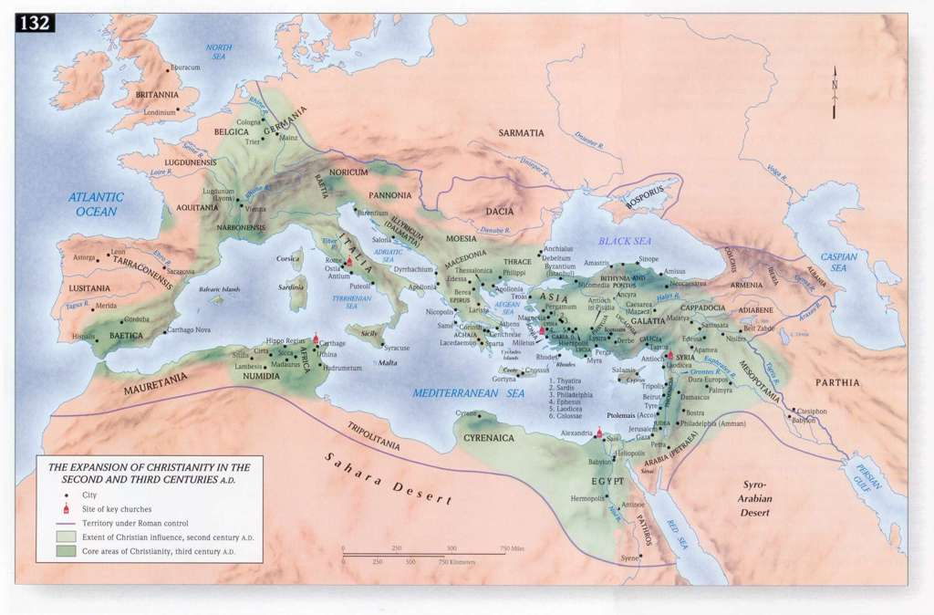
Map of Early Christianity

Slide 5
Alexandria in Pre-Constantinian Roman Empire
Founded by Alexander the Great, 4th C BC
Ancient capital of Greek Ptolemy empire
Cleopatra (d. 31 BC) last Ptolemy
Most important education center for over 800 years (4th C BC – 4th C AD)
Multiple philosophical schools
Library(s)
Museum and astronomical observatory
Most important economic center
Largest port city
Nile valley bread-basket for Roman world
Second only to Rome in overall importance in empire, until founding of Constantinople

Slide 6
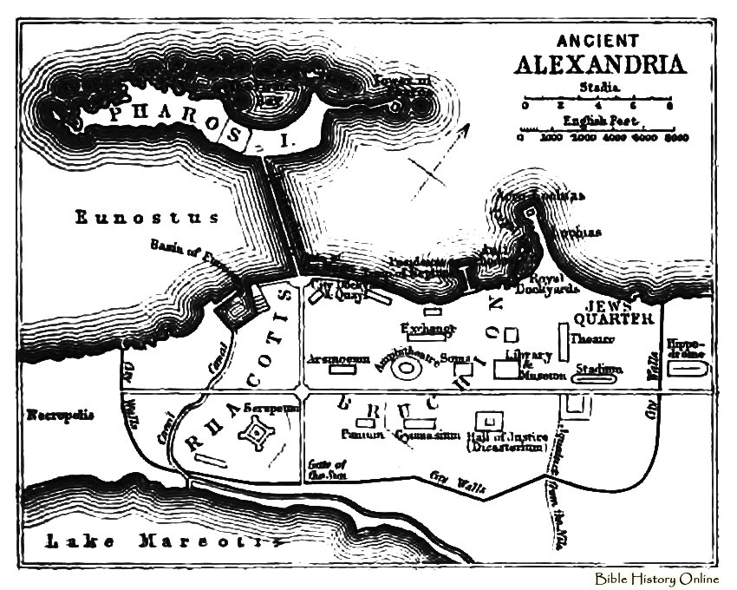
Ancient Alexandria (earlier name Rhacotis)

Slide 7
Intellectual Importance of Alexandria
It was the greatest center of learning in the ancient world for 600 years
Library
Museum
Center of Hellenistic Philosophy
Philosophical schools of all sorts established and flourished in Alexandria
Historical question: Who burnt the great library?
Plutarch said Julius Caesar (47 BC)
Edward Gibbon said Christian Emperor Theodosius (390 AD)
Christian authors said Caliph Omar (642 AD)

Slide 8
Judaism in Alexandria
Center of Diaspora (Greek) Judaism
Old Testament translated in Greek by 72 Jewish scholars “Septuagint” to be included in library
Letter of Aristeas (200 BC)
Romans destroyed Jewish Alexandria in 117; this along with development of rabbinic Judaism and evangelization by Christians ended Hellenistic (Greek) Judaism

Slide 9
Philo of Alexandria
Most influential Jewish philosopher: Philo of Alexandria, contemporary of Jesus and Paul
Leader of Jewish School in Alexandria
Also ‘political’ leader
Philosopher of ‘middle Platonism’
Combines aspects of Platonism and Stoicism
Logos, wisdom, of God begotten of God from the beginning of creation
Seed of Logos found in philosophy (see also Justin Martyr)
Moses older than Plato (Justin Martyr)
Biblical exegesis using allegory

Slide 10
Early Alexandrian Church
Rooted in earlier large and important Jewish diaspora community
LXX
Sirach
Philo of Alexandria
Traditionally founded by St. Mark
Many types of early Christianity flourished
Various gnostic sects all had schools in Alexandria
Important ‘orthodox’ Christian school in Alexandria associated with the bishop
Importance of allegory as an interpretive tool developed by ‘orthodox’
Based explicitly on Philo
Way to justify use of OT (LXX) by ‘orthodox’ opposed to gnostics

Slide 11
St. Clement of Alexandria
Probably born in Athens c 150
Went to Alexandria for advanced studies and convert to Christianity
Eventually became the head of the Christian catechetical school
May have been a presbyter
May (or may not) have taught Origen
Fled Alexandria during the persecutions of 202
Died a martyr in Cappadocia in 215

Slide 12
Trilogy by Clement of Alexandria
Exhortation to Greeks; written to philosophical, but unbelieving audience; apology
Philosophy as a way to faith
Allegorical interpretation of Scripture as developed by Philo
The Instructor; rules for living the Christian life for new Christians
The Logos is the Instructor
Logos as the Divine Word found in all truth
The Stromaties (Carpets); Discussion of true knowledge, opposed to gnostics
Philosophy needed for true gnosis
Seeds of divine truth in philosophy
Moses older than Plato
Philosophy is Greek Testament
See, for example, Benedict XVI http://www.vatican.va/holy_father/benedict_xvi/audiences/2007/documents/hf_ben-xvi_aud_20070418_en.html

Slide 13
Virtue in Christianity
Virtue is not a Biblical Concept
Scripture speaks of morality as following one of two ways
Earliest Christians known as people of the Way
Read 1 Cor 12-13
Virtue is a Greek philosophical concept, especially as found in Plato and Aristotle
Virtue-ethics is adapted by Alexandrian Jews to build a link to Greek morality
Only reference to four cardinal virtues is Wis. 8:7
Clement, following Philo, will link Biblical morality, especially new Testament, with Greek philosophy

Slide 14
Who Is the Rich Man Who Will Be Saved?
Homily on Matt 19:24
Faith, Hope, Love referred to as virtues of the soul (xviii)
Truly rich are those who are holy and can use their wealth for benefit of others (xix)
Everyone should strive for poverty of spirit; that is elimination of passions (xx)
But man cannot achieve this without God; however, God conspires with willing souls (xxi)
One purchases immortality for money by giving the perishing things of this world (xxxii)
Not for the giver to judge the worth of the recipient (xxxiii)
Rich should put themselves under a spiritual director (xli)
Homily ends with story (narrative) of young robber and repentance (xlii)

Slide 15
Recent Critical Edition
Clément d’Alexandire: Quel riche sera sauvé? Greek text by O. Stählin and L. Früchtel. Introduction and notes by Carlo Nardi and Patrick Descourtieux. Translation by Patrick Descourtieux.
Published as part of the continuing series by Sources chritienne
French commentary and translation

Slide 16
Assignments
Read Clement of Alexandria, “Who is the Rich Man who will be saved?” trans. Percy M. Barnard, London: Society for Promoting Christian Knowledge, 1901, available at http://archive.org/stream/homilyofclemento00clemuoft#page/18/mode/2up same edition also on google books.
Brown, Through the Eye of a Needle, Chapter 4
Compendium of Catholic Social Doctrine, 1-12
Write a Short Paper

