Slide 1
Lecture 5 The Sin of Usury
Dr. Ann T. Orlando
21 February 2013

Slide 2
Outline
The Constantinian Revolution
Some major socio-economic changes
Abhorrence of usury
Refresher on the Cappadocians
Gregory of Nyssa
A sidebar on history of ideas: usury in Modernity
Assignments

Slide 3
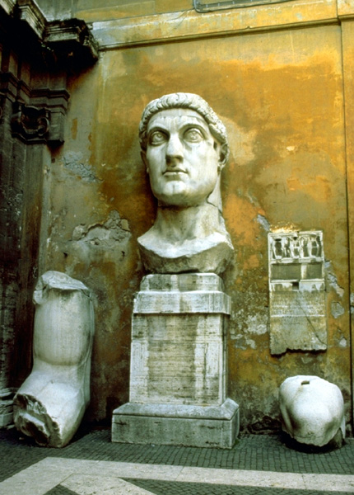
Constantine the Great (c. 280-337)
Key battle in Constantine’s take-over of entire Empire was battle of Milvian bridge over Tiber in Rome against Maxentius, son of Maximian in 312.
Constantine credits his victory to a vision he had in which he was told to go into battle with the Christian symbol
Troops carry chi-rho on their shields
By 313 Constantine has captured all of the Empire and officially declared that Christianity was to be tolerated (Edict of Milan)
http://harpy.uccs.edu/roman/constant.jpg

Slide 4
Constantine and Church in Rome
Before he leaves Rome, Constantine ‘gives’ most of Rome to the Pope
That is, he gives the land and buildings of his enemies to Pope
Most important of these is the Lateran Palace (St. John Lateran)
Eighth Century Donation of Constantine
Church overnight becomes the most important landholder in Rome
Converts pagan temples into Christian churches (for example, Pantheon)
Builds new Churches, especially at site of martyrdoms with money from Constantine (for example, Vatican)

Slide 5
Constantine the Great and the Church
Builds Churches, with his mother Helen, in Holy Land (Church of Holy Sepulcher in Jerusalem, Church of Nativity in Bethlehem)
Moves against the Donatists in North Africa
Calls Council of Nicea to resolve the Arian controversy: The Nicene Creed
Establishes ‘New Rome’: Constantinople
Dies in 337 (after murdering his wife and eldest son); baptized by an Arian bishop shortly before he dies
Considered a saint in the East
Initial reaction of Church is that the Christian kingdom has arrived

Slide 6
Major Social Changes in 4th C Due to Constantine and his successors
Christian clergy given tax relief
Churches could receive legacies
Sunday as a day of rest
Bishops could act as judges in their diocese (Roman administrative province)
Christian could not charge another Christian interest on a loan (sin of usury)
Crucifixion prohibited
No branding of prisoners because mars image of God

Slide 7
Constantine’s Monetary Reforms
In 3rd and early 4th C Roman Empire plagued by inflation and leading to demands for high rates of interest on loans, caused by a continuing devaluation of Roman gold and silver coins
Constantine reformed monetary system by introduction of the gold solidus in 309 and throughout the Empire as his conquests moved East
Key was guarantee of government backed purity of the solidus
Remained the backbone of the monetary system until 10th C
Compare to role of Federal Reserve today

Slide 8
Early Church Councils Opposing Usury
Council of Elvira (306), canon 20 prohibited usury by clergy or laymen
First Council of Arles (314), called by Constantine primarily due to the Donatist controversy, also condemned usury, canon 12 prohibited usury and threatened excommunication
Council of Nicaea (325), canon 17 prohibited usury
Many subsequent Church councils prohibit usury
For more see David Jones, Reforming the Morality of Usury, Maryland: University Press of America, 2004.

Slide 9
From Councils
Elvira (306), Canon 22
If any clergy are found engaged in usury, let them be censured and dismissed. If a layman is caught practicing usury, he may be pardoned if he promises to stop the practice. If he continues this evil practice, let him be expelled from the church.
Nicaea (325), Canon17:
Forasmuch as many enrolled among the Clergy, following covetousness and lust of gain, have forgotten the divine Scripture, which says, He has not given his money upon usury, and in lending money ask the hundredth of the sum [as monthly interest], the holy and great Synod thinks it just that if after this decree any one be found to receive usury, whether he accomplish it by secret transaction or otherwise, as by demanding the whole and one half, or by using any other contrivance whatever for filthy lucre's sake, he shall be deposed from the clergy and his name stricken from the list.
Why particular concern about clergy? Where did their money come from and for what purpose?

Slide 10
Some Definitions and Etymology
Latin, usura, extra money paid on a loan (interest)
Usury is the illicit charging of money for the use of money in a loan (note, usura literally means use or enjoy)
Latin, interesse, among other meanings is the degree of value
From antiquity through Middle Ages, interest was the legal and justified penalty for not paying a loan back on time

Slide 11
Abhorrence of Usury
Whether in Greek philosophy (Plato, Aristotle), OT, Roman Law, Rabbinic Judaism, Christianity or Islam, charging for a loan was seen as ethically wrong, a grave sin
Land and its fruitfulness was the basis for honorable wealth
Basis for highest social position
Secondarily, direct commerce and trade were also allowable means for acquiring wealth (money)
But usury was thought to be making money through the use of money and not direct labor (something for nothing)

Slide 12
Some of the Ethical Objections to Usury
A loan to one in need should be an act of charity (Christianity, Rabbinic Judaism, Islam)
One should not get paid for performing an act of charity
Usury usually included requiring collateral for a loan, thus prohibitions about requiring anything of necessity to secure a loan
Lender is increasing wealth without expending effort
Lender is in an increasingly dominant position with respect to lender, especially with compound interest
Encourages risky investments on part of borrower to generate the income to pay back the loan
Discounts the future value of something (encourages inflation)

Slide 13
Who are Cappadocians?
St. Basil the Great, 329-379, bishop of Caesarea in Cappadocia, Asia Minor (now Kayseri in Turkey)
St. Gregory Nazianzus, 325-389, Patriarch of Constantinople
St. Gregory of Nyssa, 335-394, brother of Basil
[St. Macrina, older sister of Basil and Gregory]

Slide 14
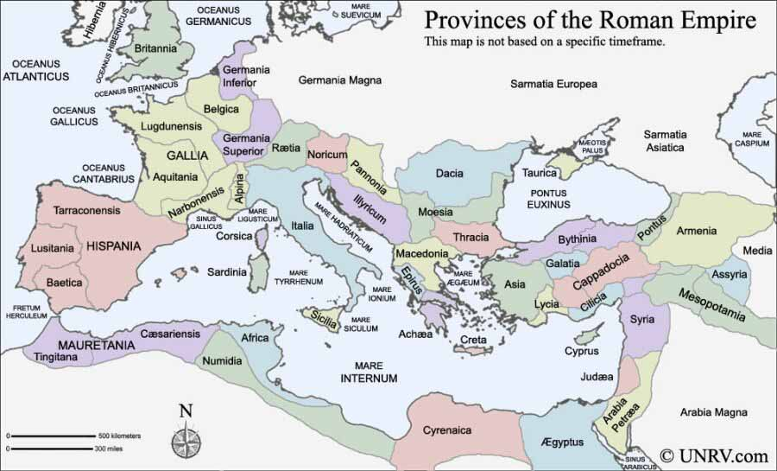
Provinces of Empire www.unrv.com/roman-empire-map.php

Slide 15
Influences on Cappadocians
Basil and Gregory of Nyssa came from a devout Christian household; their father was a bishop
Origen; especially through Gregory Thaumaturgus (Wonderworker), 213-275
Gregory Thaumaturgus was a native of Cappadocia who studied with Origen at Ceasarea, Palestine
Gregory was bishop of Pontus, reputation of performing miracles
Basil’s grandmother studied with St. Gregory
Basil and Gregory Nazianzus compiled a collection of Origen’s work known as the Philokalia
Both Basil and Gregory Nazianzus studied classical philosophy at Athens; both travelled to Egypt
Gregory Nazianzus traveled to Alexandria, influenced by Athanasius
Basil visited Egyptian monasteries

Slide 16
St. Basil the Great
Very important in development of Greek Christian spiritual practice
Rule for monastic orders
Divine Liturgy still in use
Wrote against the Arians, and also developed a theology of the Trinity, affirming the divinity of Son and Spirit
Wrote many homilies on Scripture; some of which were very influential on St. Ambrose of Milan who translated them into Latin
Famous for hospitals and monasteries that he established
Called ‘Great’ in his own lifetime

Slide 17
Basil on Wealth
Basil was explicitly concerned about dangers of wealth
Because of change in status of Christianity, many Christians were becoming wealthy
Cappadocia went through a severe famine in mid-4th Century
Rich are given wealth as stewards of God’s creation
Money will be left behind after death, but not good works
Not sharing good things is comparable to murder
Give to the poor, and make God your debtor
Most famous sermon was Sermon to Rich on Luke 12:15, Then he said to them, “Watch out! Be on your guard against all kinds of greed; life does not consist in an abundance of possessions.
Copied word for word by Ambrose
Profound impact on John Chrysostom

Slide 18
Gregory of Nyssa, d. 385
Younger brother of Basil and Macrina
Married (perhaps to sister of Gregory Nazianzus??)
May have been bishop of Nyssa; wrote catechetical instructions
Philosophically very influenced by Origen and NeoPlatonism
Also very deeply influenced by his sister, Macrina
Life of Macrina
Macrina as The Teacher in On the Resurrection

Slide 19
NeoPlatonism
Philosophy developed by Plotinus (204-270)
Alexandrian philosopher; contemporary of Origen
Extended aspects of Plato
Work is preserved in the Enneads
Emphasis on God as One,
The One as self-caused and cause of everything in universe
The One is exquisitely, beautifully simple (i.e., without complexity); the One is completely Good
Matter, as caused by One is good; therefore, evil must be what is limited or absence of being
Man as a rational creature finds his true happiness in unity with the One; moving from the limiting material to the unbounded simple, beautiful good One

Slide 20
Beginning of Modern Understanding of Usury (Interest)
See Joseph Persky, “From Usury to Interest,” Journal of Economic Perspective, Volume 21, Number 1—Winter 2007—Pages 227–236, available at http://pubs.aeaweb.org/doi/pdfplus/10.1257/jep.21.1.227
Chesterton thought Jeremy Bentham’s Defense of Usury was the beginning of the modern era
Adam Smith in Wealth of Nations had been reluctant to fully endorse usury without set limits (5%) and for a set purpose endorsed by Government
One of the very few areas in which the father of laissez faire capitalism thought Government should intervene
Bentham in Letter XIII tried to convince Smith (unsuccessfully) that there should be no limits at all on usury (interest)
Individuals (including poor uneducated) were in a better position to decide what loans were worth to them
‘Projectors’ (venture capitalists) needed loans to power technical innovation which in turn powered the new society and the happiness of its members

Slide 21
Assignments
Read Gregory of Nyssa, “Against Usury”; Casimir McCambley, "Against Those Who Practice Usury by Gregory of Nyssa," Greek Orthodox Theological Review, Vol. 36 no. 3-4 (1991), pp. 287-302 available at http://www.sage.edu/faculty/salomd/nyssa/usury.html
Brown, Through the Eye of a Needle, Chapter 1
Issue with Brown, not much discussion (none really) of the usury problem
Compendium of Catholic Social Doctrine, 340 - 341
Write Short Paper

