Slide 1
Lecture 15: Introduction to Cappadocians
22 October 2019

Slide 2
Introduction
Who were the Cappadocians
Impact on development of theology of Trinity and liturgical developments
Basil the Great

Slide 3
Who are Cappadocians?
St. Basil the Great, 329-379, bishop of Caesarea in Cappadocia, Asia Minor (now Kayseri in Turkey)
St. Gregory Nazianzus, 325-389, Patriarch of Constantinople
St. Gregory of Nyssa, 335-394, brother of Basil
[St. Macrina, older sister of Basil and Gregory]

Slide 4
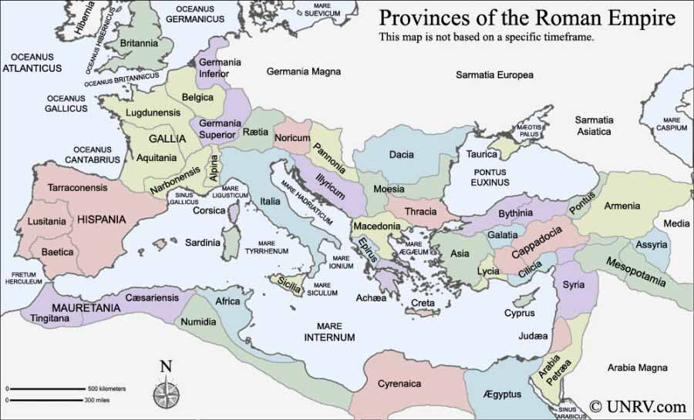
Provinces of Empire www.unrv.com/roman-empire-map.php

Slide 5
Influences on Cappadocians
Basil and Gregory of Nyssa came from a devout Christian household; their father was a bishop
Gregory Nazianzus’ father was a bishop
Origen; especially through Gregory Thaumaturgus (Wonderworker), 213-275
  Gregory Thaumaturgus was a native of Cappadocia who studied with Origen at Caesarea, Palestine
  Gregory was bishop of Pontus, reputation of performing miracles
  Basil’s grandmother studied with St. Gregory
  Basil and Gregory Nazianzus compiled a collection of Origen’s work known as the Philokalia
Both Basil and Gregory Nazianzus studied classical philosophy at Athens; both travelled to Egypt
  Gregory Nazianzus traveled to Alexandria, influenced by Athanasius
  Basil visited Egyptian monasteries

Slide 6
St. Basil the Great
Very important in development of Greek Christian spiritual practice
  Rule for monastic orders
  Divine Liturgy still in use
Wrote against the Arians, and also developed a theology of the Trinity, affirming the divinity of Son and Spirit
Wrote many homilies on Scripture; some of which were very influential on St. Ambrose of Milan who translated them into Latin
Famous for hospitals and monasteries that he established
Called ‘Great’ in his own lifetime

Slide 7
Basil’s Rule
Based on his visit to St. Pachomius as a young man
Really a series of questions and answers from ascetics to Basil, collected in the Asceticon
Basil emphasizes importance of living in community
  Doubts value of solitaries;
  Need practice of love that community requires
  ‘Whose feet will you wash?’
No abbots; more like rule by elders (presbyters)

Slide 8
Basil on Wealth
Basil was explicitly concerned about dangers of wealth
  Because of change in status of Christianity, many Christians were becoming wealthy
  Cappadocia went through a severe famine in mid-4th Century
Rich are given wealth as stewards of God’s creation
Money will be left behind after death, but not good works
Not sharing good things is comparable to murder
Give to the poor, and make God your debtor
Most famous sermon was Sermon to Rich on Luke 12:15, Then he said to them, “Watch out! Be on your guard against all kinds of greed; life does not consist in an abundance of possessions.
  Copied word for word by Ambrose
Profound impact on John Chrysostom

Slide 9
Basil and the Holy Spirit
In his works against the Arians, Basil also offers a strong defense not only of the person and divinity of the Son, but also of the Spirit
Writes On the Holy Spirit in 375
  Deity of Son and Spirit revealed in Church’s liturgy
  Importance of the epiclesis

Slide 10
Basil’s Hexameron, Homily 1
Hexameron: Homilies on Six Days of Creation
  In opposition to those who said that the good God did not create the world (e.g., Marcion, Gnostics)
  In opposition to those who said the world is eternal without design or plan (e.g., Epicureans)
Note how Basil expects that ’scientific’ theories will change, but eternal Truth does not (2, 8, 11)
Discussion of astronomers and limits of their knowledge (4)
World created as a place for training souls of men (5)

Slide 11
Basil’s Homily 10 on Psalm 1
Book of Psalms is profitable for all; music of psalms like honey mixed with medicine (1)
Psalm 1 sets tone for all of the psalms (3)
  Note metaphors
Women are included in blessedness (3)
Beginning of virtue is to move away from evil (4)
Note contrast with pleasures of moment and future joy (5)
Being around sinful people is like being around sick people: contagious (6)

Slide 12
Assignment
Read Basil Homily 1 (Hexameron) and Homily 10 (On Psalm 1)
Benedict XVI, General Audiences 4 July 2007 and 1 August 2007, Basil
  http://www.vatican.va/holy_father/benedict_xvi/audiences/2007/documents/hf_ben-xvi_aud_20070704_en.html
  http://www.vatican.va/holy_father/benedict_xvi/audiences/2007/documents/hf_ben-xvi_aud_20070801_en.html

