Slide 1
Lecture 20: Islam and Councils 7th – 8th C
7 November 2019

Slide 2
Introduction
Rise of Islam
Byzantine Reaction
John of Damascus
Seventh Ecumenical Council

Slide 3
Historical Situation in Early 7th C in East
Unified politically under control of Byzantine Emperor from Egypt to Danube
But monophysites in Egypt and Nestorians in Syria undermine religious unity
Primary contact between East and West is through the Pope
Ecclesial authorities are subordinate to civil (Pope Gelasius not withstanding)
Eastern Empire will see itself as the continuation of ancient Roman Empire until the fall of Constantinople in 1453

Slide 4
Rise of Islam
Muhammad (570-632)
The flight (hijrah) from Mecca to Medina (622) is beginning of Muslim calendar
Qur’an is revelation; its language, Arabic, is part of that revelation
Founded a religious and political movement aimed at uniting all Arab tribes.
By 716 all of North Africa, Sicily and the Iberian peninsula was under Muslim control
By 730 France and Constantinople were threatened
Stopped in France by Charles Martel at Poitiers 732
Charles Martel (the Hammer) is Charlemagne’s grandfather

Slide 5
Early Islamic Political Leadership
First four caliphs, Rashidun, rightly guided
Umayyads (Damascus, Cordoba)
Abbasids (Baghdad)
Fatimids (Cairo)
Like Hellenistic kingdoms after Alexander and then the Romans, Muslims found territory too large to be ruled consistently by one ruler

Slide 6
Early Islamic Culture
New Capital Cities
Damascus, old city but new capitol
Baghdad
Cairo
Cordoba
Dome of Rock, first great Islamic building, on Temple Mount in Jerusalem, 692
Arabic replaces Greek in Southern Mediterranean and Latin in North Africa and Spain as common language

Slide 7
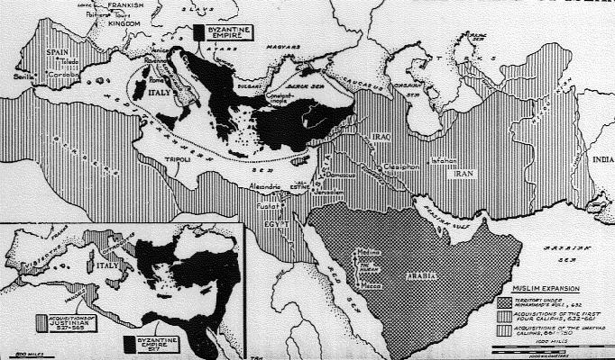
Rise of Islam 7th C

Slide 8
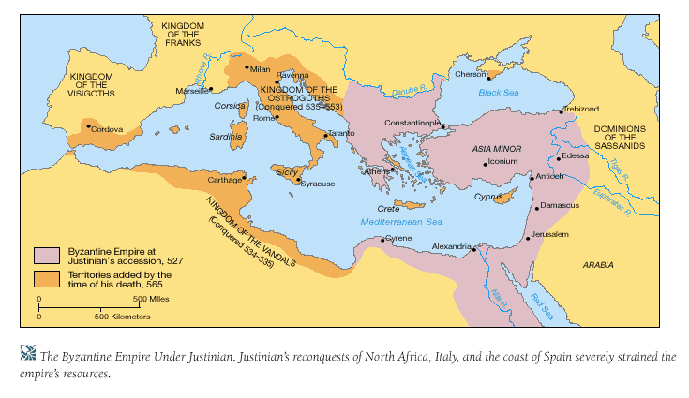
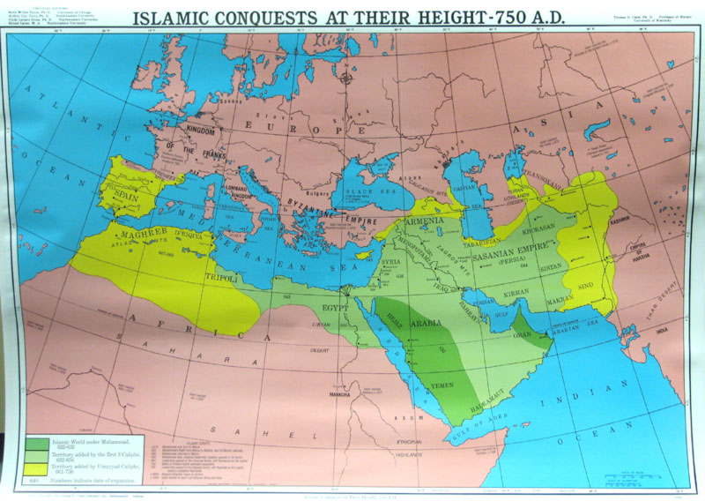
Justinian’s Empire (560) and Islamic (Arab) Conquests by 750 AD

Slide 9
Key Points of Islamic Theology
Qur’an is revealed word of God (must be in Arabic, a translation Is not really the Qur’an)
Jews and Christians are considered people of The Book
Mohammed is greatest prophet, although prophets of Old Testament and Jesus are also important
God is one, no Trinity
Images are an affront to God
Shari’a “Islamic Law”; based on Qur’an; rules for how the community of Muslims should live

Slide 10
Two Major Branches of Islam
Sunni
Ruler should be by a virtuous Muslim who followed the sunna (practice) of Mohammed as recorded in the hadiths (traditions)
Authority was with ulama or imam, wise men but not infallible, who preached the Qur’an
Defense of Qur’an through rational argument
Shi’i
Rule should be through the family of Mohammed, his son Ali by Fatima in particular. Came to be known as Shi’i, or followers, of Ali (killed at Karbala)
Authority was found in infallible imams as interpreters of the Qur’an

Slide 11
Theological Impact of Rise of Islam
Monothelite controversy
One will (divine) of Christ
Maximus the Confessor
Iconoclasm
Rejection of images
John of Damascus

Slide 12
Initial Reaction of Byzantine Empire
Attempts to counter Islam by bringing Egyptian monophysites back into ‘Orthodoxy’
Emperor Constans II (641-668) tried to reunite Egyptian Christians by accepting one-will of Christ
Pope Martin and Maximus the Confessor reject this at First Lateran Council
Constans II has Pope Martin (649-655) abducted, brought to Constantinople, tried and sent into exile where he died
Also arrested Maximus the Confessor, tortured and exiled him
Constans could get to Pope Martin because Byzantium continued to have a foothold in Ravenna until 751
In any case, Constans was unsuccessful politically
Egyptian monophysites did not accept only one will of Christ
Many Coptic Christians preferred to live under Muslim rule than Byzantine rule
After Constans II dies, Emperors no longer try to enforce this theology

Slide 13
Maximus the Confessor (580-662)
Rise of Islam
Mohamed’s flight from Mecca to Medina 612
Fall of Jerusalem in 637 and Alexandria 642
To try to bring Monophysites back under imperial control against Arabs
Patriarch of Constantinople, Sergius proposes ‘monothelete’ Christology or that Christ had one will
Pope Honorius (625-638) goes along with this
Pope Martin I at First Lateran Council in Rome rejects this in 649, in opposition to Emperor and much of Eastern Church
In any case Monophysites also reject this
Maximus the Confessor Eastern theologian who supported Chalcedon
Gave deepest theological arguments in support of two complete natures, against monothelete
Was persecuted and tortured by Emperor Heraclius
Eventually Eastern Church returns to Chalcedonian formula in Third Council of Constantinople (680)

Slide 14
The Ecumenical Councils
Nicea I, 325, called by Constantine the Great
Condemned Arianism
Son of one substance with the Father
Nicene Creed
Constantinople I, 381, Called by Theodosius the Great
Affirmed divinity of Holy Spirit
Modified Creed; what we have now
Ephesus, 431, called by Theodosius II
Condemned Nestorius, Patriarch of Constantinople
Jesus was not two separate persons, but one person both human and divine
Mary as ‘Theotokos’ Mother of God
Chalcedon, 450, called by Empress Pulcharia at request of Pope St. Leo I (the Great)
Condemned monophysites: single nature
Christ has two natures: human and divine (Leo’s Tome
Second Council of Constantinople, 553, Called by Justinian
Condemned Theodore of Mosuestia and Origen
Third Council of Constantinople, 680
Called by Emperor Constantine Pogonatus
Condemned Monothelete and Pope Honorius
Nicea II, 787
Called by Empress Irene
Condemns iconoclasts

Slide 15
Eastern Theological Response: Iconoclast Controversy
Emperors Leo III (717-741), Constantine V (741-763)
Supported “image breaking” iconoclasm as a way to attract Muslims to Christian orthodoxy
Historical Note: Emperor Leo III dropped all military support of Papacy against Lombards, forcing Pope Stephen II into an alliance with Pepin the Short
Eastern Monks vehemently opposed iconoclasts
Because Word was Incarnate, could use human images as aids to worship of God

Slide 16
John of Damascus (675-749)
Monk at St. Sabas near Jerusalem
Strong theological defense of icons
In Defense of Icons he differentiated types of worship and honor
Other important work On Orthodox Faith
Book III is a summary and clear exposition of Orthodox Christology
“Communication of idioms” as means of relating human nature of Christ to His divine nature
John of Damascus is very influential in Western Medieval theology
Also modern Catholic theology; Pope Pius XII referenced John of Damascus when proclaiming doctrine of Assumption of Mary

Slide 17
Second Council of Nicea, 787
Also known as Seventh Ecumenical Council
Called by Empress Irene, who supported icons (iconodule)
Following St. John Damascus, distinguished types of devotions
Western Reaction
Problem: Eastern church did not invite anyone from West to participate
Another problem: poor translation from Greek into Latin
Result: Charlemagne did not accept Nicea II
Theodulf wrote Libri Carolini condemning worship of images
Also encouraged Filioque in the Latin Creed
Nicaea II was recognized by Pope Hadrian (772-795) and his successors

Slide 18
Eastern Theological Response: Iconoclast Controversy
Emperors Leo III (717-741), Constantine V (741-763)
Supported “image breaking” iconoclasm as a way to attract Muslims to Christian orthodoxy
Historical Note: Emperor Leo III dropped all military support of Papacy against Lombards, forcing Pope Stephen II into an alliance with Pepin the Short
Eastern Monks vehemently opposed iconoclasts
Because Word was Incarnate, could use human images as aids to worship of God

Slide 19
John of Damascus (675-749)
Monk at St. Sabas near Jerusalem
Strong theological defense of icons
In Defense of Icons he differentiated types of worship and honor
Other important work On Orthodox Faith
Book III is a summary and clear exposition of Orthodox Christology
“Communication of idioms” as means of relating human nature of Christ to His divine nature
John of Damascus is very influential in Western Medieval theology
Also modern Catholic theology; Pope Pius XII referenced John of Damascus when proclaiming doctrine of Assumption of Mary

Slide 20
Second Council of Nicea, 787
Also known as Seventh Ecumenical Council
Called by Empress Irene, who supported icons (iconodule)
Following St. John Damascus, distinguished types of devotions
Western Reaction
Problem: Eastern church did not invite anyone from West to participate
Another problem: poor translation from Greek into Latin
Result: Charlemagne did not accept Nicea II
Theodulf wrote Libri Carolini condemning worship of images
Also encouraged Filioque in the Latin Creed
Nicaea II was recognized by Pope Hadrian (772-795) and his successors

Slide 21
A Language Problem: Filioque
Filioque means “and Son” in Latin
Starts with Augustine’s description of Trinity: Holy Spirit is mutual love of Father and Son
Holy Spirit proceeds from Father and the Son
But Augustine also said Holy Spirit proceeds form the Father
Gets incorporated in Latin Creed as Holy Spirit proceeds from Father and the Son
Greek Church (and Greek creed) states that Holy Spirit and Son proceed from the Godhead (Father); Holy Spirit proceeds from the Father through the Son
This issue developed as a stumbling block between Eastern and Western theology in 9th C

Slide 22
Assignments
John of Damascus, In Defense of Icons, available at http://medieval.ucdavis.edu/20A/Icons.html
Prepare paper on Christology

