Slide 1
HT 501: Lecture 2 The Didache
5 September 2019

Slide 2
Introduction
Historical Context of Early Christianity
Second Temple Judaism(s)
Roman-Jewish Wars
Development of Rabbinic Judaism
Early Christianity in a Jewish Context
Background of Didache
Structure
Themes

Slide 3
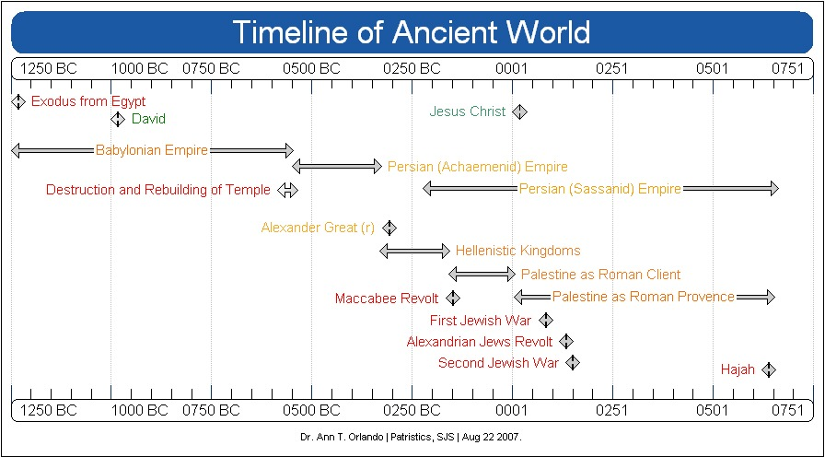

Slide 4
Timeline of Judaism
Moses c. 1250 BCE (BC) Exodus through Deuteronomy
David c. 1000 BC Samuel, Kings, Chronicles
Destruction of 1st Temple; 586 Babylonian Captivity by Nebuchadnezzar; Isaiah, Jeremiah, Ezekiel,
Return and rebuilding of Temple (Second Temple) 539 BC by Persian King Cyrus; Ezra, Nehemiah
Israel between two great Greek powers; 330 BC to 160 BC; Maccabees appeal to Rome for help; Daniel writes about whore of Babylon, but really is referring to Seleucids
Palestine a client of Rome 160 BC to 4 BC (death of Herod the Great)
Jesus Christ 1 to 33 AD
Palestine revolts, First Jewish War 66-73 AD
Destruction of Second Temple in 70 AD;
Masada 73AD
Alexandrian Jewish revolt; destruction of Alexandrian Jews by Emperor Hadrian 117 AD
Second Jewish War, Bar Kockba Rebellion, 133-135 AD
Palestine occupied by Roman Empire until 650 AD and Moslem conquests
Notes:
Mark Timeline
Future point: Luther and Papal Rome as whore of Babylon in 16th C
Celia Sirois and OT class will much, much more to say about this

Slide 5
Hellenistic Empires
Alexander the Great
Son of Philip of Macedonia; Student of Aristotle
Conquers the ‘world’ by age of 33
Founds Alexandria, center of learning for next 600 years
Dies in 323 BC; leaving his generals in charge of various parts of his conquests
Hellenistic (Greek) Empires 323 – 31 BC
Macedonians: Greece, Sicily, southern Italy
Seleucids: Asia Minor, Syria and Mesopotamia; capital in Antioch
Ptolemies: Egypt and Cyrene; capital in Alexandria
As a result of this extended period of Greek rule, the ‘lingua franca’ of the Mediterranean was Greek from the 4th C BC until the 5th C AD in the West and the 15th C in the East
Israel between two major competing Empires: Seleucid and Ptolemy
Notes:
Mark Timeline
This is why NT was written in GREEK

Slide 6
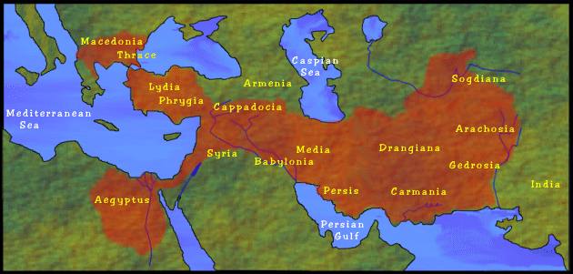
Map of Conquests of Alexander Great http://library.thinkquest.org/10805/alexmap.html

Slide 7
Old Testament Tells Much of This Story
Book of I Maccabees
May have been written in Hebrew, but only known versions are Greek
Tells the story of Jewish revolt against Seleucids and their Jewish collaborators in 161 BC
Read Chapter 1
At conclusion, successful Maccabees look to Rome for an alliance, I Macc 14
II Macc is a letter from newly successful Maccabees to Alexandrian Jews for them to come to the re-dedication of Temple (Hanukkah)

Slide 8
The Mediterranean World in First Century
The ‘world’ was dominated by Roman Empire
But not homogeneous
Core society was fusion of Roman and Greek culture; Hellenistic
Political Capital: Rome
Intellectual Capital: Alexandria
Roman Province of Palestine was on the ‘fringe’ of the Empire
Rome’s traditional enemy: Persia
Rome succeeded Hellenistic Empires
Persia succeeded Babylonian Empire

Slide 9
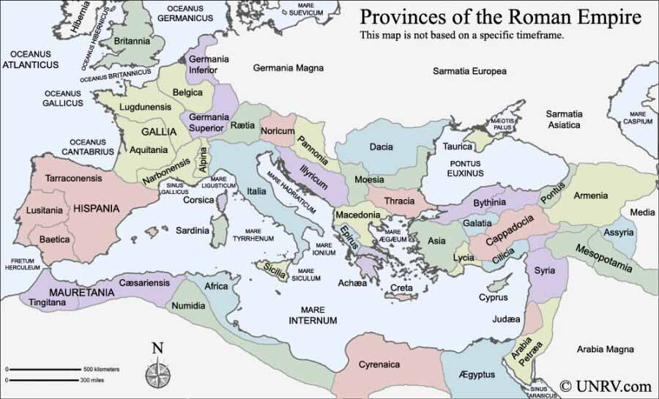
Roman Provinces www.unrv.com/roman-empire-map.php

Slide 10
Herod the Great (73 to 4 BC)
His father, Antipater, was placed in power by Romans
Herod grew up (‘hostage’) in Rome
Friend with both Octavian and Antony
On his Father’s death, Herod becomes client king of Romans
Exerts great power in Palestine, including massive building projects
Second Temple precinct
Cities of Caesarea and Tiberius
Palaces in Jerusalem, Masada
When he dies, Romans divide his kingdom among his sons with a Roman administrator

Slide 11
Judaism(s) During Jesus’ Lifetime Near End of Second Temple Judaism
Before and during Jesus’ life there were many types of Judaism in Palestine (Josephus describes this):
Pharisees: upholders of the Law (Torah)
Sadducees: from aristocracy and high priests, did not believe in resurrection of dead; closely associated with Temple
Essenes: disgusted with impurities in Temple; left for desert ; Dead Sea Scrolls usually associated with them
Zealots: ‘terrorists’ against Roman occupation
Diaspora Jews not living in Palestine but scattered around Mediterranean;
Then, as now, more Jews living outside of Palestine (Israel) than in it
Greek Jews (Hellenists in Acts of Apostles); Septuagint (LXX) Greek translation of Bible c. 200 BC in Alexandria
Jews in Mesopotamia who did not return after the exile in 6th C BC, but flourished under Persian rule; Scripture did not include any late Second Temple Greek works (e.g., Maccabees, Sirach, Wisdom)
Notes:
Importance of Septuagint; used by NT authors
Show map where is Alexandria and Antioch
Map of Jewish diaspora

Slide 12
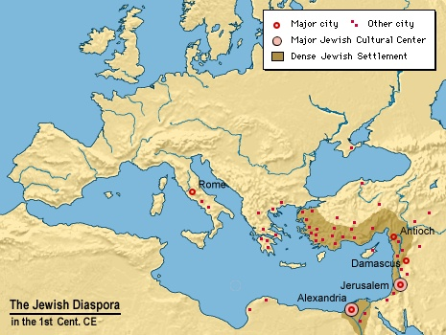
Map of First Century Jewish Communities in Roman Provinces: darkwing.uoregon.edu/~atlas/europe/static/map11.html

Slide 13
Philo and Josephus
Philo (20 BC – 50 AD), contemporary of Jesus and Apostles,
Leader of Jewish community in Alexandria
Wrote many, many philosophical treatises, apologies
Tried to create a bridge between Judaism and Greek philosophy
Key was using allegory to interpret Scripture (LXX)
Huge influence on early Christians theologians in Alexandria
Josephus (37-101 AD)
Fought against Rome in First Jewish War, but defected during the War
Tried unsuccessfully to convince Jews to surrender to Romans
Became a client of Titus; wrote a history of Jewish people (Antiquities) and a history of the War

Slide 14
Development of Rabbinic Judaism
During the First War with Rome 66-73 AD, the Sadducees, Essenes and Zealots were destroyed
In 117 AD the Emperor Hadrian destroyed the Hellenistic Jewish community in Alexandria;
Second Palestinian War, Bar Kochba rebellion, 132-135; after this war, Romans did not allow Jews into Jerusalem;
This was enforced until Julian the Apostate, Emperor 361-363
The Pharisees were the group out of which rabbinic Judaism grew in the 2nd and 3rd C AD.
They reestablished contact with the Mesopotamian Jews and their theology;
Rejected use of Greek philosophy and parts of the OT written in Greek, not Hebrew
Hellenistic (Greek) Jewish theology was taken over, preserved and used by early Christian theologians, especially in Alexandria; but rejected by rabbinic Judaism
During the Second Century the Greek (or Hellenistic) Jews seemingly either converted to Christianity or rabbinic Judaism

Slide 15
Early Christianity
Acts of the Apostles tells the story of spread of Christianity around Roman Empire
Christianity is
Primarily urban
Greek speaking
From many socials classes, but associated with Hellenistic Jewish communities
Distinction between some forms of early Christianity and Judaism were not clear
Both Christianity and rabbinic Judaism are establishing themselves and evangelizing at the same time as the genuine heirs to Second Temple Judaism(s)

Slide 16
Luke: History of Church in New Testament
Paul’s disciple, Luke, writes an ‘ordered account’ in two Books, the Gospel and Acts of the Apostles
Written in an ancient historical style;
Some important historical references in Luke
Note references to Herod the Great and Augustus; Luke 1 and 2
Prophesy of destruction of Temple; Luke 19:41-44, 21:20-24
Jesus condemned for political insurrection; Luke 23:1-4
Some important historical references in Acts
Pentecost, the ‘birthday of Church;’ Acts 2
Reference to St. Stephen and the Hellenists; Acts 6-7
Council of Jerusalem in which Paul’s position that Gentiles do not need to convert to Judaism is affirmed; Acts 15
Paul arguing with Athenian philosophers; Acts 17:16-33
Story of how the Church was spread by Paul’s missionary activity to the ends of the earth (i.e., Rome)

Slide 17
Christianity at End of First Century
Christianity spread through missionary activities to urban centers, especially with large Diaspora Jewish populations
Remember, when Paul writes Romans, he is writing to a predominantly Hellenistic Jewish Christian community that he did not found; he writes to introduce himself and his theology to Christians already in Roman
Christianity appeared to most outsiders (and some who considered themselves Christian) like another form of Judaism
Nero used Christians as scapegoats for fire in 64 AD
Jewish Christian community was small and in conflict with larger non-Christian Jewish community
Execution of Peter and Paul probably took place during this time
Rome quickly became the ‘capital’ city of Christianity
Place where Peter and Paul died
Capital of Empire
“No one” left in Jerusalem after second Roman-Jewish war

Slide 18
Historical Context of Didache
Probably associated with an early Christian community in Syria
Some scholars place it near Alexandria
May be associated with same community as Gospel of Matthew
Community with deep Jewish roots
Conflict between early Christians and early Rabbinic Judaism
Which is the ‘proper Judaism’
Probably written around 100 AD (80 to 120)
Written as a ‘handbook’ for community
Unknown author, written in Greek

Slide 19
Background to Didache
Manuscript discovered in monastery in Istanbul in 1873 by Archbishop Bryennios
11th C manuscript
Included Clement’s Letter
But that such a document had existed was well known
Sts. Athanasius, Augustine and others in 4th Century refer to it
Honored in Patristic period as important teaching
Referred to as the Teaching of the Twelve
Manuscript did not seem to be available in Medieval Europe

Slide 20
Structure of the Didache
Moral Instruction (perhaps for catechumens)
Sections 1.1 – 6.3
Two ways;
Two versions of ‘golden rule’
Liturgical Instructions
Sections 7.1-10.7
Baptism, Prayer and Fasting, Eucharist
Church Order
Sections 11.1-15.4
Apostles, prophets, bishops, deacons
Eschatology
Section 16
Apocalypse, Parousia, Judgment

Slide 21
Examples of ‘Palestinian Jewish Flavor’ in the Didache
Two ways in morality rather than virtue
Two ways very Biblical see Psalm 1:1
Virtue is a Greek philosophical concept; ‘virtue’ is not a Biblical word (read 1 Cor 13 very carefully)
On the other hand, Virtue is very important in Philo, Greek Diaspora Jews
Eucharistic prayer
Reminiscent of Jewish thanksgiving prayers at meals
No prayer of Institution

Slide 22
Didache Examples of Christian and Jewish Communities in Conflict
Baptism in name of Father, Son, Holy Spirit
Do not eat meat sacrificed to idols, otherwise no food prohibitions (Council of Jerusalem)
Do not fast as the hypocrites
Wednesday and Friday; not Monday and Thursday
Do not pray as hypocrites; pray the Our Father

Slide 23
Assignments
The Didache, in Richardson, p. 171-179.
Josephus, Antiquities of Jews 13.5.9; and 18.5.2, and War 6.4.1-8
Available at http://www.biblestudytools.com/history/flavius-josephus/
CCC: 1-17 (Introduction to Catechism)
Write short paper on either Didache or Clement’s First Letter
Review rubric on grading essays

