Slide 1
HT501: Lecture 3
Roman Empire
10 September 2019

Slide 2
Introduction
Summary of Roman Political History
Roman Society
Religion in Roman Empire
Roman ‘sports’

Slide 3
Rome Before Christ
Traditional founding date of 753 BC
Started as a Republic ruled by Senate
Punic Wars: Rome conquers and destroys Carthage 202 BC
Maccabees ask Rome for help against Seleucids 160 BC
Julius Caesar murdered 44 BC
Octavian Augustus defeats Anthony and Cleopatra at Actium in 31 BC; Roman Empire established
Jesus Christ born while Augustus was Emperor;
Rule of Augustus 31 BC – 14 AD, considered a high-water mark in terms of just rule and peace; see Luke 2:1
Notes:
Show Map of full Mediterranean
Mark Timeline

Slide 4
Importance of Battle of Actium
Before Octavius Augustus, Rome was a Republic ruled by Senate
  Octavius was the adopted son of Julius Caesar
After Battle of Actium (31 BC) Octavius Augustus becomes emperor and dictator.
  His descendents will rule Roman Empire until the murder of Nero (68 AD)
Battle of Actium also marks end of Ptolemais in Egypt
  Cleopatra last Ptolemy
  Tried to maintain her rule in Egypt first by being consort of Julius Caesar, then Mark Antony
  Cleopatra commits suicide after Battle of Actium is lost

Slide 5
First Century Roman Emperors
Julio-Claudian Emperors (31 BC to 68 AD)
  Starts with Augustus, ends with Nero’s suicide
  Consolidation of Empire won by Augustus
  Succession hereditary (including by adoption);
    Example: Tiberius, successor to Augustus
  Intra-family rivalries, often deadly
  After Augustus, increasingly demonic emperors; Nero worst of all
Flavian Emperors (Vespasian and his sons Titus and Domitian)
  Destruction of Jerusalem Temple, 70
  Vespasian built the Coliseum
  Domitian was particularly ruthless against enemies, real and imagined
NB Nero and Domitian were the only emperors that the Senate of Rome did not declare gods

Slide 6
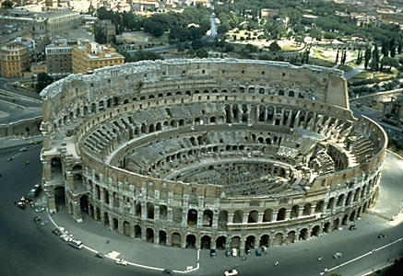
Coliseum
Built on site of Nero’s fire
Construction started by Roman Emperor Vespasian in 71 AD
  Completed by his son, Emperor Titus
Greatest arena in antiquity
  Site of Roman games
  Execution of criminals, including Christian martyrs
  Site of greatest gladiatorial contests

Slide 7
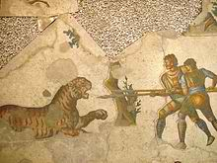
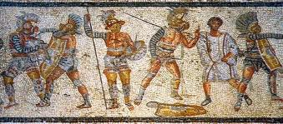
Typical Day in Coliseum
Morning: Animal Fights
Noontime: Public Executions
  Includes Christians
Afternoon: Gladiators
Example: Emperor Trajan used 11,000 wild animals and 10,000 gladiators to celebrate his triumphs in 107 AD

Slide 8
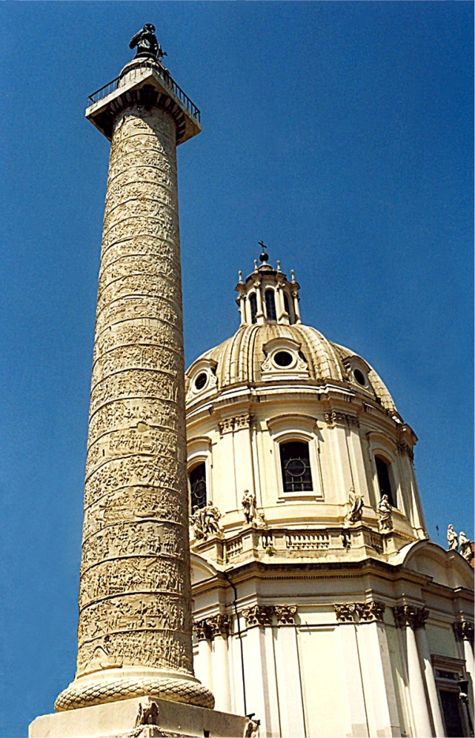
Second Century, “Five Good Emperors”
After Domitian, Nerva and then
  Trajan, 98-117
  Hadrian, 117-138
  Antonius Pius, 138-161
  Marcus Aurelius, 161-180
Policy of adopting a suitable successor, not relying on a relative
Policy of appointing excellent administrators for provinces (Pliny the Younger in Asia Minor)
The Empire was peaceful and prosperous
www.edupic.net/Images/SocialStudies/trajan's_column01.jpg

Slide 9
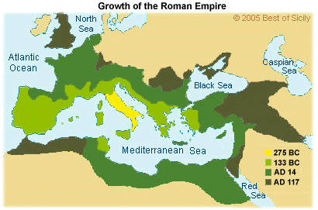
Expansion of Roman Empire

Slide 10
Roman Family
Roman household was composed of paterfamilia (father) and clients (wife, children, slaves, business associates dependent upon him)
  Father had complete control of clients until he died
  Adoption, including adult adoption, was common among wealthy families
  All sons treated equally as heirs (no primogeniture)
  Exposure of unwanted infants, at discretion of father
Duty (fortitude) to family and state was one of the most important Roman virtues
Family was a state within a state
Notes:
Mark Nero on timeline

Slide 11
Roman Public (Civic) Religion
Roman religion was a public, civic obligation;
  NOT primarily a way to have a personal relationship with Divine
  Anyone who did not offer public sacrifice for the good of the state was considered an atheist
  Impiety was a sin against gods, Roman Empire and the family
Nero started Cult of Roman Emperor as a god in his lifetime
  But Nero and Domitian are only two emperors Roman Senate did not deify
Rome linked its gods with Greek gods through Virgil’s Aeneid
Roman games often part of civil/military/religious celebration
The crime of impiety was against both civic Roman religion and/or family
  A type of treason

Slide 12
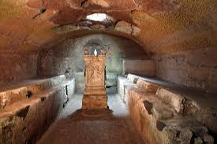
Roman Private Religion
‘Mystery Religions’ became very popular in 1st through 3rd Century Roman society
  Cults of Mithras; Isis and Osiris; Dionysius
  Romans very tolerant of other beliefs
  A way to have a personal relationship with the divine
A wealthy paterfamilia would sometimes set aside space for slaves and clients for their own sects
Example: San Clemente contains both a room for sacrifice to Mithras and a room for Christians

Slide 13
Letters Between Pliny and Trajan
Pliny the Younger (62 – 115) was the Roman administrator of Asia Minor
  Aristocratic Roman Family;
  Roman Senator
  Nephew of Pliny the Elder (23-79), who adopted him as a young man
    Wrote Natural History
    Killed by eruption of Vesuvius
Trajan
  Roman Emperor
Issue: What to do about Christians and their impiety

Slide 14
Third Century, Turmoil and Famine
Marcus Aurelius’s son, Commodus (180-192), was vicious, paranoid
  Strangled in his bath, then stabbed; end of Antonnines
After a period of civil war, Septimus Severus (193-211) becomes Emperor
  War against Persians
  Revamped Roman military and law
  Died in York, England; succeeded by sons Caracalla (211 – 217) and Geta
Series of Severides and other generals of brief reign throughout Third Century
Decius (249-251), major Christian persecution
  Attempt to re-unify Empire with renewed adherence to ancient religion
  Made people buy a libellus to prove they had sacrificed to gods
Diocletian 284-305
  Greatest persecution of Christians

Slide 15
Assignments
Letters between Pliny and Trajan; found at
  http://www.kchanson.com/ANCDOCS/latin/pliny.html (required)

